Slide 1
A new approach to uncertainty evaluation in complex measurement systems
Random-Fuzzy Variables (RFVs) approach
Evidence and Possibility Theories

Slide 2
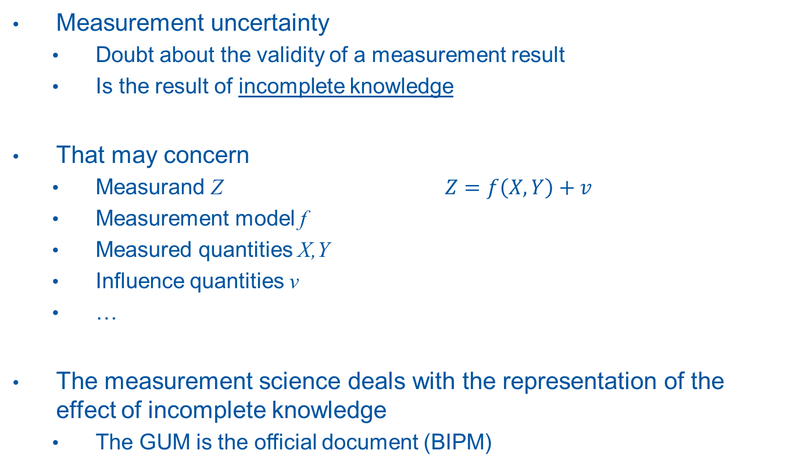
Framework
Measurement uncertainty
  Doubt about the validity of a measurement result
  Is the result of incomplete knowledge
That may concern
  Measurand Z $Z=f\left(X,Y\right)+v$
  Measurement model f
  Measured quantities X,Y
  Influence quantities v
  …
The measurement science deals with the representation of the effect of incomplete knowledge
  The GUM is the official document (BIPM)

Slide 3
Framework
The origin of incomplete knowledge
  Random and unpredictable variation of influence quantities (random contributions)
  Ignorance (subjective and incomplete knowledge, also of deterministic quantities)
The GUM recognizes both uncertainty sources and proposes
  A type A evaluation for random contributions based on PDFs
  A type B evaluation for all the other contributions based on a priori PDFs
The (implicit) assumption is that ignorance can be represented in the probability framework
Is this assumption valid?

Slide 4
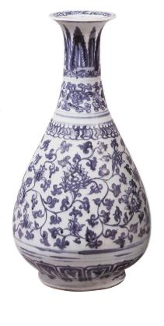
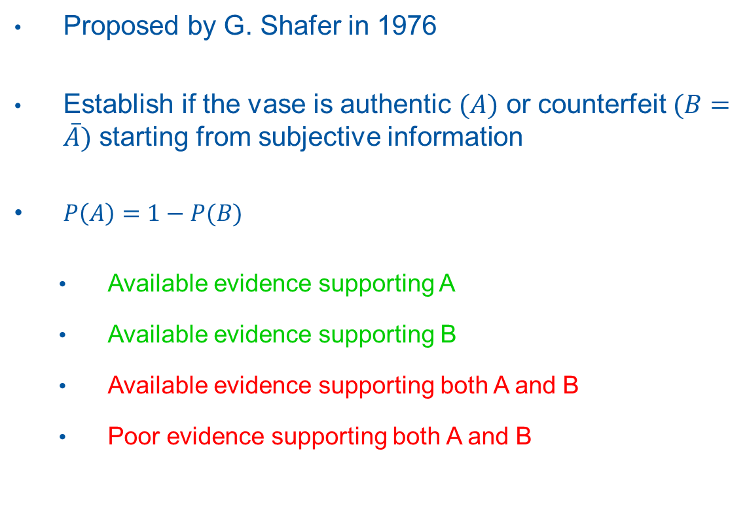
Example: the Ming vase
Proposed by G. Shafer in 1976
Establish if the vase is authentic $(A)$ or counterfeit $(B=\overline{A})$ starting from subjective information
$P\left(A\right)=1−P(B)$
  Available evidence supporting A
  Available evidence supporting B
  Available evidence supporting both A and B
  Poor evidence supporting both A and B

Slide 5
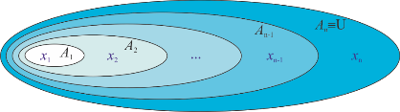

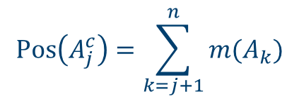
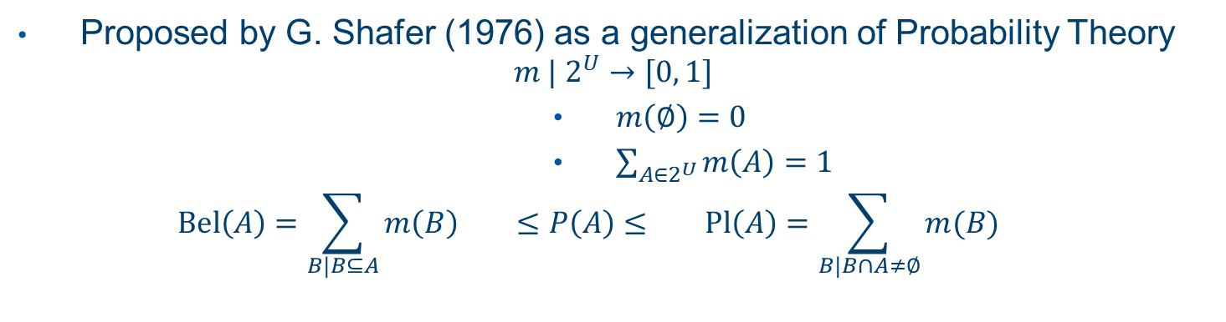
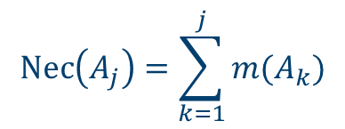

The Evidence Theory
Proposed by G. Shafer (1976) as a generalization of Probability Theory
$$m | 2^{U}→[0, 1]$$
  $m\left(∅\right)=0$
  $\sum_{A∈2^{U}}{m\left(A\right)=1}$
  $$Bel\left(A\right)=\sum_{B|B⊆A}{m\left(B\right) ≤P\left(A\right)≤ Pl\left(A\right)=\sum_{B|B∩A≠∅}{m(B)}}$$
Probability Theory
Possibility Theory
$$Nec\left(A_{j}\right)=\sum_{k=1}^{j}{m(A_{k})}$$
$$Bel\left(A\right)=\sum_{x∈A}{m\left(\left\{x\right\}\right)=Pl(A)}$$
$$Pos\left(A_{j}^{c}\right)=\sum_{k=j+1}^{n}{m(A_{k})}$$
$$Bel\left(A\right)=P\left(A\right)=Pl(A)$$

Slide 6
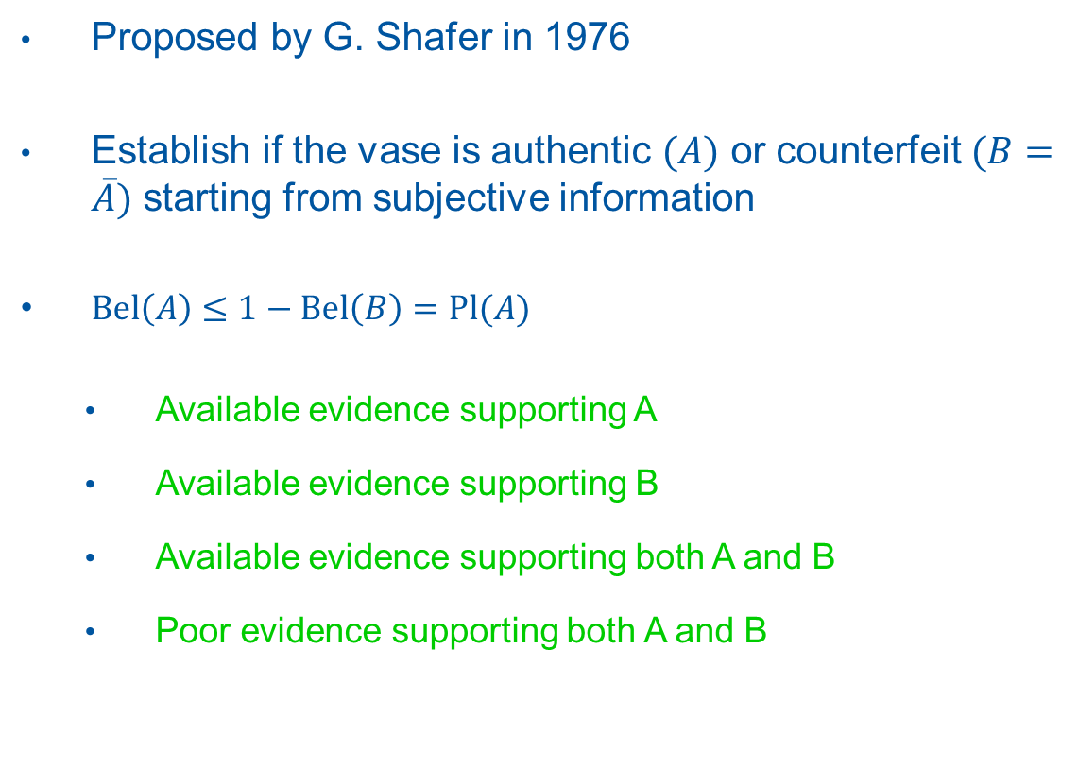
Example: the Ming vase
Proposed by G. Shafer in 1976
Establish if the vase is authentic $(A)$ or counterfeit $(B=\overline{A})$ starting from subjective information
$Bel\left(A\right)≤1−Bel\left(B\right)=Pl(A)$
  Available evidence supporting A
  Available evidence supporting B
  Available evidence supporting both A and B
  Poor evidence supporting both A and B

Slide 7
Example: the Ming vase
According to Shafer, a more general mathematical framework is needed to represent uncertainty
And he is not alone…
  «…there are at least two kinds of uncertain quantities: those which are subject to intrinsic variability and those which are totally deterministic but anyway ill-known… and it is not clear that incomplete knowledge should be modeled by the same tool as variability.» [D. Dubois, Université Paul Sabatier, Toulouse]
  « …L’approche probabiliste … excelle indiscutablement à quantifier les phénomènes aléatoires, elle bute sur la prise en compte des effets systématiques dont on ne connaît pas la valeur réelle (contenue dans un intervalle), ce qui est le cas ici, comme dans tant d’autres situations.» [Jean-Michel Pou, Delta Mu, France]

Slide 8
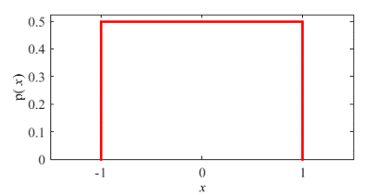
Example: uncompensated systematic effect
Suppose to use a measurement instrument to obtain a single measured value
  Uncertainty should be evaluated starting from the manufacturer datasheet (interval)
  In this case, uncertainty is mainly due to an uncompensated systematic effect
In this case, a uniform PDF in the given interval is assumed
Is this correct?

Slide 9
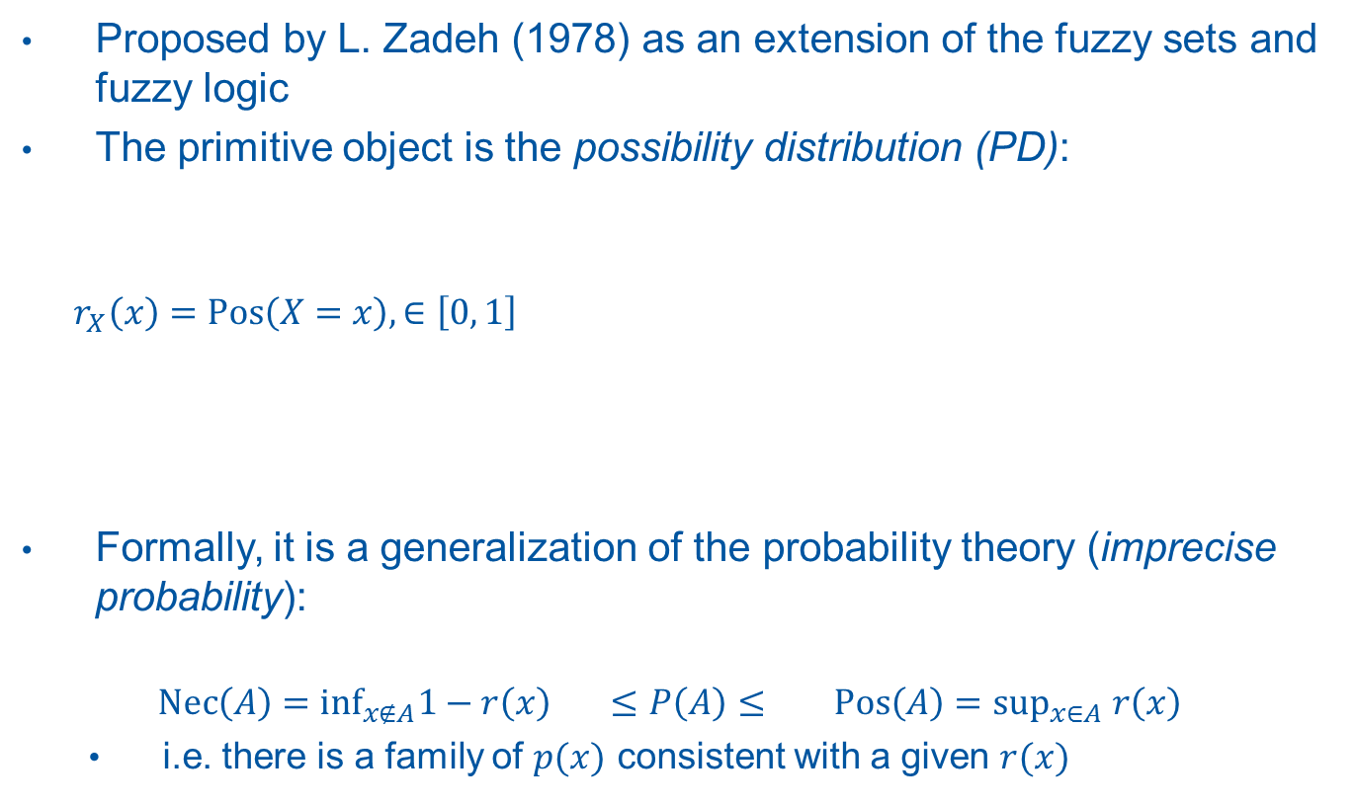
The RFV approach: Possibility theory
Proposed by L. Zadeh (1978) as an extension of the fuzzy sets and fuzzy logic
The primitive object is the possibility distribution (PD):
$$r_{X}\left(x\right)=Pos\left(X=x\right),∈\left[0, 1\right]$$
Formally, it is a generalization of the probability theory (imprecise probability):
$$Nec\left(A\right)=\inf_{x∉A}1−r\left(x\right) ≤P\left(A\right)≤ Pos\left(A\right)=\sup_{x∈A} r\left(x\right)$$
  i.e. there is a family of $p(x)$ consistent with a given $r(x)$

Slide 10

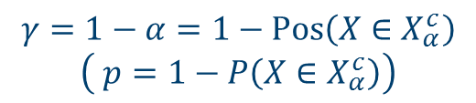
The RFV approach: PDs
$$γ=1−α=1−Pos\left(X∈X_{α}^{c}\right)$$
$$\left( p=1−P\left(X∈X_{α}^{c}\right)\right)$$
$$X_{α}$$

Slide 11
The RFV approach : RFVs
Composed by two different PDs, representing two different uncertainty sources
  “random” PD : random contributions to uncertainty
  “internal” PD : non-random contributions to uncertainty
  “external” PD : all uncertainty contributions

Slide 13
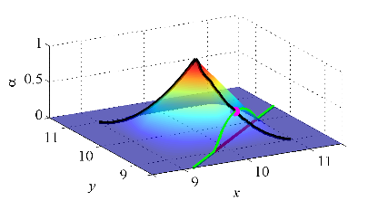
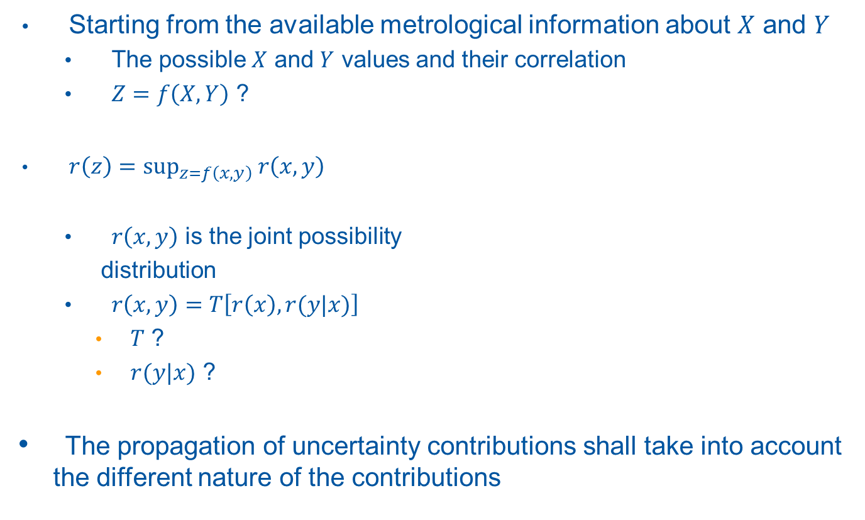
Uncertainty propagation
Starting from the available metrological information about $X$ and $Y$
  The possible $X$ and $Y$ values and their correlation
  $Z=f\left(X,Y\right)$ ?
$r\left(z\right)=\sup_{z=f\left(x,y\right)} r\left(x,y\right)$
  $r\left(x,y\right)$ is the joint possibility
  distribution
  $r\left(x,y\right)=T\left[r\left(x\right), r(y|x)\right]$
    $T$ ?
    $r(y|x)$ ?
  The propagation of uncertainty contributions shall take into account the different nature of the contributions

Slide 14
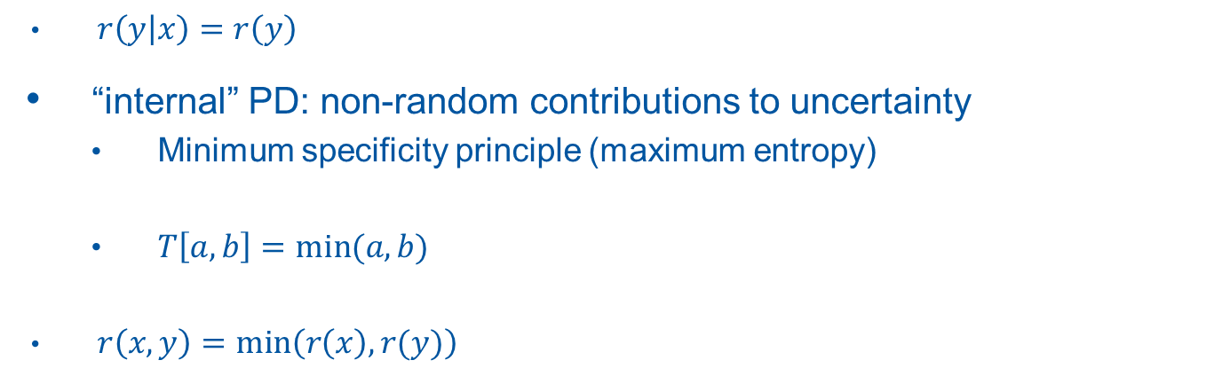
Internal joint PD, independent variables
$r\left(y | x\right)=r\left(y\right)$
  “internal” PD: non-random contributions to uncertainty
  Minimum specificity principle (maximum entropy)
  $T\left[a,b\right]=min⁡(a,b)$
$r\left(x,y\right)=min⁡\left(r\left(x\right),r(y)\right)$

Slide 15
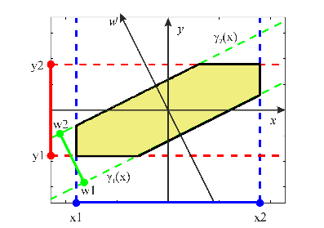
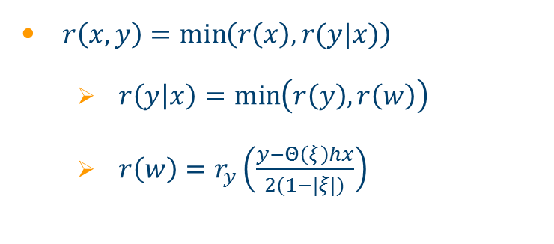



Internal joint PD, correlated variables
$ξ=0$
$ξ=2/3$
$r\left(x,y\right)=\min\left(r\left(x\right),r(y|x)\right)$
  $r\left(y | x\right)=\min\left(r\left(y\right),r\left(w\right)\right)$
  $r\left(w\right)=r_{y}\left(\frac{y−Θ\left(ξ\right)hx}{2(1−|ξ|)}\right)$
$ξ=1$

Slide 16
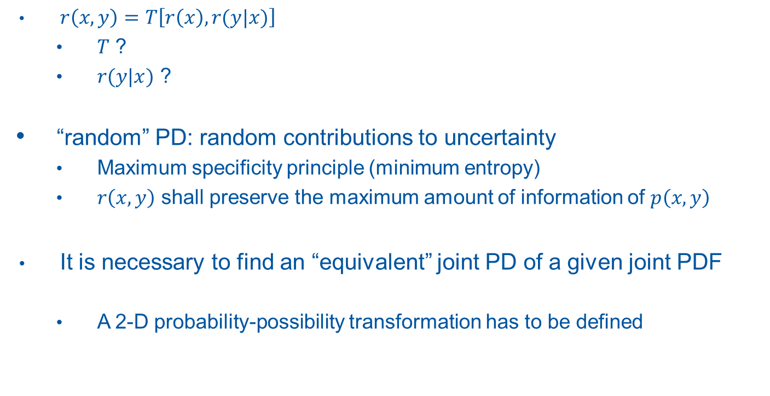
Random joint PD
$r\left(x,y\right)=T\left[r\left(x\right), r(y|x)\right]$
  $T$ ?
  $r(y|x)$ ?
  “random” PD: random contributions to uncertainty
  Maximum specificity principle (minimum entropy)
  $r\left(x,y\right)$ shall preserve the maximum amount of information of $p\left(x,y\right)$
It is necessary to find an “equivalent” joint PD of a given joint PDF
  A 2-D probability-possibility transformation has to be defined

Slide 17
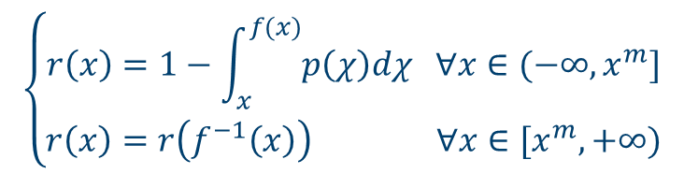
1-D probability-possibility transformation
Transformation defined by Dubois and H. Prade
  Maximum specificity principle
$$\left\{\begin{aligned}r\left(x\right)=1−\int_{x}^{f(x)}{p\left(χ\right)dχ ∀x∈(−∞, x^{m}]} \\ r\left(x\right)=r\left(f^{−1}\left(x\right)\right) ∀x∈[x^{m}, +∞)\end{aligned}\right.$$
$$f\left(x\right)>x^{m} | p\left(x\right)=p\left(f\left(x\right)\right), ∀x∈(−∞, x^{m}]$$

Slide 18
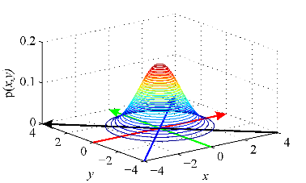
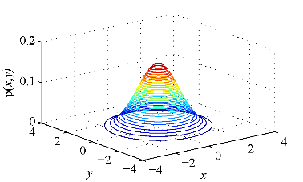
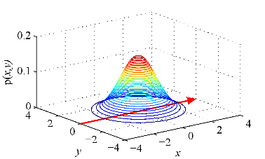
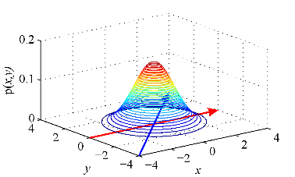
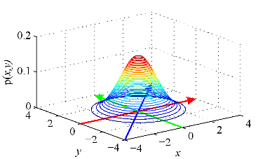
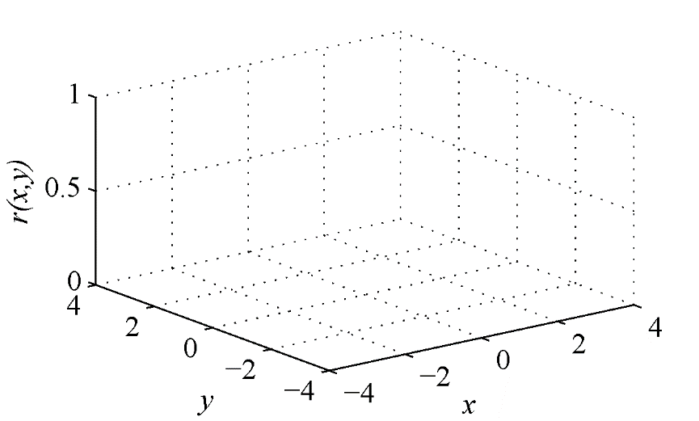
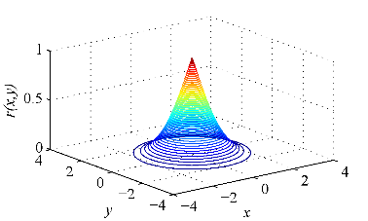
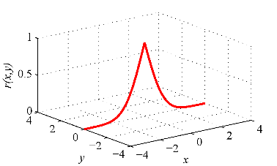
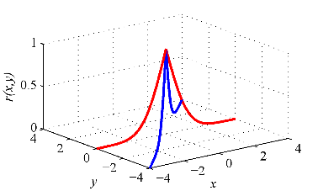
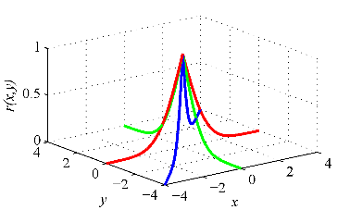
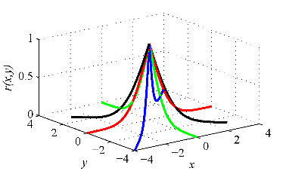
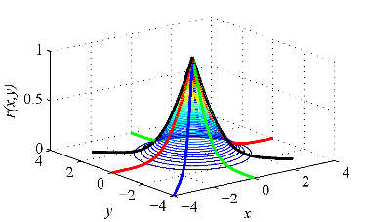

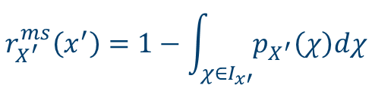
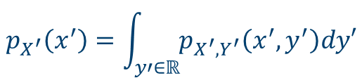

2-D probability-possibility transformation
A joint PD is maximally specific only if its marginal distributions are maximally specific
  The choice of the coordinate system is arbitrary
$$\begin{matrix}x^{′}=\left(x−x^{m}\right)\cos{θ}−\left(y−y^{m}\right)\sin{θ} \\ y^{′}=\left(x−x^{m}\right)\sin{θ}+\left(y−y^{m}\right)\cos{θ}\end{matrix}$$
$$r_{X^{′}}^{ms}\left(x^{′}\right)=1−\int_{χ∈I_{x′}}{p_{X^{′}}\left(χ\right)dχ}$$
1.
3.
$$p_{X^{′}}\left(x^{′}\right)=\int_{y′∈ℝ}{p_{X^{′},Y^{′}}\left(x^{′},y^{′}\right)dy′}$$
2.
4.
$$r_{X,Y}^{h}\left(x,y\right)=\inf_{θ} r_{X^{′}}^{ms}\left(x^{′}\right)$$

Slide 19
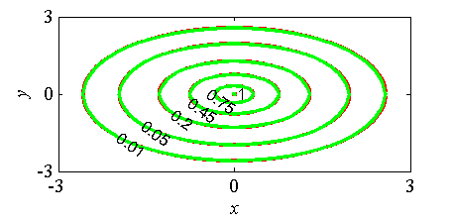
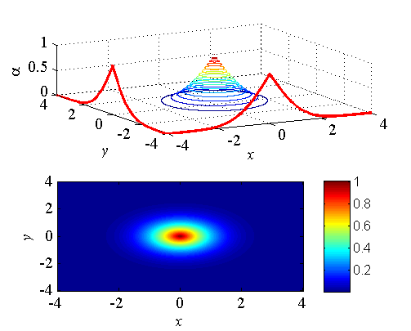

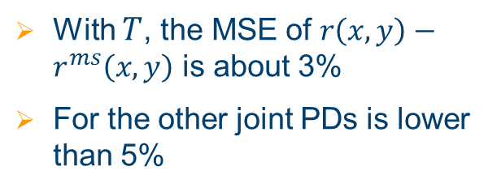

Random joint PD, independent variables
$r\left(y | x\right)=r(y)$
$r\left(x,y\right)=T\left[r\left(x\right), r(y)\right]$
  The optimal $T$ is:
$$T_{γ}^{F}\left[r\left(x\right),r(y)\right]=\log_{γ}\left(1+\frac{\left(γ^{r(x)}−1\right)\left(γ^{r(y)}−1\right)}{γ−1}\right)$$
$$ρ=0$$
  With $T$, the MSE of $r\left(x,y\right)−r^{ms}\left(x,y\right)$ is about 3%
  For the other joint PDs is lower than 5%

Slide 20
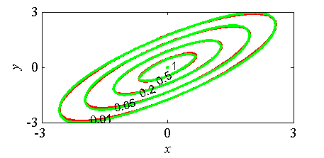
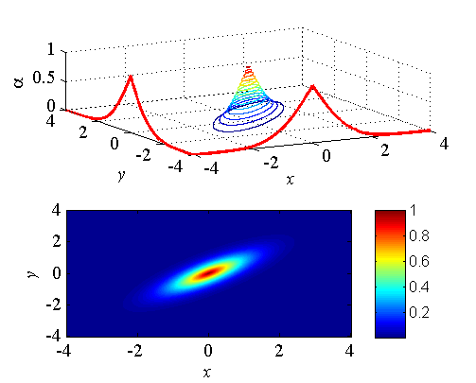


Random joint PD, correlated variables
$r\left(x,y\right)$=$T_{γ}^{F}\left[r\left(x\right),r(y|x)\right]$
  $\left\{\begin{aligned}μ_{Y|X}=μ_{Y}+ρ\frac{A_{Y}}{A_{X}}\left(x−μ_{X}\right) \\ \frac{A_{Y|X}}{A_{Y}}=\sqrt{1−ρ^{2}}\end{aligned}\right.$
$$ρ=0.8$$
  Optimal t-norm and errors are not affected!

Slide 22
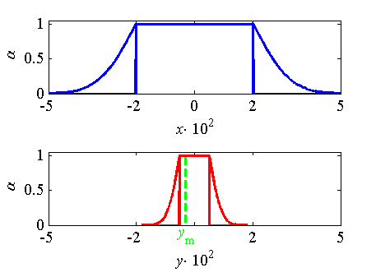
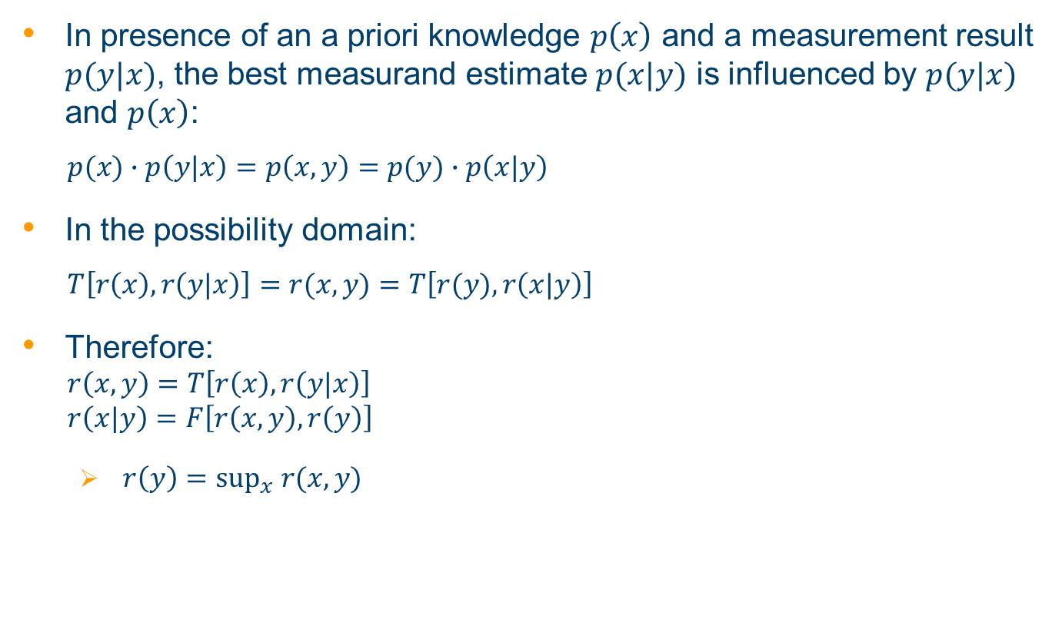
Conditional RFVs
In presence of an a priori knowledge $p\left(x\right)$ and a measurement result $p(y|x)$, the best measurand estimate $p(x|y)$ is influenced by $p(y|x)$ and $p\left(x\right)$:
$$p(x)∙p\left(y|x\right)=p\left(x,y\right)=p(y)∙p\left(x|y\right)$$
In the possibility domain:
$$T\left[r\left(x\right),r\left(y|x\right)\right]=r(x,y)=T\left[r(y),r\left(x|y\right)\right]$$
Therefore:
$$r\left(x,y\right)=T\left[r\left(x\right),r\left(y|x\right)\right]$$
$$r\left(x|y\right)=F\left[r\left(x,y\right),r\left(y\right)\right]$$
  $r\left(y\right)=\sup_{x} r(x,y)$
22

Slide 23
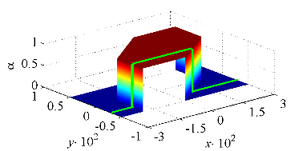
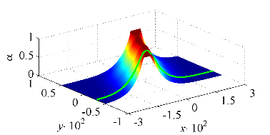

Conditional RFVs
Internal PDs:
  $T\left[r\left(x\right),r\left(y|x\right)\right]=min\left[r\left(x\right),r\left(y|x\right)\right]$
  $F\left[r\left(x,y\right),r\left(y\right)\right]=\left\{\begin{aligned}r\left(x,y\right) if r\left(y\right)>r(x,y) \\ 1 if r\left(y\right)=r(x,y)\end{aligned}\right.$
Random PDs:
  $T\left[r\left(x\right),r\left(y|x\right)\right]=T_{γ}^{F}\left[r\left(x\right),r\left(y|x\right)\right]$
  $F\left[r\left(x,y\right),r\left(y\right)\right]=F_{γ}^{F}\left[r\left(x,y\right),r\left(y\right)\right]$
  $F_{γ}^{F}\left[r\left(x,y\right),r\left(y\right)\right]=\log_{γ}\left[1+\frac{\left(γ^{r\left(x,y\right)}−1\right)\left(γ−1\right)}{γ^{r\left(y\right)}−1}\right]$

Slide 24
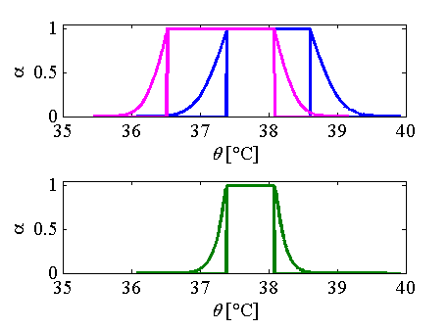
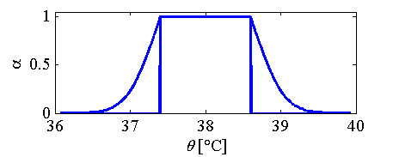
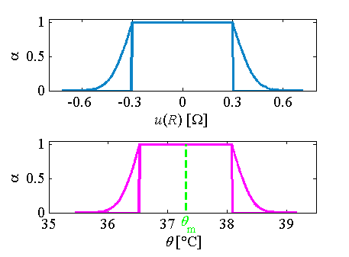
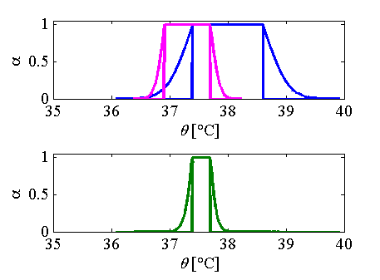


Example 3
Temperature measurement through RTD
  $R=R_{0}∙\left[1+aθ+bθ^{2}\right]+u(R)$
($R_{0}=100Ω, a=3,9083∙{10}^{−3}C^{−1},$
$b=−5,775∙{10}^{−7}C^{−2}$)
$$R_{m}=114.5Ω$$

Slide 26
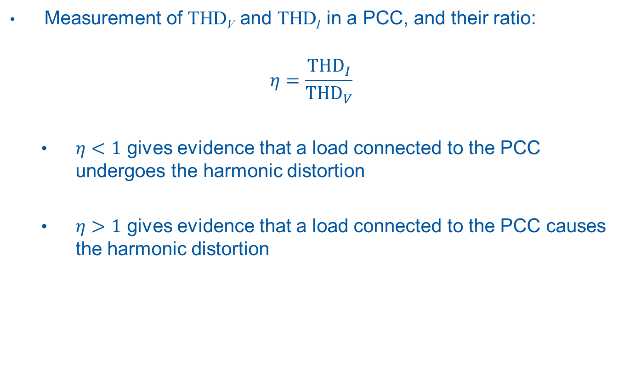
Measurement example
Measurement of THD_{V} and THD_{I} in a PCC, and their ratio:
$$η=\frac{{THD}_{I}}{{THD}_{V}}$$
  $η<1$ gives evidence that a load connected to the PCC undergoes the harmonic distortion
  $η>1$ gives evidence that a load connected to the PCC causes the harmonic distortion

Slide 27
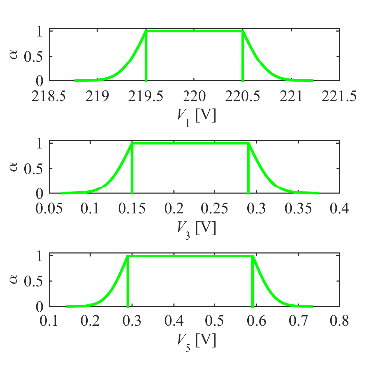
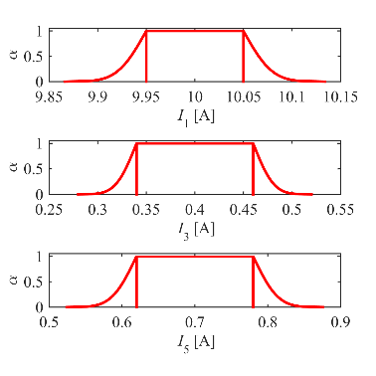
Measurement example
Let us suppose that, for a specific load, three voltage and current harmonics are present, with given RMS and uncertainty values
Starting from this information, the RFVs of V_{k} and I_{k} can be built

Slide 28


Measurement example
Starting from the RFVs of V_{k} and I_{k}, the RFVs of V_{k}² and I_{k}² can be obtained
The effect of the nonlinearity of the square
  Is negligible for V₁ and I₁
  Is evident for V₃, V₅ and I₃, I₅

Slide 29


Measurement example
Thanks to ZEP and the definition of joint RFV, the RFVs of THD_{V}, THD_{I} and η can be found
  ${THD}_{V}=\sqrt{\frac{V_{3}^{2}+V_{5}^{2}}{V_{1}^{2}}}$
  ${THD}_{I}=\sqrt{\frac{I_{3}^{2}+I_{5}^{2}}{I_{1}^{2}}}$
  $η={{THD}_{I}}/{{THD}_{V}}$
The effect of the nonlinearity of the measurement function
  Is negligible for THD_{V}, THD_{I}
  Is evident for η
Due to its definition, η is affected by huge uncertainty values

Slide 30

Comparison with Monte Carlo simulations
Monte Carlo simulations provide an histogram of the possible η values that can be transformed into an equivalent PD (blue line)
  We are considering only random effects
  The resulting PD is centered on the expected mode of η
  It is fully included in the predicted external PD
To include non-random effect also, the mode values of the V_{k} and I_{k} distributions should change in the simulations
The sup of all the obtained PDs, is the equivalent external PD provided by the simulations

Slide 31

Comparison with Monte Carlo simulations
Only the left-most (cyan line) and right-most (black line) histograms and associated PDs are shown
  The predicted external PD is compatible with the upper envelope of all the equivalent PDs provided by Monte Carlo simulations
  The equivalent PDs have different widths
  The asymmetry of the resulting external PD is mainly due to the (non negligible!) presence of non-random contributions

