Slide 2
Coupling of 2D and 3D quench models
Michał Maciejewski
Bernhard Auchmann
TE-MPE-PE
12.03.2015

Slide 3
Proof-of-concept project
The Challenge: Couple existing 2D electromagnetic and 3D thermal models in order to enhance our modelling capabilities.
The Solution: Learn and employ existing industrial standards and tools
(FMI, MpCCI, etc.) to build a quench-co-simulation framework.

Slide 4
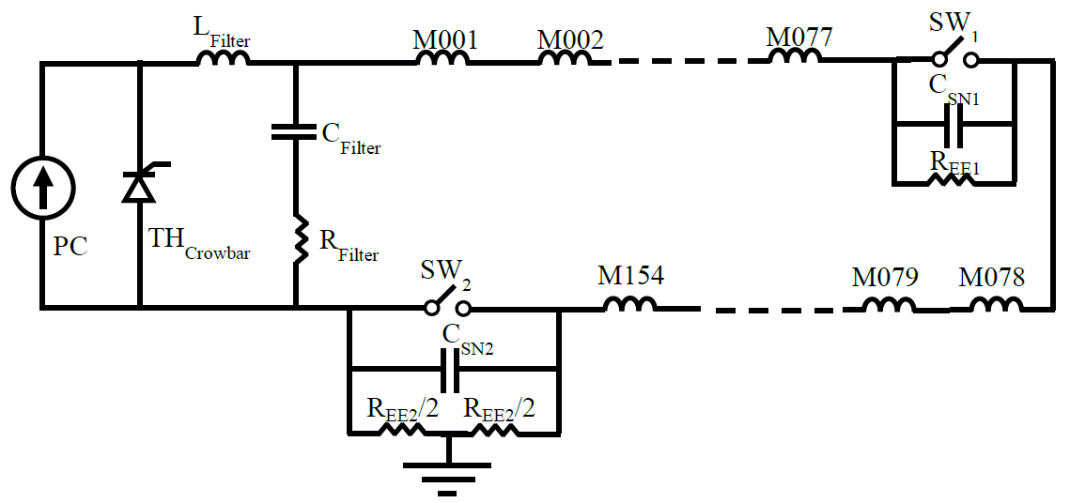
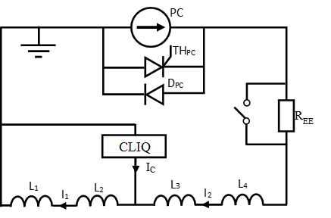
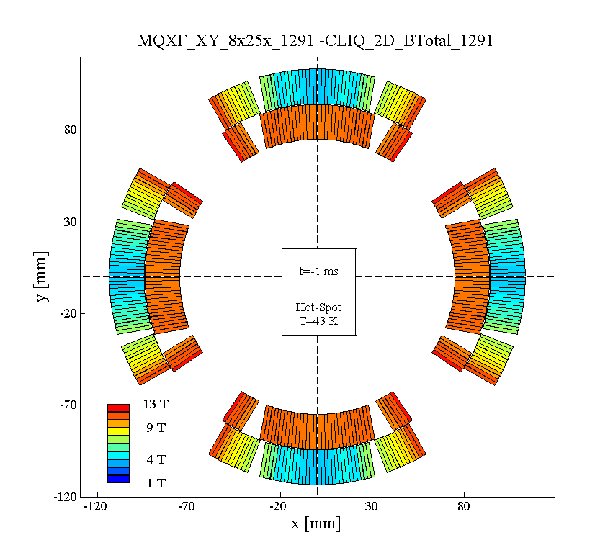
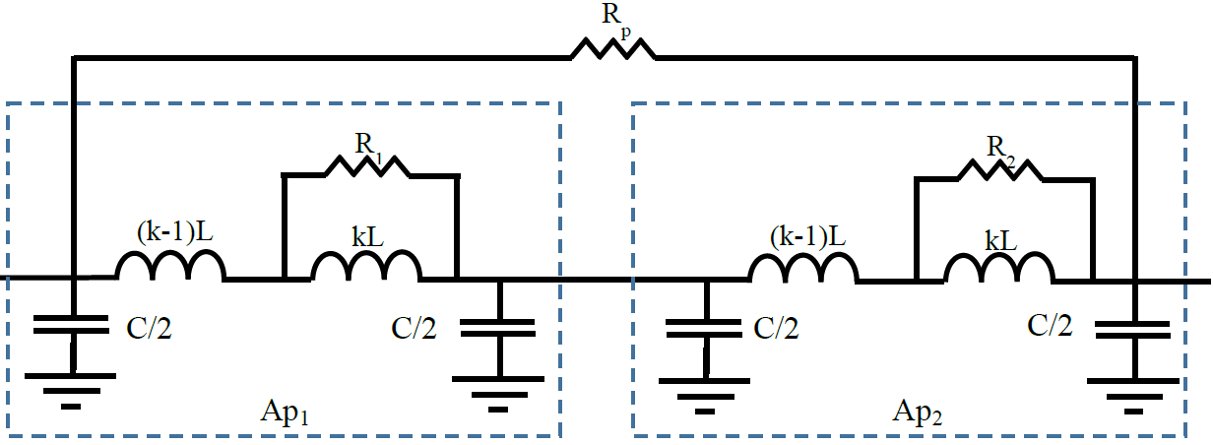
Building Blocks - QSF
Standalone magnet
RB Circuit - Chain of magnets*
k_{th,1,2}
2D representation with field map from ROXIE
Lumped-element electro-thermal model
Includes ISCL, IFCL
Turn sub-division
CLIQ, EE, QH, diode, parallel resistor
k_{th,1,3}
k_{He,1}
Thermal
Sub-network
T_{He}
c_{th,1}
(i_{ifx,b})²R_{ifx,1}
(i_{ify,b})²R_{ify,1}
(i_{is,1})²R_{is,1}
(i₁)²R₁
q₁=0
q₁=0
q₁=1
q₁=0
L₁
i₁
Electrical
Sub-network
R₁
M_{if,x,1,1}
M_{if,y,1,1}
M_{is,1,1}
L_{if,x,1}
L_{if,y,1}
L_{is,1}
i_{is,1}
Coupling Current
Sub-network
i_{if,x,1}
i_{if,y,1}
Standard: Inductor Model
Coupled: 2D model
R_{if,x,1}
R_{if,y,1}
R_{is,1}
*Migration of PSpice RB Circuit in progress

Slide 5
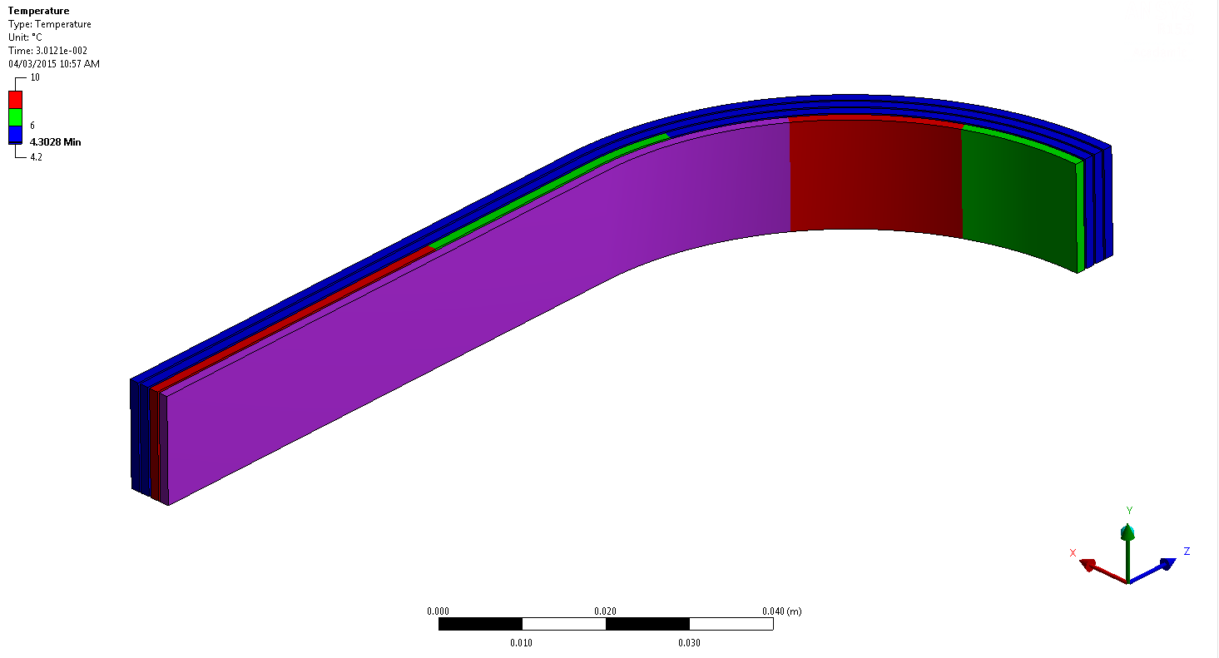
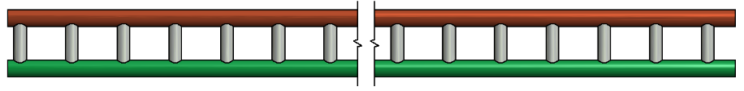

Building Blocks – ANSYS*
1D models of superconducting strand
3D SMC model
1D: Adiabatic model
Thermal model
Cu
Coupled 1D: Helium-cooled model (QP3 equivalent)
Cu
He
*Courtesy D. Paudel

Slide 6
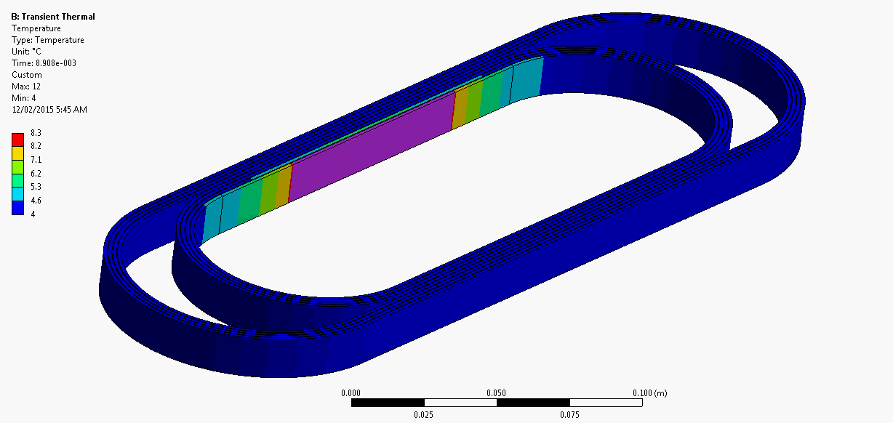













Mapping between 2D and 3D models
ANSYS*
k_{th,1,3}
$$R_{b}=\sum_{i=1}^{n}{R_{i}(T_{i},B_{b})}$$
Thermal
Sub-network
k_{He,1}
T_{He}
?
c_{th,1}
(i_{ifx,b})²R_{ifx,1}
(i_{ify,b})²R_{ify,1}
(i_{is,1})²R_{is,1}
$$T_{1}$$
$$T_{2}$$
(i₁)²R₁
$$T_{n}$$
$$Q_{Ohm.i}=q_{i}R_{i}{i_{b}}_{}^{2}$$
$$T_{i}$$
q₁=0
q₁=0
q₁=1
q₁=0
$$Q_{IFCL.i}={(1−q}_{i})R_{IFCL,i}{i_{IFCL,b}}_{}^{2}$$
$$Q_{ISCL.i}={(1−q}_{i})R_{ISCL,i}{i_{ISCL,b}}_{}^{2}$$
$$Q_{1}$$
$$Q_{2}$$
$$Q_{i}$$
$$Q_{n}$$
L₁
i_{b}
Electrical
Sub-network
R_{b}
M_{if,x,1,1}
M_{if,y,1,1}
M_{is,1,1}
SIMULINK/Spice*
Coupling Current
Sub-network
L_{if,x,1}
i_{if,x,1}
L_{if,y,1}
i_{if,y,1}
L_{is,1}
i_{is,1}
R_{if,x,1}
R_{if,y,1}
R_{is,1}
SIMULINK

Slide 7
Trip to Darmstadt - goals
Build good relations with experienced scientists
Gain hands-on experience in co-simulation
Select an appropriate framework for our project
Learn about existing coupling mechanisms
Explore available interfaces to our models

Slide 8
Thank you for your attention!
Thanks to E. Ravaioli, J. Ghini, D. Paudel, A. Verweij

