Slide 1
Nb-Ti Strand and 2D magnet coil
Deepak Paudel
March 2015, Geneva
Supervisor:
Bernhard Auchmann

Slide 2
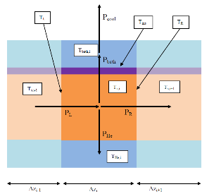
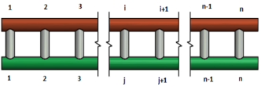
Nb-TI strand; ANSYS vs QP3 Model
QP3
ANSYS
Normal zone propagation modelled correctly for Adiabatic and single regime analysis

Slide 3
Nb-TI strand: ANSYS vs QP3 Model;
Error Anaysis
Different time steps;
Fixed, 20 µs (ANSYS)
Adaptive, smallest 3 µs (QP3)
Different regime changing algorithms.
No possibility to fall back once it has been to the higher regime (ANSYS)
No possibility to fall back to transient regime once it has been to higher regime (QP3)

Slide 4
Nb-TI strand: ANSYS vs QP3 Model;
Time steps:
Fixed, 3 µs (ANSYS)
Adaptive, smallest 3 µs (QP3)
Same regime changing scheme

Slide 5



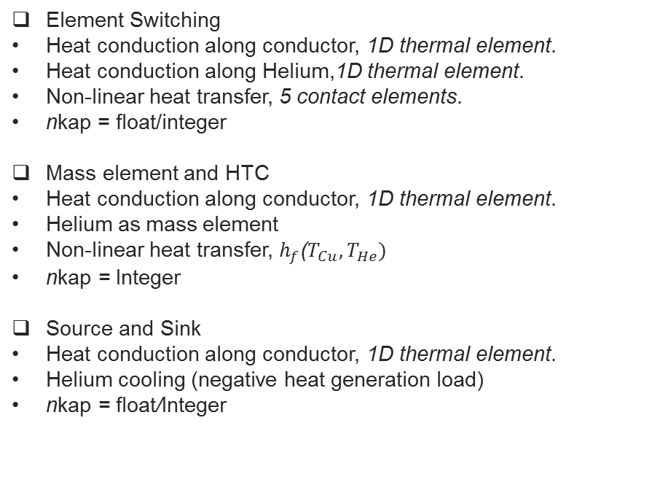

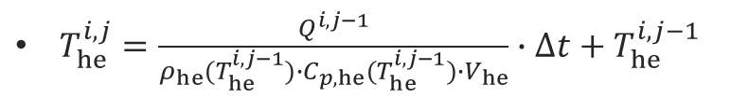


Nb-Ti strand models
Element Switching
Heat conduction along conductor, 1D thermal element.
Heat conduction along Helium,1D thermal element.
Non-linear heat transfer, 5 contact elements.
nkap = float/integer
Mass element and HTC
Heat conduction along conductor, 1D thermal element.
Helium as mass element
Non-linear heat transfer, $h_{f}$($T_{Cu},T_{He})$
nkap = Integer
Source and Sink
Heat conduction along conductor, 1D thermal element.
Helium cooling (negative heat generation load)
nkap = float/Integer
Nb-Ti Strand
He-Mass
$$Q^{i,j}{=h}_{f}^{i,j}(T_{Cu}^{i,j},T_{he}^{i,j})∙∆T$$
$$Q^{i,j}(T_{Cu}^{i,j},T_{he}^{i,j})$$
Helium cooling
1
2
i
n
$Q^{i,j}\left(T_{Cu}^{i,j},T_{he}^{i,j}\right)=h_{f}^{i,j}(T_{Cu}^{i,j},T_{he}^{i,j})∙(T_{Cu}^{i,j}−T_{he}^{i,j})$
$$Q^{i,j}(T_{Cu}^{i,j})$$
Joule heating
$T_{he}^{i,j}=\frac{Q^{i,j−1}}{ρ_{he}(T_{he}^{i,j−1})∙C_{p,he}(T_{he}^{i,j−1})∙V_{he}}∙∆t+T_{he}^{i,j−1}$
$$T_{he}^{i,0}=1.9 k$$

Slide 6

Element Switching

Slide 7

Mass element and HTC
Q($h_{f}$($T_{Cu},T_{He})∙(∆T)$)

Slide 8


Source and Sink
$$Q^{i,j}(T_{Cu}^{i,j},T_{he}^{i,j})$$
1
2
i
n
$$Q^{i,j}(T_{Cu}^{i,j})$$

Slide 9
PERFORMANCE ANALYSIS
Total simulation time 0.064 s
QP3
Adaptive time stepping
Min Δt = 3e-5 s
Max Δt = 1e-4 s
ANSYS
Fixed time step
Δt = 3e-5 s
21350 steps

Slide 10
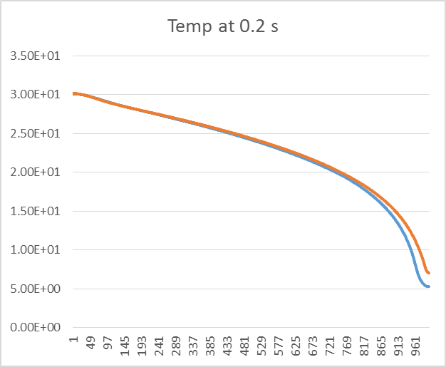
PERFORMANCE ANALYSIS
Total simulation time 0.2 s
QP3
Adaptive time stepping
Min Δt = 5e-5 s
Max Δt = 1e-4 s
ANSYS
Adaptive time stepping
Min Δt = 1e-5 s
Initial Δt = 1e-5 s
Max Δt = 1e-3 s

Slide 11

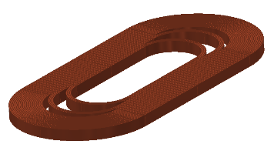
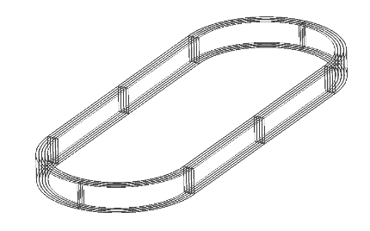
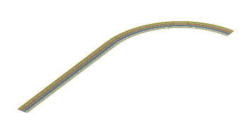
2D AND 3D MODEL OF THE MAGNET COIL; GEOMETRY
ANSYS APDL
Macros and algorithms builds the geometry
Parametrisation
ANSYS Workbench
Import CAD file/ construct via GUI
Limited Parametrisation
Easy
CAD file SMC 11T
Simplify

Slide 12
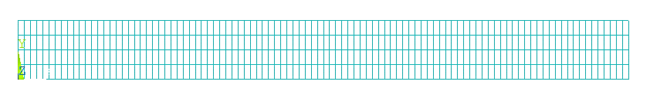
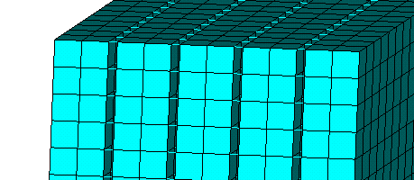
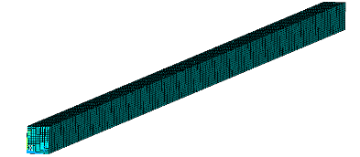
2D AND 3D MODEL OF THE MAGNET COIL
Length = 1 m
Kapton= contact elements
Nb-Ti, Rutherford cable
Length =1 m
Parametric construction
Thermal resistance defined through contact elements

Slide 13

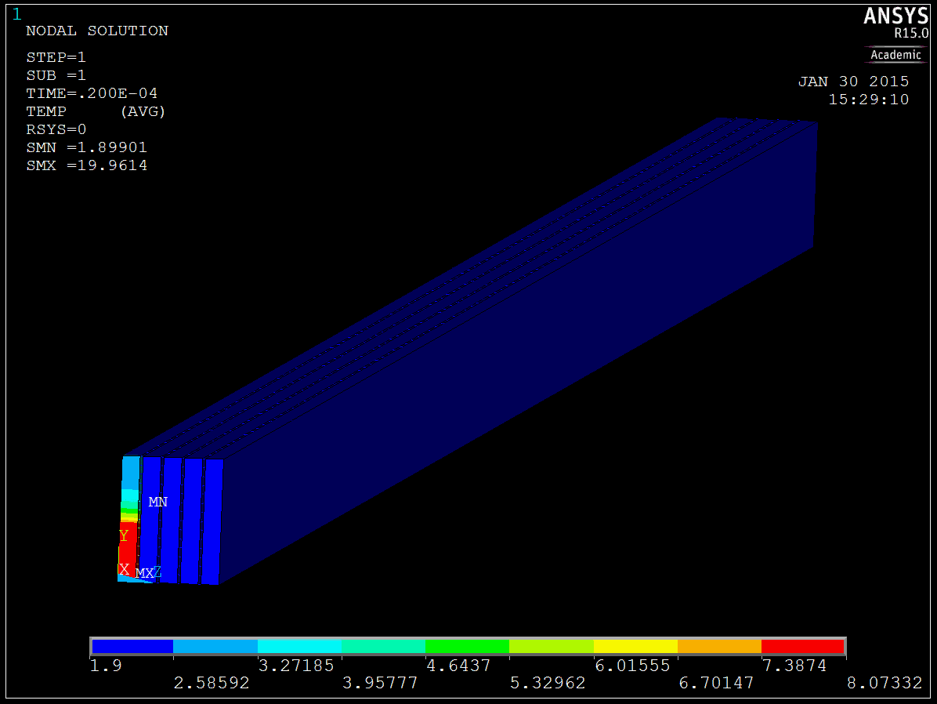
Computation time; ̴ 3 min (800 Elements )
Computation time; ̴ 1 hour (20,000 Elements)

Slide 14
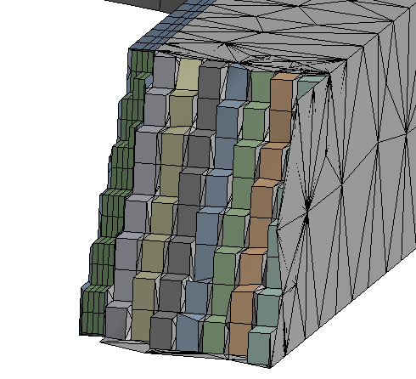
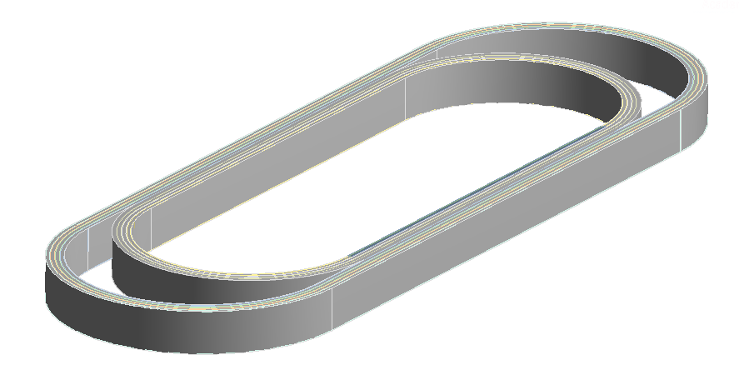
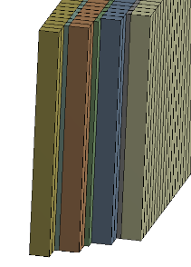
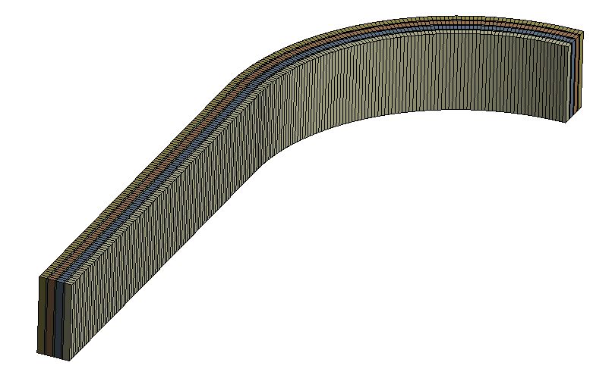
2D AND 3D MODEL OF SMC 11 T
Imported CAD file
Nb3Sn, Rutherford cable
̴ 300 mm
G10
Simplified model

Slide 15
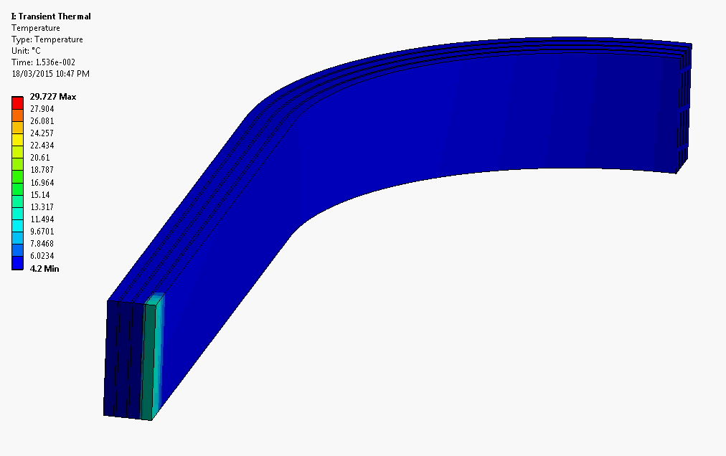
QUENCH PROPAGATION
Computation time: 4 minute, Discretization: 0.75 mm (1400 elements) minimum Δt: 1e-5s

Slide 16
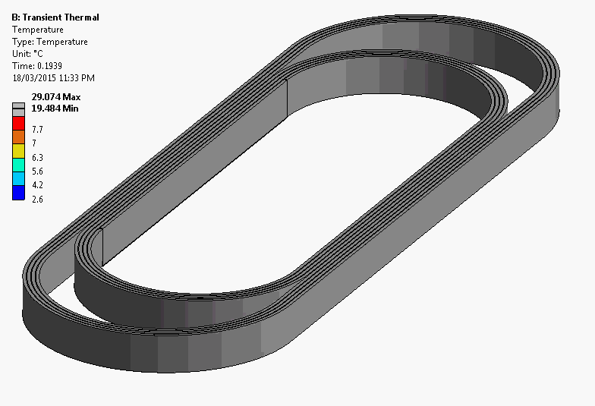
QUENCH PROPAGATION
Computation time: 4 hour, Discretization: 280,000 elements minimum Δt: 1e-5s

Slide 17
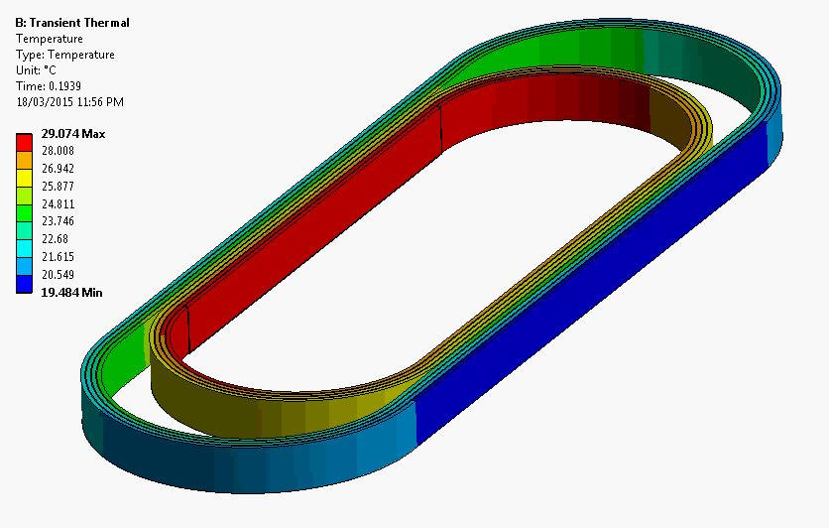
HOTSPOT TEMPERATURE
Computation time: 4 hour, Discretization: 280,000 elements minimum Δt: 1e-5s

