Slide 2
Lessons learned during stay at
TU Darmstadt
Michał Maciejewski
Bernhard Auchmann
TE-MPE-PE
02.04.2015

Slide 3




Trip to Darmstadt
Goal: Learn co-simulation principles and existing frameworks as
well as consult the proof-of-concept project.
Period: 21/03-28/03
Place: Technical University of Darmstadt, TEMF Institute
Graduate School of Computational Engineering
Cooperation: prof. Sebastian Schöps
prof. Herbert De Gersem

Slide 4
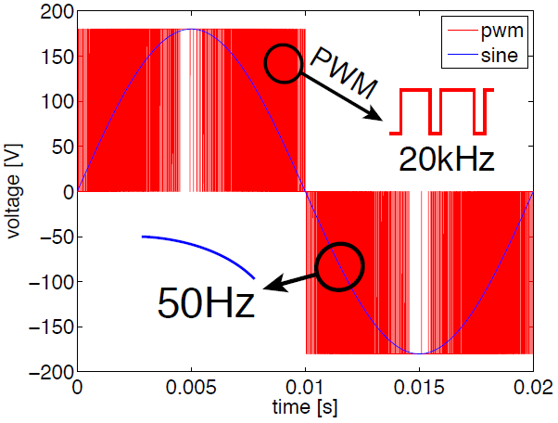
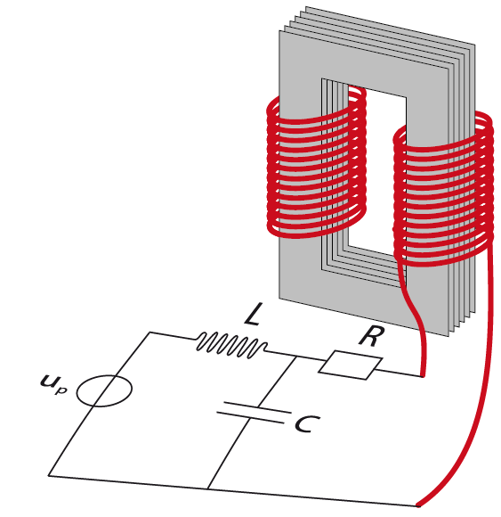
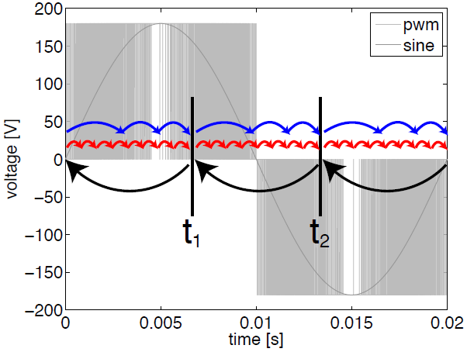
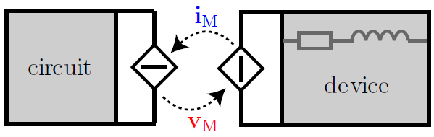
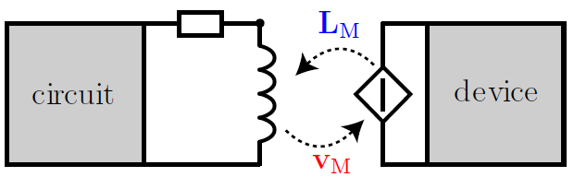

Why Coupling?
DC/AC Converter +Transformer
Multirate
Fast System → small steps
SlowSystem → large steps
Different time steps improve efficiency
Multi-rate
S.Schöps, Multiscale Modelling and Multirate Time-Integration of Field/Circuit Coupled Problems, PhD Thesis

Slide 5

Coupling in Time Domain Between 2 Systems
One-way Coupling/Parameter Extraction
„Strong” Coupling
S1
S1
t
t_{end}
t
t_{end}
S2
S2
E.x. FLUKA → QP3
„Weak” Coupling
Dynamic Iteration / Waveform Relaxation
S1
S1
t
t_{end}
t
t_{end}
S2
S2
The Challenge: How to measure coupling degree?
BG&PH: Sensitivity analysis
*Courtesy
S.Schöps
Notes:
Good example is better than one hour lecture ;)

Slide 6
Coupling in Time Domain Between 2 Systems
Dynamic Iteration / Waveform Relaxation
S1
t_{end}
t
t_{end}
S2
The Challenge: How to measure coupling degree?
BG&PH: Sensitivity analysis
*Courtesy
S.Schöps
Notes:
Good example is better than one hour lecture ;)

Slide 7
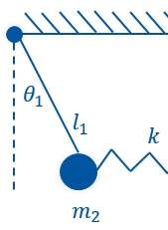
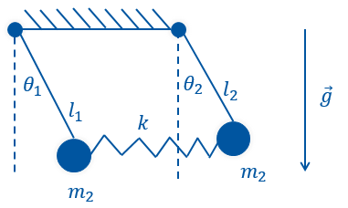
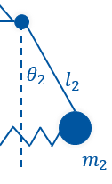

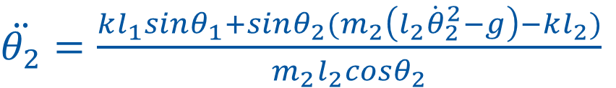


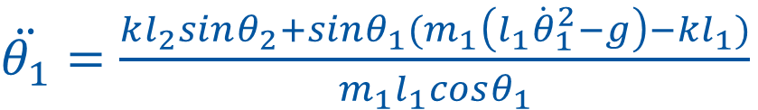





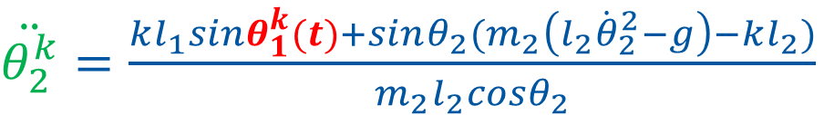
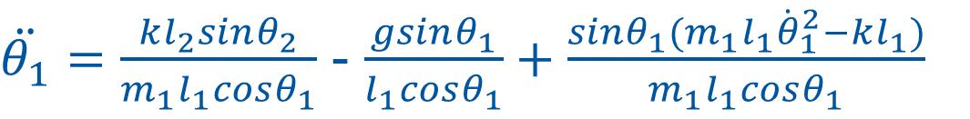



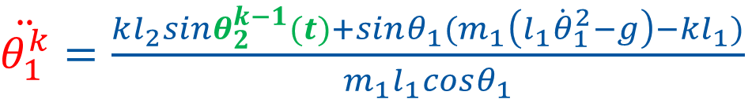
Coupled Pendulum - Demo
$\ddot{θ_{1}}=$ $\frac{kl_{2}sinθ_{2}+sinθ_{1}(m_{1}\left(l_{1}{\dot{θ}}_{1}^{2}−g\right)−kl_{1})}{m_{1}l_{1}cosθ_{1}}$
$\ddot{θ_{1}}=\frac{kl_{2}sinθ_{2}}{m_{1}l_{1}cosθ_{1}}$ - $\frac{gsinθ_{1}}{l_{1}cosθ_{1}}+\frac{sinθ_{1}(m_{1}l_{1}{\dot{θ}}_{1}^{2}−kl_{1})}{m_{1}l_{1}cosθ_{1}}$
$$θ_{1}$$
$$θ_{2}$$
$$l_{2}$$
$$\vec{g}$$
$\ddot{θ_{1}}=$ $\frac{kl_{2}sinθ_{2}+sinθ_{1}(m_{1}\left(l_{1}{\dot{θ}}_{1}^{2}−g\right)−kl_{1})}{m_{1}l_{1}cosθ_{1}}$
$$l_{1}$$
$\ddot{θ_{2}}=$ $\frac{kl_{1}sinθ_{1}+sinθ_{2}(m_{2}\left(l_{2}{\dot{θ}}_{2}^{2}−g\right)−kl_{2})}{m_{2}l_{2}cosθ_{2}}$
$$k$$
$$m_{2}$$
$$m_{2}$$
Gauss-Seidel Coupling scheme
$\ddot{θ_{1}^{k}}=$ $\frac{kl_{2}sinθ_{2}^{k−1}(t)+sinθ_{1}(m_{1}\left(l_{1}{\dot{θ}}_{1}^{2}−g\right)−kl_{1})}{m_{1}l_{1}cosθ_{1}}$
$$θ_{2}^{k−1}(t)$$
$$θ_{1}^{k}(t)$$
$\ddot{θ_{2}^{k}}=$ $\frac{kl_{1}sinθ_{1}^{k}(t)+sinθ_{2}(m_{2}\left(l_{2}{\dot{θ}}_{2}^{2}−g\right)−kl_{2})}{m_{2}l_{2}cosθ_{2}}$
The Challenge: In what order should we solve subsystems?
BG: Computational Causality
The Challenge: How to select appropriate coupling interface?
BG&PH: Analytical equations/benchmarking

Slide 8
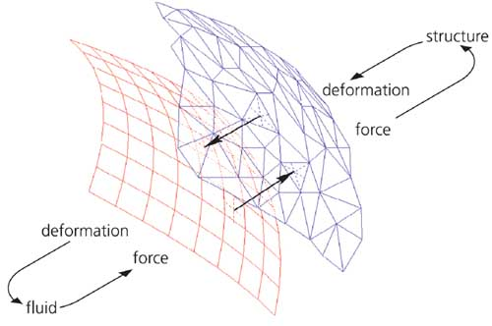

Analysis of Existing Tools/Techniques
Circuit Solvers | Co-Simulation Frameworks | Adaptive Meshing
1. Spice 2. Qucs | MpCCI PreCICE | Moving Mesh Multi-Splice

Slide 9
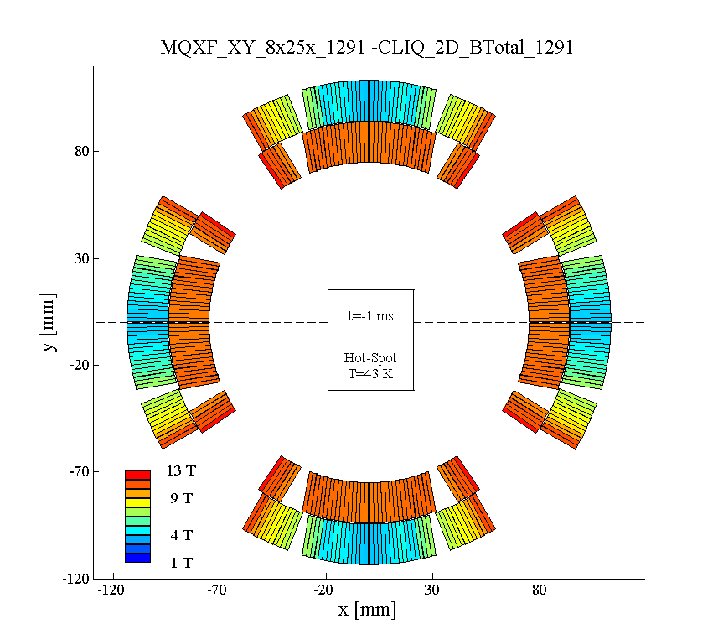
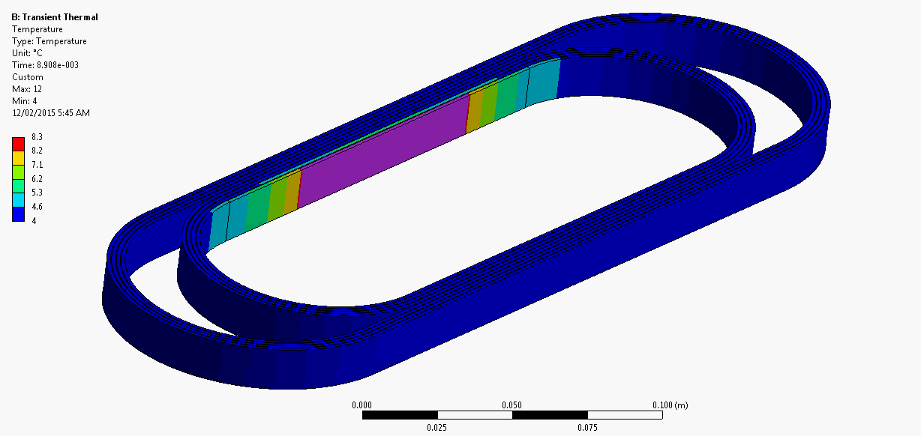

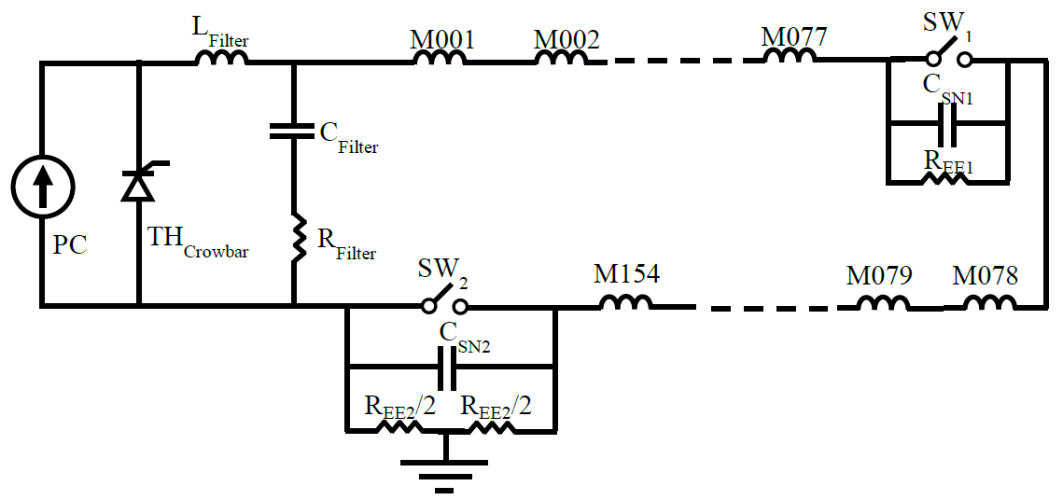












Mapping between 2D and 3D models
ANSYS*
k_{th,1,3}
$$R_{b}=\sum_{i=1}^{n}{R_{i}(T_{i},B_{b})}$$
Thermal
Sub-network
k_{He,1}
T_{He}
?
c_{th,1}
(i_{ifx,b})²R_{ifx,1}
(i_{ify,b})²R_{ify,1}
(i_{is,1})²R_{is,1}
$$T_{1}$$
$$T_{2}$$
(i₁)²R₁
$$T_{n}$$
$$Q_{Ohm.i}=q_{i}R_{i}{i_{b}}_{}^{2}$$
$$T_{i}$$
q₁=0
q₁=0
q₁=1
q₁=0
$$Q_{IFCL.i}={(1−q}_{i})R_{IFCL,i}{i_{IFCL,b}}_{}^{2}$$
$$Q_{ISCL.i}={(1−q}_{i})R_{ISCL,i}{i_{ISCL,b}}_{}^{2}$$
$$Q_{1}$$
$$Q_{2}$$
$$Q_{i}$$
$$Q_{n}$$
L₁
i_{b}
Electrical
Sub-network
R_{b}
M_{if,x,1,1}
M_{if,y,1,1}
M_{is,1,1}
SIMULINK/Spice*
Coupling Current
Sub-network
L_{if,x,1}
i_{if,x,1}
L_{if,y,1}
i_{if,y,1}
L_{is,1}
i_{is,1}
R_{if,x,1}
R_{if,y,1}
R_{is,1}
SIMULINK
*Adaptive meshing

Slide 10
Immediate Future Plans – Milestones
Couple lumped EM turn Simulink model (IFCL/ISCL) with thermal ANSYS model
Employ MpCCI to couple ANSYS EM and ANSYS thermal simulations
Write code adapters for MpCCI to redo 1)
Perform benchmarking study
ANSYS
ANSYS
Thermal
ANSYS
Electromagnetic
MATLAB
ANSYS
MATLAB
MPCCI
Coupling
MPCCI

Slide 11
Thank you for your attention!
Thanks to E. Ravaioli, J. Ghini, D. Paudel, A. Verweij, S. Schöps

