Slide 1
Progress and status of Accelerator Fault Tracking PROJECT
Jakub Janczyk
22/01/2015

Slide 2
Summary of my work
Started in February 2014
First few months spent working on Cardiogram – improvements, additional features and created charts for data from 2010-2012 (https://wikis.cern.ch/display/AFT/AWG+Fault+Data+Cardiograms)
Then started work on Accelerator Fault Tracking project
  Pawel Wilk joined in June 2014

Slide 3
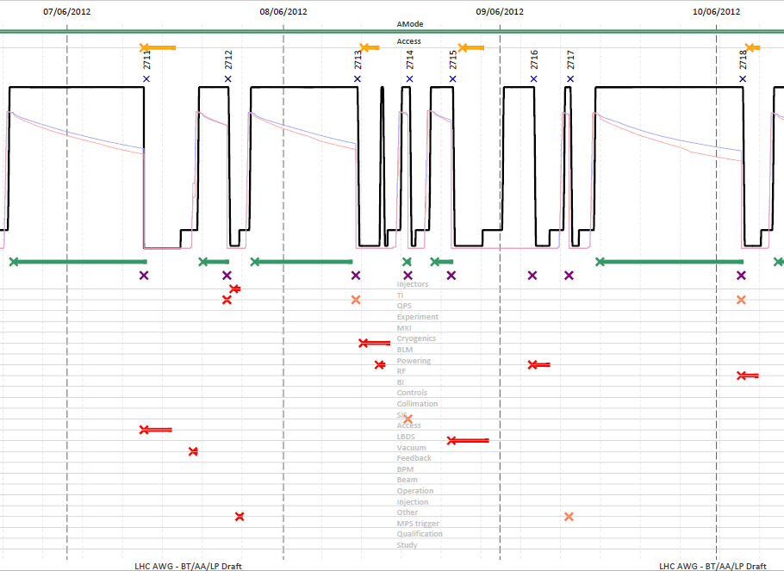
Cardiogram - example
Accelerator
Mode (Proton Physics, Ion Physics, etc.)
Access
Fill Number
Particle Momentum
Beams Intensities
Stable Beams
PM Beam Dump
Beam Dump
Classification
Fault Lines
(Systems/ Fault
Classifications)
Credit AWG
Fault

Slide 4
Accelerator Fault Tracking (AFT)
Project launched February 2014 (BE/CO, BE/OP, TE/MPE collaboration)
Goals:
Capture consistent and complete fault data
Facilitate fault tracking from perspective of all interested parties (OP, equipment groups, working groups)
Single source of data – easier to complete, clean and analyse.
Provide consistent / standardized statistics, analyses, reports for different users (8:30 meetings, weekly reports / summaries)
Interactive overview of faults (cardiogram on demand)
Proactively identify incomplete data
Plans for current stage:
Put in place a fault tracking infrastructure to capture LHC faults data from an operational perspective
Enable data exploitation by others (e.g. AWG and OP) to identify areas to improve accelerator availability for physics
→ https://aft-test.cern.ch:11400

Slide 5
AFT details
2 different Clients: eLogbook and AFT Web Application
2 APIs: Java API for eLogbook integration and REST API for Web Application
eLogbook integration – keep process of creating faults by operators as it was before (limited set of possible operations)
Web Application to be used by wider community – Equipment Groups, Working Groups, Experts and anyone from inside of CERN

Slide 6
Functionalities
eLogbook: Creating faults, basic editing, extracting
Web Application: Creating, full editing (including i.e. references between fault), advanced search, statistics, reports, etc.
Everyone will be able to display faults’ details, statistics, etc.
Creating/editing is secured – based on RBAC and standard NICE accounts

Slide 7
Server side technologies
Oracle database
Java
Embedded Jetty
Hibernate
Spring (including Spring MVC for REST API)
Spring Security + RBAC for authentication and authorization
Joda Time
RMI for eLogbook API

Slide 8
Web technologies
JavaScript
AngularJS framework – migration to Sencha ExtJS framework is already planned for this year
Bootstrap
Bootsrap-UI, AngularStrap for components
RequireJS

Slide 9

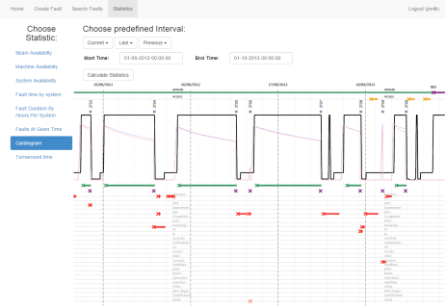


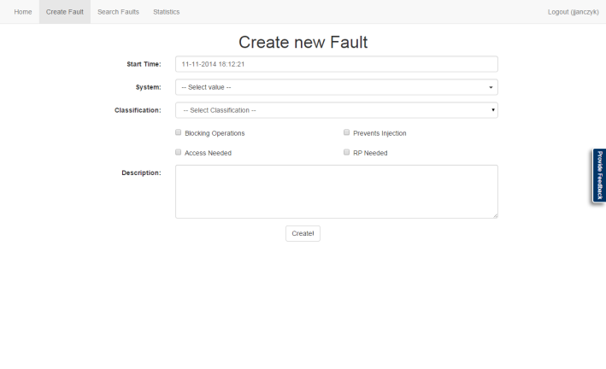

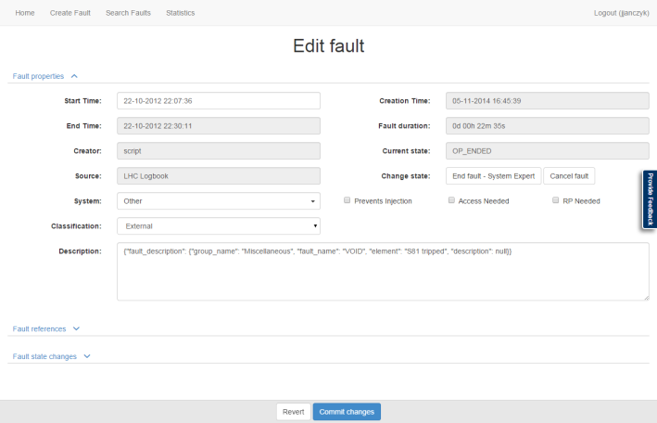

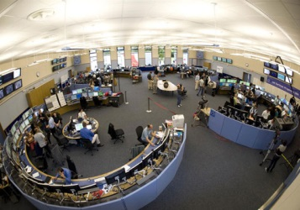
Architecture
< Statistics / Reports / Analysis >
< Fault Creation / Advanced Editing - EQP/OP>
AFT
REST
Hibernate
Web API
REST
AFT Server
(stateless)
PM
LDB
MDB
RMI
AFT Client API
< Fault Creation & Basic Editing (e-Logbook) OP >

Slide 10
Live demo

Slide 11
Extra slides

Slide 12
Plans (as presented by Chris Roderick @ LMC 30-04-2014)
Provide infrastructure to consistently & coherently capture, persist and make available accelerator fault data for further analysis.
Foreseen project stages:
Put in place a fault tracking infrastructure to capture LHC fault data from an operational perspective
  Enable data exploitation by others (e.g. AWG and OP) to identify areas to improve accelerator availability for physics
  Ready before LHC beam commissioning
  Infrastructure should already support capture of equipment group fault data, but not primary focus
Focus on equipment group fault data capture
Explore integration with other CERN data management systems (e.g. Infor EAM)
  potential to perform deeper analyses of system and equipment availability
  in turn - start predicting and improving dependability
To support data analysis, AFT data extraction infrastructure should also provide data complimentary to the actual fault data - such as accelerator operational modes and states.
Scope:
Initial focus on LHC, but aim to provide a generic infrastructure capable of handling fault data of any CERN accelerator.

Slide 13
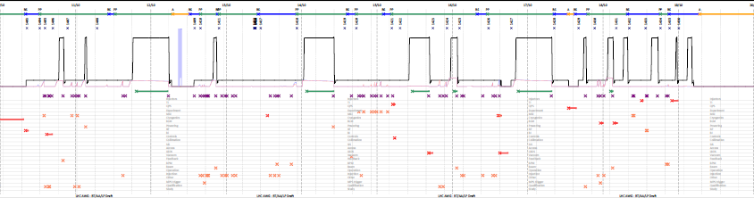
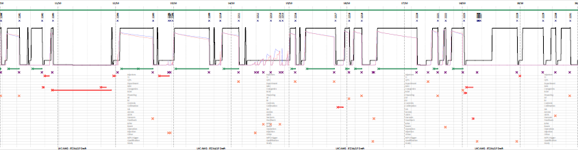
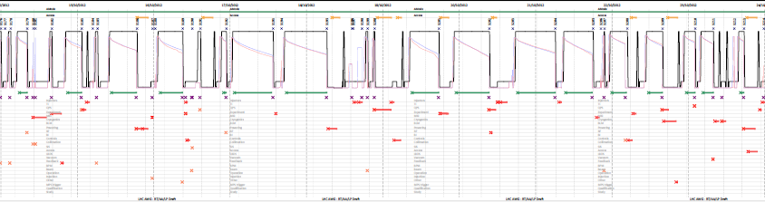
2010
2011
2012

