Slide 1
From 10⁻¹² TeV to 10¹⁶ TeV
Introduction to accelerator physics and technology: The Large Hadron Collider
Rüdiger Schmidt
KIT Workshop Freudenstadt 2015

Slide 2

To accelerate a particle to very very high energy …
Particle energy about 2*10¹⁰ TeV

Slide 3
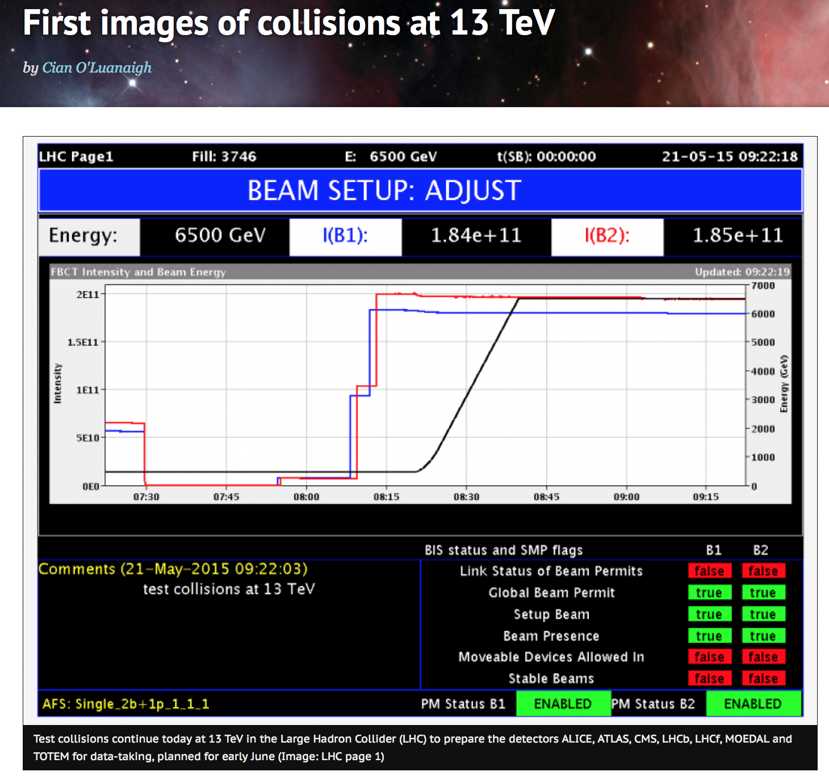
To accelerate particles to much lower energy
….… 6.5 TeV for a proton, for an ion >500 TeV
Energy stored in the entire proton beam = 2*10¹⁵ TeV

Slide 4
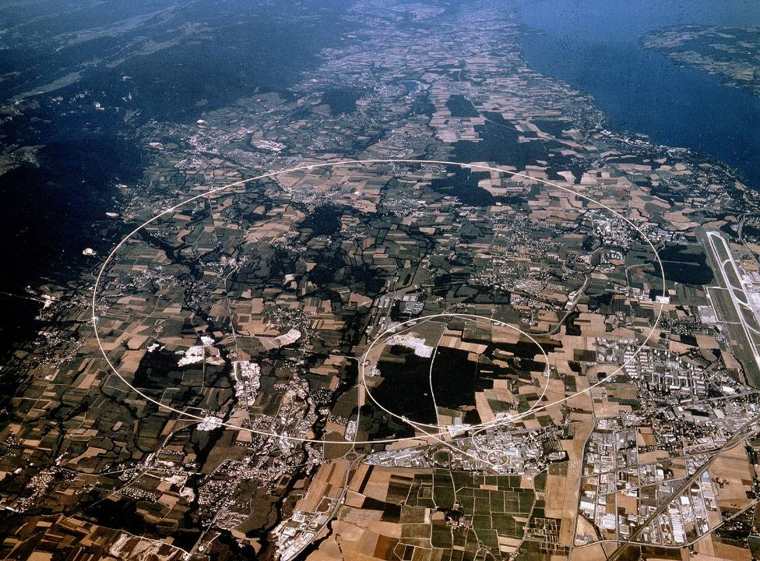
LHC pp and ions
7 TeV/c – up to now 6.5 TeV/c
26.8 km Circumference
Switzerland
Lake Geneva
LHC Accelerator
(100 m down)
LHCb
CMS, TOTEM
CERN-Prevessin
ALICE
SPS Accelerator
ATLAS
France
CERN Main Site

Slide 5
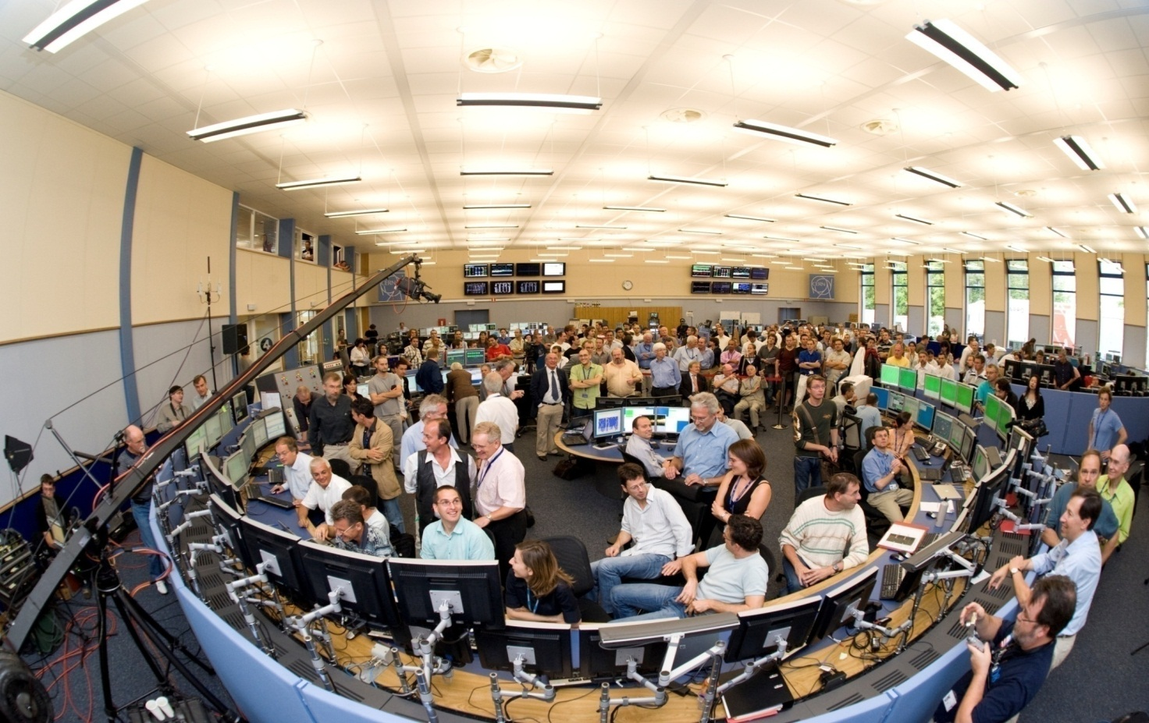
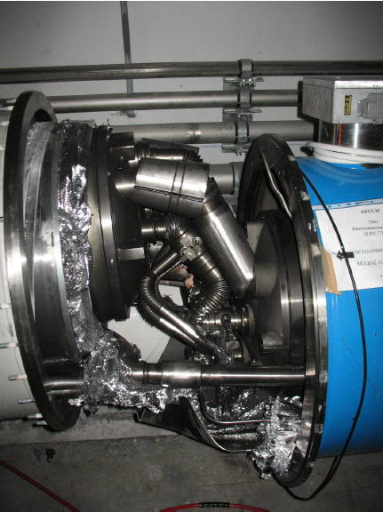

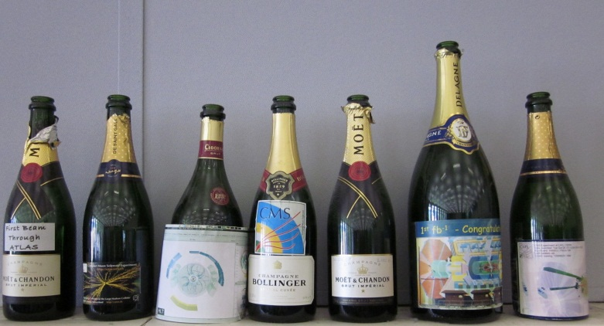
LHC: A long story starting in the distant past
First ideas to first protons: from 1984 to 2008
Tears of joy…. first beam in 2008
Tears of despair (and hopefully last) accident in 2008
The story of the champagne bottles

Slide 6
Overview
Accelerator physics and LHC crash course - DONE
Energy and Luminosity
What is accelerator physics?
Acceleration and deflection of charged particles
Energy and Luminosity Challenges
Short Accelerator Physics Course
Particle Energy and Superconducting Magnets
Understanding LHC operation
Challenges for high intensity beams operation
Preparing for the next 20 years: HL-LHC…..
Preparing for the next 50 years: FCC study…..

Slide 7
Energy and Luminosity

Slide 8
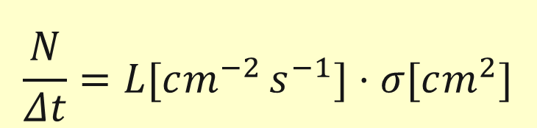
Energy and (integrated) Luminosity
Particle physics requires an accelerator colliding beams with a centre-of-mass energy as high as possible
The event rate is determined by cross-section and luminosity
In order to observe events with low cross-section, the luminosity should exceed 10³⁴ [cm⁻²s⁻¹]
The time available for data-taking with high luminosity is important
$$\frac{N}{Δt}=L[cm^{−2 }s^{−1}]⋅σ[cm^{2}]$$

Slide 9
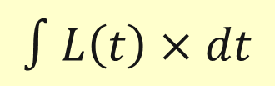
Integrated Luminosity and Availability
The total number events is proportional to the Integrated Luminosity:
It has the unit of [cm⁻²] and is expressed in Inverse Picobarn or Inverse Femtobarn
The availability of the accelerator plays an essential role: all systems must work correctly, very challenging for such complex machine
$$∫L\left(t\right)×dt$$

Slide 10
The LHC: just another collider ?
 | Start | Type | Max proton energy [GeV] | Length [m] | B Field [Tesla] | Lumi [cm⁻²s⁻¹] | Stored beam energy [MJoule]
TEVATRON Fermilab Illinois USA | 1983 | p-pbar | 980 | 6300 | 4.5 | 4.3 10³² | 1.6 for protons
HERA DESY Hamburg | 1992 | p – e+ p – e- | 920 | 6300 | 5.5 | 5.1 10³¹ | 2.7 for protons
RHIC Brookhaven Long Island | 2000 | Ion-Ion p-p | 250 | 3834 | 4.3 | 1.5 10³² | 0.9 per proton beam
LHC CERN | 2008 | Ion-Ion p-p | 7000 Now 6500 | 26800 | 8.3 | 10³⁴ Now 7.7× 10³³ | 362 now 180
Factor |  |  | 7 | 4 | 2 | 50 | 100

Slide 11
What is Accelerator Physics ?

Slide 12

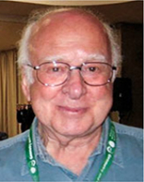
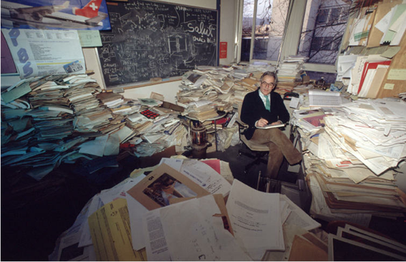
thinking, thinking, thinking …. and predicting the results
....sometimes correctly!
Peter Higgs

Slide 13
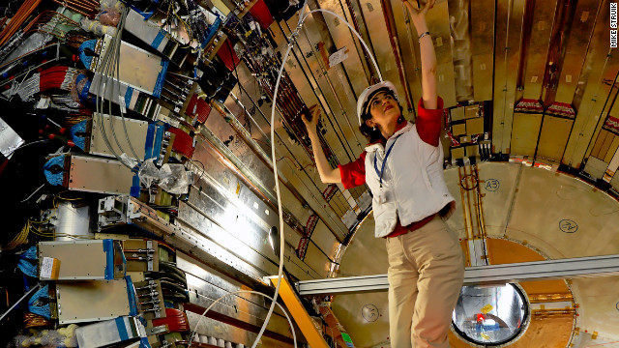
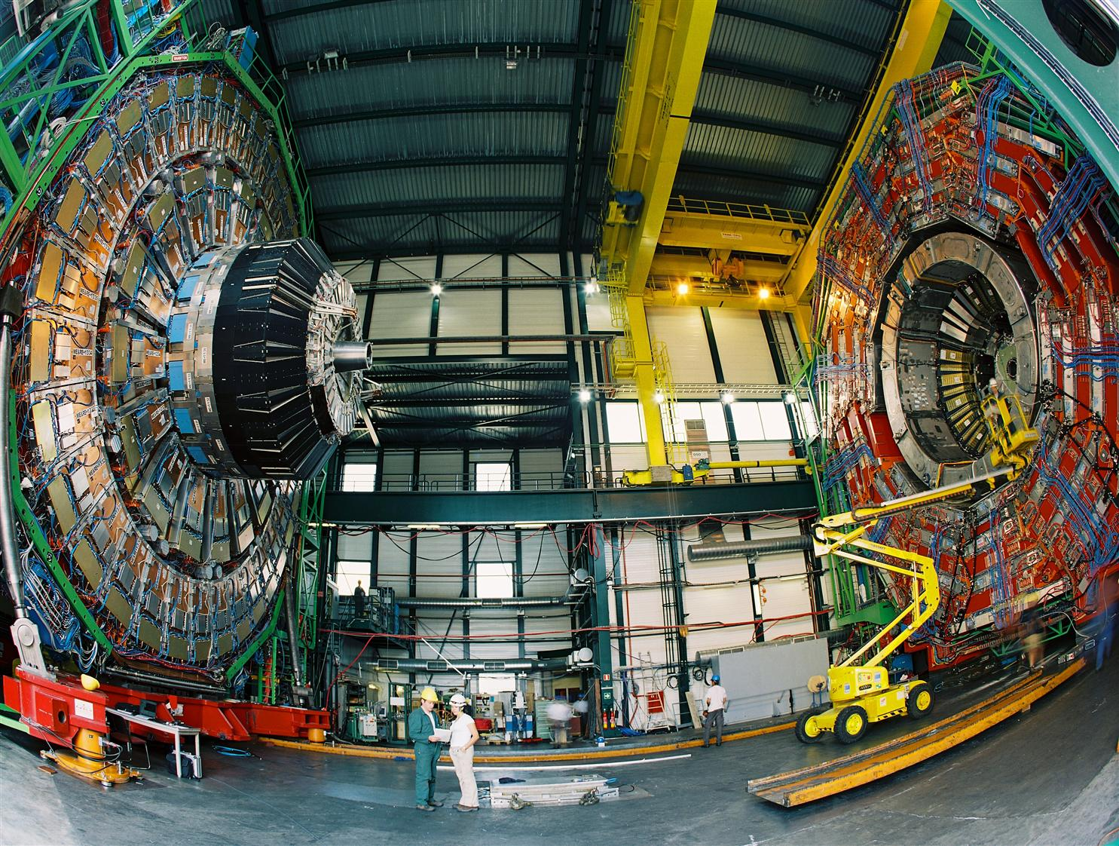
…building the detectors and
analysing the results
Experimental Physicist
F.Gianotti Person of the year

Slide 14



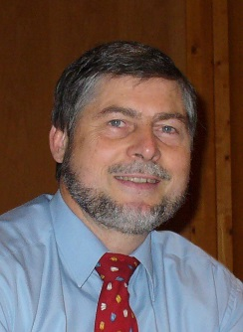
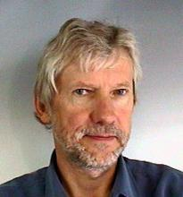
The hierarchy in physics
19/7/2012
citing Mike Lamont (Head of CERN accelerator operation):
Among physicists there is a hierarchy: » On top are the theorists, then the experimental physicist, then us, the machine people.«
German original: Und unter den Physikern gebe es eine Hierarchie: »Ganz oben stehen die Theoretiker, dann kommen die Experimentalphysiker und dann wir, die Maschinenleute.«

Slide 15


Accelerator Physicist
Plumber of the year
…building very long, exceptionally cold and extremely complex machines …

Slide 16

What is accelerator physics … and technology?
The physics and engineering required to plan, develop, construct and operate particle accelerators
Electrodynamics
Relativity
Particle physics, nuclear physics and radiation physics
Thermodynamics
Mechanics
Quantum Mechanics
Physics of nonlinear systems
Material science, solid state physics and surface physics
Vacuum physics
Plasma physics and laser physics
Plus: mechanical engineering, electrical engineering, computing science, metrology, civil engineering
Plus: Management, reliability engineering and system engineering
What does he need to know?
A fairly clever plummer is needed

Slide 17
Acceleration and deflection of charged particles
How to get to high energy?
How to make many collisions (~10⁹/s)?

Slide 18
Lorentz Force
The force on a charged particle is proportional to the charge, the electric field, and the vector product of velocity and magnetic field:
For an electron or proton the charge is:
Acceleration (increase of energy) only by electrical fields – not by magnetic fields:

Slide 19
Particle acceleration
  Acceleration of elementary particles to high energy in an electrical field, e.g. 1 GeV => 1 GV
    No constant electrical field above some Million Volt (break down)
    => Use of time dependent electrical field
1 MeV requires U = 1 MV

Slide 20
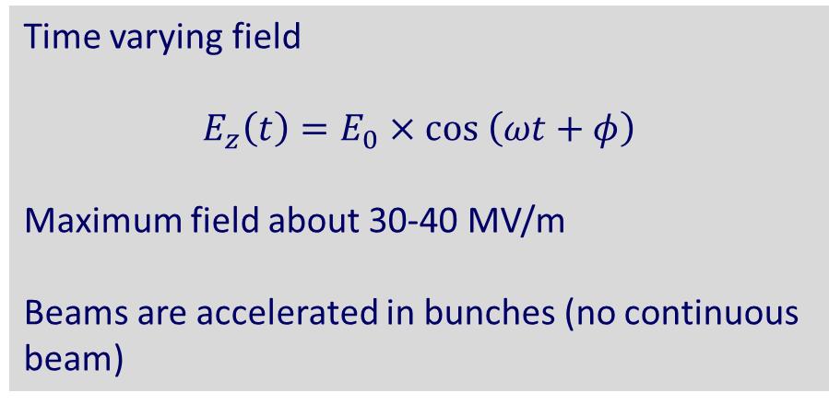
Particle acceleration with RF cavity
Time varying field
$$E_{z}\left(t\right)=E_{0}×cos \left(ωt+φ\right)$$
Maximum field about 30-40 MV/m
Beams are accelerated in bunches (no continuous beam)
LHC RF frequency 400 MHz (typical frequency for an accelerator)

Slide 21
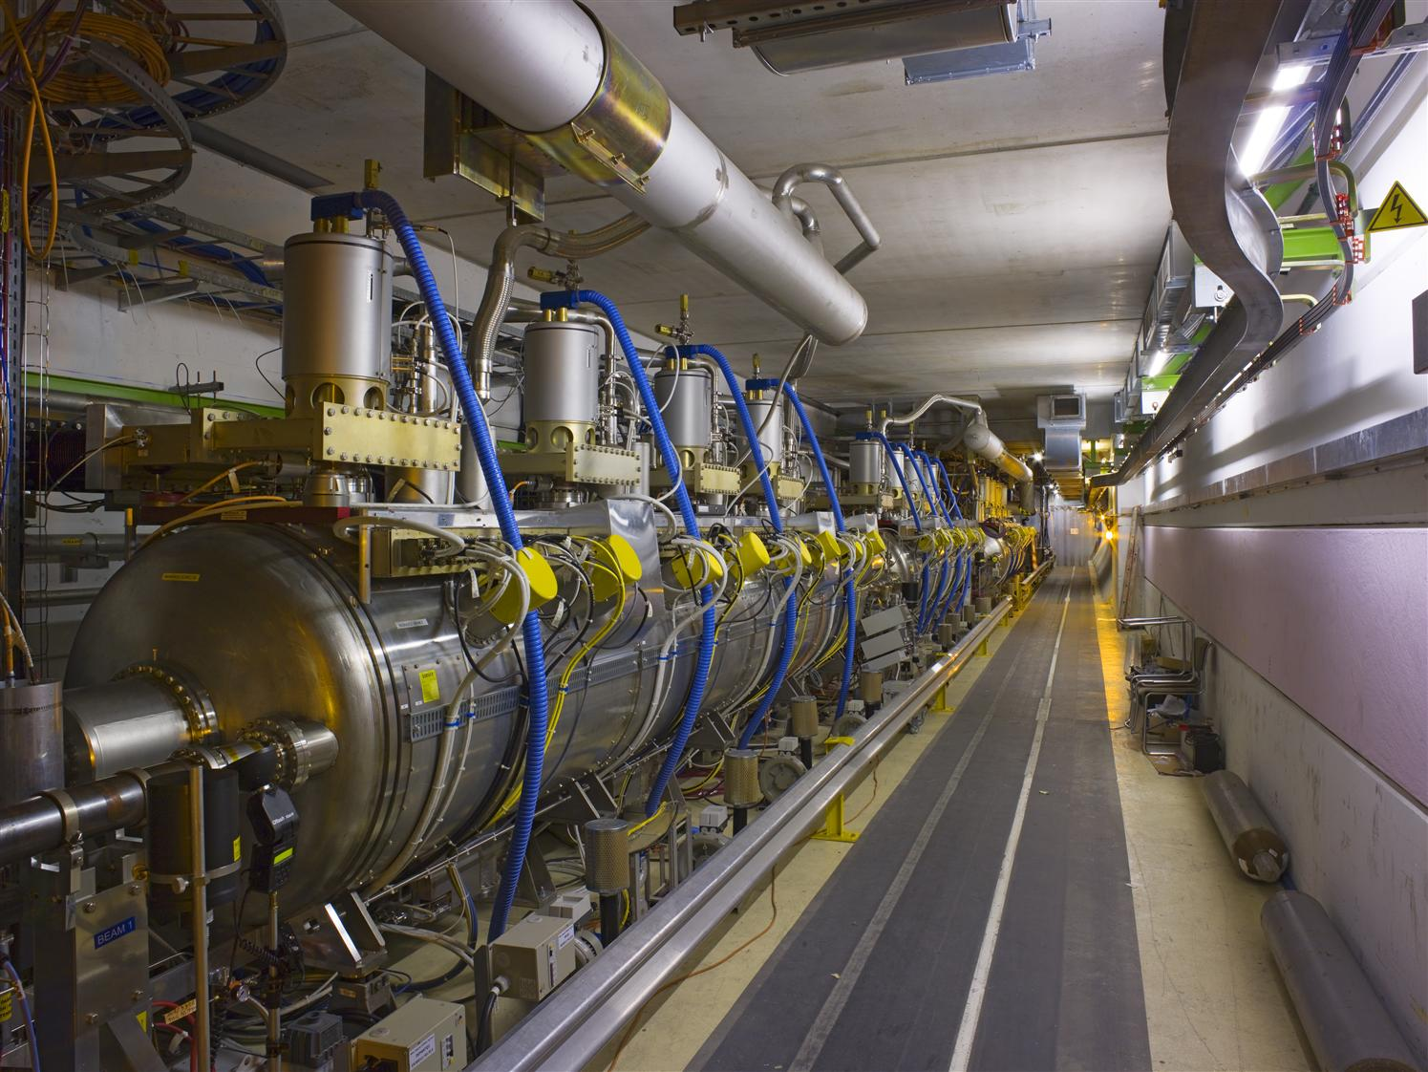
RF systems: 400 MHz
400 MHz system:
16 superconducting cavities (copper sputtered with niobium) for 16 MV/beam, built and assembled in four modules

Slide 22
400 MHz RF buckets and bunches
The particles oscillate back and forth in time/energy
The particles are trapped in the RF voltage:
this gives the bunch structure
RF Voltage
2.5 ns
time
ΔE
LHC bunch spacing = 25 ns / 50 ns = 10 / 20 buckets ⇔ 7.5 m / 15 m
RF bucket
time
2.5 ns
450 GeV 7 TeV
RMS bunch length 11.2 cm 7.6 cm
RMS energy spread 0.031% 0.011%

Slide 23
To collide particles at very high energy
Linear collider versus Circular collider

Slide 24
Linear accelerator: use accelerating structure once
Accelerating beams to high energy in a linear collider:
The beams are accelerated during one passage and the perticles are colliding only once at the center of the experiment
Accelerating structures
Experiment
Accelerating structures
  Acceleration of particles with time-varying electrical field
    Limit 30-40 MeV/m with superconducting cavities
    Limit about 100 MeV/m with other technologies, not yet used (CLIC)
    Some 100 GeV … ~TeV conceivable for e+e- colliders
    Reaching an energy of 14 TeV c.m. (such as LHC) would require an accelerator with a length > 400 km (with 40 MV/m)
    Long-term: acceleration in a plasma … not ready for a HEP collider

Slide 25
Circular accelerator: re-use accelerating structure
Accelerating structure
Accelerating beams to high energy in a synchrotron
Beam are injected into the accelerator
The particles make many turns
The magnetic field is slowly increased, and particles are accelerated when travelling through the accelerating structure
The beams can be extracted, or stored for many hours at top energy, bunches collide each turn
Major limitations: emission of synchrotron radiation and strength of the magnetic field
Magnets around the accelerator to bring the beam back to the accelerating structure
Today achieved particle momentum of 6.5 TeV/c at LHC
Experiment

Slide 26
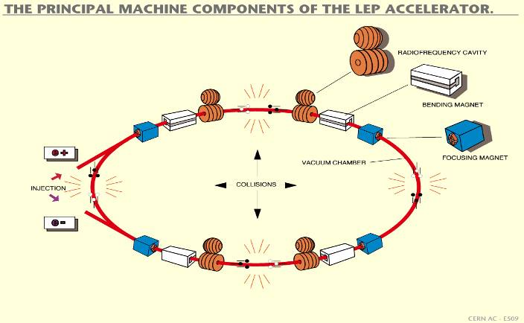
Synchrotron – circular accelerator
LHC circular machine with energy gain per turn ~0.5 MeV
acceleration from 450 GeV to 6.5 TeV takes about 20 minutes
Experiment
Experiment

Slide 27
Operational cycle of a synchrotron
Injection at low energy
Ramping of magnetic field and acceleration by RF field
Operation (collisions) at top energy
Magnetic field
Can be extended
Beam intensity
450 GeV
CERN - SPS
26 GeV
Injection
Injection
Time
Cycle ~20 s

Slide 28
Particle Energy challenge

Slide 29
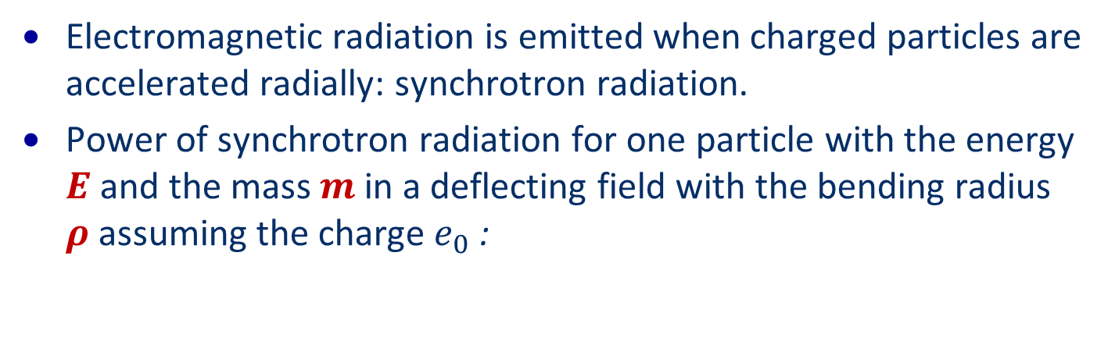
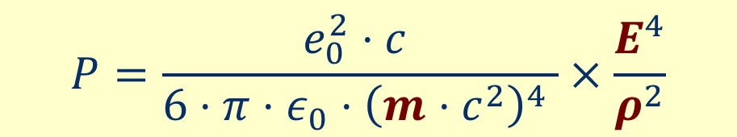
Major limitation: Synchrotron Radiation
Electromagnetic radiation is emitted when charged particles are accelerated radially: synchrotron radiation.
Power of synchrotron radiation for one particle with the energy $E$and the mass $m$ in a deflecting field with the bending radius $ρ$ assuming the charge $e_{0}$ :
$$P=\frac{e_{0}^{2}⋅c }{6⋅π⋅ε_{0}⋅{\left(m⋅c^{2}\right)}^{4} }×\frac{E^{4}}{ρ^{2}}$$
LEP with electron-positron beams at 100 GeV/c: 16000 kW
LHC with proton-proton beams at 7000 GeV/c
and about 100 times more particles: 2.2 kW

Slide 30
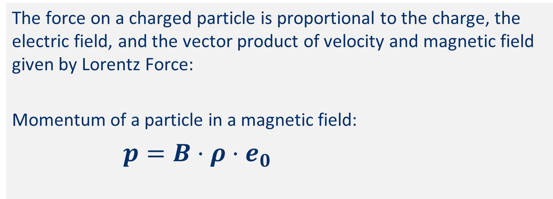
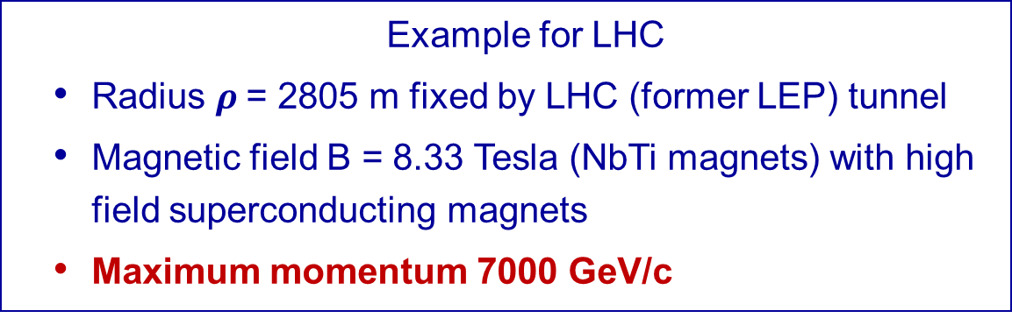
Major limitation: Strength of deflecting field
The force on a charged particle is proportional to the charge, the electric field, and the vector product of velocity and magnetic field given by Lorentz Force:
Momentum of a particle in a magnetic field:
$p=B⋅ρ⋅e_{0}$
z
s
B
v
F
x
  Example for LHC
  Radius $ρ$= 2805 m fixed by LHC (former LEP) tunnel
  Magnetic field B = 8.33 Tesla (NbTi magnets) with high field superconducting magnets
  Maximum momentum 7000 GeV/c

Slide 31
LEP / LHC in tunnel with a length of 27 km
Particles | Momentum [GeV/c] | Energy loss per turn [GeV] | Energy loss per turn [%] | Energy loss [MeV/m] | Bending field [T]
e+e- | 102.00 | 3.22 | 3.16 | 0.172 | 0.12
p | 7000.00 | 6.29E-06 | 0.00 | 0.000 | 8.30
p | 187232.00 | 3.22 | 0.00 | 0.000 | 222.00
e+e- | 7000.00 | 71385649.93 | 1019795.00 | 3818950.942 | 8.30
e+e- | 175.00 | 27.89 | 15.93 | 1.492 | 0.21

Slide 32
LEP / LHC tunnel: limitations for protons
Particles | Momentum [GeV/c] | Energy loss per turn [GeV] | Energy loss per turn [%] | Energy loss [MeV/m] | Bending field [T]
e+e- | 102.00 | 3.22 | 3.16 | 0.172 | 0.12
p | 7000.00 | 6.29E-06 | 0.00 | 0.000 | 8.30
p | 14000.00 | 1.02E-04 | 0.00 | 0.000 | 16.60
p | 187232.00 | 3.22 | 0.00 | 0.000 | 222.00
e+e- | 7000.00 | 71385649.93 | 1019795.00 | 3818950.942 | 8.30
e+e- | 175.00 | 27.89 | 15.93 | 1.492 | 0.21
Protons with synchrotron radiation loss GeV/turn as electrons in LEP: magnetic field more than one order of magnitude above what is possible today (14 TeV could possibly be conceived)

Slide 33
LEP / LHC tunnel: limitations for e+e-
Particles | Momentum [GeV/c] | Energy loss per turn [GeV] | Energy loss per turn [%] | Energy loss [MeV/m] | Bending field [T]
e+e- | 102.00 | 3.22 | 3.16 | 0.172 | 0.12
p | 7000.00 | 6.29E-06 | 0.00 | 0.000 | 8.30
p | 14000.00 | 1.02E-04 | 0.00 | 0.00 | 16.60
p | 187232.00 | 3.22 | 0.00 | 0.000 | 222.00
e+e- | 7000.00 | 71385649.93 | 1019795.00 | 3818950.942 | 8.30
e+e- | 175.00 | 27.89 | 15.93 | 1.492 | 0.21
Electrons with same magnetic field as protons in LHC: energy loss in a few cm.
……. and with a large reduced field, but somewhat higher than LEP, still much too high

Slide 34
Luminosity challenge
How to make many collisions (~10⁹/s)?

Slide 35
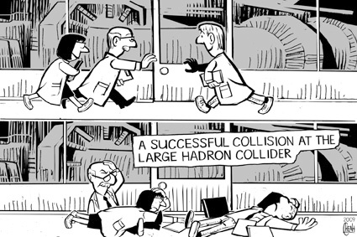
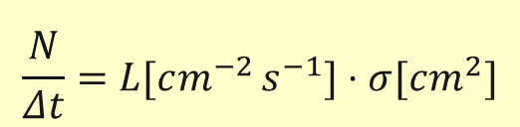
How to get to many many many many collisions ?
$$\frac{N}{Δt}=L[cm^{−2 }s^{−1}]⋅σ[cm^{2}]$$

Slide 36
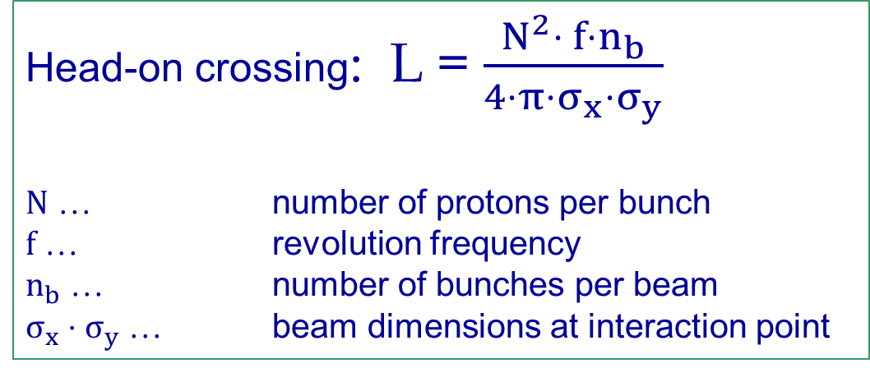
Luminosity parameters for a circular collider
Head-on crossing: L = $\frac{N^{2}⋅ f⋅n_{b}}{4⋅π{⋅σ}_{x}⋅σ_{y}}$
N … number of protons per bunch
$f$ … revolution frequency
$n_{b}$ … number of bunches per beam
$σ_{x}⋅σ_{y}$ … beam dimensions at interaction point

Slide 37
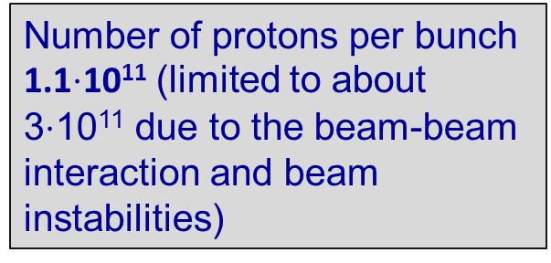
LHC Luminosity: parameters for head on collisions
Number of protons per bunch 1.1$⋅$10¹¹ (limited to about 3$⋅$10¹¹ due to the beam-beam interaction and beam instabilities)
Beam size given by injectors and by space in vacuum chamber
f = 11246 Hz
Beam size 16 μm,
for β = 0.5 m (β is a function of the lattice)
L = $\frac{N^{2}⋅f⋅n_{b}}{4⋅π⋅σ_{x}⋅σ_{y}}$ $= 3.5×{10}^{30} \left[cm^{−2} s^{−1}\right] (n_{b}$ = 1, one bunch)
~2800 bunches (every 25 ns one bunch) L = 10³⁴ [cm⁻²s⁻¹]
Watch out for another limitation: Event pile-up

Slide 38
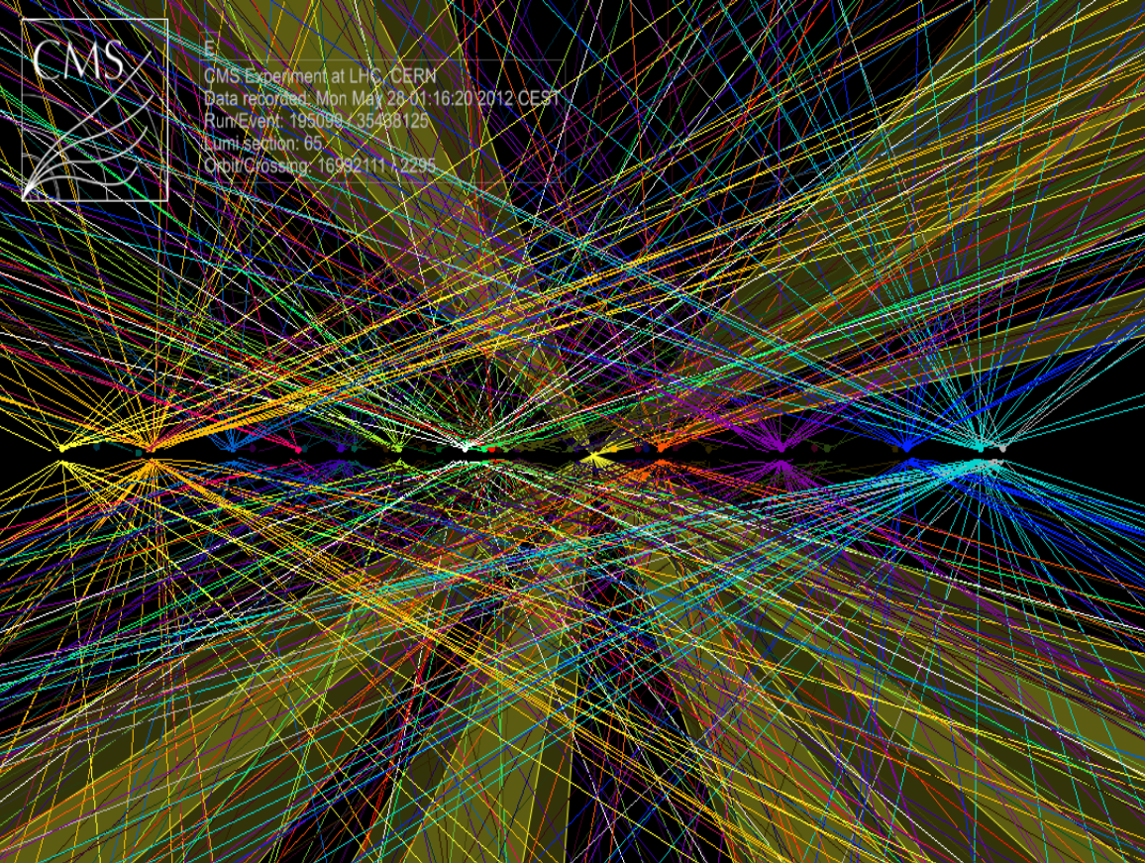
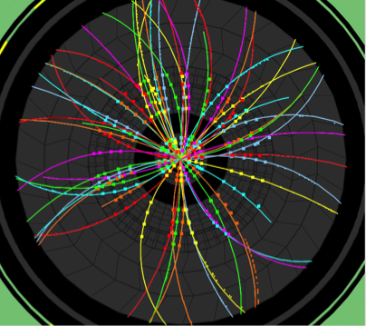
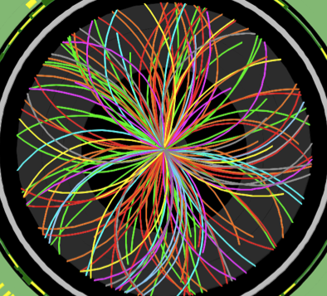

The price of the high luminosity with fewer collisions: for each bunch crossing there are up to ~35 interactions.
2010: ~ 2 events/x-ing
2011: ~ 10 events/x-ing
2012: ~ 20 events/x-ing

Slide 39
Crossing parameters with many bunches
Quadrupole
Collision point in experiment
Quadrupole
Parasitic crossing
Parasitic crossing
~ 80m
Illustration drawing
Large beam size in adjacent quadrupole magnets
Crossing angle to avoid additional collision points
Separation between beams needed, about 10 σ (σ = rms beam size)
Limitation with aperture in quadrupoles

Slide 40
Experimental long straight sections
The 2 LHC beams are brought together to collide in a ‘common’ region
Over ~260 m the beams circulate in one vacuum chamber with ‘parasitic’ encounters (when the spacing between bunches is small enough)
Total crossing angle of about 300 μrad

Slide 41
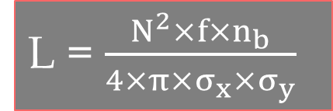
Event pile up in LHC experiments
Assuming nominal parameters, for one bunch crossing, the number of colliding proton pairs (events) is given by:
L = $\frac{N^{2}×f×n_{b}}{4×π×σ_{x}×σ_{y}}$

Slide 42
Challenges for high luminosity operation
Large beam intensity => Energy stored in beams
Dumping the beam in a safe way in case of failure
Avoiding beam losses, in particular in the superconducting magnets (beam induced magnet quenching (for LHC, when 10⁻⁸-10⁻⁷ of beam hits magnet at 7 TeV/c)
Radiation, in particular in experimental areas from beam collisions (beam lifetime is dominated by this effect)
Beam dynamics
Instabilities and Electron Cloud
UFOs
Beam-beam effects

Slide 43
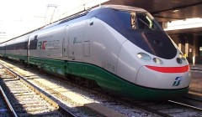


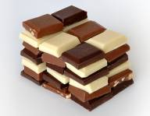
Energy stored in the beam
For LHC at 7 TeV/c the energy stored in the beam is equal to 362 MJ
The energy of an 200 m long fast train at 155 km/hour corresponds to the energy of 362 MJoule stored in one LHC beam
362 MJoule: the energy stored in one LHC beam corresponds approximately to…
90 kg of TNT
8 litres of gasoline
15 kg of chocolate
It’s how ease the energy is released that matters most !!

Slide 44
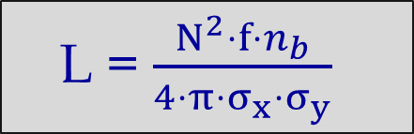
Some essential parameters for accelerators
Particle type (e+, e-, p, antiproton, ion, …)
Energy / momentum of a particle
Beam intensity / beam current
Beam size => beam emittance
Trajectory / closed orbit
Betatron oscillations
Betatron tune (Q value)
L = $\frac{N^{2}⋅f⋅n_{b}}{4⋅π⋅σ_{x}⋅σ_{y}}$

Slide 45
Short Accelerator Physics Course
How to transport particles in an accelerator?

Slide 46
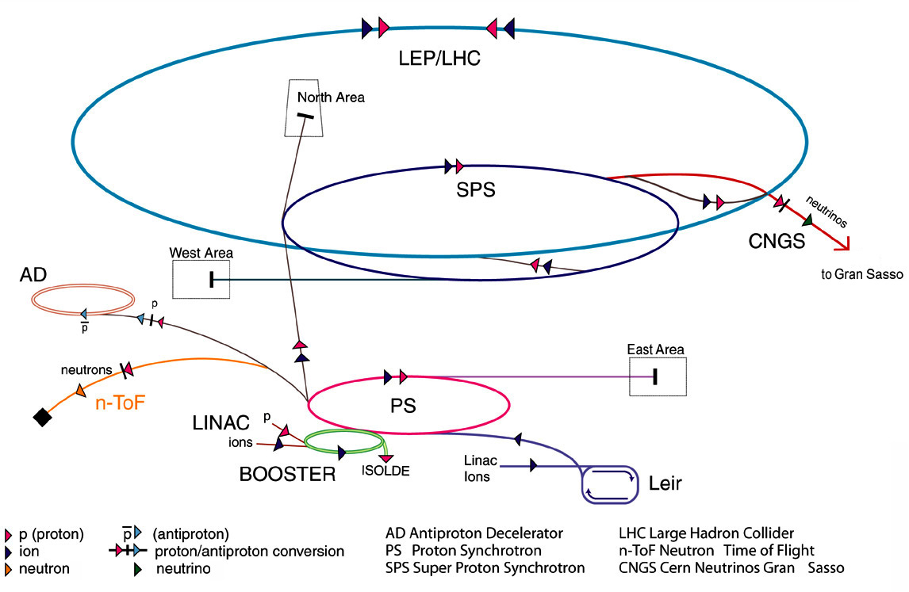
CERN accelerator complex
?
?
?
?
High intensity beam from SPS to LHC at 450 GeV via TI2 and TI8, LHC accelerates to 7 TeV

Slide 47
SPS, transfer line and LHC
Beam is accelerated in the SPS to 450 GeV (stored energy of 3 MJ)
Beam is transferred from SPS to LHC
Beam is accelerated in the LHC to 6.5 TeV (stored energy of some 100 MJ)
Scraping of beam in SPS before transfer to LHC
IR8
Injection kicker
Switching magnet
CNGS Target
Fast extraction kicker
SPS
6911 m
450 GeV / 400 GeV
3 MJ
Acceleration cycle of ~10 s
Transfer line 3km
Injection kicker
LHC
IR2
Fast extraction kicker
1 km
Transfer line

Slide 48
Beam transport
Need for getting protons on a circle: dipole magnets
Need for focusing the beams with lenses:
Particles with different injection parameters (angle, position) separate with time
  Assuming an angle difference of 10⁻⁶ rad, two particles would separate by 1 m after 10⁶ m. At the LHC, with a length of 26860 m, this would be the case after 50 turns (5 ms !)
Particles would „drop“ due to gravitation
The beam size must be well controlled
  At the collision point the beam size must be tiny
Particles with (slightly) different energies should stay together

Slide 49
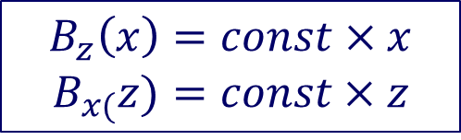
Force by quadrupole magnets
$$B_{z}\left(x\right)=const×x$$
$$B_{x(}z)=const×z$$
From Maxwell’s
equations
Here: a particle with positive charge travels in s-direction, into the table
z
z
View along particle path
x
x
x
Top view:
defocusing
z
Side view: focusing
s
s

Slide 50
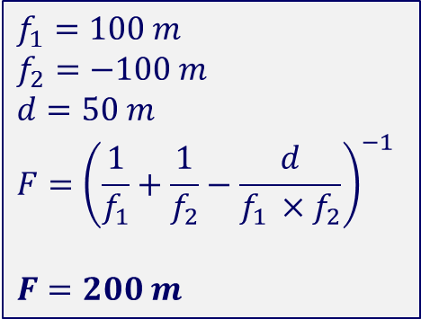
Focusing by two quadrupole magnets, thin lenses
Horizontal plane
$$f_{1}=100 m$$
$$f_{2}=−100 m$$
$$d=50 m$$
$$F={\left(\frac{1}{f_{1}}+\frac{1}{f_{2}}−\frac{d}{f_{1 }×f_{2}}\right)}^{−1}$$
$$F=200 m$$
d = 50 m
Vertical plane

Slide 51
Phase Space of an ensemble of particles
X
X’
X’
X
X

Slide 52
Phase Space of an ensemble of particles
X
X’
X’
X
X

Slide 53
Phase Space of an ensemble of particles
X
X’
X’
X
X

Slide 54
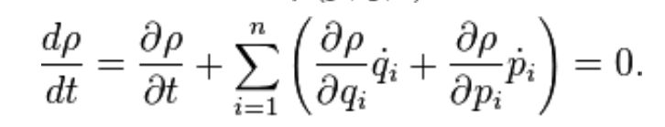
Phase Space of an ensemble of particles
X’
Many particles, same „normalised“ amplitude
X
Real beam: many particles, different amplitudes
X’
This conservation law: phase space volume occupied by a collection of systems evolving according to Hamilton's equations of motion is preserved in time
X

Slide 55
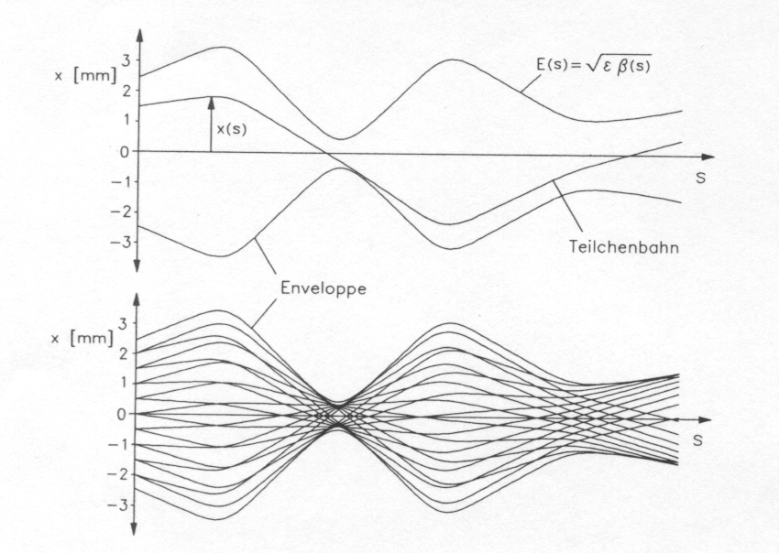
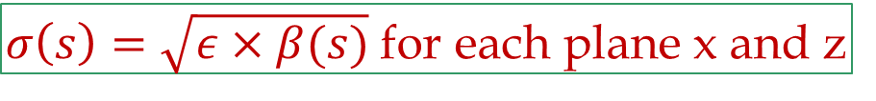
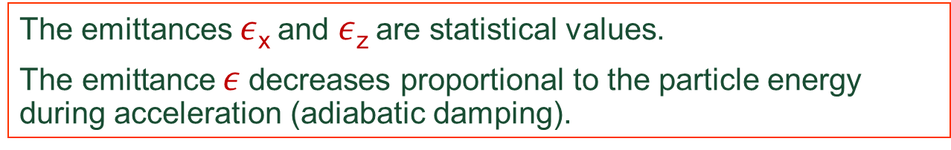
Betatron oscillations for many particles
Beam size at longitudinal position s
K.Wille
$σ\left(s\right)=\sqrt{ε×β(s)}$ for each plane x and z
The emittances $ε$_{x} and $ε$_{z} are statistical values.
$\text{The} \text{emittance} ε$ decreases proportional to the particle energy during acceleration (adiabatic damping).

Slide 56
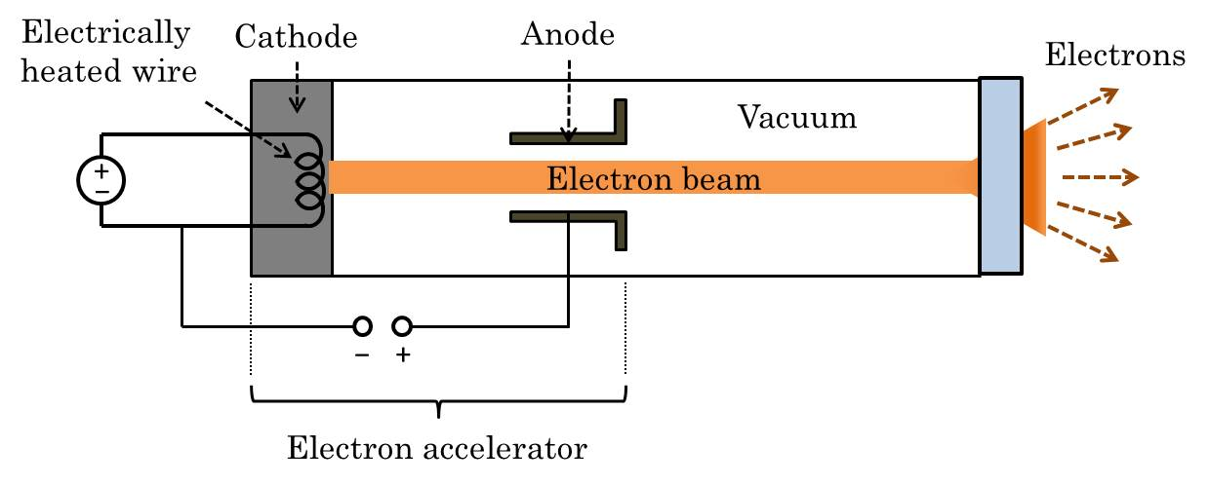


Light and particle sources

Slide 57
Particle stability and magnets
Particle oscillations in quadrupole field (small amplitude)
Harmonic oscillation after coordinate transformation
Circular movement in phase space
All particles in a circular accelerator oscillate around a trajectory in the accelerator: the closed orbit
With correct coordinate transformation, these betatron oscillations have sinusoidal shape
This is exactly true for a system with linear fields (only quadrupolar fields), and only approximately true for non-linear field

Slide 58
Magnets and beam transport
Dipole magnets
  To make a circle around LHC
Quadrupole magnets
  To keep beam particles together
  Particle trajectory stable for particles with nominal momentum
Sextupole magnets
  To correct the trajectories for off momentum particles
  Particle trajectories stable for small amplitudes (about 10 mm)
Multipole-corrector magnets
  Sextupole - and decapole corrector magnets at end of dipoles
Particle trajectories can become instable after many turns (even after, say, 10⁶ turns)

Slide 59
A (F0D0) cell in the LHC arcs
Vertical / Horizontal plane
(QF / QD)
Quadrupole magnets controlling the beam size „to keep protons together“ (similar to optical lenses)
LHC Cell - Length about 110 m (schematic layout)
SSS
sextupole
corrector
(MCS)
quadrupole
MQF
orbit corrector
quadrupole
MQD
orbit corrector
quadrupole
MQF
orbit corrector
main
dipole
MB
main
dipole
MB
main
dipole
MB
main
dipole
MB
main
dipole
MB
main
dipole
MB
special corrector (MQS)
lattice sextupole (MS)
decapole
octupole
corrector
(MCDO)
special corrector (MO)
lattice sextupole
(MS)
special corrector (MO)
lattice sextupole
(MS)
10000 magnets powered in 1700 electrical circuits

Slide 60
Particle stability and magnets
Particle oscillations in quadrupole field (small amplitude)
Harmonic oscillation after coordinate transformation
Circular movement in phase space
Particle oscillation assuming non-linear fields, large amplitude
Amplitude grows until particle is lost (touches aperture)
No circular movement in phasespace

Slide 61
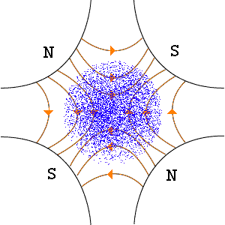
Visualising bunch oscillation in accelerator

Slide 62
Particle energy and superconducting magnets
…….the magnetic field strength determines the beam energy

Slide 63
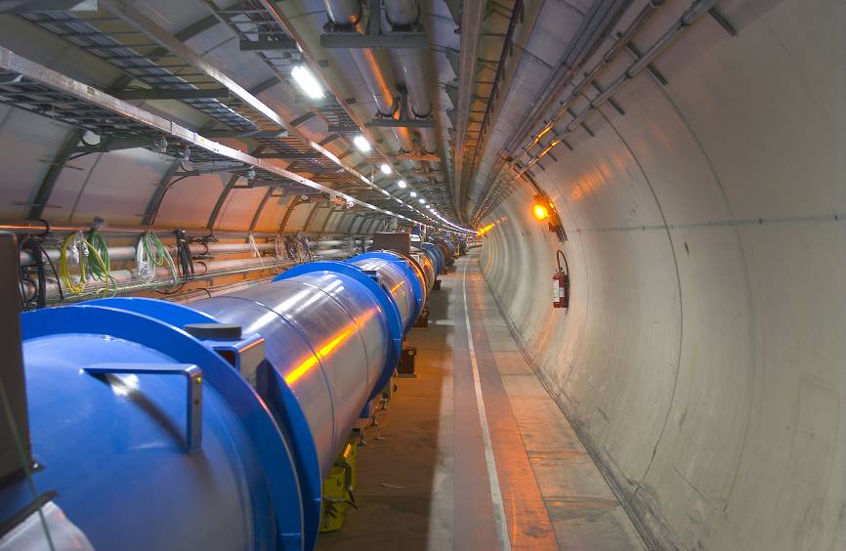
Superconducting magnets in LHC tunnel
  Deflection by 1232 superconducing dipole magnets

Slide 64
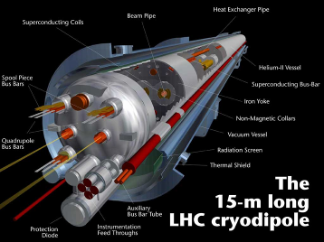
Dipole magnets for the LHC
1232 Dipole magnets
Length about 15 m
Magnetic Field 8.3 T for 7 TeV
Two beam tubes with an opening of 56 mm
plus many other magnets, to ensure beam stability (1700 main magnets and about 8000 corrector magnets)

Slide 65
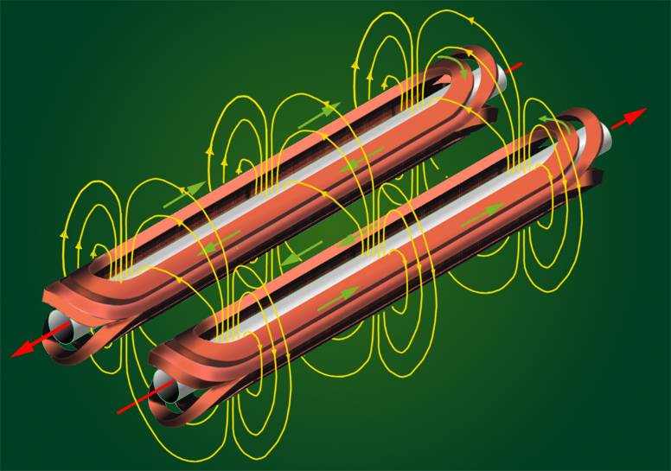
Coils for Dipolmagnets

Slide 66
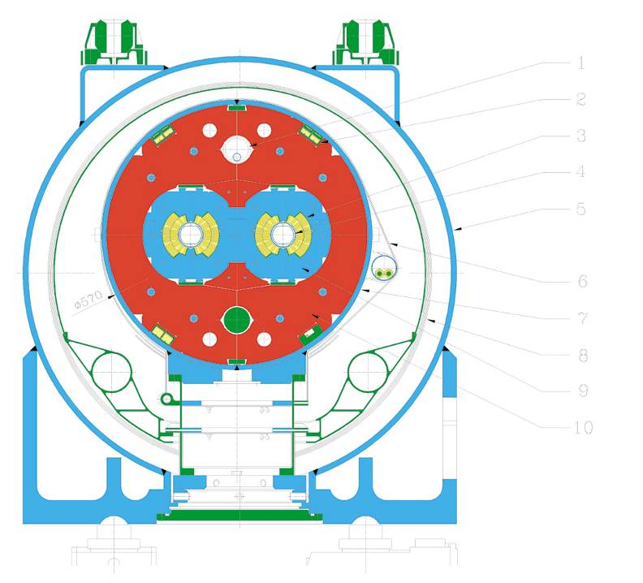
Dipole magnet cross section
16 mBar cooling tube
Ferromagnetic iron
Nonmagetic collars
Supraconducting coil
Beam tubes
Steelcylinder for Helium
Insulationvacuum
Vacuumtank
Supports

Slide 67
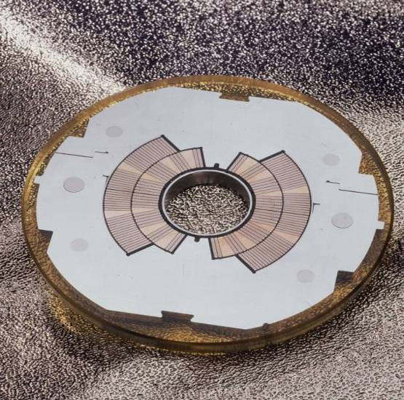
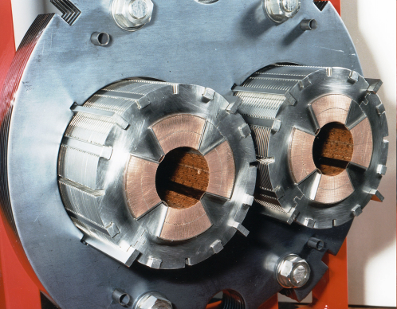
Coils: dipole and quadrupole magnets
Quadrupolemagnet

Slide 68
Operating temperature of superconductors (NbTi)
J [kA/mm²]
The superconducting state only occurs in a limited domain of temperature, magnetic field and transport current density
Superconducting magnets produce high field with high current density
Lowering the temperature enables better usage of the superconductor, by broadening its working range
T [K]
B [T]

Slide 69
Operational margin of a superconducting magnet
Applied Magnetic Field [T]
Bc critical field
Bc
quench with fast loss of ~5 · 10⁶ protons
8.3 T
QUENCH
quench with fast loss of
~5 · 10⁹ protons
Tc critical
temperature
0.54 T
Tc
1.9 K
9 K
Temperature [K]

Slide 70
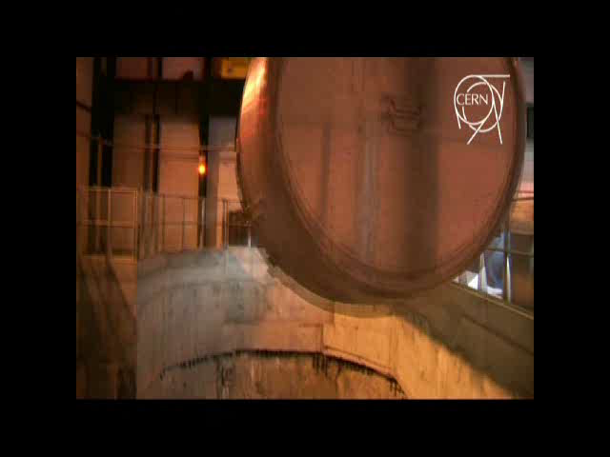
Dipole magnets from surface to tunnel

Slide 71
LHC energy evolution
Energy (TeV)
7 TeV
Design
5 TeV
Magnet de-training after installation
Decided to start operating at 5 TeV …..never got there
2007
2008
2009
2010
2011
2012
2013
2014
2015

Slide 72


September 10th 2008
A brief moment of glory

Slide 73
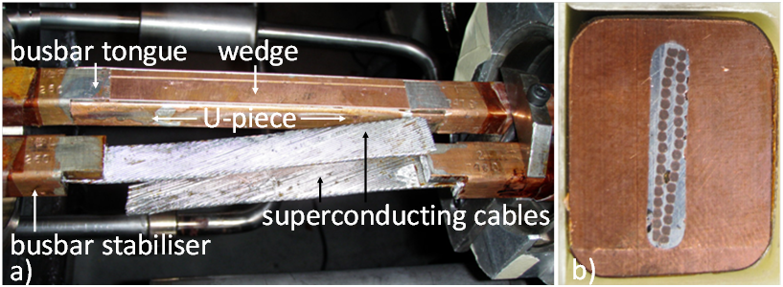
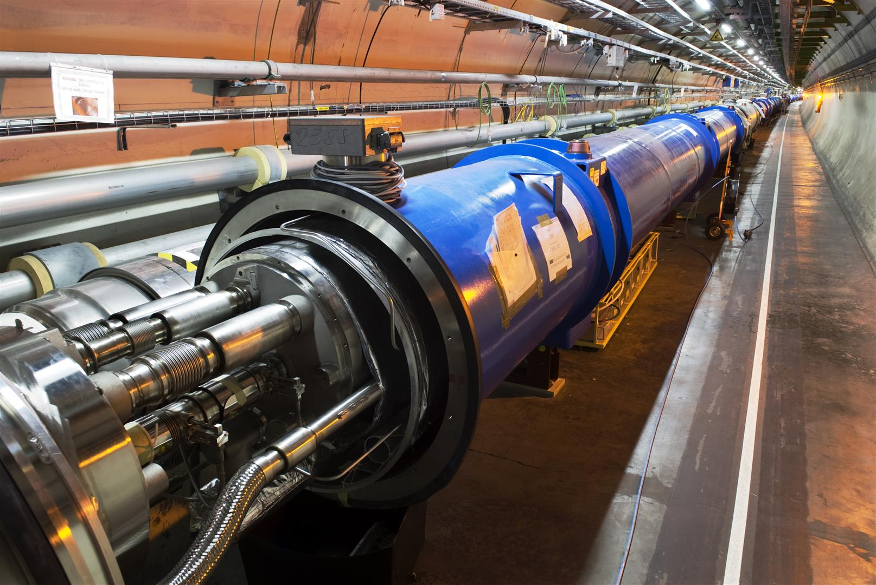
September 19th 2008
On 19th September magnet interconnections became the hot topic for more than 1 year

Slide 74
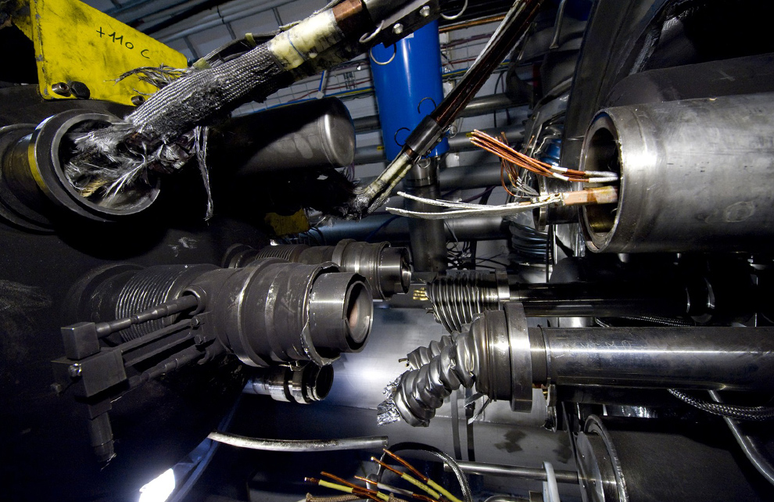

Incident September 19th 2008
An interconnect was not ok and opened. An electrical arc provoked a He pressure wave damaging ~700 m of LHC, polluting the beam vacuum over more than 2 km
Arcing in the interconnection
(not so) Proud to present the:
LHC Horror Picture Show
Magnet displacement
53 magnets had to be repaired
Over-pressure

Slide 75

More problems on the joints
The copper stabilizes the bus bar in the event of a cable quench (=bypass for the current while the energy is extracted from the circuit).
Protection system in place in 2008 not sufficiently sensitive.
A copper bus bar with reduced continuity coupled to a badly soldered superconducting cable can lead to a serious incident.
Solder
No solder
wedge
bus
U-profile
bus
X-ray
During repair work, inspection of the joints revealed systematic voids caused by the welding procedure.
Energy limitation for Run 1 !!

Slide 76
LHC energy evolution
Energy (TeV)
7 TeV
Design
5 TeV
Magnet de-training after installation
Joint problems,
incident
3.5 TeV
Consolidation delays
1.18 TeV
2007
2008
2009
2010
2011
2012
2013
2014
2015

Slide 77


LHC is back !
20th November 2009: after 14 months of repair
3 weeks later

Slide 78
LHC energy evolution
Energy (TeV)
Interconnect improvements
7 TeV
Design
6.5 TeV
5 TeV
Magnet de-training after installation
4 TeV
Joint problems,
incident
3.5 TeV
3.5 TeV
Consolidation delays
1.18 TeV
Operation after installation of new protection system
2007
2008
2009
2010
2011
2012
2013
2014
2015

Slide 79

Understanding LHC operation
Filling
Ramp
Squeeze
Adjust
Stable beams
Pilot beam
Batches
Closed orbit
Beta function
Betatron tunes
Emittance
Impedance

Slide 80

From first year to first fb-1
2008
First beam in LHC
2010
First fb-1

Slide 81

…..to 2012

Slide 82

2015: arriving at 13 TeV cm energy

Slide 83

Fill 2195 - start of the fill about 1 h (2011)
Start injection
End injection
Start energy ramp
End energy ramp
3.5 TeV
~1 hour

Slide 84

Excellent fill (2011)
Stable beams
Injection and ramp
Beam dump
A nice long fill of about 18 hours……
For physics, the most interesting quantity is the integrated luminosity

Slide 85


Slide 86
Challenges for high beam intensity operation
Machine Protection and Collimation
Electron clouds
Instabilities
UFOs
Damage of components by em fields from beam

Slide 87
LHC Layout
eight arcs (sectors)
eight long straight section (about 700 m long)
Beam dump blocks
IR5:CMS
Signal to kicker magnet
IR4: RF + Beam instrumentation
IR6: Beam dumping system
IR3: Moment Beam Cleaning (warm)
IR7: Betatron Beam Cleaning (warm)
IR2: ALICE
IR8: LHC-B
Detection of beam losses with >3600 monitors around LHC
IR1: ATLAS
Injection
Injection
Beams from SPS

Slide 88

Hydrodynamic tunnelling
In case that the beam is accidentally deflected into a magnet, each bunch will heat the material.
The pressure will build up and the density is reduced.
The following bunches will penetrate deeper into the material.
A controlled experiment was performed at the SPS with a 1 MJ beam, demonstrating hydrodynamic tunnelling.
The penetration for the full beam at the LHC is expected to be around 30 m.
A single bunch at top energy could drill a hole in the vacuum chamber.
Target damaged by the SPS beam, after penetrating 60 cm of solid copper (~0.5% LHC beam energy)
F.Burkart, N.Tahir et al
Notes:
88

Slide 89
Beam losses, machine protection and collimation
Continuous beam losses
Collimation prevents too high beam losses around the accelerator (beam cleaning)
A collimation system is a (very complex) system installed in the LHC to capture mostly halo particles
Such system is also called (beam) Cleaning System
Accidental beam losses
“Machine Protection” protects equipment from damage, activation and downtime
Machine protection includes a large variety of systems
89
Notes:
89

Slide 90
Layout of beam dump system in IR6
To get rid of the beams (also in case of emergency!), the beams are ‘kicked’ out of the ring by a system of kicker magnets send into a dump block !
Ultra-high reliability system !!
Septum magnets deflect the extracted beam vertically
Kicker magnets to paint (dilute) the beam
Beam dump block
15 fast ‘kicker’ magnets deflect the beam to the outside
about 700 m
about 500 m
The 3 μs gap in the beam gives the kicker time to reach full field.
quadrupoles
Beam 2

Slide 91


Beam dump line

Slide 92

Beam dump with 1380 bunches
Beam spot at the end of the beam dumping line, just in front of the beam dump block

Slide 93

RF contacts for guiding image currents
View of a two sided collimator
about 100 collimators are installed in LHC
2 mm
Beam spot
length about 120 cm
Ralph Assmann, CERN

Slide 94
Betatron beam cleaning
Primary
collimator
Secondary
collimators
Shower
absorbers
Tertiary
collimators
SC
Triplet
Cold aperture
Tertiary beam halo
+ hadronic showers
Circulating beam
Arc(s)
Cleaning insertion
Arc(s)
IP
Illustration drawing

Slide 95


Beam Loss Monitors
Ionization chambers to detect beam losses:
  Reaction time ~ ½ turn (40 μs)
  Very large dynamic range (> 10⁶)
There are ~3600 chambers distributed over the ring to detect abnormal beam losses and if necessary trigger a beam abort !
Very important beam instrumentation!

Slide 96

BLM system: beam losses before collisions
ATLAS Experiment
ALICE Experiment
MomentumCleaning
RF and
BI
CMS Experiment
Beam
dump
Betatron Cleaning
LHCb Experiment

Slide 97

Continuous beam losses during collisions
ATLAS Experiment
ALICE Experiment
MomentumCleaning
RF and
BI
CMS Experiment
Beam
dump
Betatron Cleaning
LHCb Experiment

Slide 98

Accidental beam losses during collisions
ATLAS Experiment
ALICE Experiment
MomentumCleaning
RF and
BI
CMS Experiment
Beam
dump
Betatron Cleaning
LHCb Experiment

Slide 99

Accidental beam losses during collisions

Slide 100
Limits to the bunch population
High bunch population and tight bunch spacing make the beams prone to instabilities related to impedances i.e. to self-generated fields
Induced (or ”image”) currents
EM interaction through the chamber wall→ ”impedance”
Vacuum chamber
Orbit (pipe axis of symmetry)
x
s
”Test” particle
”Source” particle
Direct EM interaction → ”direct space-charge”
~r.m.s 8 cm
~15 m
V
~1.6×10¹¹ p
s

Slide 101
Limits to the bunch population
High bunch population and tight bunch spacing make the beams prone to instabilities related to impedances i.e. to self-generated fields
Induced (or ”image”) currents
EM interaction through the chamber wall→ ”impedance”
Vacuum chamber
Orbit (pipe axis of symmetry)
x
s
”Test” particle
”Source” particle
Direct EM interaction → ”direct space-charge”
In 2012 instabilities have become critical due to higher bunch intensity and tighter collimators settings → larger impedance. Cures:
  Transverse feedback
  Non-linear magnetic fields (sextupoles, octupoles, beam-beam) that produce a frequency spread among particles – kill coherent motion
We are far away from a full understanding!

Slide 102


Wake fields and Impedances Challenge
Intense bunches generate electromagnetic fields when passing inside a structure (in particular Carbon collimators – opening of ~1 mm!!!)
→ results in an EM force, called wake field in time domain coupling with the beam
Avoid the abrupt transition for the beam fields at the location of the beam passage (taper)
Reduce the resistivity of the material
Abrupt transition
With taper
B. Salvant

Slide 103
Electron cloud challenge
In high intensity accelerators with positively charged beams and closely spaced bunches, electrons liberated on vacuum chamber surface can multiply and build up a cloud of electrons.
Bunch N+1 accelerates e-,
multiplication at impact
Process repeats for Bunch N+2 …
Bunch N liberates e-
e-
e-
++++++
++++++
++++++
N
N+1
N+2
e-
Beam screen
The cloud triggers vacuum pressure increases and beam instabilities!
Electron energies are in the 10 to few 100 eV range.

Slide 104

Electron cloud effects
Secondary emission yield [SEY]
SEY>SEY_{th} ➔ avalanche effect (multipacting)
SEY_{th} depends on bunch spacing and population
Possible consequences:
  instabilities, emittance growth, desorption, vacuum degradation, background
  excessive energy deposition in the cold sectors
Electron bombardment of a surface has been proven to reduce secondary electron yield (SEY) of a material as a function of the delivered electron dose. This technique, known as scrubbing, provides a mean to suppress electron cloud build-up.
G. Iadarola, G. Rumolo

Slide 105
Electron cloud mitigation
Strong reduction of e-clouds with larger bunch spacing:
With 50 ns spacing e-clouds are much weaker than with 25 ns !
→ One of the main reason to operate in 2012 with 50 ns spacing
Remedy: conditioning by beam-induced electron bombardment (“scrubbing”) leading to a progressive reduction of the SEY (Secondary Electron Yield).
  Done at 450 GeV where fresh beams can be injected easily.

Slide 106
From 2012 to 2015 …and beyond
2012: high intensity proton operation at 4 TeV
2013: few weeks for ion operation
2013-2015: consolidation (interconnects, others)
2015…..2017: proton and ion operation at 6.5 TeV
Operate with 25 ns bunch spacing (50 ns spacing not favoured due to event pile-up)
Maximize the integrated luminosity
Small focusing – β* as small as possible
Highest possible efficiency

Slide 107
Dipole training campaign
The 1232 main dipole magnets had to be trained for 6.5 TeV operation.
  2-3 training quenches could be performed for each sector in 24 hours, limited by the recovery time of the cryogenic system.
  About 150 training quenches were required.
The large spread in number of quenches between the eight sectors (arcs) is due to the mixture of magnets from the 3 producers.
Training quenches are due to frictional energy from coil movements.

Slide 108

Electron cloud mitigation
Strong dependence of e-clouds on bunch spacing.
Conditioning of the vacuum chamber by beam-induced electron bombardment (“scrubbing”): progressive reduction of the SEY
Conditioning is performed at 450 GeV where fresh beams can be injected easily.
One must condition with a beam that is more powerful (→ more electron could generation) that the beam one plans to use for operation.
With 50 ns spacing e-clouds are much weaker than for 25 ns spacing !
→ To ease life during Run 1, bunch spacing was reduced to 50 ns
Vacuum chamber in 2012 run

Slide 109

Scrubbing for 50 ns operation
During the first scrubbing run for 50 ns operation, a 25 ns beam is used to condition the vacuum chamber.
50 ns beam
~1400 bunches
1.7 x 10¹¹ p/b
25 ns Scrubbing
50 ns
Scrubbing
25 ns beam
~2800 bunches
1.15 x 10¹¹ p/b
50 ns physics
e-cloud free ☺

Slide 110

(Second) 2015 scrubbing run
Beam1 intensity
Beam2 intensity
Heat load in cryogenic system
Scrubbing with 25 ns beams
At the end, machine conditions were reasonable for ~1200 bunches operation (max. possible 2800). Number of bunches limited by high vacuum pressures at injection on some absorbers and cryogenic heat load

Slide 111


25 ns beam quality
Bunch
intensity
Trains of 72 bunches
Bunch emittance (μm)
The 25 ns beams are operated with trains of 48, 72 or 144 bunches (nominal 288), the signature of electron clouds is visible:
Intensity along the trains.
Blown up bunches.
Scrubbing has not completely removed e-clouds. The conditioning has to continue in parallel to physics operation.

Slide 112

UFOs at LHC

Slide 113


Surprising ‘Unidentified Falling Objects’
Very fast localized beam losses are observed when the LHC beam intensity is increased.
The beam losses were traced to dust particles entering into the beam – ‘UFO’.
Losses too high => beams dumped to avoid a quench, but sometimes magnets quench
2015: 2 UFO quenches (vs. >10 beam dumps due to UFOs in the arc + 2 in LSS)
Conditioning of the UFO-rate expected
In one accelerator component UFOs were traced to Aluminum oxide particles.
100µm
10µm
25ns scrubbing
Rate (/hour)
time

Slide 114

2015 Overview
50 ns
25 ns
50 ns scrubbing run
25 ns scrubbing run

Slide 115

2015 Overview
25 ns scrubbing run
50 ns
25 ns
50 ns scrubbing run

Slide 116

Run 1 versus Run 2
The start-up of Run 2 was faster then for Run 1, but we are still far from the Run 1 performance. We are still in the learning phase for 25 ns.
Operation with 50 ns beams is easier !

Slide 117
Luminosity projections
Some scenarios @ 6.5 TeV
Beam | k | N_{b} [10¹¹ p] | ε [μm] | β* [m] | Peak L [10³⁴ cm⁻²s⁻¹] | Event pile-up | Int. L(*) [fb⁻¹]
25 ns – 2015 | ~1500 | 1.1 | 3.5 | 0.8 | 0.31 | 14 | ~2
25 ns – standard | ~2700 | 1.2 | 3.0 | 0.8 | 0.78 | 21 | ~20
25 ns – pushed | ~2500 | 1.2 | 2.0 | 0.4 | 1.7 | 51 | ~40-50
50 ns | 1360 | 1.6 | 2.2 | 0.4 | 1.65 | 90 | ~30
(*): per year

Slide 118
The next 20 years
LHC
and
High Luminosity-LHC (HL-LHC)

Slide 119
LHC - the next years
LHC Run 1
At 4 TeV/c, demonstrated LHC potential, integrated luminosity of 30 fb⁻¹
Long Shutdown 1
LHC Run 2 Physics at 6.5 TeV
Deliver 300 fb⁻¹ at ≥ 6.5 TeV/c
Long Shutdown 2
“Ultimate” Physics
Long Shutdown 3
High Luminosity LHC
Deliver 3000 fb⁻¹ at ≥ 6.5 TeV/c

Slide 120

Horizon 2025: LHC High Luminosity Upgrade
Motivation
Very ambitious target for $∫L\left(t\right)×dt$ : 200 – 300 fb⁻¹/y (×10 today)
Radiation damage limit of existing sc quadrupoles close to experiments
Past experience from 2010-2012 operating with 50 ns bunch spacing
Operation with large bunch intensity possible (no serious limitation)
Single bunch with > 3x10¹¹ protons per bunch with 2.5 um emittance provided by injector complex
Operation with very small beams (low β* optics) successfully tested in injector complex
Pile-up/pile-up density HL-LHC beam physics constraint ➔ bunch spacing of 25 ns and luminosity leveling required for 2015 and later
Total current: collimation efficiency, upper limits from: beam dump, vacuum, machine protection, radiation protection, …
Electron cloud

Slide 121




Integrated Luminosity increase by levelling
$\int{Ldt}$ increase by increasing $L_\max{ }$not feasible (pile up too high): Luminosity levelling can increase $\int{Ldt}$
High availability is required (optimise length of fills)
L [10³⁴ cm⁻²s⁻¹]
Too many events per bunch crossing, pile-up too high for experiment
Increase of $∫Ldt$ with Luminosity levelling
No way to achieve $∫Ldt$ for HL-LHC
t [h]

Slide 122
Luminosity parameters with crossing angle
Head-on collision…..
…..not an option for HL-LHC

Slide 123

Luminosity parameters with crossing angle
HL-LHC: Bunches collide with smaller beams and a larger crossing angle as in LHC: reduction of luminosity
Angle crossing (ineffective overlap):
L = $\frac{N^{2}⋅ f⋅n_{b}}{4⋅π{⋅σ}_{x}⋅σ_{y}}⋅R$
$R…$ reduction factor
Tilt bunches before collisions with crab cavities: recovering luminosity => R ~1

Slide 124








Hardware for the Upgrade
Main modifications of LHC
  New high field/larger aperture interaction region sc magnets
  Crab Cavities to take advantage of the small β*
  New collimators (lower impedance)
  Cryo-collimators and high field 11 T dipoles in cold part of LHC
  Additional cryo plants for magnets and RF (P1, P4, P5)
  Superconducting links to allow power converters to be moved to protected areas (availability)

Slide 125

LHC operational cycle
Machine setup: (Optimum turnaround time ~2h 20m)
Stable beams: Luminosity production (~10 h)
Energy
Beam Intensity
Beam dump due to a failure implies on average 5.5 hours of turnaround – impacting availability for physics significantly!
Time

Slide 126
Integrated Luminosity and Availability
5.5 h
6.1 h
Stable
Beams
Stable
Beams
Turnaround
Turnaround
30 %
6.9 h
Turnaround
Stable Beams
Fault
Turnaround
70 %
  Machine Failure Rate (MFR) = fraction of premature beam dumps due to a failure = 70 %
Monte Carlo model for integrated luminosity:
  Based on observed failure distributions
  The model accurately reproduces 2012 operation
  Extrapolated distributions for future LHC runs and HL-LHC
A. Apollonio

Slide 127

Availability for HL-LHC
$$MFR=FRACTION OF PREMATURE DUMPS$$
SCENARIO 2
2012 AVAILABILITY
HL TARGET
SCENARIO 1
To achieve HL-LHC parameters, challenging upgrades to achieve availability is required
A. Apollonio

Slide 128

LHC High Luminosity Upgrade
M. Lamont

Slide 129
First ideas for LHC presented in 1984
Physics operation started 25 years later
Preparing for the next 50 years
FCC Study – Proton collisions at a c.m. energy of 100 TeV

Slide 130
C.M. energy evolution
30 years
10 x energy
25 years
7 x energy
Hadron collider c.m. energy evolution [GeV vs. year]

Slide 131


FCC Study Scope
Conceptual Design Report (CDR) and cost review for the next European Strategy Update in 2018:
pp-collider (FCC-hh)
  ~16 T-> 100 TeV c.m. pp in 100 km
  ~20 T-> 100 TeV c.m. pp in 80 km
e⁺e⁻ collider (FCC-ee) as potential intermediate step
p-e collider (FCC-he) option
Requires a 80-100 km infrastructure in Geneva area

Slide 132


SSC
SSC (Superconducting Super Collider): particle accelerator complex under construction in the vicinity of Waxahachie, Texas, to be the world's largest and most energetic Hadron Collider 87.1 km and an c.m. energy of 40 TeV.
When the project was cancelled in 1993, 22.5 km of tunnel and 17 shafts to the surface were already dug, nearly two billion dollars had already been spent on this facility.
Green field: no lab, no injectors, area moderately attractive….. and no working LHC
Crazy ?

Slide 133
Luminosity evolution
Hadron collider peak luminosity evolution per Interaction Point [x 10³⁰ cm⁻²s⁻¹]

Slide 134
FCC-hh parameter (other parameter sets exist)
parameter | FCC-hh | LHC nominal
Energy | 100 TeV c.m. | 14 TeV c.m.
Dipole field | 16 T | 8.33 T
Number of IP | 2 main + 2 | 4
Normalized emittance | 2.2 μm | 3.75 μm
Luminosity / IP_{main} | 5 x 10³⁴ cm⁻²s⁻¹ | 1 x 10³⁴ cm⁻²s⁻¹
Energy stored in each beam | 8.4 GJ | 0.36 GJ
Synchrotron radiation | 28.4 W/m/aperture | 0.17 W/m/aperture
Bunch spacing | 25 ns (5 ns) | 25 ns

Slide 135

FCC-hh design targets
Pushing the energy frontier by maximizing the energy reach
Hadron collider only option for exploring energy scale at tens of TeV
FCC
x 2
x 3.7
LHC nominal
Ph. Lebrun

Slide 136
Advanced superconductors to reach high fields
400
Nb-Ti
Nb₃Sn
HTS
Ph. Lebrun

Slide 137
FCC-hh Challenges: Magnets
FCC-hh baseline: 16 T Nb3Sn technology for 100 TeV in 100 km
  Develop Nb3Sn-based 16 T dipole technology
  With sufficient aperture of ~40 mm (LHC = 56 mm) and accelerator features (field quality, ability to protect, cycling operation).
  Learn from Nb3Sn magnets in the LHC (HL-LHC 11 T dipoles).
  Technology push to achieve duplication of critical current density of Nb3Sn
  Possible goal: 16 T short dipole models by 2018 (in collaboration with America, Asia, Europe).
  In parallel HTS development targeting 20 T
  HTS insert, generating 5 T additional field, ~40mm aperture and accelerator features.
  R&D goal: demonstrate HTS/LTS technology for building magnets with a field of 20 T.

Slide 138


FCC-hh challenges
Stored beam energy
Stored energy 8 GJ per beam
  20 times higher than LHC, equivalent to A380 (560 t) at nominal speed (850 km/h)
  Collimation, control of beam losses and radiation effects (shielding) important
  Injection, beam transfer and beam dump very critical
Damage of a beam with an energy of 2 MJ
Machine protection issues to be addressed early on!

Slide 139
FCC-hh Challenges
High synchrotron radiation load on beam pipe (up to 26 W/m/aperture in arcs, total of ~5 MW)
  Heat extraction: photon stop, beam screen design, cryo load, ….
Synchrotron radiation damping
  Beams shrinking, controlled blow up, luminosity levelling, etc…
Impedances, instabilities, feedbacks
  Beam-beam, e-cloud, resistive wall, feedback systems design
Optics and beam dynamics
  IR design, dynamic aperture studies, SC magnet field quality

Slide 140
FCC study
Status
Study launched at FCC kick-off meeting in February 2014
Presently forming a global collaboration based on general MoUs between CERN and individual partners + specific addenda for each participant
First International Collaboration Board meeting on 9-10 September 2014 at CERN, chaired by Prof. L. Rivkin (PSI/EPFL)
Design study proposal: EU support in the Horizon 2020 program approved

Slide 141
Scope of FCC study
Main emphasis of the conceptual design study: long-term goal of a hadron collider with a centre-of-mass energy of the order of 100 TeV in a new tunnel of 80 - 100 km circumference.
Conceptual design study shall also include a lepton collider and its detectors, as a potential intermediate step towards realization of the hadron facility. Potential synergies with linear collider detector designs should be considered.
Options for e-p scenarios and their impact on the infrastructure shall be examined at conceptual level.
The study shall include cost and energy optimisation, industrialisation aspects and provide implementation scenarios, including schedule and cost profiles

Slide 142
FCC study
49 FCC collaboration members, 27 Feb. 2015 (now >60)
ALBA/CELLS, Spain
U Bern, Switzerland
BINP, Russia
CASE (SUNY/BNL), USA
CBPF, Brazil
CEA Grenoble, France
CIEMAT, Spain
CNRS, France
Cockcroft Institute, UK
U Colima, Mexico
CSIC/IFIC, Spain
TU Darmstadt, Germany
DESY, Germany
TU Dresden, Germany
Duke U, USA
EPFL, Switzerland
GWNU, Korea
U Geneva, Switzerland
Goethe U Frankfurt, Germany
GSI, Germany
Hellenic Open U, Greece
HEPHY, Austria
IFJ PAN Krakow, Poland
INFN, Italy
INP Minsk, Belarus
U Iowa, USA
IPM, Iran
UC Irvine, USA
Istanbul Aydin U., Turkey
JAI/Oxford, UK
JINR Dubna, Russia
FZ Jülich, Germany
KEK, Japan
KIAS, Korea
King’s College London, UK
KIT Karlsruhe, Germany
Korea U Sejong, Korea
MEPhI, Russia
MIT, USA
NBI, Denmark
Northern Illinois U., USA
NC PHEP Minsk, Belarus
U. Liverpool, UK
PSI, Switzerland
Sapienza/Roma, Italy
UC Santa Barbara, USA
U Silesia, Poland
TU Tampere, Finland

Slide 143
Conclusions
LHC demonstrated that an ultra-complex accelerator can operate reliably, achieve high luminosity and produce excellent physics
The next step is HL-LHC – with an increase of integrated luminosity by one order of magnitude
Reaching a luminosity an order of magnitude above 10³⁴ [cm⁻²s⁻¹] and operating reliably is a formidable challenge
Today, the only realistic option to collide particles at a c.m. energy in the range of 100 TeV are circular proton colliders
We will learn from HL-LHC as a preparation for FCC
There are a number of very interesting challenges for the realisation of such collider, and scientists who are interested in such R&D are very welcome to join!

Slide 144
Thanks for your attention
Thanks a lot for slides from several colleagues, in particular G.Arduini, M.Lamont and J.Wenninger
Plumber visiting Freudenstadt

Slide 145
Literature
The Physics of Particle Accelerators: An Introduction, Klaus Wille, Oxford, 2000
Proceedings of CERN ACCELERATOR SCHOOL (CAS), Yellow Reports, many topics, General Accelerator Physics, and topical schools on Vacuum, Superconductivity, Synchrotron Radiation, Cyclotrons, and others… http://cas.web.cern.ch/cas/
5th General CERN Accelerator School, CERN 94-01, 26 January 1994, 2 Volumes, edited by S.Turner
A.Wolski, Beam Dynamics in High Energy Particle Accelerators, Imperial College Press
Superconducting Accelerator Magnets, K.H.Mess et al., WorldScientific 1996
Handbook of Accelerator Physics and Engineering, A.W.Chao and M.Tigner, World Scientific, 1998
A.Sessler, E.Wilson: Engines of Discovery, World Scientific, Singapur 2007
Conferences and Workshops (EPAC, PAC, IPAC, …) – http://www.jacow.org

Slide 146

Comment: Screen
Beam dump scintillating screen: Alumina doped with 0.5% chrome sesquioxide and at room temperature two principal lines of luminescence at 692.9 and 694.3 nm are generated with a decay time of 3.4 ms.

Slide 147

Comment: Extraction kicker magnet
Kicker magnet (LHC) : one turn for the current (low inductance), HV, field, kick strength per magnet 0.428 Tm, length 1.4 m
L. DUCIMETIERE

Slide 148

Comment: LHC Beam Screen
Vacuum chamber 1.9 K (stainless steel)
Helium tubes 4-40 K
Beam screen (stainless steel + copper)

