Slide 2
dBLM measurements in IP4
Marcel Bursy, Oliver Stein, Daniel Wollmann

Slide 3
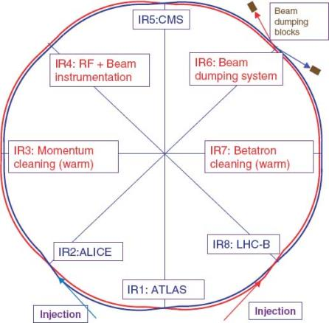
dBLMs in IP4
Diamond BLMs

Slide 4
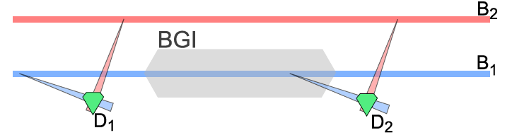
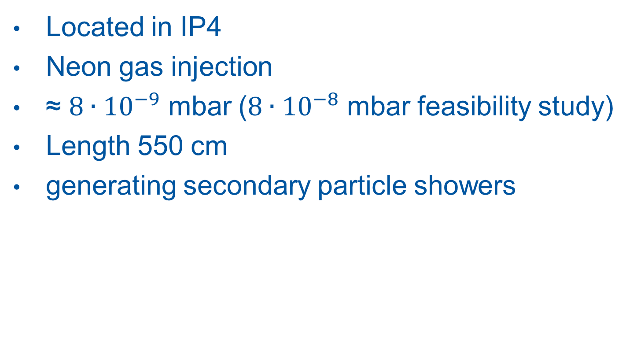
Beam gas ionization monitor - BGI
Located in IP4
Neon gas injection
≈ $8∙{10}^{−9}$ mbar ($8∙{10}^{−8}$ mbar feasibility study)
Length 550 cm
generating secondary particle showers

Slide 5
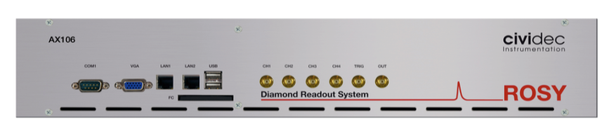
ROSY Readout System
1.6 ns resolution
Edge-trigger
Turn clock synchronization
55.000 bin histogram → one turn
Fesa-class from S. Pedersen (BE-BI-SW)

Slide 6
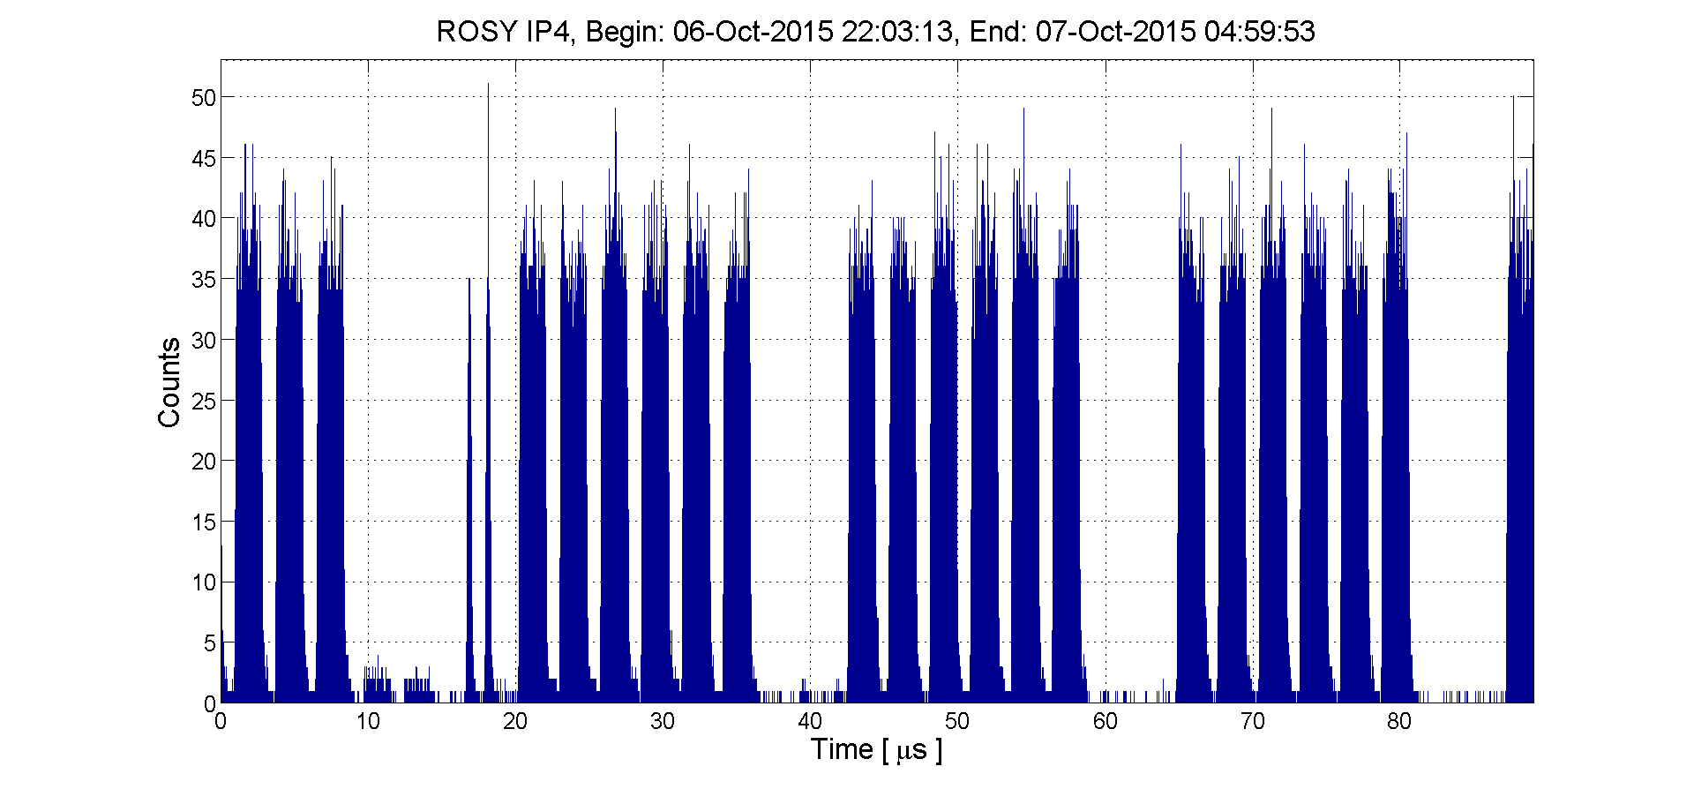
ROSY Histogram
Integration time: 7 h

Slide 7
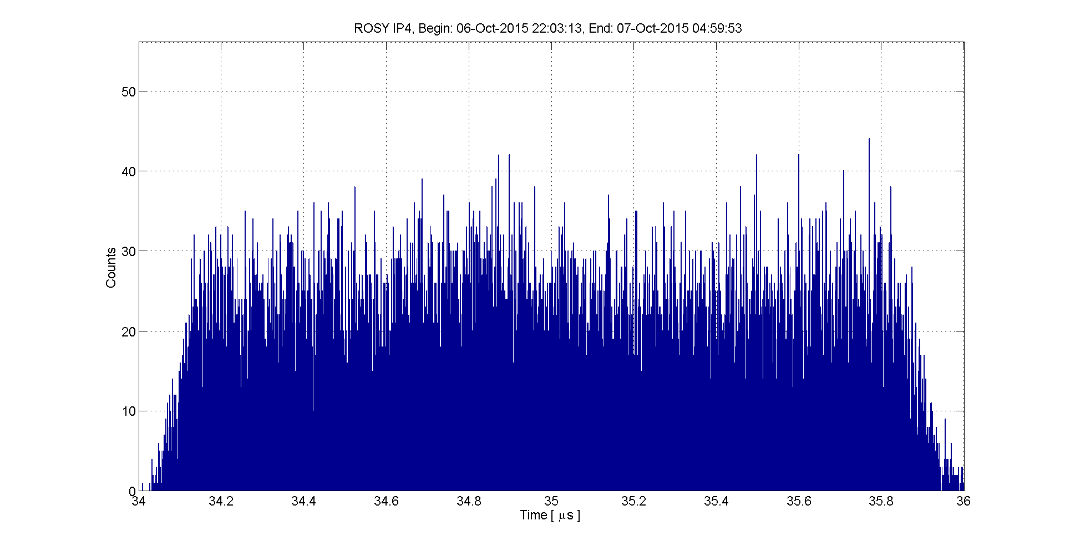
ROSY Histogram

Slide 8
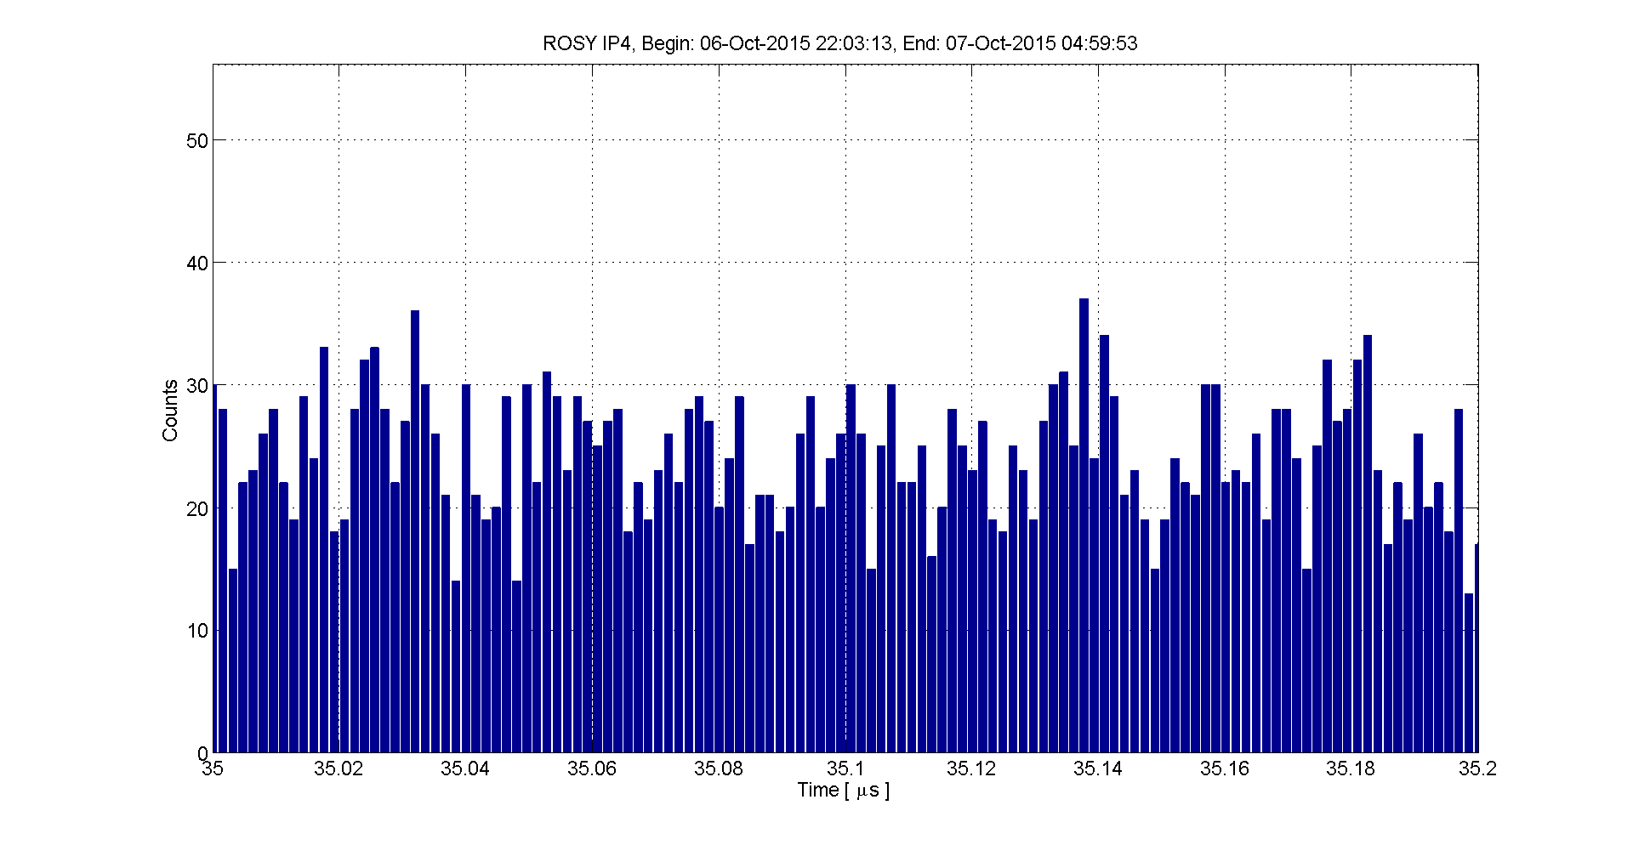
ROSY Histogram

Slide 9
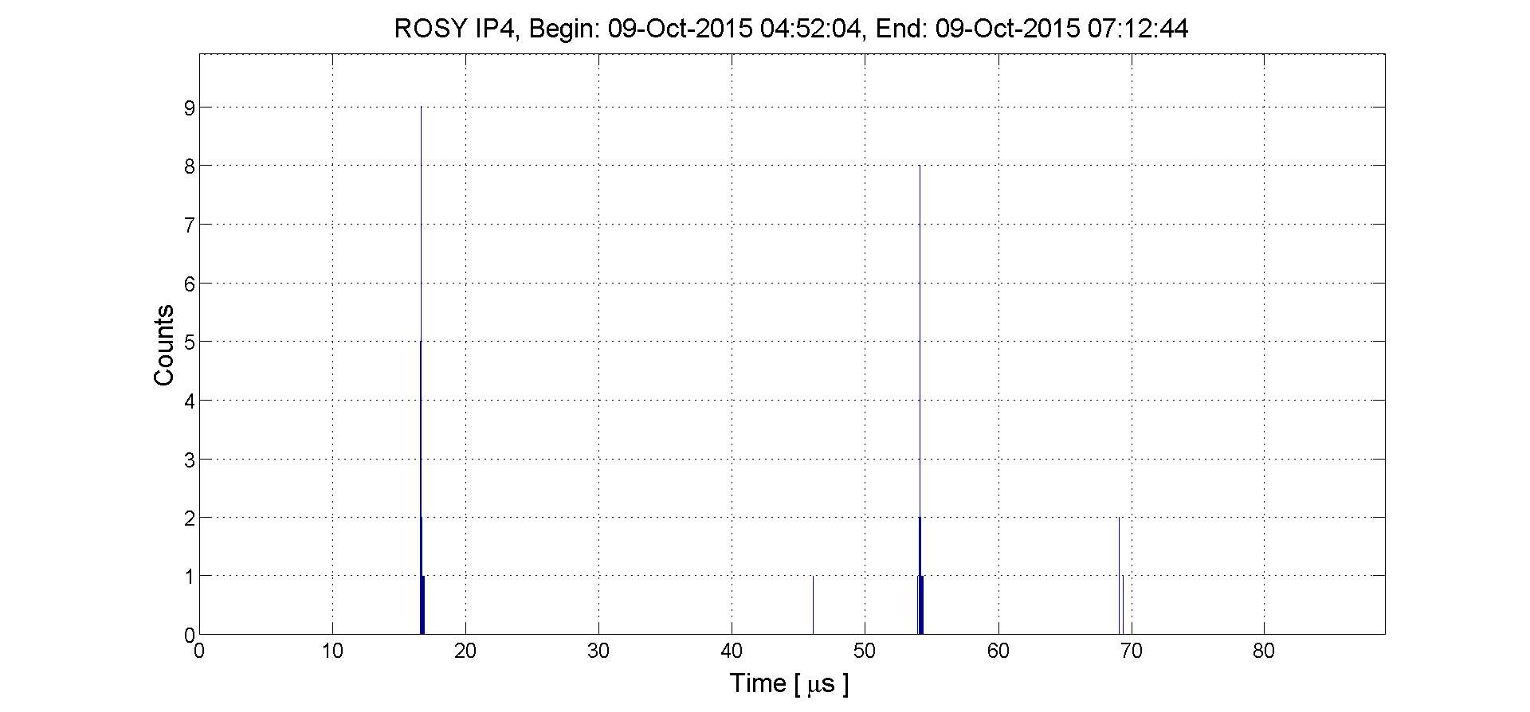
MD Fill – two bunches
Integration time: 2 h

Slide 10
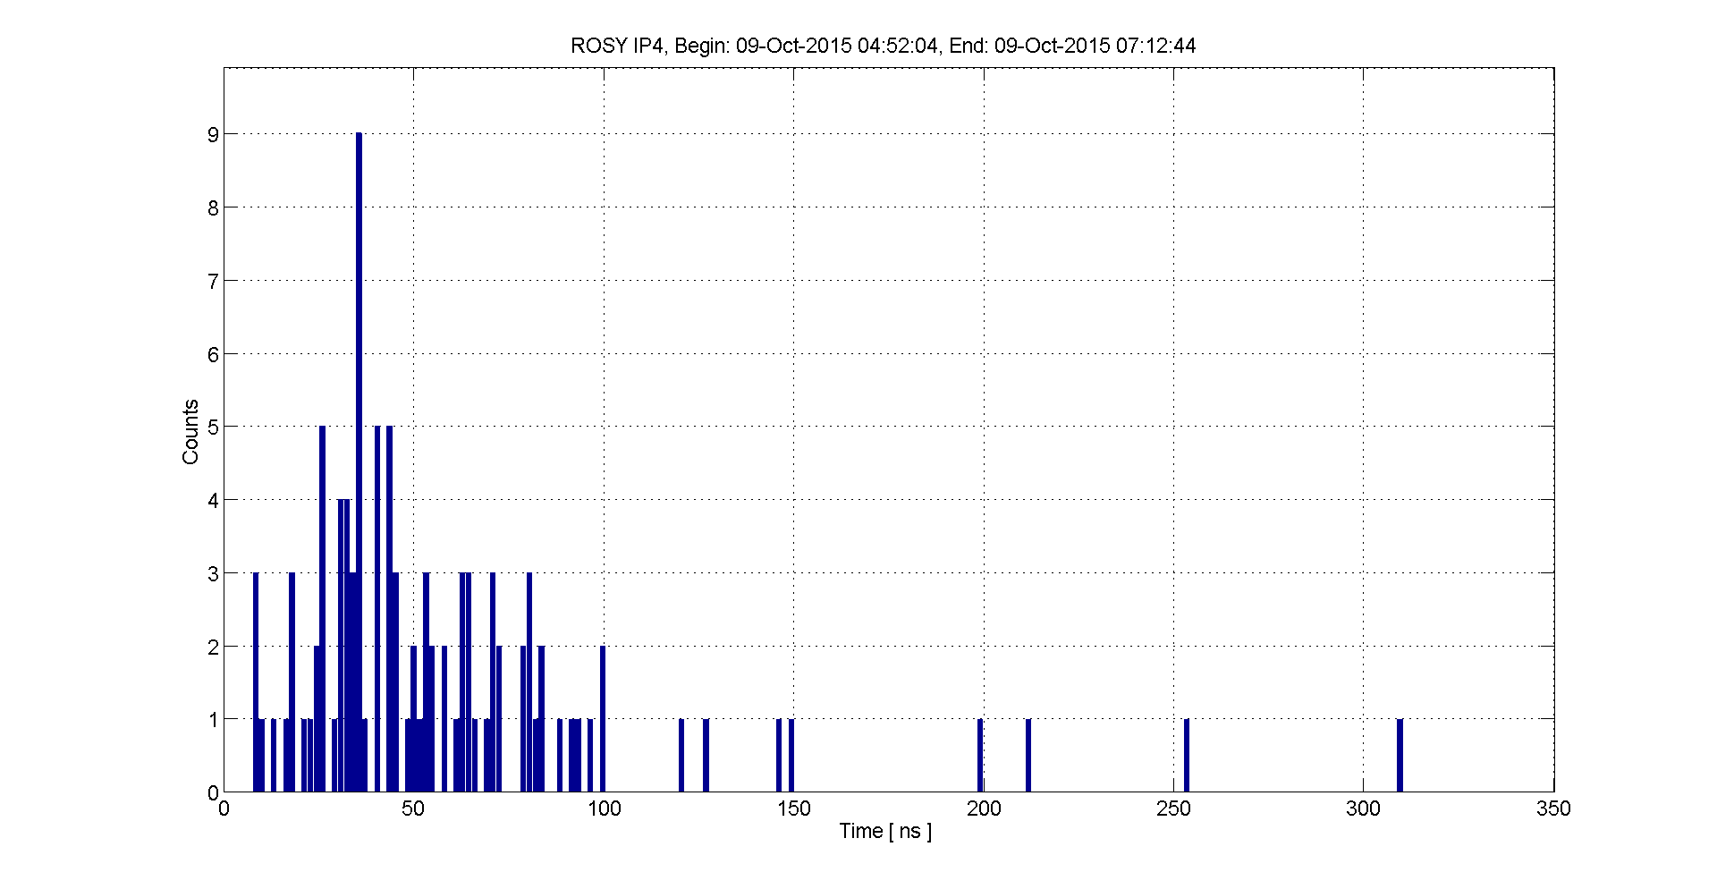
MD Fill – single bunch

Slide 11
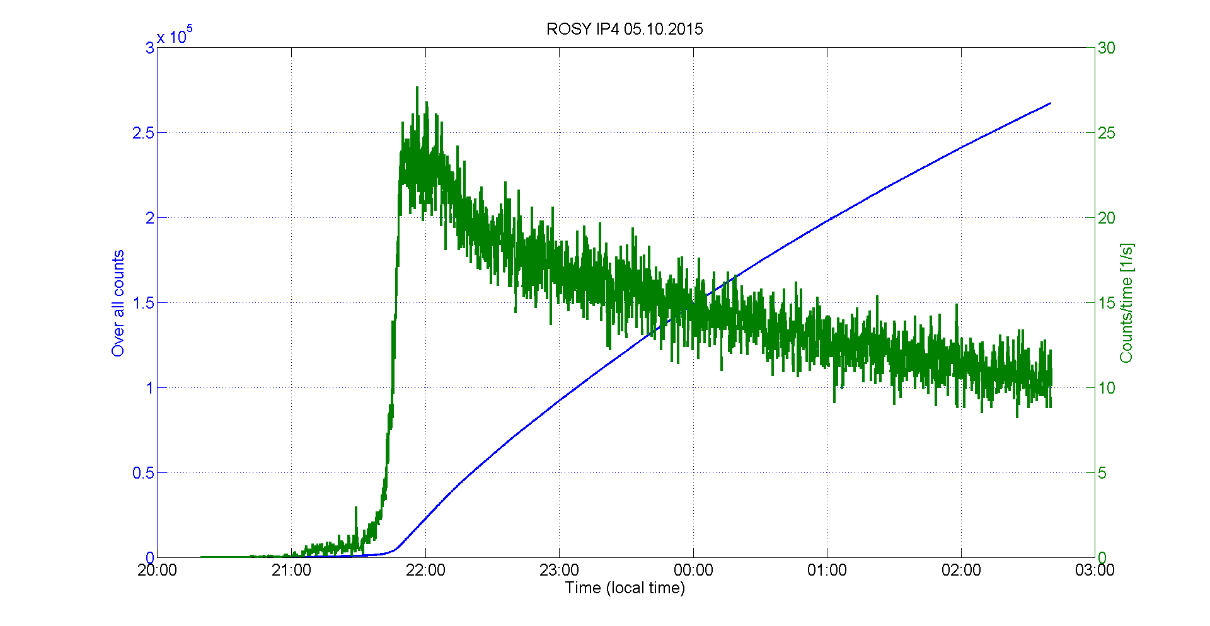
Overall counts – count rate

Slide 12
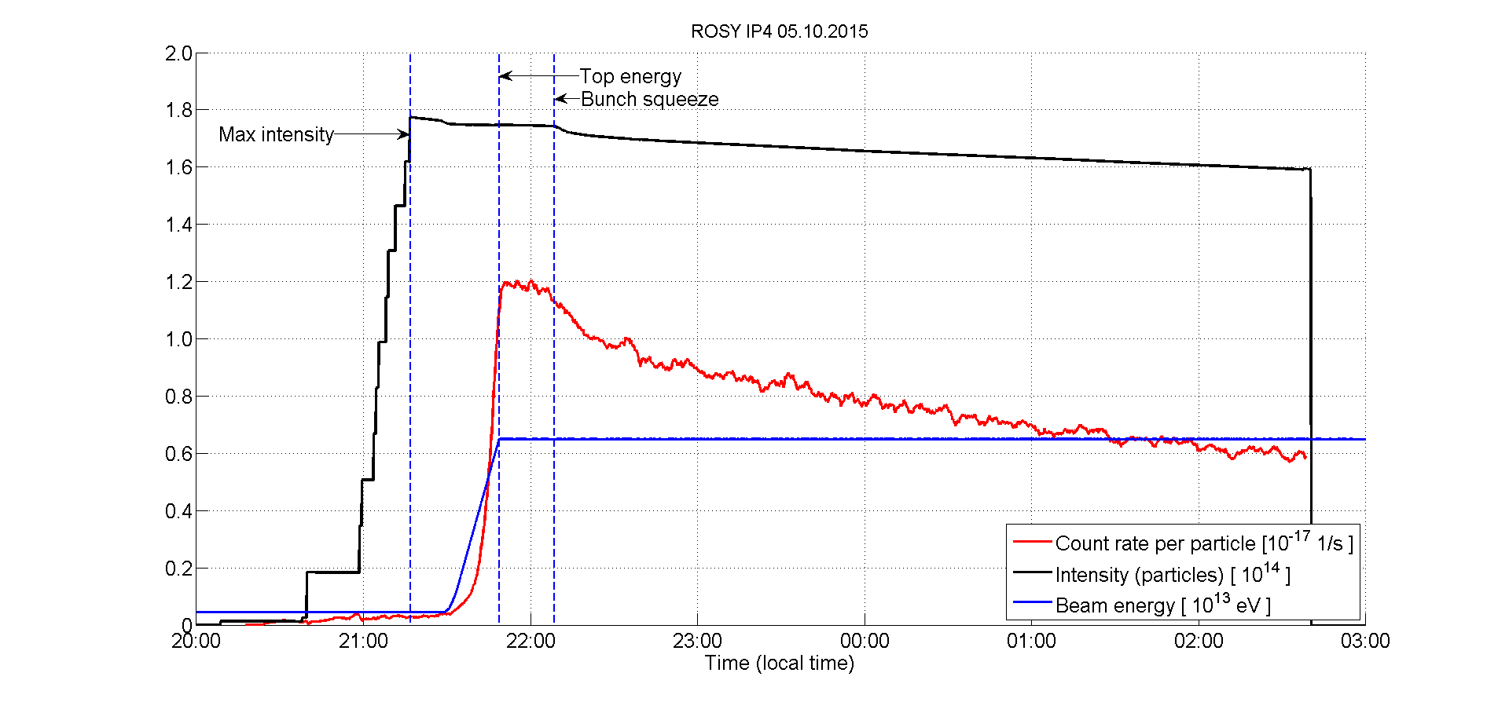
Count rate per particle
6.5 TeV

Slide 13
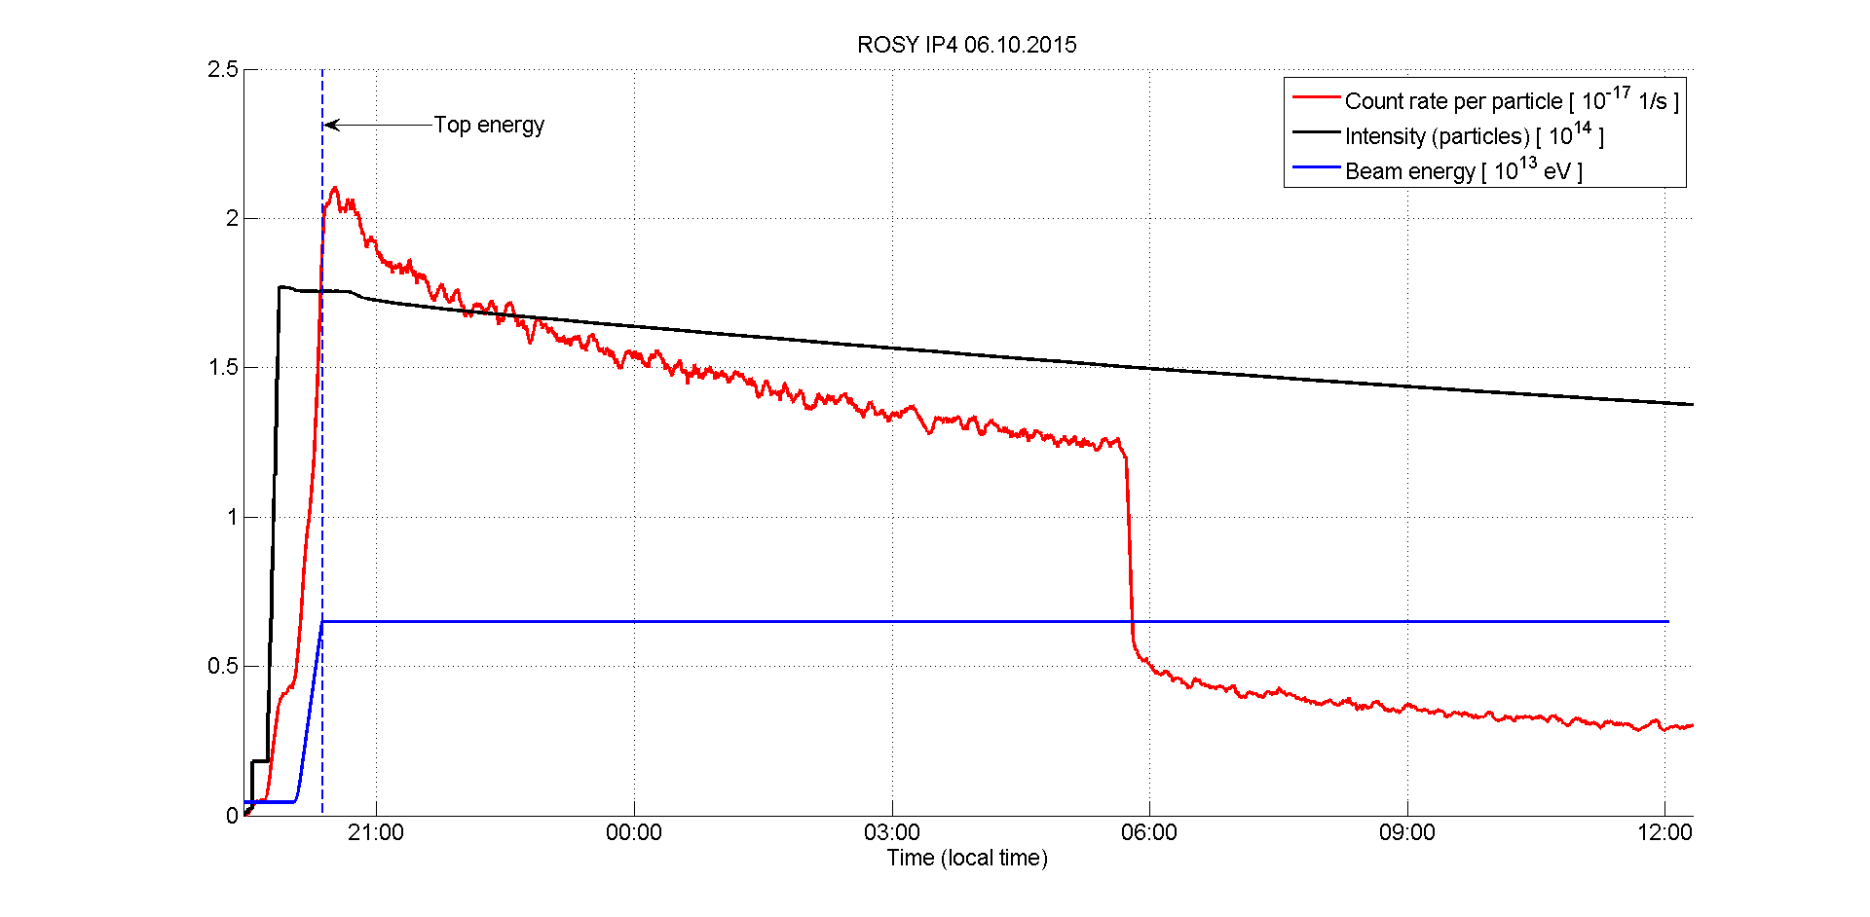
Count rate per particle

Slide 14
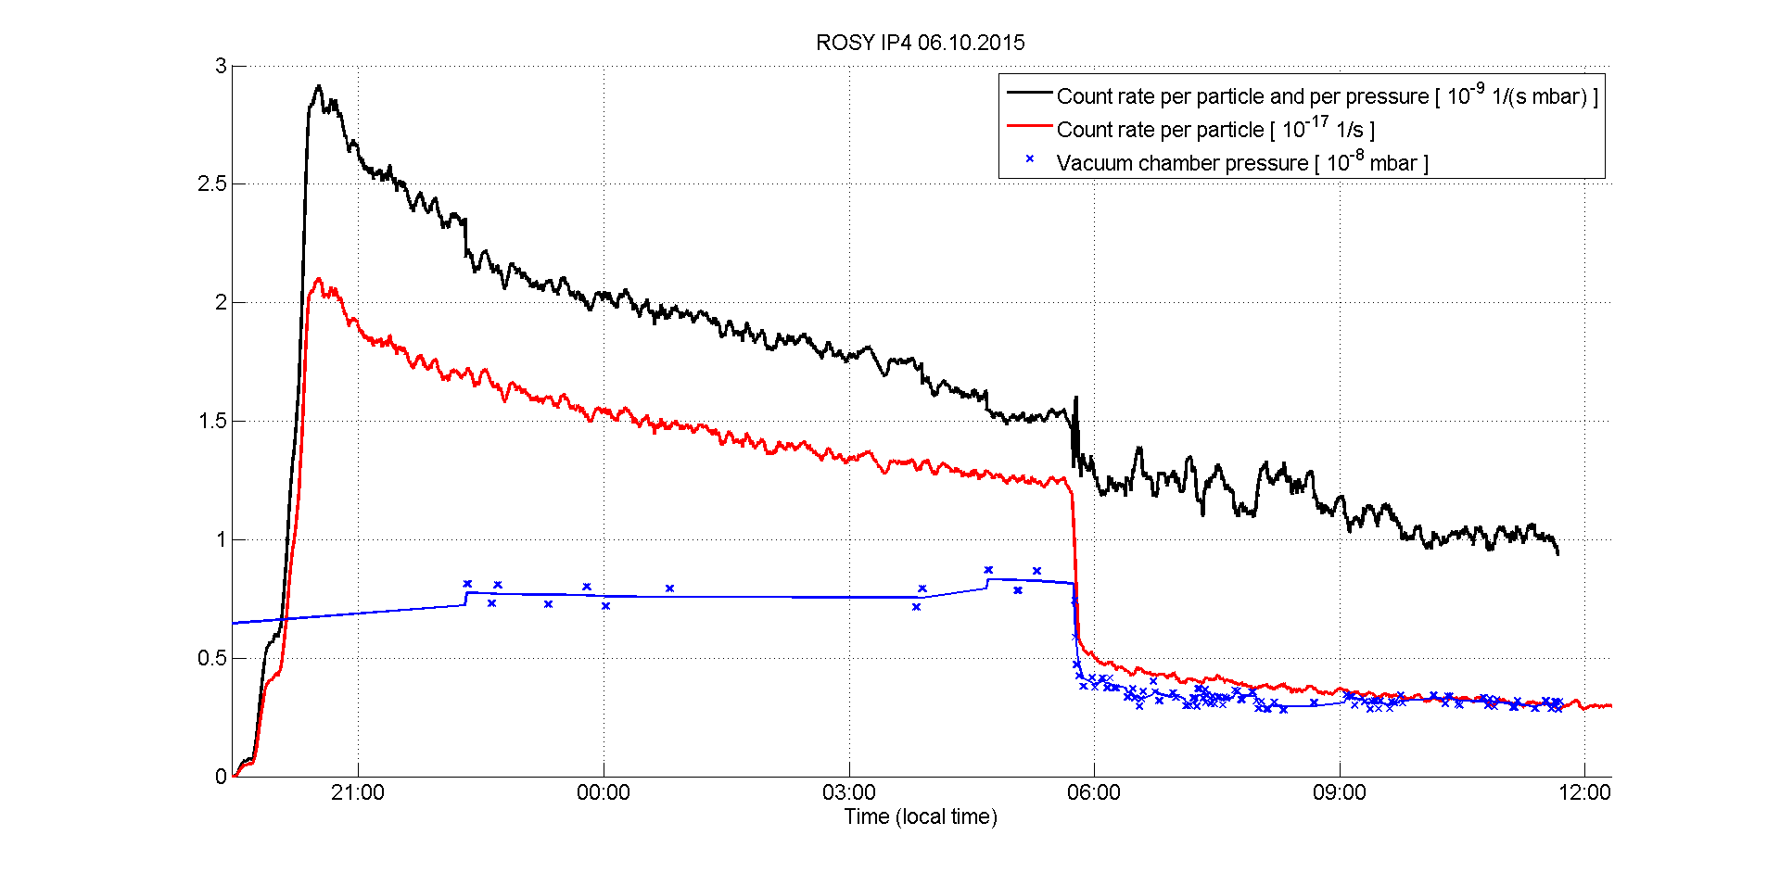
Count rate per particle and pressure

Slide 15
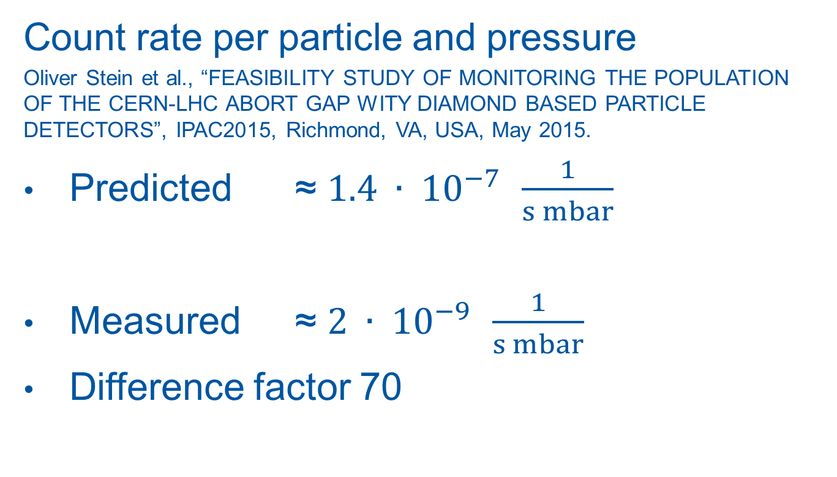
Prediction vs. reality
Count rate per particle and pressure
Oliver Stein et al., “FEASIBILITY STUDY OF MONITORING THE POPULATION OF THE CERN-LHC ABORT GAP WITY DIAMOND BASED PARTICLE DETECTORS”, IPAC2015, Richmond, VA, USA, May 2015.
Predicted ≈ $1.4 ∙ {10}^{−7 } \frac{1}{s mbar}$
Measured ≈ $2 ∙ {10}^{−9 } \frac{1}{s mbar}$
Difference factor 70

Slide 16
Summary
ROSY is measuring in IP4
With and without BGI gas injection
Questions
Histogram time resolution
Count rate lower than predicted

Slide 17
Thank you for your attention!

