Slide 2
CLIQ on MB
Gaelle Dib, Alejandro Fernandez, Emmanuele Ravaioli, Gerard Willering
We would like to acknowledge the work of and the fruitful collaboration with the various teams in making the tests possible, in particular the following sections:
TE-MPE-EE, TE-MPE-PE, TE-MSC-LMF, TE-MSC-MDT, TE-MSC-TF, TE-CRG and TE-EPC-MPC.
TE-MPE-PE
01.10.2015
CLIQ on MB
E. Ravaioli and A. Fernandez

Slide 3
Outline
CLIQ
Measurements
Simulations
Differential inductance
Conclusions

Slide 4
CLIQ

Slide 5

CLIQ (Coupling-Loss Induced Quench)
Current change
Magnetic field change
s
Coupling losses (Heat)
Temperature rise
QUENCH

Slide 6
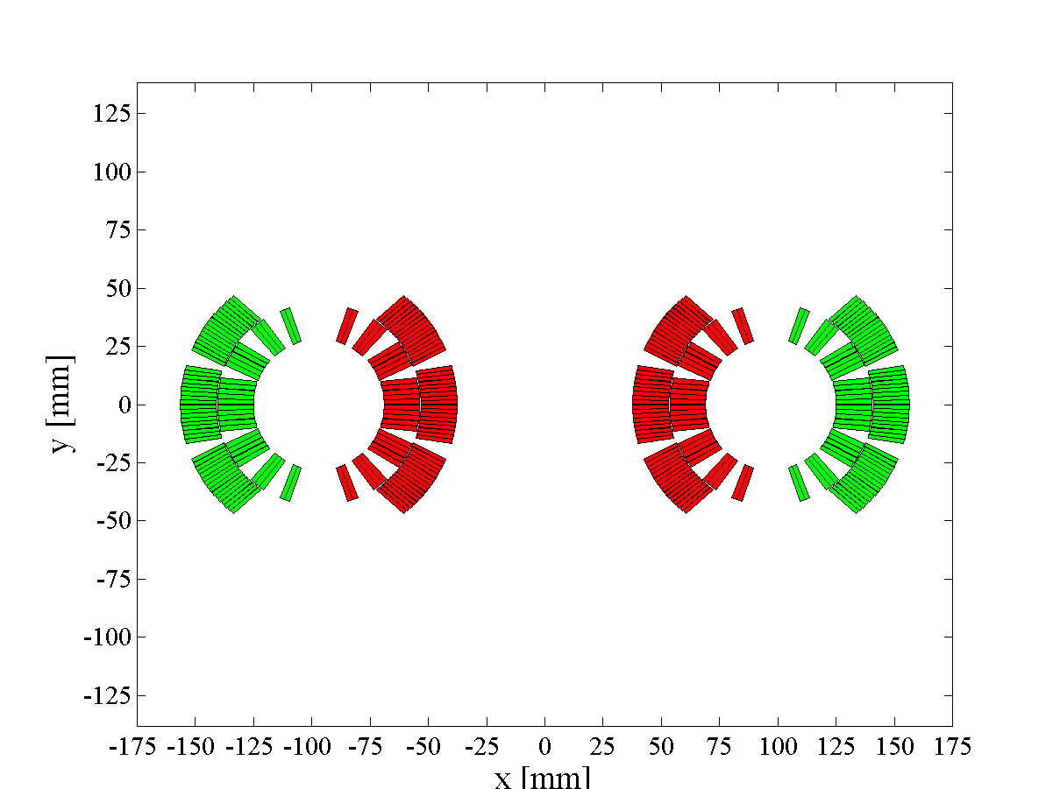
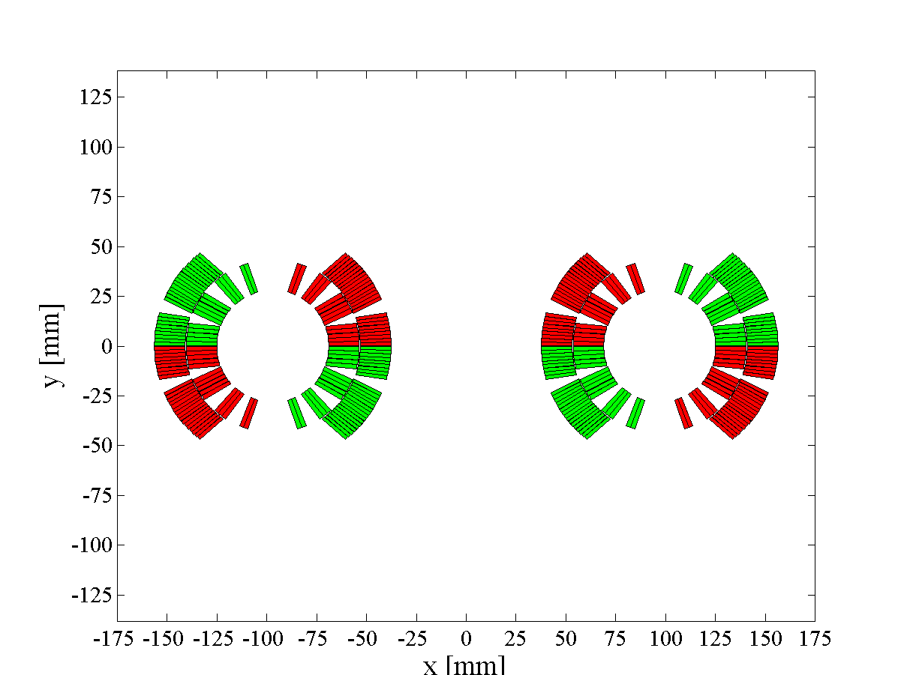
CLIQ configurations
1-CLIQ Not Optimized
1-CLIQ Optimized
2-CLIQ Optimized
Higher dI/dt, More efficient dB/dt

Slide 7
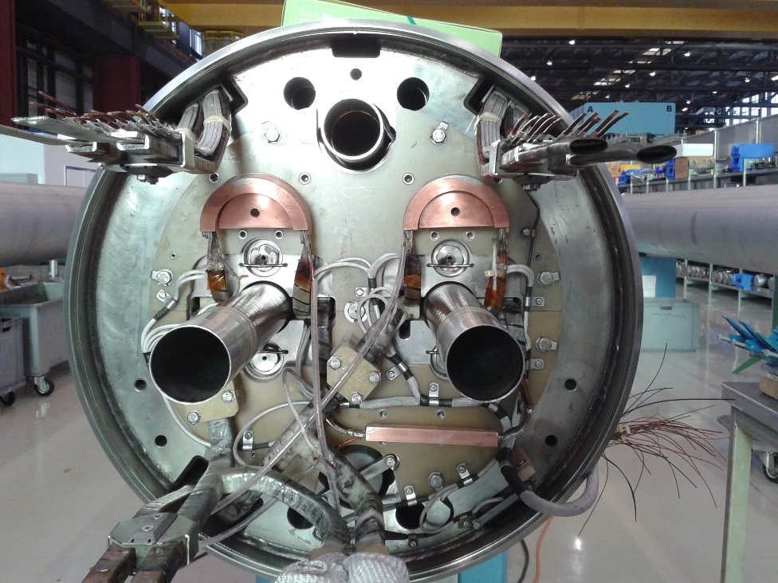
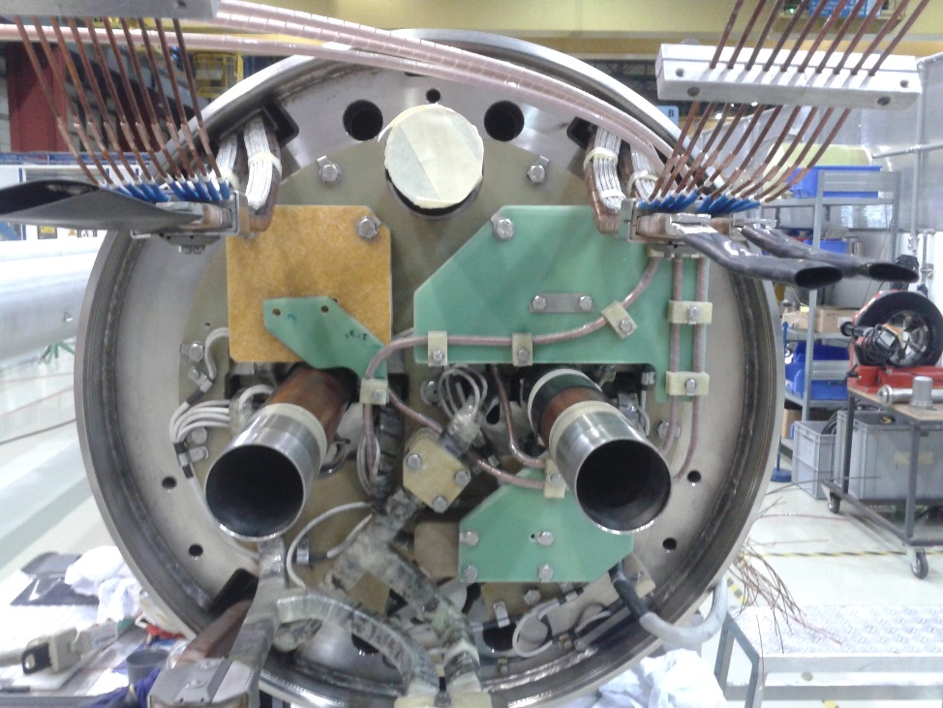
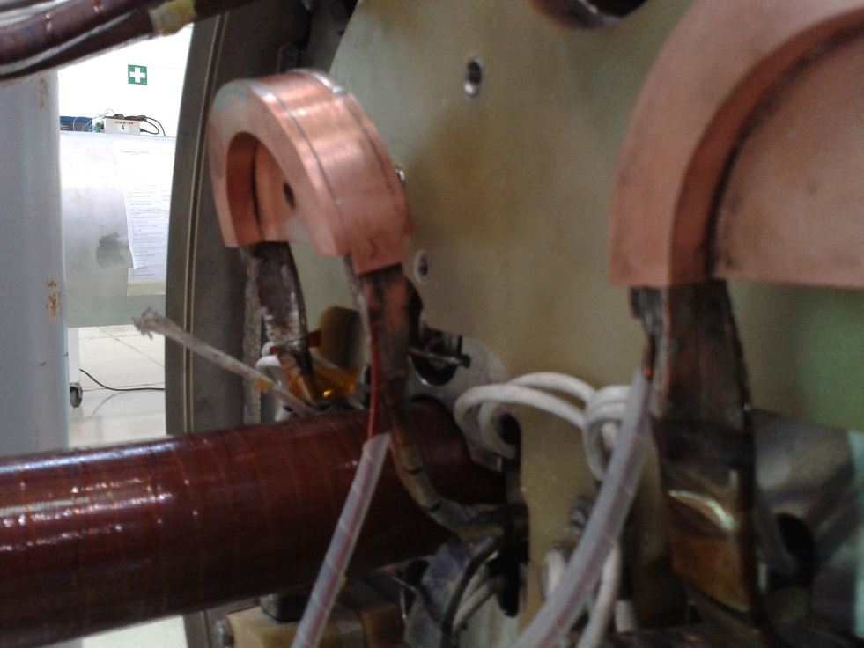
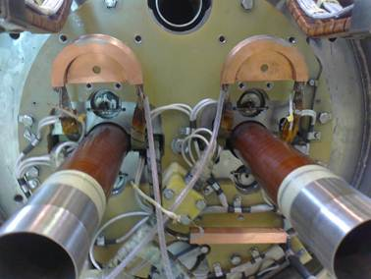
Pics – Addition of CLIQ leads in B180

Slide 8
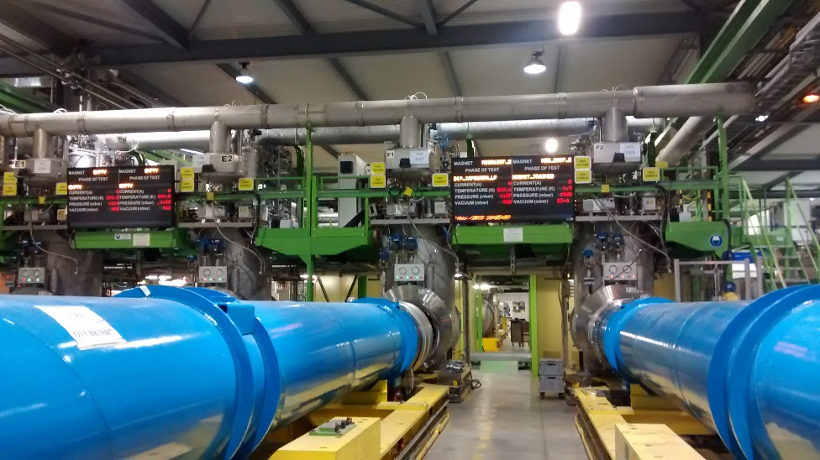
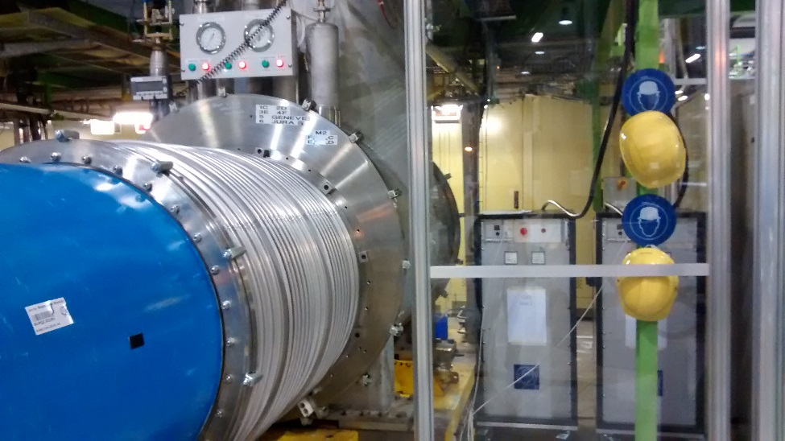
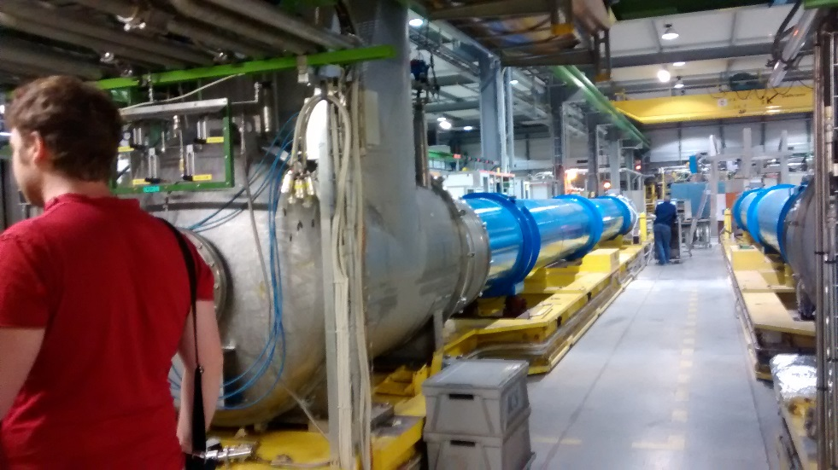
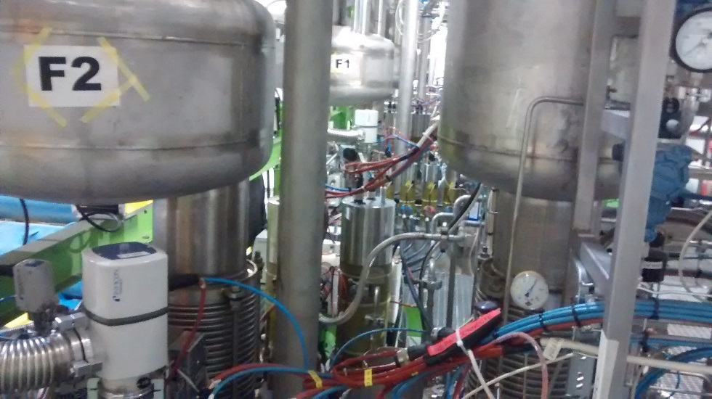
Pics – Magnet test station in SM18

Slide 9


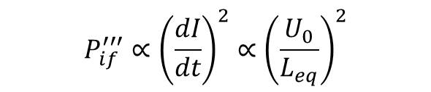


CLIQ behavior
$$P_{if}^{′′′}∝{\left(\frac{dI}{dt}\right)}^{2}∝{\left(\frac{U_{0}}{L_{eq}}\right)}^{2}$$
$$E_{CLIQ}=N_{C} \frac{1}{2}CU_{0}^{2}$$
$$I_{max}∝ U_{0}\sqrt{\frac{C}{L_{eq}}}$$
$$f= \frac{1}{2π\sqrt{L_{eq}C}}$$
$${\frac{dI}{dt}}_{max}∝\frac{U_{0}}{L_{eq}}$$

Slide 10
Measurements

Slide 11
Typical CLIQ discharge

Slide 12
Typical CLIQ discharge

Slide 13
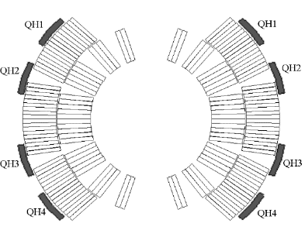
Quench heaters configuration
Aperture 2
Aperture 1

Slide 14
CLIQ and QH at every current level

Slide 15
3 kA: CLIQ-QH comparison

Slide 16
3 kA: All tests
CLIQ on MB
E. Ravaioli and A. Fernandez

Slide 17
6 kA: CLIQ-QH comparison
CLIQ on MB
E. Ravaioli and A. Fernandez

Slide 18
6 kA: All tests
CLIQ on MB
E. Ravaioli and A. Fernandez

Slide 19
9 kA: CLIQ-QH comparison
CLIQ on MB
E. Ravaioli and A. Fernandez

Slide 20
9 kA: CLIQ configurations
CLIQ on MB
E. Ravaioli and A. Fernandez

Slide 21
11.85 kA: All tests
CLIQ on MB
E. Ravaioli and A. Fernandez

Slide 22
12.7 kA: All tests
CLIQ on MB
E. Ravaioli and A. Fernandez

Slide 23
2-CLIQ, 1-CLIQ comparison at 6 kA
1-CLIQ
2-CLIQ
CLIQ on MB
E. Ravaioli and A. Fernandez

Slide 24
Quench load and hot-spot temperature
Calculated from t=0
(quench detection card triggered)
Assumptions: RRR=187; Magneto-resistivity=6E-11 Ohm m/T; Quench detection + validation time: 15 ms.
CLIQ on MB
E. Ravaioli and A. Fernandez

Slide 25
Simulations

Slide 26
Parameters of the models
Parameter | Set 1 | Set 2 | Set3
Number of blocks | 204 | 204 | 264
RRR | 150 (All poles) | 200 (1U) 150 (1L) 100(2U) 125 (2L) | 194 (1U) 187 (1L) 192(2U) 192 (2L)
Magneto resistivity [Ohm*m/T] | 4.2E-11 (All poles) | 6E-11 (All poles) | 5E-11 (1U) 6E-11 (1L) 7E-11 (2U) 5E-11 (2L)
Effective transverse resistivity factor | 2 | 1 | 0.9
Helium fraction [%] | 5 | 5 | 4.5
Resistance of the CLIQ leads [mOhm] | 20 | 15 | 10
CLIQ on MB
E. Ravaioli and A. Fernandez

Slide 27
3 kA: Simulations
CLIQ on MB
E. Ravaioli and A. Fernandez

Slide 28
6 kA: Simulations
CLIQ on MB
E. Ravaioli and A. Fernandez

Slide 29
9 kA: Simulations
CLIQ on MB
E. Ravaioli and A. Fernandez

Slide 30
9 kA: Simulations
CLIQ on MB
E. Ravaioli and A. Fernandez

Slide 31
11.85 kA: Simulations
CLIQ on MB
E. Ravaioli and A. Fernandez

Slide 32
11.85 kA: Simulations
CLIQ on MB
E. Ravaioli and A. Fernandez

Slide 33
Quench load and hot spot-temperature
CLIQ on MB
E. Ravaioli and A. Fernandez

Slide 34
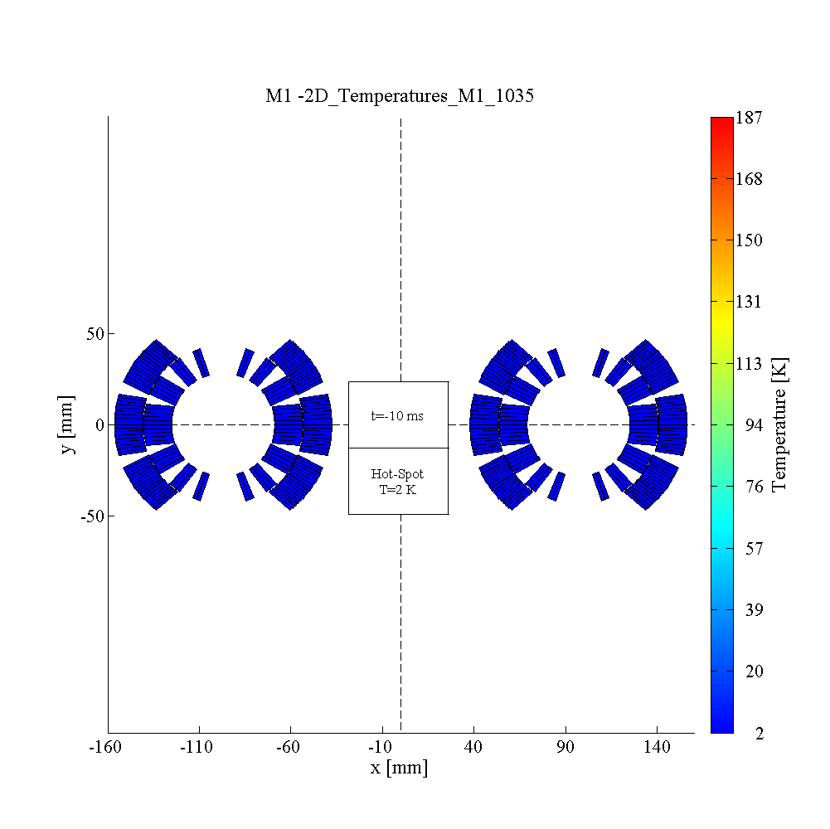

Temperature profile at nominal current
2xCLIQ + 1xQH
2xQH
CLIQ on MB
E. Ravaioli and A. Fernandez

Slide 35
Differential inductance

Slide 36
Differential inductance
The differential inductance of the CLIQ discharge circuit is influenced by
Mainly coil geometry (without the other effects, differential inductance = nominal)
Magnetization (persistent currents in the filaments)
Coupling currents
Iron yoke saturation
Eddy currents in the copper of the cables
CLIQ on MB
E. Ravaioli and A. Fernandez

Slide 37
Three tested conditions (more possible)
Effect on the differential inductance | Superconducting After magnetic cycle | Superconducting After warm up | Resistive (~14 K)
Coil geometry | YES | YES | YES
Magnetization in the SC | YES | NO | NO
Coupling currents | YES | YES | NO
Iron yoke saturation | YES | YES | YES
Eddy currents in the cable | NO | NO | YES
Others…? | ? | ? | ?
CLIQ on MB
E. Ravaioli and A. Fernandez

Slide 38
CLIQ current – 80 mF, 500 V
 | f [Hz] | Ipeak [A] | % Leq | Req [Ω]
80mF after MagCycle | 11.30 | 2446 | 68% | 0.0366
80mF after WarmUp | 10.55 | 2305 | 78% | 0.0368
80mF resistive | 10.22 | 2277 | 83% | 0.0322
CLIQ on MB
E. Ravaioli and A. Fernandez

Slide 39
CLIQ current – 40 mF, 500 V
 | f [Hz] | Ipeak [A] | % Leq | Req [Ω]
40mF after MagCycle | 16.95 | 1830 | 60% | 0.051
40mF after WarmUp | 15.77 | 1735 | 70% | 0.047
40mF resistive | 14.49 | 1649 | 83% | 0.038
CLIQ on MB
E. Ravaioli and A. Fernandez

Slide 40
Frequency transfer functions – |Z|
Simple calculation with nominal parameters
CLIQ 80 mF
CLIQ 40 mF
CLIQ on MB
E. Ravaioli and A. Fernandez

Slide 41
Frequency transfer functions – phase
CLIQ 80 mF
CLIQ 40 mF
Simple calculation with nominal parameters
CLIQ on MB
E. Ravaioli and A. Fernandez

Slide 42
Conclusions
CLIQ successfully tested on a full-scale LHC main dipole magnet
Model predicted the measured transients with reasonable accuracy
CLIQ can discharge more quickly even this long coil (quench load -20%, hot-spot T -150 K)
Wealth of information acquired to further improve the available magnet models (for example operating conditions, CLIQ configurations, differential inductance,…)

Slide 43
Annex

Slide 44
3 kA: Simulations
CLIQ on MB
E. Ravaioli and A. Fernandez

Slide 45
6 kA: Simulations
CLIQ on MB
E. Ravaioli and A. Fernandez

Slide 46
9 kA: All tests
CLIQ on MB
E. Ravaioli and A. Fernandez

