Slide 1
LHC injection loss measurements with diamond based BLMs
Oliver Stein, Florian Burkart, Marcel Bursy

Slide 2
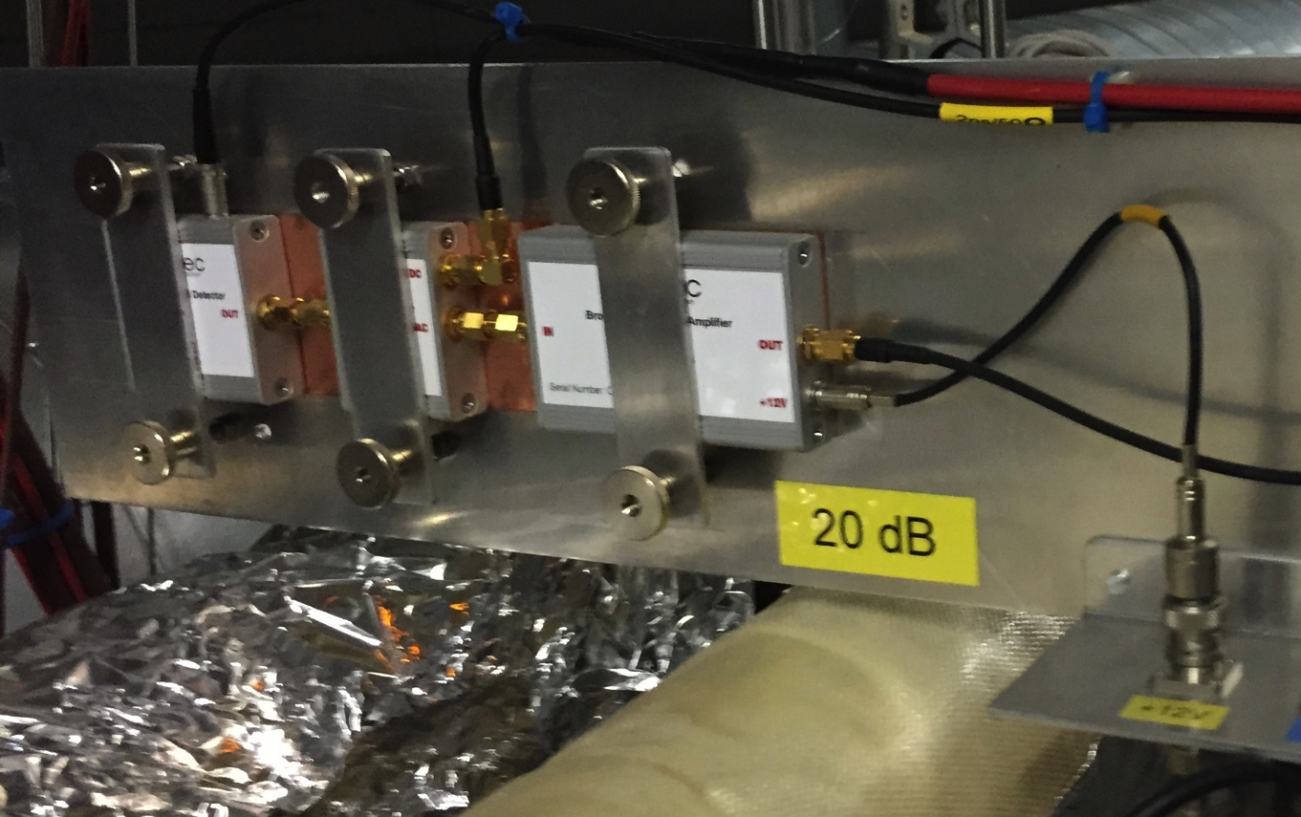
dBLMs@LHC
10 dBLMs successfully installed at the LHC.
2 IP2/IP8 injection losses
4 IP4 abort gap population measurements at the BGI
2 IP6 loss signatures
during beam dump
2 IP7 global losses
IP4
Abort gap monitor
IP6
Extraction losses
dBLM
IP7
Collimation
losses
IP2
Injection
beam 1
IP8
Injection
beam 2
LHC beam pipes

Slide 3
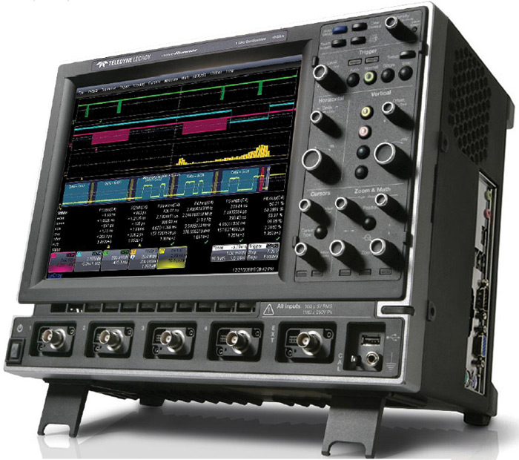
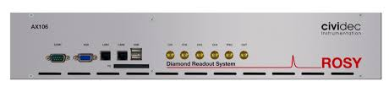
dBLMs@LHC
2 Types of dBLMs insatlled.
pCVD 500μm diamond detector, CIVIDEC (IP2, IP6, IP7, IP8)
sCVD 500μm diamond detector, CMS (IP4)
2 DAQ system installed.
Scope, Lecroy waverunner 4 ch. working
Rosy CIVIDEC, Scope and Histogram experimental

Slide 4
dBLMs for injection loss measurements IP2
Goal: Better understanding of the injection losses.
Time structure
Dynamic range

Slide 5
SPS extraction and LHC injection
Fast kicker magnets deflect the beam.
SPS → transfer line → LHC
Kicker:
Rise time (R)
Flat top (FT)
Fall time (F)
Absorber blocks protect downstream accelerator components.
SPS: TPSG
LHC: TDI (σ: 9, -1.53)
LHC: TCP (σ: 4.5, -4.17)
R
FT
F
Magnet strength
Time

Slide 6
LHC injection
SPS
MKE
TPSG
OFF
MKI
dBLM
TDI
LHC
OFF

Slide 7
LHC injection
SPS
MKE
TPSG
ON
MKI
dBLM
TDI
LHC
OFF

Slide 8
LHC injection
SPS
MKE
TPSG
ON
MKI
dBLM
TDI
LHC
ON

Slide 9
LHC injection
SPS
MKE
TPSG
OFF
MKI
dBLM
TDI
LHC
OFF

Slide 10
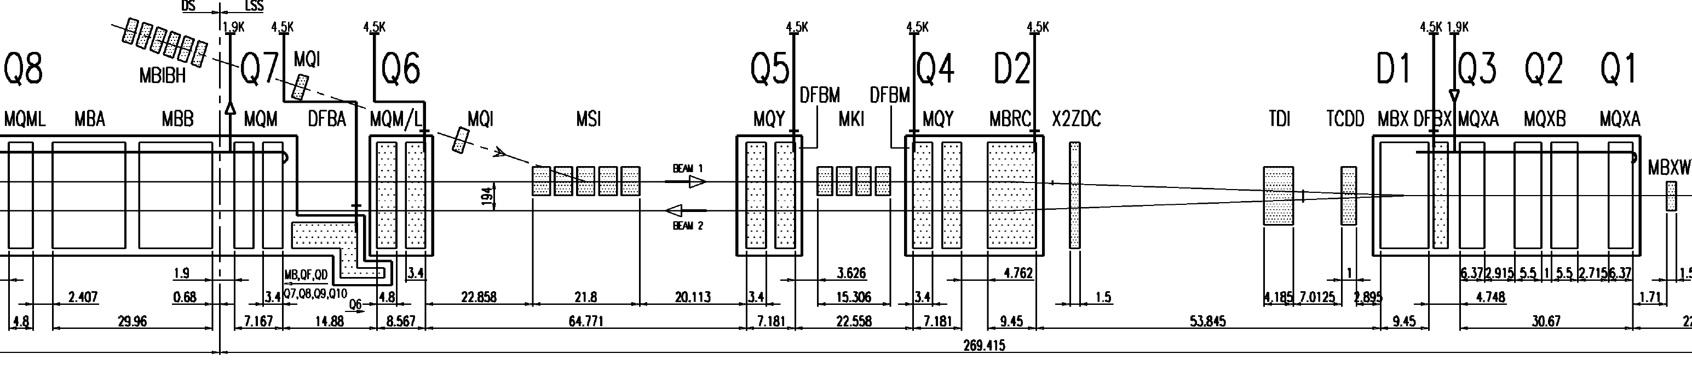
Injection beam 1, dBLM position
Position:
Point 2, injection
Dcum: 3254 m
~ 3 m downstream of TDI
dBLM
ATLAS
ALICE

Slide 11
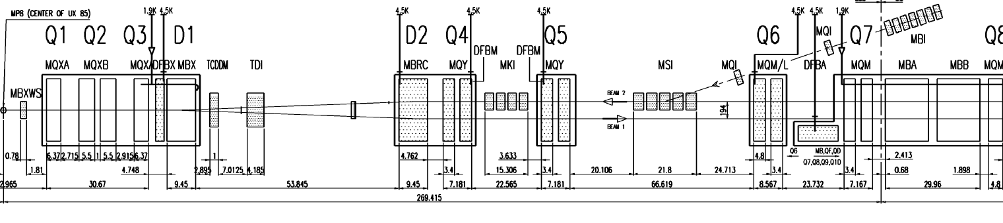
Injection beam 2, dBLM position
Position:
Point 8, injection
Dcum: 23392 m
~ 0.5 m downstream of TDI
LHCB
dBLM
ATLAS

Slide 12
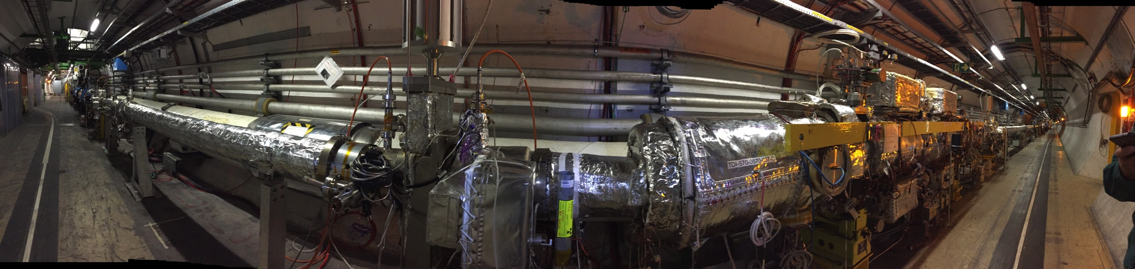
Injection beam 2, dBLM position
Position:
Point 8, injection
Dcum: 23392 m
~ 0.5 m downstream of TDI
LHCb
dBLM
TDI
ATLAS

Slide 13
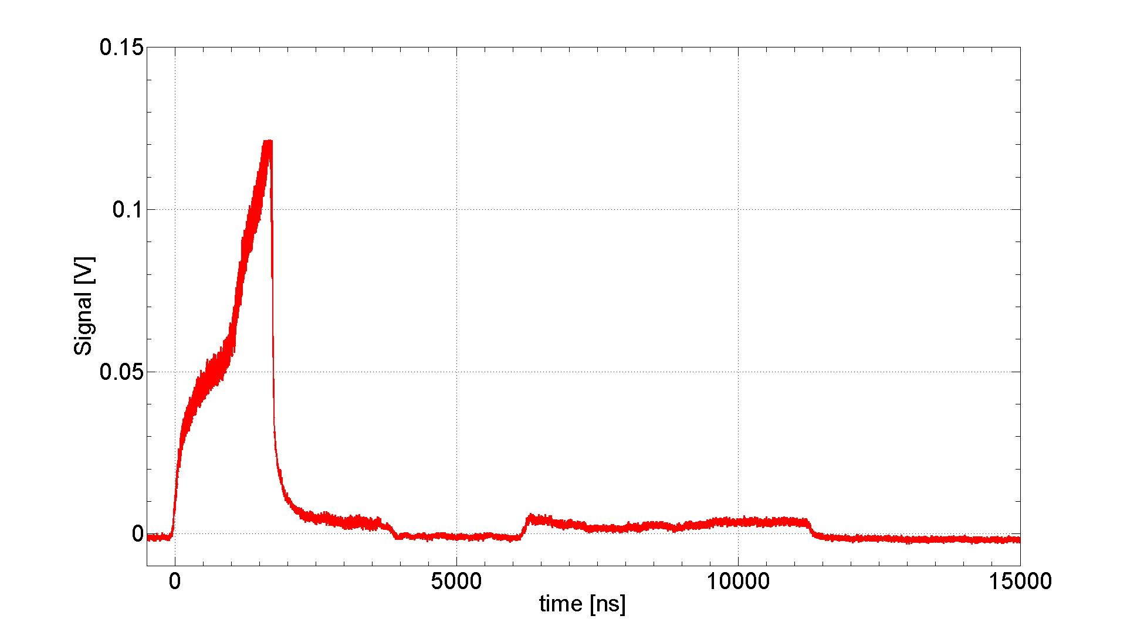
Injection IP8, 72 bunches
Courtesy of F. Burkart

Slide 14
Injection IP8, 72 bunches
First bunch
MKE4 FT: 11.5 μs
MKI8 RT: 0.9 μs
MKI8 FT: 4.28 μs
72b injected
Courtesy of F. Burkart

Slide 15
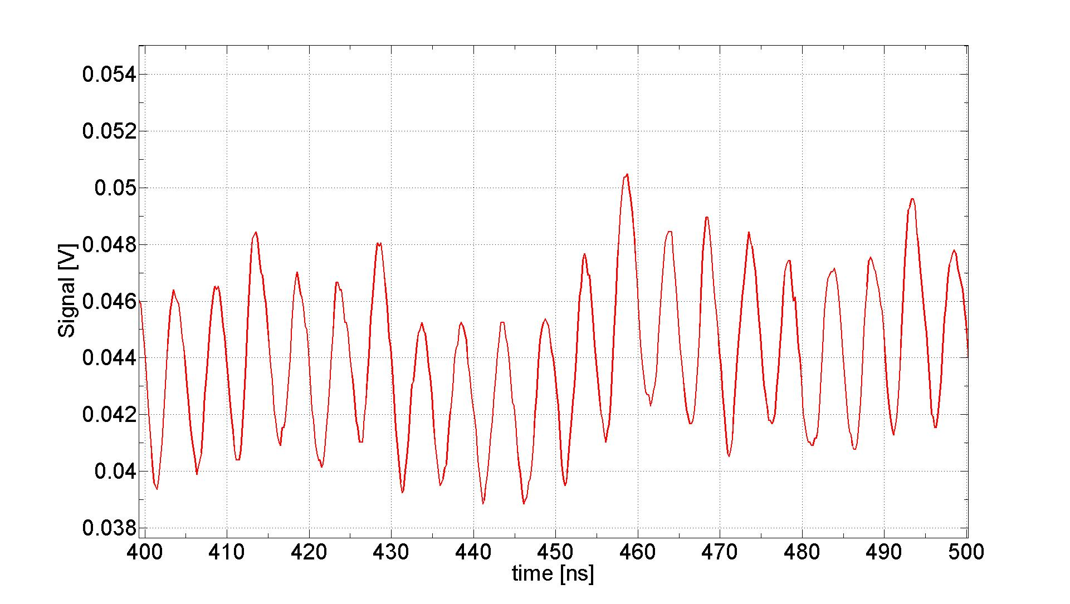
Injection IP8, 72 bunches, zoom
Δt = 5ns
Corresponds to 200 MHz RF SPS structure.
Courtesy of F. Burkart

Slide 16
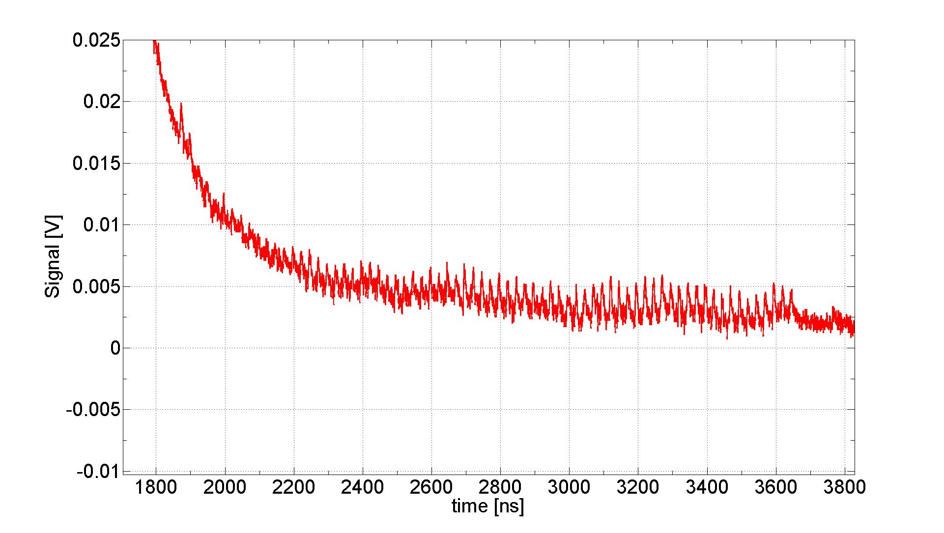
Injection IP8, 72 bunches, zoom
First bunch
Δt = 5ns
Corresponds to 200 MHz RF SPS structure.
72th bunch
Courtesy of F. Burkart

Slide 17
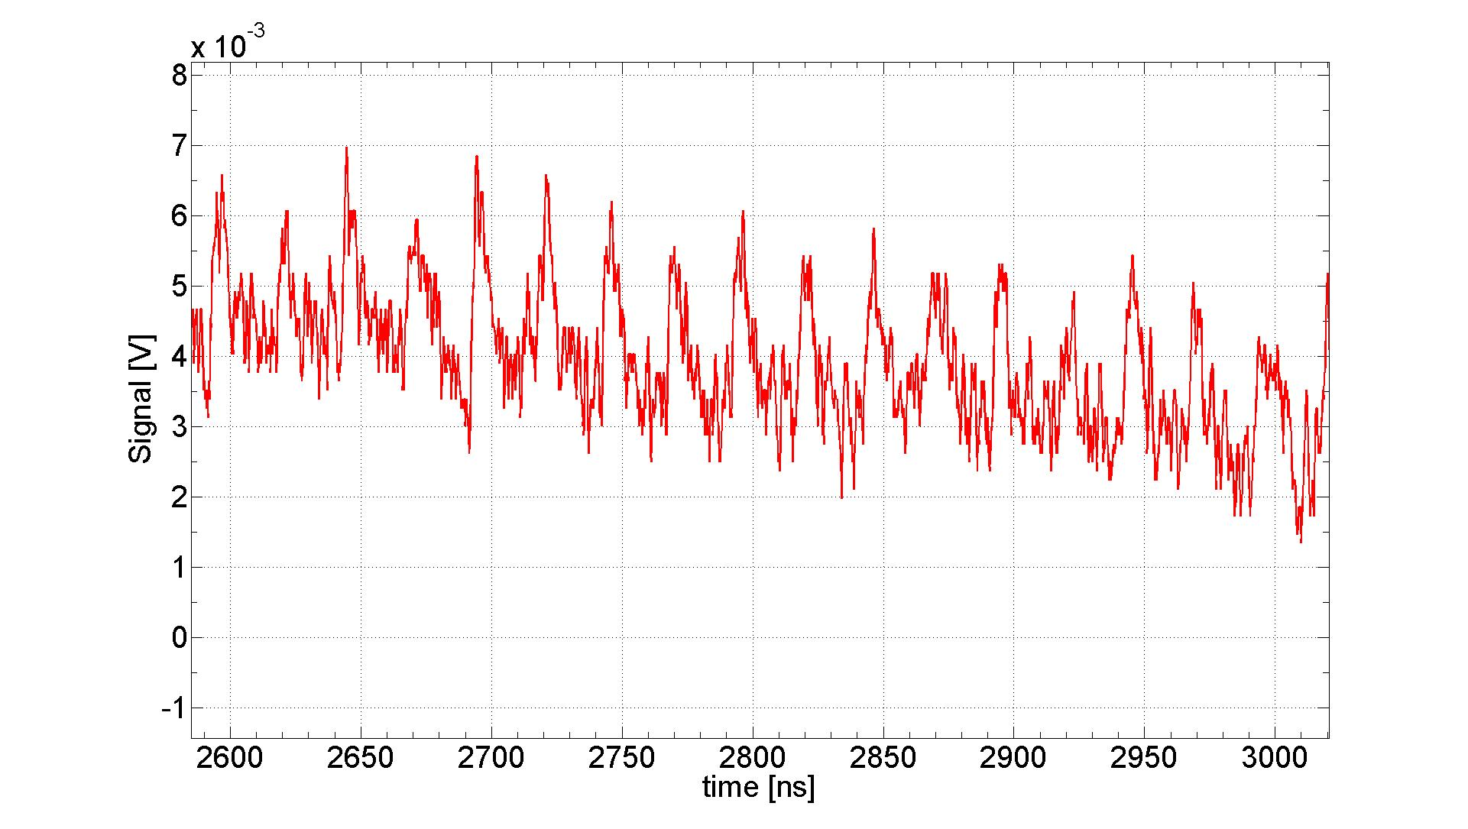
Injection IP8, 72 bunches, zoom
25 ns
Courtesy of F. Burkart

Slide 18
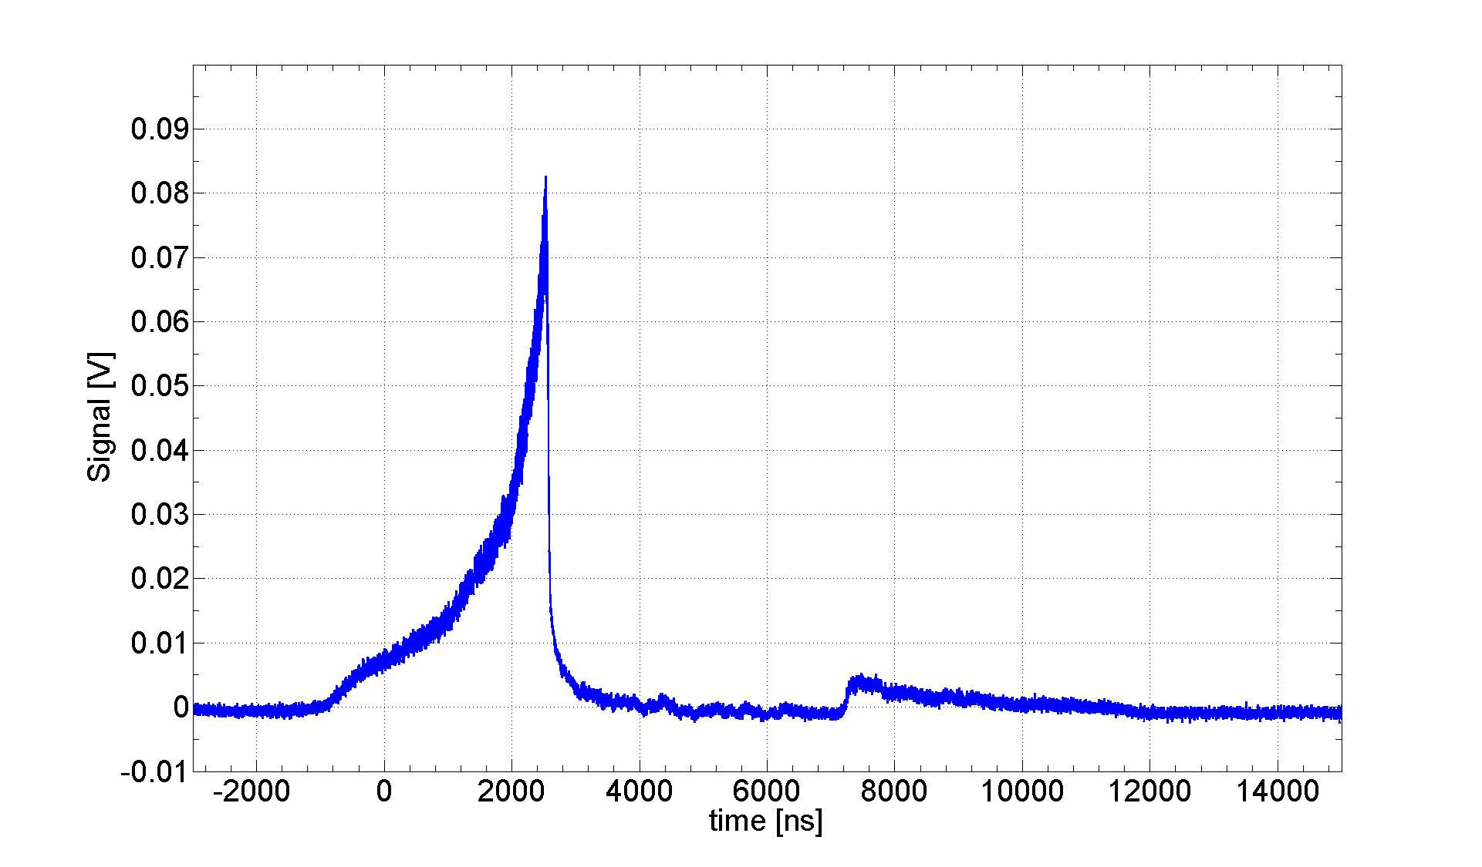
Injection IP2, 72 bunches
MKE6 FT: 8 μs
MKI2 RT: 0.9 μs
MKI2 FT: 4.32 μs
72b injected
Courtesy of F. Burkart

Slide 19
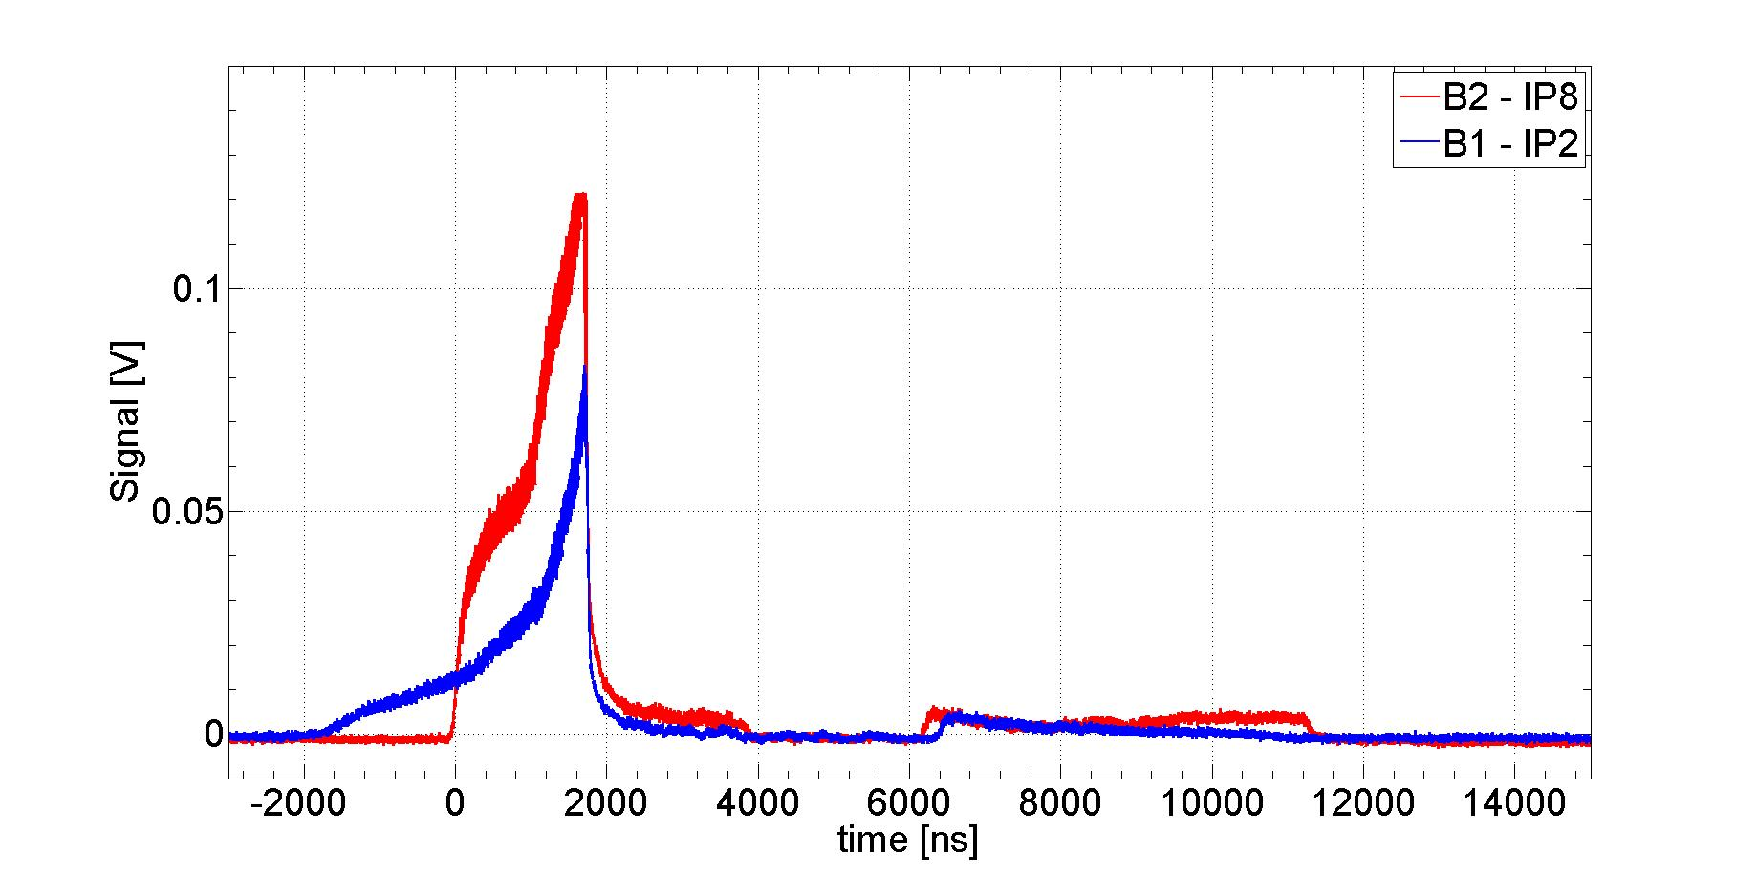
Comparison of the injection signals
Courtesy of F. Burkart

Slide 20
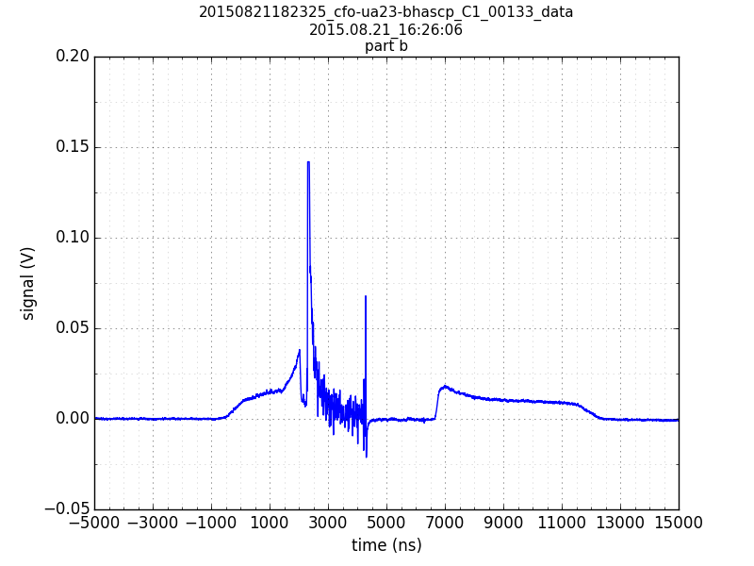
Losses from bunch train
Unbunched beam and bunch train losses are clearly different.
Relatively rare
Very high signal > 10V
More data needed
Losses from bunch train
Unbunched beam

Slide 21
Linearity between dBLM und icBLM@TDI
Data from ~50 injections compared with IQC data for Beam 1

Slide 22
Injection signatures of 72 and 144 bunches
144b injection ~ 75% of dump threshold.
No bunch train signal.
First loss signature
comparable.
Second loss signal
only for 144b.
1^{st.}
2^{nd.}

Slide 23

Injection signatures of 72 and 144 bunches
144 bunches
Kicker flat top constant.
Recaptured beam before and after
the bunch train (scree)?
Magnet strength
72 bunches
Time

Slide 24
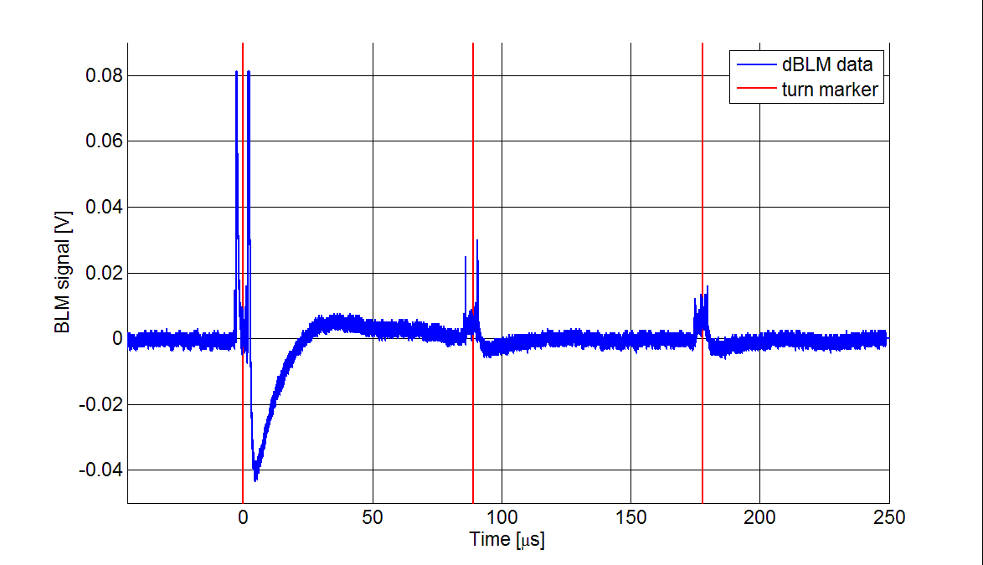
Injection oscillations in IP7, B2
First measurements in IP7, global aperture bottle neck
Courtesy of M. Bursy

Slide 25
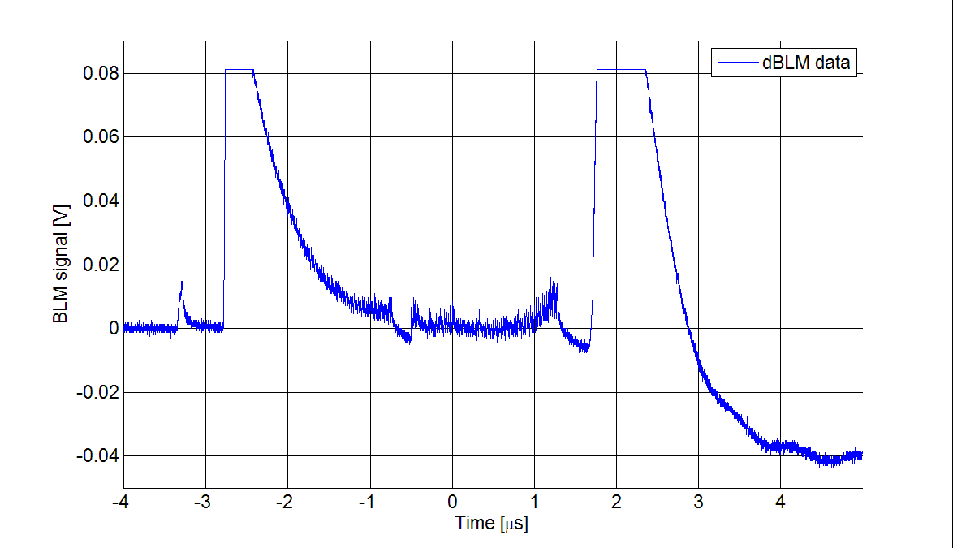
Injection oscillations in IP7, B2
Courtesy of M. Bursy

Slide 26
LHC injection, additional dBLM in SPS
SPS
MKE
dBLM
TPSG
OFF
MKI
dBLM
TDI
LHC
OFF

Slide 27
LHC timing information and triggering
Current measurement setup:
Trigger on signal
Better:
Trigger on LHC injection pre-pulse.
Needed Hardware:
  BST fibre needed, Eva Cavalo contacted.
  P0 decoder card, production needed
  Lars Jensen, Marek Gasior contacted
Simultaneous measurements in SPS extraction,
LHC injection, IP7 collimation

Slide 28
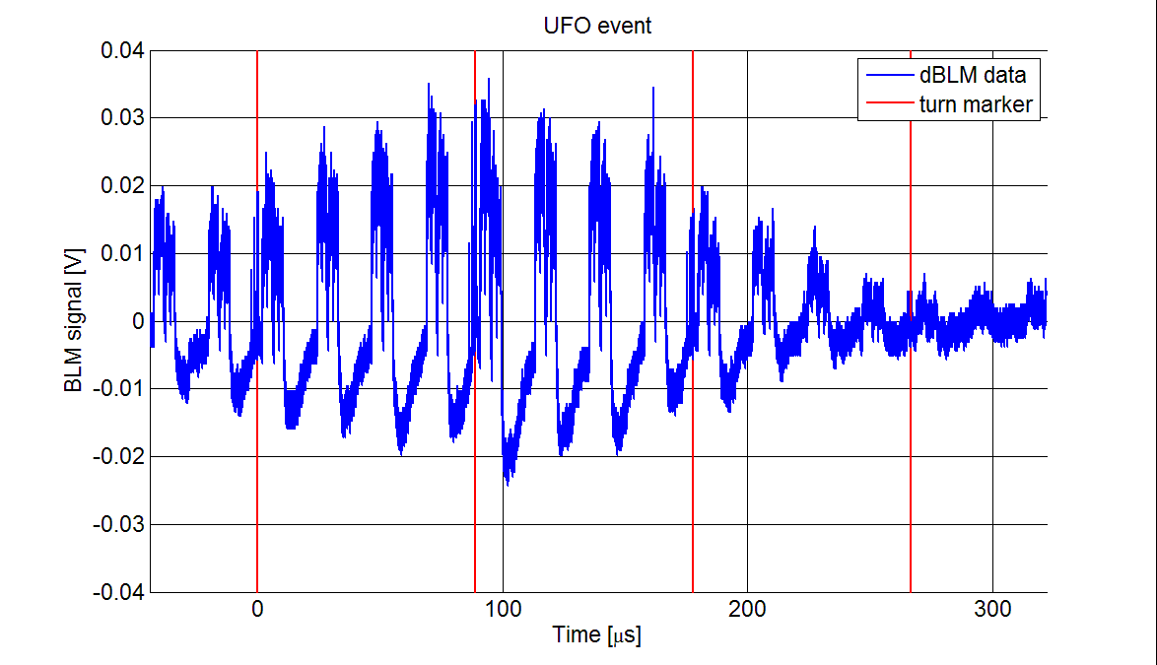
What else? UFO detection in IP7
Courtesy of M. Bursy

Slide 29
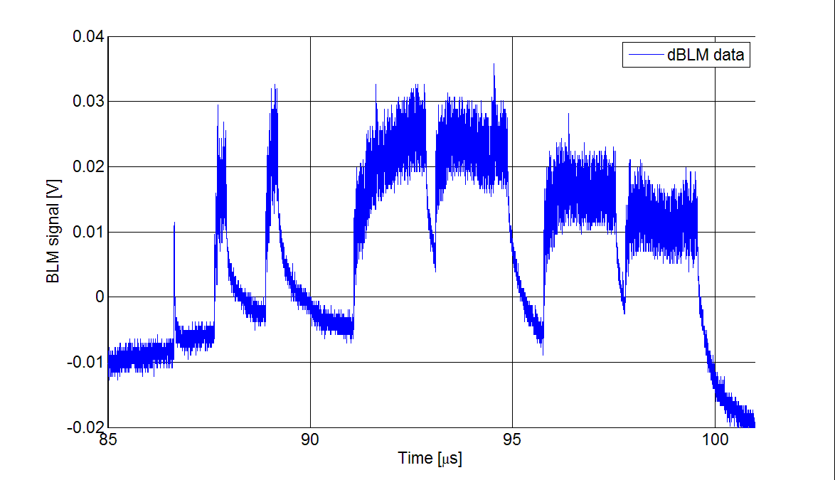
What else? UFOs
Courtesy of M. Bursy

Slide 30
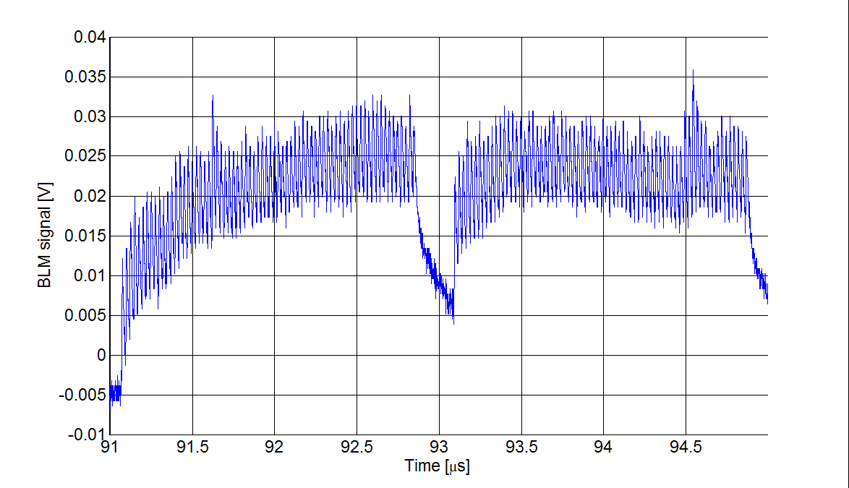
What else? UFOs

Slide 31
Thank you for your attention!

