Slide 2
Quench heater discharge analysis based on Neural Networks
Feasibility and implementation through a case study
Lorenzo Bortot
Bernhard Auchmann
TE-MPE-PE
18.06.2015
Special thanks to
A. Verweij, B. Auchmann, Z. Charifoulline, M. Maciejewski, A. Apollonio, G. Valentino

Slide 3
Outline
QH overview
A Case-study
  Data
  Pre processing
  Signal Features
The idea behind a Neural Network
NN Training
NN Validation
SWOT & Debriefing

Slide 4
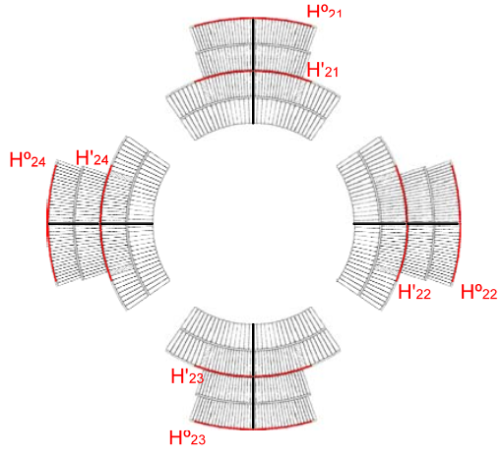

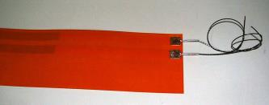

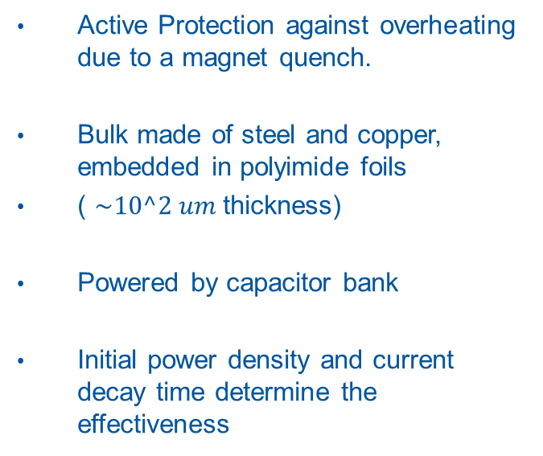
QH overview
QH topology
in MQY
Active Protection against overheating due to a magnet quench.
Bulk made of steel and copper, embedded in polyimide foils
( $\sim 10^2 um$thickness)
Powered by capacitor bank
Initial power density and current decay time determine the effectiveness
If a QH failed, any arc or discharge phenomenon could be potentially deadly for the magnet coils
Identify and exclude any QH
at first sight of performances
degradation

Slide 5
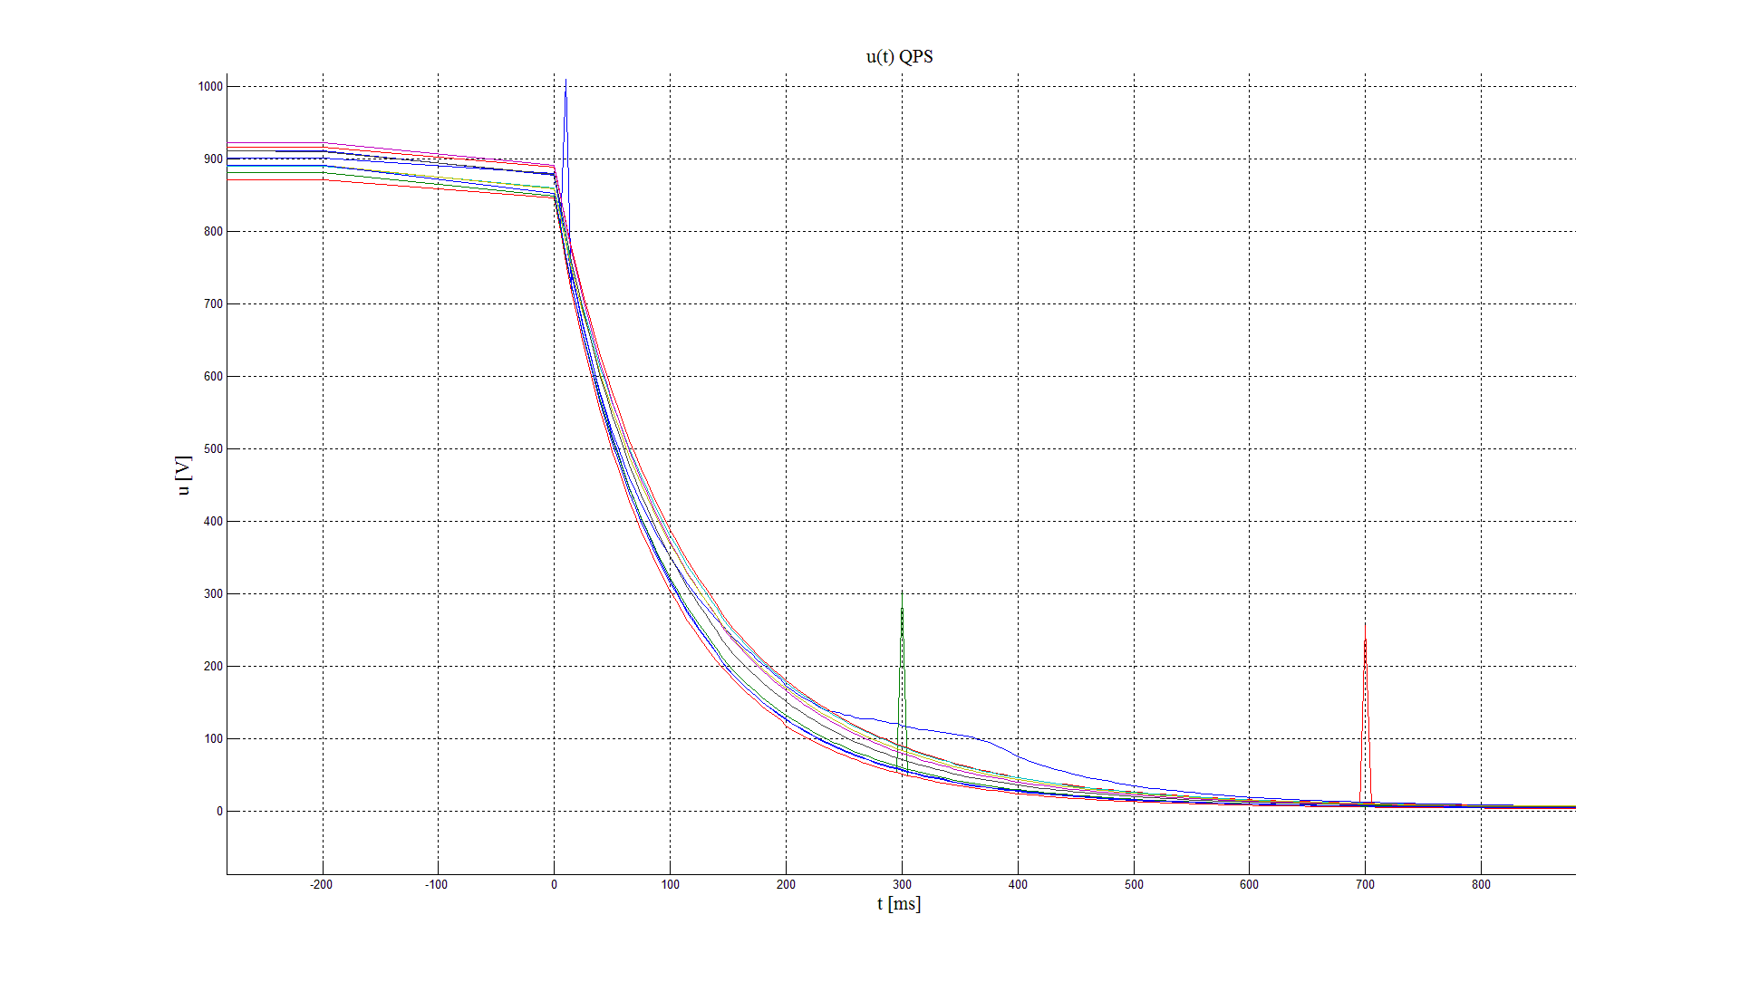



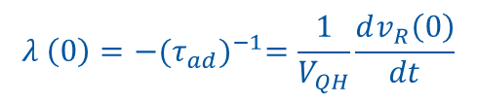



A case-study: Data 1/3
What we expect to see:
$$v_{R}\left(t\right)=V_{QH} e^{λ\left(t\right)t}$$
where
$$λ \left(t\right)=−{{(C}_{QH}R_{QH}(t))}^{−1}$$
$$λ \left(0\right)={−(τ_{ad})}^{−1}=\frac{1}{V_{QH}}\frac{dv_{R}\left(0\right)}{dt}$$
What we actually observe: IPQ-RQ4 (MQY)
$V_{QH} ?$
Monotonic criterion ?
Derivative ?
Fault!
$$\frac{dv_{R}\left(0\right)}{dt} ?$$
$$v_{R}\left(t\right) ?$$
$$v_{R}\left(end\right) ?$$

Slide 6
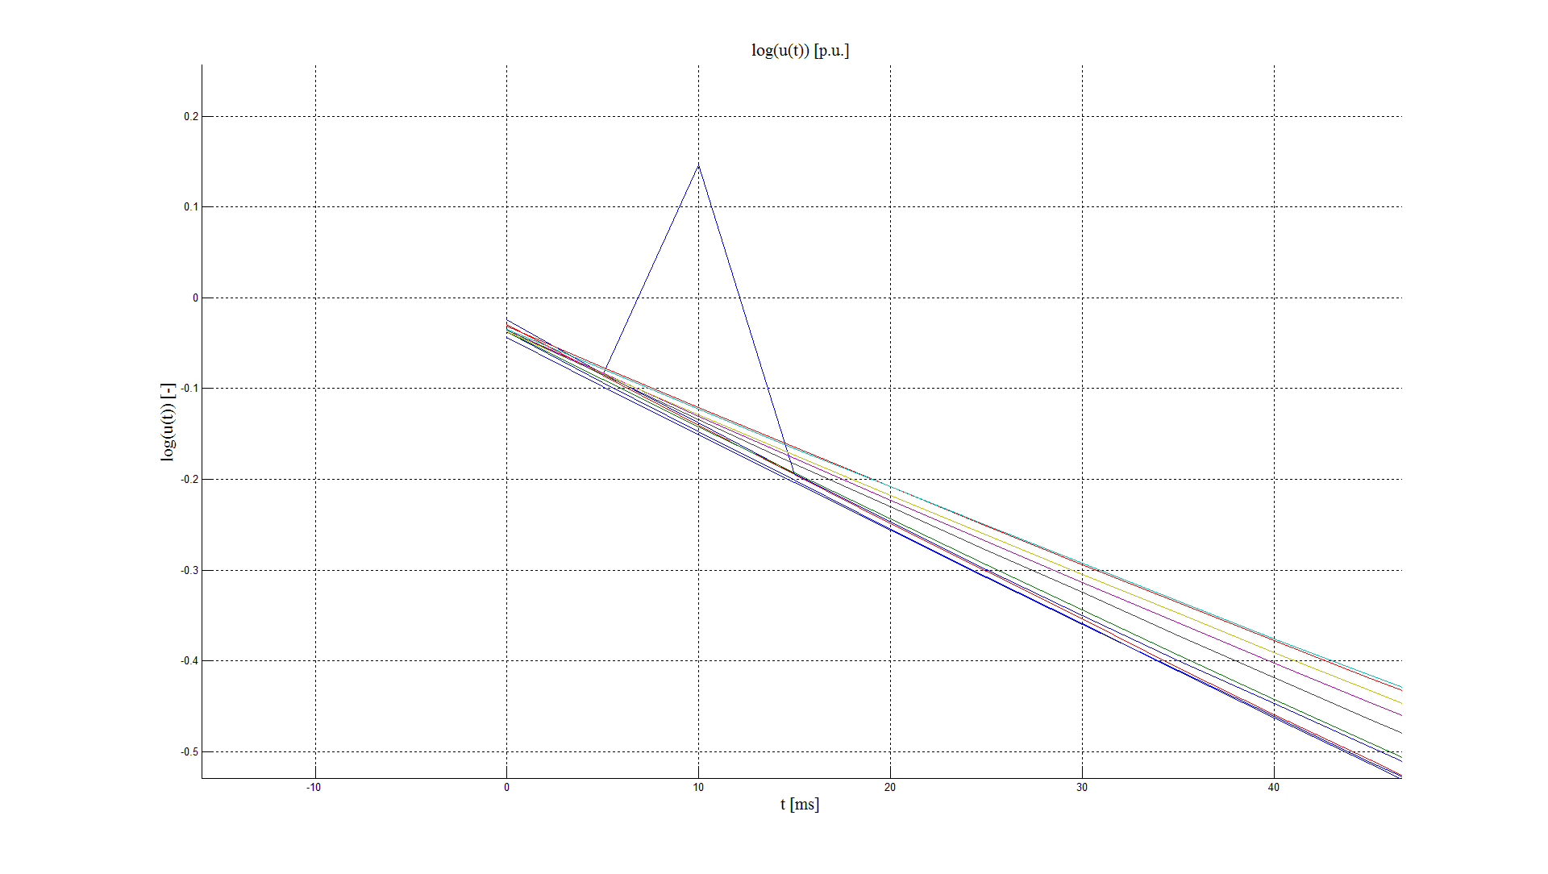
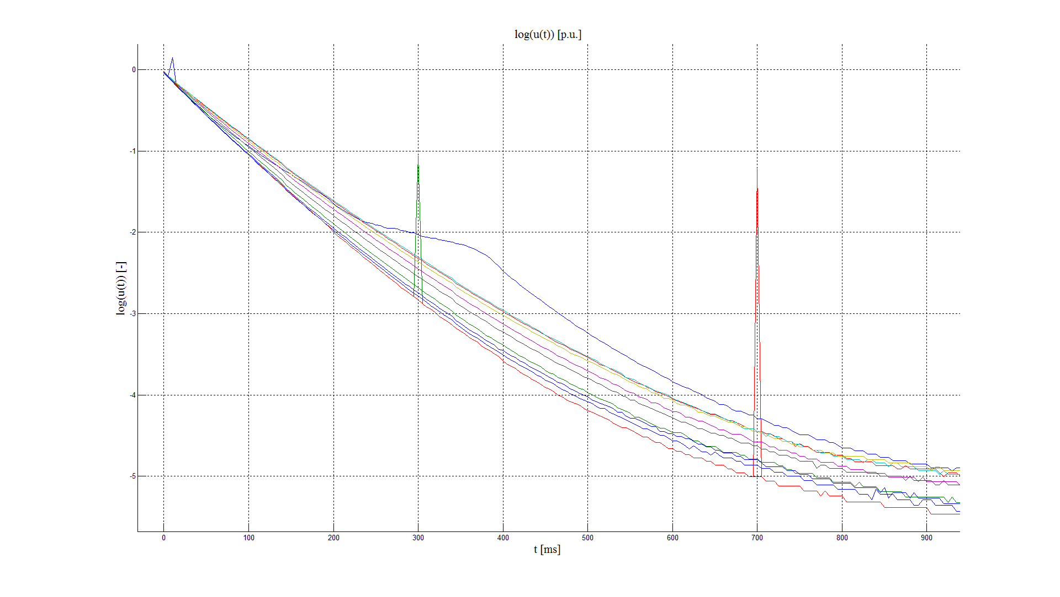







A case-study: Data 2/3
What we expect to see: $v_{R}^{∗}(t)=Log\left(\frac{v_{R}\left(t\right)}{V_{QH}}\right)$
$$v_{R}^{∗}\left(t\right)=λ\left(t\right)t$$
What we actually observe:
$$\frac{dv_{R}^{∗}\left(0\right)}{dt} ?$$
$$\left[0,0\right] ?$$
$$λ_{1,2,..n} \left(0\right) ?$$
$$v_{R}^{∗}\left(t\right) ?$$
$$v_{R}^{∗}\left(end\right) ?$$

Slide 7
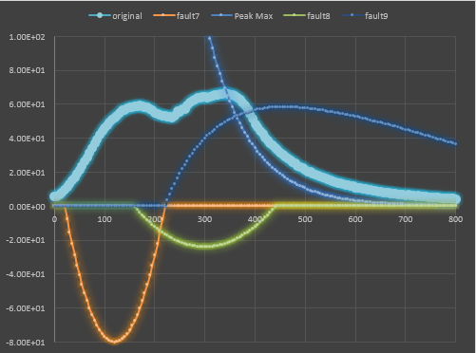
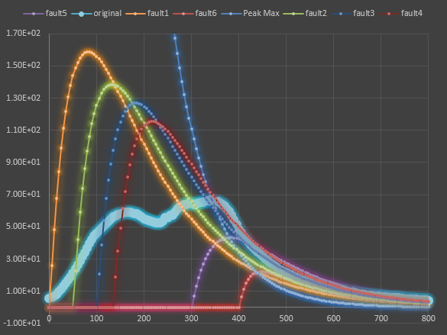
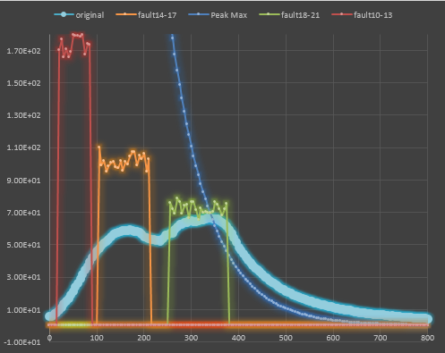
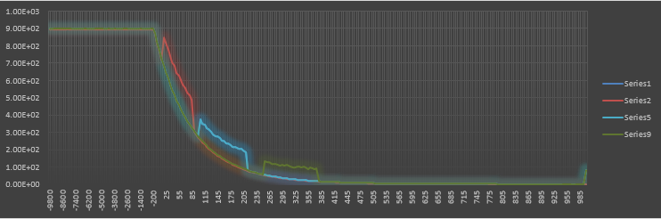
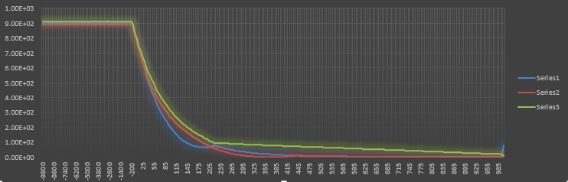
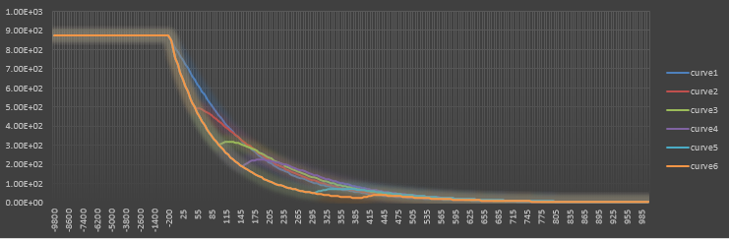
A case-study: Data 3/3
No validation with just a single fault!
Analysis of the only fault available
Extraction of the “fingerprint”
Modelling of synthetic faults
  Lightning impulses (double exponential decay)
  Low voltages (parabolic curve)
  Open circuits (quasi-constant value)
  Noisy steps (constant val + random noise)
Hints are highly
appreciated!

Slide 8
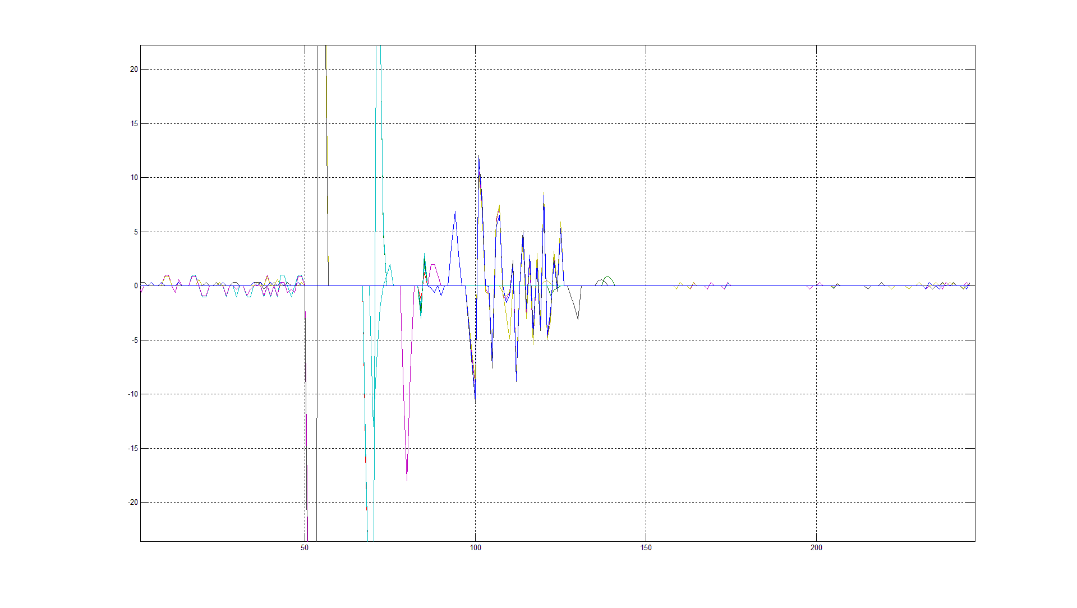
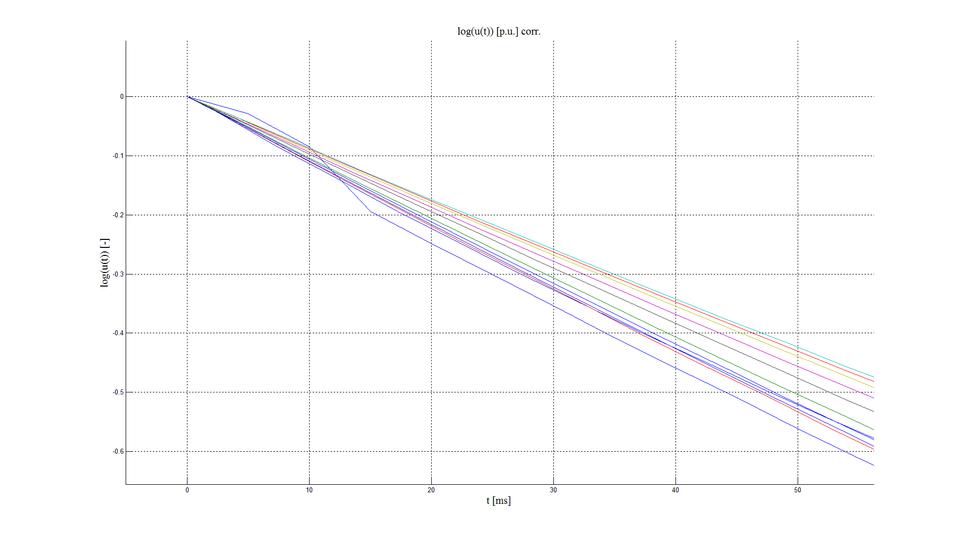


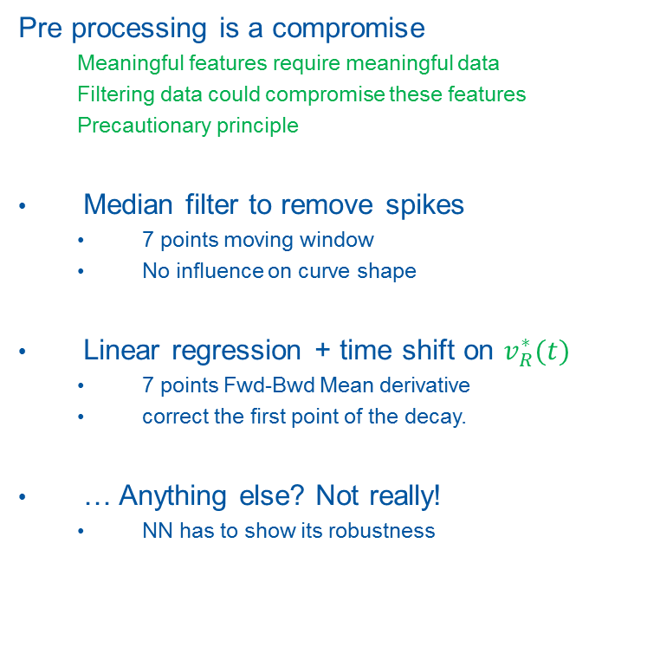
A case-study: Pre processing
$$v_{R}\left(t\right) −v_{R filtered}\left(t\right)$$
Pre processing is a compromise
  Meaningful features require meaningful data
  Filtering data could compromise these features
  Precautionary principle
Median filter to remove spikes
  7 points moving window
  No influence on curve shape
Linear regression + time shift on $v_{R}^{∗}(t)$
  7 points Fwd-Bwd Mean derivative
  correct the first point of the decay.
… Anything else? Not really!
  NN has to show its robustness
$$v_{R}^{∗}(t)$$

Slide 9

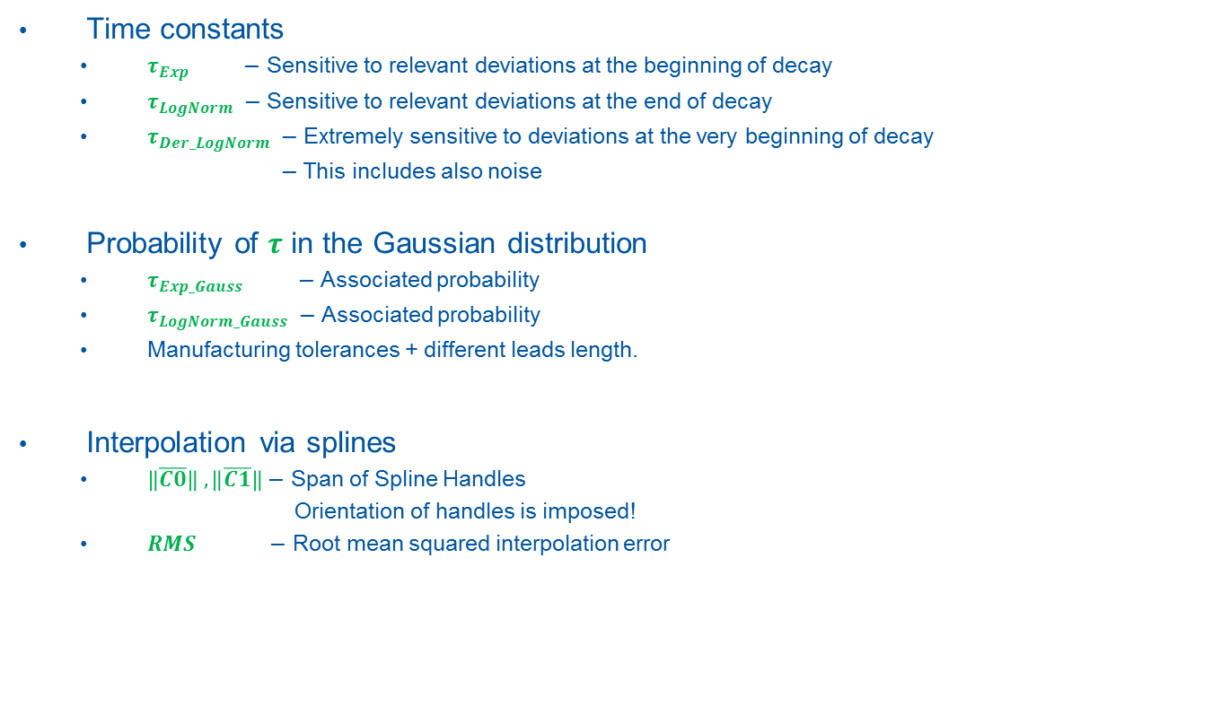

A case-study: signal features 1/2
Time constants
  $τ_{Exp} −$ Sensitive to relevant deviations at the beginning of decay
  $τ_{LogNorm} −$Sensitive to relevant deviations at the end of decay
  $τ_{Der_LogNorm} −$Extremely sensitive to deviations at the very beginning of decay
  $−$ This includes also noise
Probability of $τ$ in the Gaussian distribution
  $τ_{Exp_Gauss} −$ Associated probability
  $τ_{LogNorm_Gauss} −$ Associated probability
  Manufacturing tolerances + different leads length.
Interpolation via splines
  $\left\|\overline{C0}\right\| ,\left\|\overline{C1}\right\|−$ Span of Spline Handles
  Orientation of handles is imposed!
  $RMS −$ Root mean squared interpolation error
$$\overline{C}0$$
$$\overline{C}1$$

Slide 10

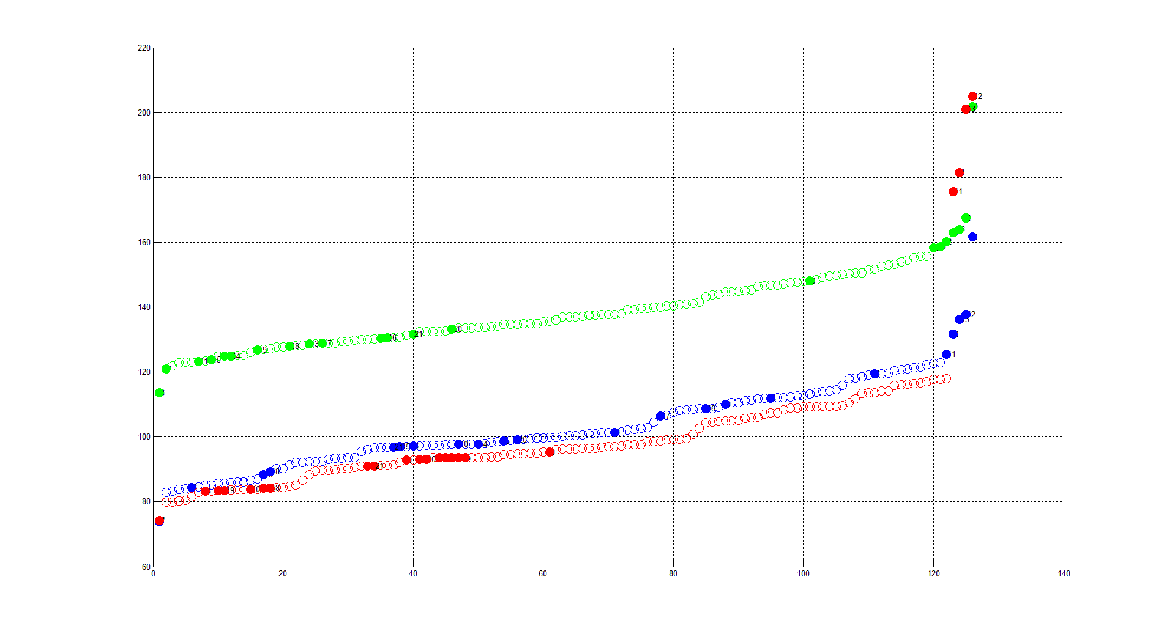
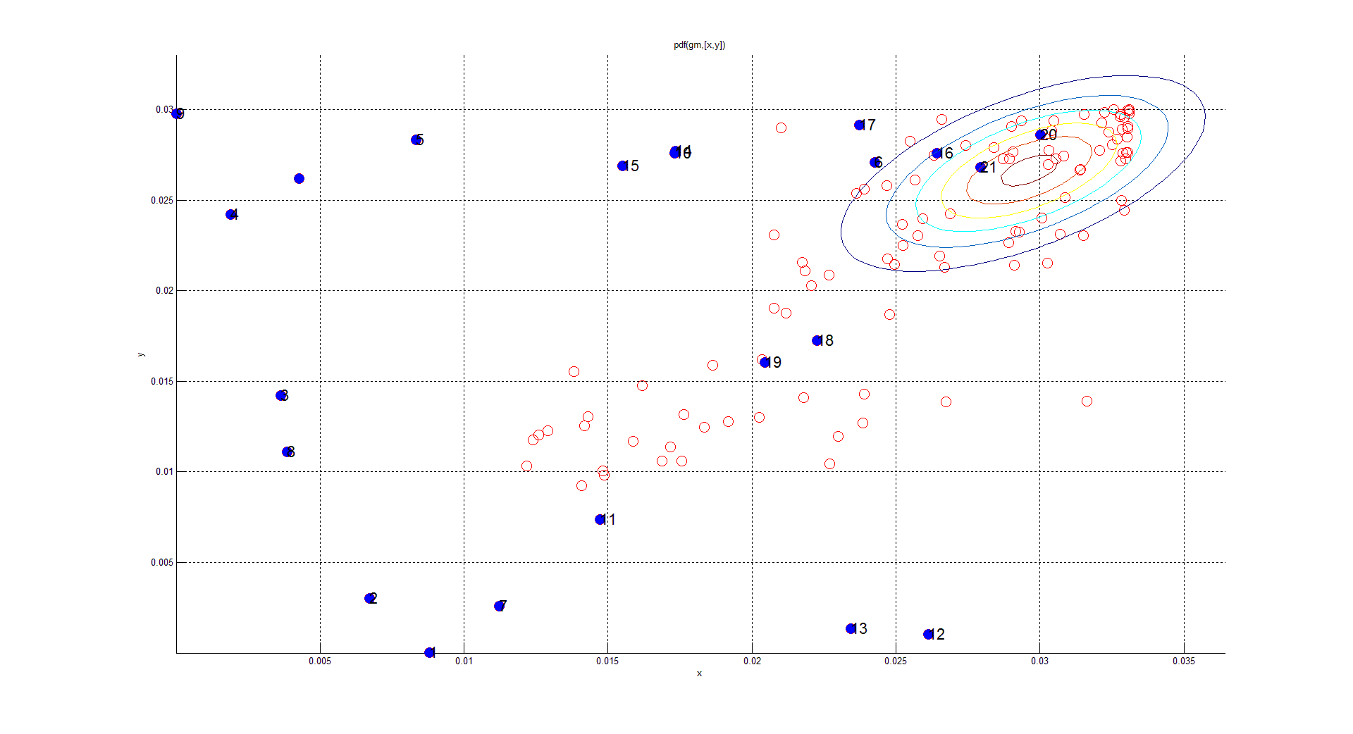
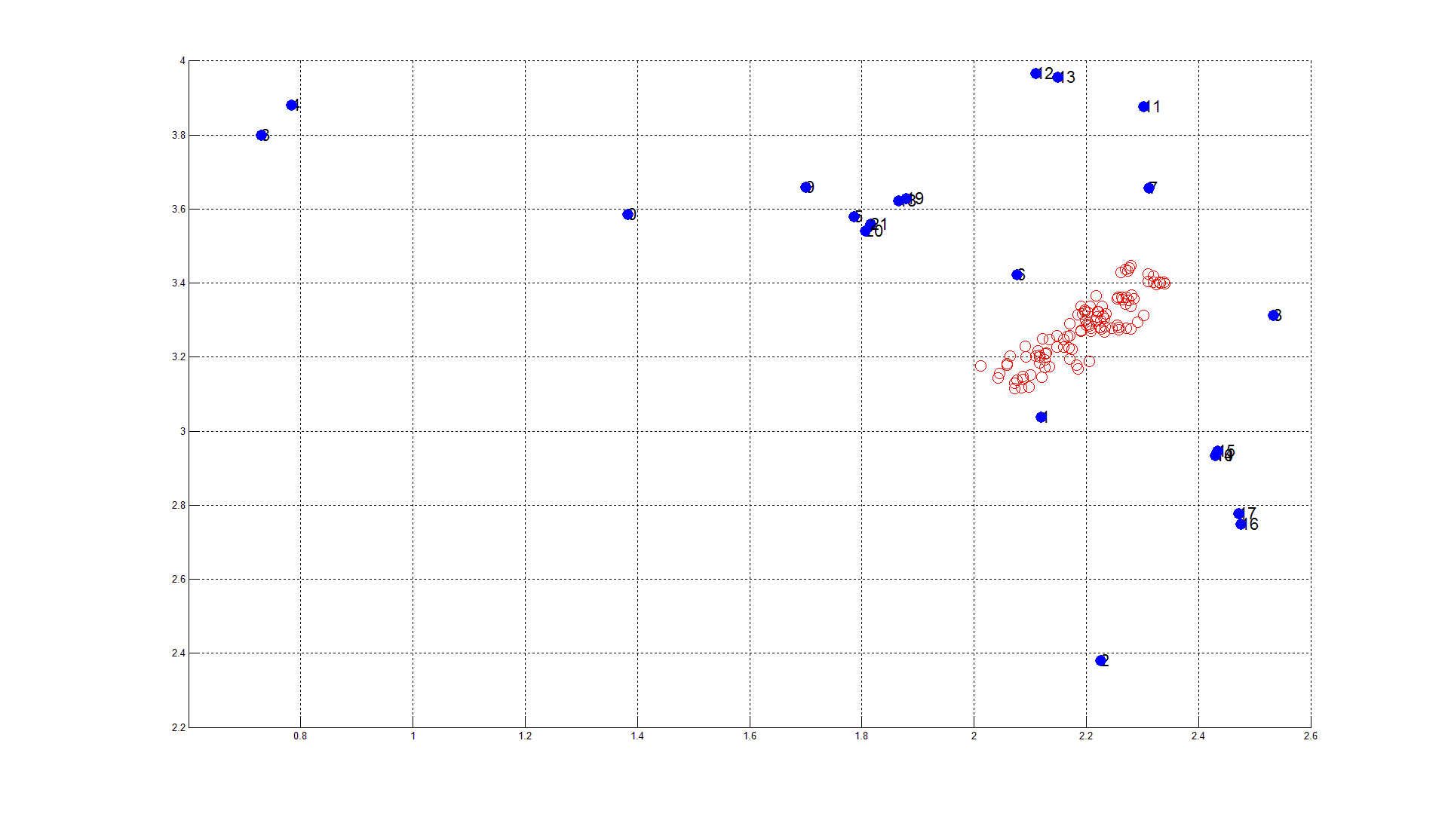
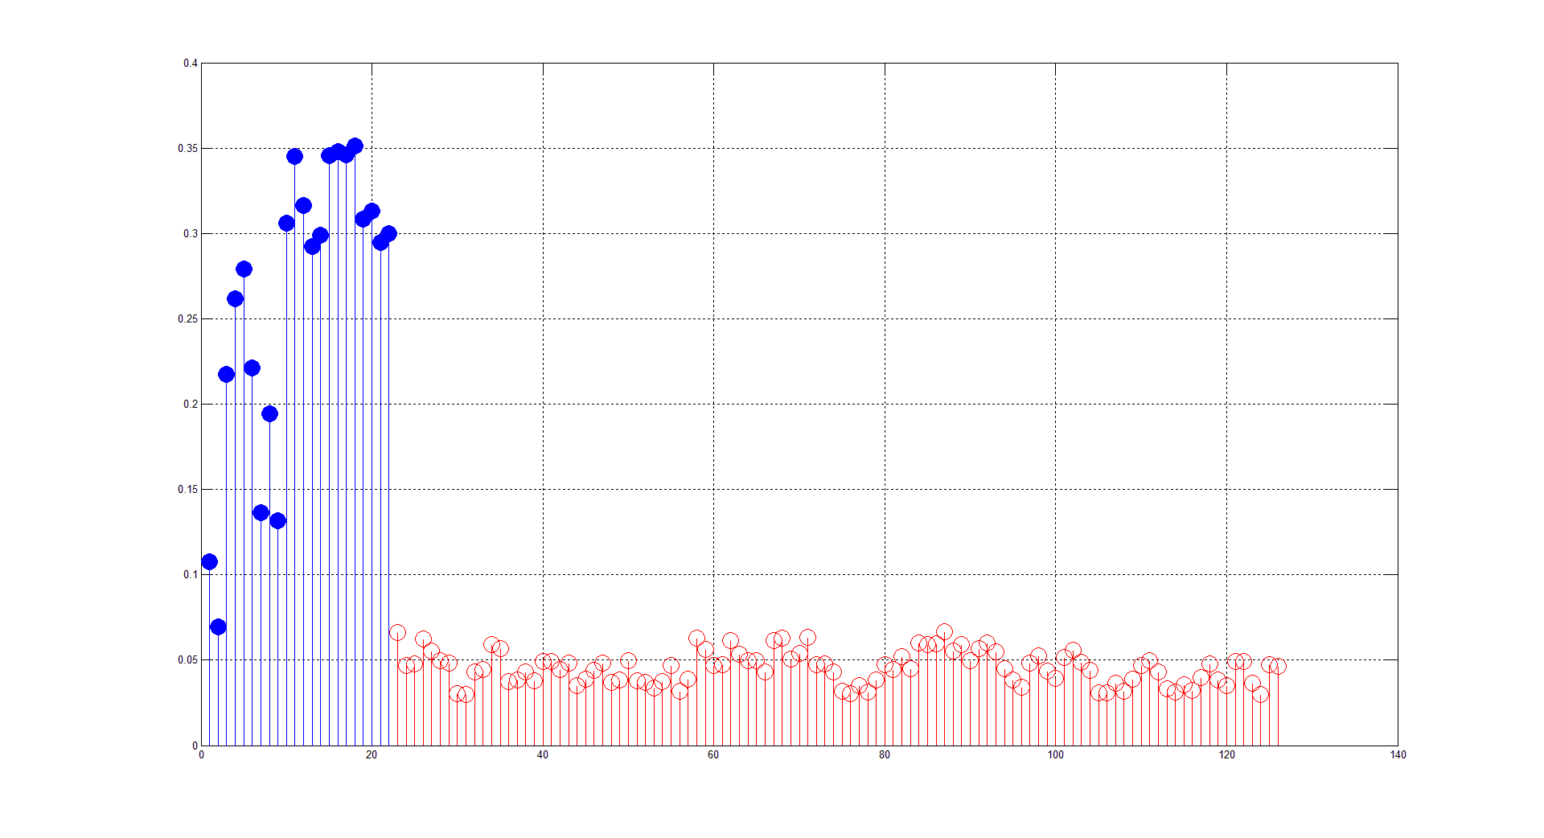








A case-Study: Signal Features 2/2
What animal?
Filled dots for the features of faulty curves
$$τ_{LogNorm}$$
$$τ_{LogNorm_Gauss}$$
$$τ_{Exp}$$
$$τ_{Der_LogNorm}$$
$$τ_{Exp_Gauss}$$
$$\left\|\overline{C1}\right\|$$
$$RMS$$
$$\left\|\overline{C0}\right\|$$
No free lunch !

Slide 11







What is a Neural Network?
Faulty curves: somehow different from healthy ones
Mental process:
  Extraction of qualitative features
  Application of an evaluation function called
  Recognition Memory, trained on previous experiences.
  Output (classification)
Neural Network process:
  Extraction of quantitative features like RGB dominant colour, length of teeth ecc..
  Application of an evaluation function: the Neural Network
  The embedded experience lies in the internal weights and
  comes from a previous training process
  Output (classification)
  … How can be sure that it makes sense?
  Existence (Universal approximation) Theorem (Hornik, Stinchombe, White 1989) :
3-layer Neural Network can approximate any continuous function on a compact domain.
It only guarantees that a solution exists, nothing about IF and HOW get it
Get the intruder!
Easy, isn’t? But why?
A performant NN relies
mostly on good features!!

Slide 12
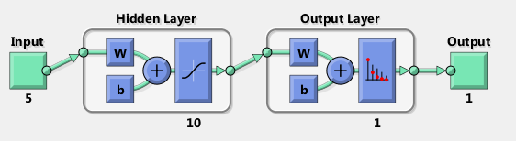
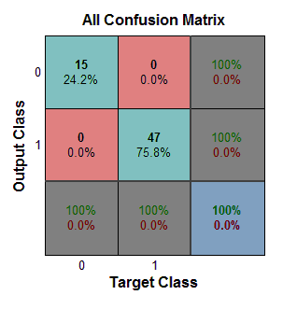




NN Training
Output
Reference
QH decays no faults
$$class=1$$
$$?$$
$$class=1$$
Signal conditioning
NN
$$≠$$
QH decays with faults
$class=0$
$class=0$
Next round
True
Weights adjustment
Training Set 15/22 faults + 47/102 good decays
Use of Matlab® Toolbox NN Pattern Recognition
Training worked fine

Slide 13
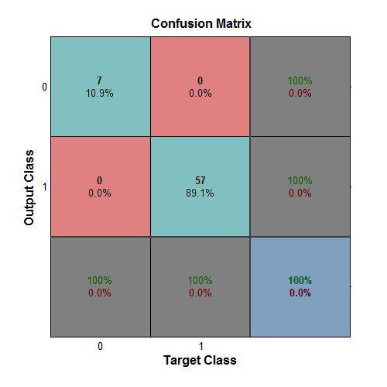
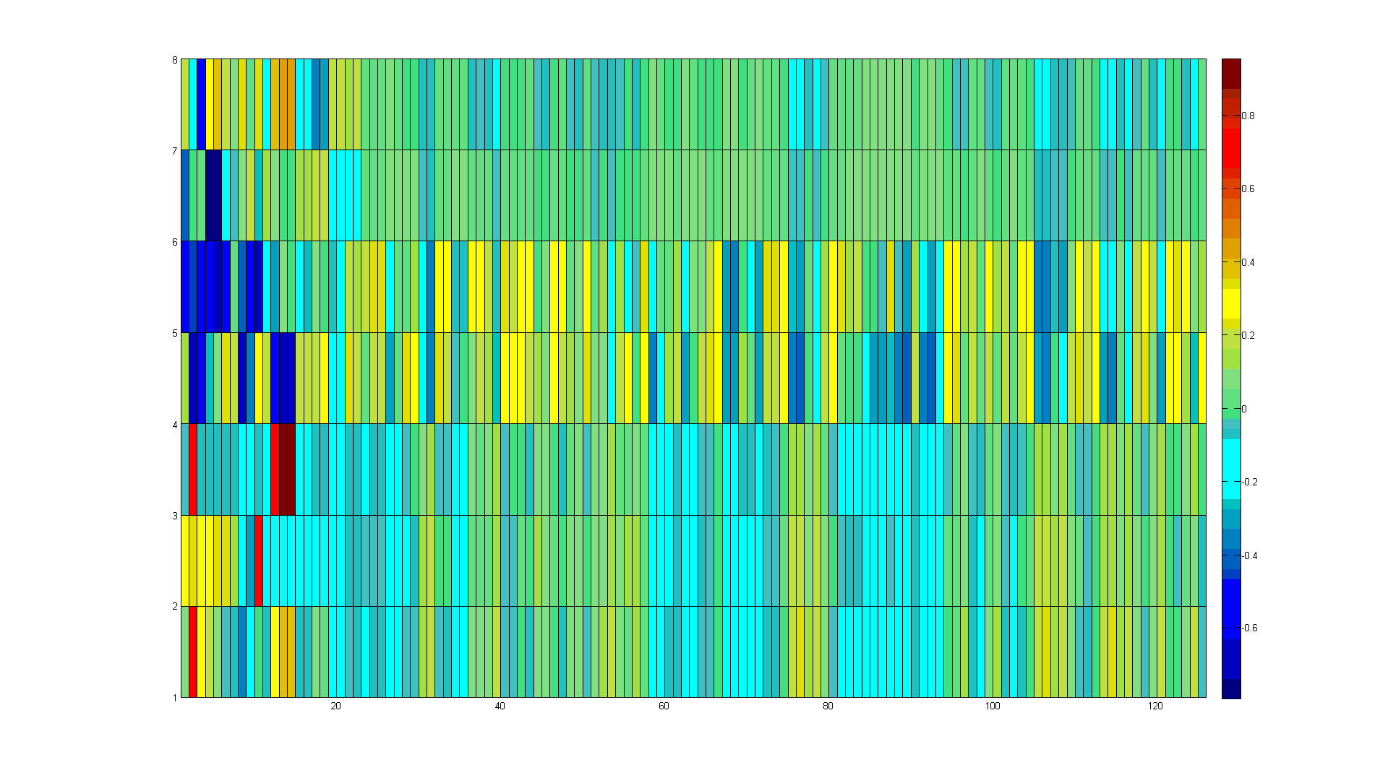
Numerical Results
Validation Set 7/22 of faults + 55/102 of good decays
Random choice of training and validation sets
Just for curiosity, this is what the NN sees…
Mismatch rate 0%

Slide 14
SWOT Analysis
Strengths | Weaknesses
Very performant Robust Continuous learning process Adaptable formulation High dimensional vision | Numerical tool, no physics Black box as known as Magic box Data availability Synthetic faults for training Output quality dependent from expertise of developer
Opportunities | Threats
Improvements beyond Matlab® Toolbox Support Vector Machines Adaptable formulation | NN setup not fully optimized Lack of extended tests on different circuits Necessity of Matlab® in-built functions Safety features vs black boxes

Slide 15
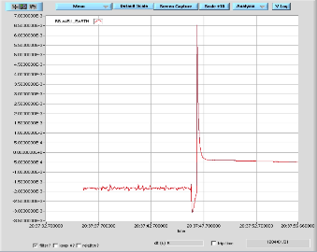
Next steps
Short term
Studies on new data sets
More artificial faults
Improve training strategy
Improve the NN
Replace Matlab® toolbox
Benchmark based on smaller and smaller precursors
Long term
General code refactoring
Keep on searching for robust yet sophisticated methods
Extension to other problems (earth currents)

Slide 16
Thank you for your attention!

Slide 17
Extra Slides

Slide 18
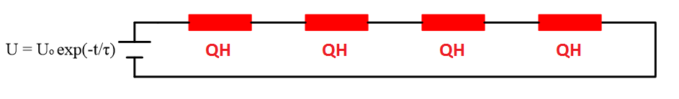
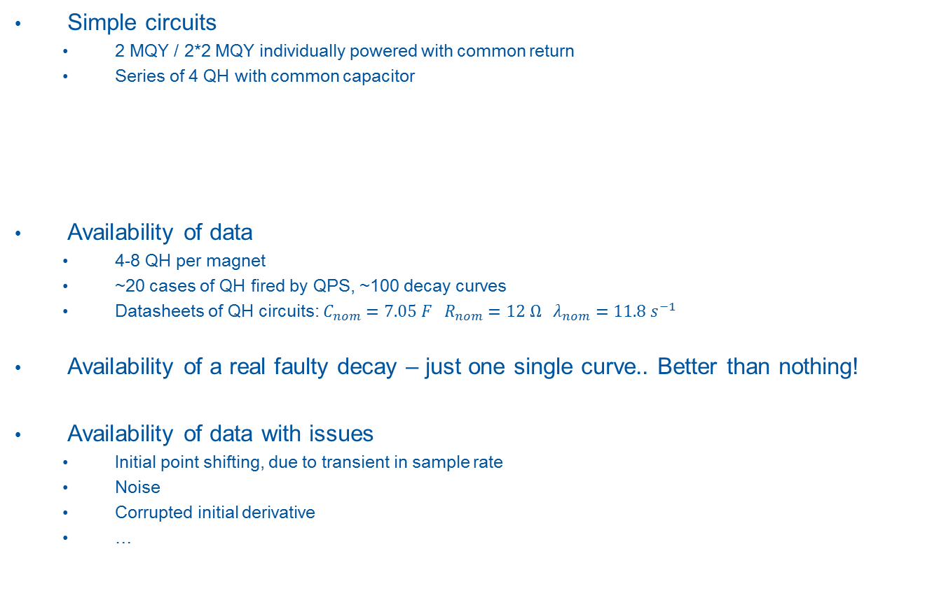
Case Study: IPQ-RQ4 (MQY)
Simple circuits
  2 MQY / 2*2 MQY individually powered with common return
  Series of 4 QH with common capacitor
Availability of data
  4-8 QH per magnet
  ~20 cases of QH fired by QPS, ~100 decay curves
  Datasheets of QH circuits: $C_{nom}=7.05 F R_{nom}=12 Ω λ_{nom}=11.8{ s}^{−1}$
Availability of a real faulty decay – just one single curve.. Better than nothing!
Availability of data with issues
  Initial point shifting, due to transient in sample rate
  Noise
  Corrupted initial derivative
  …
AP1
AP2

Slide 19
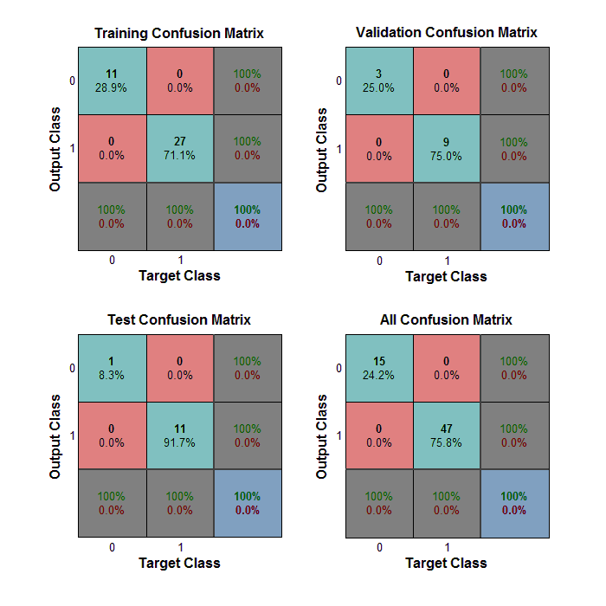
Implementation – Training set
Training Set 70% rand class0 + 45% rand class1
  60% Training - Decays shown to the network that is adjusted according to its error.
  20% Validation - These are used to measure network generalization.
  20 %Testing - independent measure of network performance during and after training.
Use of Matlab® Toolbox
  NN Pattern Recognition
Columns: expected values
Rows: values provided by NN

