Slide 2
The new old TE-MPE-PE website
Michał Maciejewski, Bernhard Auchmann, Daniel Wollmann, Arjan Verweij and other section members
TE-MPE-PE
11.06.2015

Slide 3

Acknowledgements
Many thanks to Daniel Wollmann and Beam Impact Team for setting up and initial development of section website. Great job!

Slide 4
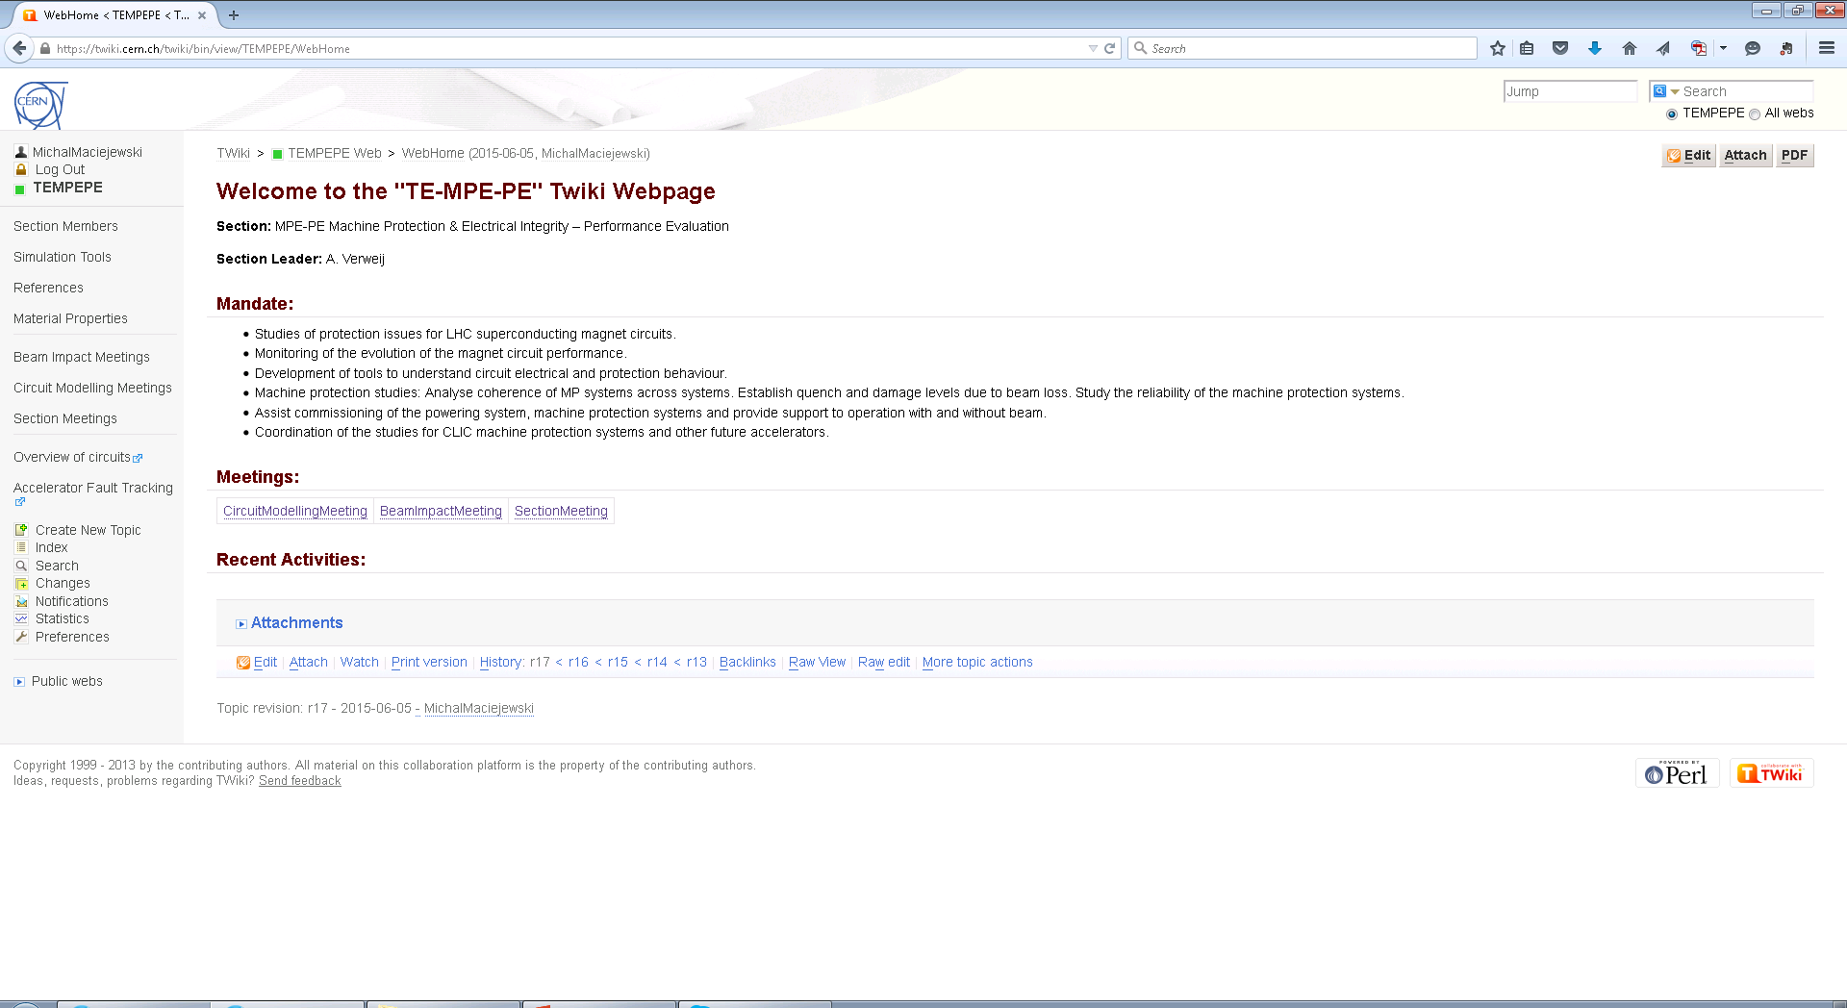
https://cern.ch/te-mpe-pe
https://twiki.cern.ch/twiki/bin/view/TEMPEPE

Slide 5


You are also the section website developer!

Slide 6


Onedrive – cloud storage (8 GeV)
https://social.cern.ch/

Slide 7

Presentation upload rule
Every presentation has to be uploaded to the website before any meeting!

