Slide 1
Update on the automation of quench heater analysis
Zinour Charifoulline
Automation team: Odd Oyvind Andreassen, Jean-Christophe Garnier, Markus Zerlauth &K, Roman Gorbonosov

Slide 2
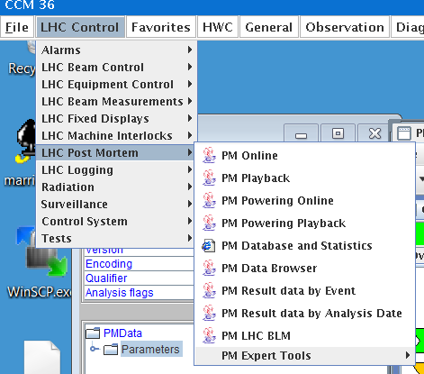
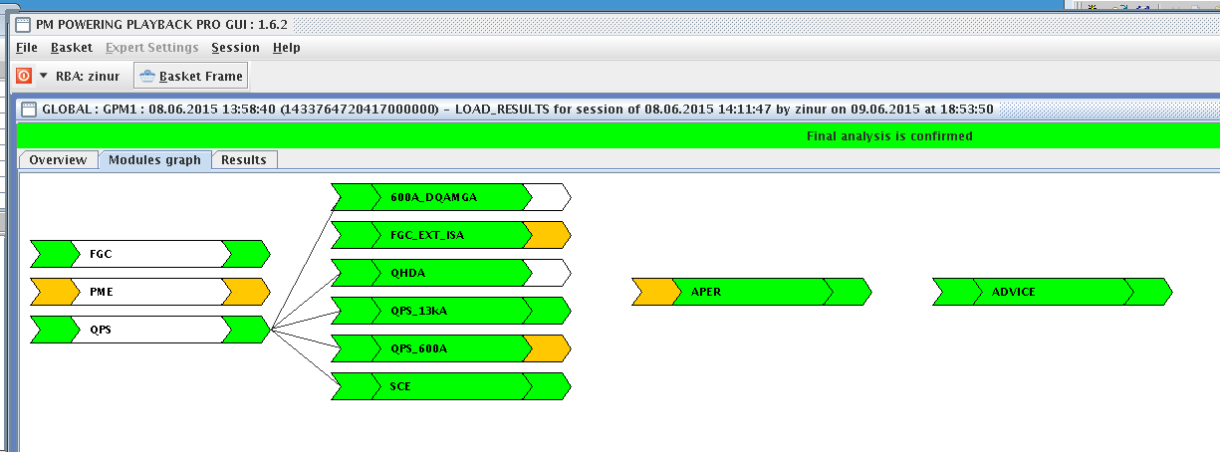
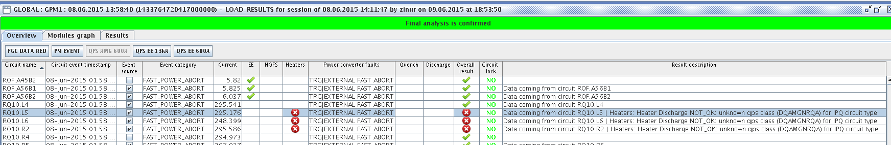
Quench heater analysis as a part of PM analysis framework (1)
qhda – labView executable module within the java environment since ~2010.

Slide 3
The LHC circuits protected by quench heaters and post LS1 QPS zoo
2014 - 2015
Circuit | QPS Class | #HDS | Comments
RB | DQAMCNMB_PMHSU | 4 x 1232 | Voltage and current signals
RQD/RQF | DQAMCNMQ_PMHSU | 2 x 392 | Voltage and current signals, but I_HDS≡0
IT (RQX) | DQAMGNC | 8 x 8 | One PM, old hardware&firmware
IPD | DQAMGNRD | 2 x 4 | One PM, old hardware&firmware
IPQ/IPD | DQAMGNRQA | 2 x 46 | A&B duplication for HDS signals
IPQ | DQAMGNRQB | 4 x 38 | A&B duplication for HDS signals
IPQ | DQAMGNRQC | 8 x 6 | A&B duplication for HDS signals
∑ = 6076 quench heaters
Some details about analysis and criteria
qps_howto_DQHDS_config_2015.pdf, Reiner Denz

Slide 4
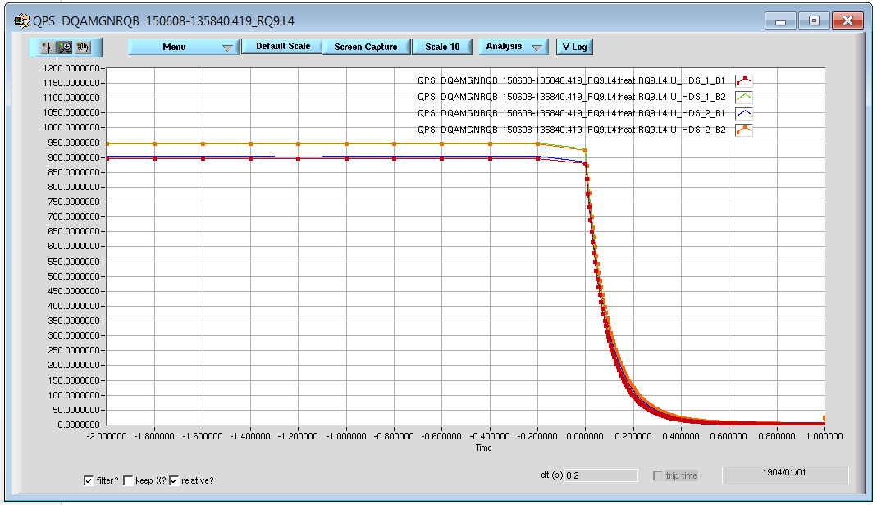
Quench heater analysis automation: IPD, IPQ and IT (1)
1: 810V < Initial Charge < 1000V
average, median filter
3: Decay time constant:
±5ms with respect to the reference discharge
4: Curve to curve comparison with reference discharge
(details in the next slide)
2: 0 < Final Charge < 10V?
DISCHARGE = Yes, if ∆V>20V for at least 1 heater
average, median filter

Slide 5
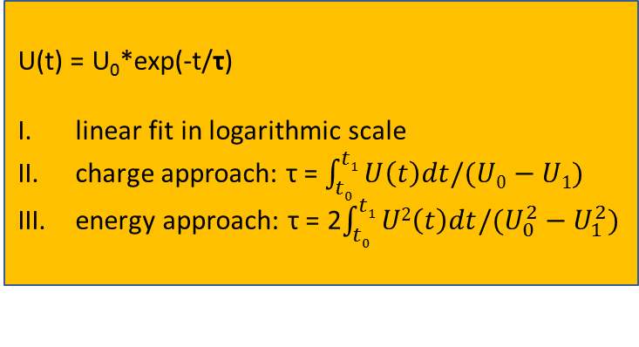
Quench heater analysis automation: IPD, IPQ and IT (2)
U(t) = U₀*exp(-t/τ)
linear fit in logarithmic scale
charge approach: τ = $\int_{t0}^{t1}{U\left(t\right)dt/(U0−U1)}$
energy approach: τ = 2$\int_{t0}^{t1}{U2\left(t\right)dt/(U_{0}^{2}−U_{1}^{2})}$
3: Decay time constant:
±5ms with respect to the reference discharge

Slide 6
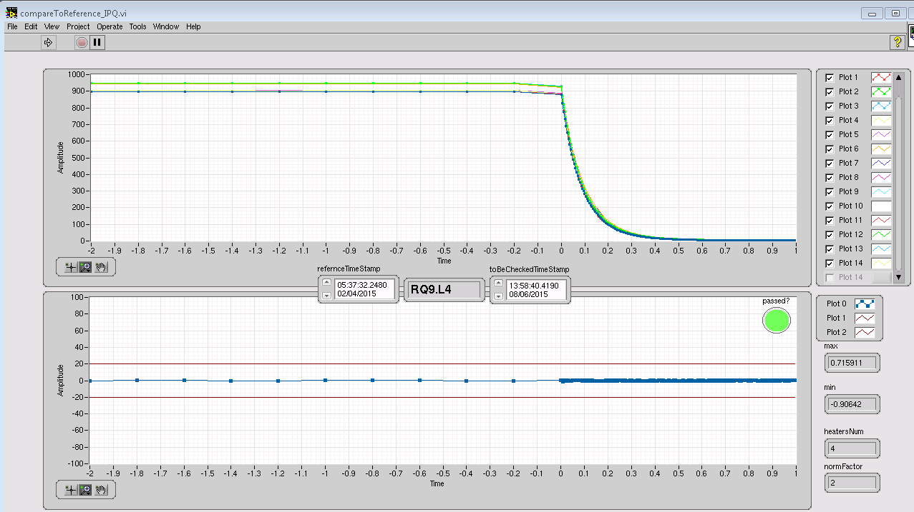
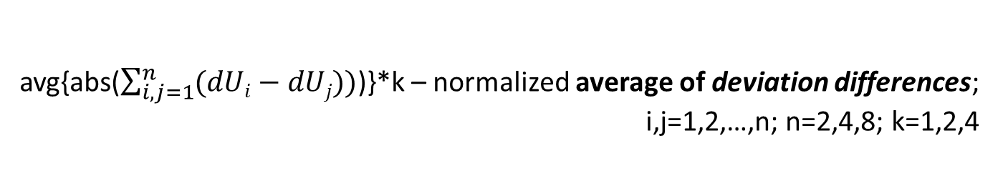
Quench heater analysis automation: IPD, IPQ and IT (3)
4: Curve to curve comparison with reference discharge
4 + 4 curves
U_{i}(t) & U_REF_{i}(t) – discharges curves; i=1,2,…,n; n=2,4,8
dUi(t)=(U_{i}(t)-U_REF_{i}(t)) – deviation curves; i=1,2,…,n; n=2,4,8
avg{abs($\sum_{i,j=1}^{n}{(dUi−dUj))}$)}*k – normalized average of deviation differences; i,j=1,2,…,n; n=2,4,8; k=1,2,4
1 curve as a result of comparison

Slide 7
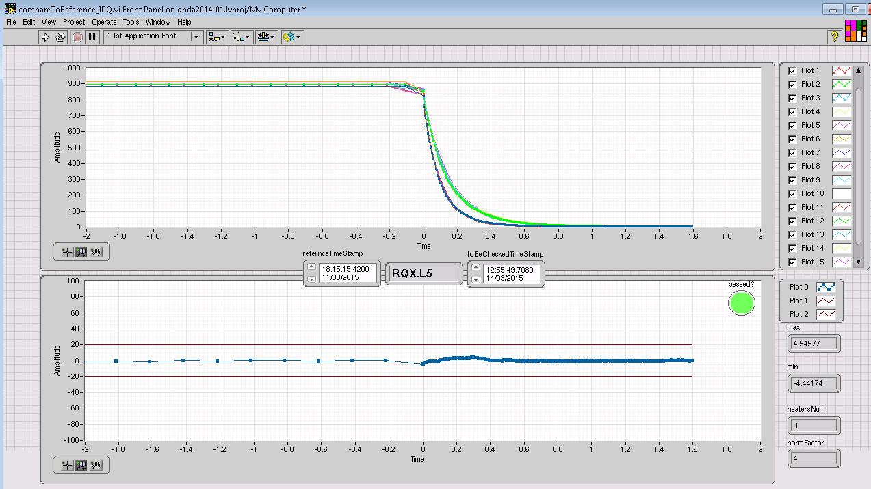
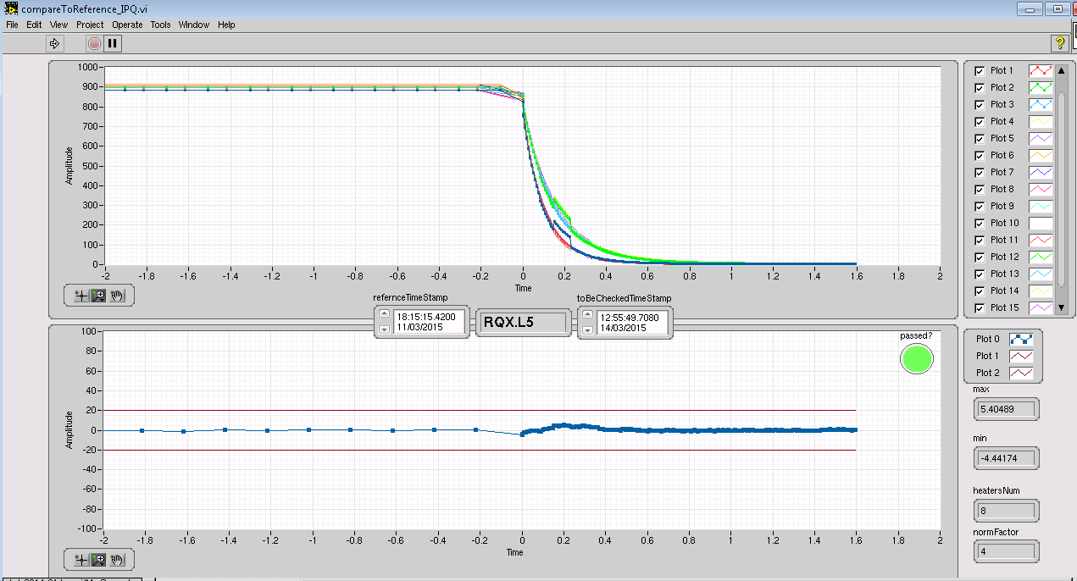
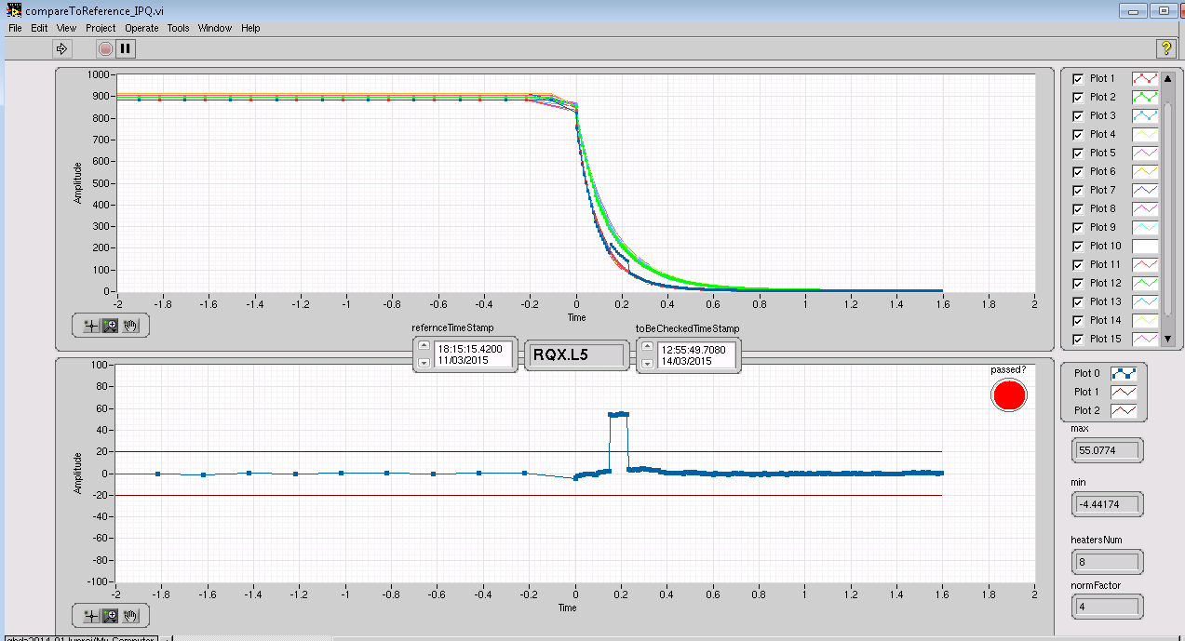
Quench heater analysis automation: IPD, IPQ and IT (4)
Disturbance in all 8 curves
Disturbance in 1 curve

Slide 8
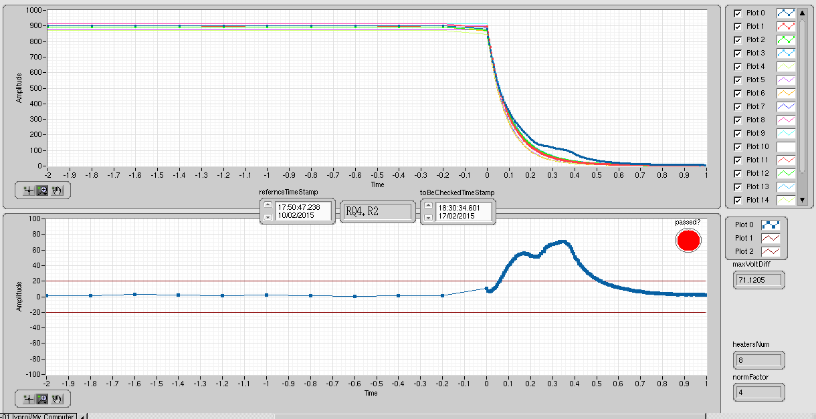
Quench heater analysis automation: IPD, IPQ and IT (5)
The real event from HWC 2015
Decay time constant:
98ms->120ms
Not accepted

Slide 9
The LHC circuits protected by quench heaters and post LS1 QPS zoo
2014 - 2015
Circuit | QPS Class | #HDS | Comments
RB | DQAMCNMB_PMHSU | 4 x 1232 | Voltage and current signals
RQD/RQF | DQAMCNMQ_PMHSU | 2 x 392 | Voltage and current signals, but I_HDS≡0
IT (RQX) | DQAMGNC | 8 x 8 | One PM, old hardware&firmware
IPD | DQAMGNRD | 2 x 4 | One PM, old hardware&firmware
IPQ/IPD | DQAMGNRQA | 2 x 46 | A&B duplication for HDS signals
IPQ | DQAMGNRQB | 4 x 38 | A&B duplication for HDS signals
IPQ | DQAMGNRQC | 8 x 6 | A&B duplication for HDS signals
∑ = 6076 quench heaters
qps_howto_DQHDS_config_2015.pdf, Reiner Denz

Slide 10
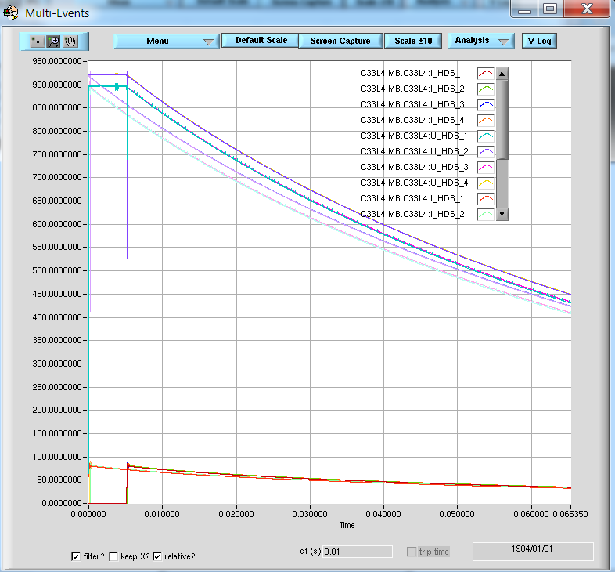
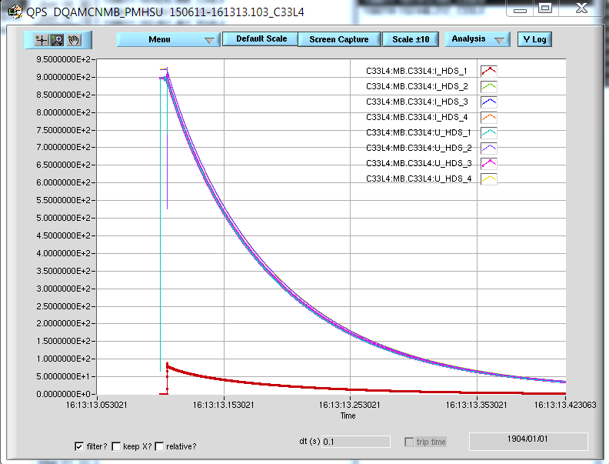
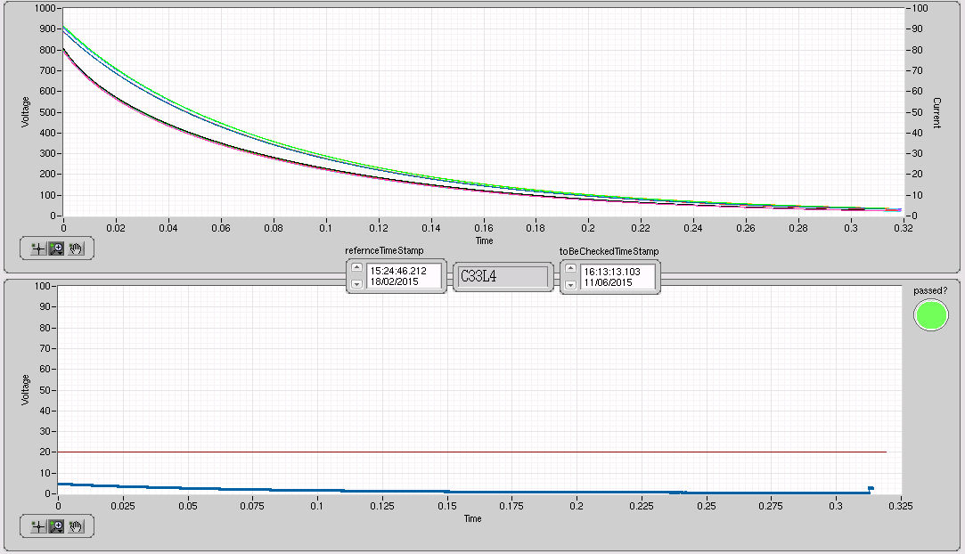
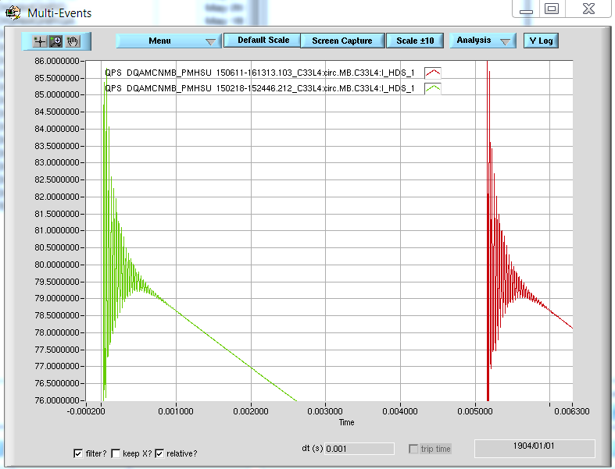
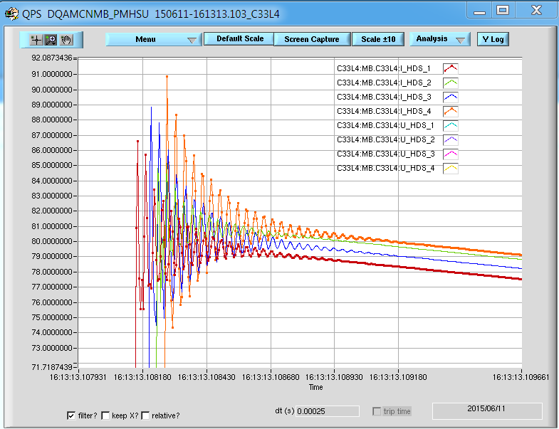
Quench heater analysis automation: MB (1)
Initial charge and resistance
Decay Time Constants
Final Charge
+ reference discharge
Voltage
Current
Curve to curve comparison
stdev<10⁻³

Slide 11
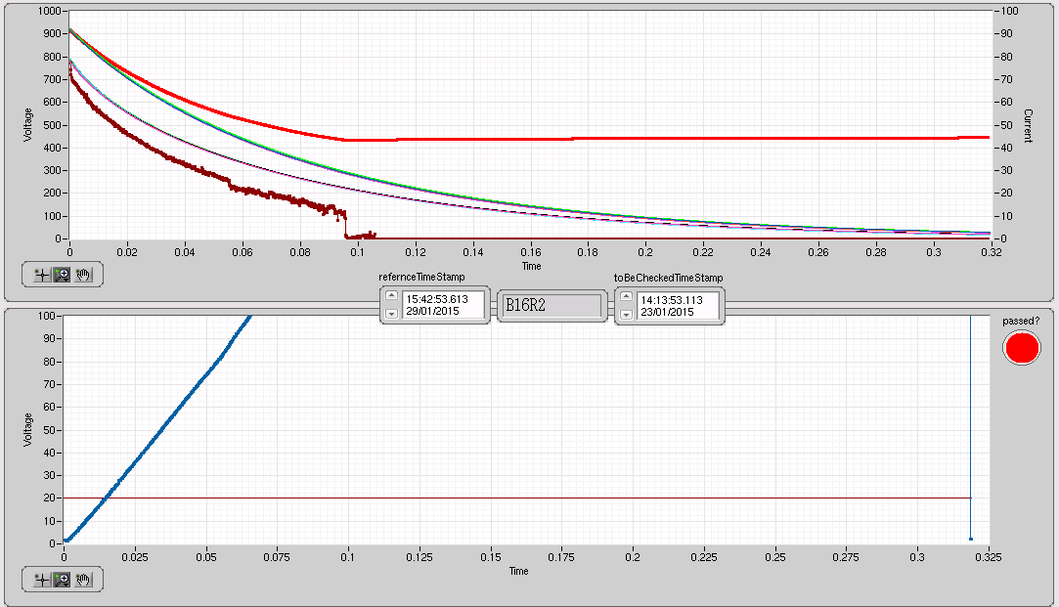
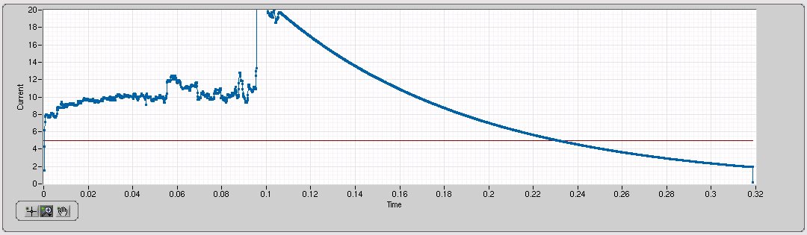
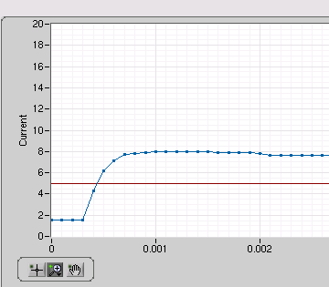
Quench heater analysis automation: MB (2)
Voltage
Current
ΔR≈1Ω

Slide 12
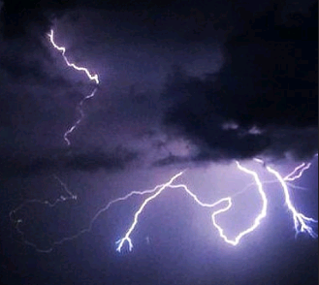
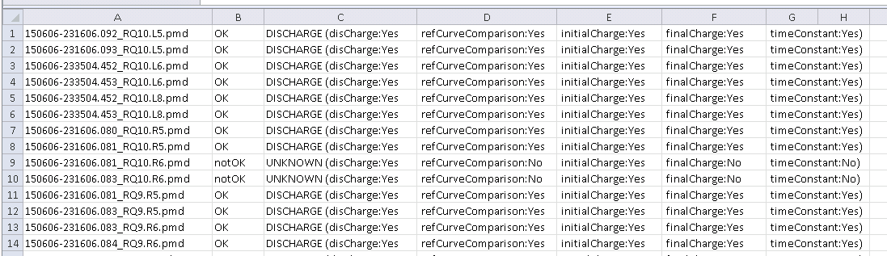
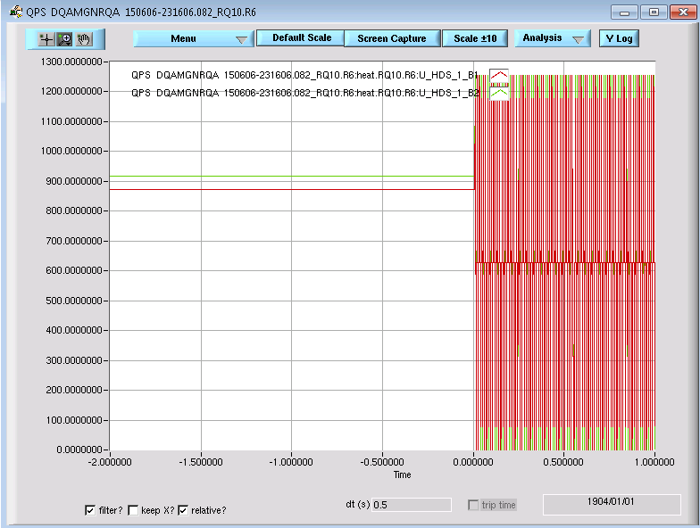
Quench heater analysis automation: RQ9 and RQ10 (1)
Thunderstorm@06/06/2015 analysed by Sandrine

Slide 13
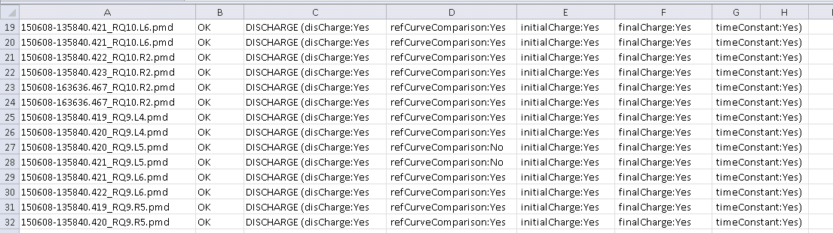
Quench heater analysis automation: RQ9 and RQ10 (2)
Thunderstorm@08/06/2015 analysed by Per
All OK! But some blind discharges due to the common crate controller ☹

Slide 14
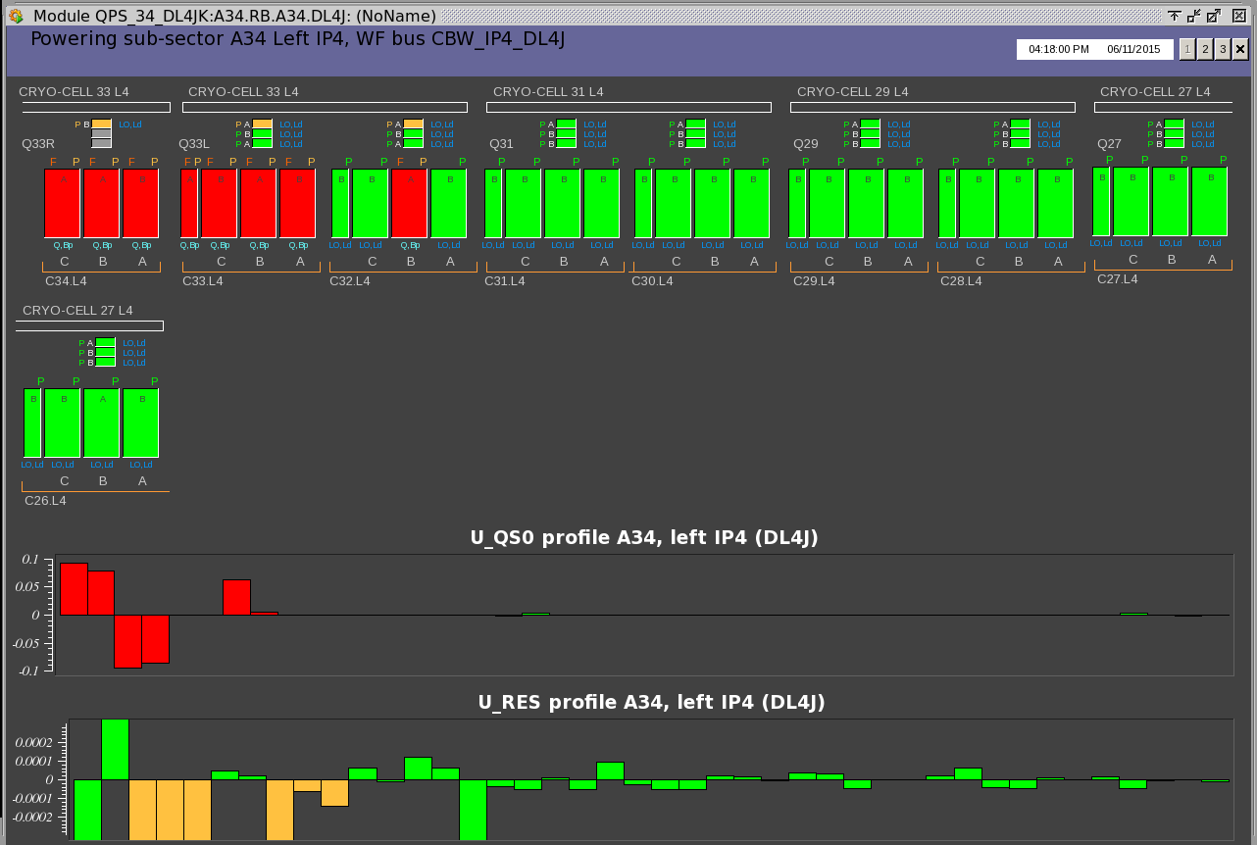
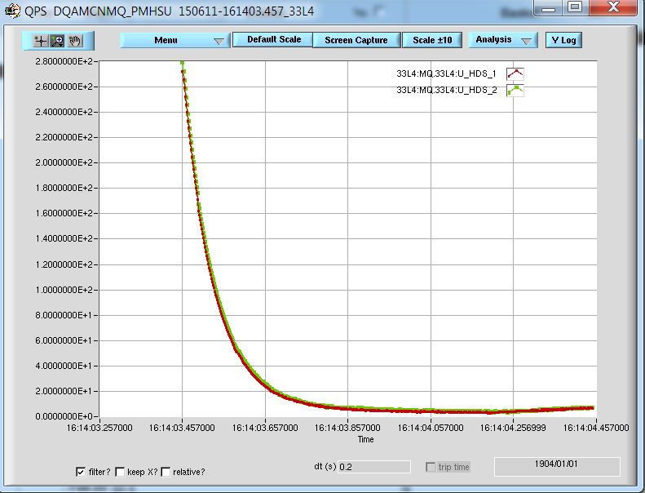
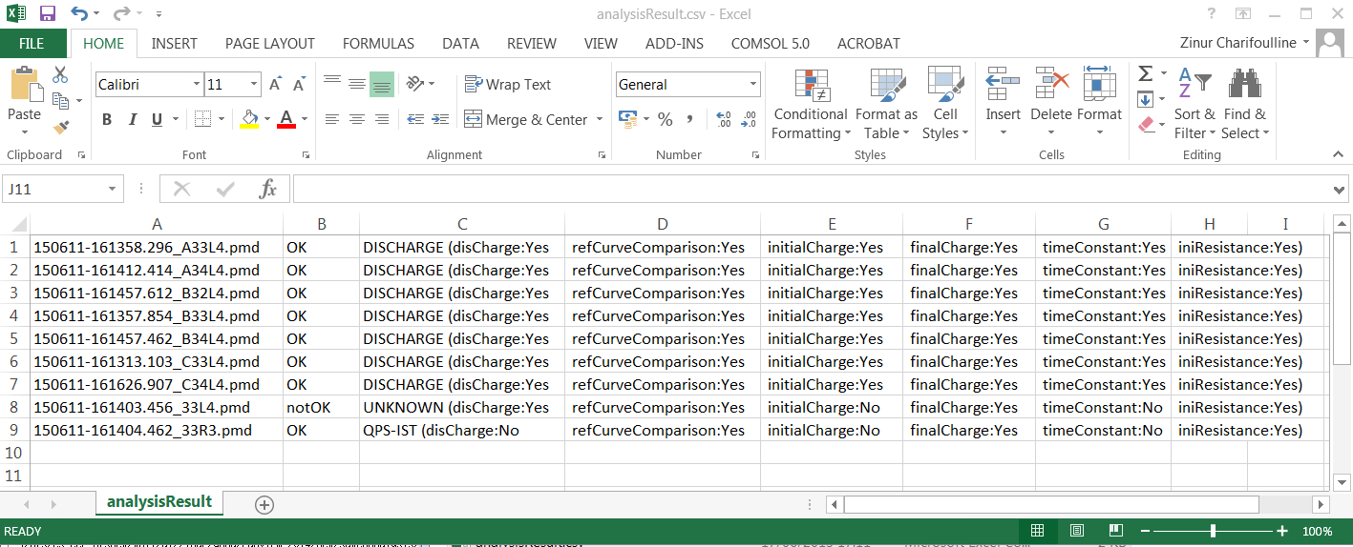
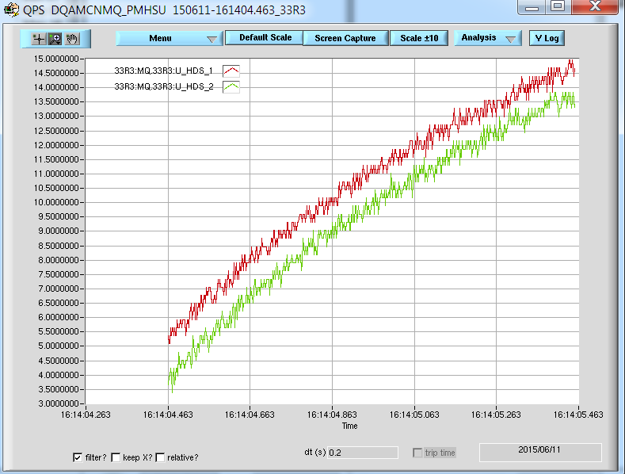
Quench heater analysis automation: quench in RB.A34@11/06/2015

Slide 15
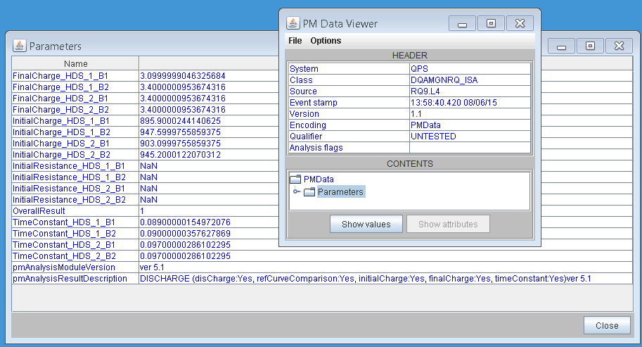
Quench heater analysis as a part of PM analysis framework (2)
pmd-file
mpp-logbook, mailto, APEX, Jira, ?
Only “Powering” Playback?
What about heater firing out of powering time? Answer: Yes

Slide 16
Conclusion
Current status of the qhda-module in the PM framework:
The previous version in PM framework is obsolete (ver4.1, 2013)
The new LV-code is ready to try in dev-mode
The new executable version will be ready by the end of the week (?)
It is planned to upload, to test and to make it working during TS#1
Odd, J-C, Roman, Zinur 09/06/2015 17h00

Slide 17
Thanks!

Slide 18
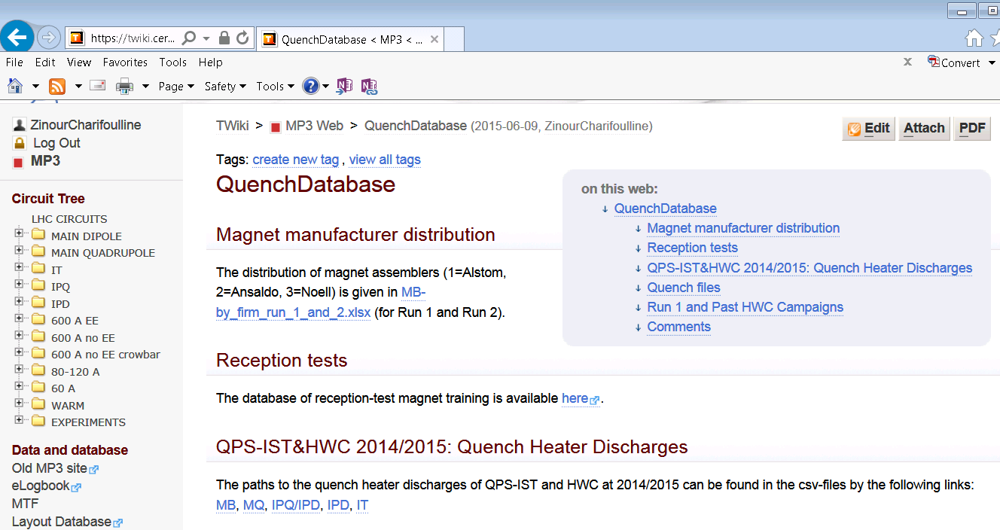
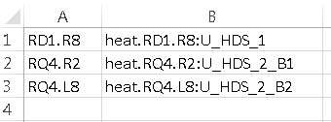
Analysis type | Criteria
Initial Charge | 810V < U_HDS < 1000V
Final Charge | 0V < U_HDS < 10V
Decay Time Constant | τ_{REF} ± 5ms
Curve to Curve comparison | within ±20V
Discharge = Yes | If ΔU_HDS > 20V
IPQ/IPD Nonconformities
Updated 09/06/2015

Slide 19
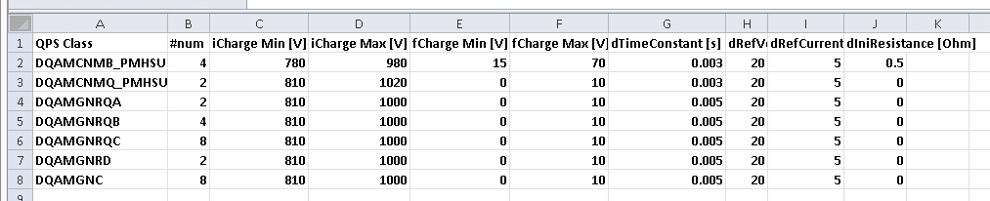
Acceptance limits table

Slide 20
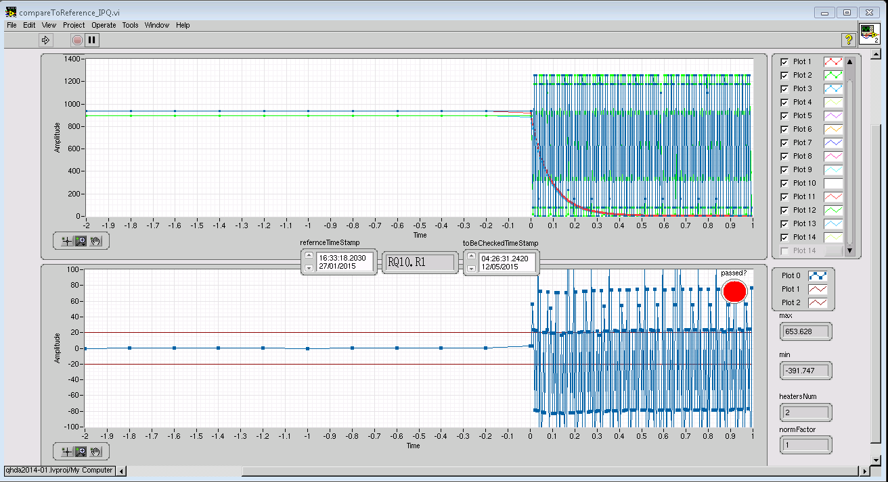
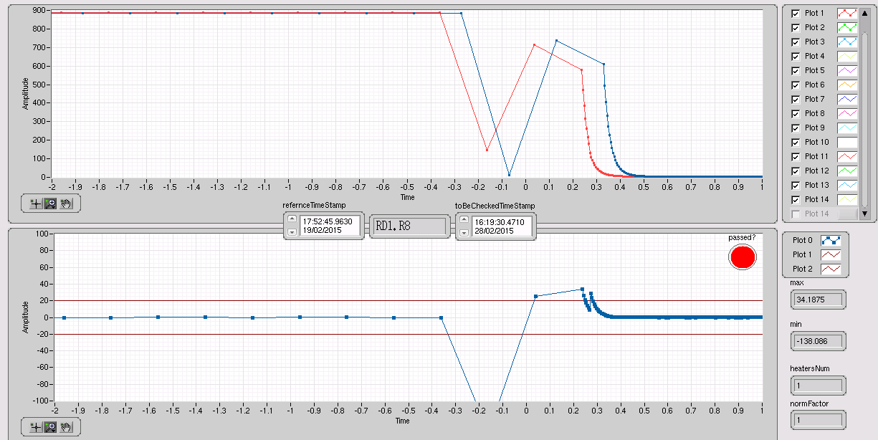

Slide 21
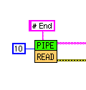

QHDA – executable (compiled) LV2014 code
QHDA
Analysys
RB
RQD/RQF
IPQ, IPD, IT
PMD-filename
SDDS PM
PMD-file
Analysis result description
Analysis module version
Time constant
Initial charge
Final charge
Overall result
RB, RQ – 3 PMs ?
IPQ, IPD - A/B ?
Reference discharge data input ?
Hardcoded or will be read ?
From where ? User: pma/password ?

