Slide 1
Quench Simulation in Commercial Software
Synthesis and Next Steps
Deepak Paudel
June 2015, Geneva
Supervisor:
Bernhard Auchmann

Slide 2
Outline
Project objective
Summary of the results
Conclusion
Next steps

Slide 3
Project Objectives
i) Quench simulation model of a superconducting strand.
ii) Comparison with custom software QP3.
Performance, Stability and Usability

Slide 4
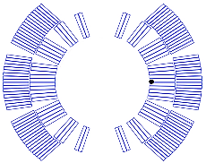
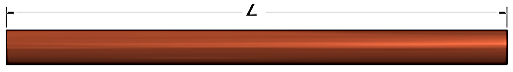
Summary of the results >
Adiabatic Model
No heat transfer to helium
Worst case scenario
Both COMSOL and ANSYS are able to calculate hot-spot temperature and quench propagation speed with satisfactory accuracy.
Inner coil of LHC dipole magnet
I = 150 A
B = 2.88 T T_{op} = 1.9 K
Variation in hot‑spot temperature and quench speed in reference to QP3

Slide 5

Summary of the results > Adiabatic model >
Quench speed for different mesh refinement
L = 1m
Element size = 1/n [m]
For element size ≤ 1 mm change in quench speed dropped below 1%

Slide 6
Summary of the results > Adiabatic model >
Comparison with QP3
Performance
commercial software are better
Usability
  commercial software are comparatively easy to use.
Stability
  commercial software so no sign of instability for large number of elements

Slide 7
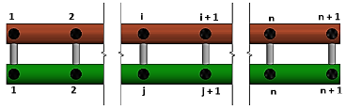
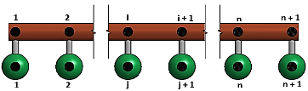
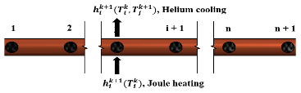
Summary of the results >
Helium Cooled Model
Model 1
Model 2
Variation in hot‑spot temperature and quench speed in reference to QP3
Simulation Environment | Hot-spot temperature difference (K) | Quench propagation speed difference (m/s)
Model 1 | 0.11 (0.46%) | 0.015 (2.80%)
Model 2 | 0.11 (0.46%) | 0.005 (0.93%)
Model 3 | 0.09 (0.37%) | 0.010 (1.87%)
Model 3

Slide 8
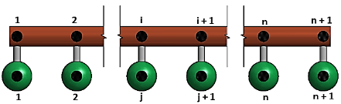
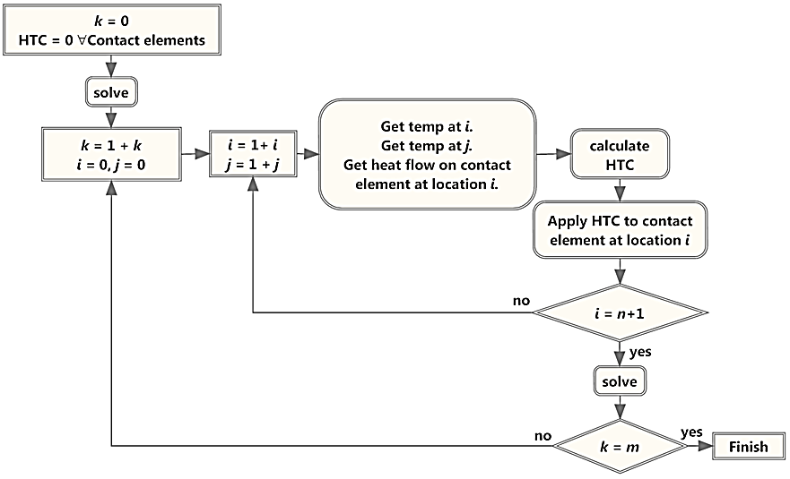
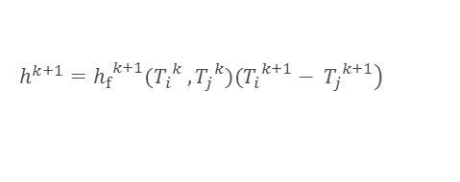
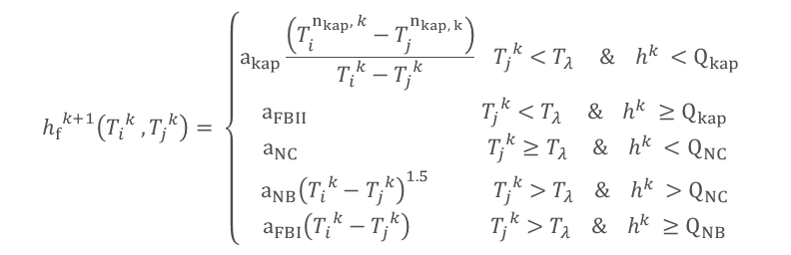
Summary of the results > Helium Cooled Model >
Main Issue: Non-Linear heat transfer between conductor and helium
$$\left.h^{k+1}={h_{f}}^{k+1}({T_{i}}^{k} , {T_{j}}^{k})({T_{i}}^{k+1}− {T_{j}}^{k+1}\right)$$
$${h_{f}}^{k+1}\left({T_{i}}^{k} , {T_{j}}^{k}\right)= \left\{\begin{matrix}a_{kap}\frac{\left(T_{i}^{n_{kap}, k}−T_{j}^{n_{kap, k}}\right)}{{T_{i}}^{k}−{T_{j}}^{k}} {{ T}_{j}}^{k}<T_{λ} \& h^{k} <Q_{kap} \\ a_{FBII} {T_{j}}^{k}<T_{λ} \& h^{k} ≥Q_{kap} \\ a_{NC} {{ T}_{j}}^{k}≥T_{λ} \& h^{k} <Q_{NC} \\ a_{NB}{\left({T_{i}}^{k}−{T_{j}}^{k}\right)}^{1.5} {{ T}_{j}}^{k}>T_{λ} \& h^{k} >Q_{NC} \\ a_{FBI}\left({T_{i}}^{k}−{T_{j}}^{k}\right) {{ T}_{j}}^{k}>T_{λ} \& h^{k} ≥Q_{NB}\end{matrix}\right.$$
Heat transfer coefficient depends upon two temperatures, heat flux and integrated heat
Separate Algorithm is needed which is executed every time step.

Slide 9
Summary of the results > Helium Cooled Model >
Hot-spot temperature for different time step sizes, Δt
For Δt ≤ 10 μs change in hot-spot temperature dropped below 1%

Slide 10
Summary of the results > Helium cooled Model
Comparison with QP3
simulation time t = 1000 μs
ANSYS
Time step size, Δt = 10 μs
Total time taken 280 s
QP3
Time step size, Δt = 3 - 100 μs
Total time taken 5.5 s
Performance
commercial models are far outperformed by QP3.
Usability
  commercial software are comparatively easy to use.
Stability
-

Slide 11
Conclusion
Adiabatic scenario of quench simulation is more efficient in commercial software packages.
Generic simulation platform of ANSYS cannot take into account the non-linear heat transfer between the conductor and the helium.
The non-linear heat transfer was modelled by coupling a custom algorithm with standard routines of ANSYS.
In the helium cooled model the regime changing algorithm is not compatible with automatic time stepping scheme of the simulation environment. The model so far uses fixed time stepping method and is far outperformed by QP3.
QP3 still remains as an efficient tool for the quench simulation of 1D superconducting wire.

Slide 12
Next Steps
Explore user programmable feature of ANSYS and MatLab/COMSOL.
Explore adaptive spatial discretization methods in COMSOL.

Slide 13
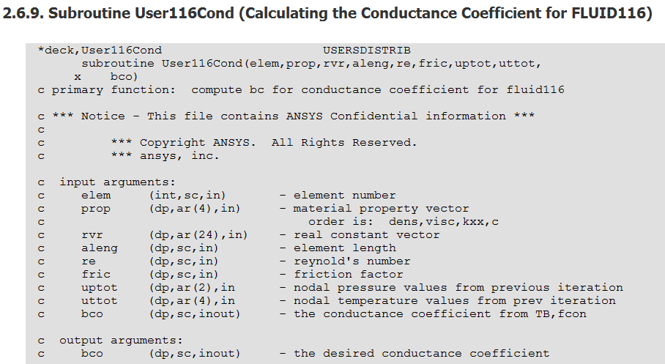
Next Steps >
User programmable feature of ANSYS
ANSYS program has an open architecture.
Possible to write our own routines or subroutines in C, C++ or FORTRAN.
Tailoring ANSYS program according to the organizational need
Example

Slide 14
Next Steps > User Programmable Features of ANSYS >
Useful existing subroutines
Creating New Element
Modifying and Monitoring Existing Elements
Customizing Material Behaviour
Customizing Loads
Running APDL as a subroutine

