Slide 1
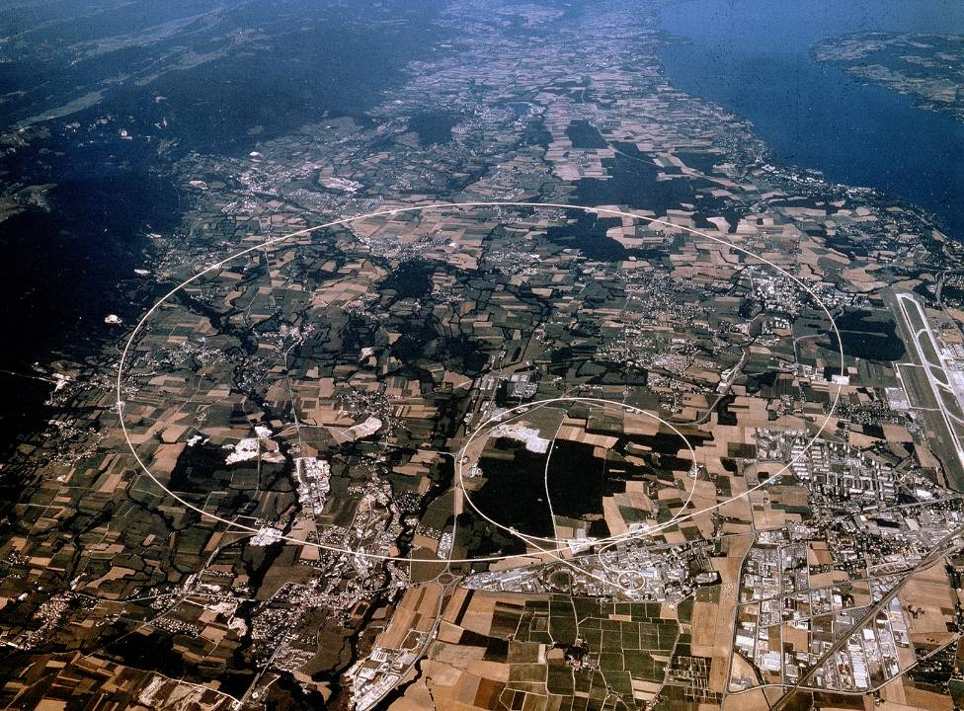
Summary of ADS Reliability Workshop
Apollonio – 25/06/2015
andrea.apollonio@cern.ch

Slide 2
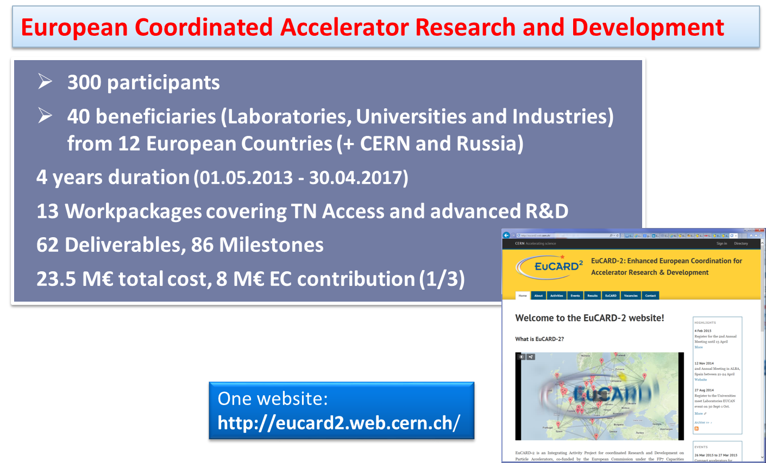

EuCARD-2
M. Vretenar

Slide 3
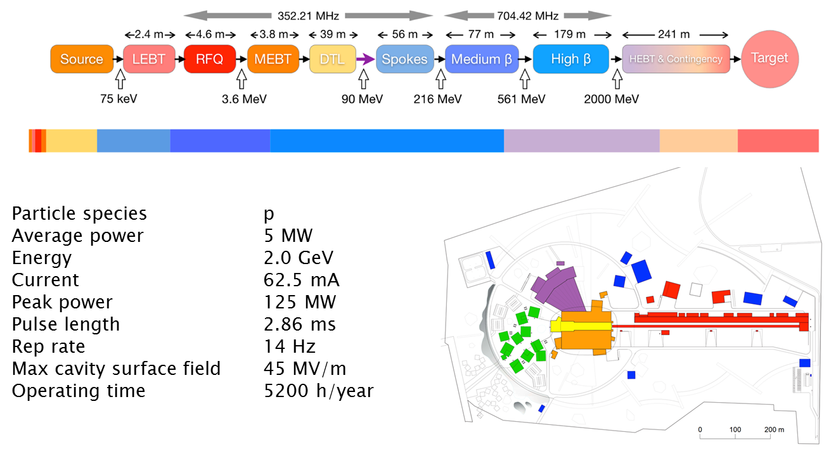
The ESS Linac
E. Bargallo
Accelerator Operation

Slide 4
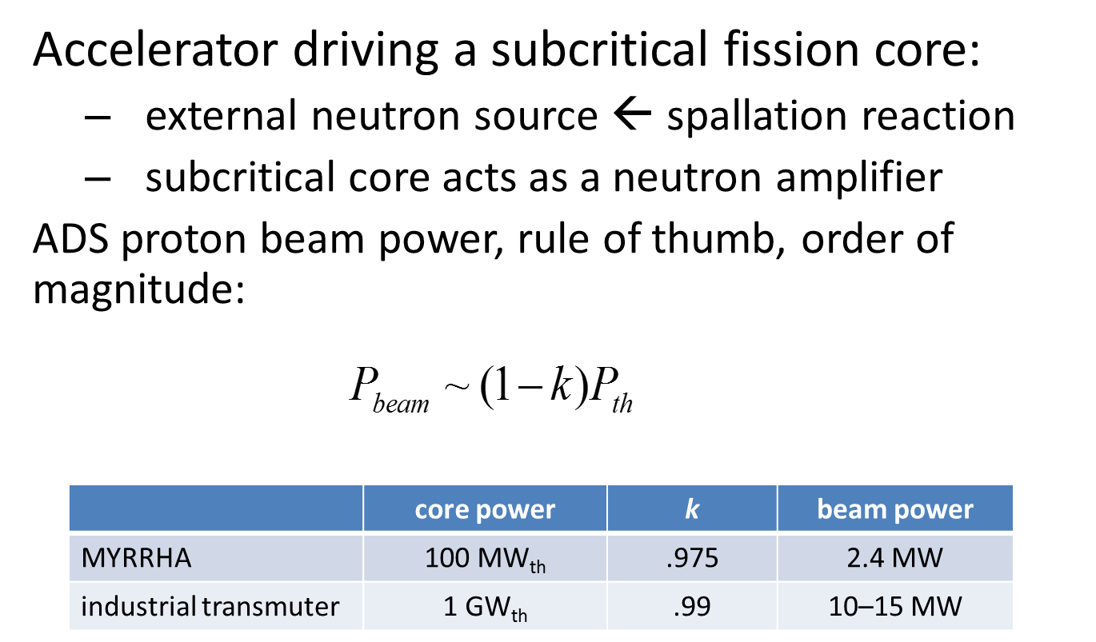
Accelerator for ADS
D. Vandeplassche

Slide 5
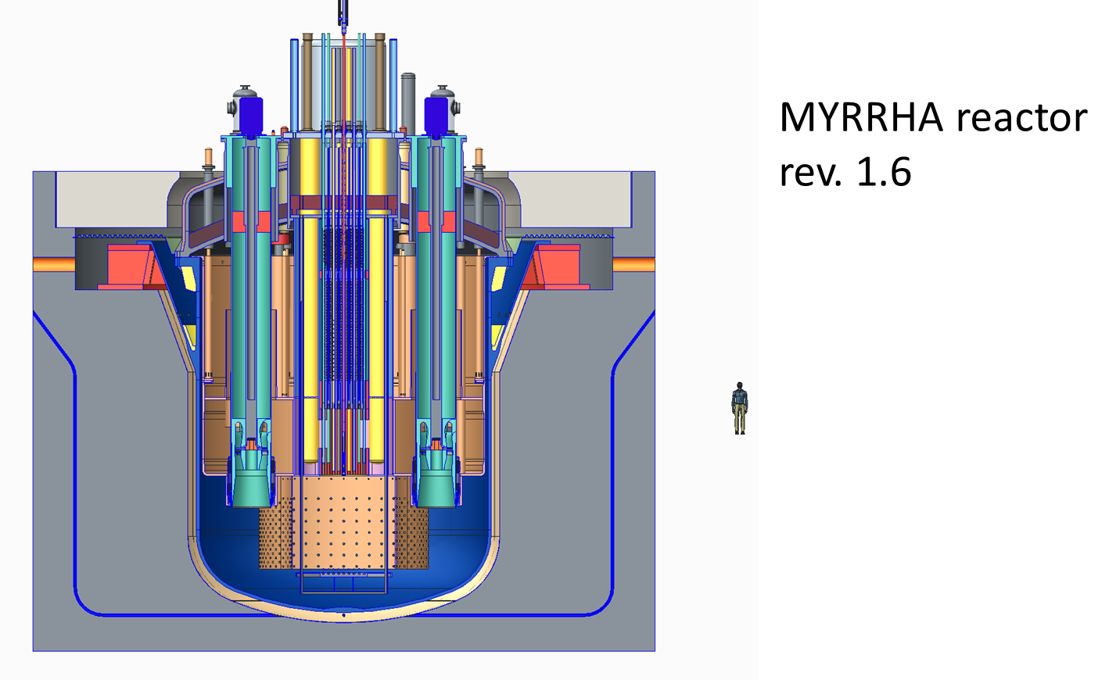
ADS Target
D. Vandeplassche

Slide 6
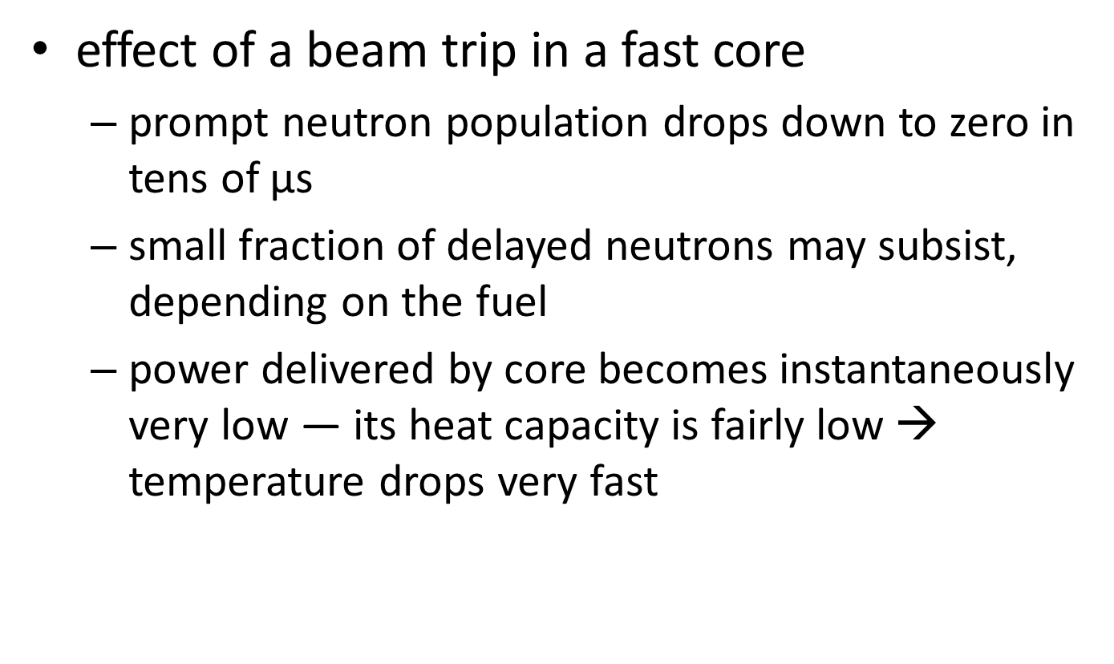
Beam Trips
D. Vandeplassche

Slide 7
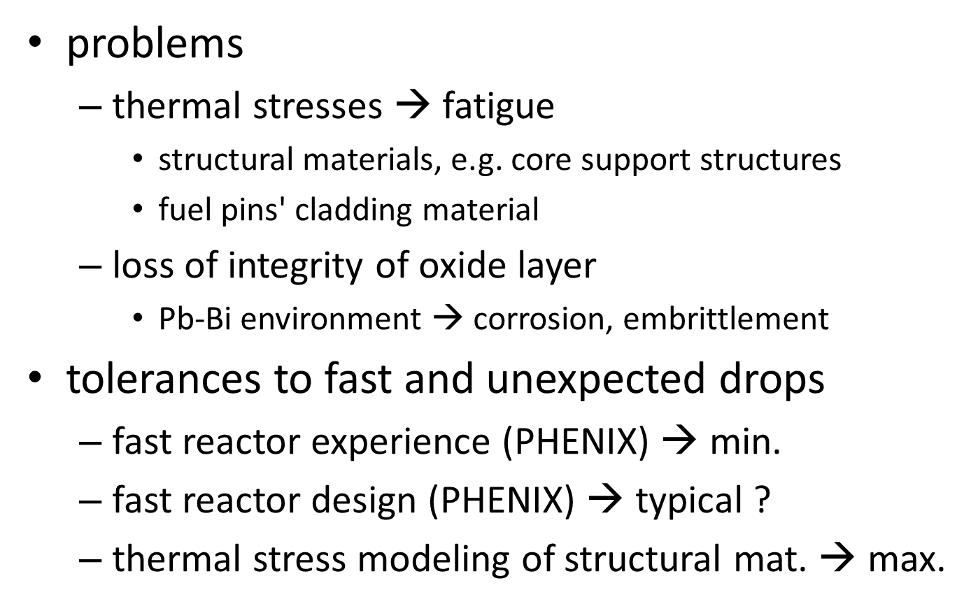
Consequences of Beam Trips
D. Vandeplassche

Slide 8
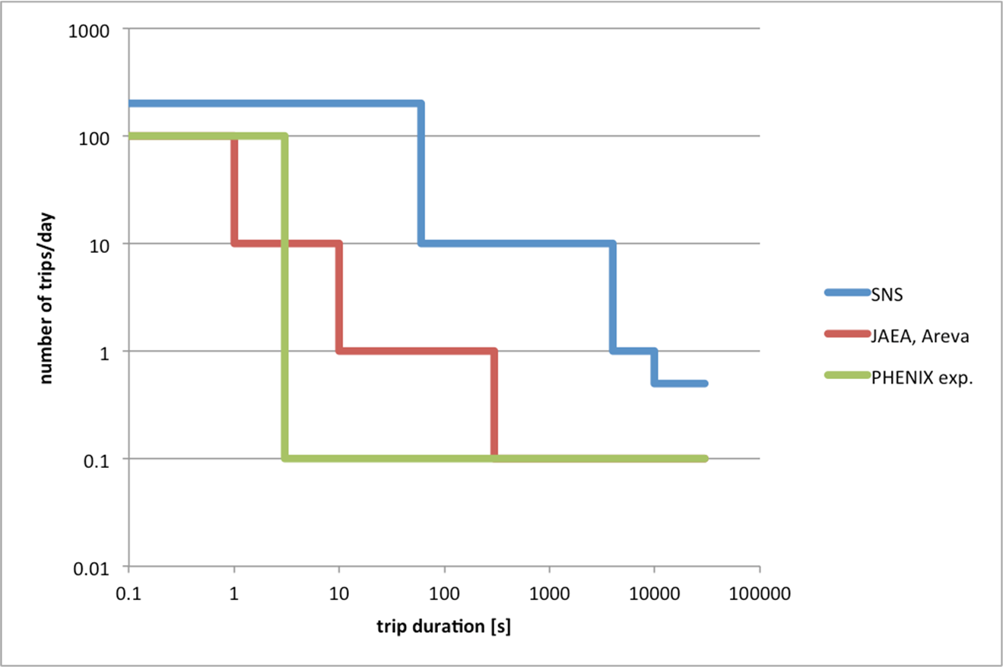
Beam Trips Data
D. Vandeplassche

Slide 9
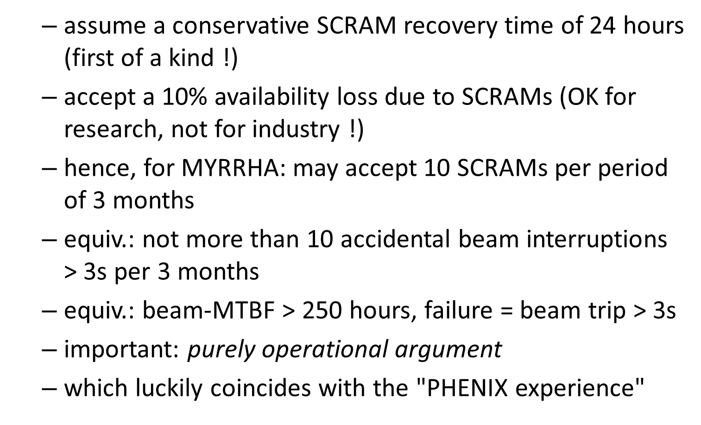
Availability Target
D. Vandeplassche

Slide 10
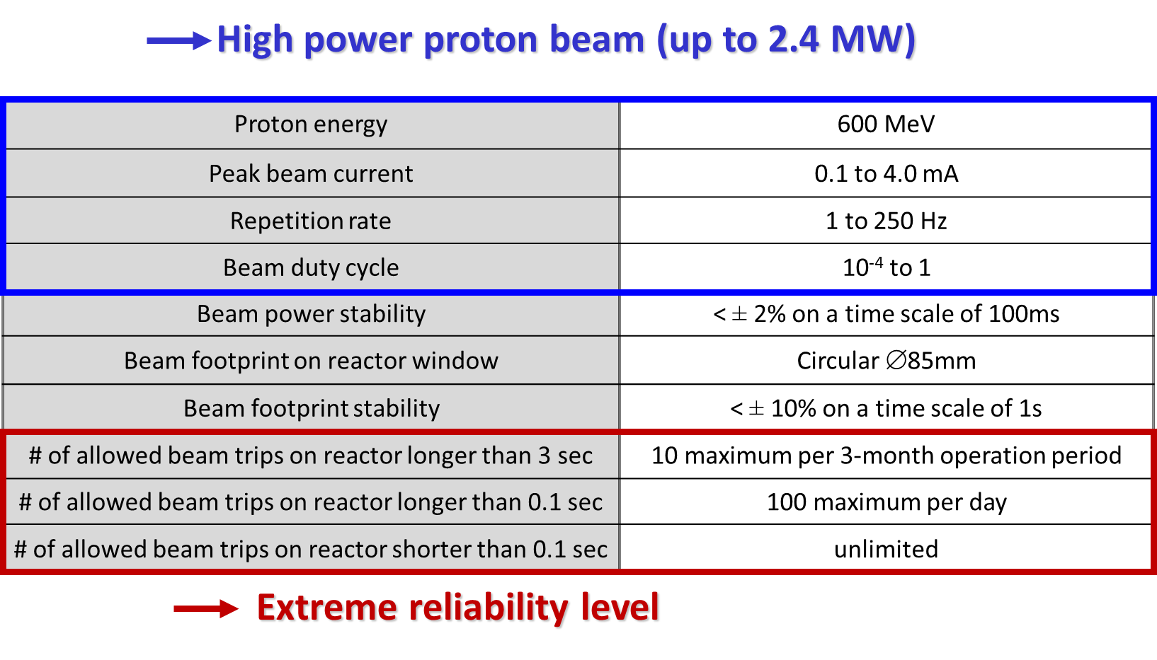
MYRRHA ADS Proton Beam Requirements
J.-L. Biarrotte

Slide 11
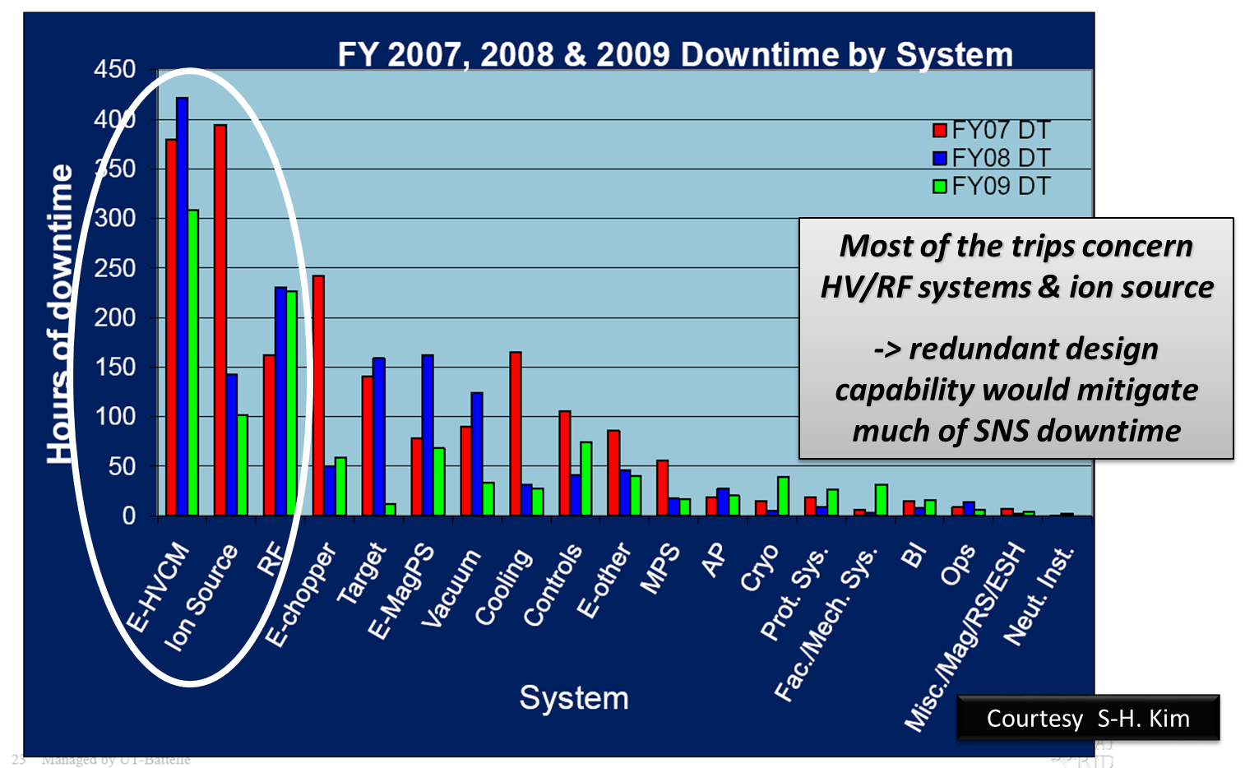
SNS Downtime by System
J.-L. Biarrotte

Slide 12
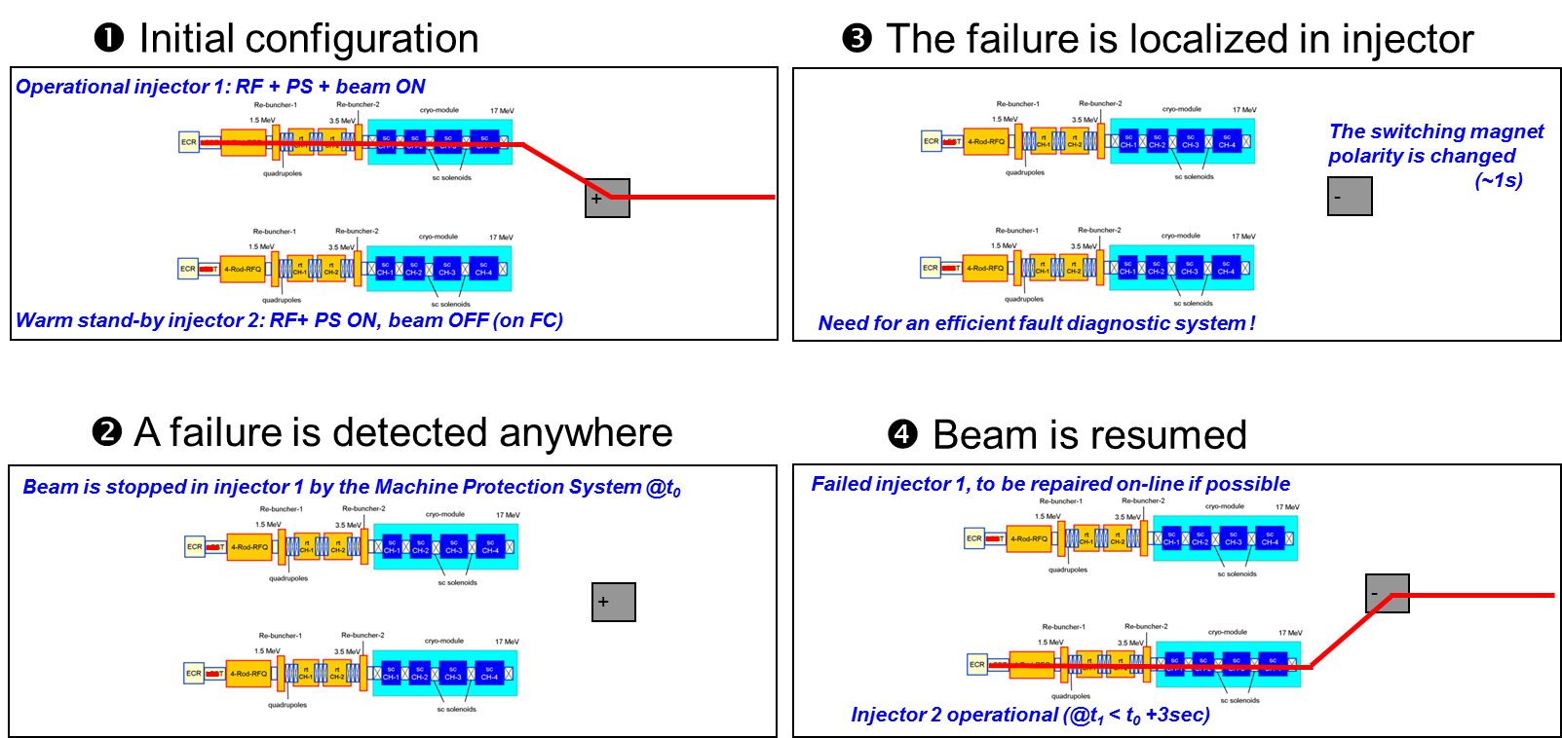
Strategy for a Fault in the Injector
J.-L. Biarrotte

Slide 13
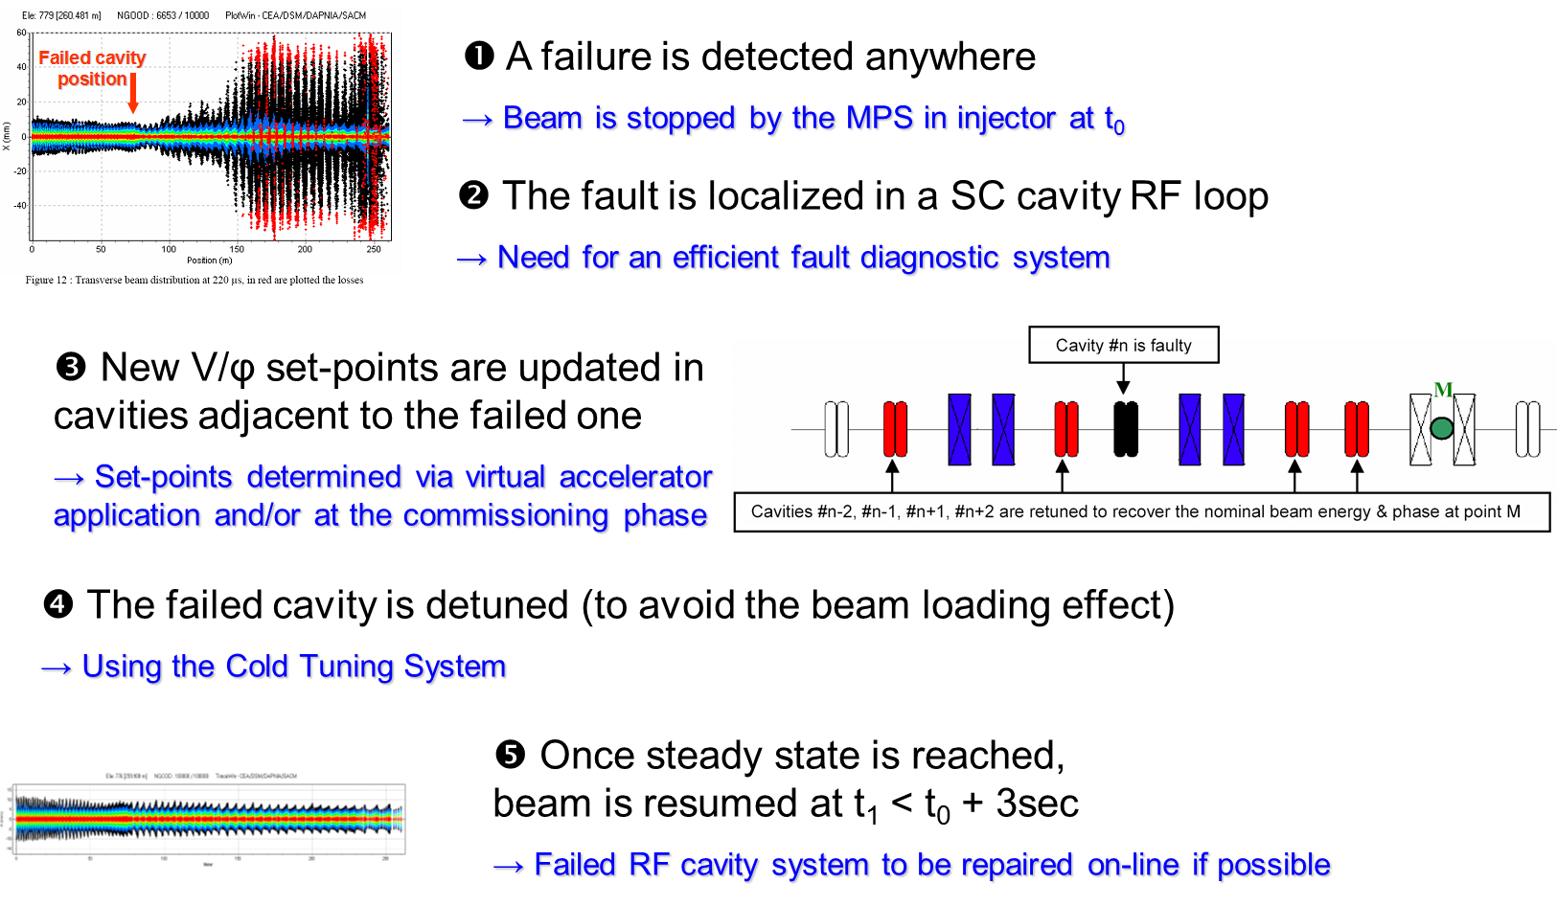
Strategy for a Fault in the Linac
J.-L. Biarrotte

Slide 14
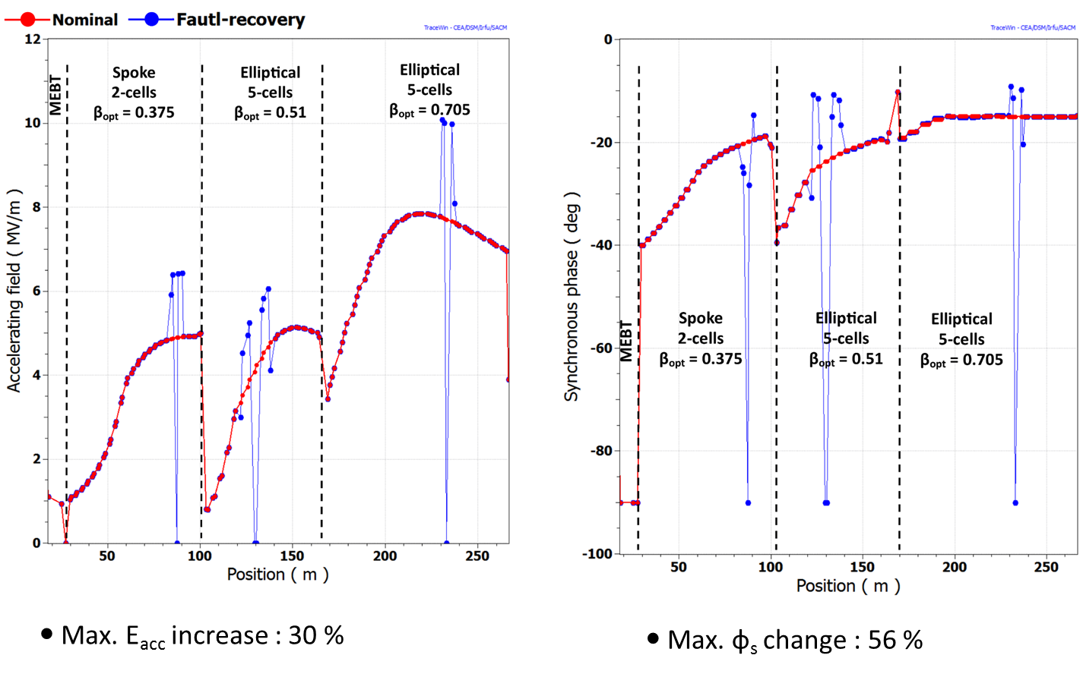
Multiple Failure Scenario (1)
F. Bouly

Slide 15
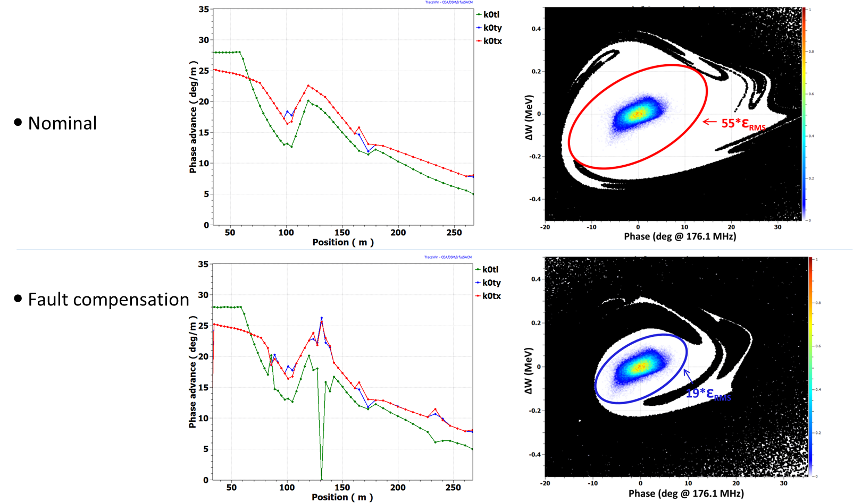
Multiple Failure Scenario (2): Acceptance
F. Bouly
Accelerator Operation

Slide 16
Availability of the PSI Proton Accelerator
J. Grillenberger
Accelerator Operation

Slide 17
The ESS Linac
E. Bargallo
Accelerator Operation

Slide 18
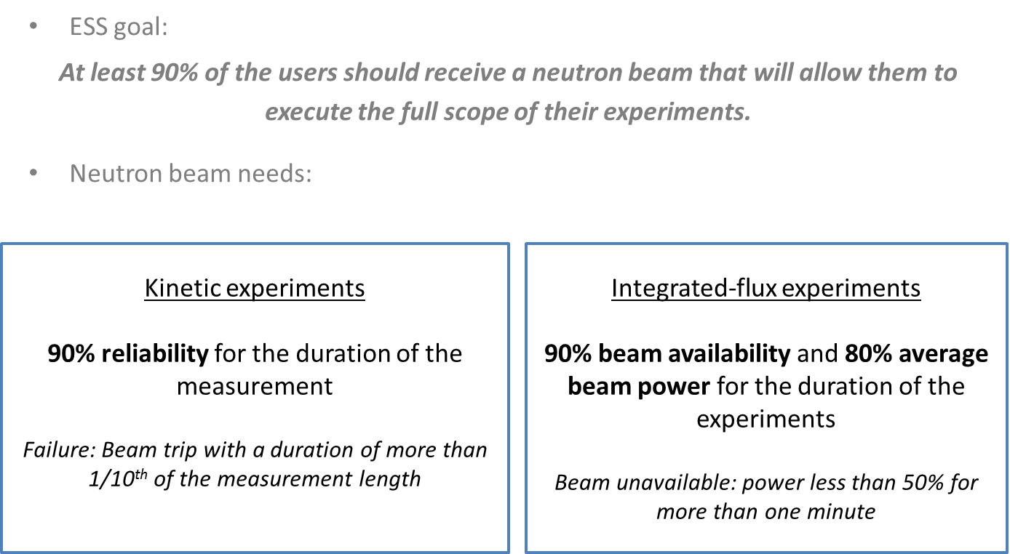
Availability Requirements
E. Bargallo
Operation

Slide 19
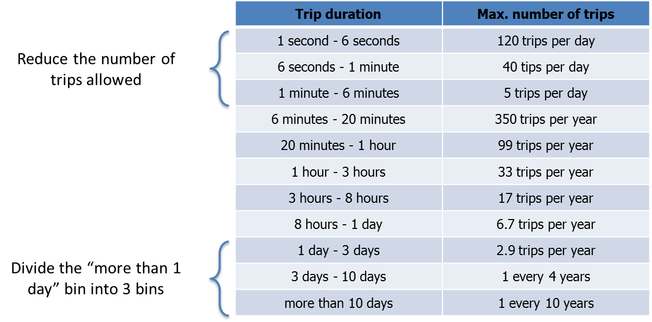
Allowed Number of Beam Trips
E. Bargallo
Accelerator Upgrades

Slide 20
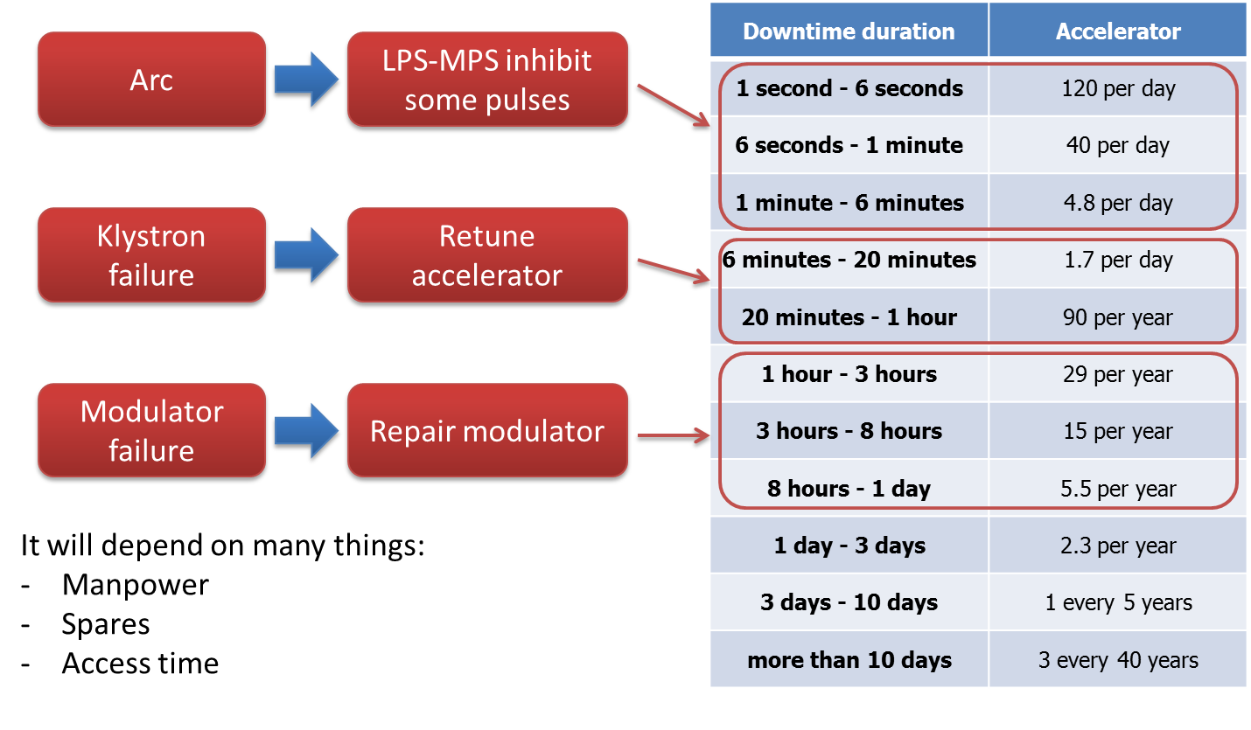
Failure Examples
E. Bargallo
Accelerator Upgrades

Slide 21

ITER Introduction
A. Vergara
Accelerator Upgrades

Slide 22
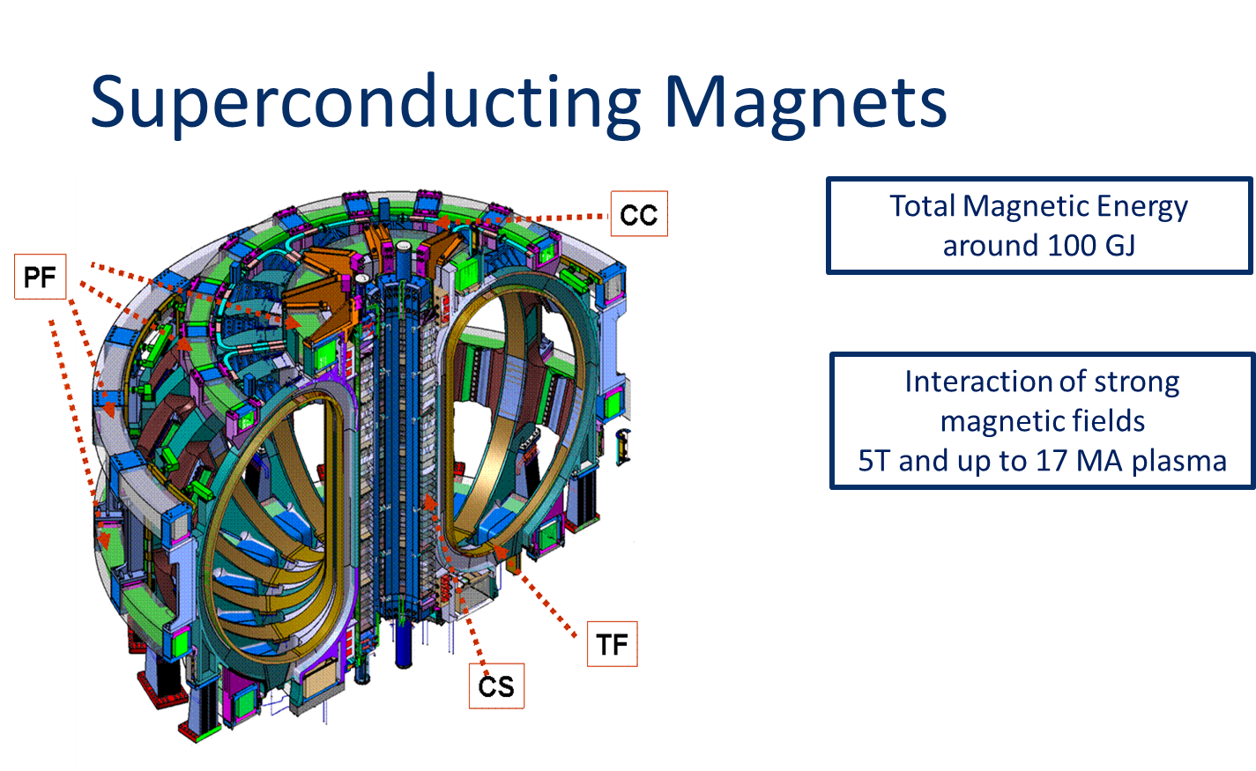
Sources of Risk at ITER
A. Vergara

Slide 23
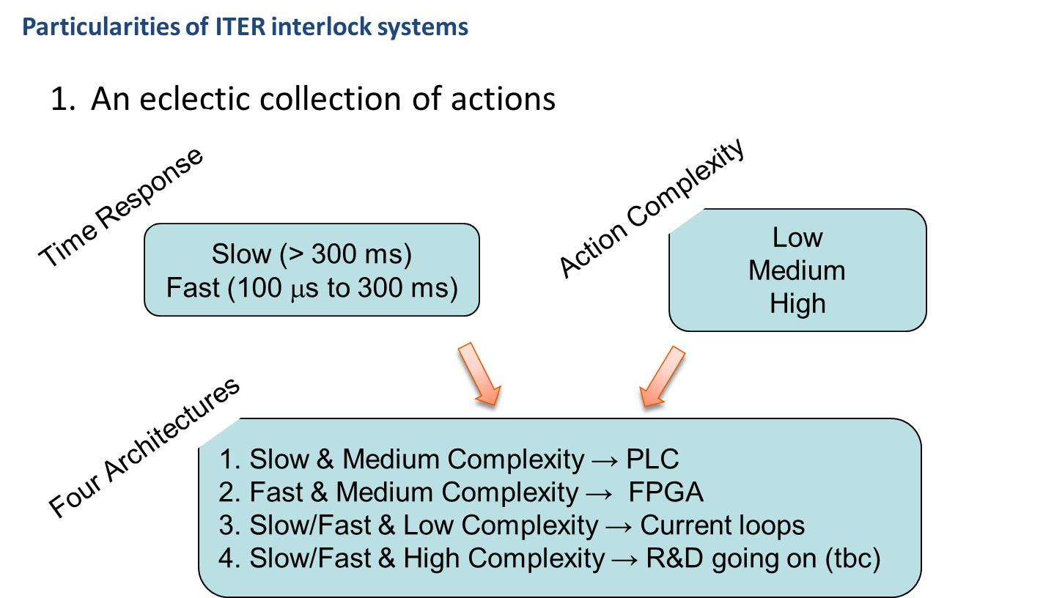
Interlock Strategy at ITER
A. Vergara

Slide 24
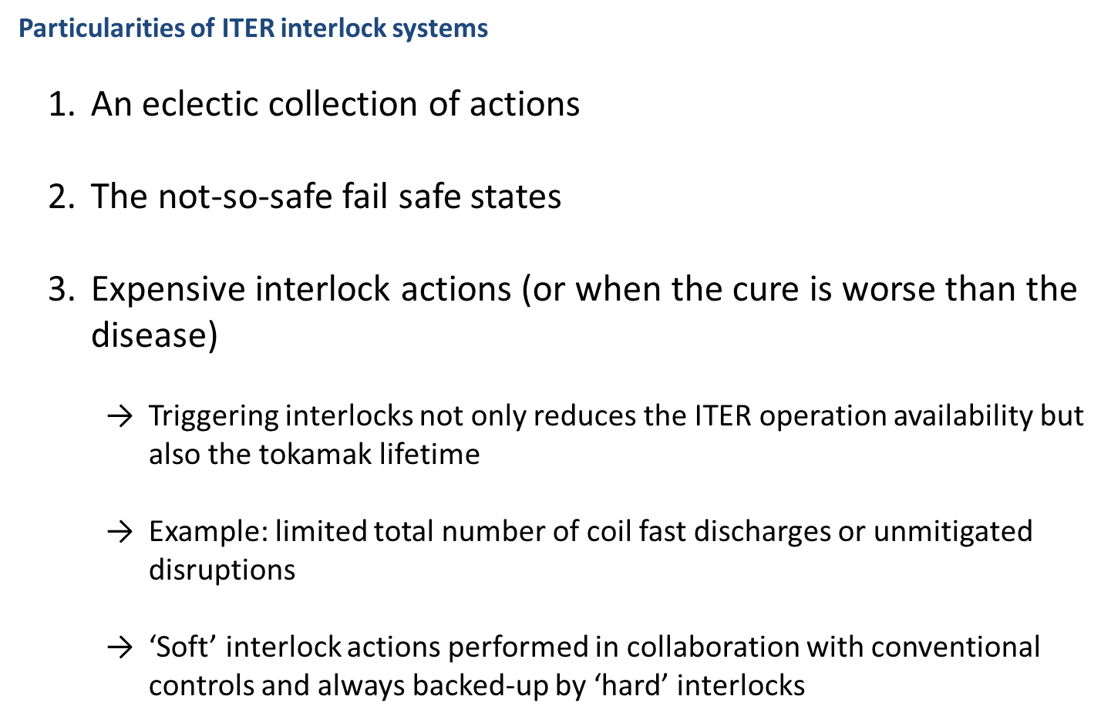
Interlocks at ITER
A. Vergara

Slide 25
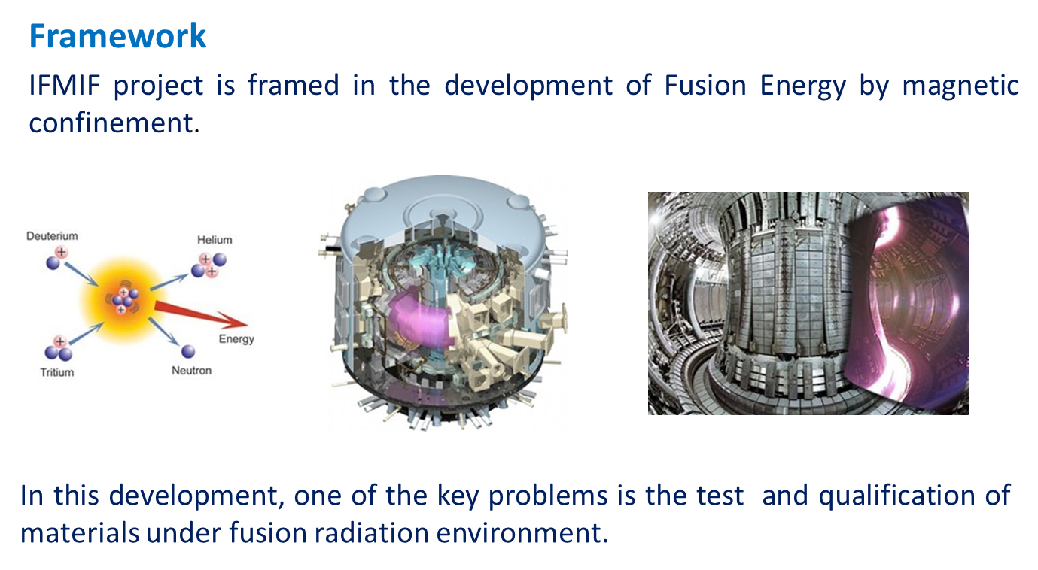
IFMIF Project
J. M. Arroyo

Slide 26
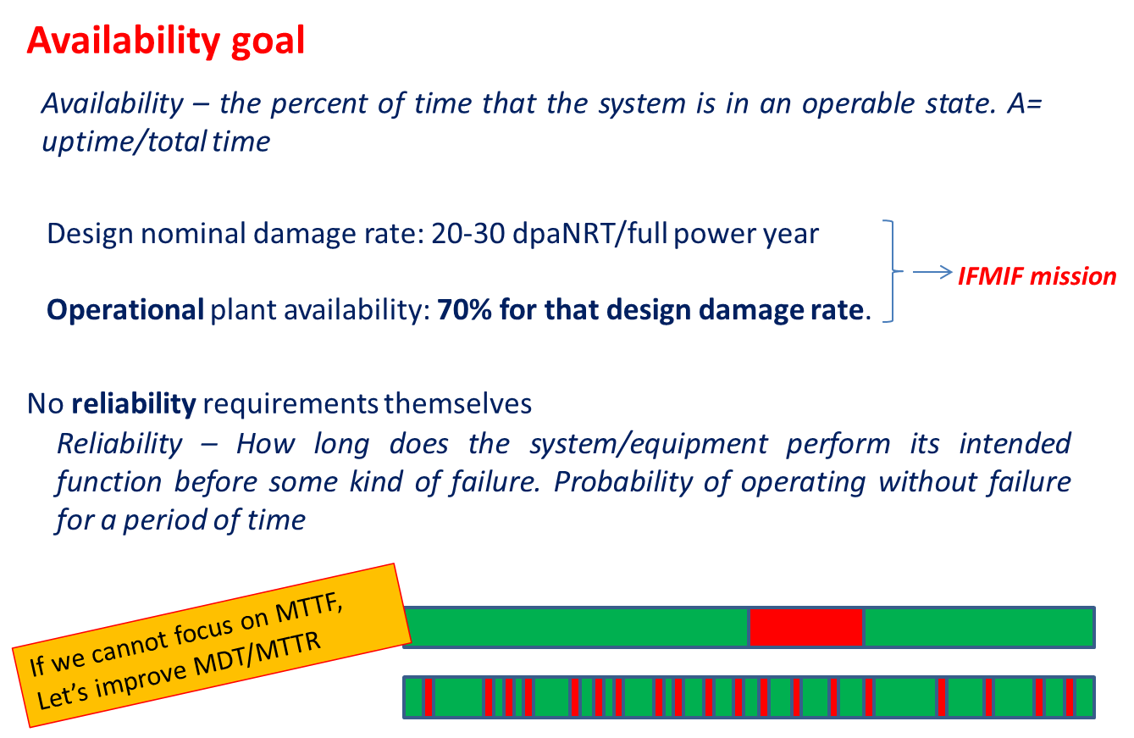
Availability in IFMIF
J. M. Arroyo

Slide 27
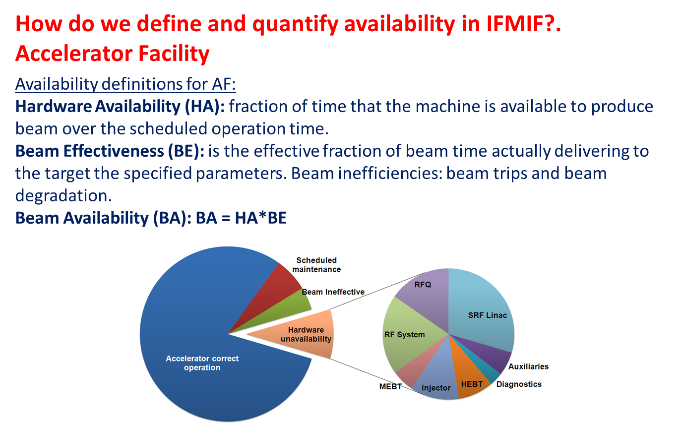
Definition
J. M. Arroyo

Slide 28
Conclusions
The interest in Accelerator Reliability is growing...
Different definitions for different facilities (often confusion between availability and reliability)
A collaboration among different institutes is very beneficial
Setting-up a network to share information (requires effort and commitment)
…EuCARD3 proposal
Accelerator Upgrades

