Slide 1
Results of microscopic analysis II
V. Raginel, A. Gerardin

Slide 3
T3 – Cylinder 1

Slide 4
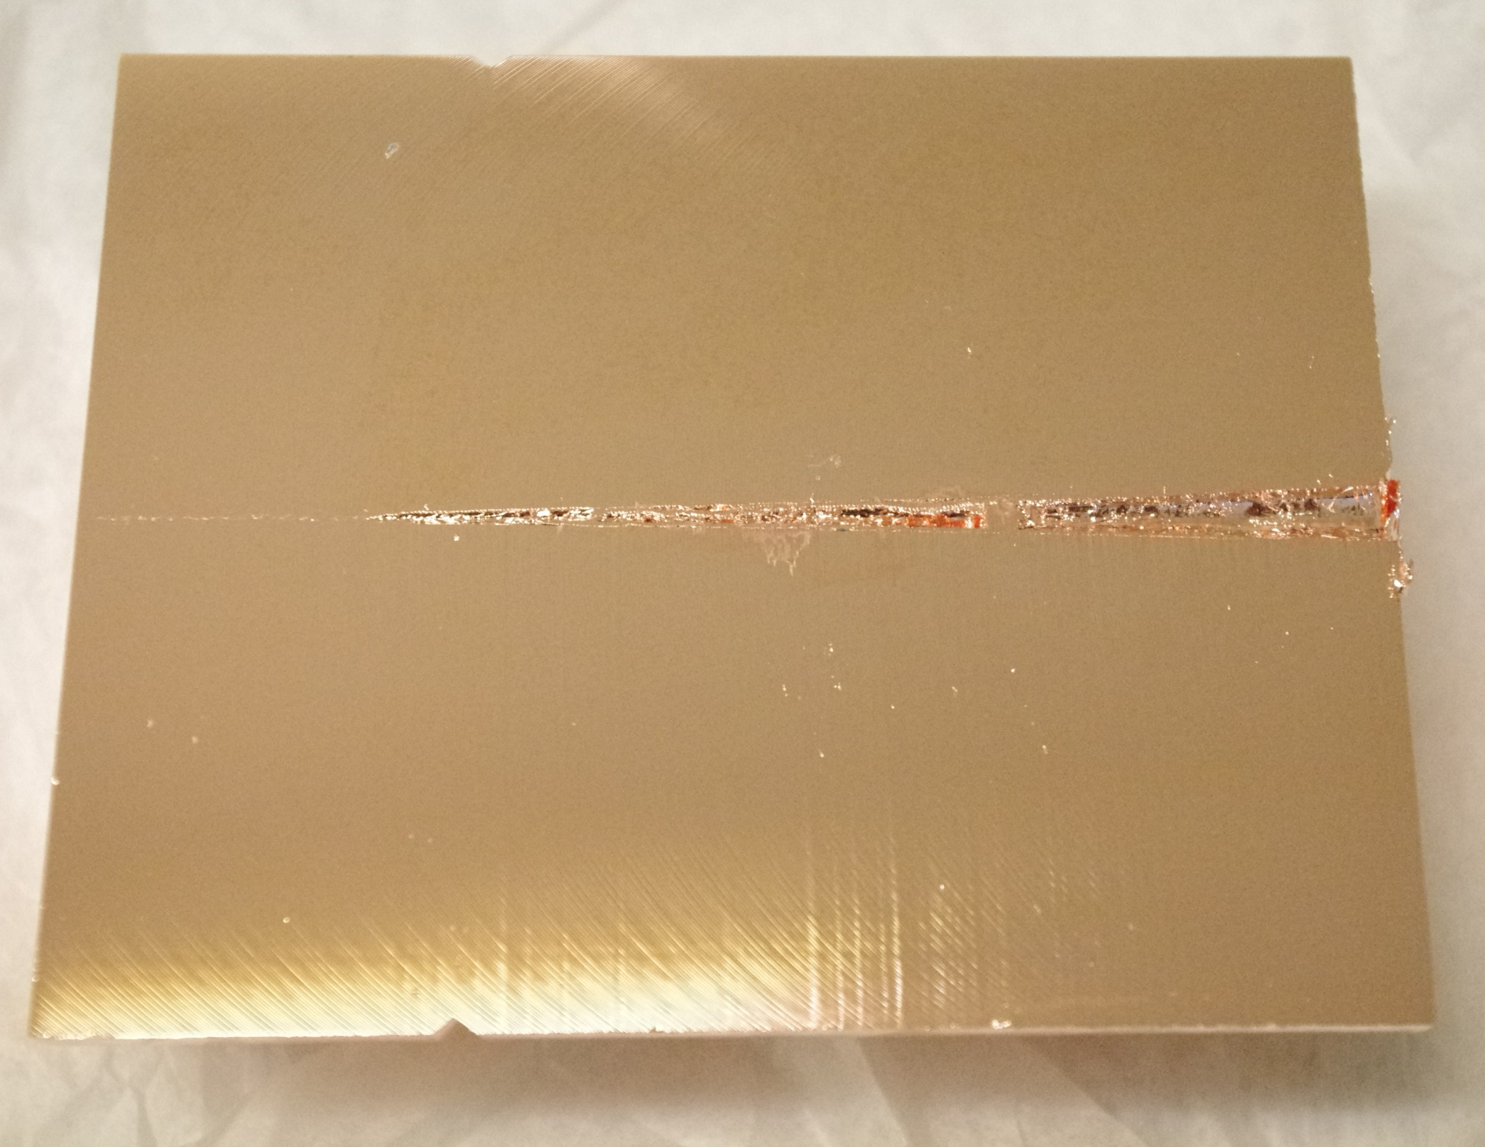

Slide 5
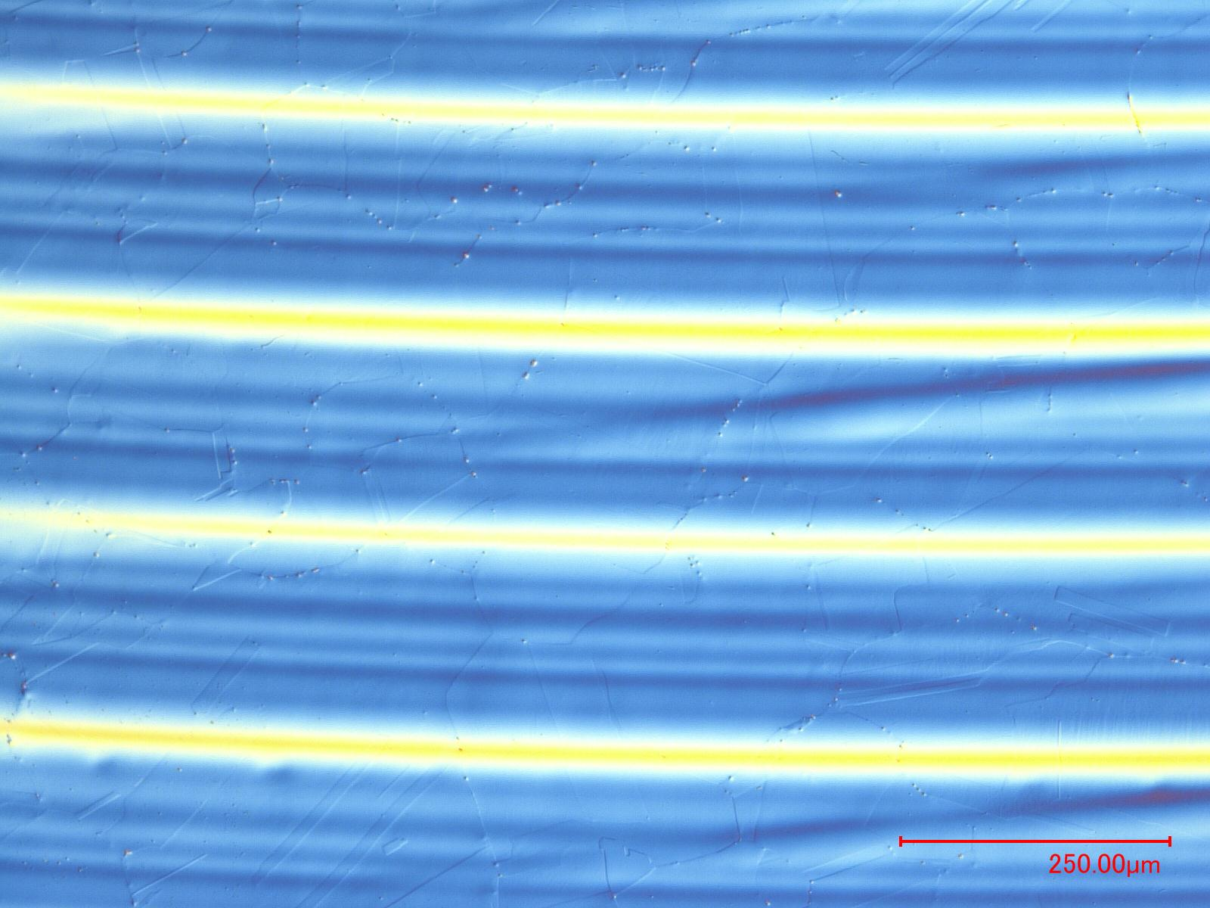
Base material: Average grain size ~100 um

Slide 6
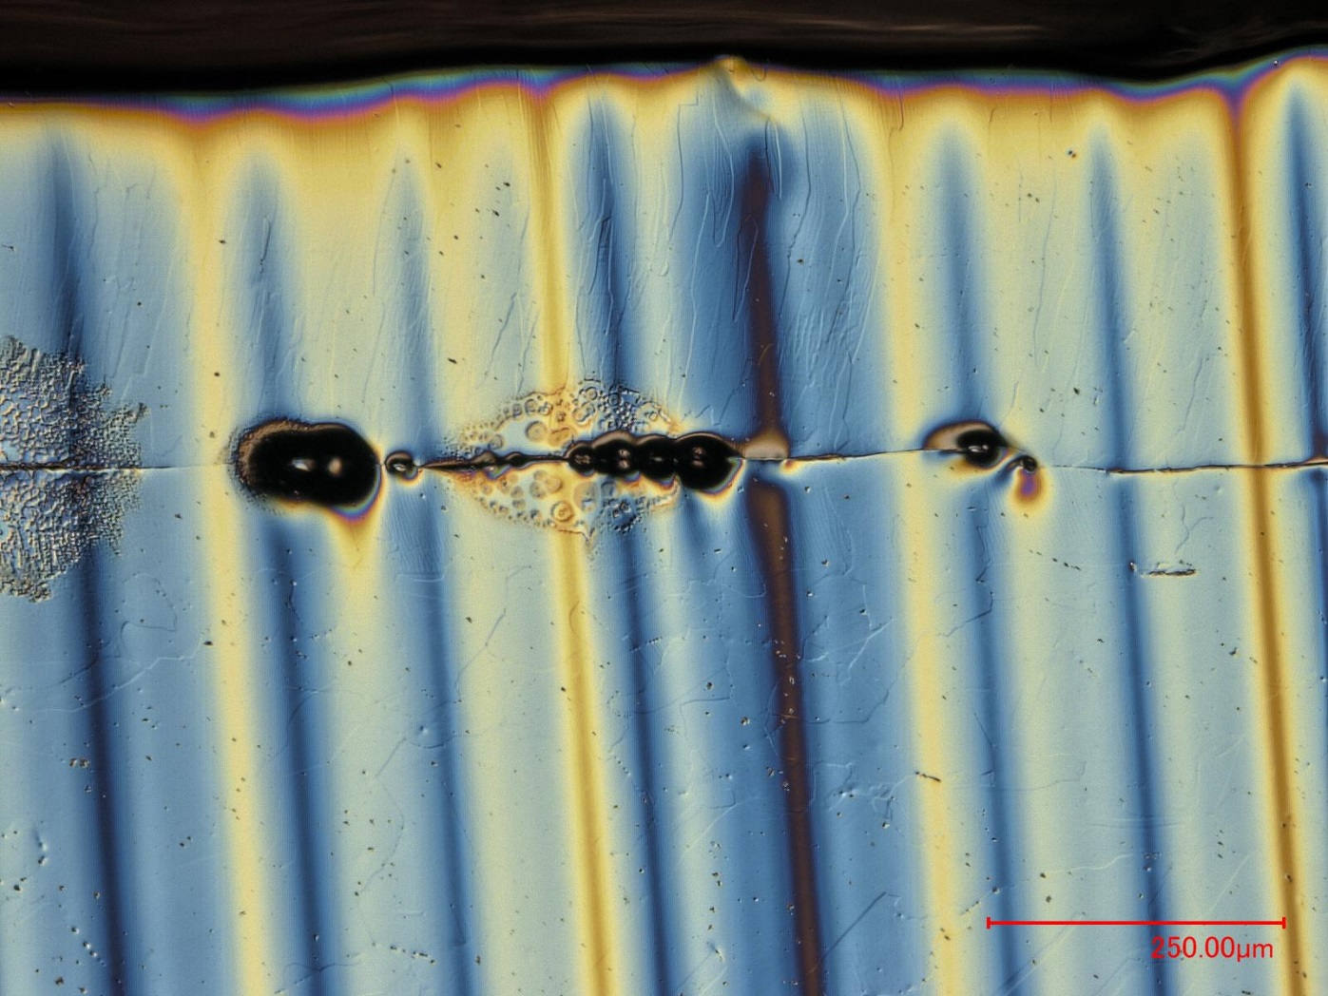
Columnar grains
Molten
Non-molten

Slide 7
T3 – Cylinder 9

Slide 8
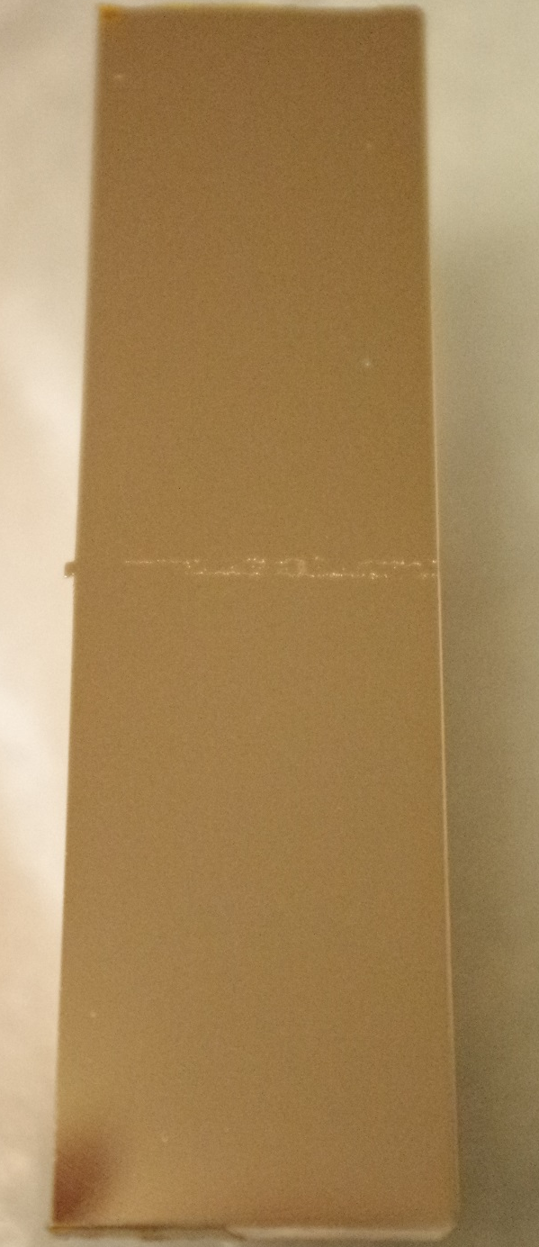
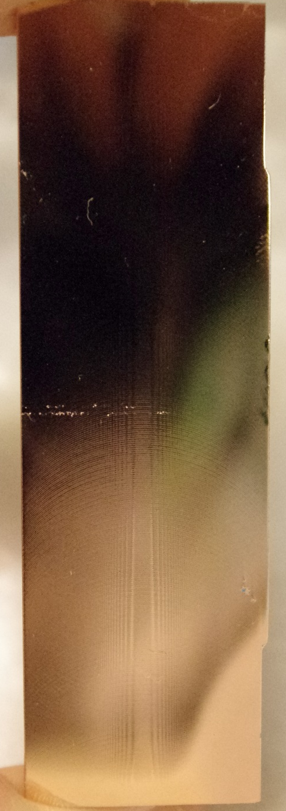

Slide 9
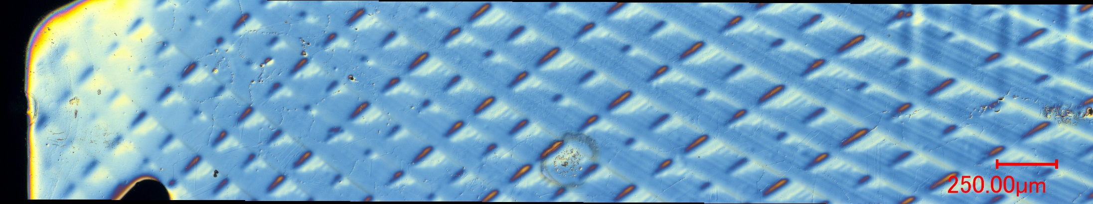
First ~5 mm - T3-9/1

Slide 10
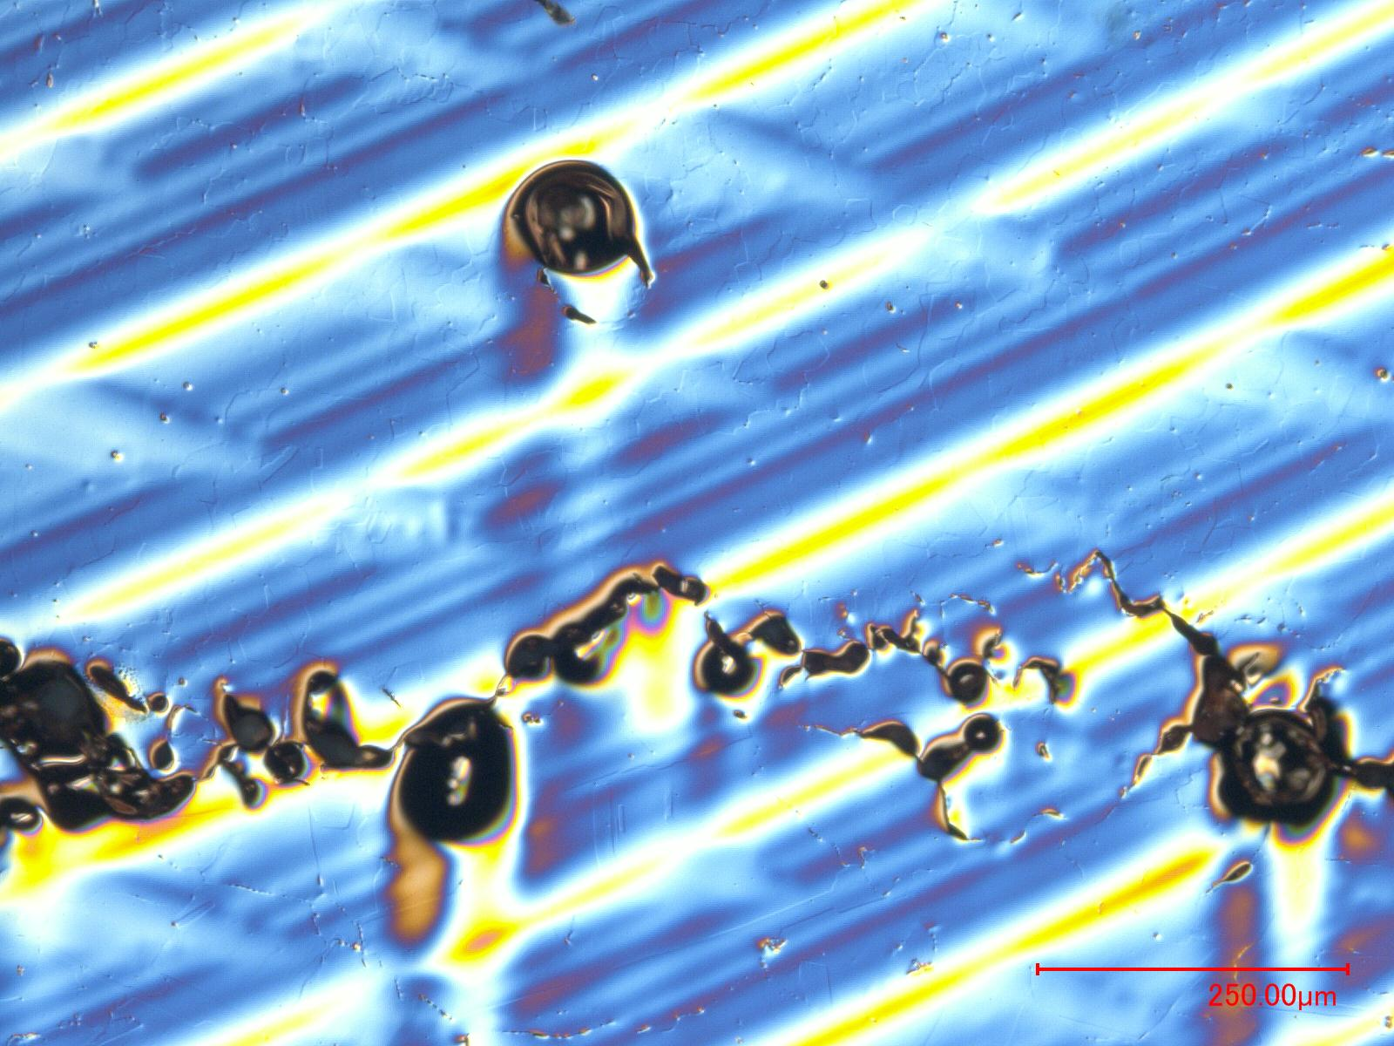
T3-9/1
Molten
Small Grains ~ 30 um
Non-molten
Grains ~ 100 um

Slide 11
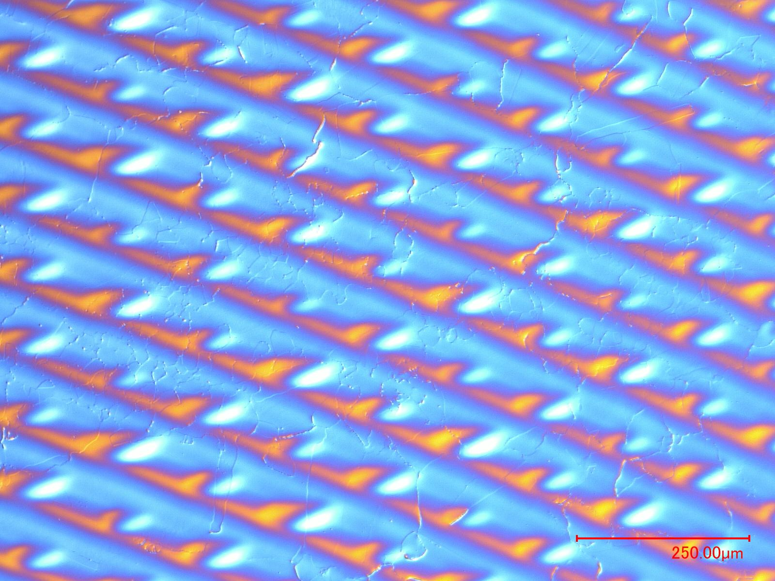
T3-9/2 - After last visible micro-cavity
Non-molten
Partially molten
Non-molten

Slide 12
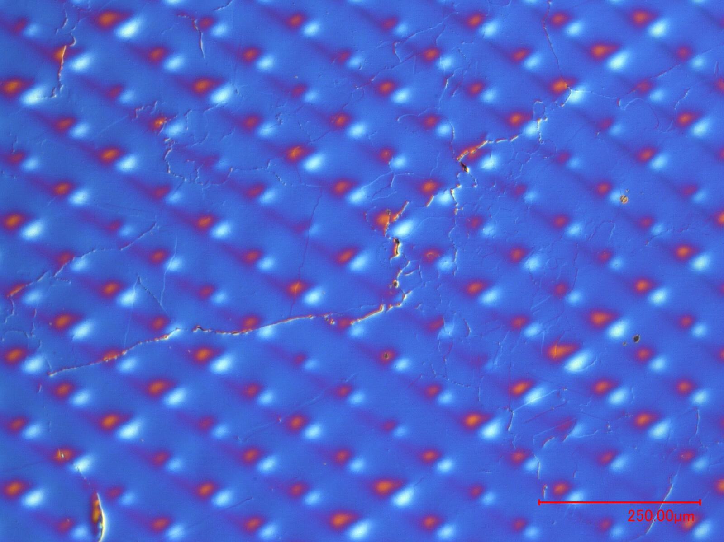
T3-9/2 - After last visible micro-cavity
Crack following join of grains

Slide 13
T2 – Cylinder 8

Slide 14
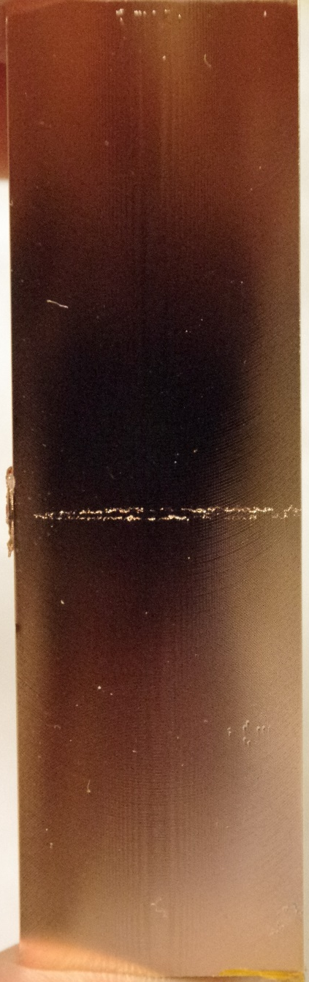
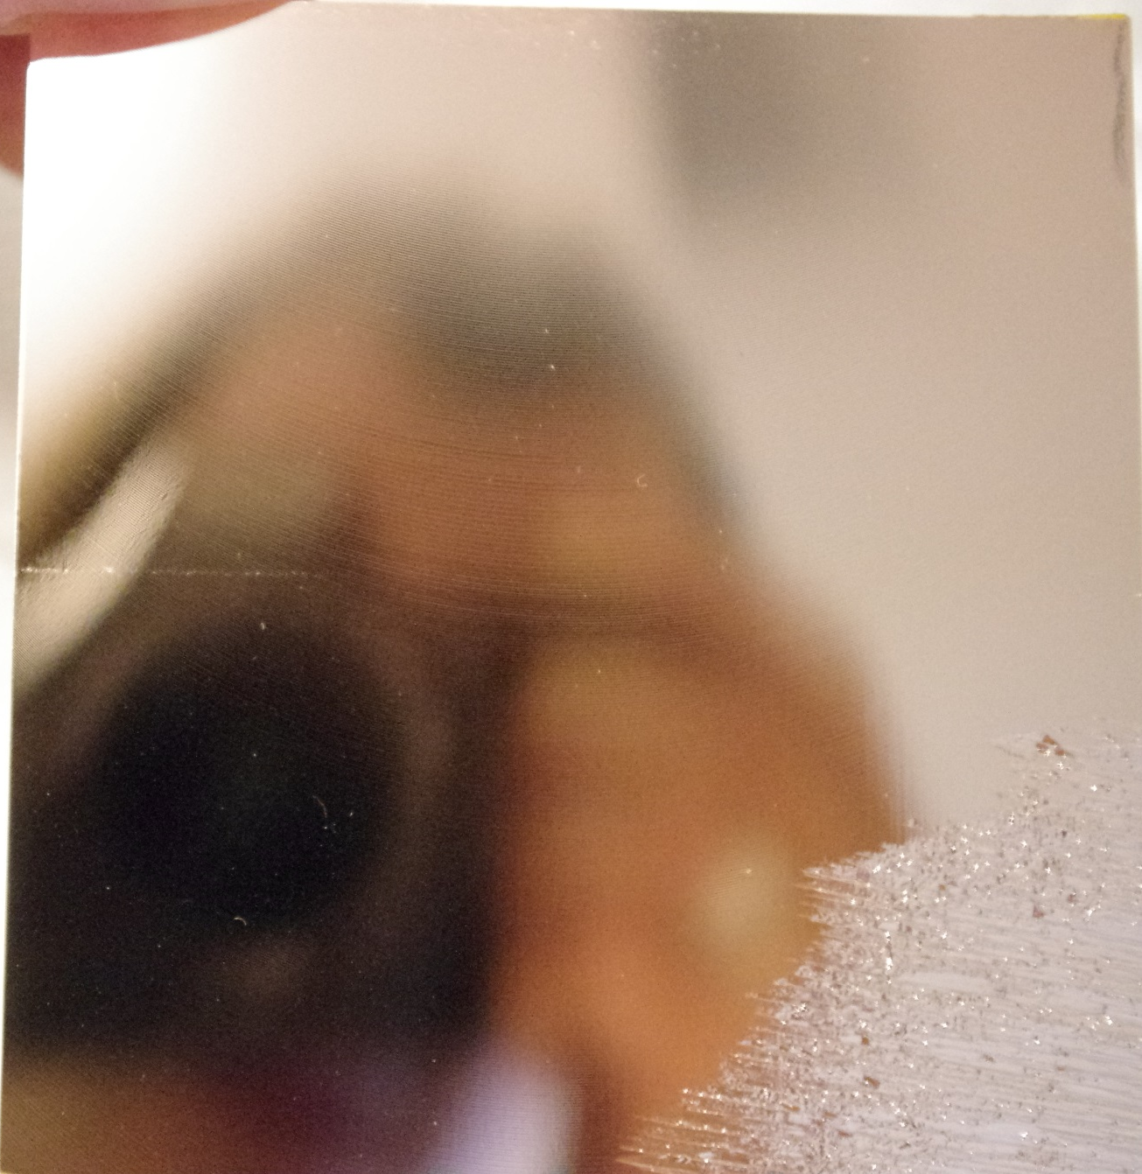

Slide 15
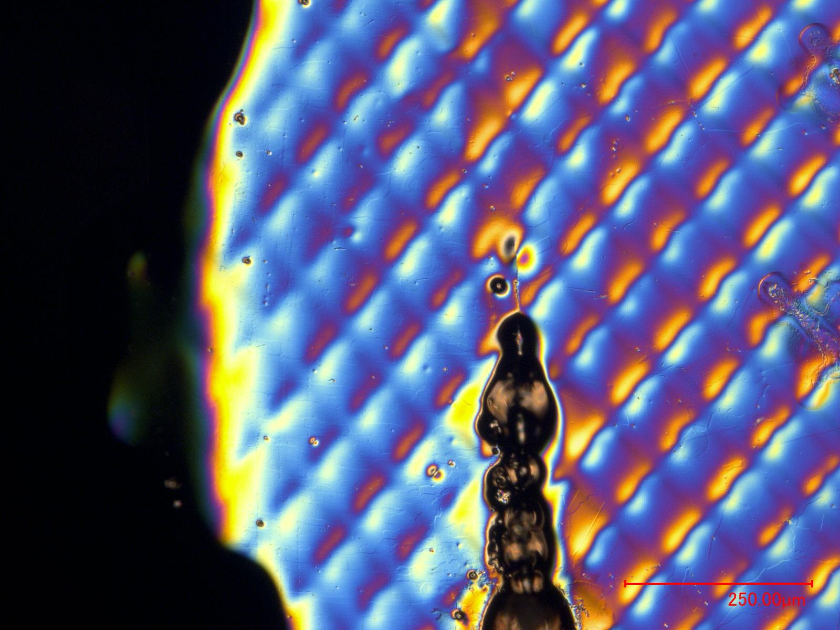
Zoom of the splash coming from cylinder 7
T2-8/1

Slide 16
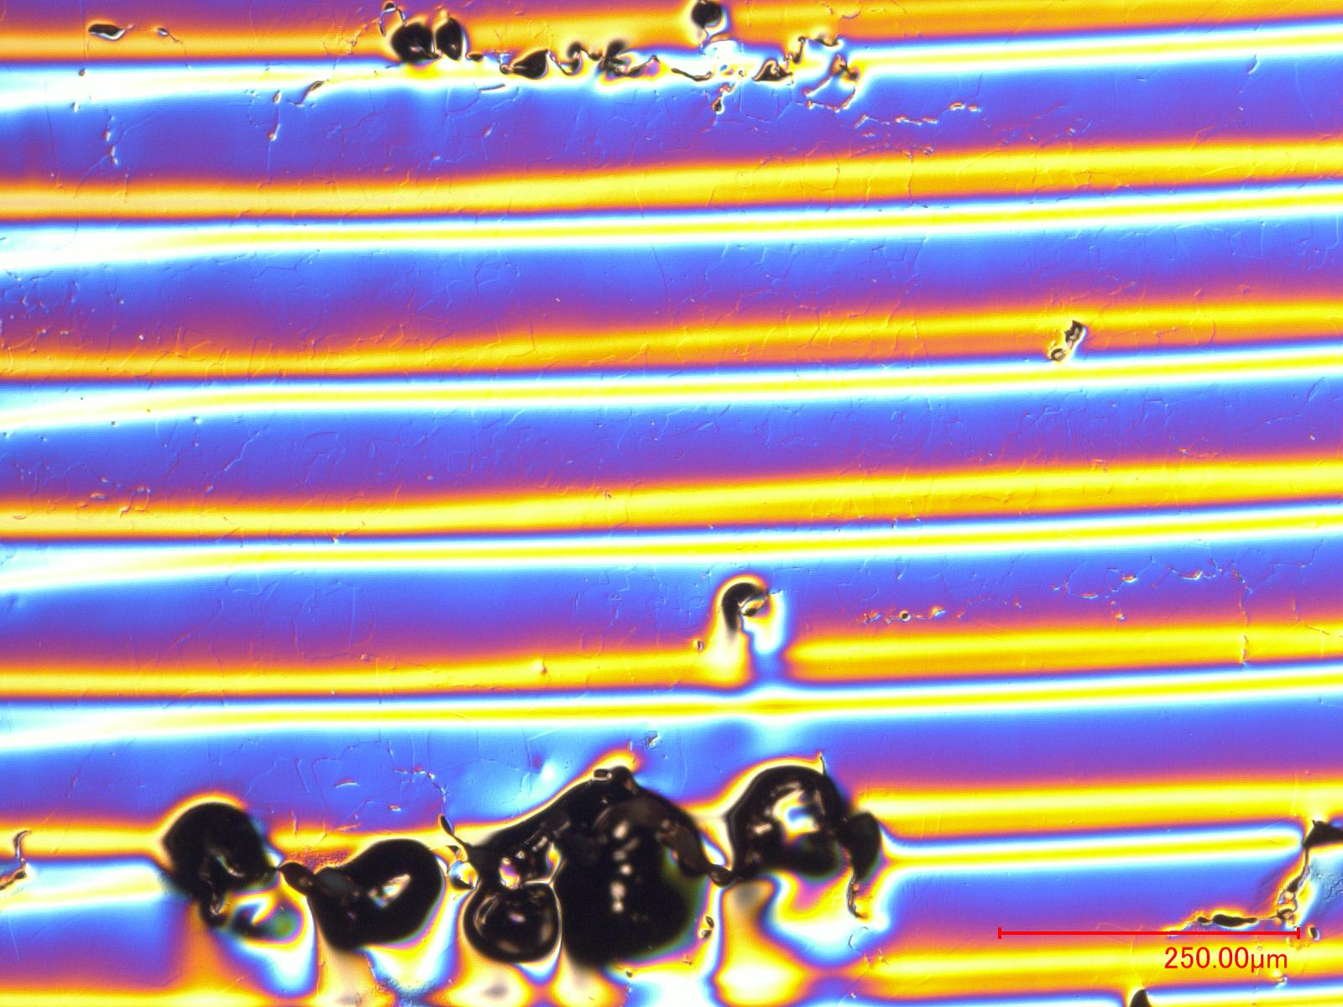
Between the two lines formed by the micro-cavities - T2-8/1
Molten
Small Grains ~ 30 um
Non-molten

Slide 17
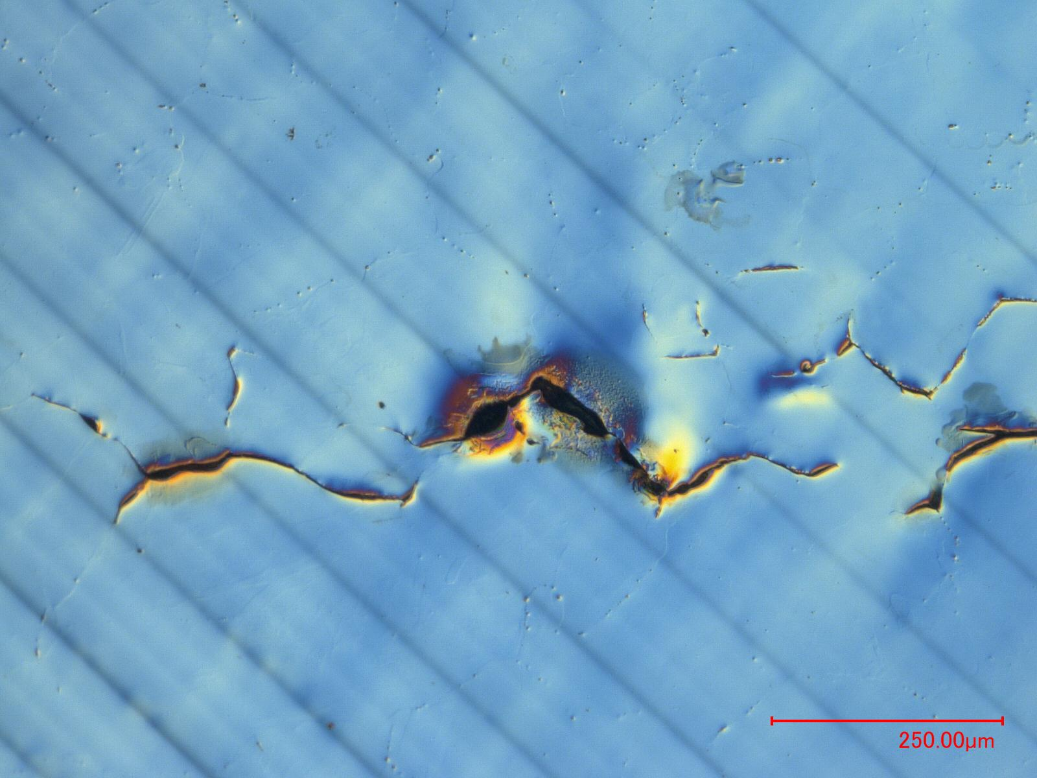
Single line crack in T2-8/2

Slide 18
T1 – Cylinder 6

Slide 19
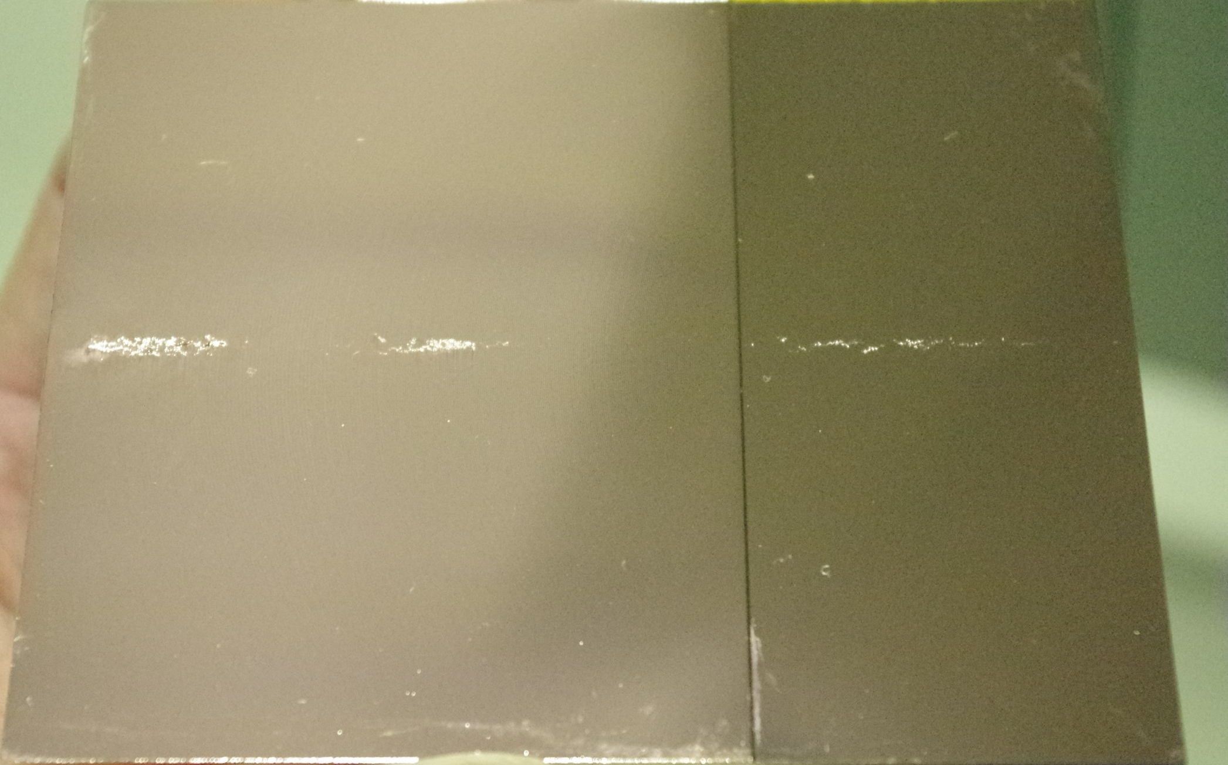

Slide 20
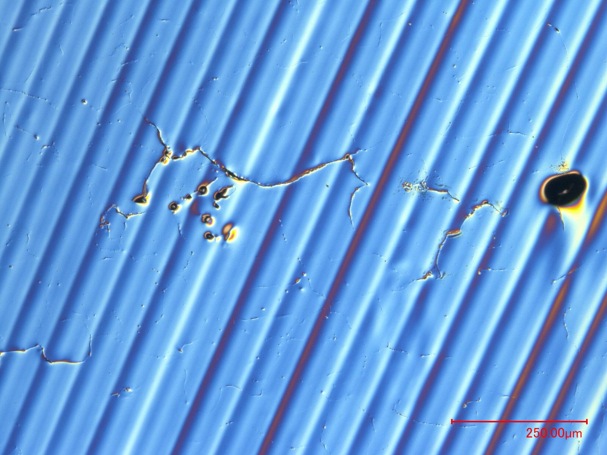
Example of a crack in T1-6

Slide 21
Conclusions
Damage Depth confirmed. (T1/58 cm, T2/79.5cm, T3/85cm)
Copper that has been molten shows smaller grains structure than the original material, or columnar grains (e.g. T3 cylinder 1)
It is confirmed that in the last damage cylinders of each target, the copper between the two lines of micro-cavities has be molten.

