Slide 2
Influence of an impact angle and cooling on the temperature of the irradiated target
An Introduction
John Treado

Slide 3
Overview
Introduction to the Project
Current Status
Goals

Slide 4

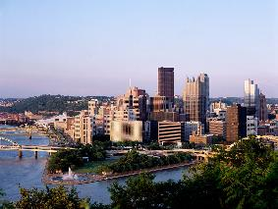
My Bio
Originally from Pittsburgh PA
Entering my fourth year at Georgetown University
I’m a physics major, mostly interested in non-equilibrium physics
CERN has been a great way to bridge simulations and accelerator physics

Slide 5
Motivation for the Project
For a plane that intersects a cylinder at an angle ψ, analogous to a beam striking a target with a ψ impact angle, the volume of a cylinder is constant for all angles but the area is given by
s is the horizontal distance the cylinder progresses into the target
An impact angle will increase heat transfer, but not energy deposition

Slide 6
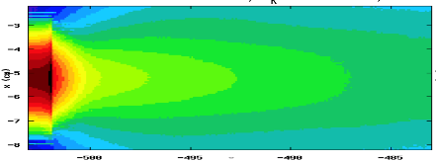
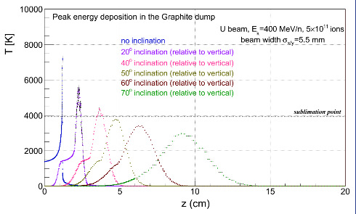
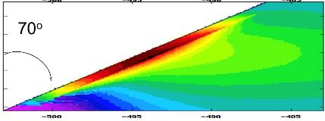

Motivation cont. – GSI model
Source: S. Damjanovic, GSI, 24/11/13
Notes:
Motivation: GSI was suspect model, we pay more attention to binning to minimize artifacts, so we seek to improve on GSI results. Also, small glancing angles can be incredibly damaging without cooling, so we want to see if cooling can benefit heat transfer

Slide 7
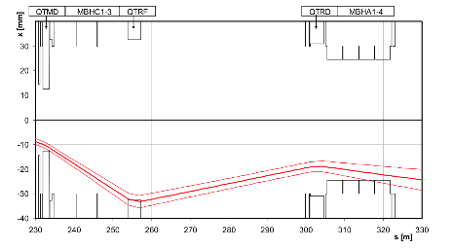
Motivation cont.
Also, 2004 SPS incident, where .59 mrad impact angle destroyed TT40 magnet
However, no cooling
So, for sharp impact angles (~10^-4 radians), will cooling help minimize temperatures in case of steady state losses??
Source: Goddard et al., 2005

Slide 8
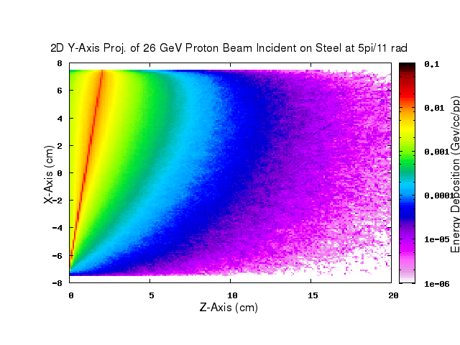
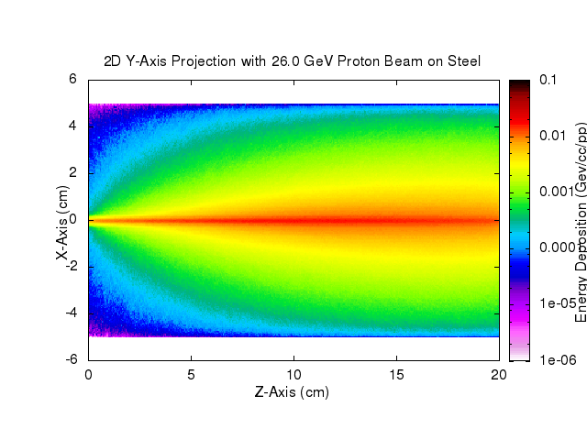
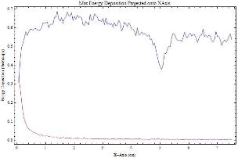
The Model – FLUKA
So far, we’ve simulated a 26 GeV Proton Beam first with σ in x,y = 1mm from orthogonal to glancing angles at 20 mrad
Target is a 304 stainless steel cylinder with 7.5 cm radius and 20 cm depth
For Binning, we use a Cartesian mesh with .5 mm bins
We incline the angle and position of the beam and keep the target the same, should reduce FLUKA artifacts
Use FLUKA to calculate energy deposition

Slide 9
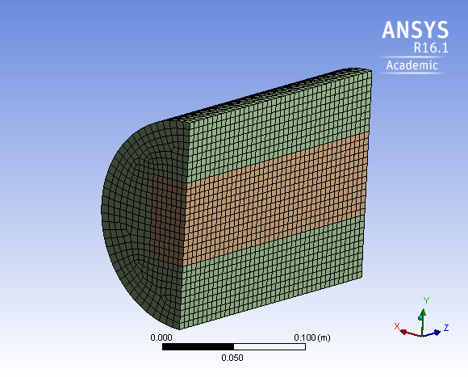
The Model -- ANSYS
Same geometry, now we import Energy Deposition values from FLUKA to calculate power deposition and heat transfer
Two modes
  Single pulse: 4 ns pulse duration, 10^11 protons, exposure time of 1s
  Multi-pulse: same pulse duration, but 25 ns spacing, with 1s exposure
  Introduce cooling via convective heat transfer at 5-20 K

Slide 10
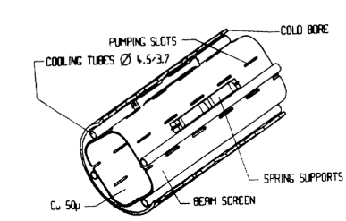
Goals
Eventually use 6.5 TeV beam and σ = 1.6 mm to mimic LHC beam dump, add cooling
Create geometry that models beam screen, use localized cooling (He at 5-20 K) with convective heat transfer, at top and bottom to investigate damage limits in the presence of sharp impact angles
Angerth et al.

