Slide 1
Maurice Baveco (Summer Student)
Introduction presentation
Lumped element modelling of superconducting circuits with SPICE
TE-MPE-PE
Supervisors:
Bernhard Auchmann & Michal Maciejewski

Slide 2
Content
General introduction about myself
Project description
SPICE
Circuit simulation example using SPICE
Current project progress & outlook

Slide 3
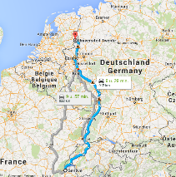
General introduction
Maurice Antoine Baveco, 22 years
University of Twente, Enschede, The Netherlands
Graduated Bachelor Electrical Engineering in April 2015
Internship Siemens May & June 2015
Master Electrical Engineering: track Integrated Circuit Design, starting September 2015, University of Twente
After Master: maybe PhD, not sure yet ☺

Slide 4
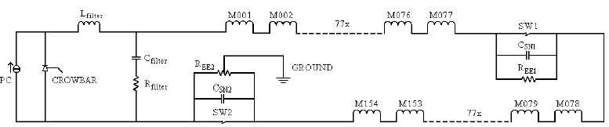
Project description
Main goal: learning and benchmarking SPICE vs other simulation tools (PSpice & MATLAB/Simulink)
Simulation case: transient effects in SC circuits
Modelling of LHC main dipole circuit (RB)
Source: E. Ravaioli et al., Modelling of the Voltage Waves in the LHC Main Dipole Circuits, Applied Superconductivity, IEEE Trans. on, 22(3), pp. 9002704-9002704, 2012
Notes:
Quench → Fast Power Abort (FPA) to protect Power Converter (PC) from energy release in quenched magnet

Slide 5




SPICE
Simulation Program with Integrated Circuit Emphasis
Developed at University of California, Berkeley in 1970
Q: Why SPICE?
A: Basis language of other circuit simulators used in industry (Cadence Spectre, LT SPICE, PSpice)
Results of project enable an assessment of SPICE vs other tools
Notes:
Labview noemen bij National Instruments
Comparison of performance, maintainability, scalability and material parametrization

Slide 6
Circuit simulation example using SPICE
Filter of LHC main dipole circuit (RB)

Slide 7
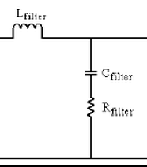
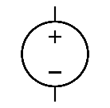



Circuit simulation example using SPICE
Goal: Perform frequency analysis (transfer function) of filter in SPICE
Draw schematic of circuit to be simulated
$$V_{in}$$
$$V_{out}$$

Slide 8


Circuit simulation example using SPICE
2. Assign node numbers to circuit
1
2
$$V_{in}$$
3
$$V_{out}$$
0

Slide 9
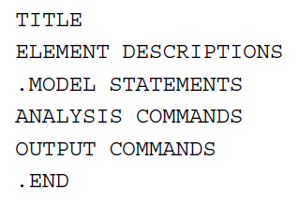
Circuit simulation example using SPICE
3. Generate netlist (.cir file) in SPICE language
General programming sequence:

Slide 10
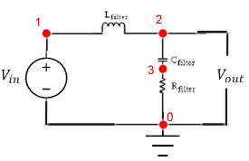



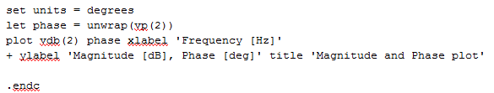
Circuit simulation example using SPICE
3. Generate netlist (*.cir file) in SPICE language
Notes:
Notepad++ noemen als programma waarin je de netlists schrijft

Slide 11
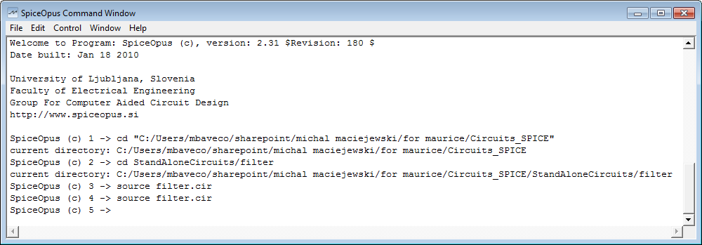
Circuit simulation example using SPICE
4. Run netlist (.cir file) in SpiceOpus
Command: source filter.cir
Notes:
Explain use of SpiceOpus

Slide 12

Circuit simulation example using SPICE

Slide 13
Current project progress & outlook
Current project progress:
  Study of SPICE & analysis of LHC main dipole circuit RB
  Subnetwork implementation and simulating
    Power converter, filter, dipole and energy-extraction unit
Outlook
  RB circuit integration based on developed subnetworks
  Analog behavioural modelling of RB circuit
  Final presentation & report

Slide 14
Questions?

Slide 15
Thank you for your attention

