Slide 1
Maurice Baveco (Summer Student)
Final presentation
Lumped element modelling of superconducting circuits with SPICE
TE-MPE-PE
Supervisors:
Bernhard Auchmann & Michal Maciejewski
Notes:
-short
-final presentation
-titel
-under supervision of:

Slide 2
Content
Acknowledgments
Project goal
Simple RB circuit model
Detailed RB circuit model
Conclusions
Recommendations for future work
Notes:
-short
-name content

Slide 3
Acknowledgments
Michal Maciejewski
Bernhard Auchmann
Emmanuele Ravaioli
TE-MPE-PE (Arjan Verweij)
Notes:
-first acknowlegments
-michal: I liked working together, learned a lot here, grateful to had chance to come
-bernhard: thanks for working together, and giving me the opportunity to work here
-emmanuele: always willing to give explanation about RB circuit + Pspice
-tempepe led by Arjan Verweij, general: I enjoyed working here
Alejandro also for working in same office

Slide 4
Goal of the project
Research questions:
  To what extent is SPICE capable of modelling complex electrical networks (such as the LHC main dipole circuit)?
  What are SPICE limitations in terms of advanced circuit modelling (analog behavioural modelling, initial conditions, diodes and thyristors for example)?
Goal:
Learning SPICE and reproduce with an acceptable agreement the existing PSpice RB circuit model in order to migrate from PSpice to SPICE
Playing with solver options was outside the scope of the project (applies to any solver)
Notes:
-kind of short
-reason: stated to give a clear overview of the project and what we wanted to achieve

Slide 5
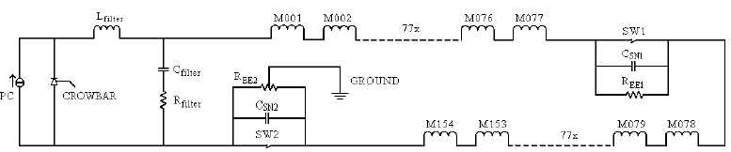
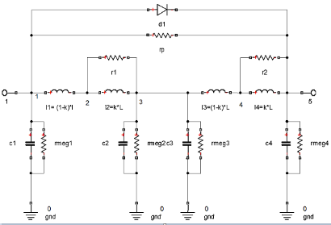

Simple RB circuit
Source: E. Ravaioli et al., Modelling of the Voltage Waves in the LHC Main Dipole Circuits, Applied Superconductivity, IEEE Trans. on, 22(3), pp. 9002704-9002704, 2012
Notes:
Very quickly address components of circuit, this is this, this is this etc

Slide 6
SPICE netlist
RB circuit basic (simple pc (current source), simple filter, no grounding lines + basic eeunits )
.include '../Librarysc/scpc.cir'
.include '../Librarysc/scfilter.cir'
.include '../Librarysc/scdipole.cir'
.include '../Librarysc/scee.cir'
.include '../Librarysc/sceeground.cir'
*Circuit definition
xpc (1 2) powerconverter
xfilter (2 3 1) filter
vmeasure (3 4) dc 0
xdipole1 (4 5) dipole Param: valr1=10 valr2=10
…
xee1 (81 82) eeunit
xdipole78 (82 83) dipole Param: valr1=9.07 valr2=10
...
xee2 (159 1 0) eeunitground
*Analysis/Simulation commands
.control
destroy all
tran 0.05s 600s
*Output commands (printing/plotting)
plot i(vmeasure)
print v(4,5) v(4,3:xdipole1) v(3:xdipole1,5) >> Dipole1.txt
…
.endc
.end
Notes:
The Rbcircuit is now implemented into SPICE language
Highlight short each step of the netlist
Give short explanation about netlists of SPICE
-a previous modelling example can be found in my previous presentation

Slide 7
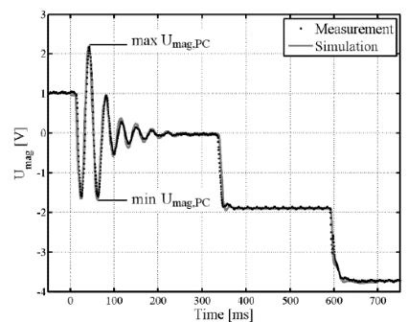
Results SPICE vs paper PSpice
Voltage MB 26 SPICE
Voltage MB 26 paper PSpice
Source PSpice: E. Ravaioli et al., Modelling of the Voltage Waves in the LHC Main Dipole Circuits, Applied Superconductivity, IEEE Trans. on, 22(3), pp. 9002704-9002704, 2012
Notes:
-stilte
-belangrijke slide, dus wat meer tijd voor nemen
-vertellen wat mensen hier zien, en dat de overeenkomstigheid veelbelovend lijkt
End with: Explain max and min v_pc. Bridge to next slide

Slide 8
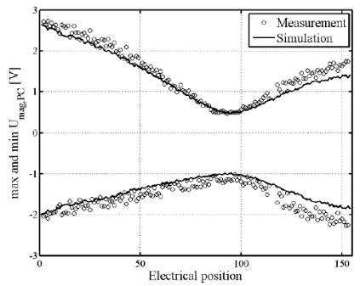


Results SPICE vs paper PSpice
Oh oh… Discrepancy! What to do?
Max and min $V_{PC}$ SPICE
Max and min $V_{PC}$ paper PSpice
Source PSpice: E. Ravaioli et al., Modelling of the Voltage Waves in the LHC Main Dipole Circuits, Applied Superconductivity, IEEE Trans. on, 22(3), pp. 9002704-9002704, 2012
Notes:
-Dan andere resultaat
-vertel dat het heel onoverzichtelijk is om de signalen van 154 dipoles in 1 plot weer te geven
-daarom van elke dipole alleen het max en minimum waarde geplot to show information of the whole chain
- Ook tijd voor deze slide

Slide 9
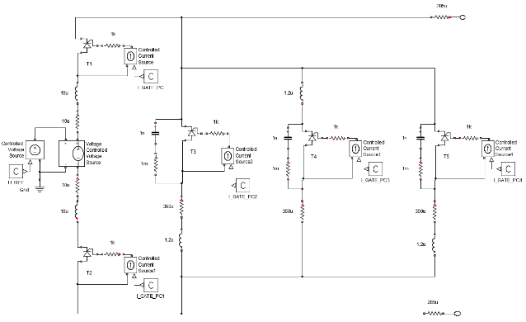
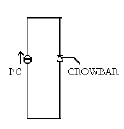
Detailed RB Circuit SPICE
More detailed model required
Example: subcircuit Power Converter
Current source PC → Voltage source PC
Notes:
-because of discrepancy more detailed model required
-here the PC will be discussed
-first simple current source, now more detailed circuit with 5 switches

Slide 10
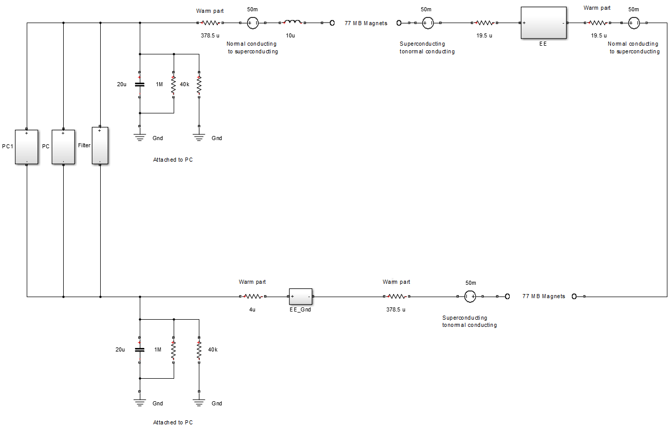
Without grounding lines but can be added
Notes:
-kort houden! Niet alles opnieuw weer vertellen
Only highlight difference with respect to simple RB circuit: parasitics

Slide 11
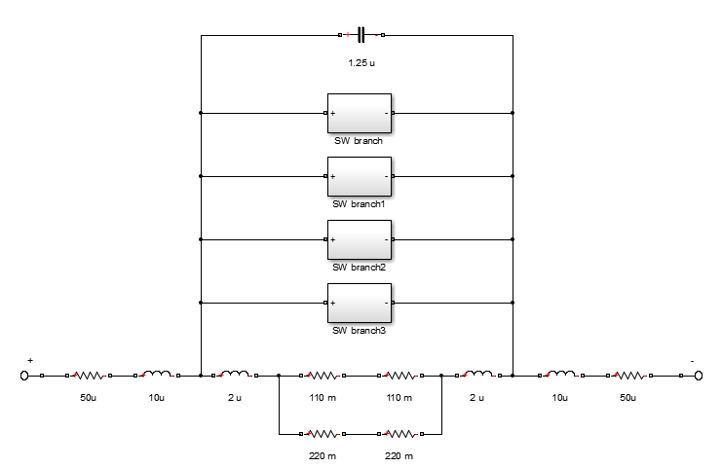
Energy extraction unit
Notes:
-energy extraction unit is specifically discussed because that was the subcircuit that caused the most problems
-parasitics
-ee resistors
-4 switches
-small capacitance

Slide 12
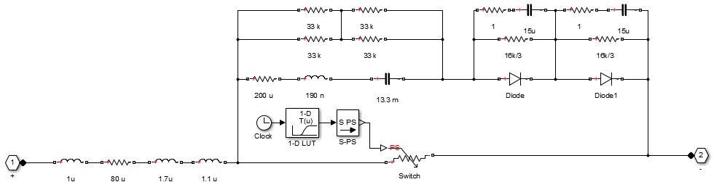
Energy extraction – single branch
Full model of a single branch: causes convergence problems in SpiceOpus
Notes:
-vertel bridge: 1 switching branch is now displayed here
-this is full model: causes problemes
Initital guess was that problems comes from the diodes.
-so what did we do?

Slide 13
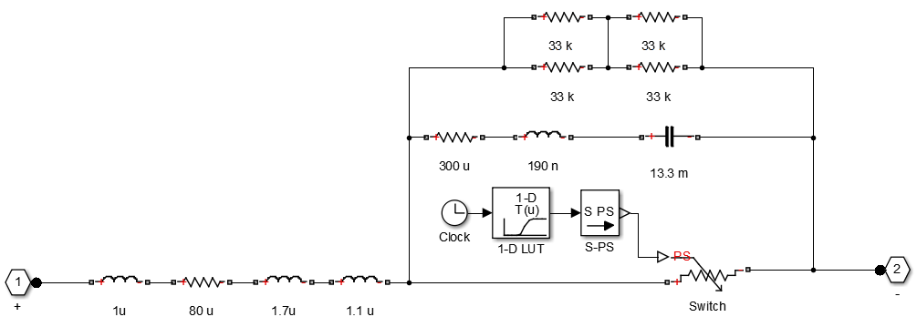
Energy extraction – single branch
Adjusted model of a single branch: still convergence problems in SpiceOpus
Notes:
-diodes are removed
-but still convergence/solver problems

Slide 14
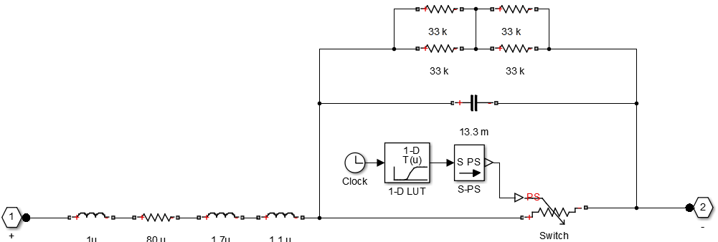
Energy extraction – single branch
Model of a single branch used for simulation: SpiceOpus able to run
Notes:
-model single branch sed for simulation: able to run

Slide 15

Results SPICE vs paper PSpice
Max and min $V_{PC}$ SPICE
Max and min $V_{PC}$ paper PSpice
Source PSpice: E. Ravaioli et al., Modelling of the Voltage Waves in the LHC Main Dipole Circuits, Applied Superconductivity, IEEE Trans. on, 22(3), pp. 9002704-9002704, 2012
Notes:
-see similar plot as the previous plot showed
-now better agreement (local minimum is less deep)
-still not full agreement: possible explanation: because of missing components in Eeunit may cause not full agreement

Slide 16
Results SPICE vs paper PSpice
Voltage MB 26 SPICE
Voltage MB 26 paper PSpice
Source PSpice: E. Ravaioli et al., Modelling of the Voltage Waves in the LHC Main Dipole Circuits, Applied Superconductivity, IEEE Trans. on, 22(3), pp. 9002704-9002704, 2012
Notes:
De voltage across MB 26 again
Still good agreement

Slide 17
Workflow – Simulating with SPICE
Design electrical circuit
Assign nodes & generate netlist (possibly with external script)
Run netlist in SpiceOpus
Post-process results (also with external scripts)
-External scripts are needed (for creating large netlists, parametric sweep and post-processing)
-Workflow of simulating with SPICE has to be automatized AND optimized
Notes:
-new slide: i explain here short.. Workflow
-automatized: now there are too many staps that user has to do manually

Slide 18
Conclusions
Strengths SPICE:
Simple, powerful and robust (also conclusion of Lorenzo)
SPICE has shorter simulation time than PSpice for similar models.
Possibility to work with custom library in SPICE: powerful. In PSpice not.
SPICE is capable to model complex electrical networks (like RB)
Results show a promising agreement
Quickly getting started phase (also conclusion of Lorenzo)
Possibility to share and develop circuits with more persons: easy to distribute netlists and work from same directory (thanks to library)
Drawbacks SPICE:
A GUI missing in SPICE (you need to draw the circuits yourself)
More advanced electrical components are missing in SPICE environment
(e.g. thyristor)
Notes:
-take time for this: important part

Slide 19
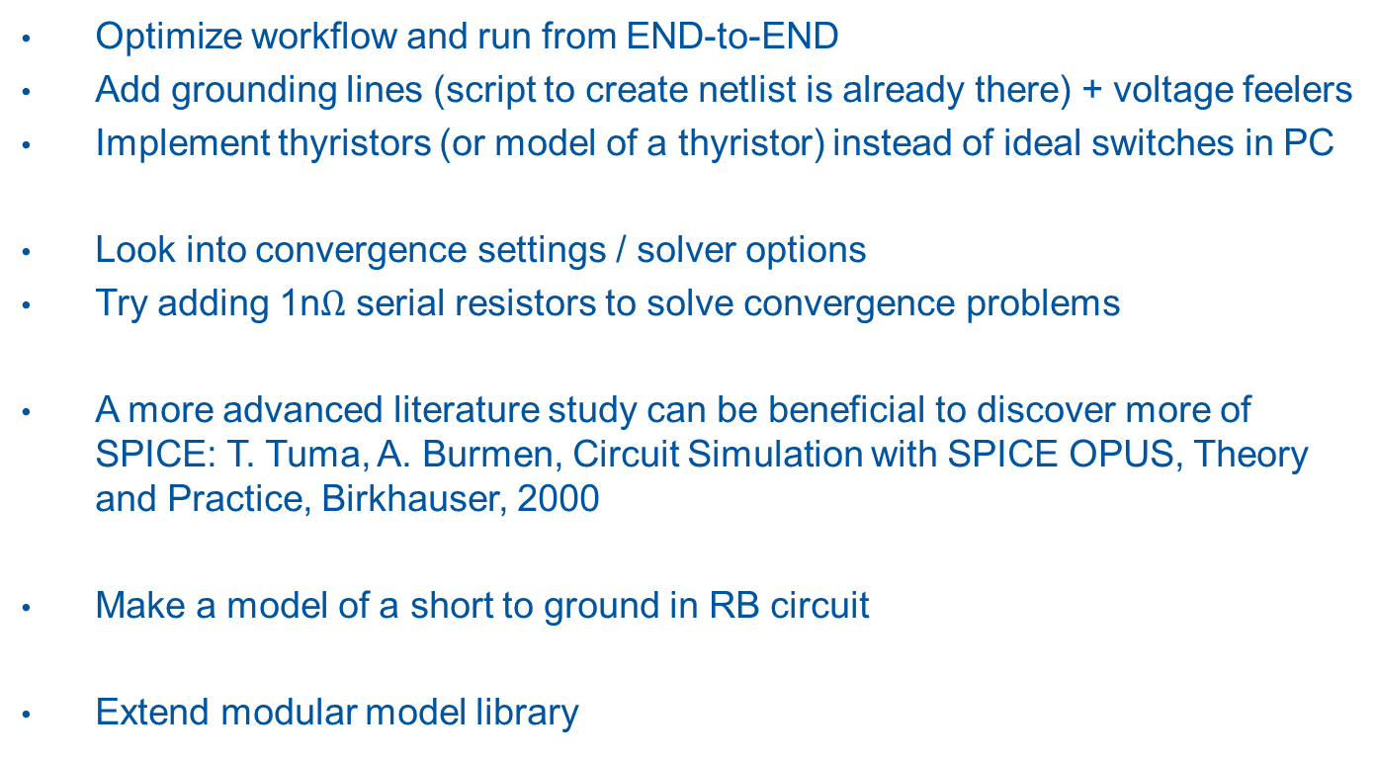
Recommendations for future work
Optimize workflow and run from END-to-END
Add grounding lines (script to create netlist is already there) + voltage feelers
Implement thyristors (or model of a thyristor) instead of ideal switches in PC
Look into convergence settings / solver options
Try adding 1n$Ω$ serial resistors to solve convergence problems
A more advanced literature study can be beneficial to discover more of SPICE: T. Tuma, A. Burmen, Circuit Simulation with SPICE OPUS, Theory and Practice, Birkhauser, 2000
Make a model of a short to ground in RB circuit
Extend modular model library
Notes:
End to End: user provides input, START, and results are immediately post processed and shown in figures

Slide 20
Questions?

Slide 21
Thank you for your attention
And thanks to all of the section again, I enjoyed working here at CERN ☺
Contact:
Email: mauricebaveco@gmail.com
LinkedIn: https://nl.linkedin.com/pub/maurice-baveco/82/692/349
Notes:
Would like to stay in contact? One can always send me an email or approach me on linkedin

Slide 22
One more thing…
Notes:
To ceize this moment that everybody is together, i would like to give something to my supervisors now:

Slide 23
Supporting slides

Slide 24
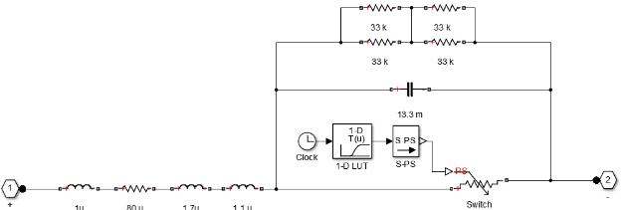
SPICE vs PSpice
SPICE
PSpice

Slide 25
Comparison of voltage

Slide 26
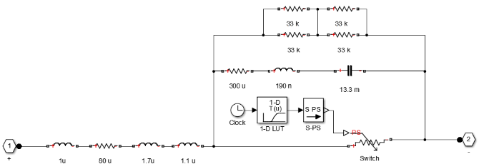
SPICE vs PSpice
SPICE
PSpice

Slide 27
Comparison of voltage

