Slide 1

Introduction to the MPE software process
TE-MPE-PE Clean code workshop - 9th July 2015
Raphaela Heil

Slide 2
Introduction
Develop complex software systems
  Face programming challenges/problems
Share our experiences and solutions
Notes:
hopefully some our experiences useful for PE

Slide 3
Structure
Who are we?
Our goals
Our projects
Summary

Slide 4
Who are we?
MPE software team
  10 developers, frequent rotations
Our expertise
  Java, a bit of C++, Python & Groovy
  A bit of Linux administration
  Software engineering

Slide 5
Who are we ?
Agile and Scrum
  Keep software operational and deliver often
  Constant involvement of collaborators
Collaborations with
  Hardware experts (QPS, BIS, SMP, …)
  Operators
  Other software teams at CERN
Notes:
Agile & Scrum: maybe heard before
not going into details: flexible and iterative development
constant involvement through Demos, etc --> constant feedback

Slide 6
Our goals
Machine protection integration into the accelerator environment
  Supervision, diagnostics/analysis, systematic testing
Software quality standards
  Dependable system
  Focus on introducing new features rather than maintaining systems

Slide 7
Our projects – A short introduction
Artefact | Count
MPE Products | ~ 10
Software Projects | > 120
Lines of code | ~ 2,1 million
Commits | > 9700
Code Reviews | > 400
Notes:
ideally: # of commits == # of releasable products -> continuous delivery==> code should always be in a deliverable state -> stay operational despite changes/new features
numbers: fairly complex projects ----> a lot to know and remember
quality standards, techniques, technologies important
----> be able to handle complexity
----> create reliable products

Slide 8
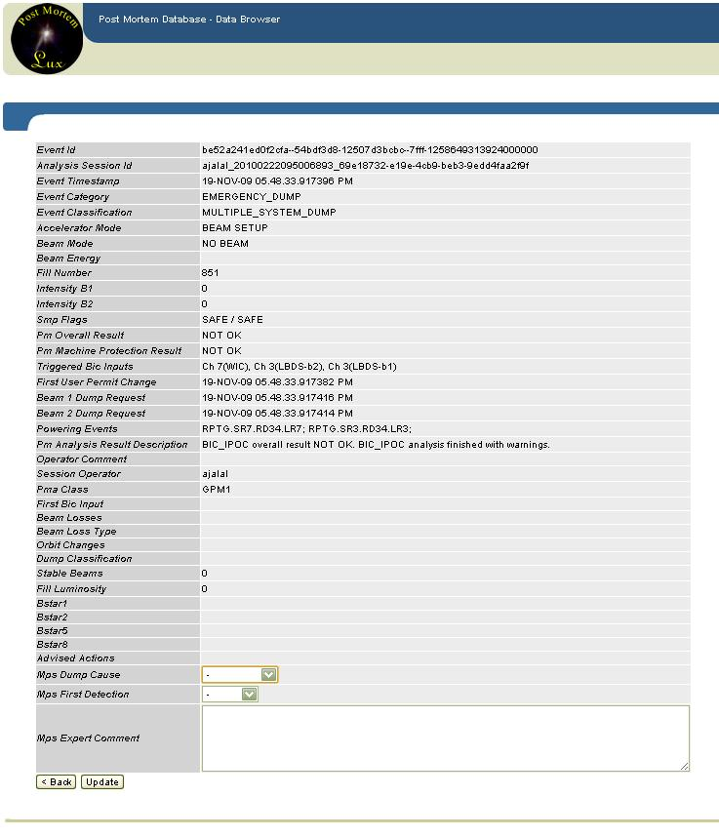
Post Mortem
Data collection
  HW devices send critical information to the PM storage
Event browsing
Notes:
known to some
one part data collection & display

Slide 9
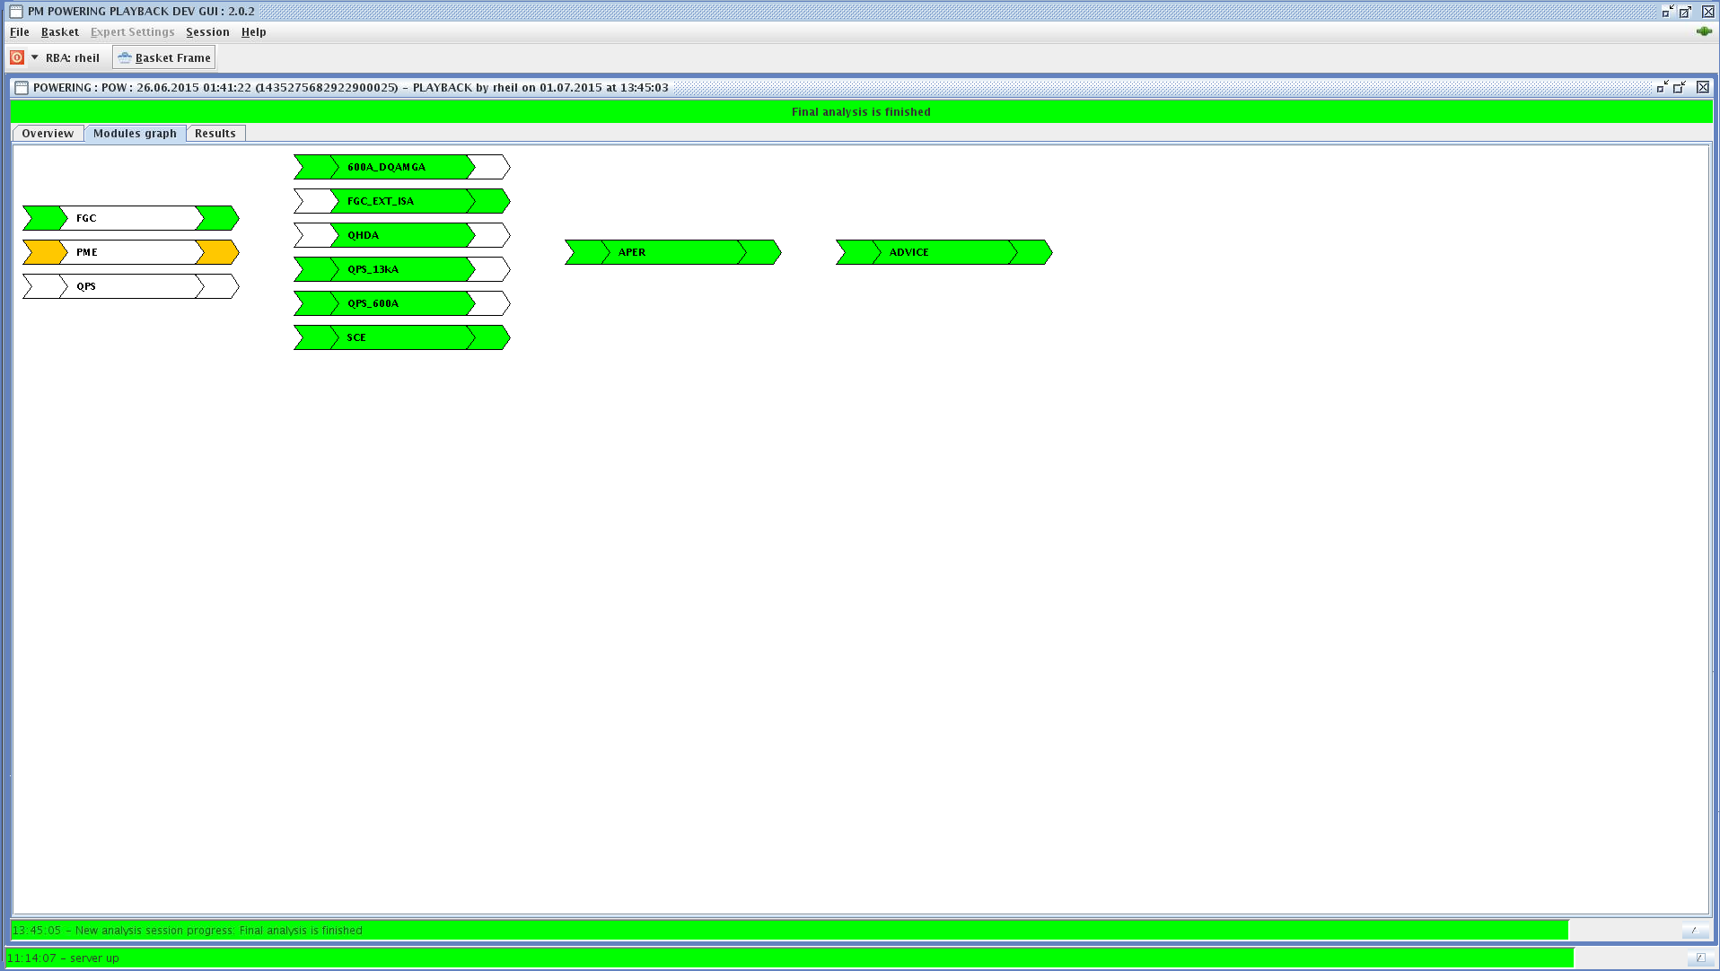
Post Mortem
Post Mortem Analysis
  Modules
  Event browsing
Future plans:
  Provide programmatic access to all the information

Slide 10
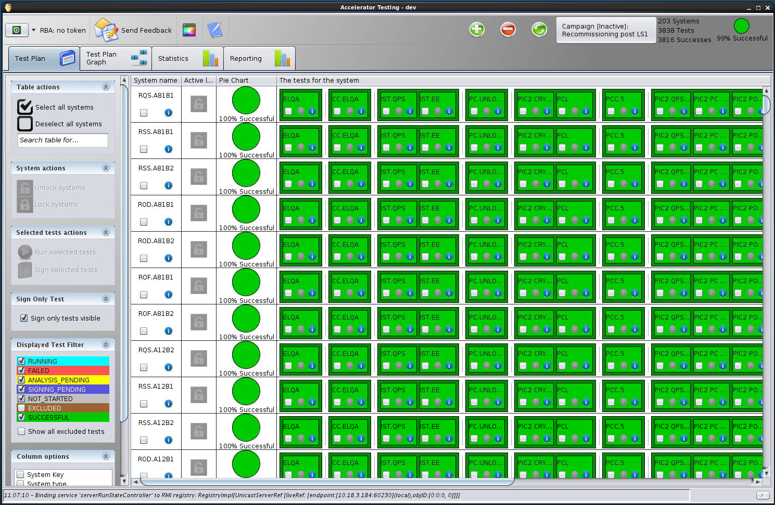
AccTesting
Commissioning of accelerator systems
  Powering systems
  Others, e.g. MPS and MKD
Schedule and track tests/results
  Uses the Analysis Framework, PM and Logging DB
API to retrieve test information
Future plans:
  Integrate more systems
  Provide a better public API for reporting
Notes:
used during Ls1 powering tests----> ~2000 tests executed
----> significant increase in process speed

Slide 11
Analysis Framework
Analysis of LHC diagnostics data
Assertions described in a Java-like language, e.g.:
assertThat(I_MEAS).isLessThan(55.0, AMPERE).at(PM_EVENT_TRIGGER);
Used for the LS1 powering campaign
Future plans:
  Use Analysis Framework in PM framework and for operations
  Extend features, to support more systems

Slide 12
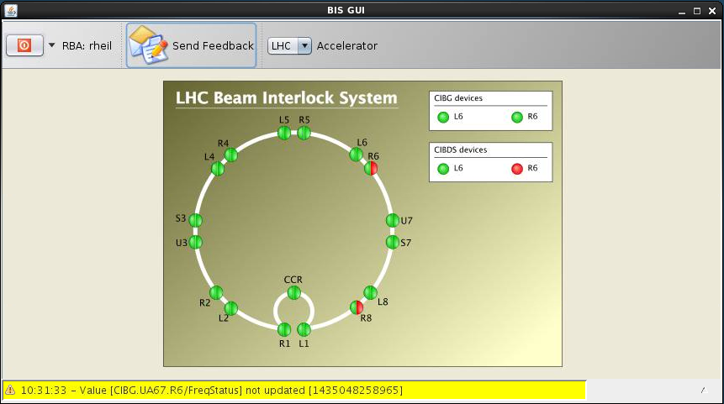
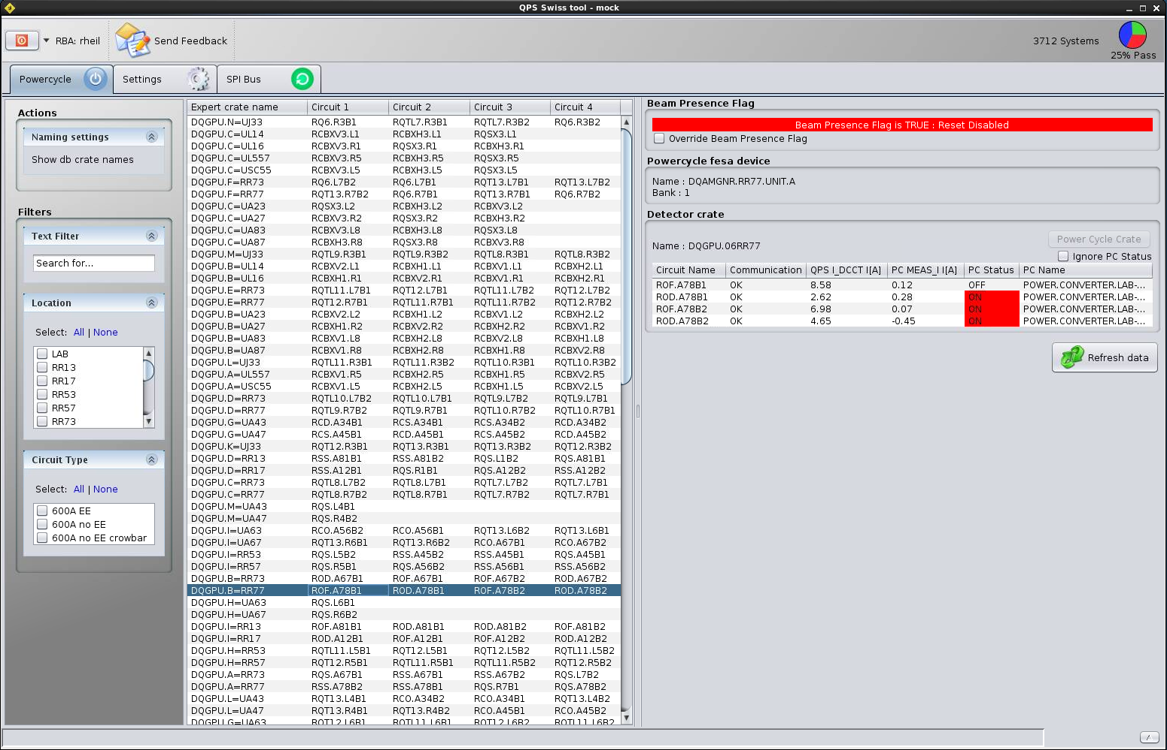
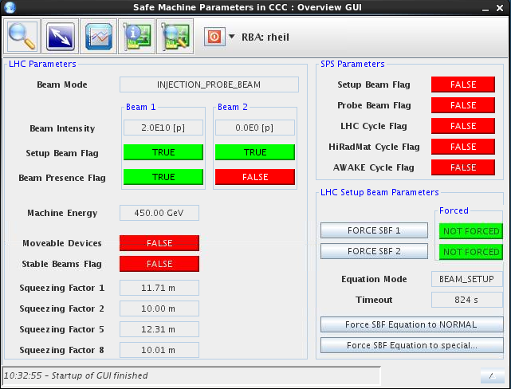
BIS, SMP, QPS
Monitoring software for
  Beam Interlock System
  Quench Protection System
  Safe Machine Parameter
  Fast Magnet Current Change Monitoring

Slide 13
Summary
Dynamic team managing a number of complex projects
  → need for quality standards
  → special techniques & technologies to support creation of reliable products
Gathered experiences/solutions applicable to PE software challenges

Slide 14
Thank you for your attention!
Next up: Software development process and tools

