Slide 1
Software projects in TE-MPE-PE
Michał Maciejewski, Bernhard Auchmann, Lorenzo Bortot, Emmanuele Ravaioli, Jonas Ghini, Deepak Paudel, Arjan Verweij and others
TE-MPE-PE
24.06.2015

Slide 2



Quench Simulation Framework
GUI
Middle layer(server)
Simulink (Solver, Libraries, Model)

Slide 3
Quench Simulation Framework
Features
Object-oriented code
Automatic simulation of electrothermal transients in SC magnets
Three-layer architecture
(Solver, Server, GUI)
Improvements
Code refactoring and full versioning
Unit testing
Integration testing
Bug reporting
Code review
How to distribute to other labs and not get into troubles?

Slide 4
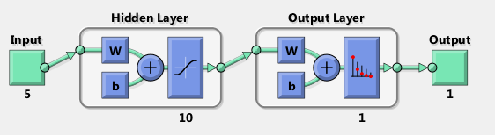




Quench Heater Neural Networks
- Analysis of QH faults be means of NN
Output
Reference
QH decays no faults
$$class=1$$
$$?$$
$$class=1$$
Signal conditioning
NN
$$≠$$
QH decays with faults
$class=0$
$class=0$
Next round
True
Weights adjustment

Slide 5
Quench Heater Neural Networks
Features
OOP Matlab Code
Analyses Quench Heater Failures by means of neural networks
Acquires data via LabVIEW PM tool
Could be integrated with other tools
Improvements
Code refactoring and versioning
Architecture refinement
Access to PM
Code review
How to integrate developed NN with existing Java tools?

Slide 6
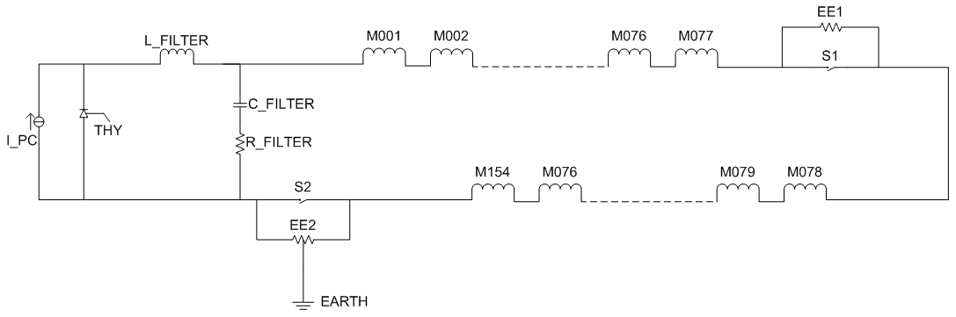
RB circuit analysis
simulation of faults in LHC main dipole circuit
Comparison with PM measurements
Prediction of possible problems

Slide 7
RB circuit analysis
Features
Large collection Matlab scripts
Analyses of electrical phenomena and failure modes in the LHC RB circuit
Could be integrated with simulation tools
Improvements
Code refactoring and versioning
Java-MATLAB PM code
Code review

Slide 8
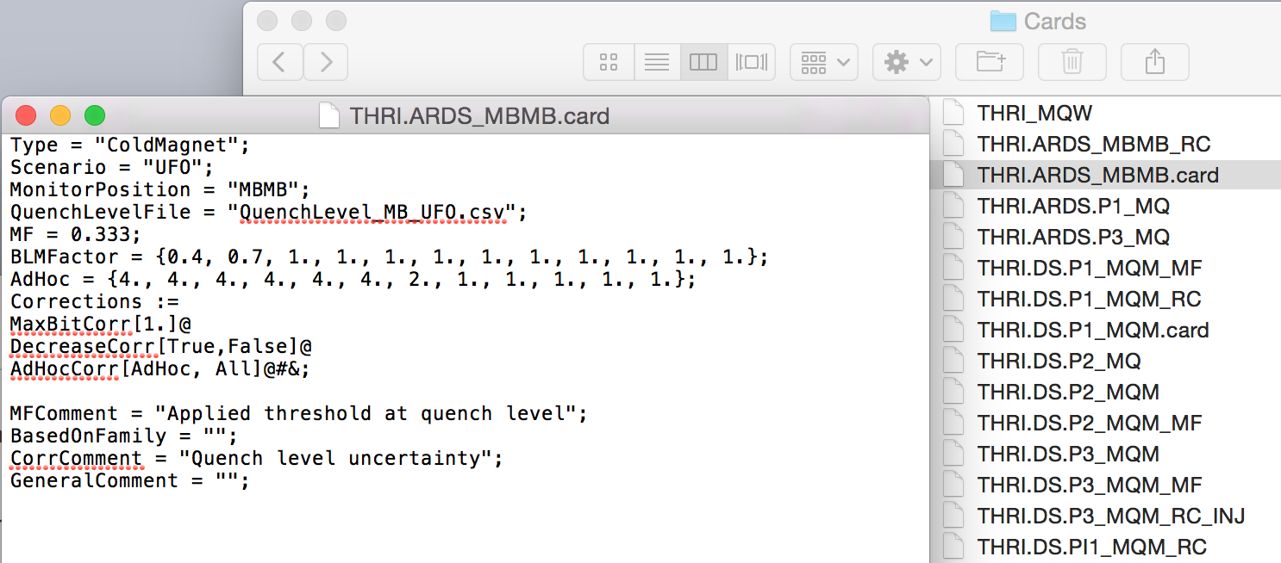
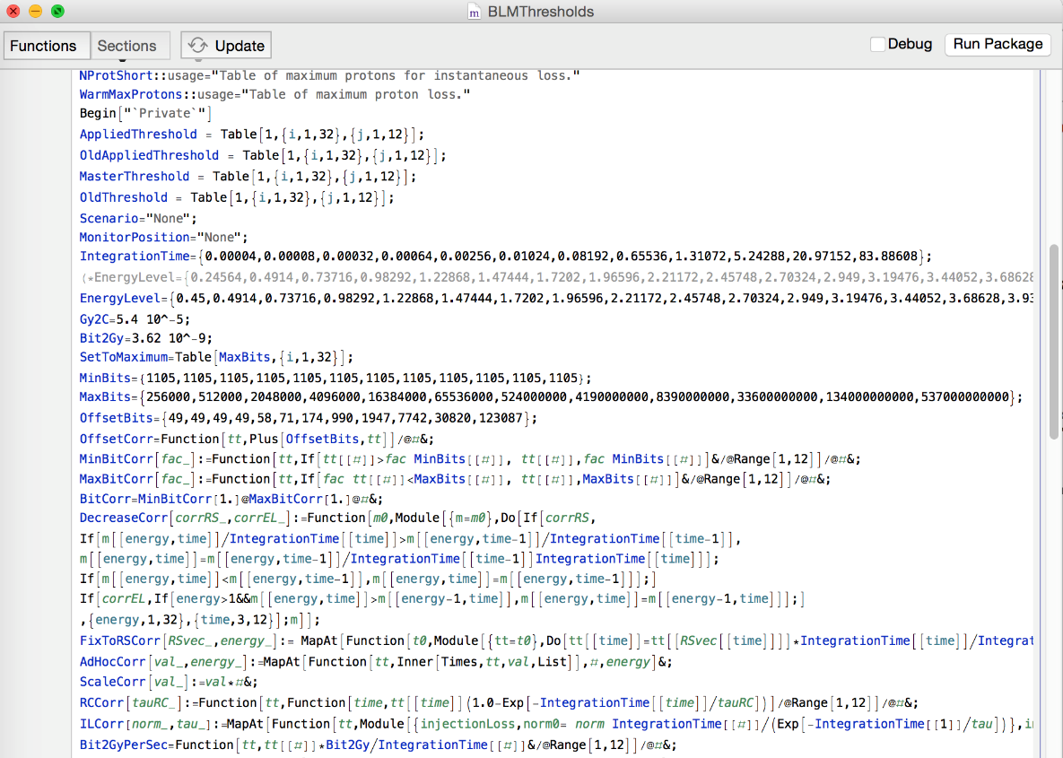
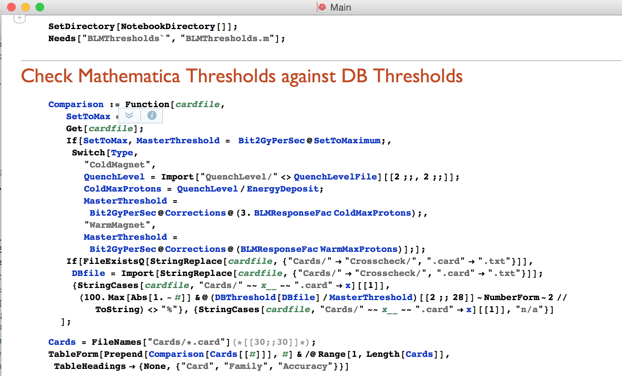
BLM Thresholds Generator
Input file per threshold family
Package code
Main comparing thresholds with
those generated for the machine.

Slide 9
BLM Thresholds Generator
Features
Mathematica code
CERN svn versioning
Input files in Mathematica syntax
Concise functional programming
Compact (uncommented, several 100 slocs) “Package”
Small main
Improvements
Code refactoring
Unit testing
Code review

Slide 10
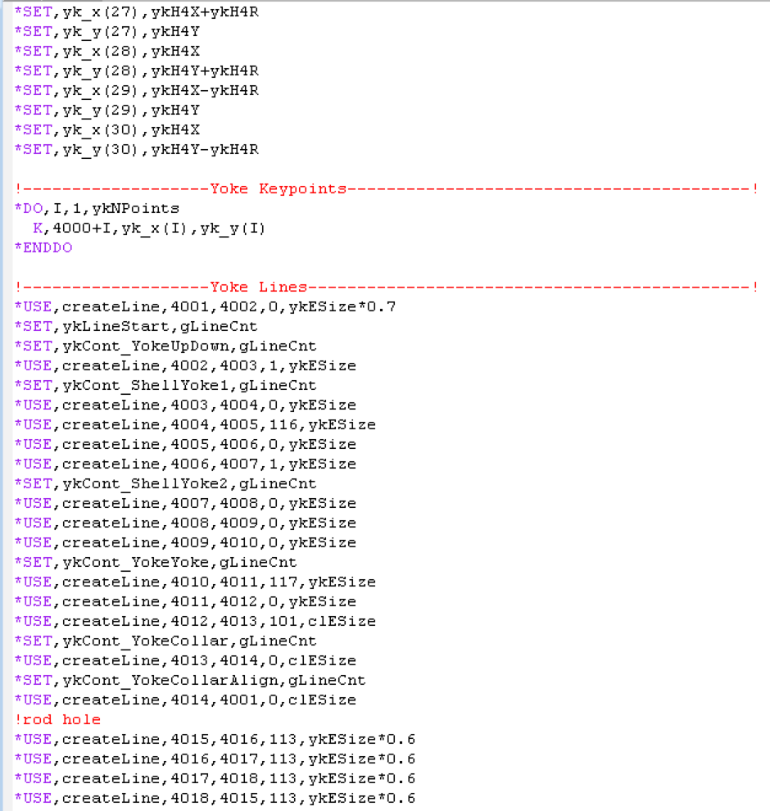
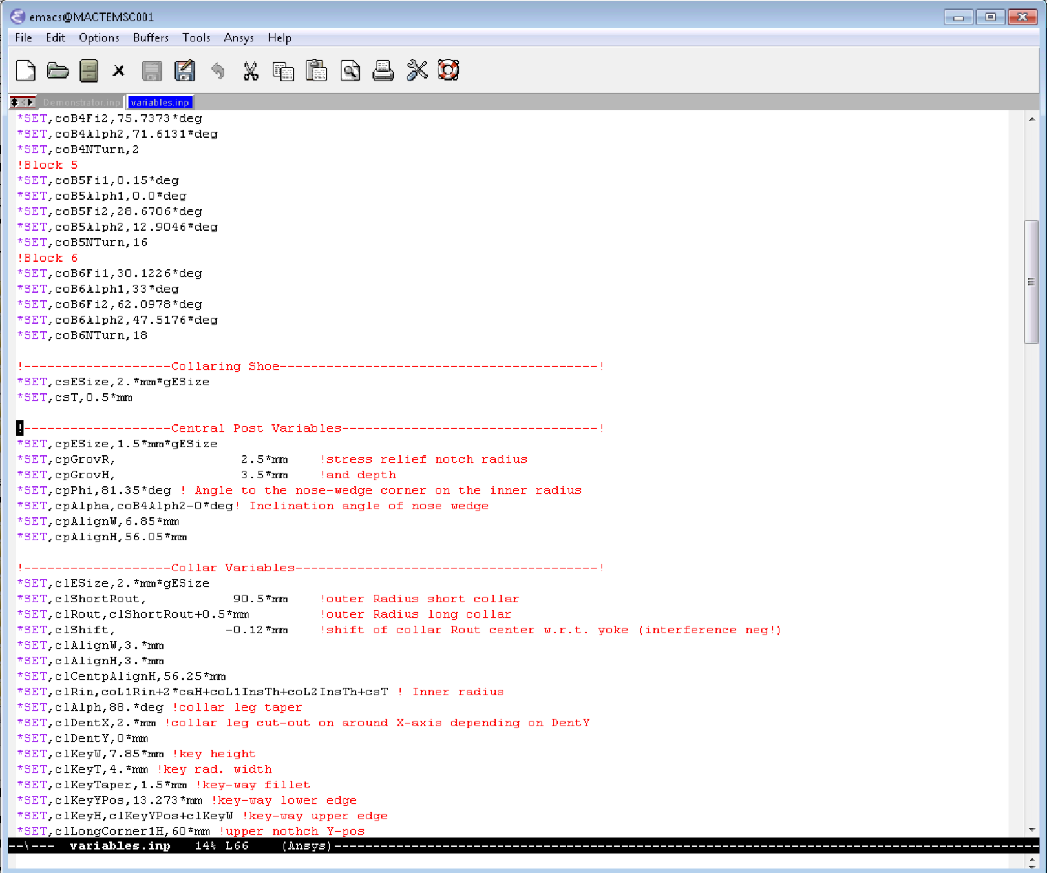
ANSYS flexible programming
namespacing
cl ... Collar, yk … yoke,
cs … collaring shoe
Pointers to otherwise hard-coded
numbering of geometry features

Slide 11
ANSYS flexible programming
Features
Use “namespaced” variables.
Pointers to avoid direct referencing.
Improvements
Code refactoring and versioning
Code review

