Slide 1
Workshop on good programming style
Summary
Michał Maciejewski, Bernhard Auchmann, Lorenzo Bortot, Emmanuele Ravaioli, Jonas Ghini, Deepak Paudel, Arjan Verweij, Jean-Christophe Garnier, Raphaela Heil, Kamil Król, Mateusz Koza and others
TE-MPE-PE
24.06.2015

Slide 2
We do write code…
… which is a Challenge!
Project | Environment
Neural Network Quench Heater Analysis | MATLAB, NN Toolbox
QPS faults analysis | LabVIEW
Quench Simulation Framework | MATLAB/Simulink
UFO Study | MATLAB, Mathematica
FEM Modelling | ANSYS, COMSOL, Opera
BLM Threshold Generator | Mathematica
QP3, CUDI | Fortran, LabVIEW
RB Circuit Analysis | MATLAB
… | …
… a lot of code …

Slide 3
Simple facts
One reads code much more often than writes
One writes code that might work for years
One day someone will have to understand your code
Notes:
MATEUSZ
3 slogans that make perfect sense for software developers
Pay attention to make it readable
Pay attention to make it maintainable
Make sure this won’t be a nightmare

Slide 4




Workshop summary
Goal: To learn core software development skills/processes
Date: 09/07/2015, 9h30-12h30
Attendees: 12 people
Speakers: Raphaela Heil, Mateusz Koza, Kamil Król
Minutes: https://wikis.cern.ch/display/MPESC/2015-07-09+Minutes+from+workshop +about+clean+code+development

Slide 5
Naming conventions: think twice if the name describes its purpose… and is short
I
Acronym | Meaning
CLIQ | Coupling-Loss Induced Quench
QPS | Quench Protection System
HS | HotSpot
Nb-Ti | Niobium-titanium
Nb3Sn | Niobium-tin
CLIQ – name of class/data structure describing CLIQ
U_CLIQ – CLIQ charging voltage – constant parameter all capitals
u_CLIQ – evolution of CLIQ voltage with time – hungarian notation
noOfCLIQUnits – internal variable needed to count CLIQ units
calculateCLIQEnergy() – function name camel case + brackets
Notes:
MATEUSZ
What I want you to understand from this worshop

Slide 6
Use of functions: break down the problem into small parts and solve one after another
II
private void readProcessAndPlotData() {
/* Open and read file with voltage signal */
FileReader.openFile(INPUT_FILE_PATH);
double[] voltageValues= FileReader.readDoubles();
FileReader.closeFile();
/* Divide voltage by constant current to get resistance. */
int[] resistanceValues = new int[voltageValues.length];
for (int i = 0; i < voltageValues.length; i++) {
resistanceValues[i] = voltageValues[i] / CURRENT;
}
/* Plot resistance on the chart. */
Chart chart = ChartUtils.createChart();
chart.setValues(resistanceValues);
chart.display();
}
Notes:
I am not a smart guy. I can’t quickly understand many connections in the code. However with function I can quickly follow the flow – I know inputs and Outputs. Name tells me what is inside.
What I want you to understand from this worshop

Slide 7
Use of functions: break down the problem into small parts and solve one after another
II
private void readAndPlotData() {
double[] voltageValues= readFile(INPUT_FILE_PATH);
double[] resistanceValues= calculateResistance(voltageValues, CURRENT);
plotValues(resistanceValues);
}
Functions increase readability
One can reuse code instead of duplicate it
Functions make the code testable
Single function should do just one logical or content-related operation
Notes:
I am not a smart guy. I can’t quickly understand many connections in the code. However with function I can quickly follow the flow – I know inputs and Outputs. Name tells me what is inside.
What I want you to understand from this worshop

Slide 8
Representation: failure at planning is planning a failure
III
A regular quadrilateral, which means that it has four equal sides and four equal angles.
private void readProcessAndPlotData() {
/* Open and read file with voltage signal */
/* Divide voltage by constant current to get resistance. */
/* Plot resistance on the chart. */
}
Read file
Calculate R=U/I
Present
Notes:
No, it’s not an accelerator ;)
What I want you to understand from this worshop

Slide 9
Exception handling: a problem one expects and handles is not a problem anymore
IV
What if a file does not exist?
private double[] readFile(String filePath) {
try {
FileReader.openFile(filePath);
} catch(FileNotFoundException exception) {
logError(“File doesn’t exist!”, exception);
FileUtils.createNewFile();
}
double[] signalValues = FileReader.readDoubles();
FileReader.closeFile();
return signalValues;
}
}
This situation is expected to happen so we can prepare countermeasures.
This exception is handled!
Notes:
MATEUSZ
What I want you to understand from this worshop

Slide 10
Architecture: If your code grows big then think about layers
V
Acquisition Layer
Analysis Layer
Presentation Layer
Notes:
MATEUSZ
What I want you to understand from this worshop

Slide 11
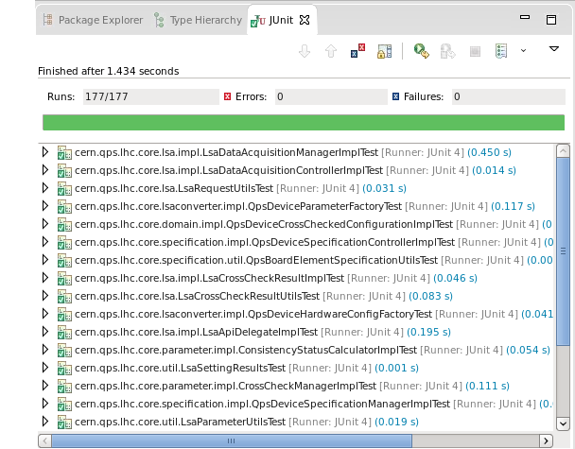
Code testing: no more fear while modifying the code
VI
public double calculateResistance(double circuitVoltage, double circuitCurrent) {
return circuitVoltage / circuitCurrent;
}
@Test
public void testCalculateResistance() {
assertEquals(5, calculateResistance(10, 2));
}
@Test(expected = ArithmeticException.class)
public void testCalculateResistanceWithException() {
calculateResistance(10, 0);
}
Notes:
MATEUSZ
What I want you to understand from this worshop

Slide 12
Parametrization: stop commenting bits of code to execute different parts
VII
/* Uncomment if you want to calculate resistance from voltage measured at 07Jun2015. */
FileReader.openFile(“voltage07Jun2015.csv”);
/* Uncomment if you want to calculate resistance from voltage measured at 17Jun2015. */
// FileReader.openFile(“voltage17Jun2015.csv”);
/* Uncomment if you want to calculate resistance from voltage measured at 01Aug2014. */
// FileReader.openFile(“voltage01Aug2014.csv”);
<properties>
<property>
<key>inputFile</key>
<value>C:/working-dir/files/qpsPmData.pmd</value>
</property>
<property>
<key>thresholdsFile</key>
<value>C:/working-dir/files/qpsThresholds.csv</value>
</property>
</properties>
Notes:
MATEUSZ
What I want you to understand from this worshop

Slide 13
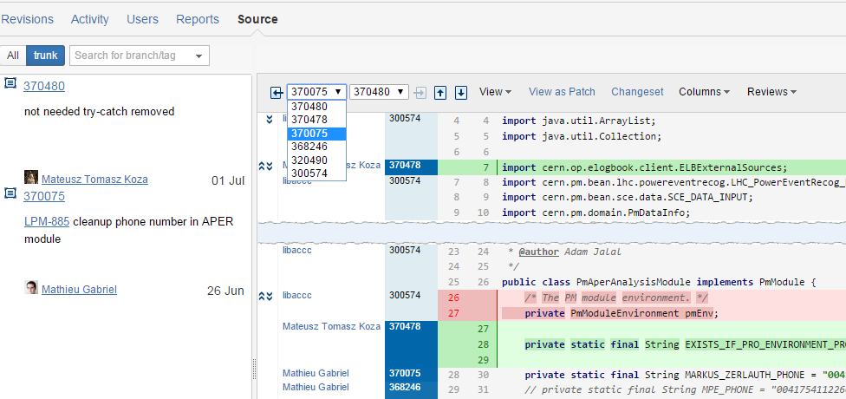
Code versioning: you no longer need script_v1.m, script_v2.m, script_v3a.m
VIII
Notes:
Also for Latex
What I want you to understand from this worshop

Slide 14

Pair programming: two heads are better than one
IX
Two developers, one keyboard
  One writes code
  One thinks about further steps, looks from wider perspective, finds conceptual problems
Responsibilities are switched every now and then
Advantages
  Cleaner solutions
  Knowledge sharing
Notes:
MATEUSZ
What I want you to understand from this worshop

Slide 15
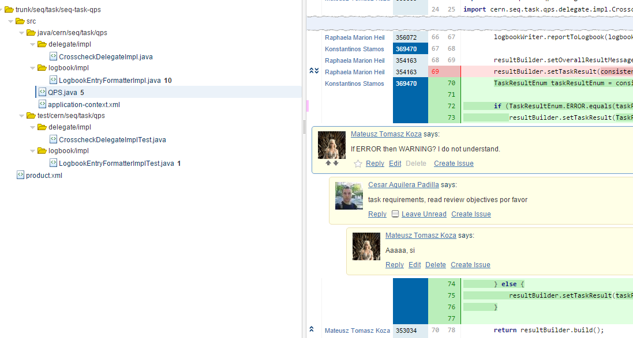
Code reviewing: everyone knows what’s happening around – expertise continuity
X
Code review
  Systematic examination of delivered code made by other teammates involved or not into the process.
  Can be done face to face or with advantage of specialised tools
  Improves quality – Two heads (or more!) are better than one
  Helps other people understand our work
Notes:
MATEUSZ
What I want you to understand from this worshop

Slide 16

Next steps
Definition of coding conventions
  Naming convention
  Heuristics for GUI
  What mechanisms apply to what projects:
  prototypes → single user → multi user → machine protection
Projects consulating (NN, QSF, PM, …)
Setting up a repository + code review tool

Slide 17
Discussion
?
What we could profit from?
How about a workshop on OOP?

Slide 18
Thank you for your attention

