Slide 2
TE-MPE-PE new member presentation
Alejandro Fernández Navarro
TE-MPE-PE
16.07.2015

Slide 3
Background
2009-2014: Industrial Engineer specialized in Energy, at Universidad Politécnica of Madrid (UPM)
2013-2014: 5th year and Master´s thesis at Aalto University of Helsinki (Erasmus).
“Impact of fusion neutrons on helium production in beryllium and tungsten, and tritium breeding in ITER and DEMO”
2012-2014: European Master of Science in Nuclear Engineering (EMSNE) granted by the European Nuclear Education Network (ENEN)
Others:
Computer skills (EES, Matlab, Arcgis, Serpent, Java, Autocad, Photoshop, Solid Edge).
Languages: English, French. Work experience as light and sound technician and teacher

Slide 4
Foreseen project at TE-MPE-PE
“Modelling and testing of circuit protection of new superconducting magnets for the HL-LHC project”
Contract: Trainee. FTEC-2015 Spanish Trainee Programme. Agreement CERN-Ciemat. Supervisor: Arjan Verweij. Aimed at recent Master graduates. Duration 1 to 2 years
First steps: Learn about superconductivity, quench protection, CLIQ and the Quench Simulation Framework (QSF)
Now-August: CLIQ simulations of the LHC main dipole magnets. Testing in SM-18
Following months: CLIQ simulations of the HL-LHC superconducting magnets (like the Nb3Sn, MQXF quadrupole magnet). Testing in SM-18

Slide 5
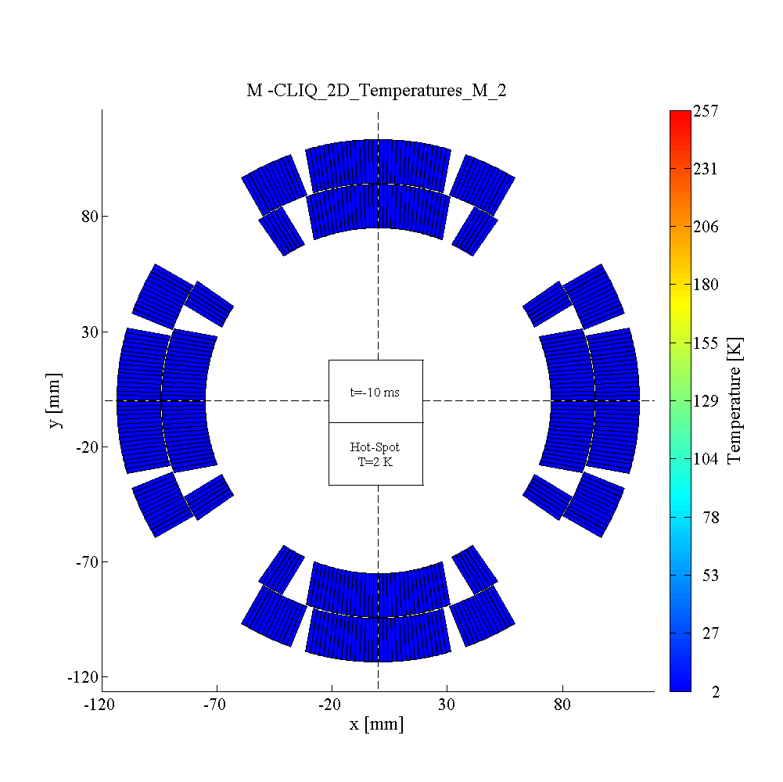
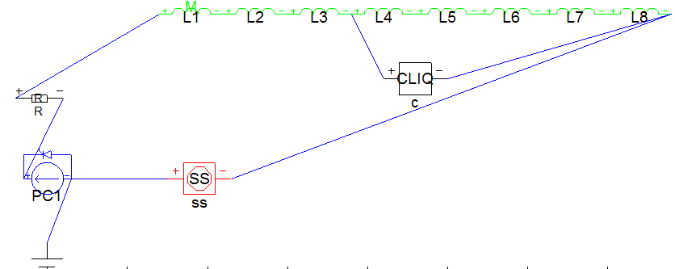
CLIQ simulation example: MQXF, 12kA

