Slide 1

Software development process and tools
Mateusz Koza, Kamil Król

Slide 2
Motivation
You read code much more often than write
You write code that might work for years
One day someone will have to understand your code
Notes:
MATEUSZ
Pay attention to make it readable
Pay attention to make it maintainable
Make sure this won’t be a nightmare

Slide 3
Core skills
Coding conventions
Use of functions
Problem representation
Divide et impera
Exception handling
Code testing
Architecture
Parametrization
Code versioning
Pair programming
Code reviewing
Notes:
KAMIL

Slide 4
Core skills
Coding conventions
Use of functions
Problem representation
Divide et impera
Exception handling
Code testing
Architecture
Parametrization
Code versioning
Pair programming
Code reviewing
Notes:
KAMIL

Slide 5
DatabaseRow row = Database.getRow();
int a = row.column1;
int b = row.column2;
double c = b / a;
data.add(new Measurement(t, c));
Notes:
KAMIL

Slide 6
Coding conventions
Why coding conventions are so important?
Naming conventions
  What does it mean good name?
  Avoid using short / too long names
  Separate words
Notes:
KAMIL

Slide 7
Naming conventions
Name variables meaningfully and in unified way – exampleDescriptiveName
Name constants with capital letters. Separate words using underscore EXAMPLE_CONSTANT_NAME
Choose function names that self describe themselves – exampleFunction()
Use only well know acronyms – Qps, Lhc,
avoid less known – Dqamcnmb,
Notes:
KAMIL

Slide 8
DatabaseRow row = Database.getRow();
int a = row.column1;
int b = row.column2;
double c = b / a;
data.add(new Measurement(t, c));
Notes:
KAMIL

Slide 9
DatabaseRow row = Database.getRow();
int current = row.column1;
int b = row.column2;
double c = b / current;
data.add(new Measurement(t, c));
Notes:
KAMIL

Slide 10
DatabaseRow row = Database.getRow();
int current = row.column1;
int voltage = row.column2;
double c = voltage / current;
data.add(new Measurement(t, c));
Notes:
KAMIL

Slide 11
DatabaseRow row = Database.getRow();
int current = row.column1;
int voltage = row.column2;
double resistance = voltage / current;
data.add(new Measurement(time, resistance));
Notes:
KAMIL

Slide 12
Core skills
Coding conventions
Use of functions
Problem representation
Exception handling
Code testing
Architecture
Parametrization
Code versioning
Pair programming
Code reviewing
Notes:
KAMIL

Slide 13
double varianceEnExp = Math.variance(tauEnExp);
double sigmaEnExp = Math.sqrt(varianceEnExp);
Notes:
KAMIL

Slide 14
double varianceEnExp = Math.variance(tauEnExp);
double sigmaEnExp = Math.sqrt(varianceEnExp);
double varianceEnLog = Math.variance(tauEnLog);
double sigmaEnLog = Math.sqrt(varianceEnLog);
Notes:
KAMIL

Slide 15
double varianceEnExp = Math.variance(tauEnExp);
double sigmaEnExp = Math.sqrt(varianceEnExp);
double varianceEnLog = Math.variance(tauEnLog);
double sigmaEnLog = Math.sqrt(varianceEnLog);
double varianceDer = Math.variance(tauDer);
double sigmaDer = Math.sqrt(varianceDer);
Notes:
KAMIL

Slide 16
Small meaningful units of logic - functions
Functions allow to increase readability by splitting the code into meaningful modules
Splitting can improve maintainability of the code
Thanks to functions you can reuse code instead of duplicate it
Functions make the code testable
  Single function should do just one logical or content-related operation
Notes:
KAMIL

Slide 17
double varianceEnExp = Math.variance(tauEnExp);
double sigmaEnExp = Math.sqrt(varianceEnExp);
double varianceEnLog = Math.variance(tauEnLog);
double sigmaEnLog = Math.sqrt(varianceEnLog);
double varianceDer = Math.variance(tauDer);
double sigmaDer = Math.sqrt(varianceDer);
double calculateSigma(double[] tau) {
double variance = Math.variance(tau);
return Math.sqrt(variance);
}
Notes:
KAMIL

Slide 18
double varianceEnExp = Math.variance(tauEnExp);
double sigmaEnExp = Math.sqrt(varianceEnExp);
double varianceEnLog = Math.variance(tauEnLog);
double sigmaEnLog = Math.sqrt(varianceEnLog);
double varianceDer = Math.variance(tauDer);
double sigmaDer = Math.sqrt(varianceDer);
double calculateSigma(double[] tau) {
double variance = Math.variance(tau);
return Math.sqrt(variance);
}
Notes:
KAMIL

Slide 19
double sigmaEnExp = calculateSigma(tauEnExp);
double sigmaEnLog = calculateSigma(tauEnLog);
double sigmaDer = calculateSigma(tauDer);
double calculateSigma(double[] tau) {
double variance = Math.variance(tau);
return Math.sqrt(variance);
}
Notes:
KAMIL

Slide 20
Core skills
Coding conventions
Use of functions
Problem representation
Divide et impera
Exception handling
Code testing
Architecture
Parametrization
Code versioning
Pair programming
Code reviewing
Case study
Notes:
KAMIL

Slide 21
How to represent our ideas?
A plane figure whose boundary (the circumference) consists of points equidistant from a fixed point (the centre).
Notes:
MATEUSZ
Description can be expressed many ways. It can be for example bunch of words to define very well the expectactions.

Slide 22
How to represent our ideas?
A plane figure whose boundary (the circumference) consists of points equidistant from a fixed point (the centre).
Notes:
MATEUSZ
Or it can be simply graphics that explains more than thousands words.

Slide 23
How to represent our ideas?
Graphically - Unified Modelling Language (UML)
  Sequence diagrams – to represent system behaviour
As Text - Pseudo code
  A way to represent algorithms as text
  Meaningful and generic regardless technology
Notes:
MATEUSZ
But let’s have a look how software developers do the description of the problems. We have mainly two tools to describe our problems.
Unified modeling language – made for easy and meaningful standardized graphics to explain e.g. assumptions, or behavior of systems.
Pseudocode -

Slide 24
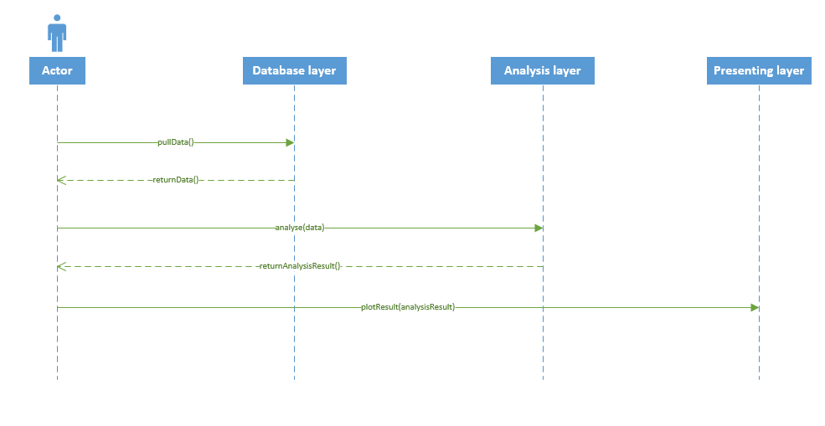
How to represent our ideas?
UML – sequence diagrams
  represents the flow fromof one activity to another activity. The activity can be described as an operation of the system
Notes:
MATEUSZ
Here we can see an example of sequence diagram – probably the most common UML diagram to describe the system work flow. Very easy to learn, very powerful to explain component or system behavior.

Slide 25
How to represent our ideas?
Pseudo code – the way how to present algorithms
  informal high-level description of the operating principle of a computer program or other algorithm.
Notes:
MATEUSZ
The keyword in case of pseudo code is “high level”. It means that to really write or understand this way of description, you don’t have to know any specific programming language, but just set of conventions and possible statements.

Slide 26
How to represent our ideas?
Pseudo code – descriptional
  Uses words to describe intuitively the problem
  For each signal from signalValues
  multiply signal by SCALAR
  assign signal to modifiedSignalValues
  end for
Notes:
MATEUSZ
Pseudo code can be divided into two ways of expressing problems. Basically the easiest and most understandable is descriptional pseudo code. Looks like you’d just saying what is supposed to do.

Slide 27
Case study – resistance calculation
  Our colleague Steve develops a code that calculates crowbar resistance. Code will help detecting failures. For that purpose it reads voltage signal from a file. Since current is not measure he assumes a constant value. Resistance calculated this way is displayed to experts.
Read file
Calculate R=U/I
Present
Notes:
MATEUSZ
Even simple graphics can be used to intuitively explain sophisticated issues

Slide 28
private void readProcessAndPlotData() {
/* Open and read file with voltage signal */
FileReader.openFile(INPUT_FILE_PATH);
double[] signalValues = FileReader.readDoubles();
FileReader.closeFile();
/* Divide voltage by constant current to get resistance. */
int[] modifiedSignalValues = new int[signalValues.length];
for (int i = 0; i < signalValues.length; i++) {
modifiedSignalValues[i] = SCALAR* signalValues[i];
}
/* Plot resistance on the chart. */
Chart chart = ChartUtils.createChart();
chart.setValues(modifiedSignalValues);
chart.display();
}
Notes:
KAMIL

Slide 29
private void readProcessAndPlotData() {
/* Open and read file with voltage signal */
FileReader.openFile(INPUT_FILE_PATH);
double[] signalValues = FileReader.readDoubles();
FileReader.closeFile();
/* Divide voltage by constant current to get resistance. */
int[] resistanceValues = new int[voltageValues.length];
for (int i = 0; i < voltageValues.length; i++) {
resistanceValues[i] = voltageValues[i] / CURRENT;
}
/* Plot resistance on the chart. */
Chart chart = ChartUtils.createChart();
chart.setValues(resistanceValues);
chart.display();
}
Is it a clean code?
Notes:
KAMIL

Slide 30
Core skills
Coding conventions
Use of functions
Problem representation
Divide et impera
Exception handling
Code testing
Architecture
Parametrization
Code versioning
Pair programming
Code reviewing
Notes:
KAMIL

Slide 31
private void readAndPlotData() {
/* Open and read file with voltage signal */
FileReader.openFile(INPUT_FILE_PATH);
double[] voltageValues = FileReader.readDoubles();
FileReader.closeFile();
/* Divide voltage by constant current to get resistance. */
int[] resistanceValues = new int[voltageValues.length];
for (int i = 0; i < voltageValues.length; i++) {
resistanceValues[i] = voltageValues[i] / CURRENT;
}
/* Plot resistance on the chart. */
Chart chart = ChartUtils.createChart();
chart.setValues(resistanceValues);
chart.display();
}
Notes:
KAMIL

Slide 32
private void readAndPlotData() {
double[] voltageValues = readFile(INPUT_FILE_PATH);
/* Divide voltage by constant current to get resistance. */
int[] resistanceValues = new int[voltageValues.length];
for (int i = 0; i < voltageValues.length; i++) {
modifiedSignalValues[i] = voltageValues[i] / CURRENT;
}
/* Plot values on the chart. */
Chart chart = ChartUtils.createChart();
chart.setValues( resistanceValues );
chart.display();
}
private double[] readFile(String filePath) {
FileReader.openFile(filePath);
double[] signalValues = FileReader.readDoubles();
FileReader.closeFile();
return signalValues;
}
Notes:
KAMIL

Slide 33
private void readAndPlotData() {
double[] voltageValues = readFile(INPUT_FILE_PATH);
double[] resistanceValues = calculateResistance(voltageValues, CURRENT);
/* Plot values on the chart. */
Chart chart = ChartUtils.createChart();
chart.setValues(resistanceValues );
chart.display();
}
private double[] readFile(String filePath) {
FileReader.openFile(filePath);
double[] signalValues = FileReader.readDoubles();
FileReader.closeFile();
return signalValues;
}
private double[] calculateResistance(double[] voltageValues, int current) {
double[] resistanceValues = new int[voltageValues.length];
for (int i = 0; i < voltageValues.length; i++) {
resistanceValues[i] = voltageValues[i] / current;
}
return resistanceValues;
}
Notes:
KAMIL

Slide 34
private void readAndPlotData() {
double[] voltageValues = readFile(INPUT_FILE_PATH);
double[] resistanceValues = calculateResistance(voltageValues, CURRENT);
plotValues(resistance Values);
}
private double[] readFile(String filePath) {
FileReader.openFile(filePath);
double[] signalValues = FileReader.readDoubles();
FileReader.closeFile();
return signalValues;
}
private double[] calculateResistance(double[] voltageValues, int current) {
double[] resistanceValues = new int[voltageValues.length];
for (int i = 0; i < voltageValues.length; i++) {
resistanceValues[i] = voltageValues[i] / current;
}
return resistanceValues;
}
private void plotValues(double[] signalValues) {
Chart chart = ChartUtils.createChart();
chart.setValues(signalValues);
chart.display();
}
Notes:
KAMIL

Slide 35
Core skills
Coding conventions
Use of functions
Problem representation
Divide et impera
Exception handling
Code testing
Architecture
Parametrization
Code versioning
Pair programming
Code reviewing
Notes:
KAMIL

Slide 36
private double[] readFile(String filePath) {
FileReader.openFile(filePath);
double[] signalValues = FileReader.readDoubles();
FileReader.closeFile();
return signalValues;
}
What if a file does not exist?!
Notes:
MATEUSZ
Everything would be fine here in the perfect world. But the perfect world doesn’t exist unfortunately. In the real world lots of things can happen. Train can get out of the tracks, or simply file could have been relocated and this path does not exist anymore.

Slide 37
Handling exceptional situations
Block try…catch
try {
/* perform operation that might throw exception */
} catch ( /* expected exception */ ) {
/* perform exceptional operation-come back from error state */
}
  Always try to catch for specific expected exception
  Put inside the block only exceptional code
Notes:
MATEUSZ
A manner how to handle exceptions is try catch block. I suppose everyone knows exactly what’s that – but just to remind – this is block that allows to handle possible program failures and recover from error state.

Slide 38
Handling exceptional situations
Good usage
try {
FileReader.openFile(filePath);
} catch (FileNotFoundException exception) {
logError(“Cannot open file", exception);
FileUtils.createNewFile();
}
Notes:
MATEUSZ

Slide 39
What if file does not exist?
private double[] readFile(String filePath) {
try {
FileReader.openFile(filePath);
} catch(FileNotFoundException exception) {
logError(“File doesn’t exist!”, exception);
FileUtils.createNewFile();
}
double[] signalValues = FileReader.readDoubles();
FileReader.closeFile();
return signalValues;
}
}
This situation is expected to happen so we can prepare countermeasures.
This exception is handled!
Notes:
MATEUSZ
Let’s come back to our problem. First of all this is how we try to catch possible exception. Now if file does not exist, assumed actions will be performed. Please keep in mind this meaningful log message, that makes us able to understand problems that appeared.

Slide 40
Handling exceptional situations
Example of bad usage
try {
performSimulation(5);
} catch (Exception e1) {
try {
performSimulation(4);
} catch (Exception e2) {
try {
performSimulation(3);
} catch (Exception e3) {
try {
performSimulation(2);
} catch (Exception e4) {
}
}
}
}
Notes:
MATEUSZ – check of simulation time (5), (4), (3) is more descriptive then trials and errors.
We should always avoid loosing the cause of original problem.

Slide 41

10 minute coffee break
Notes:
KAMIL

Slide 42
Core skills
Coding conventions
Use of functions
Problem representation
Divide et impera
Exception handling
Code testing
Architecture
Parametrization
Code versioning
Pair programming
Code reviewing
Notes:
KAMIL

Slide 43
How can we test our solutions?
Testing
Unit testing
Notes:
MATEUSZ
What is testing? What is unit testing?
Testing is making sure that written code returns deterministic output for given input.
Unit testing is making sure that single piece of code behaves as expected and is resistant for boundary cases, possible user failures. This testing assume that we don’t consider the impact of environment. We test it regardless side effects.

Slide 44
public double calculateResistance(double circuitVoltage, double circuitCurrent) {
return circuitVoltage / circuitCurrent;
}
Notes:
MATEUSZ

Slide 45
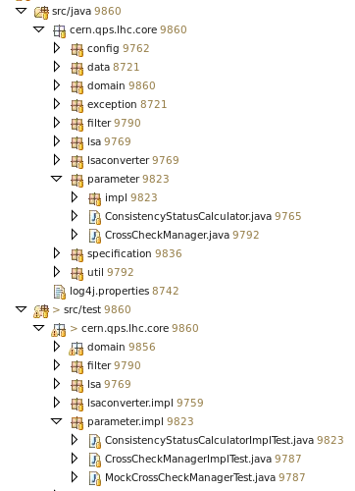
How can we test our solutions?
Unit testing - principles
  Test single piece of code regardless the environment side effects.
  Test boundary cases, failure cases, try to break your code
  Think about good test naming and structuring
Notes:
MATEUSZ
Don’t e.g. rely on the dependencies being used by method – this is what we call environmental influence

Slide 46
How can we test our solutions?
Unit testing - benefits
  Benefit from tested project in case of changes
  Understand code better reading existing tests
  Early find possible problems
Notes:
MATEUSZ

Slide 47
public double calculateResistance(double circuitVoltage, double circuitCurrent) {
return circuitVoltage / circuitCurrent;
}
@Test
public void testCalculateResistance() {
assertEquals(5, calculateResistance(10, 2));
}
Notes:
MATEUSZ

Slide 48
public double calculateResistance(double circuitVoltage, double circuitCurrent) {
return circuitVoltage / circuitCurrent;
}
@Test
public void testCalculateResistance() {
assertEquals(5, calculateResistance(10, 2));
}
@Test(expected = ArithmeticException.class)
public void testCalculateResistanceWithException() {
calculateResistance(10, 0);
}
Notes:
MATEUSZ

Slide 49
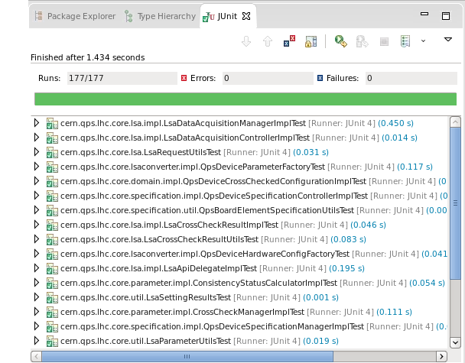
As you can see – testing is not only an urban legend…
Notes:
MATEUSZ
There is many opinions that testing is waste of time. That’s not true! If you have to maintain your code, you save a lot of time thanks to having tests!

Slide 50
How can we test our solutions?
Unit testing extensions are available for almost every language.
  MATLAB: http://www.mathworks.com/matlabcentral/fileexchange/22846-matlab-xunit-test-framework
Notes:
MATEUSZ

Slide 51
Core skills
Coding conventions
Use of functions
Problem representation
Divide et impera
Exception handling
Code testing
Architecture
Parametrization
Code versioning
Pair programming
Code reviewing
Notes:
KAMIL

Slide 52
Splitting responsibilities
– multiple layers of the application
Acquisition Layer
Analysis Layer
Presentation Layer
Notes:
KAMIL

Slide 53
Splitting responsibilities
– multiple layers of the application
Clean separation between different functionalities of the application
Possibility to reuse some parts of the logic in multiple projects
Increased maintainability of project
Extendable architecture
Notes:
KAMIL

Slide 54
Core skills
Coding conventions
Use of functions
Problem representation
Divide et impera
Exception handling
Code testing
Architecture
Parametrization
Code versioning
Pair programming
Code reviewing
Notes:
KAMIL

Slide 55
/* Uncomment if you want to calculate resistance from voltage measured at 07Jun2015. */
FileReader.openFile(“voltage07Jun2015.csv”);
/* Uncomment if you want to calculate resistance from voltage measured at 17Jun2015. */
// FileReader.openFile(“voltage17Jun2015.csv”);
/* Uncomment if you want to calculate resistance from voltage measured at 01Aug2014. */
// FileReader.openFile(“voltage01Aug2014.csv”);
Notes:
KAMIL

Slide 56
Parametrization of the application
Parametrization means saving time
How to parametrize an application?
  Execution arguments
  Configuration files e.g. XML
Notes:
KAMIL

Slide 57
Execution arguments
Hej Kamil, zmień proszę ten slajd zgodnie ze slajdem 55
Notes:
KAMIL

Slide 58
XML configuration file
<properties>
<property>
<key>inputFile</key>
<value>C:/working-dir/files/qpsPmData.pmd</value>
</property>
<property>
<key>thresholdsFile</key>
<value>C:/working-dir/files/qpsThresholds.csv</value>
</property>
</properties>
Notes:
KAMIL

Slide 59
Core skills
Coding conventions
Use of functions
Problem representation
Divide et impera
Exception handling
Code testing
Architecture
Parametrization
Code versioning
Pair programming
Code reviewing
Notes:
KAMIL

Slide 60
Working in the team – code versioning
Revision control
  Management of changes made to documents
  Facilitates (makes possible) cooperation between developers
  Unified storage for changes, simple look into the history, everything in one place
Notes:
MATEUSZ

Slide 61
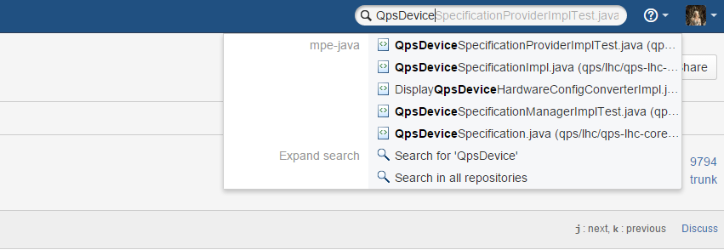
Working in the team – code versioning
Multiple implementations: SVN, GIT etc.
  At CERN: SVN (IT) and GIT (IT)
Good support and tools both for all common OS and development tools
Notes:
MATEUSZ

Slide 62
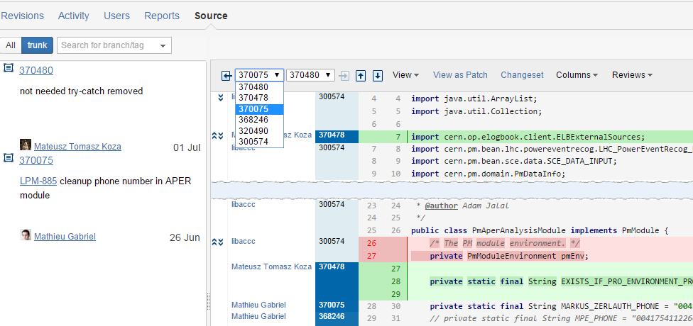
Working in the team – code versioning
Desktop/web tools to browse content of the repository
Notes:
MATEUSZ

Slide 63
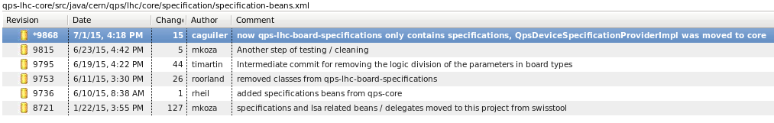
Working in the team – code versioning
Desktop/web tools to browse content of the repository
Notes:
MATEUSZ

Slide 64
Core skills
Coding conventions
Use of functions
Problem representation
Divide et impera
Exception handling
Code testing
Architecture
Parametrization
Code versioning
Pair programming
Code reviewing
Notes:
KAMIL

Slide 65

Pair programming – two heads better than one
Two developers, one keyboard
  One writes code
  One thinks about further steps, looks from wide perspective, finds conceptual problems
Responsibilities are switched every now and then
Advantages
  Cleaner solutions
  Knowledge sharing
Notes:
MATEUSZ

Slide 66
Core skills
Coding conventions
Use of functions
Problem representation
Divide et impera
Exception handling
Code testing
Architecture
Parametrization
Code versioning
Pair programming
Code reviewing
Notes:
KAMIL

Slide 67
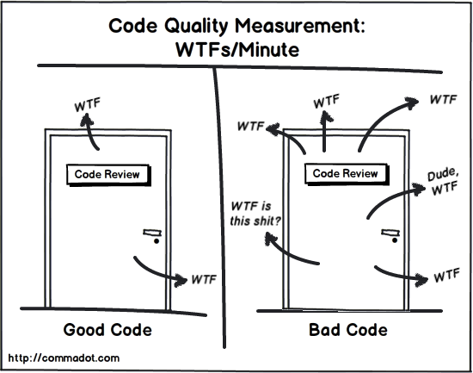
Reviews
Code review
Notes:
KAMIL

Slide 68
Reviews
Code review
  Systematic examination of delivered code made by other teammates involved or not into the process.
  Can be done face to face or with advantage of specialised tools
  Improves quality – Two heads (or more!) are better than one
  Helps other people understand our work
Notes:
KAMIL

Slide 69
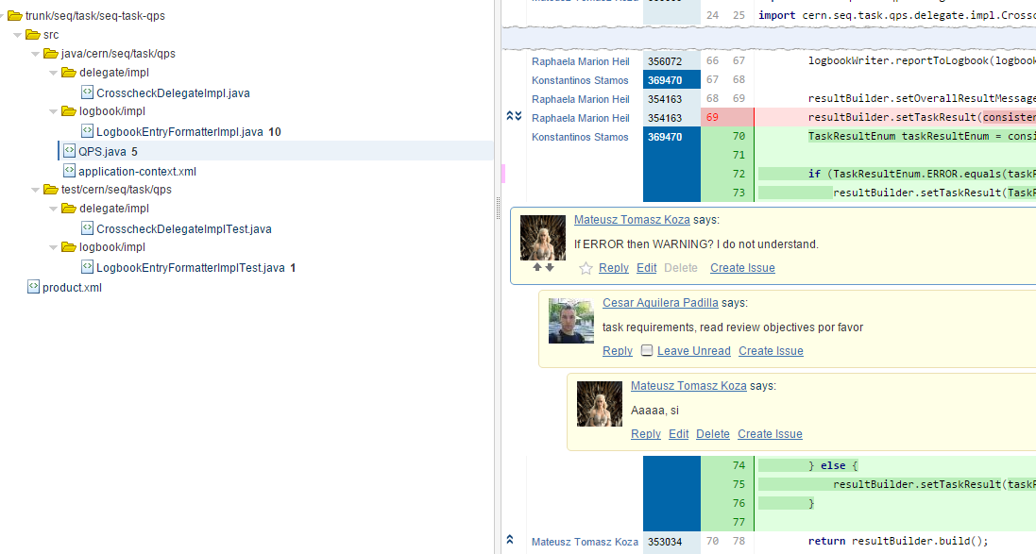
Reviews
Code review – crucible
Notes:
KAMIL

Slide 70
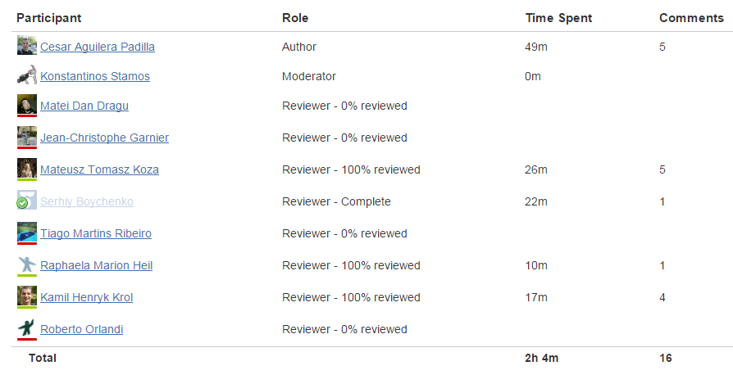
Reviews
Code review – crucible
Notes:
KAMIL

Slide 71
Our coding decalogue
Naming conventions: think twice if the name describes its purpose… and is short
Use of functions: break down the problem into small parts and solve one after another
Representation: failure at planning is planning a failure
Exception handling: a problem one expects and handles is not a problem anymore
Architecture: try to follow Acquire → Analyse → Present
Notes:
MATEUSZ

Slide 72
Our coding decalogue
Code testing: no more fear while modifying the code
Parametrization: stop commenting bits of code to execute different parts
Code versioning: you no longer need script_v1.m, script_v2.m, script_v3a.m
Pair programming: two heads are better than one
Code reviewing: everyone knows what’s happening around – expertise continuity
Notes:
MATEUSZ

Slide 73
Interested?
Interesting literature:
  Clean Code: A Handbook of Agile Software Craftsmanship, Robert C. Martin
  The Clean Coder, Robert C. Martin
You can always pass by our office at 5th floor.
Notes:
KAMIL

Slide 74
Thank you!
Special thanks to: Jean-Christophe, Markus, Bernhard Michał and Lorenzo

