Slide 2
CLIQ on D2, Q4 and D1 of HL-LHC
Alejandro Fernandez, Emmanuele Ravaioli
TE-MPE-PE
22.10.2015
CLIQ on D2, Q4 and D1 of HL-LHC
E. Ravaioli and A. Fernandez

Slide 3
Outline
Insertion Region
D2
Q4
D1
Conclusions
Annex
CLIQ on D2, Q4 and D1 of HL-LHC
E. Ravaioli and A. Fernandez

Slide 4
Insertion Region
CLIQ on D2, Q4 and D1 of HL-LHC
E. Ravaioli and A. Fernandez

Slide 5
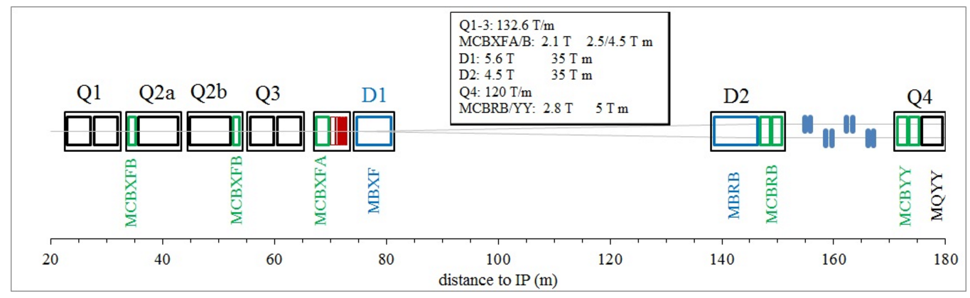
Layout of the Insertion Region of
HL-LHC
Separation Dipole
Recombination Dipole
Two-in-one Quadrupole
CLIQ on D2, Q4 and D1 of HL-LHC
E. Ravaioli and A. Fernandez

Slide 6
D2
CLIQ on D2, Q4 and D1 of HL-LHC
E. Ravaioli and A. Fernandez

Slide 7
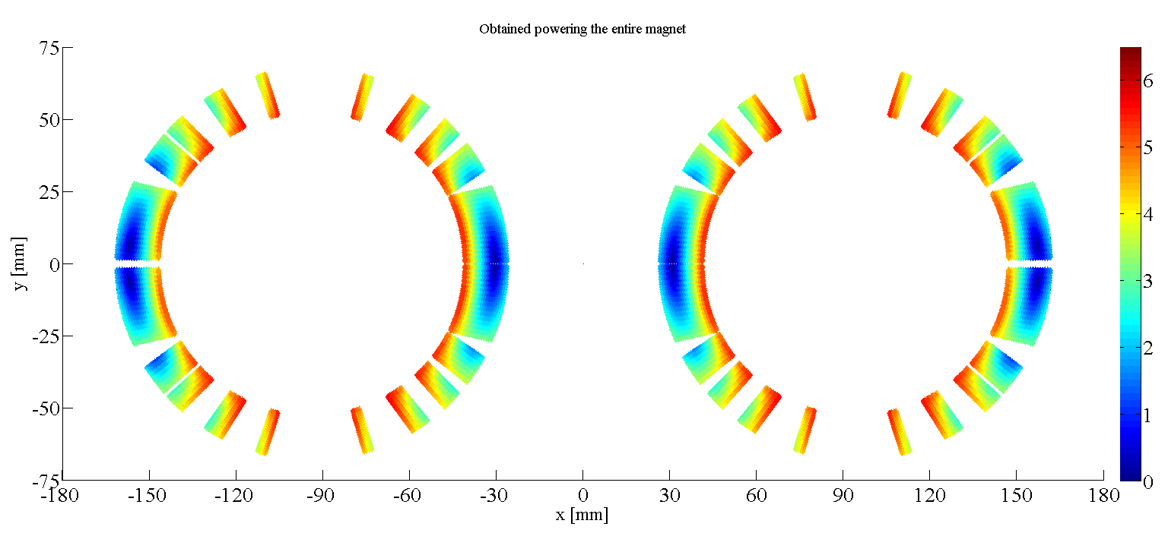

D2 cross-section and characteristics
Characteristic | Value
Name | D2 Recombination dipole (MBRD)
Magnet type | Twin-aperture dipole (asymmetric), 1 coil layer
Aperture | 105 mm
Coil material | Nb-Ti
Magnetic length | 7.79 m
Nominal current | 12050 A
Nominal magnetic field peak | 5.2 T
Operational temperature | 1.9 K
Cable type | Rutherford, MB outer layer (36 strands)
Number of half-turns | 248
_
+
_
+
CLIQ on D2, Q4 and D1 of HL-LHC
E. Ravaioli and A. Fernandez

Slide 8
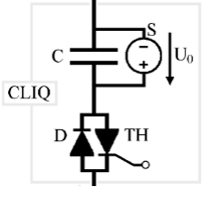
CLIQ connection schemes
1-CLIQ
Configuration: 13-24
2-CLIQ
Configuration: 13-24
CLIQ on D2, Q4 and D1 of HL-LHC
E. Ravaioli and A. Fernandez

Slide 9
CLIQ capacitance sweep at nominal current
CLIQ on D2, Q4 and D1 of HL-LHC
E. Ravaioli and A. Fernandez

Slide 10
Hot spot temperature against current
CLIQ on D2, Q4 and D1 of HL-LHC
E. Ravaioli and A. Fernandez

Slide 11
CLIQ discharge and current drop
1 CLIQ unit at 1 kV, 20 mF. 12050 A
CLIQ on D2, Q4 and D1 of HL-LHC
E. Ravaioli and A. Fernandez

Slide 12
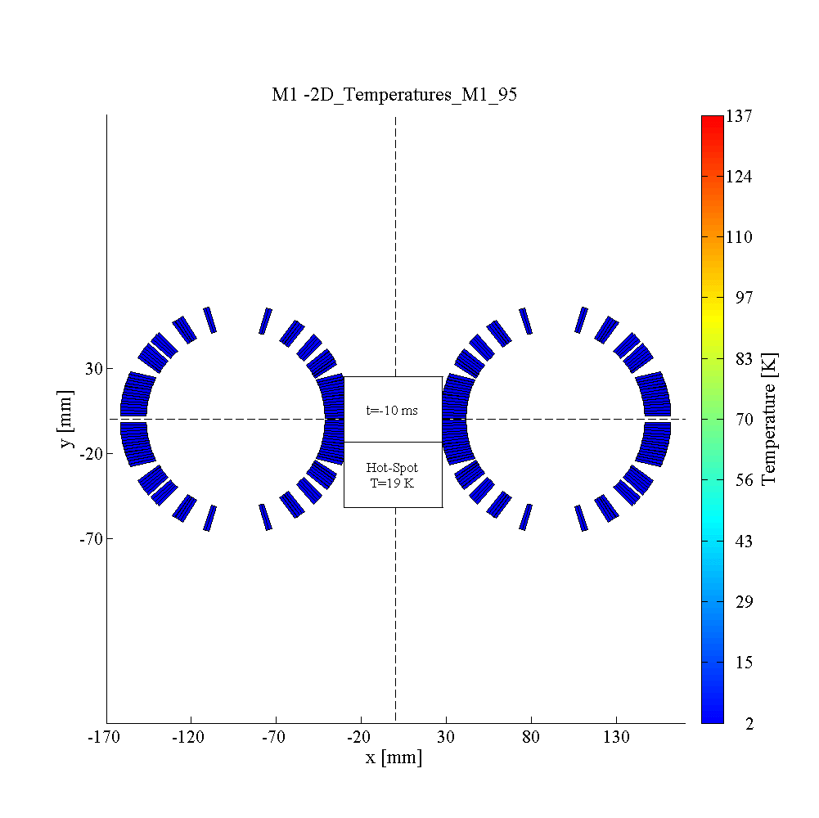
Temperature profile
1 CLIQ unit at 1 kV, 20 mF. 12050 A
CLIQ on D2, Q4 and D1 of HL-LHC
E. Ravaioli and A. Fernandez

Slide 13
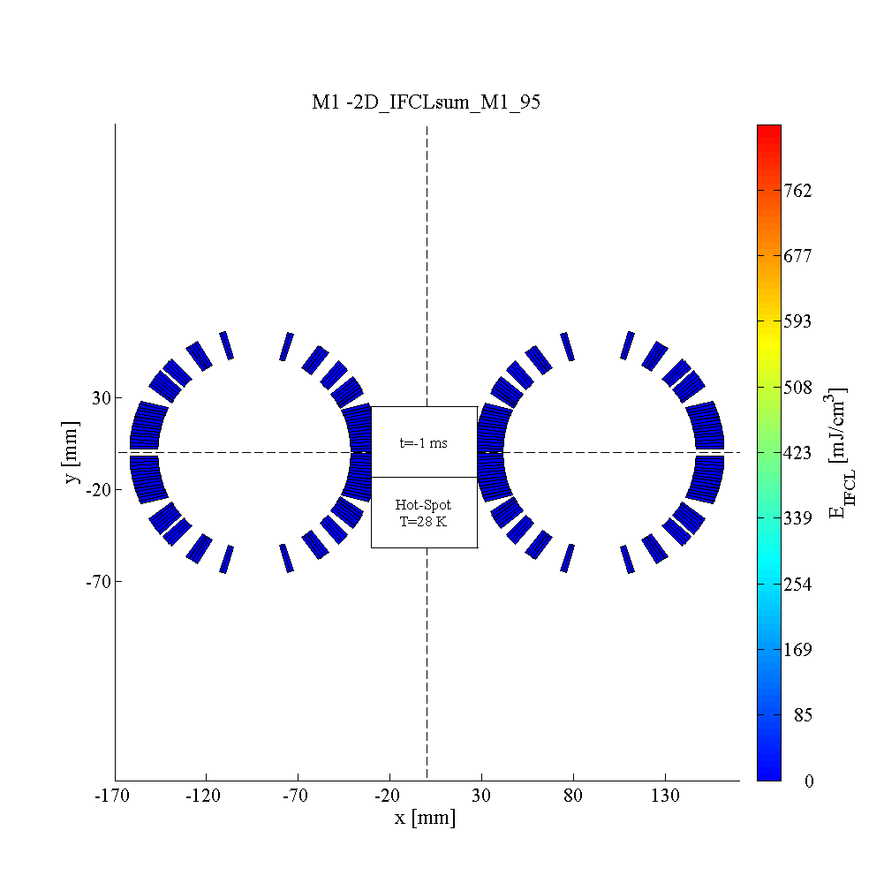
Inter-filament Coupling Losses
1 CLIQ unit at 1 kV, 20 mF. 12050 A
CLIQ on D2, Q4 and D1 of HL-LHC
E. Ravaioli and A. Fernandez

Slide 14
Voltages to ground
1 CLIQ unit at 1 kV, 20 mF. 12050 A
CLIQ on D2, Q4 and D1 of HL-LHC
E. Ravaioli and A. Fernandez

Slide 15
Q4
CLIQ on D2, Q4 and D1 of HL-LHC
E. Ravaioli and A. Fernandez

Slide 16
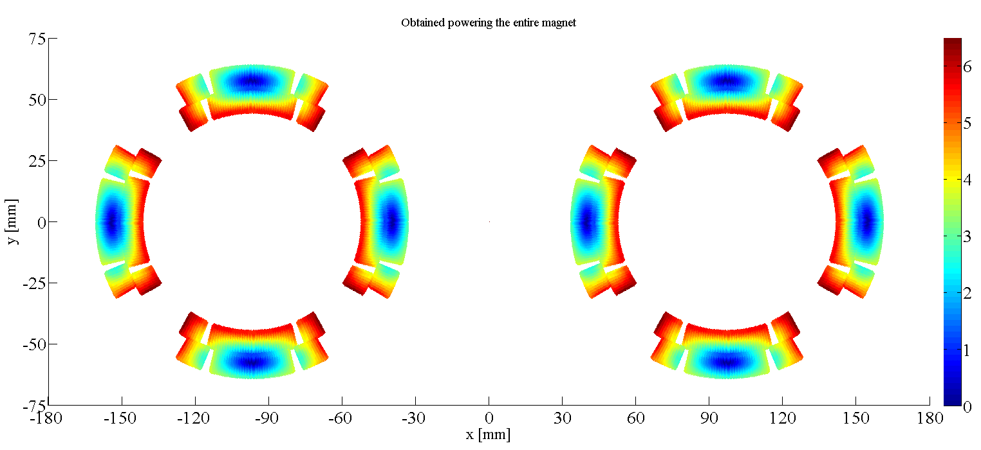
Q4 cross-section and characteristics
Characteristic | Value
Name | Q4 two-in-one quadrupole (MQYY)
Magnet type | Twin-aperture quadrupole, 2 coil layers
Aperture | 90 mm
Coil material | Nb-Ti
Magnetic length | 3.67 m
Nominal current | 4815 A
Nominal magnetic field peak | 6.6 T
Operational temperature | 1.9 K
Cable type | Rutherford, MQM (36 strands)
Number of half-turns | 816
_
_
+
+
+
+
_
_
CLIQ on D2, Q4 and D1 of HL-LHC
E. Ravaioli and A. Fernandez

Slide 17
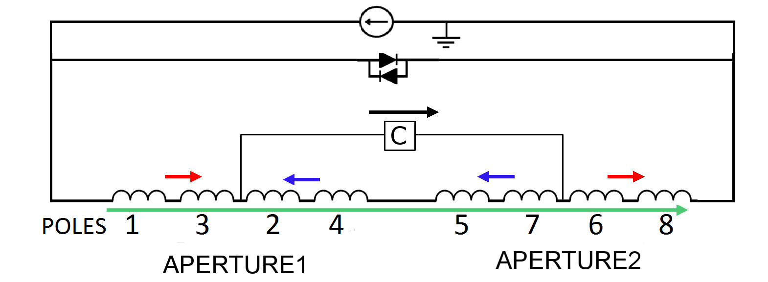
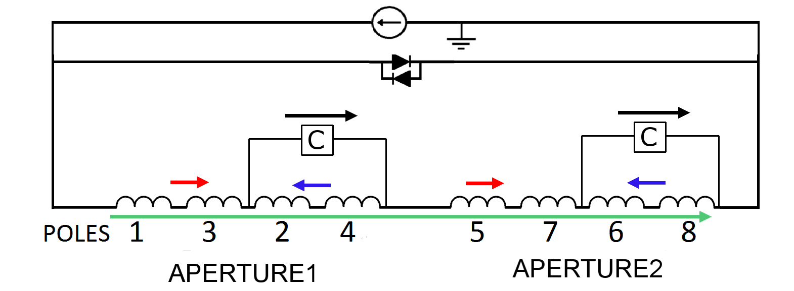
CLIQ connection schemes
1-CLIQ
Configuration:
2457-1368
2-CLIQ
Configuration:
1357-2468
CLIQ on D2, Q4 and D1 of HL-LHC
E. Ravaioli and A. Fernandez

Slide 18
Hot spot temperature against current
CLIQ on D2, Q4 and D1 of HL-LHC
E. Ravaioli and A. Fernandez

Slide 19
CLIQ discharge and current drop
1 CLIQ unit at 1 kV, 20 mF. 4815 A
CLIQ on D2, Q4 and D1 of HL-LHC
E. Ravaioli and A. Fernandez

Slide 20
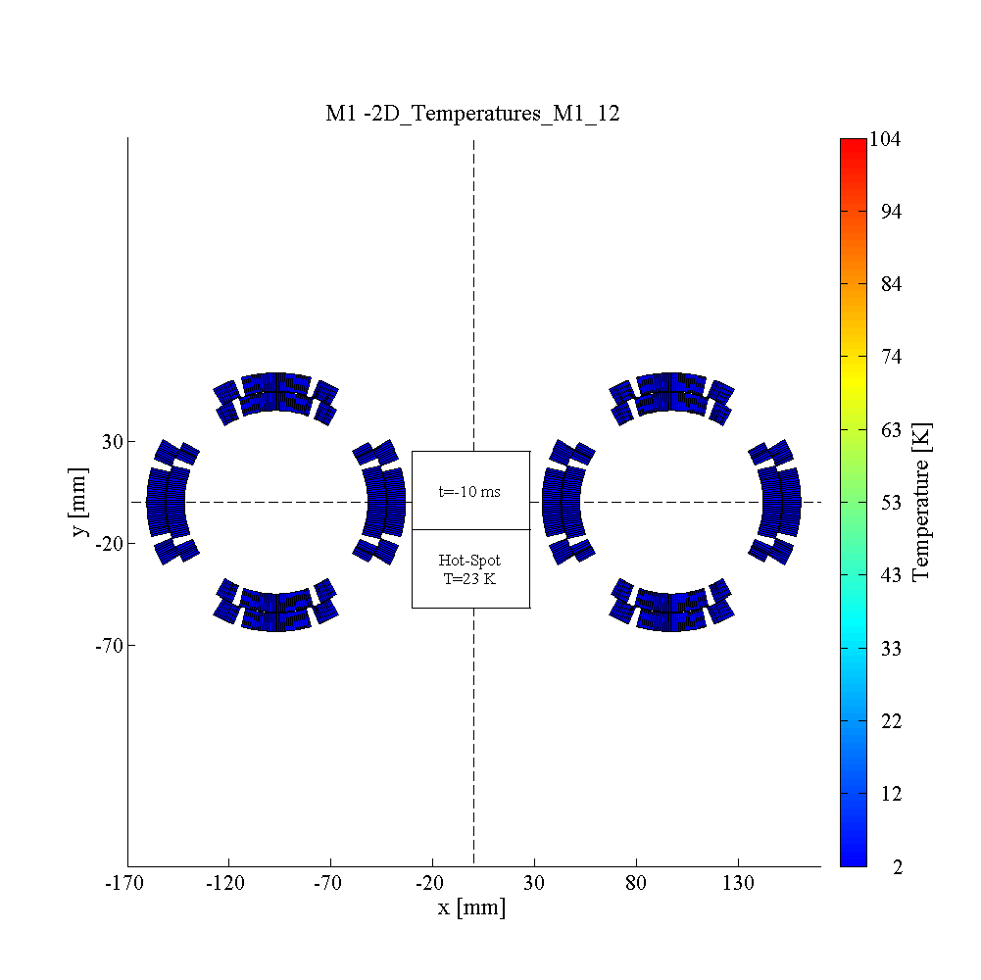
Temperature profile
1 CLIQ unit at 1 kV, 20 mF. 4815 A
CLIQ on D2, Q4 and D1 of HL-LHC
E. Ravaioli and A. Fernandez

Slide 21
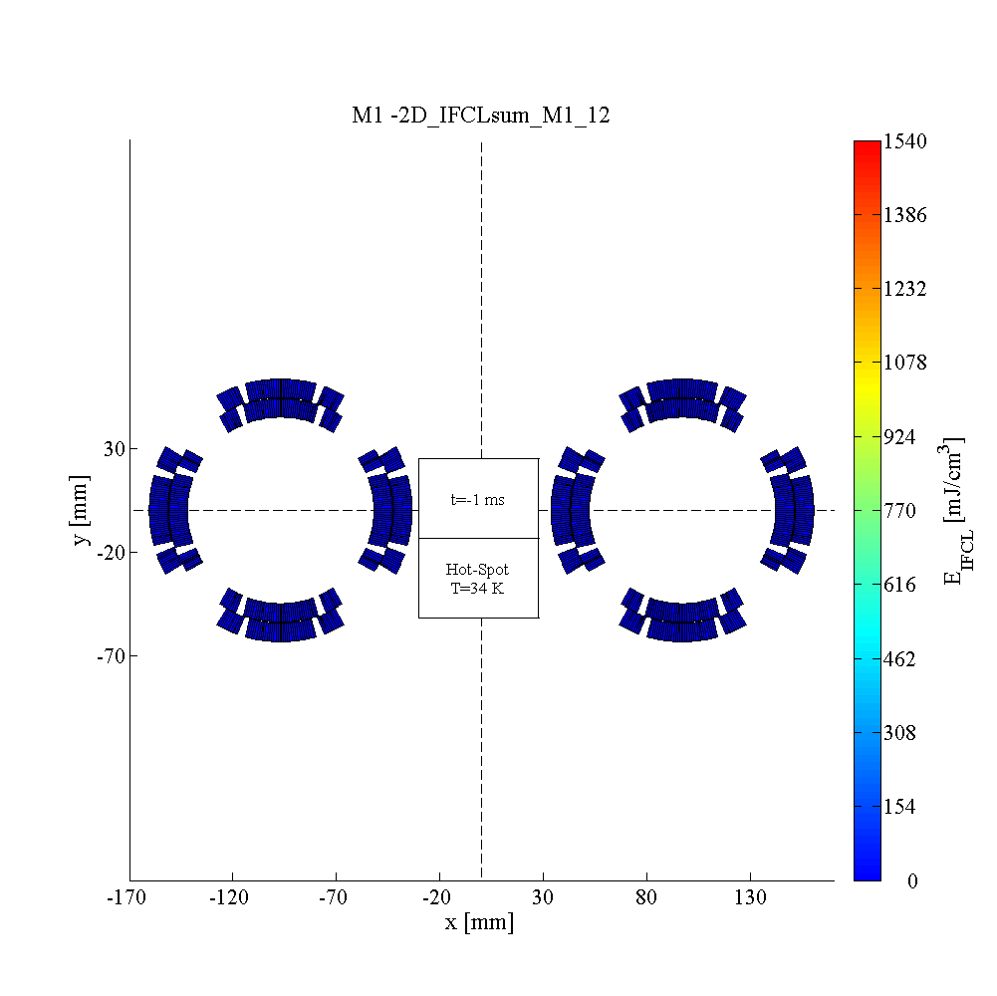
Inter-filament Coupling Losses
1 CLIQ unit at 1 kV, 20 mF. 4815 A
CLIQ on D2, Q4 and D1 of HL-LHC
E. Ravaioli and A. Fernandez

Slide 22
Voltages to ground
1 CLIQ unit at 1 kV, 20 mF. 4815 A
CLIQ on D2, Q4 and D1 of HL-LHC
E. Ravaioli and A. Fernandez

Slide 23
D1
(model magnet)
CLIQ on D2, Q4 and D1 of HL-LHC
E. Ravaioli and A. Fernandez

Slide 24
D1 cross-section and characteristics
Characteristic | Value
Name | D1 Separation dipole (MBXF)
Magnet type | Single-aperture dipole, 1 coil layer
Aperture | 150 mm
Coil material | Nb-Ti
Magnetic length | 1.85 m long model magnet (full length 6.27 m)
Nominal current | 12000 A
Nominal magnetic field peak | 6.9 T
Operational temperature | 1.9 K
Cable type | Rutherford, MB outer layer (36 strands)
Number of half-turns | 176
_
+
CLIQ on D2, Q4 and D1 of HL-LHC
E. Ravaioli and A. Fernandez

Slide 25
CLIQ connection scheme
1-CLIQ
Configuration: 1-2
CLIQ on D2, Q4 and D1 of HL-LHC
E. Ravaioli and A. Fernandez

Slide 26
Hot spot temperature against current
CLIQ on D2, Q4 and D1 of HL-LHC
E. Ravaioli and A. Fernandez

Slide 27
CLIQ discharge and current drop
1 CLIQ unit at 500 V, 28.2 mF. 12000 A
CLIQ on D2, Q4 and D1 of HL-LHC
E. Ravaioli and A. Fernandez

Slide 28
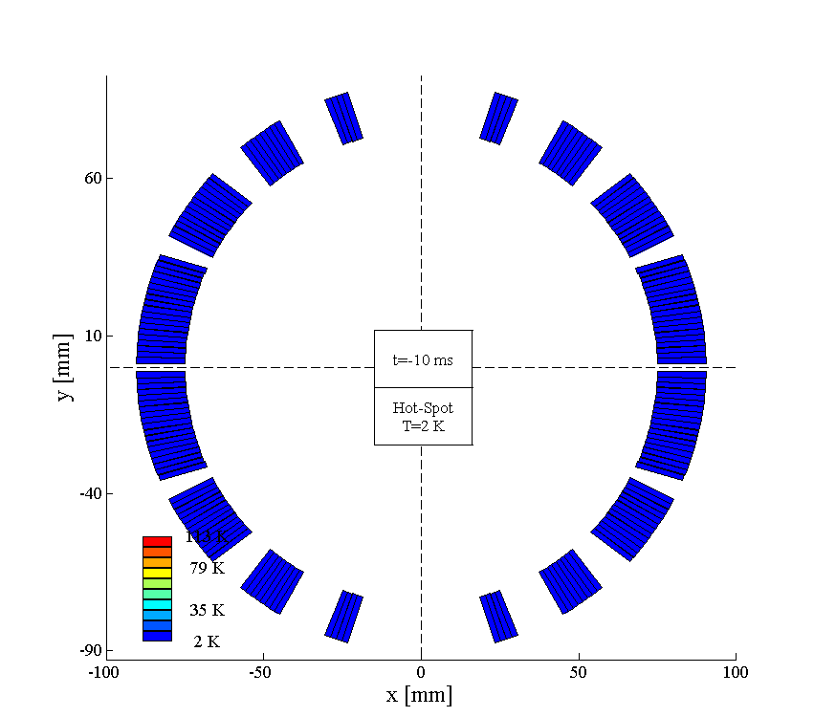
Temperature profile
1 CLIQ unit at 500 V, 28.2 mF. 12000 A
CLIQ on D2, Q4 and D1 of HL-LHC
E. Ravaioli and A. Fernandez

Slide 29
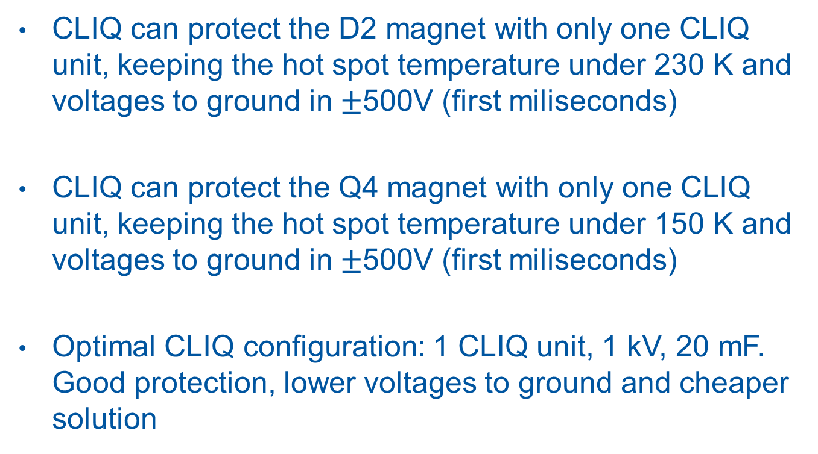
Conclusions
CLIQ can protect the D2 magnet with only one CLIQ unit, keeping the hot spot temperature under 230 K and voltages to ground in $±$500V (first miliseconds)
CLIQ can protect the Q4 magnet with only one CLIQ unit, keeping the hot spot temperature under 150 K and voltages to ground in $±$500V (first miliseconds)
Optimal CLIQ configuration: 1 CLIQ unit, 1 kV, 20 mF. Good protection, lower voltages to ground and cheaper solution
CLIQ on D2, Q4 and D1 of HL-LHC
E. Ravaioli and A. Fernandez

Slide 30
Annex
CLIQ on D2, Q4 and D1 of HL-LHC
E. Ravaioli and A. Fernandez

Slide 31
CLIQ (Coupling-Loss Induced Quench)
Current change
Magnetic field change
Coupling losses (Heat)
Temperature rise
QUENCH
CLIQ on D2, Q4 and D1 of HL-LHC
E. Ravaioli and A. Fernandez

Slide 32


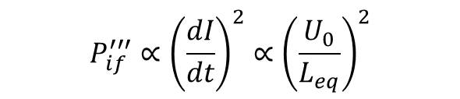


CLIQ behavior
$$P_{if}^{′′′}∝{\left(\frac{dI}{dt}\right)}^{2}∝{\left(\frac{U_{0}}{L_{eq}}\right)}^{2}$$
$$E_{CLIQ}=N_{C} \frac{1}{2}CU_{0}^{2}$$
$$I_{max}∝ U_{0}\sqrt{\frac{C}{L_{eq}}}$$
$$f= \frac{1}{2π\sqrt{L_{eq}C}}$$
$${\frac{dI}{dt}}_{max}∝\frac{U_{0}}{L_{eq}}$$
CLIQ on D2, Q4 and D1 of HL-LHC
E. Ravaioli and A. Fernandez

Slide 33
CLIQ discharge at nominal current
2 CLIQ units at 500 V, 80 mF
CLIQ on D2, Q4 and D1 of HL-LHC
E. Ravaioli and A. Fernandez

Slide 34

Temperature profile
2 CLIQ units at 500 V, 80 mF. 12050 A
CLIQ on D2, Q4 and D1 of HL-LHC
E. Ravaioli and A. Fernandez

Slide 35

Inter-filament Coupling Losses
2 CLIQ units at 500 V, 80 mF. 12050 A
CLIQ on D2, Q4 and D1 of HL-LHC
E. Ravaioli and A. Fernandez

Slide 36
Inter-filament Coupling Losses
2 CLIQ units at 500 V, 80 mF. 12050 A
CLIQ on D2, Q4 and D1 of HL-LHC
E. Ravaioli and A. Fernandez

