Slide 1
A FIRST LOOK AT 2015
FAULT STATISTICS
Apollonio, L. Ponce, B. Todd
awg-core@cern.ch
LBOC - 28/7/2015
Acknowledgements: T. Griesemer, A. Niemi, C. Roderick &
AFT team, R. Schmidt, D. Wollmann

Slide 2
Fault Analysis
Reference period:
  3/4/2015 – 22/7/2015
  Week 14 - Week 30 (up to Wed)
The tools:
  eLogbook
  Accelerator Fault Tracker
  (https://aft.cern.ch/#/home)

Slide 3
AWG: Fault Review
Ensure consistency of availability data throughout the year
Weekly fault review by AWG-core (AFT + eLogbook):
  Missing faults
  PM events
  Fault attributes
  Fault dependencies
  Fault duration
Some statistics:
  ~ 40-50 events analysed per week
  ~ 10-20 modifications per week (mainly fault attributes)

Slide 4
Fault Dependencies
System Available/Fault:
Blocking Fault:
Parent/Child Fault:
Postponed Fault (not yet implemented in the AFT):

Slide 5
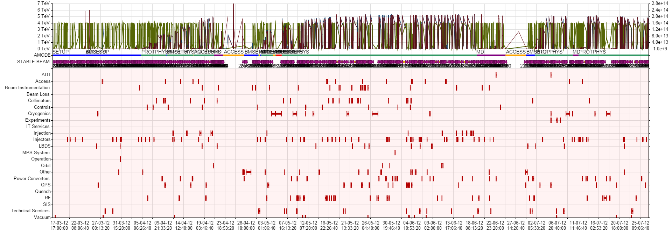
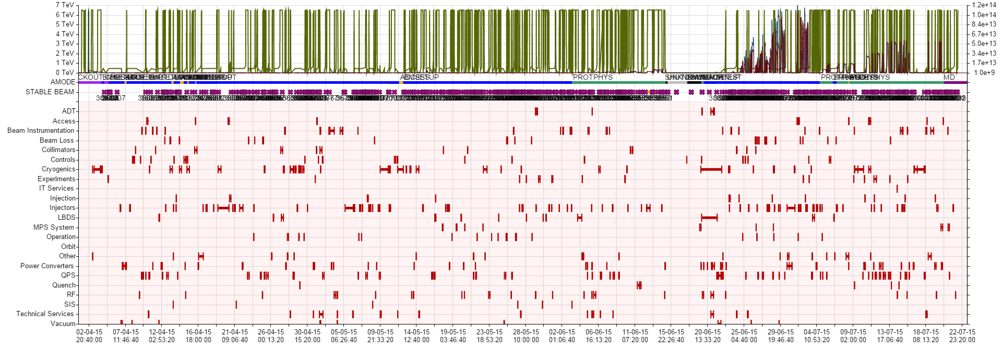
2012 vs 2015 Cardiogram (up to July)
2012 → 370 faults
2015 → 544 faults

Slide 6
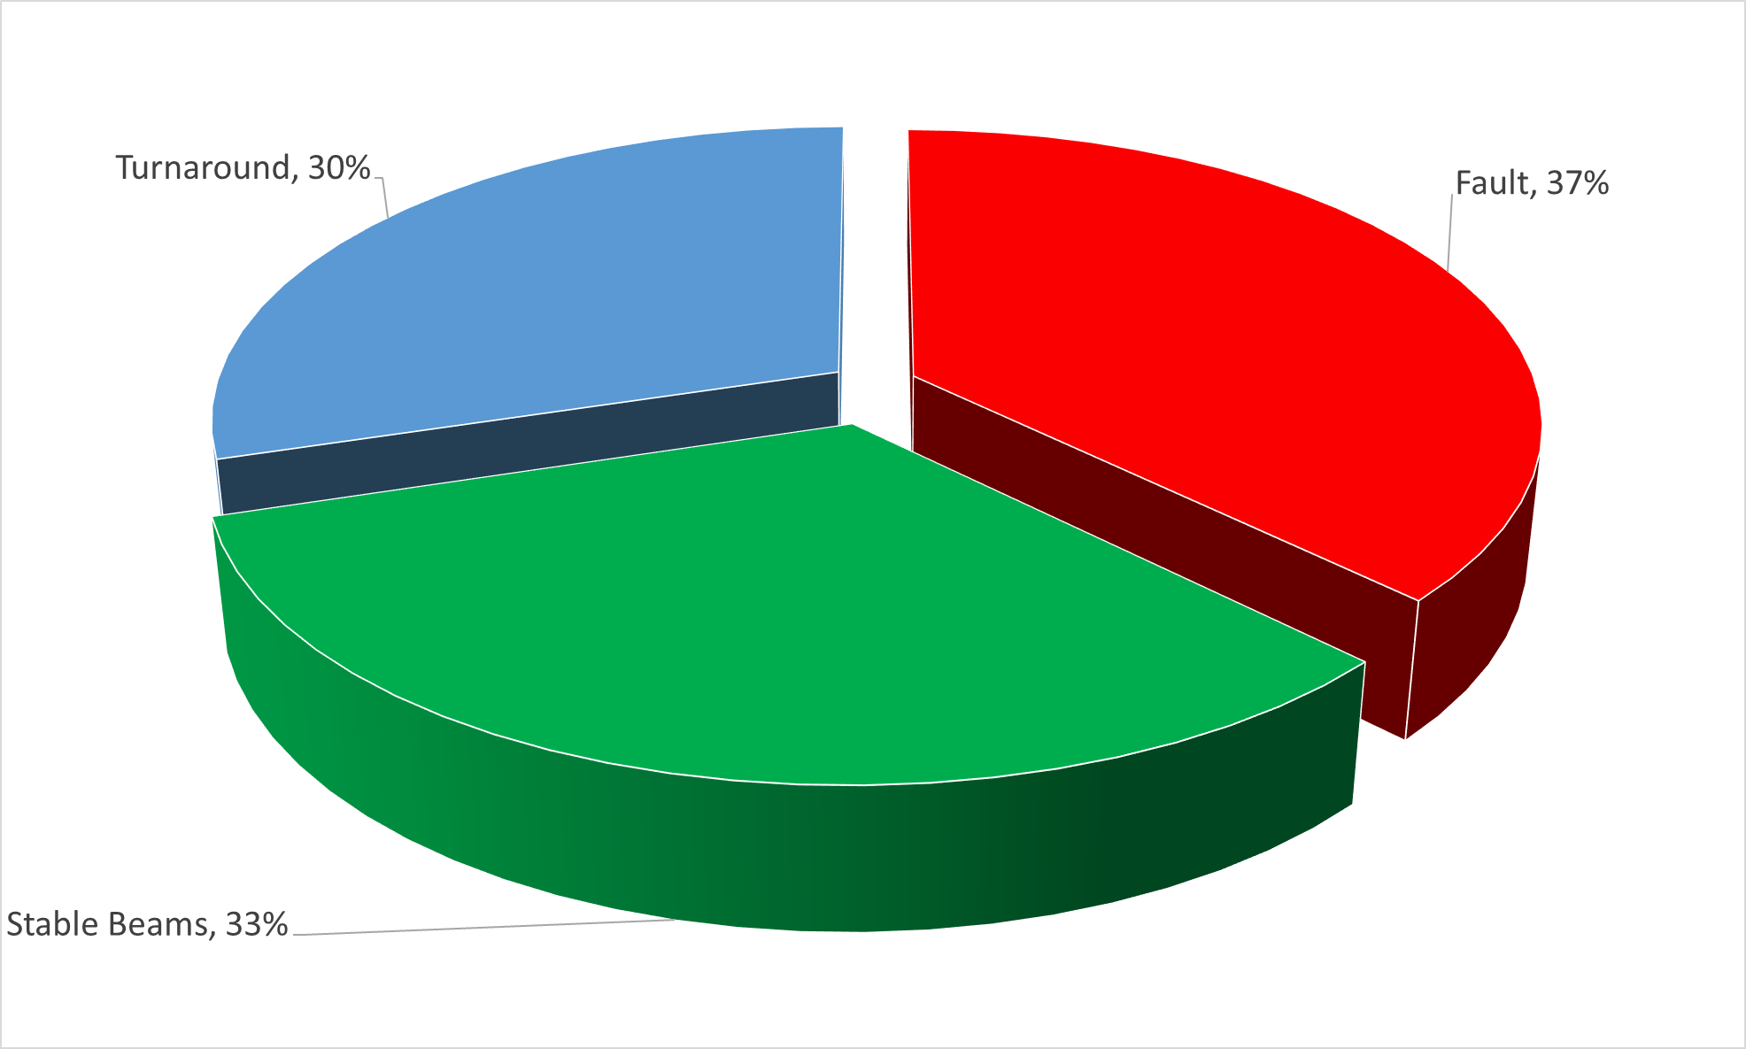
2012 Operation (estimate)
LHC Availability: 63 %
Turnaround: time to recover stable beams conditions after a beam dump, when no faults occur (minimum: 2h20 in 2012)

Slide 7
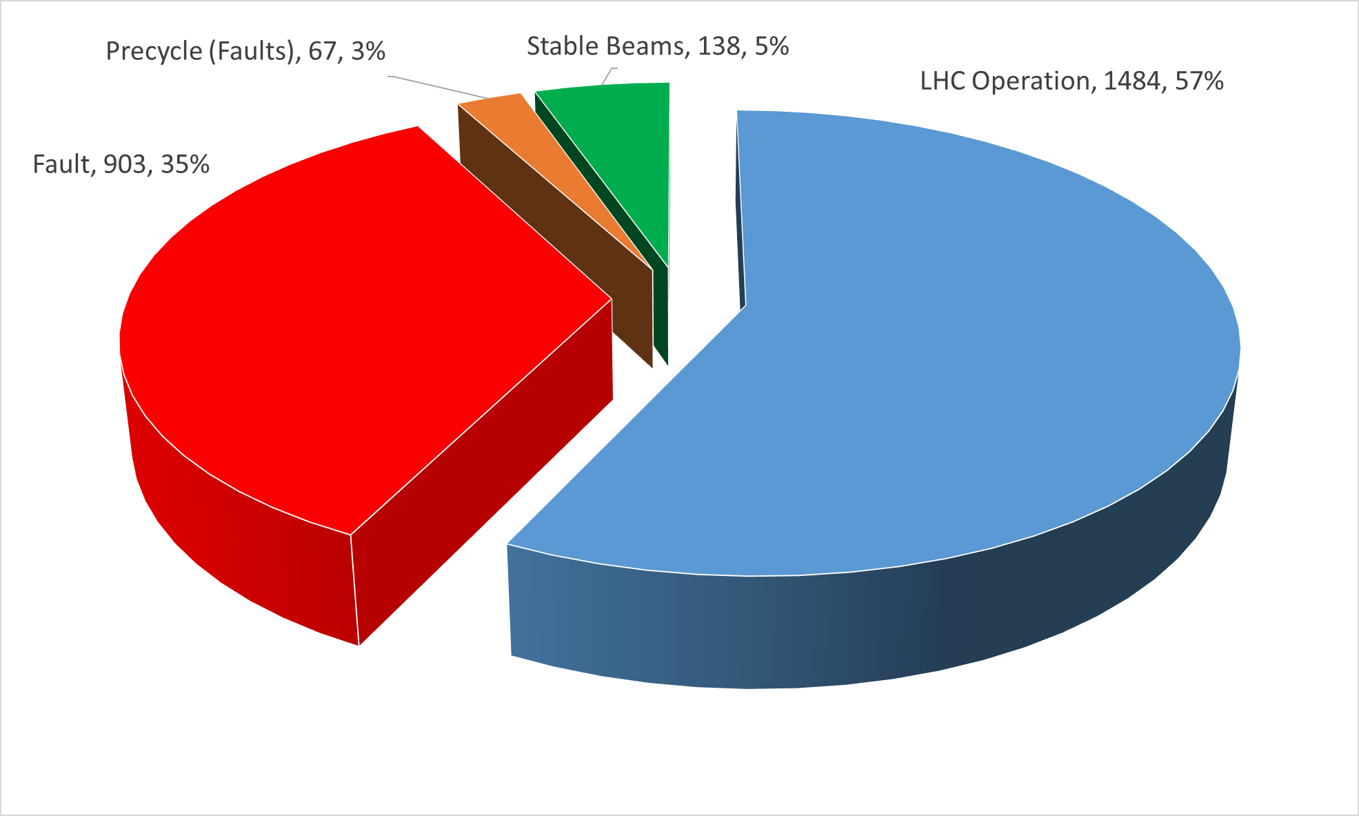
2015 Operation
Assumption: pre-cycle duration following every fault → 1 h
67 pre-cycles due to faults (67 h)
LHC Availability: 62 %

Slide 8
Notable Faults (> 24 h)
Cryogenics:
  Quench recovery (Week 14, blocked by Cryo/Controls)
  Cooling and ventilation (Week 19, child fault)
  Cold Compressor, breakdown of insulation vacuum of 4.5 K refrigerator in Pt8 (Week 25/26)
  Cold compressor + Quench recovery S34 (Week 28)
  Controls, DFBAO regulation problem (Week 29)
Injectors:
  Linac2 HV cable replacement (Week 16/17)
  SPS magnet replacement (Week 19)
  Source cathode to be exchanged (Week 27)
LBDS:
  Generator MKD B2, switch replacement (Week 25, mostly in the shadow of long cryo-stop)

Slide 9
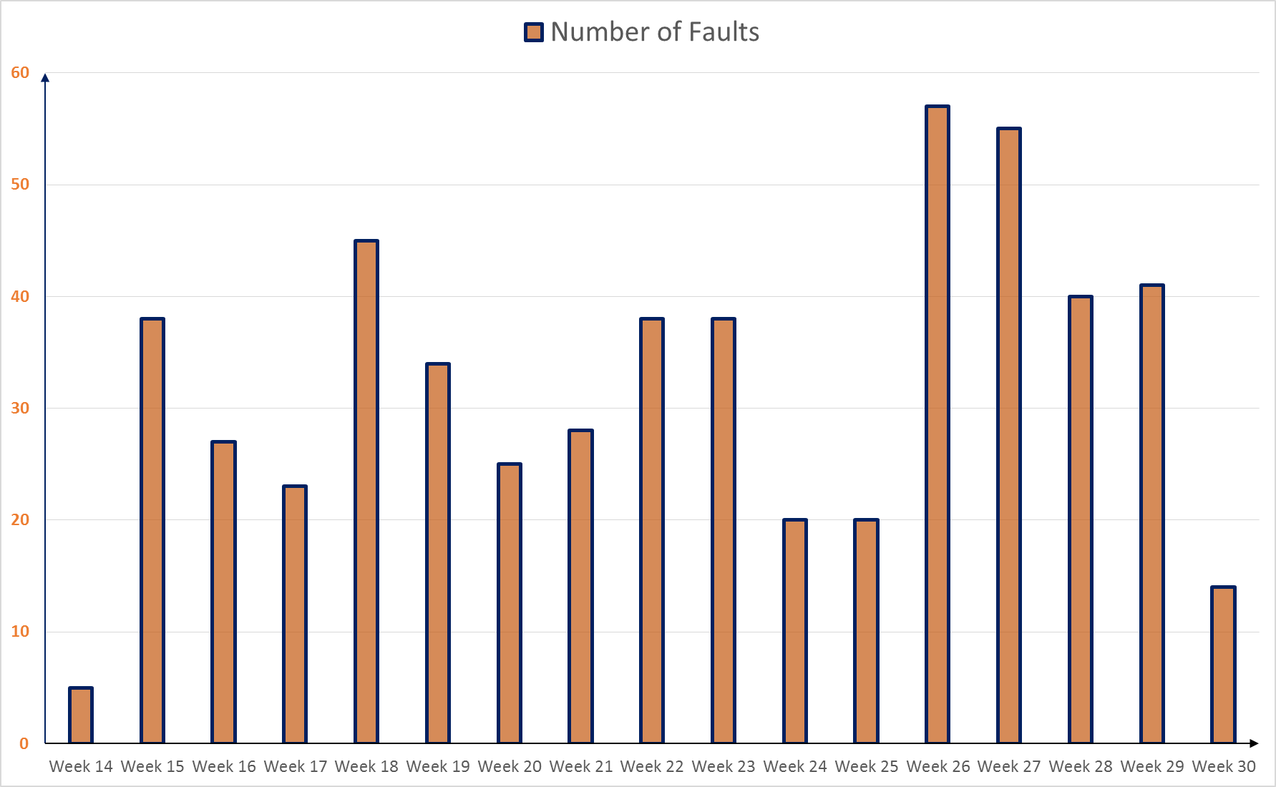
Number of Faults per Week
Scrubbing run
3 - 50 b
152 - 482 b

Slide 10
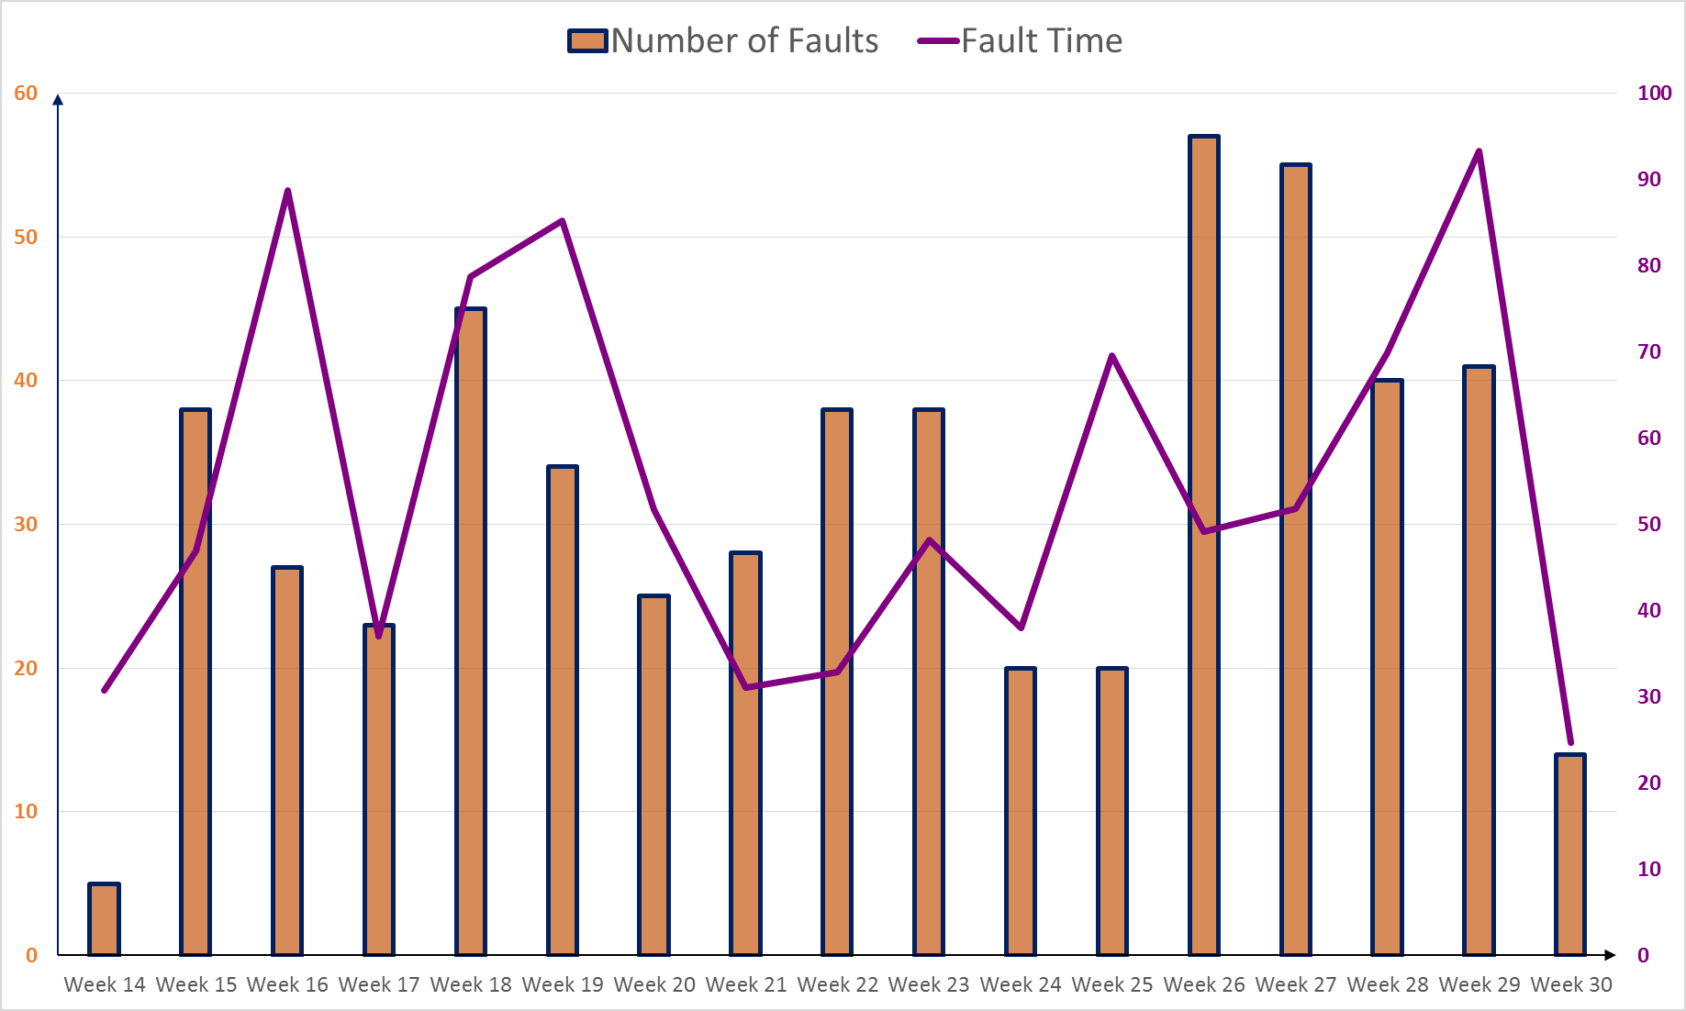
Number of Faults + Fault Time per Week
Transverse Instabilities
h
Linac2 HV cable
Cryo CV + SPS magnet replacement
Cryo + LBDS
19 QPS faults
TS1
Scrubbing run
3 - 50 b
152 - 482 b

Slide 11
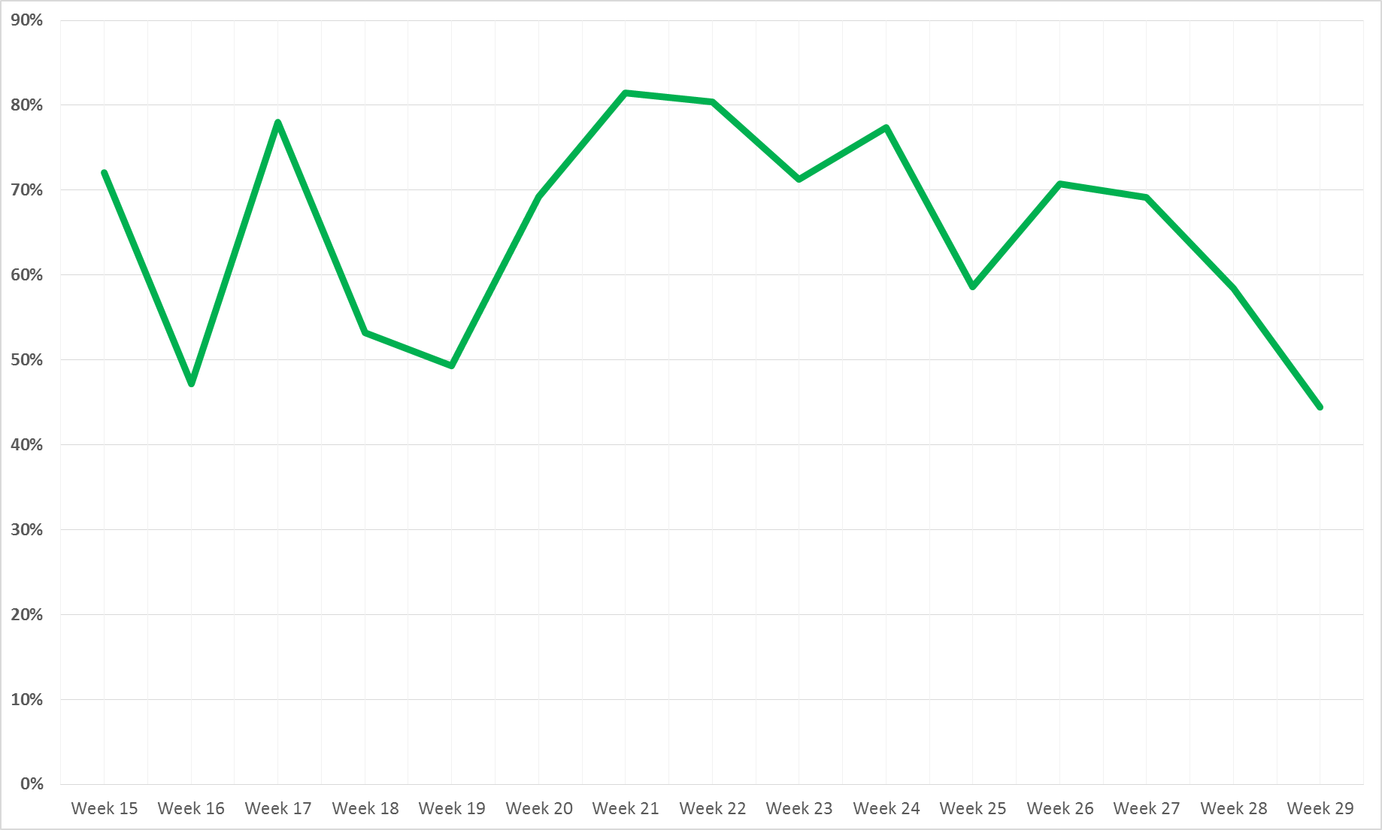
LHC Availability by Week
LHC Availability
65 %
Cryo + LBDS
Linac2 HV cable
Cryo CV + SPS magnet replacement
19 QPS faults
3 - 50 b
Scrubbing run
152 - 482 b
Not including pre-cycles due to faults in the unavailability

Slide 12
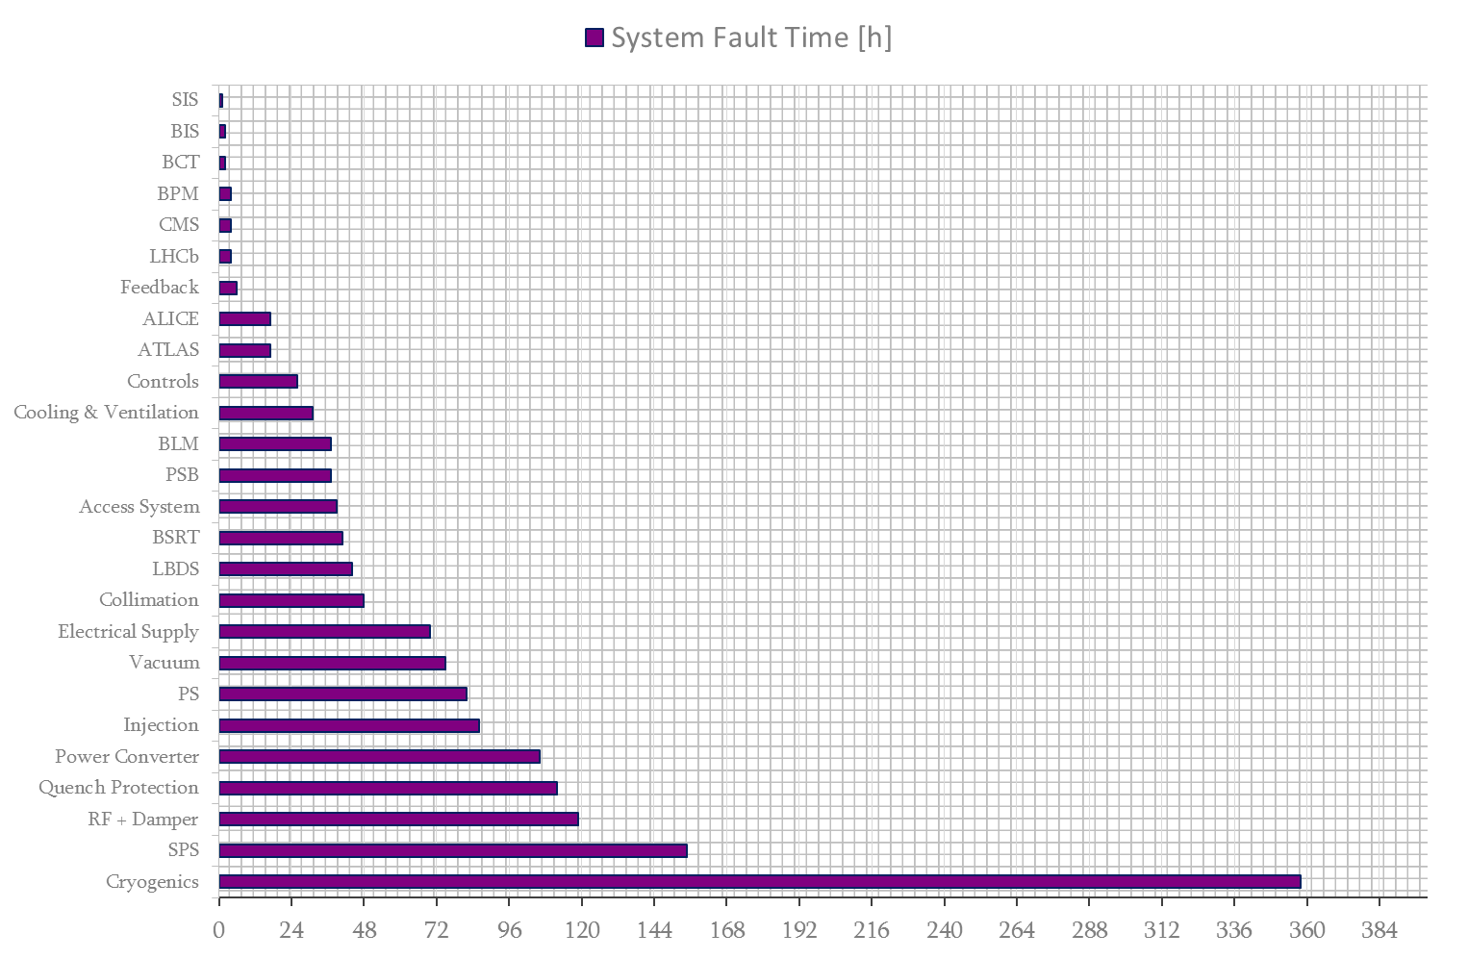
Reminder: 2012 System Fault Time
Total System Fault Time: 1524 h
B. Todd, Evian 2012

Slide 13
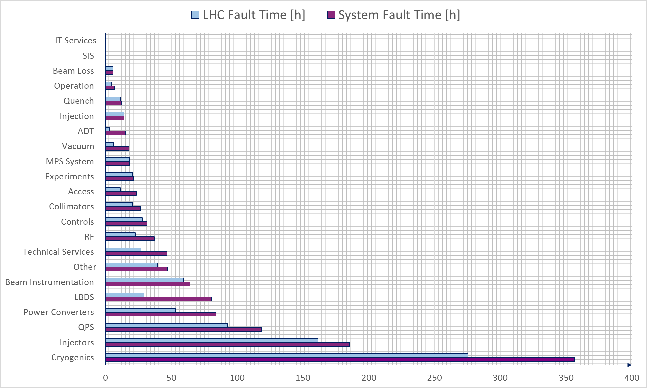
Fault Time in 2015
Total LHC Fault Time: 903 h
Cryo: 72 h quench recovery (child)
LHC Fault Time: filtering faults occurred in the shadow of others
System Fault Time: NOT filtering faults occurred in the shadow of others

Slide 14
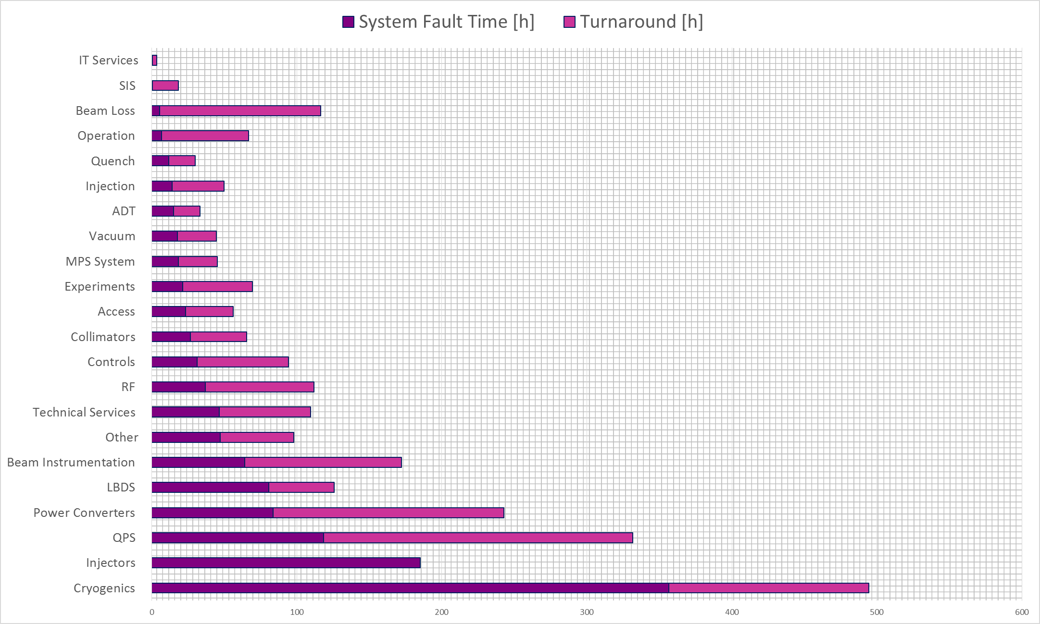
Impact of Faults on Operation (1/2)
Turnaround: additional 3 h added for every fault occurrence to measure the impact on operation

Slide 15
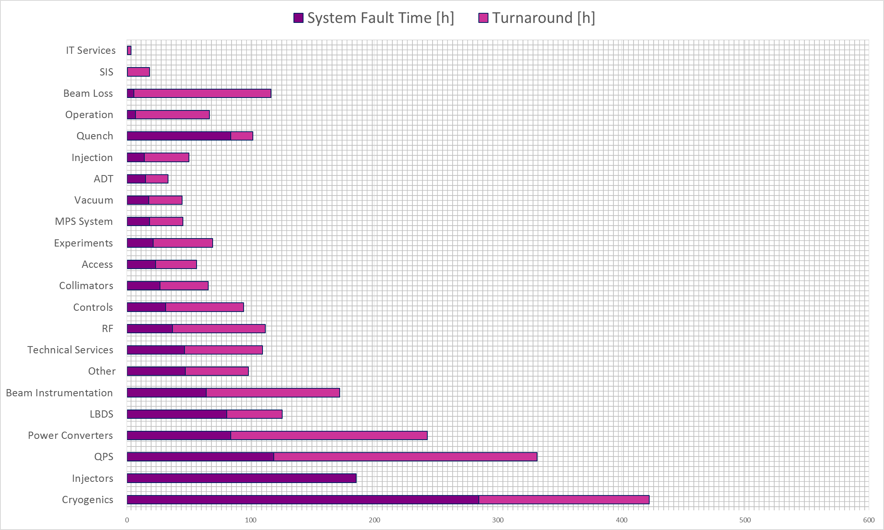
Impact of Faults on Operation (2/2)
Trade-off to be found!
72 h quench recovery assigned to parent fault (Quench)
Turnaround: additional 3 h added for every fault occurrence to measure the impact on operation

Slide 16
Recurring Failures
SIS Timeout (4 times, solved)
Ventilation doors left open (9 times)
SEUs on QPS DQQBS boards (A. Siemko, LMC)
UFOs/ULOs (+ quench) (G. Papotti, LMC)
  5 dumps so far, including 1 beam induced quench (04L8, 10L3, 34L8 → quench, 12L6, 15L2)
  15R8.B2: 10 dumps
Earth Fault: RCS.A78B2 (several times over the last week)

Slide 17
AFT: Wishlist
Add operation mode line from the eLogbook in the cardiogram
Add attribute “pre-cycle needed”
Add links between related faults (e.g. SIS timeout)
Add suspended faults
Add filter for faults ‘not blocking operation’ in the statistics page (already in the cardiogram with AFT v1.0.7)
Improvements for statistics page
  Fault time plots accounting for fault dependencies and parallel faults (% and absolute numbers)
  Filter faults based on attributes, duration, OP mode

Slide 18
Conclusions
AFT is a consolidated tool for availability tracking
  Improvements continuously under discussion with AFT team
AWG weekly fault review to ensure data consistency
Availability similar to 2012 (60 - 65 %)
  Considering increased energy, BUT low intensity
Notable failure modes (scaling with intensity!?)
  UFOs/ULO
  Beam-induced quenches (already ~3 days for quench recovery)
  Radiation effects on electronics
  RCS.A78B2 earth fault

Slide 19
Thank you for your attention
THANK YOU FOR YOUR ATTENTION

Slide 20
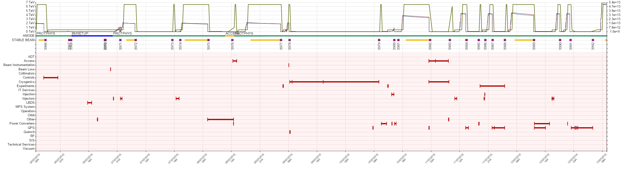
LHC Cardiogram: Example

Slide 21
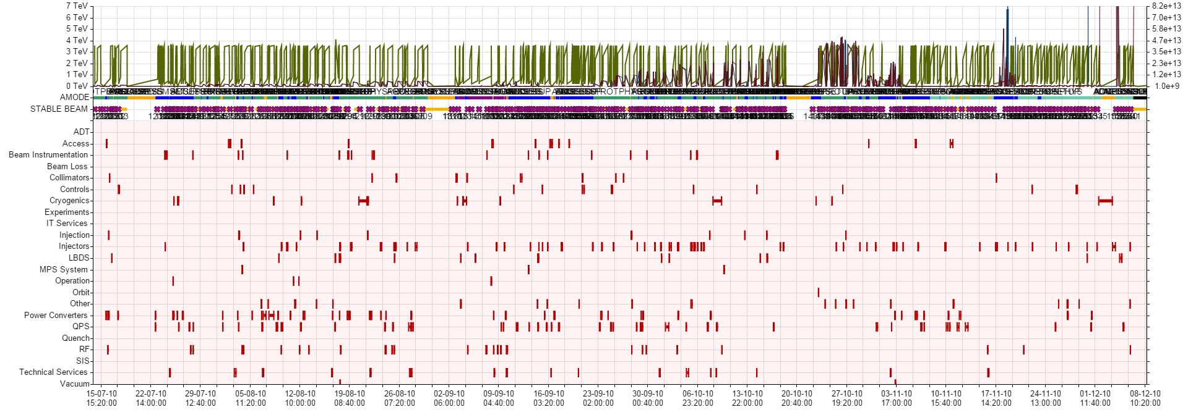
2010 vs 2015 Cardiogram
2010
2015

Slide 22
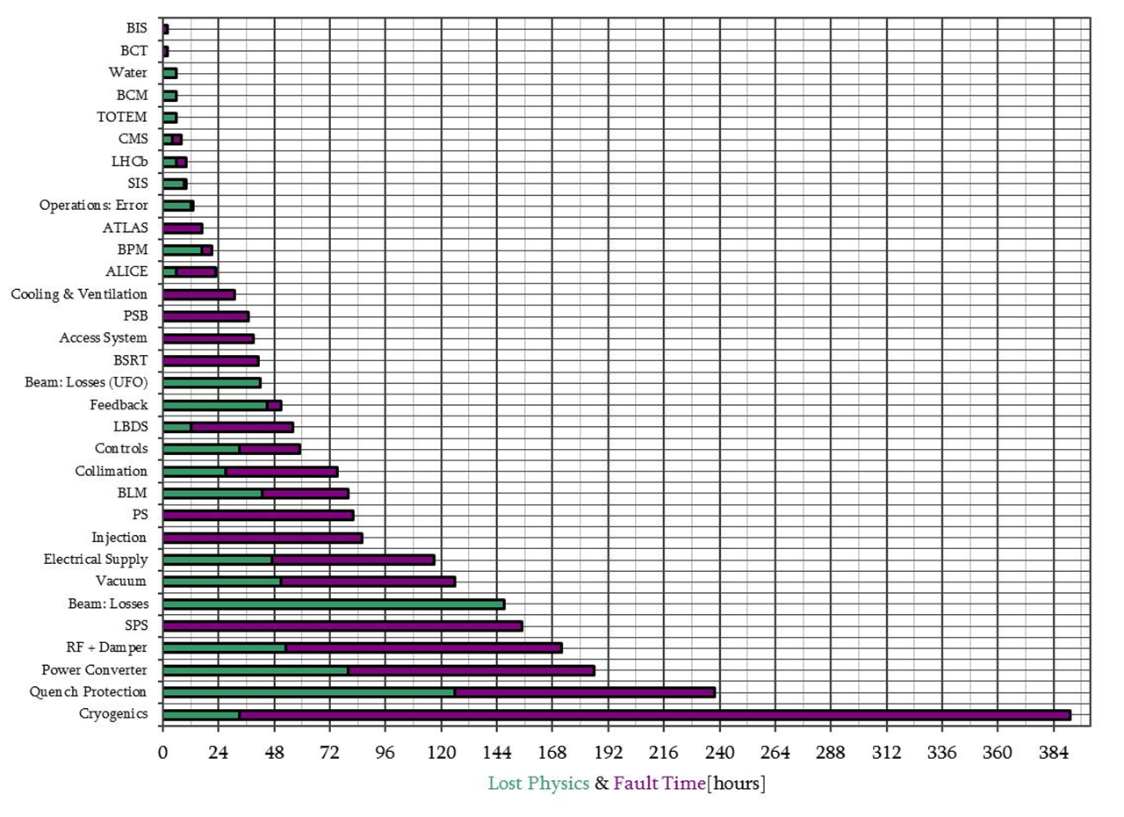
Operations : Lost Physics + Fault Time
812 hours = 34 days = lost physics
1524 hours = 64 days = fault time
B. Todd, Evian 2012

Slide 23
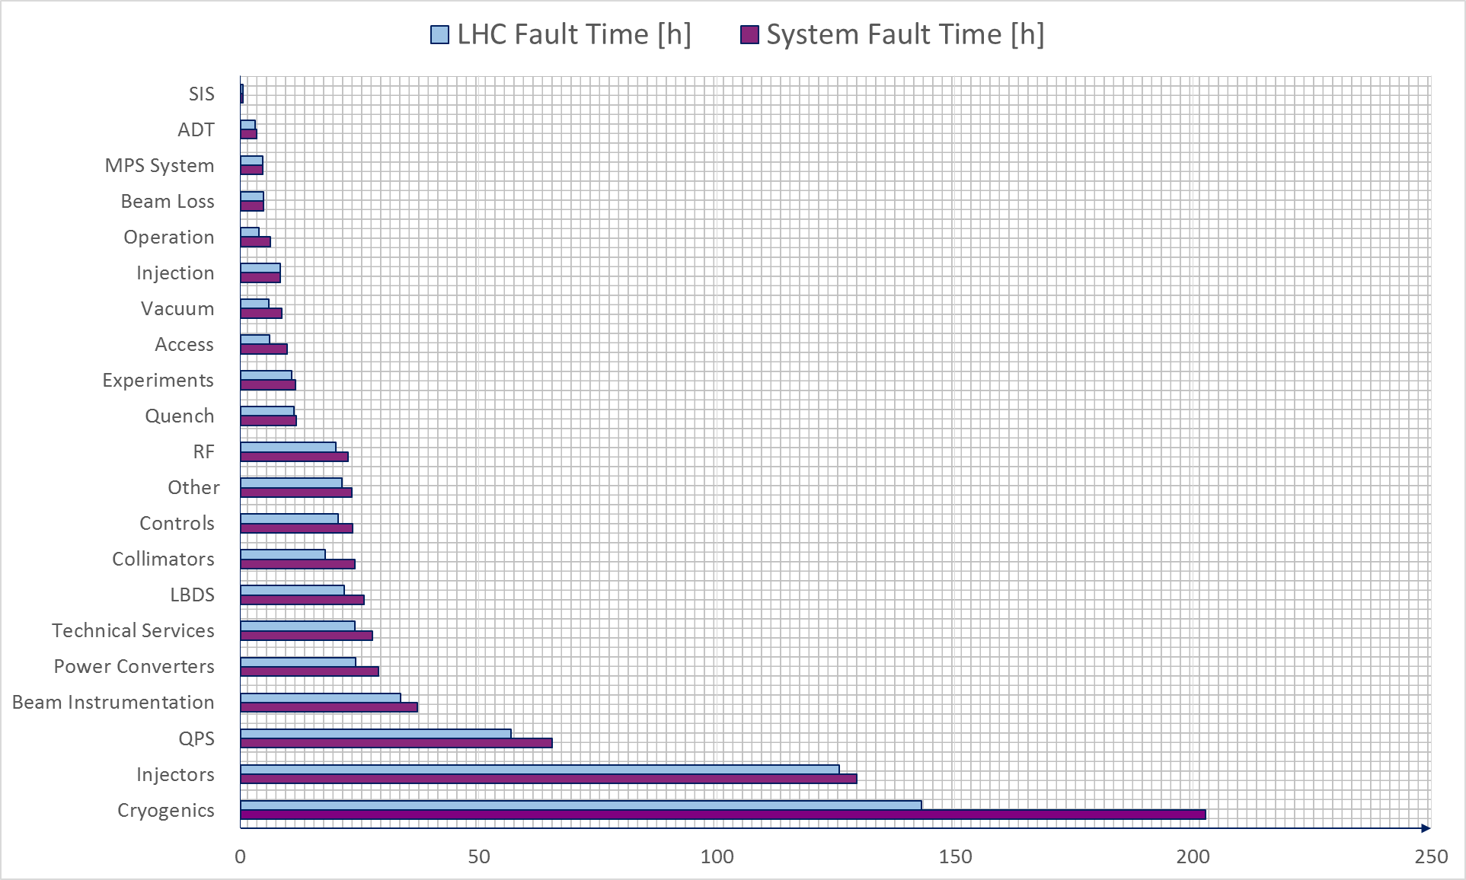
LHC Unavailability up to TS1
Total LHC Fault Time: 568 h
Cryo: 55 h quench recovery (child)
LHC Fault Time: filtering faults occurred in the shadow of others
System Fault Time: NOT filtering faults occurred in the shadow of others

Slide 24
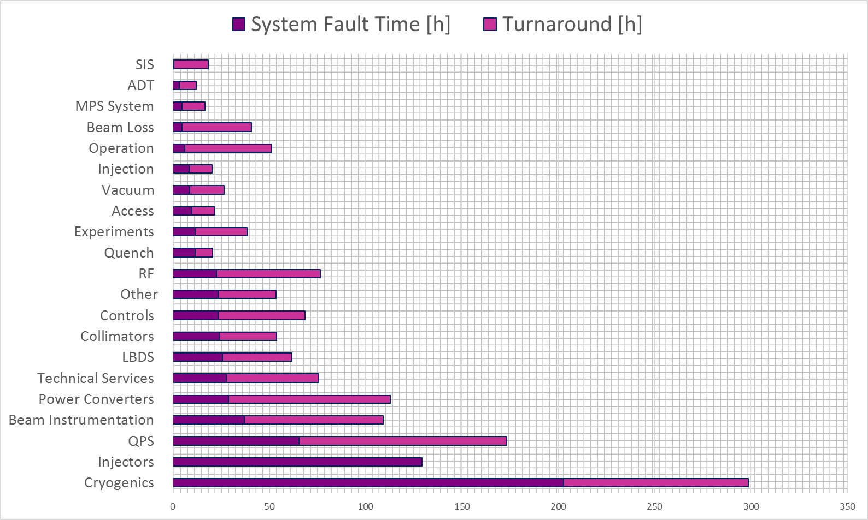
Impact on Operation up to TS1 (1/2)
Turnaround: additional 3 h added for every fault occurrence to measure the impact on operation

Slide 25
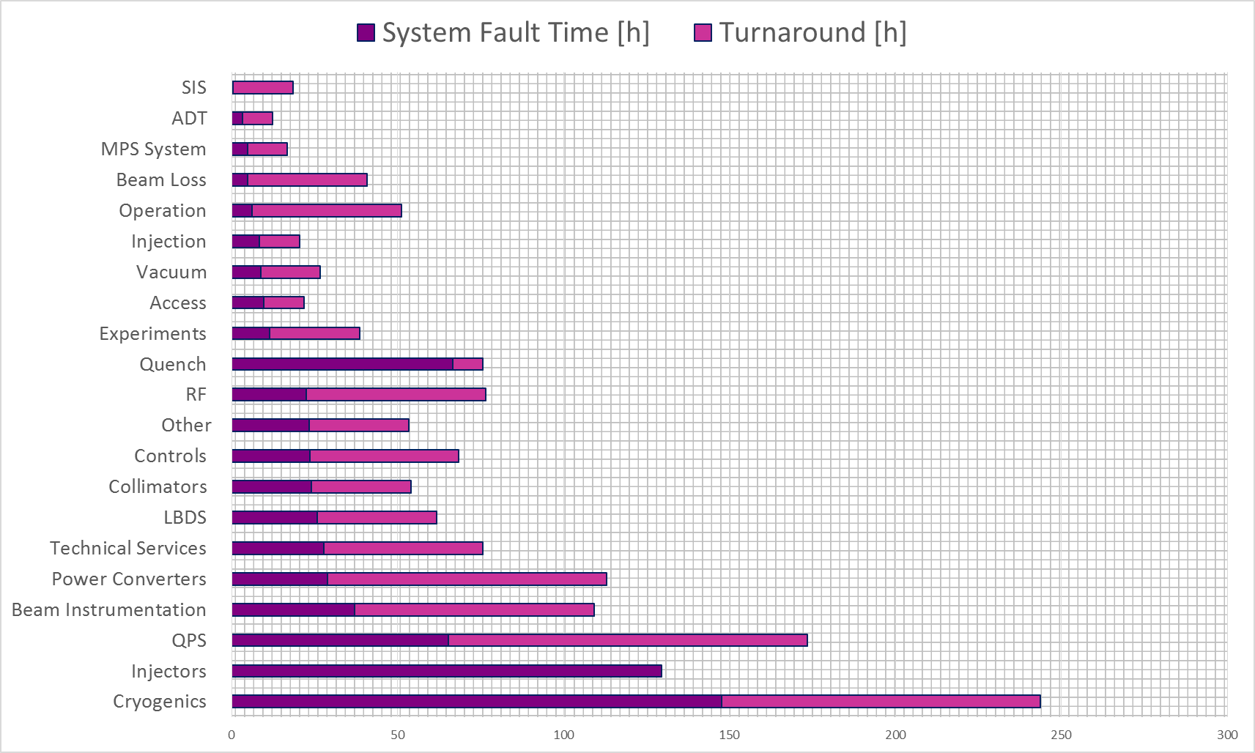
Impact on Operation up to TS1 (2/2)
Turnaround: additional 3 h added for every fault occurrence to measure the impact on operation

Slide 26
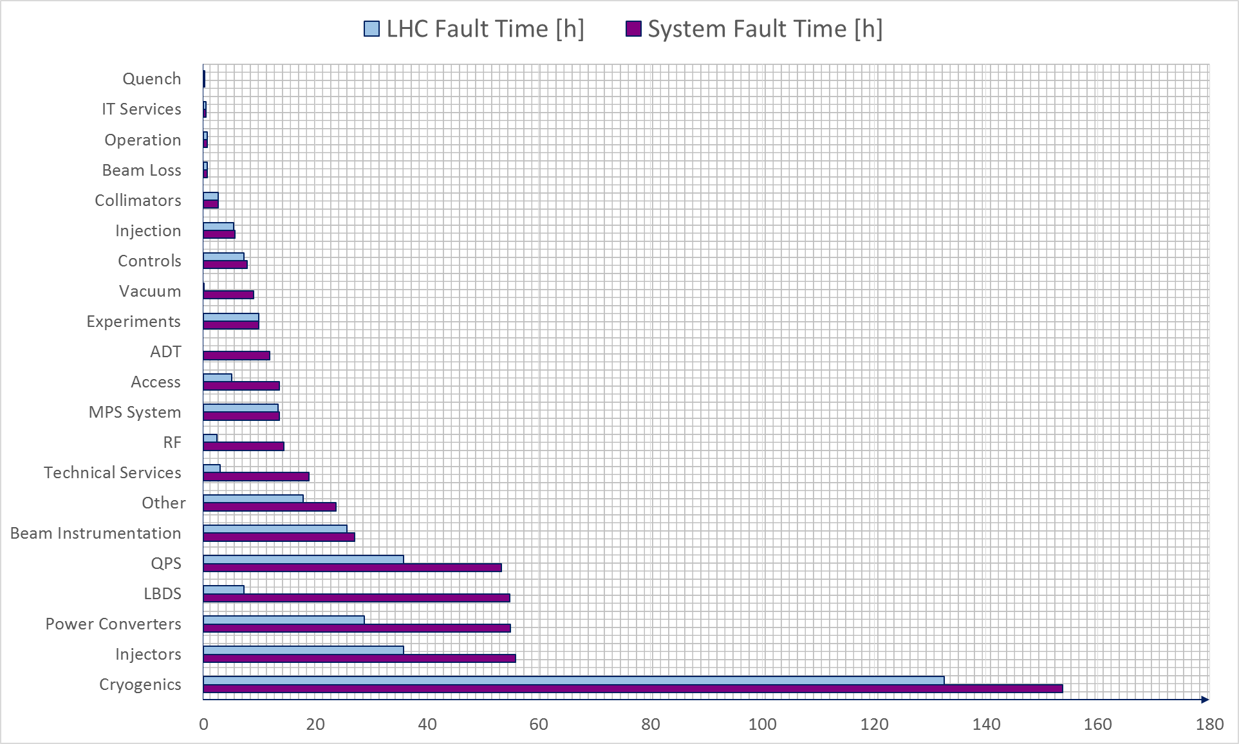
LHC Unavailability after TS1
Total LHC Fault Time: 335 h
Cryo: 17 h quench recovery (child)
LHC Fault Time: filtering faults occurred in the shadow of others
System Fault Time: NOT filtering faults occurred in the shadow of others

Slide 27
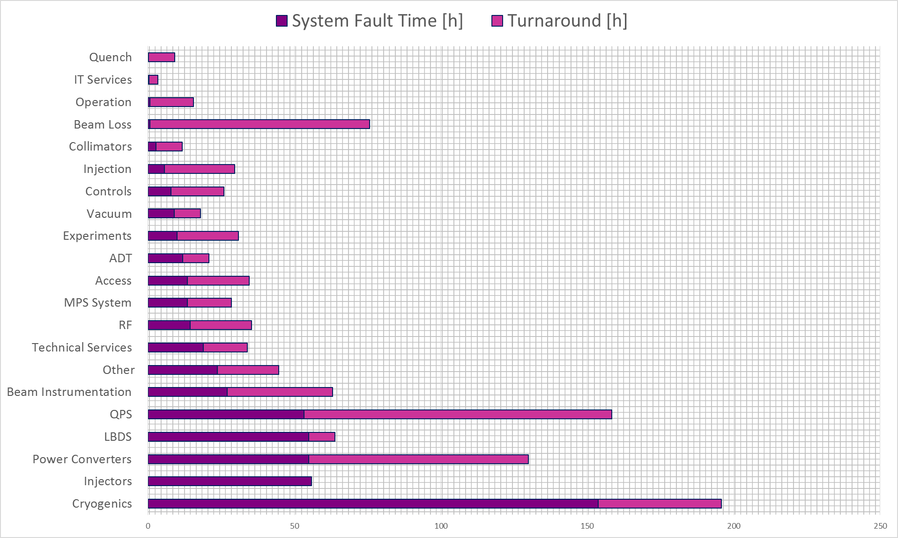
Impact on Operation after TS1 (1/2)
Turnaround: additional 3 h added for every fault occurrence to measure the impact on operation

Slide 28
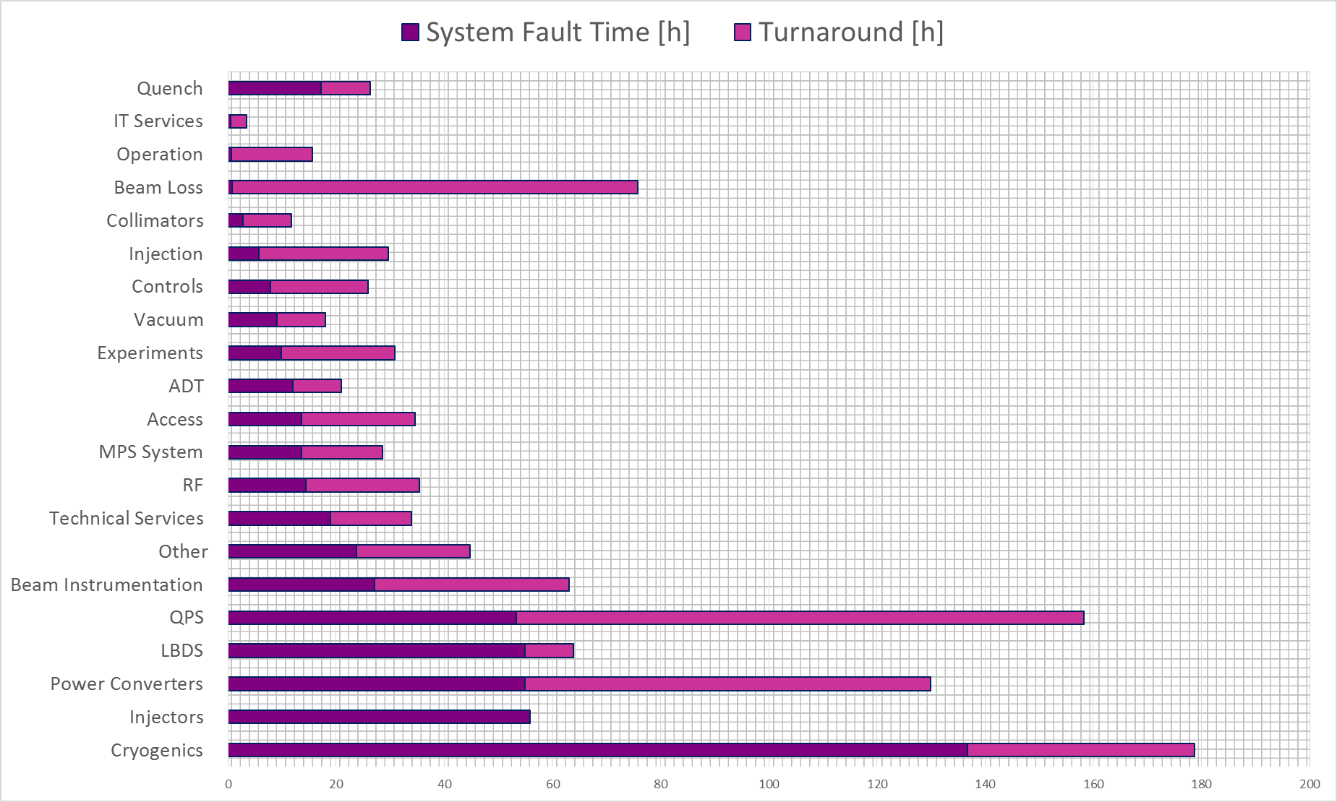
Impact on Operation after TS1 (2/2)
Trade-off to be found!
Turnaround: additional 3 h added for every fault occurrence to measure the impact on operation

Slide 29
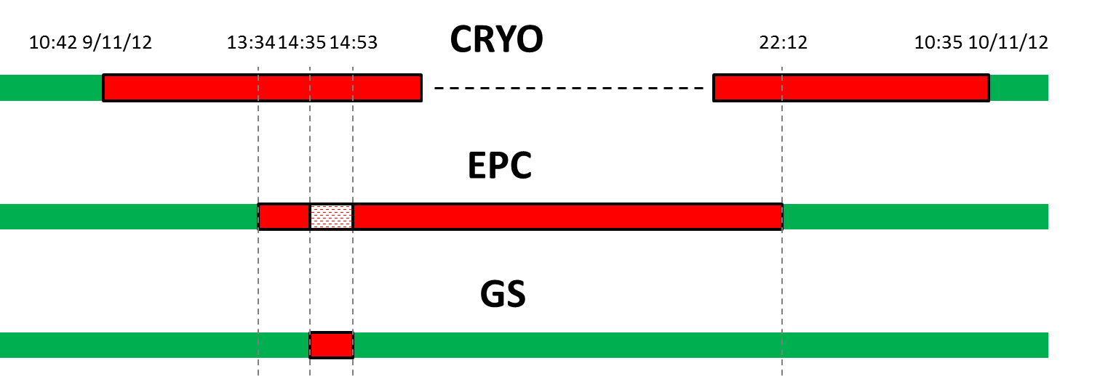
GS BLOCKING FAULT IN THE SHADOW OF A LONG CRYO STOP ON 9/11/2012
In the shadow of a long cryo-stop on 9/11/2012, several interventions (QPS, Vacuum, EPC) were scheduled. Due to a door blocked, the EPC intervention had to be suspended waiting for the GS piquet. Only after that the EPC intervention was possible.
LHC

Slide 30
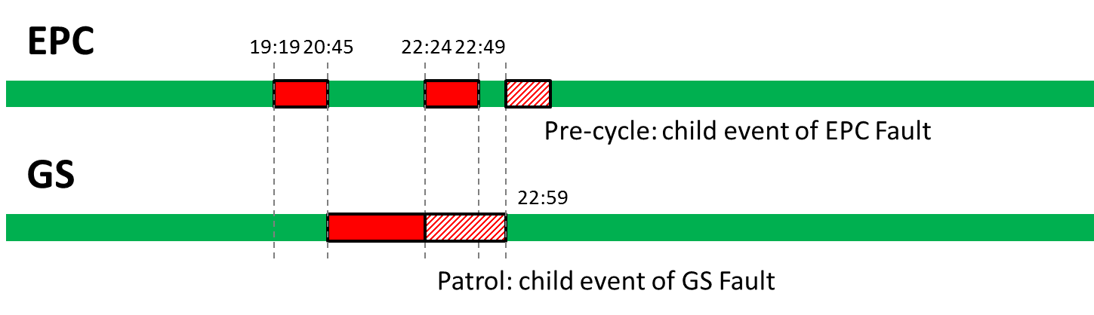
GS BLOCKING FAULT + CHILD EVENTS ON 23/10/2012
EPC access is needed after a beam dump. This had to be suspended for a problem in the access system, waiting for the GS piquet. A patrol was needed afterwards. Only after that the EPC intervention was possible and a pre-cycle needed.
LHC

Slide 31
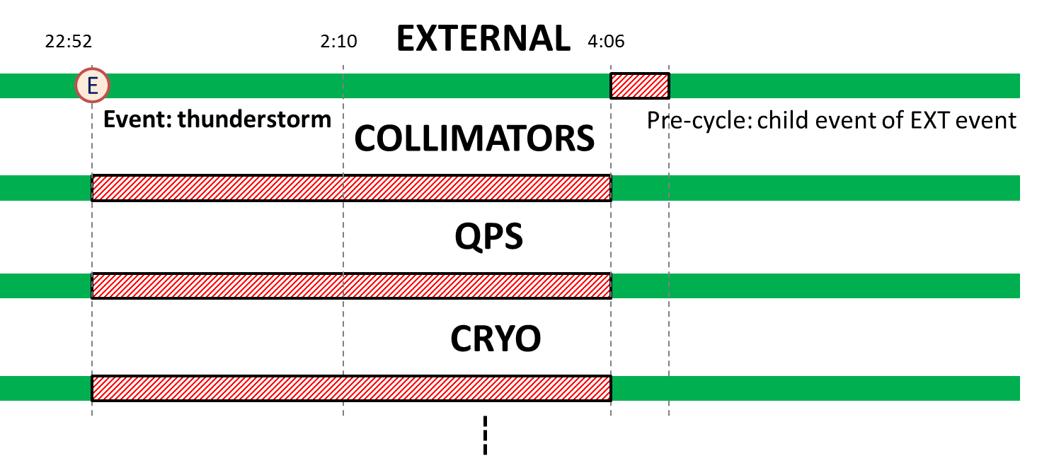
THUNDERSTORM AND CHILD FAULTS ON 21/8/2012
A thunderstorm caused faults in many systems (QPS, collimators, Cryo, experiments,…); these are all child faults of the external event. The sequence of events/faults is not clearly deducible from the logbook due to the big number of faults.
LHC
Difficult to trace back the series of events in the logbook

Slide 32
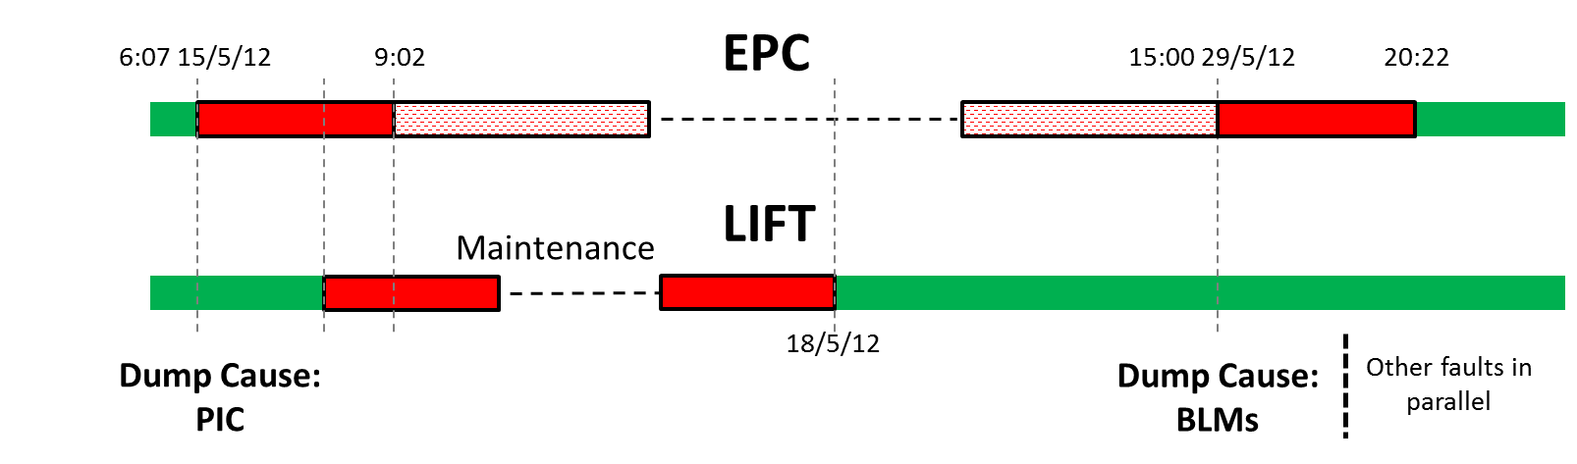
EPC OCTUPOLE FAULTS AND LIFT MAINTENANCE
15/5/2012 to 29/5/2012
A fault of a power converter of an octupole (ROF.A81.B1) was detected by the PIC on 15/5/2012. Intervention was impossible due to scheduled maintenance on the lift. The repair was then postponed. A fault of a power converter of another octupole (ROF.A67.B1) occurred on 29/5/2012. The combined effect of the two faults on the octupoles caused losses in IR7, detected by the BLMs.
LHC

