Slide 1
Results of microscopic analysis II
V. Raginel, A. Gerardin, M. Thiebert

Slide 3
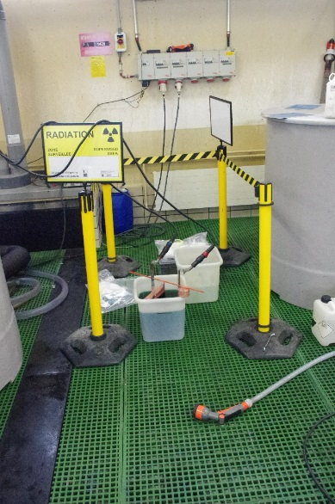
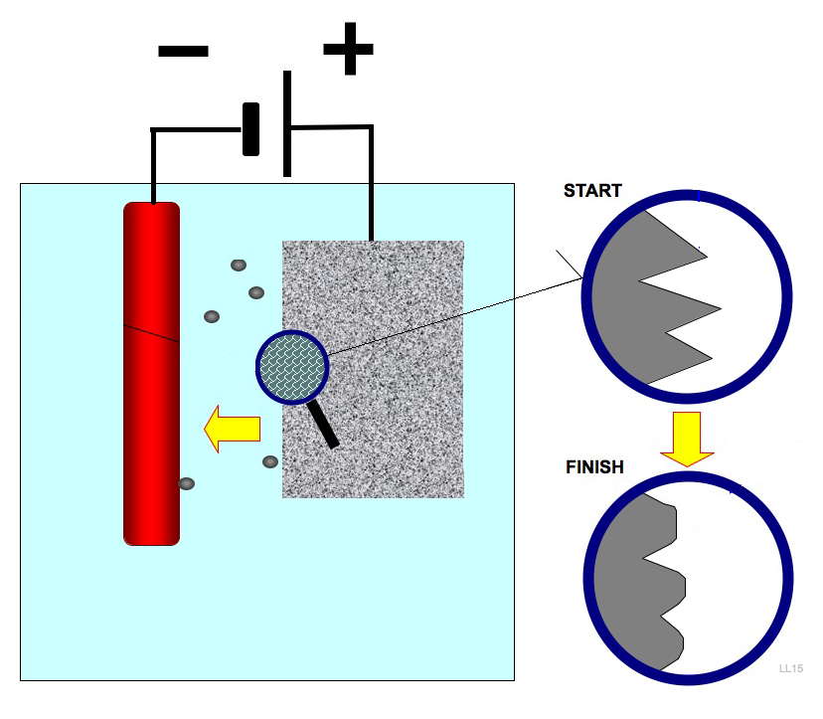
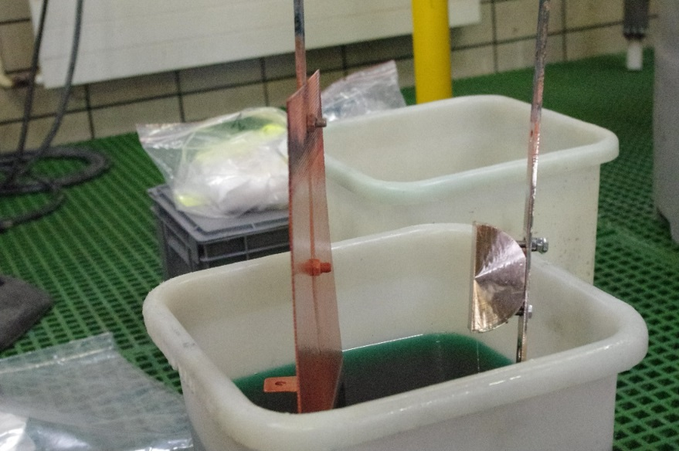
Electropolishing of the Cylinder
Current passes from anode to cathode. Electrolyte bath is phosphoric acid (H₃PO₄)
Anode (Cylinder): Copper is oxidized and dissolved in the electrolyte
Cu -> Cu²⁺ + 2 e⁻
Cathode: Reduction of the copper
  Cu²⁺ + 2 e⁻ -> Cu
Cu

Slide 4
T3 – Cylinder 1
400 GeV/c
144b with 1.5E11p
σ = 0.2 mm

Slide 5
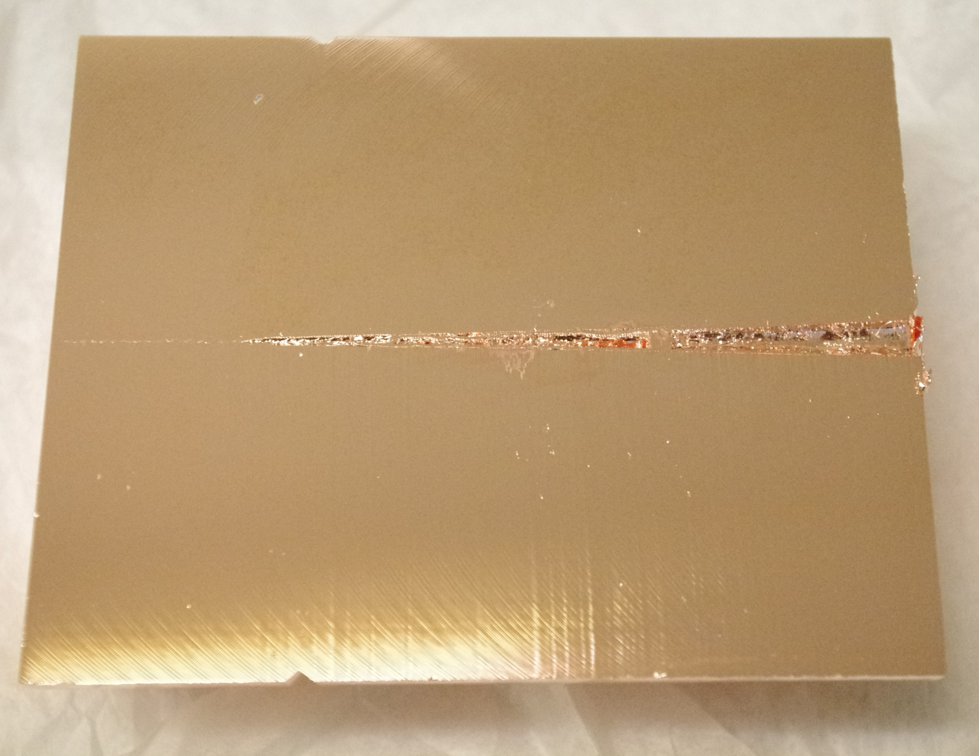

Slide 6
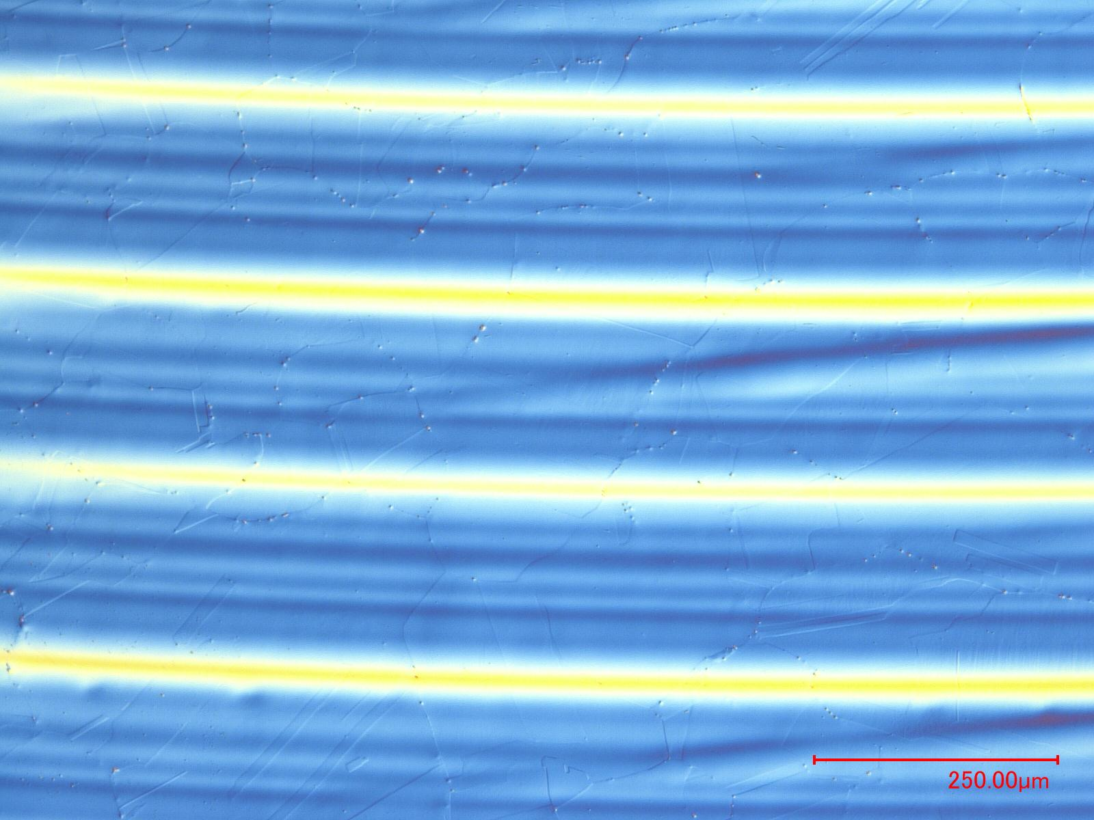
Base material: Average grain size ~100 um

Slide 7
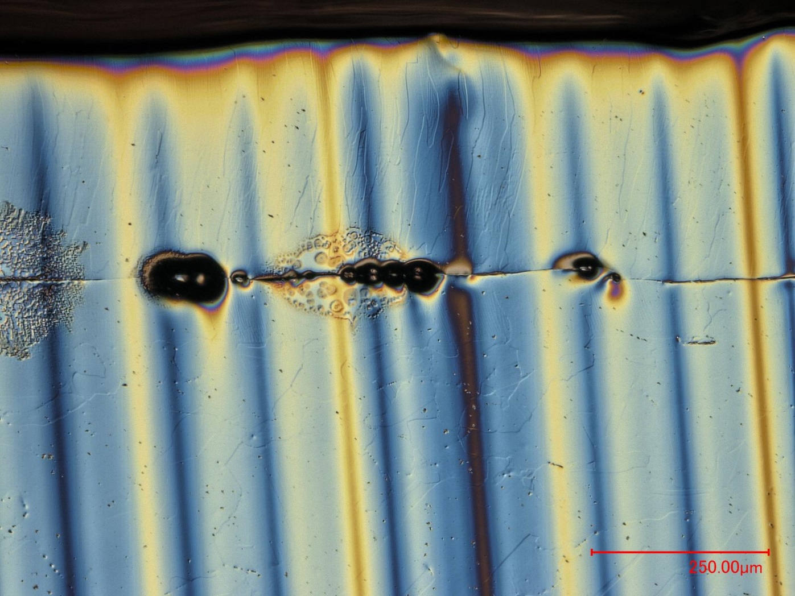
Columnar grains
Molten
Non-molten

Slide 8
T3 – Cylinder 9
400 GeV/c
144b with 1.5E11p
σ = 0.2 mm

Slide 9
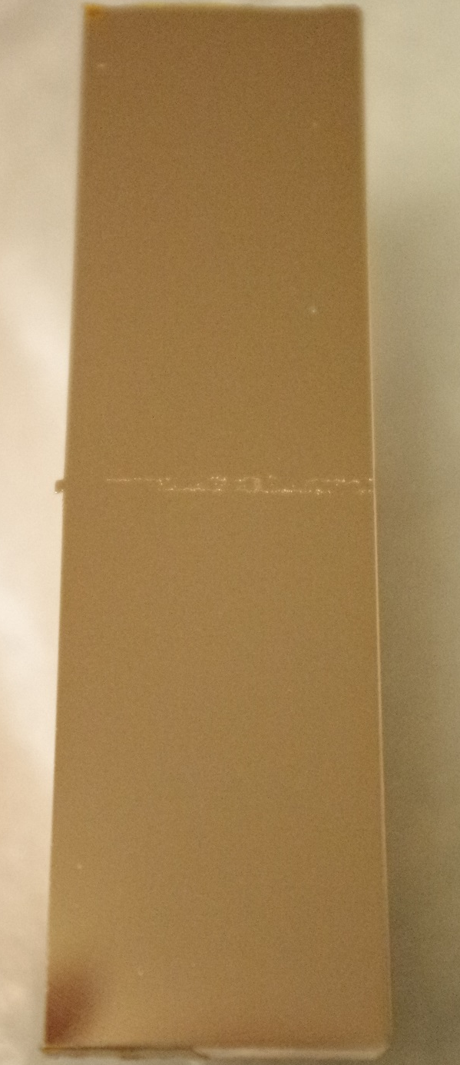
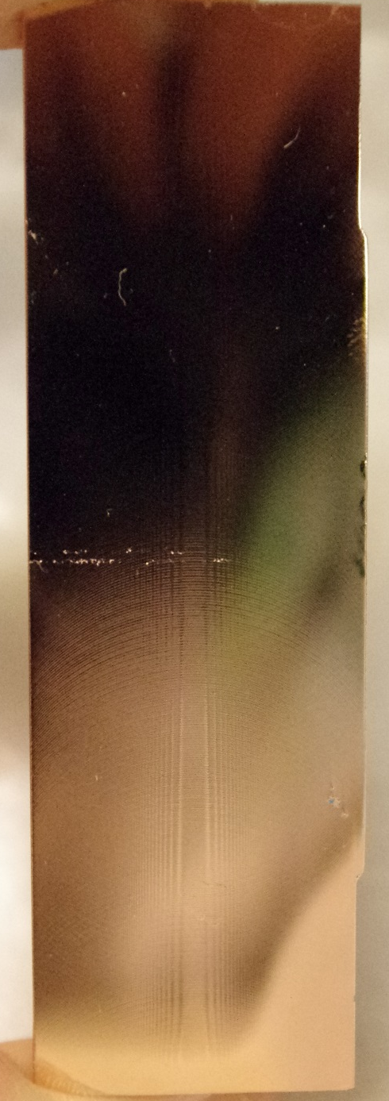

Slide 10
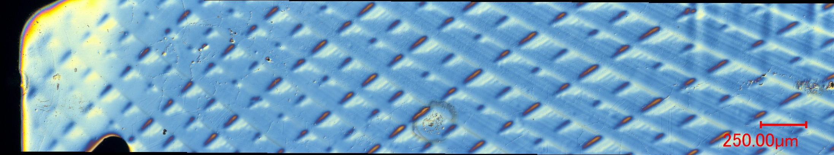
First ~5 mm - T3-9/1

Slide 11
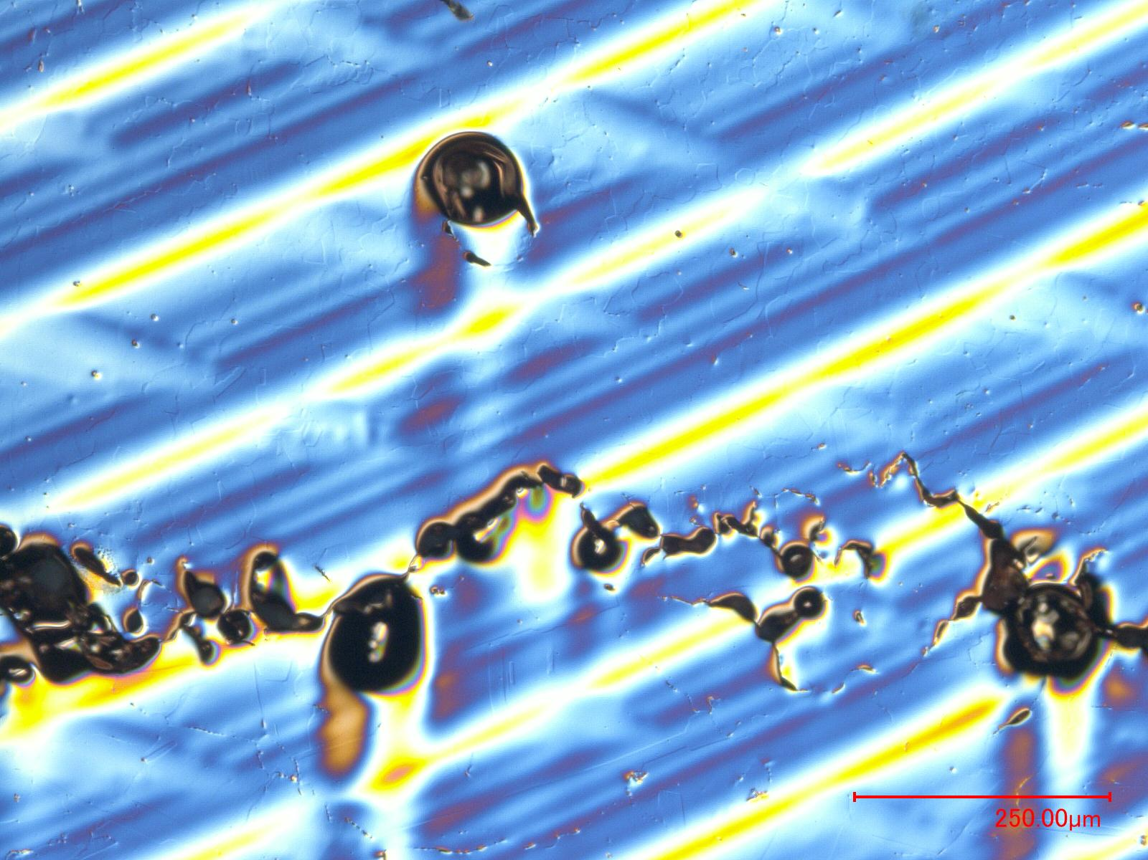
T3-9/1
Molten
Small Grains ~ 30 um
Non-molten
Grains ~ 100 um

Slide 12
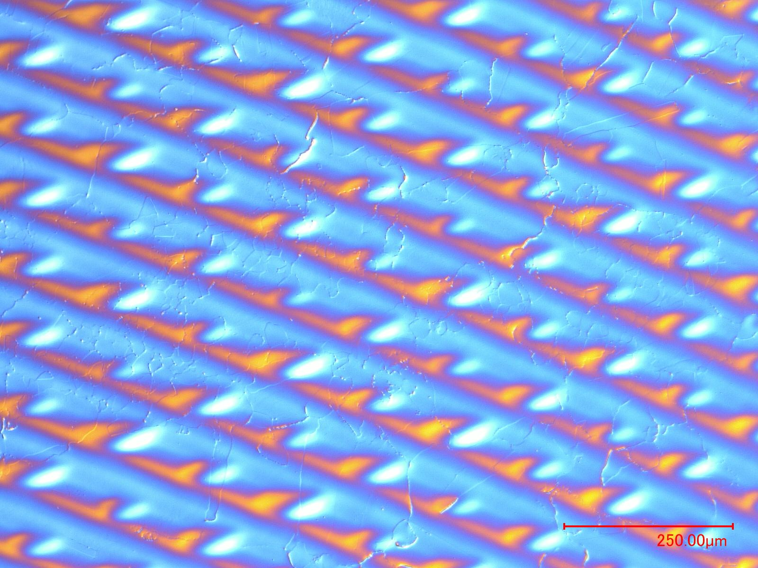
T3-9/2 - After last visible micro-cavity
Non-molten
Partially molten
Non-molten

Slide 13
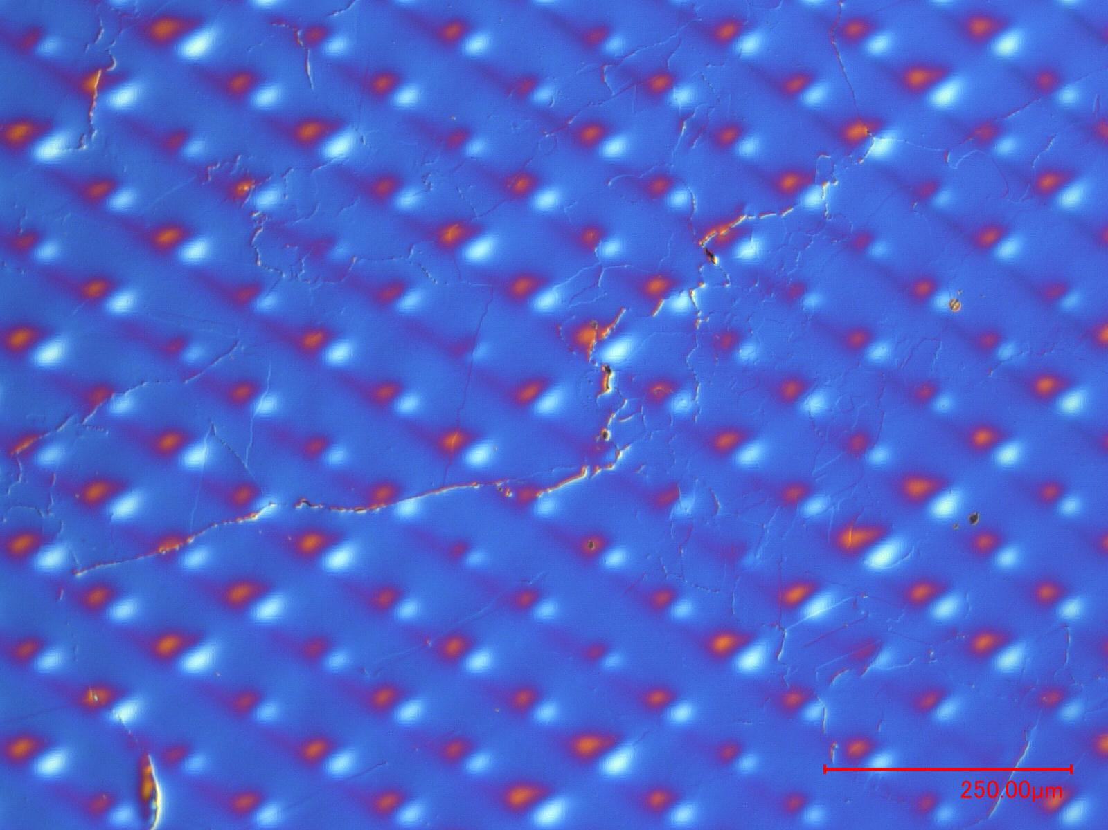
T3-9/2 - After last visible micro-cavity
Crack following join of grains

Slide 14
T2 – Cylinder 8
400 GeV/c
108b with 1.5E11p
σ = 0.2 mm

Slide 15
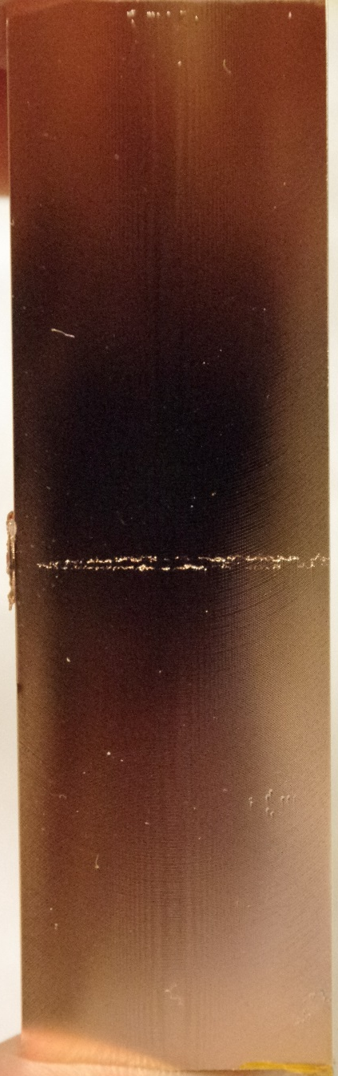
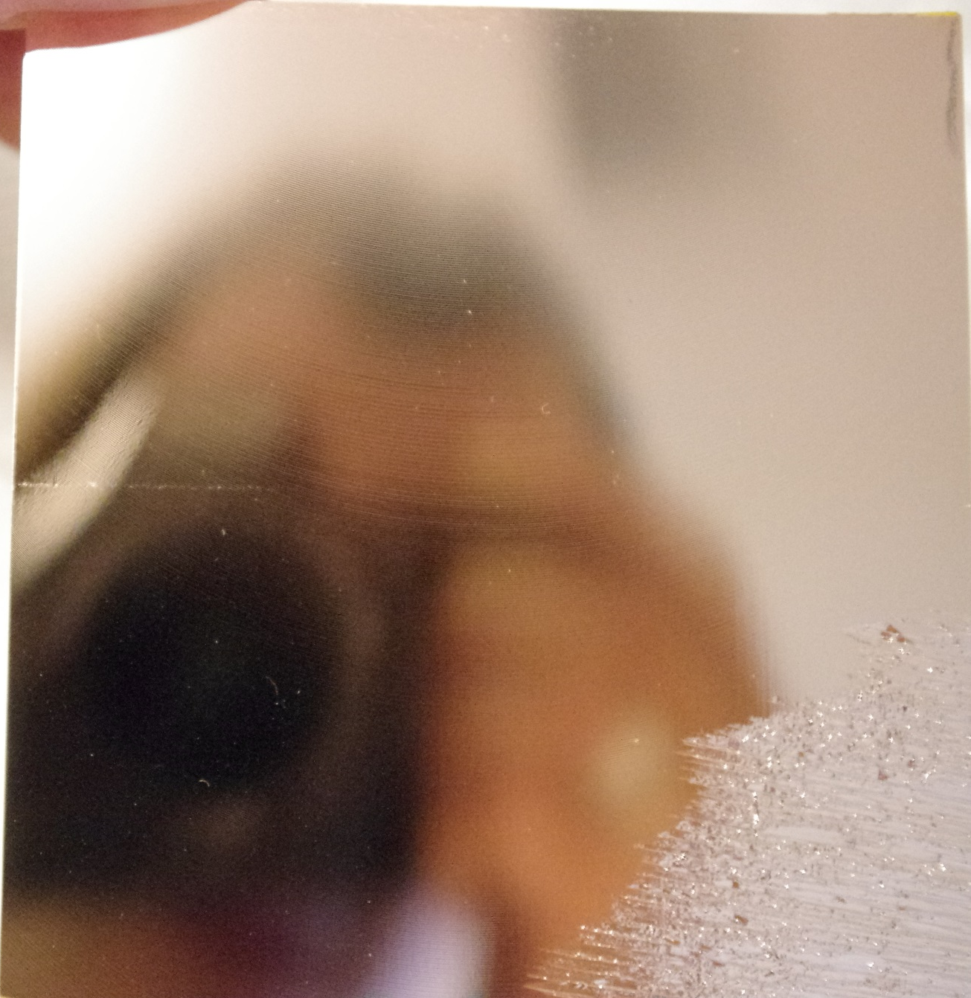

Slide 16
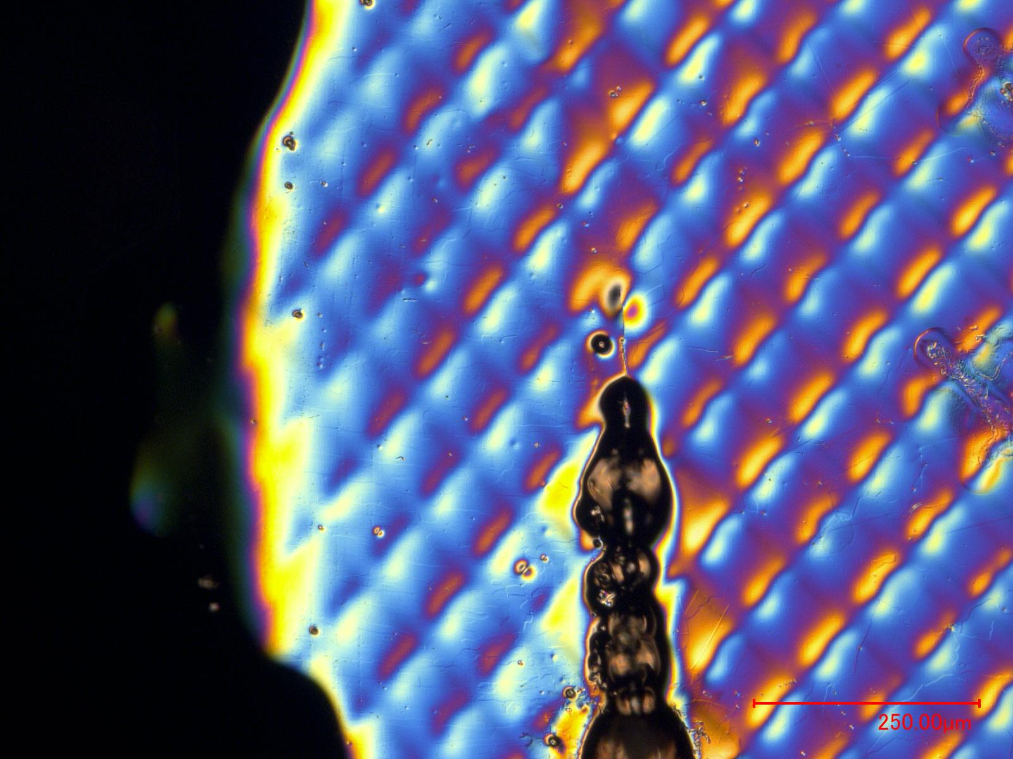
Zoom of the splash coming from cylinder 7
T2-8/1

Slide 17
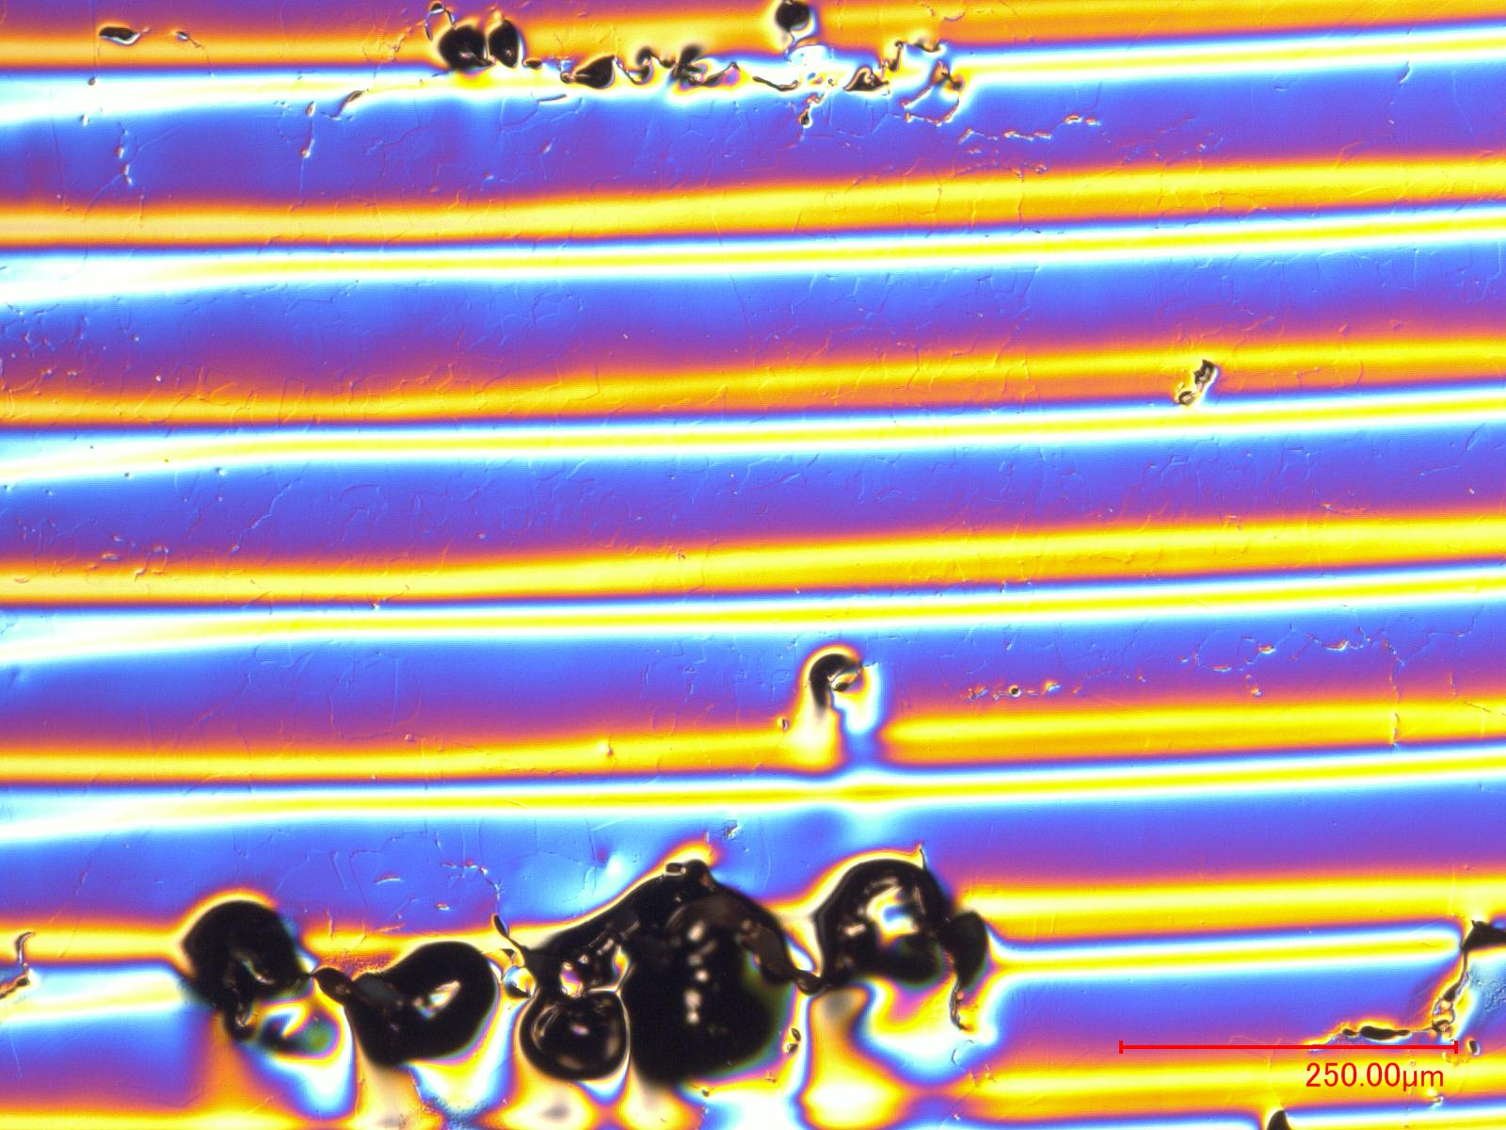
Between the two lines formed by the micro-cavities - T2-8/1
Molten
Small Grains ~ 30 um
Non-molten

Slide 18
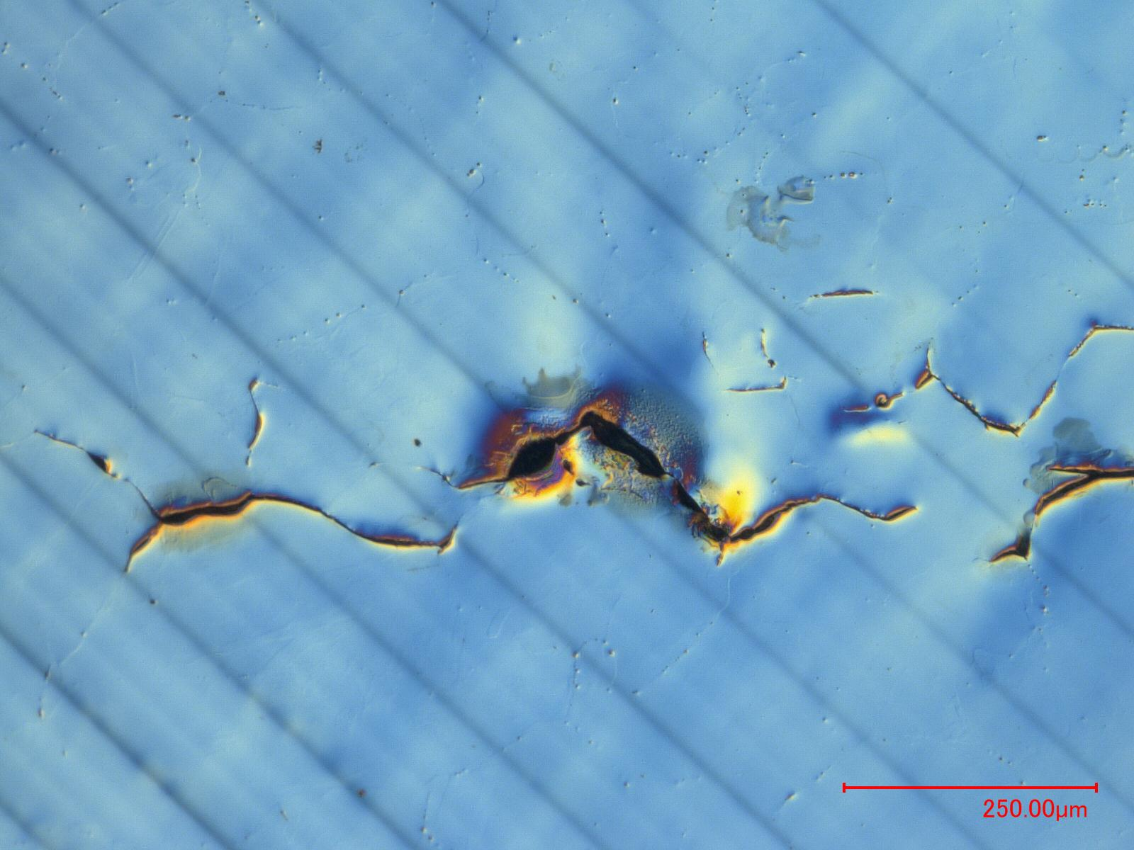
Single line crack in T2-8/2

Slide 19
T1 – Cylinder 6
400 GeV/c
144b with 1.5E11p
σ = 2 mm

Slide 20
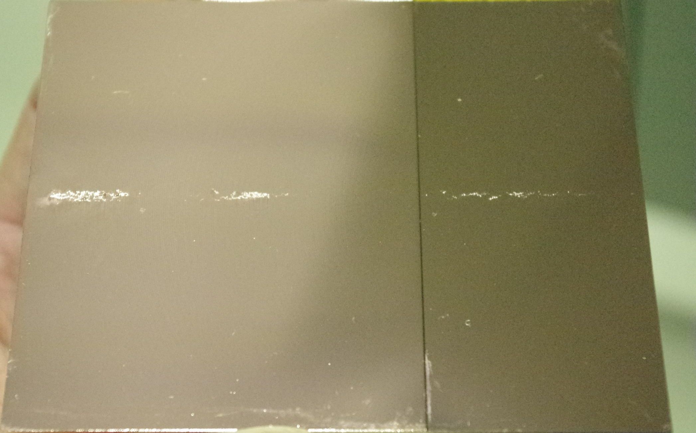

Slide 21
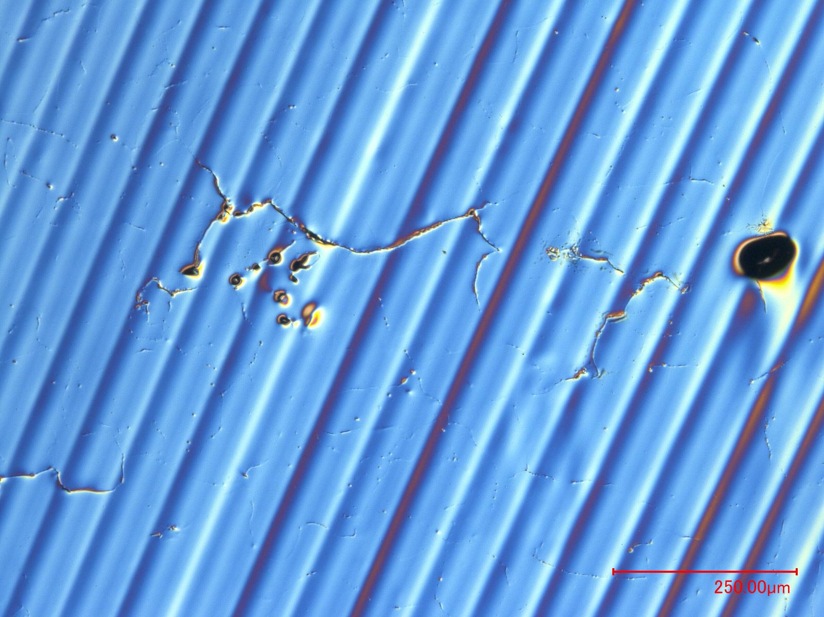
Example of a crack in T1-6

Slide 22
Conclusions
Damage Depth confirmed. (T1/58 cm, T2/79.5cm, T3/85cm)
Copper that has been molten shows smaller grains structure than the original material, or columnar grains (e.g. T3 cylinder 1)
It is confirmed that in the last damage cylinders of each target, the copper between the two lines of micro-cavities has be molten.

Slide 23
Spare Slides

Slide 24
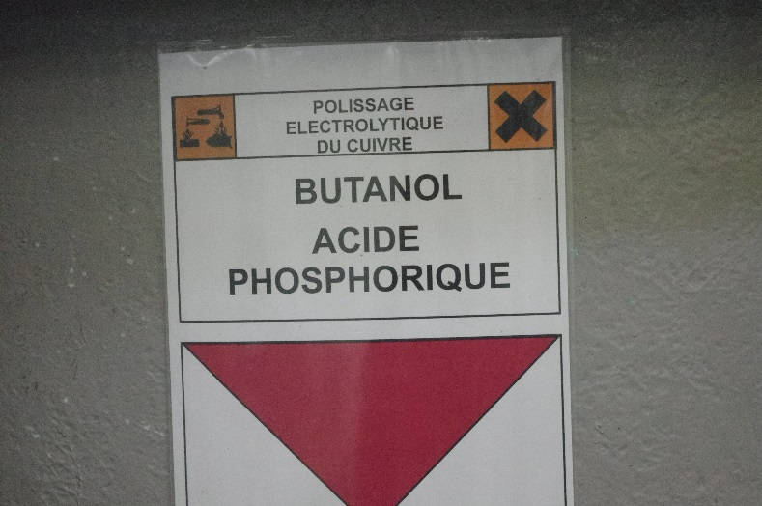
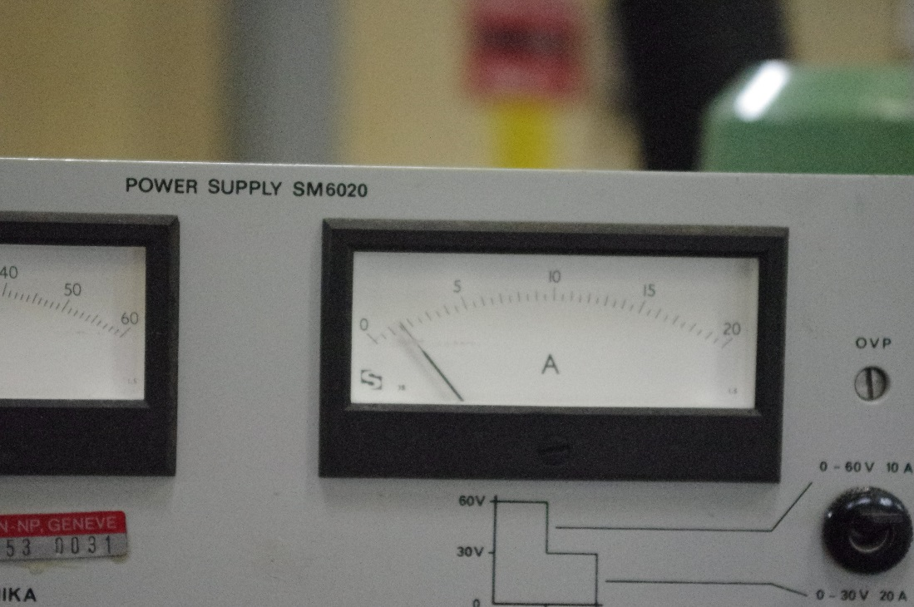
Electropolishing of the Cylinder

