Slide 1
Introduction to availability modelling in ELMAS
Arto Niemi

Slide 2


Introduction
Arto Niemi, PhD student at Tampere University of Technology in a group of Reliability Engineering
Work before in projects involving
  Aircraft reliability and prognostics studies and method development
  Power plant operation cost and availability analysis for warranty cost calculation
  Telecommunication maintenance strategy optimization, data driven diagnostics (SOM) and general data analytics

Slide 3
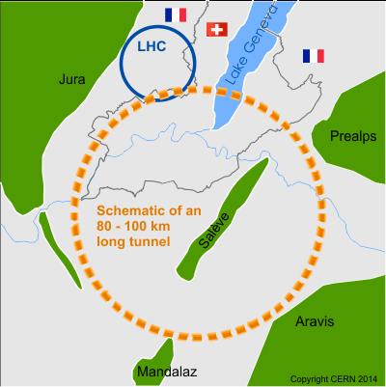
RAMS for FCC
The goal of the project is develop methods and tool for availability analysis to be used in FCC study
However, to develop the methods and test their applicability we work with the data from LHC and the injector chain
The main task is to develop a high level fault tree model for “generic” accelerator to be used to study current accelerators and future ones.

Slide 4

The Model
The model is made with ELMAS software from Finnish company Ramentor
The model has three levels:
  L1: Runs and long shutdowns
  L2 Annual level: proton physics, technical stops, etc.
  L3 Proton physics operations: Stable beams, turn around…
www.ramentor.com

Slide 5
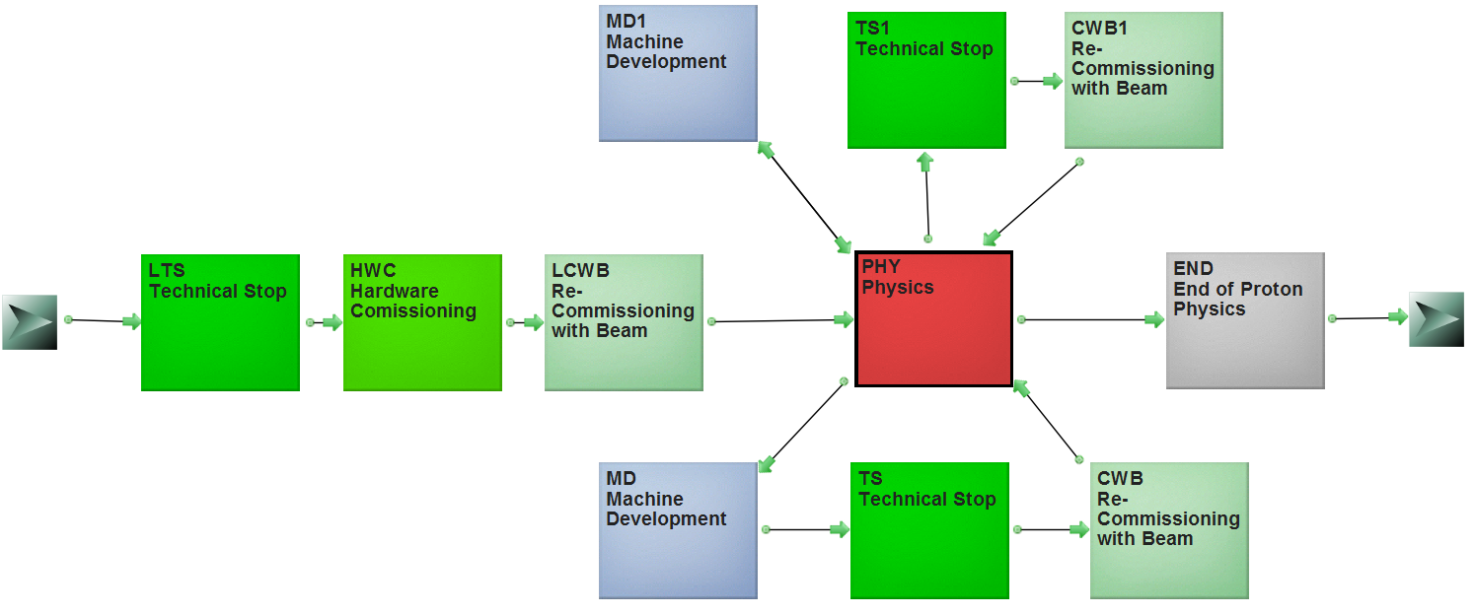
Level 2 Model Schematic
The year starts with commissioning followed by proton physics
The proton physics is interrupted by technical stops and machine development

Slide 6
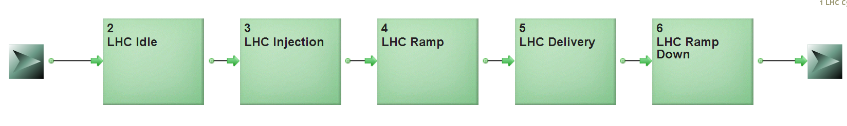
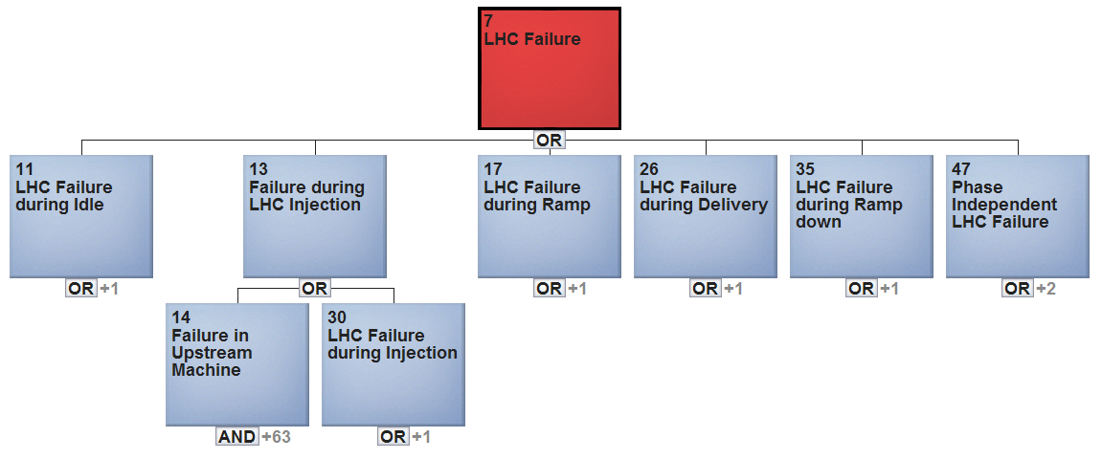
Level 3 Model
The phases (green) activate different parts of the fault tree (blue)
Under these nodes will be the nodes for the failure modes Magnets, RF, Vacuum…
If the failure rate is phase independent it’s just under the phase independent failures

Slide 7
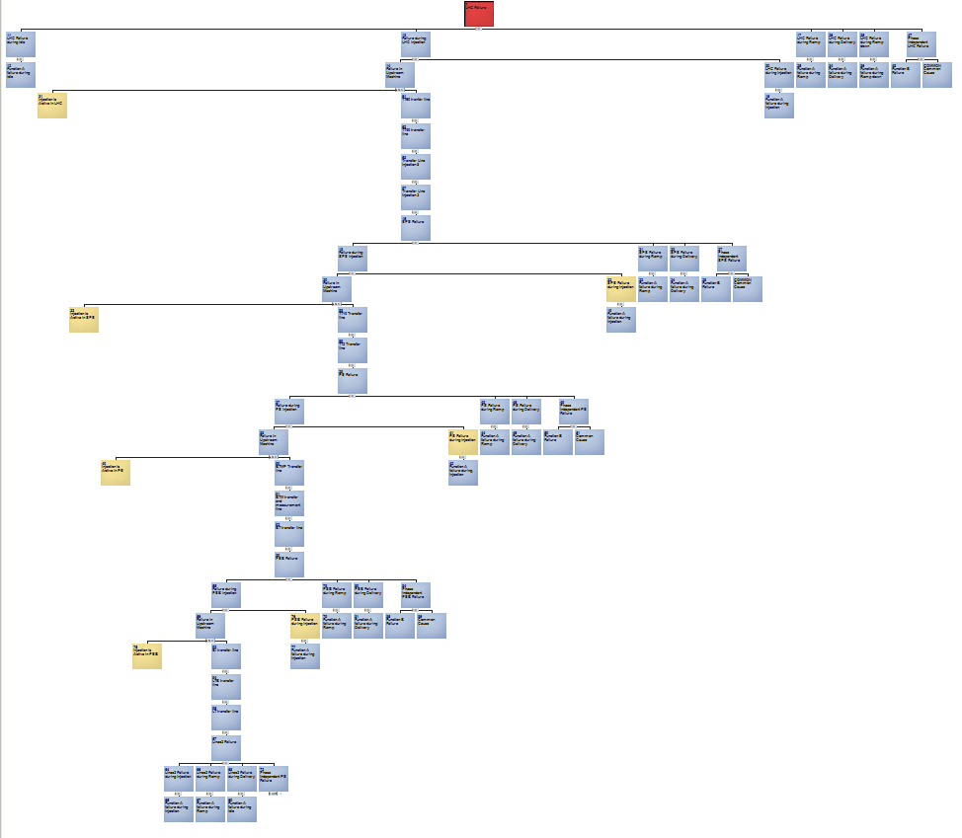
The Injector Chain
The injection is special as failure can occur either in the accelerator (LHC) or in it’s injector chain
From the LHC the injector chain goes all the way back to Linac2 and contains all the transfer lines

Slide 8
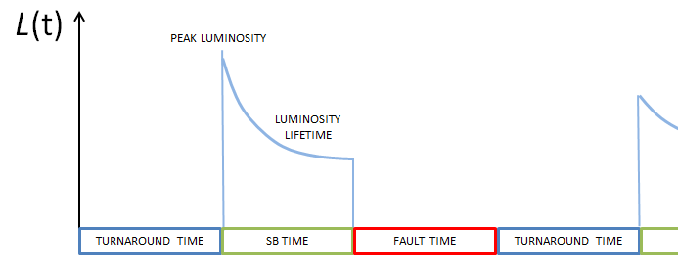

Probabilistic availability analysis
In the model the failures cause unavailability as any risk the probability and consequence are needed.
The probability of failure is given by failure rate, which can be calculated from data or estimated by experts.
  The rate can time dependent different rate at different operational phases or “age” dependent
  After technical stop failure rate seems to increase. we plan to repeat 2011 TS analysis* with 2015 data
The consequence is not only the repair time.
  If the failure occurs during the stable beams or during a turnaround the amount of lost production is different.
  Some failures need pre-cycle
$$Risk=Prob∗Consequences$$
*Matteo Solfaroli Camillocci, Evian 2011
A schematic from A. Apollonio’s PhD thesis.

Slide 9
Conclusions
The time dependency of the failure rate and consequences leads very quickly very complex cause consequence logics. So, analytical solution is not practical and Monte-Carlo simulation is needed.
We work in collaboration with IT to have data easily available
Modelling of the LHC is needed for verification that model produces accurate results.
Once that is done the model can be used for testing “what if” scenarios and more detail can be added to interesting systems.
What if injection and turnaround lasts 10 hours for FCC?
A figure from A. Apollonio’s PhD thesis.

Slide 10
TS analysis results
Extra slides
By M. Solfaroli Camillocci, Evian 2011

Slide 11
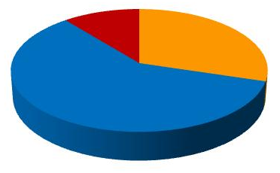
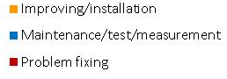
TS#1
28 – 31 March – 4 days + 1 recovery day
3243 keys given
WHERE WERE WE?
Slot of 1.38 TeV operation
Last 3.5 TeV physics fill (1645):
  200 b (24 bpinj) - (ready for 296 b)
  ~1.22E¹¹ p per bunch
  Peak lumi: 2.5E³² cm⁻² s⁻¹
10%
30%
60%
GOAL of the week
Recovery from TS and start preparation for high intensity

Slide 12
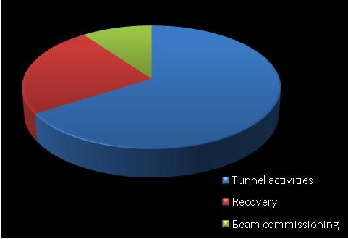
TS#1 - Recovery
Start of HWC
Global CRYO start
Inj region aperture measurements for higher intensity
MKB.B2
First pilot
Dump @450GeV
CRYO
TS
Recovery
Beam comm
Mon 28th
7am
Thu 31st
6.25pm
Fri 1st
10.29am
Fri 1st
9.59pm
Sat 2nd
01.23am
Sat 2nd
~2pm
t
Activity | Duration [h]
Tunnel activities (TS) | 84
Recovery | 31
Beam commissioning | 12
TOT | 127
10%
24%
66%
 | TOTAL | NOT related | HW | SW
TIME lost | 14.5 h | 48% | 62% | 38%

Slide 13
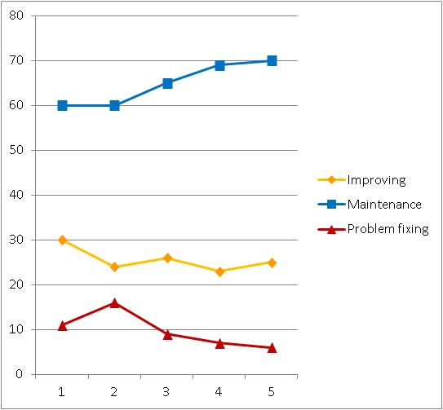
Some numbers…
TS Analysis Results From 2011
Tunnel activities vs TSs
 | Keys | Maintenance | Improving | Problem fixing
TS#1 | 3243 | 60% | 30% | 10%
TS#2 | 2831 | 60% | 24% | 16%
TS#3 | 3062 | 65% | 26% | 9%
TS#4 | 3645 | 69% | 24% | 7%
TS#5 | 3404 | 70% | 24% | 6%

Slide 14
…more…
 | Time lost [h] | NOT related | HW | SW
TS#1 | 14.5 | 48% | 62% | 38%
TS#2 | 15.5 | 94% | 90% | 10%
TS#3 | 19.5 | 46% | 85% | 15%
TS#4 | 6.5 | 15% | 8% | 92%
TS#5 | 4 | 50% | 62% | 38%
Pretty low statistics to have meaningful conclusions...
...in general HW issues require more time to be fixed

Slide 15
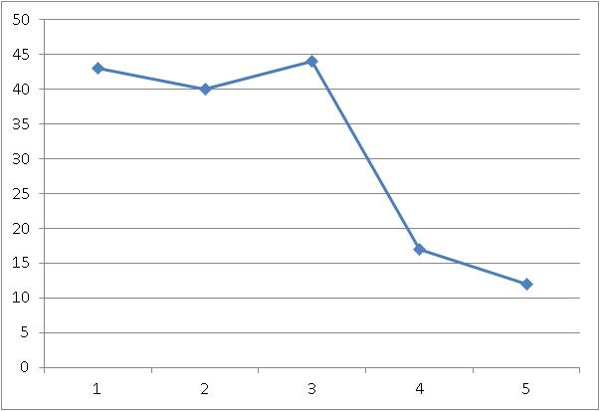
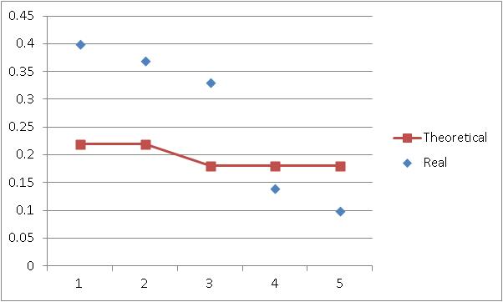
…and more!
X = number of days allocated
Allocated time for recovery = 24 h
 | Recovery + Beam commissioning | TOT TS time (x-1)*24 + 12 + 24 | Recovery coefficient (theoretical) | Recovery coefficient (real)
TS#1 | 43 h | 108 h | 0.22 | 0.4
TS#2 | 40 h (67 h including cryo stop) | 108 h | 0.22 | 0.37
TS#3 | 44 h (130 h considering the power cut) | 132 h | 0.18 | 0.33
TS#4 | 18 h | 132 h | 0.18 | 0.13
TS#5 | 13 h | 132 h | 0.18 | 0.09
Recovery time vs TSs
Recovery coefficient

Slide 16
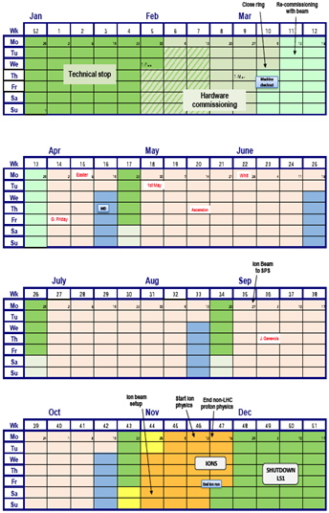
Conclusions
Need to improve fault details recording
Most of activities is maintenance, can it be reduced?
No systematic source of trouble over the 5 TSs !!
It seems clear that we are improving in recovery…
  (“After TS, an increment in faults was observed. Effect is decreasing along the run” Walter @Chamonix 2011)
  Need to apply a control for SW changes (through a meeting to coordinate and create a list?) which could:
    Improve changes, by coordinating them
    Increase operational efficiency, by making easier the identification of the source of problems
    Reduce impact of changes on other systems
  4 TSs foreseen for 2012...can we push forward some maintenance and have 3 TSs of 5 days?
2012

