Slide 1
A preliminary comparison of the FCC magnet designs from the protection point of view

Slide 2
FCC magnet design
The main actor is EuroCirCol Work Package 5 (ECC WP5)
  Our section is involved together with TUT (Antti Stenvall and Tiina Salmi)
During the last coordination meeting (9 Oct. 2015) different magnet designs were presented
  Three different cos-theta designs @ (4.5K, 4.5K, 1.9K), INFN
  Three different block designs @ 4.5K, CEA
You can find all detailed infos on our Twiki page / FCC circuit protection

Slide 3
cos-theta designs, INFN
Available data
 | cos-theta 4.5K Dip 1 | cos-theta 4.5K Dip 2 | cos-theta 1.9K | LHC MB
N_{turns/pole} | 113 | 157 | 100 | 40
B_{nom} [T] | 16 | 16 | 16 | 8.33
I [kA] | 14.6 | 11.1 | 12.0 | 11.85
L_{sp} [mH/m] (both ap.) | 41.3 | 79.7 | 35.6 | 6.9
E_{sp} [MJ/m] (both ap.) | 4.4 | 4.9 | 2.6 | 0.48
cos-theta 4.5K Dip 1
cos-theta 4.5K Dip 2
cos-theta 1.9K

Slide 4
Block designs, CEA
Available data
 | Block v10 | Block v11 | Block v12 | LHC MB
N_{turns/pole} | 174 | 292 | 174 | 40
B_{nom} [T] | 16 | 16 | 16 | 8.33
I [kA] | 9.33 | 6.14 | 10.15 | 11.85
L_{sp} [mH/m] (both ap.) | 106 | 298 | 100 | 6.9
E_{sp} [MJ/m] (both ap.) | 4.6 | 5.6 | 5.2 | 0.48
Block v10
Block v11
Block v12

Slide 5
The role of our section
Design for protectability
  Discuss the capability to protect a specific superconducting magnet during the design phase
The final goal is to avoid the design of a magnet
  Optimized from the electromagnetic, mechanical, thermal, …, point of views
  But that cannot be protected !

Slide 6


First approach
Keep for the protection system the same layout as in the LHC
And set some parameters
$$l_{oct}=8 km$$
$$l_{cir}=l_{oct} \left(N_{cir per oct}=1\right)$$
$$N_{MB,cir}=485$$
$$N_{EE, cir}=2$$
$$t_{ramp}=1800 s$$
$$τ_{FPA}=100 s$$
 | cos-theta 4.5K Dip 1 | cos-theta 4.5K Dip 2 | cos-theta 1.9K
dI/dt_{ramp} [A/s] | 8.1 | 6.2 | 6.7
dI/dt_{FPA} [A/s] | 146.0 | 111.0 | 120.0
 | Block v10 | Block v11 | Block v12
dI/dt_{ramp} [A/s] | 5.2 | 3.4 | 5.6
dI/dt_{FPA} [A/s] | 93.3 | 61.4 | 101.5

Slide 7
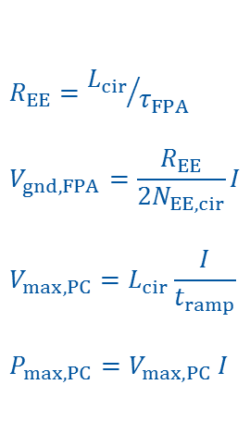
First approach
 | cos-theta 4.5K Dip 1 | cos-theta 4.5K Dip 2 | cos-theta 1.9K
L_{cir} [H] | 286.3 | 552.7 | 246.6
E_{cir} [GJ] | 30.5 | 34.0 | 17.8
R_{EE} [mΩ] | 2863.2 | 5527.1 | 2466.0
V_{gnd,FPA} [V] | 10450.8 | 15337.7 | 7397.9
V_{max, PC} [V] | 2322.4 | 3408.4 | 1644.0
P_{max, PC} [MW] | 33.9 | 37.8 | 19.7
$$R_{EE}={L_{cir}}/{τ_{FPA}}$$
$$V_{gnd, FPA}=\frac{R_{EE}}{2N_{EE, cir}}I$$
$$V_{max, PC}=L_{cir}\frac{I}{t_{ramp}}$$
$$P_{max, PC}=V_{max, PC} I$$
 | Block v10 | Block v11 | Block v12
L_{cir} [H] | 735.2 | 2066.8 | 693.6
E_{cir} [GJ] | 32.0 | 39.0 | 35.7
R_{EE} [mΩ] | 7351.6 | 20667.8 | 6935.5
V_{gnd,FPA} [V] | 17147.7 | 31725.1 | 17598.8
V_{max, PC} [V] | 3810.6 | 7050.0 | 3910.9
P_{max, PC} [MW] | 35.6 | 43.3 | 39.7
As expected, voltage to ground is huge and the design of the PC is unfeasible !

Slide 8


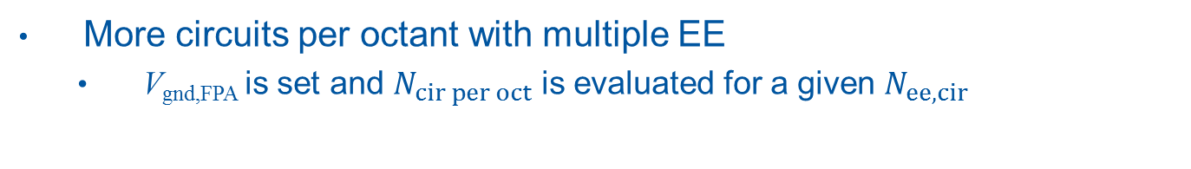


Second approach
$$t_{ramp}=1800 s$$
$$τ_{FPA}=100 s$$
More circuits per octant with multiple EE
  V_{gnd,FPA} is set and $N_{cir per oct}$ is evaluated for a given $N_{ee, cir}$
$$N_{ee, cir}=2$$
$$N_{ee, cir}=4$$
$$N_{ee, cir}=8$$

Slide 9
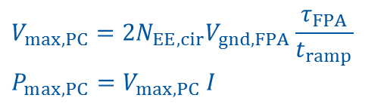
Second approach
$$t_{ramp}=1800 s$$
$$τ_{FPA}=100 s$$
From the PC point of view
$$V_{max, PC}={2N}_{EE,cir}V_{gnd,FPA}\frac{τ_{FPA}}{t_{ramp}}$$
$$P_{max, PC}=V_{max, PC} I$$
For highest current
(cos-theta 4.5K Dip 1)
For lowest current
(Block v11)

Slide 10

Second approach
$$t_{ramp}=1800 s$$
$$τ_{FPA}=200 s$$
More circuits per octant with multiple EE
  V_{gnd,FPA} is set and $N_{cir per oct}$ is evaluated for a given $N_{ee, cir}$
$$N_{ee, cir}=2$$
$$N_{ee, cir}=4$$
$$N_{ee, cir}=8$$

Slide 11
Second approach
$$t_{ramp}=1800 s$$
$$τ_{FPA}=200 s$$
From the PC point of view
$$V_{max, PC}={2N}_{EE,cir}V_{gnd,FPA}\frac{τ_{FPA}}{t_{ramp}}$$
$$P_{max, PC}=V_{max, PC} I$$
For highest current
(cos-theta 4.5K Dip 1)
For lowest current
(Block v11)

Slide 12
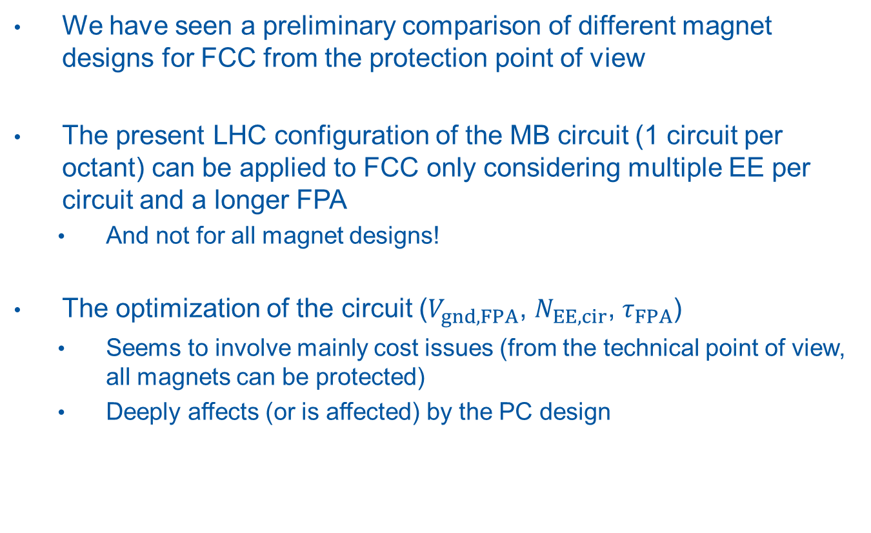
Conclusions
We have seen a preliminary comparison of different magnet designs for FCC from the protection point of view
The present LHC configuration of the MB circuit (1 circuit per octant) can be applied to FCC only considering multiple EE per circuit and a longer FPA
  And not for all magnet designs!
The optimization of the circuit ($V_{gnd,FPA}$, $N_{EE, cir}$, $τ_{FPA}$)
  Seems to involve mainly cost issues (from the technical point of view, all magnets can be protected)
  Deeply affects (or is affected) by the PC design

