Slide 1
Quench Simulation in COMSOL
Deepak Paudel, Michal Maciejewski
August 2015, Geneva
Supervisor:
Bernhard Auchmann

Slide 2
Outline
1D FEM model of magnet coil
Mesh Adaptation
Implementation of helium non-linear cooling behavior
Performance Analysis
Outlook.

Slide 3
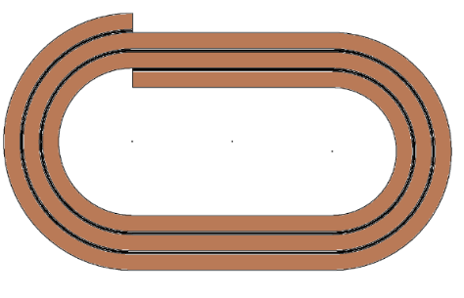
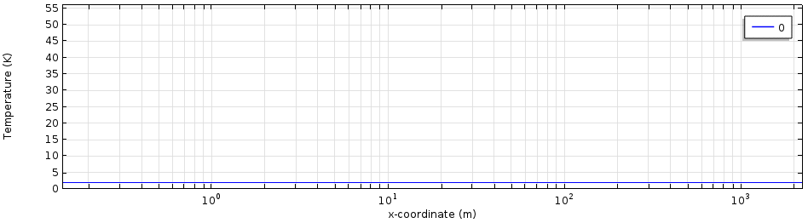
1D FEM model of magnet coil
Single 1D 2.25 km long line model representing LHC dipole magnet. I = 4200 A , B = 2.88 T
Heat conduction along cable was calculated using COMSOL default heat diffusion equation.
The joule heat generation and turn to turn heat conduction was calculated by defining function in COMSOL GUI which was than applied as body loads to the model.
Model Characteristics
Adaptive time stepping (Δt = 10 - 100 μs)
Adaptive mesh (h = 1 mm - 15 cm )
Total simulation time = 1 s
Total computation time = 5 hours
No of elements (15000 - 20000)
Without adaptive mesh (2e6, ~ 100 times faster)

Slide 4
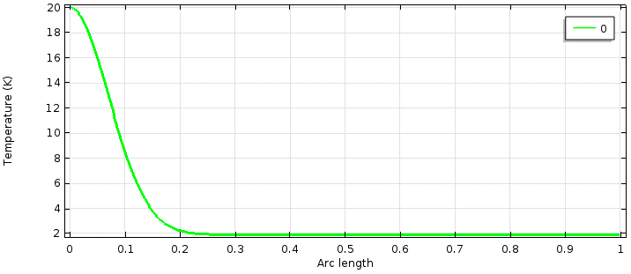
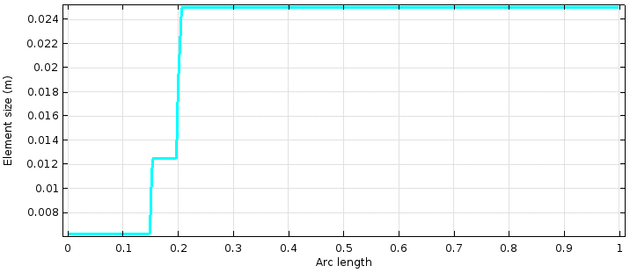
Mesh Adaptation
QP3 like model with mesh adaptation feature.
Results in much fast performing model while accuracy remaining same as fixed mesh model.
For 1 m long model we don’t benefit from mesh adaptation feature.
However, for large model size, the computation time reduces significantly.
(In reference to slide 3)

Slide 5

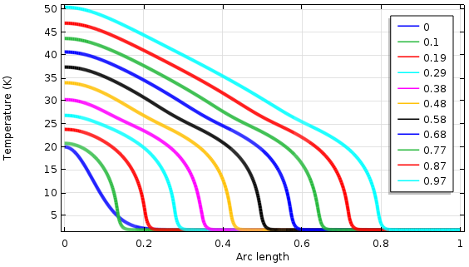
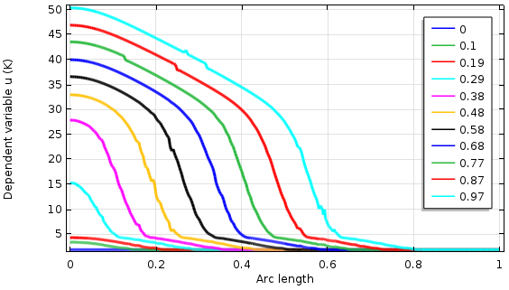
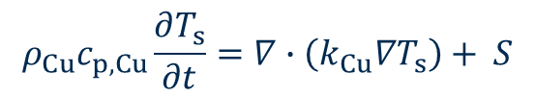

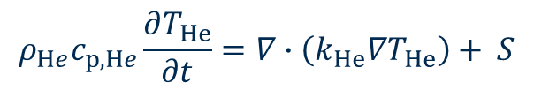
Implementation of helium cooling dynamics
Same geometry - Two field variables (T_{s},T_{He})
Strand domain
Helium domain
y
Heat diffusion equation
Heat diffusion equation
$$ρ_{Cu}c_{p,Cu}\frac{∂T_{s}}{∂t}=∇∙\left(k_{Cu}∇T_{s}\right)+ S$$
$$ρ_{He}c_{p,He}\frac{∂T_{He}}{∂t}=∇∙\left(k_{He}∇T_{He}\right)+ S$$
$k_{He}=0$ (assumed)
sink
source
S = Joule(T_{s}) - a_{He}/(a_{Cu}*L)*h_{He}(T_{s}, T_{He}, h_{He}) [W/m³]
S = h_{He}(T_{s}, T_{He}, h_{He})*a_{He}/v_{He} [W/m³]
Initial condition
Initial condition
Gaussian shape temperature profile representing heat pulse
1.9 K

Slide 6
Performance analysis
QP3 like 1D strand model
I = 150 A B = 2.88 T
Approximation fun. order
QP3 - Linear
ANSYS - Linear (was used)
Requires discretization in the scale less than 1 mm
n = 1000 Linear, Compu time = 110 s (QP3 )
In COMSOL Convergence achieved with discretization scale of 1 cm (Cubic order approximation )

Slide 7
1D FEM Coil Model Development Workflow

Coil geometry
Winding direction
CAD
ROXIE

Coil Geometry

Turn2turn Mapping

1D FEM Model

Physics
Coil | Helium

Solver

Slide 8
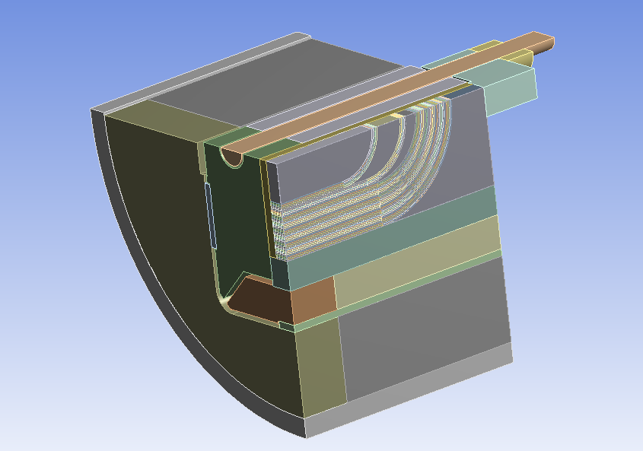
SMC with mech. structure
Heaters
Central Post
Wedges
Mid-plane insulation
Interlayer insulation
Entire cold-mass

Slide 9
3D FEM Coil Model Development Workflow
Coil geometry
Winding direction
Heaters
Central Post
Wedges
Mid-plane insulation
Interlayer insulation
Entire cold-mass
Water Heat Exchange
CAD
ROXIE
CAD
ROXIE
Additional elements
Coil Geometry
Coil Geometry
Automatic detection of thermal contacts
Turn2turn Mapping
3D FEM Model
Unstructured | Structured
1D FEM Model
Physics
Heat Exchange| Magnet, Helium
Physics
Magnet, Helium
Solver
Solver

Slide 10
3D FEM Coil Model Development Workflow - Questions
#4 Tips on how to read geometry from CAD
Coil geometry
Winding direction
Heaters
Central Post
Wedges
Mid-plane insulation
Interlayer insulation
Entire cold-mass
Water Heat Exchange
CAD
ROXIE
Additional elements
Coil Geometry
Automatic detection of thermal contacts
#2 How to script entire process? (COMSOL API)
3D FEM Model
Unstructured | Structured
#1 How to adaptively mesh 3D to get 1D performance?
Physics
Heat Exchange| Magnet, Helium
Solver
#3 Performance optimisation

Slide 11

Outlook 1/2 Co-simulation
Coil geometry
Winding direction
CAD
ROXIE
Electro thermal
Electromagnetic
Electrical
SPICE
Simulations Coupling

Slide 12
Outlook 2/2 – extendibility
Coil geometry
Winding direction
CAD
ROXIE
Electro thermal
Electro thermal
Electromagnetic
Electrical
CFD
SPICE
Open Foam
Simulations Coupling

Slide 13
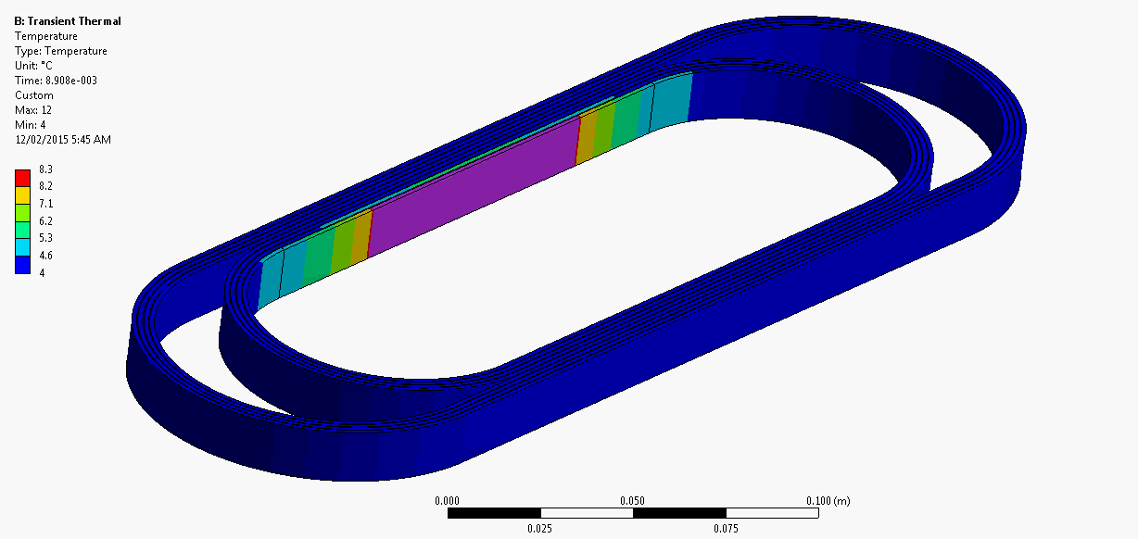
3D Magnet Coil
ANSYS SMC 11 T
Quench Propagation
Hexahedral mesh, no mesh adaption for time dependent solver.

Slide 14
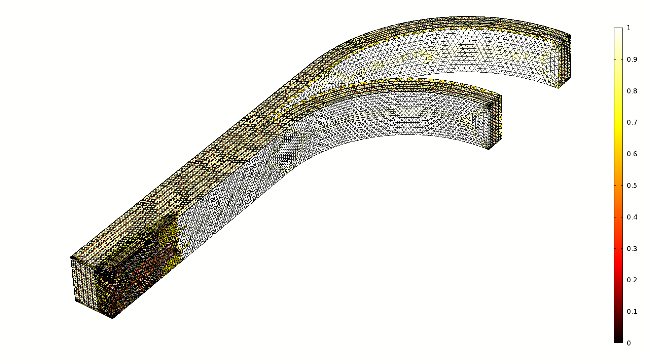
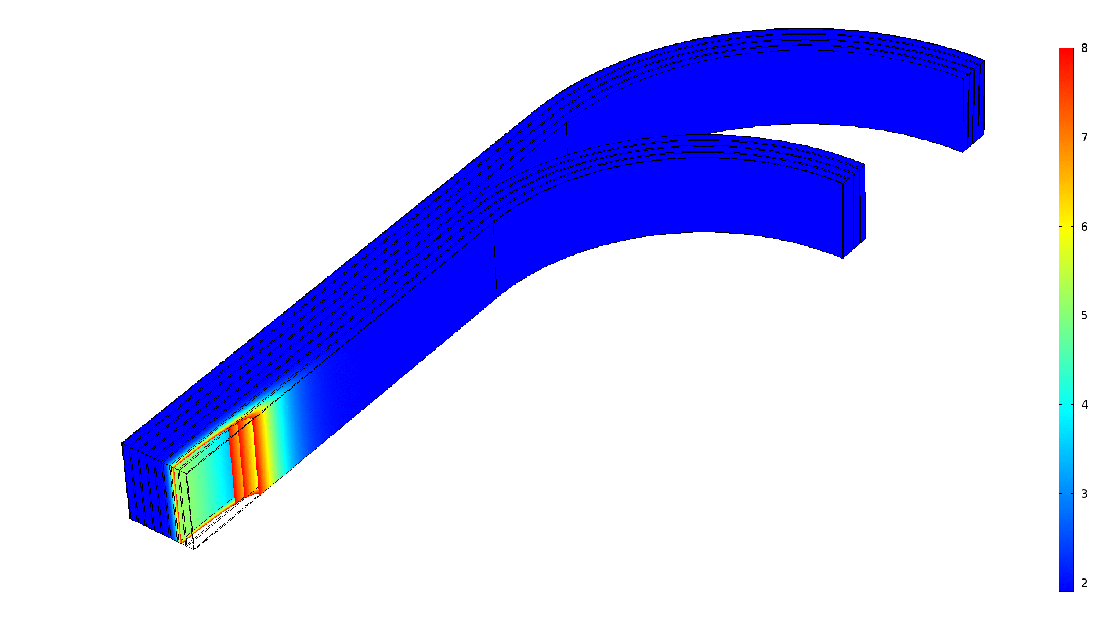
3D COMSOL models
SMC 11T
Tetrahedral Mesh adaptation
Quench Propagation
3D Strand Mesh adaptation

Slide 15
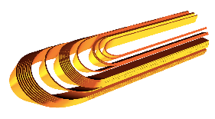
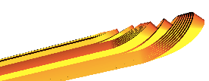
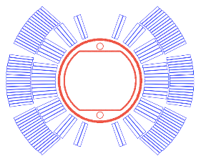
Outlook
What has been accomplished
A 3D quench propagation model which takes into consideration non-linear material property and non-linear helium cooling behaviour.
What we would like to achieve
A quench propagation model representing actual 3D model of the magnet coil, with non-linear helium cooling behaviour taken into consideration.
Issue
Magnet are usually large (15 m) and proper calculation needs fine discretization which can be computationally expensive.
Mesh adaption feature
COMSOL GUI provides this feature which is not efficient enough for our problem. We need to have knowledge of using COMSOL scripts which would allows us to define our own mesh adaptive algorithms.
Domain decomposition solver (and Cluster computing)
In order to solve large problems more efficiently on multiple processors. Dividing the modelling domain into subdomains where each PDE in the subdomain is easier to solve.
Model performance optimization

