Slide 1
TE-MPE-PE
new member presentation
Odei Rey Orozko

Slide 2
QUALIFICATIONS
Degree in Mathematics, University of the Basque Country (EHU)
Masters degree in Mathematical Modelling, Statistics and Computing, EHU
Computer skills: MatLab, Python, C++
PREVIOUS WORK
Researcher at Department of Applied Mathematics, EHU. (2012)
Mathematical modelling in finance
Junior professional at ESS. (2013)
Reliability Analysis for the accelerator
Researcher at the Department of Electrical and Electronics. (2014) Generation and modelling of dialogues based on stochastic structural models
FUTURE WORK

Slide 3

MATHEMATICAL MODELLING IN FINANCE
BLACK SCHOLES EQUATION
PDE governing the price evolution of a European call (Nobel price in 1997)
V(s,t)?
NUMERICAL METHODS IMPLEMENTED (MatLab):
Implicit Euler (EulerIM)
Crank Nicolson(CR)
Rannacher with 2 or 3 initial steps (RN2 or RN3)
Runge-Kutta IMEX of order 2 and 2 or 3 stages (RK IMEX2 or RK IMEX3)

Slide 4
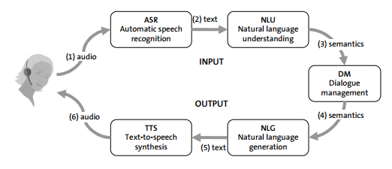
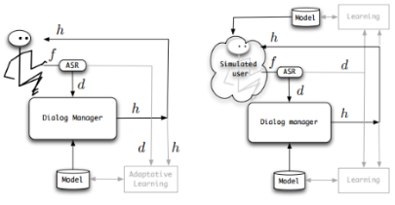
GENERATION AND MODELLING OF SDS I
WHAT IS A SPOKEN DIALOG SYSTEM?
A software tool allowing communication via voice in order to perform a certain task
DESIGN - STRUCTURE

Slide 5
GENERATION AND MODELLING OF SDS II
DESIGNS OF THE DM
Hand-crafted rules combined with statistical knowledge
Bayesian networks
Stochastic Finite-State models
Partially Observable Markov Decision Process (state-of-the-art)
Model: Stochastic Finite State Bi-Automata (PFSBA)
Algorithm to estimate the parameters of the PFSBA: Online-Learning
* Python based software: generate and evaluate dialogs

Slide 6
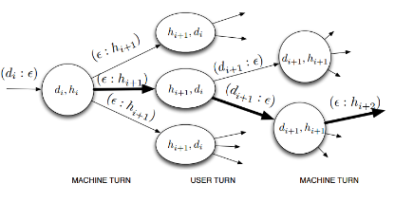
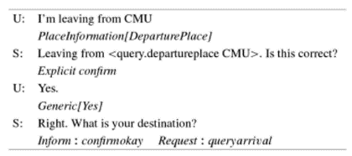
GENERATION AND MODELLING OF SDS III
EXPERIMENTS: LEARNING THE MODEL FROM LET’S GO CORPUS - INITIAL ESTIMATION
Set of spoken dialogues in the bus information domain.
Provides schedules and route information about the Pittsburgh city’s bus service.

Slide 7
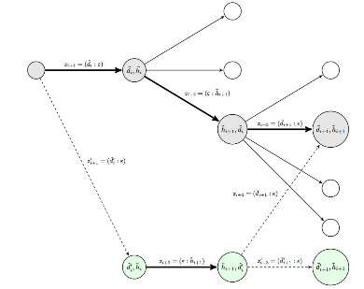
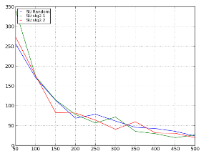
GENERATION AND MODELLING OF SDS IV
ONLINE LEARNING:
EXPERIMENTS: ONLINE ESTIMATION
DM:
Bayes decision rule (max. like-hood)
Online learning
SU:
Fully random
Behaviours learned from the Corpus (2)

Slide 8
RELIABILITY ANALYSIS FOR THE ACCELERATOR I
BASE
Reliability Analysis - November 2012 - Rebecca Seviour.
All systems were listed in one excel file - 600 lines.
Different types of redundancy and repair cases were assumed to fine-tune the overall LINAC reliability and availability numbers.
Mission time = 144 h = 6 days.
PRELIMINARY RELIABILITY ANALYSIS: EXCEL BASED MODEL
Created one excel file per system.
Removed redundancy and repair assumptions.
Mission time = 1h according to input from XFWG on reliability.
Identify failure rate/MTBF data source.
Identify the statistical model behind and support with mathematical evidence. Documentation work.
Implemented statistical model that calculates the overall reliability and availability numbers and creates a structure graph of the system.
Why excel as input/output tool? Accessible to everyone! Good starting point for further studies!

Slide 9
RELIABILITY ANALYSIS FOR THE ACCELERATOR II
Optional input :
No. of spares
Type of redundancy
Repair policy
Switch-over time
Other delays
STATISTICAL MODEL – “BOTTOM TO TOP APPROACH”
INPUT :
CASE 1 (Subsystem)
MTBF
Percent of Anticipated failures
No. Of Equip. *
MTTR
CASE 2 (Assembly)
No. of Equip. *
CASE 3 (Equipment / Failure mode)
No input data needed!
Taking into account number of spares.
SCRF Cavity
Mechanical Tuner Assembly
Vacuum Valve
SCRF Cavity / Module
Tuner Assembly / Module
Vacuum Valve / Module
Cryostat structure
CRYOSTAT

Slide 10
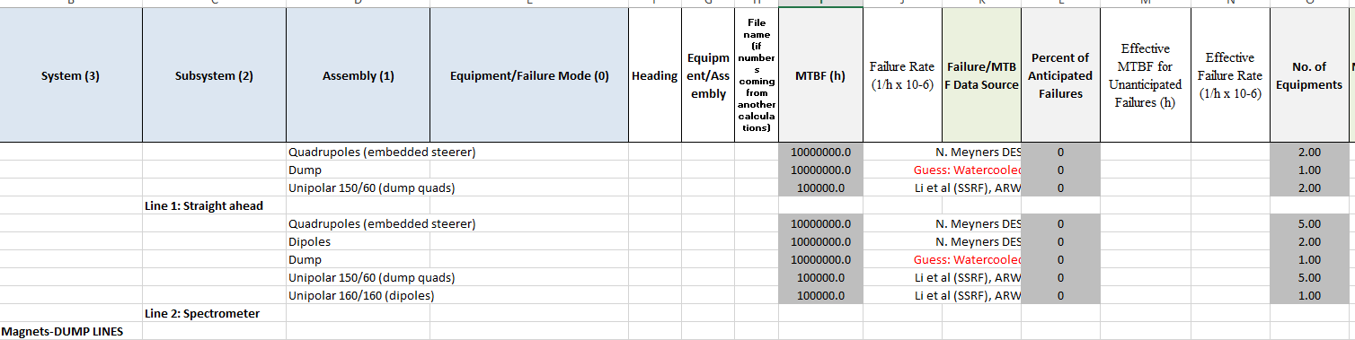
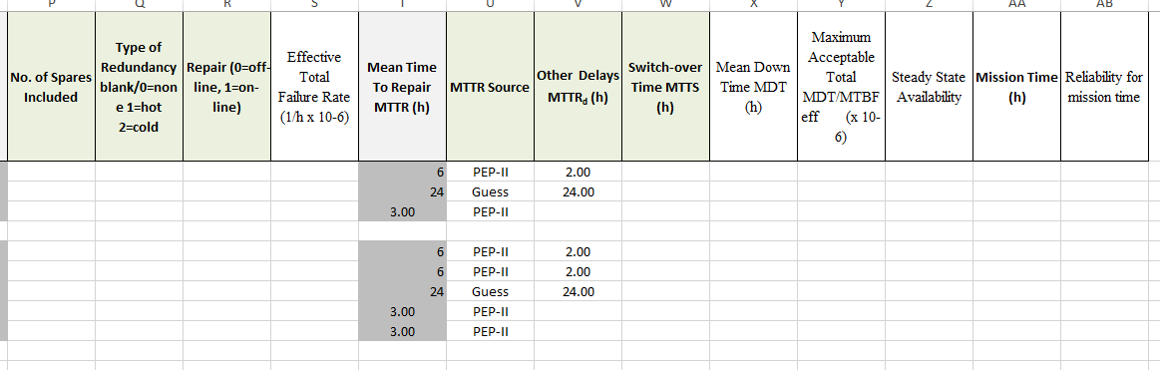

Slide 11
RELIABILITY ANALYSIS FOR THE ACCELERATOR II
STATISTICAL MODEL – “BOTTON TO TOP APPROACH”
OUTPUT:
For each subsystem / assembly / equipment
Failure rate
Effective MTBF for Unanticipated Failures
Effective Failure rate
Effective Total Failure rate
Mean Down Time (MDT)
Steady State Availability
Reliability for Mission time

Slide 12
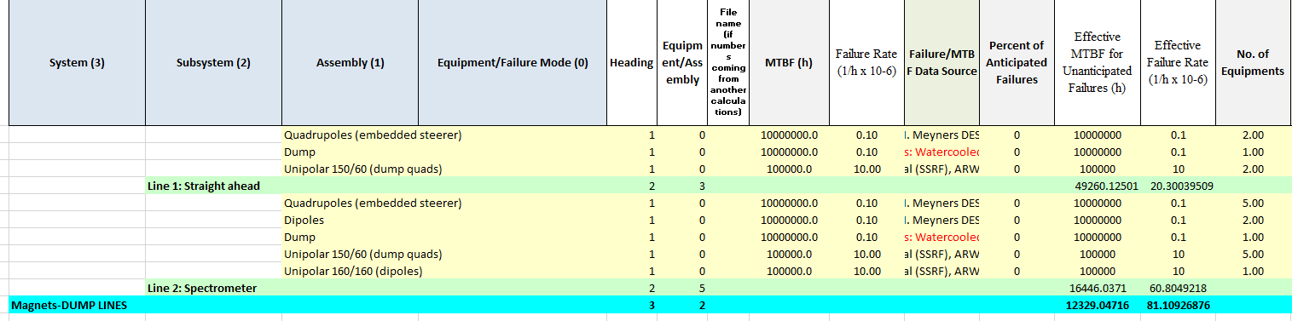
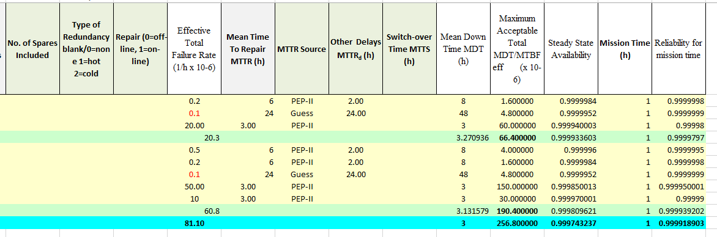

Slide 13
FUTURE WORK
Comparative study of the modeling tools available.
Detection of the methods to identify the critical parameters.
Formulation of “best approaches” (existing, new mathematical models or methodologies).
Implementation and testing of the proposed new “best approaches”.
Comparison of the new modeling tools and existing ones.
OBJECTIVES
Optimize the overall operational efficiency of accelerators
CLIC

