Slide 1
LHC Fault Tracking Project
or
LHC failure studies progress

Slide 2
Motivation
Intention
1. Illustrating the project goals
2. Present failure data sources
  3. Discuss methods of how to process the data to reach the goals

Slide 3
Project goals
General: Find weak spots to improve the systems
Sort and assign the occured failures
Observe failure patterns and key dependencies
Failure behaviour for different intensities and beam parameters (some systems independent)
Weibull distributions (aging factor)
Calculate system availability for future goals of the LHC (High Luminosity)

Slide 4
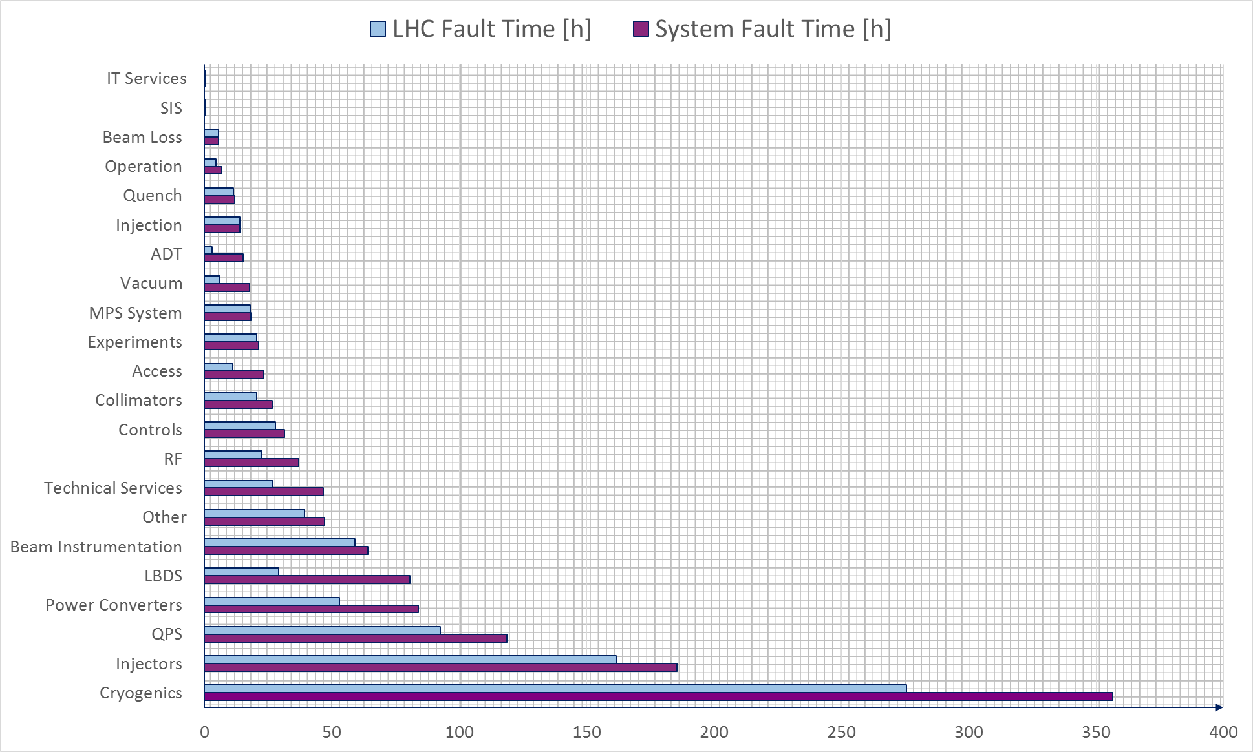
Downtime distributions
2015
Difference: shadows

Slide 5
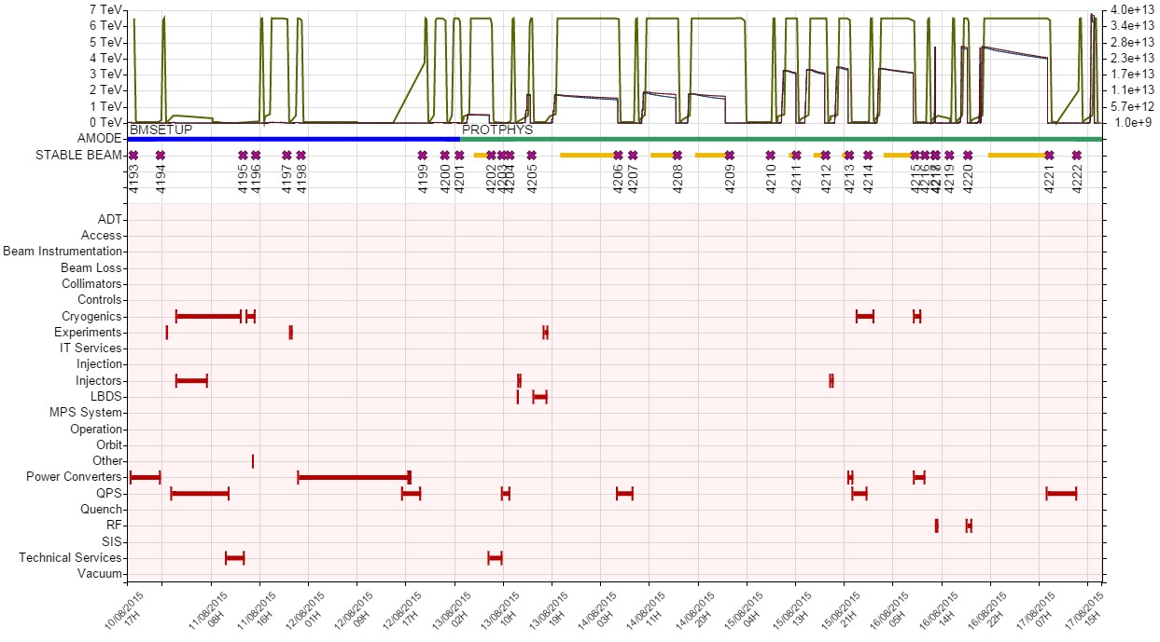
Failure data sources - AFT
  Details:
    High level description (Hardware, Controller)
    Imports data from logbook

Slide 6
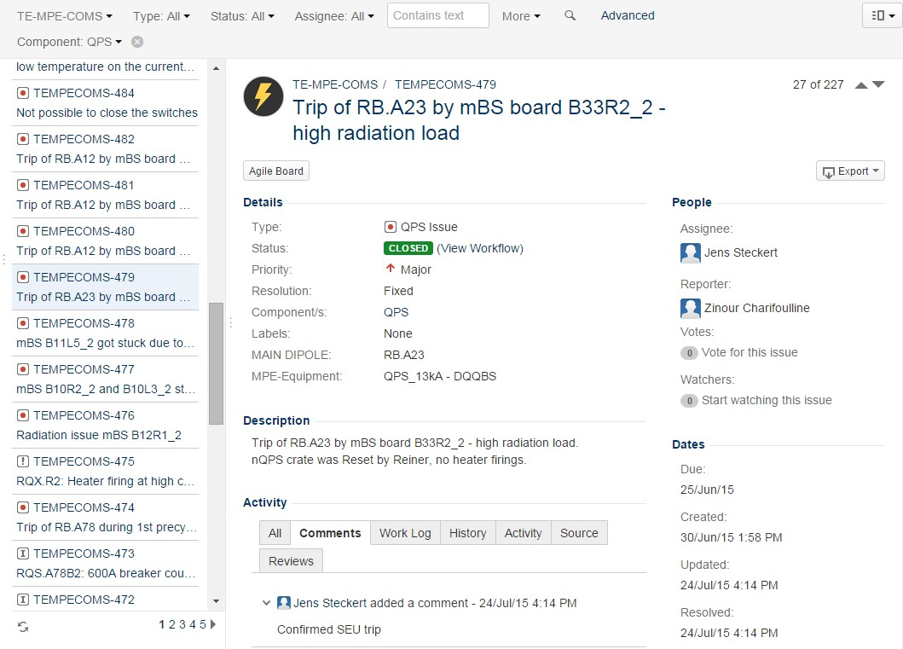
Failure data sources - COMS
Details:
  Since 2012
  Including minor failures (not affecting operation)
  Time assignment not precise

Slide 7
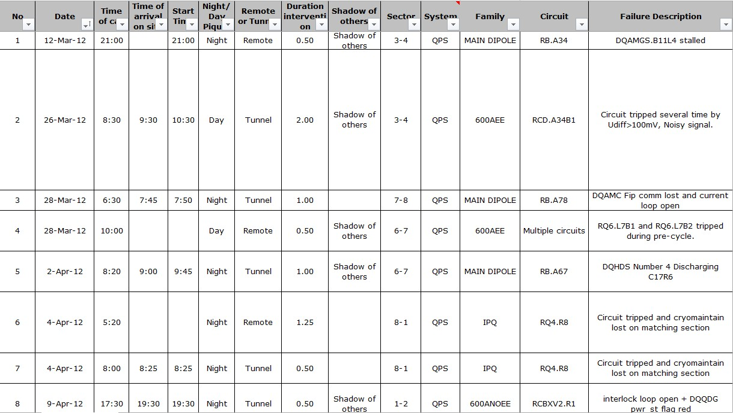
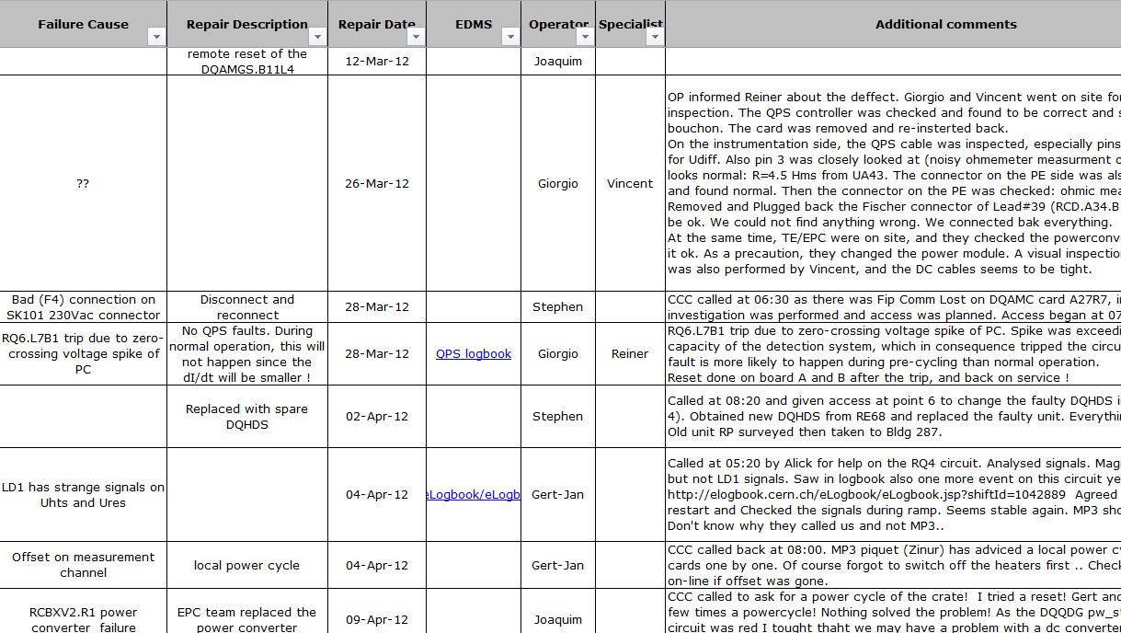
Failure data sources - Piquet
Details:
  only failures requiring piquet
  Mostly QPS

Slide 8
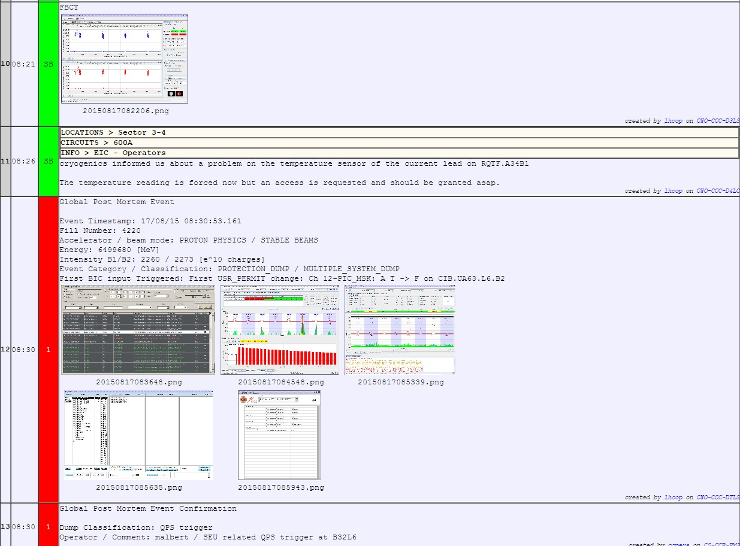
Failure data sources - logbook
Colorful line:
Correlation to
operational mode
(e.g. Scrubbing)
Details:
  Before „failure reviews“ (by availability workgroup since 2015), sometimes wrongly assigned or incomplete failure data
  Provides data for the Cardiogram

Slide 9
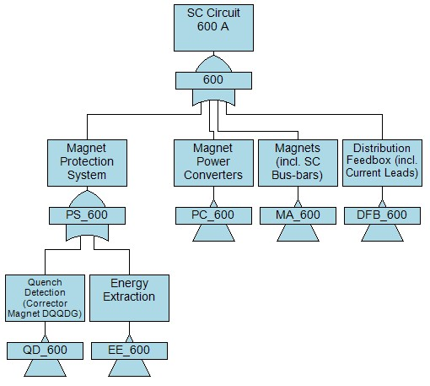
Failure studies – Powering circuits
QPS is the first analysed system of the failure studies
(System of MPS + many failures to observe ;-))
Possible division
of 600 A EE circuit:

Slide 10
Failure studies - Recurring
Recurring failures in 2012 (source: Piquet data)
Family | Failure | # faults
600 A EE | Switch | 11
600 A no EE | RCBXV2.R1 RQSX3.L8 | 2 3
600 A no EE crowbar | RQT12.R3B1 | 2
IPQ | RQ4.R8 RQ7.R4 RQ4.L1 | 2 2 5
IT | RQX.L8 | 4
MAIN QUAD | 13 kA earth FIP comm lost FIP comm lost | 3x same day 3x same day 2x MQ9.L7
MAIN DIPOLE | RB.A67 EE 13 kA FLT timeout RB.A45 nQPS | 3x in 2 weeks 2x same day

Slide 11
Failure studies - Sectors
Sector comparison: Dipoles and Quadrupoles failures 2012
Sector | Dipole | Quadrupole
12 | 3 | 6
23 | 1 | 3
34 | 1 | 0
45 | 8 | 3
56 | 0 | 1
67 | 7 | 3
78 | 1 | 1
81 | 8 | 0
∑ | 29 | 17

Slide 12
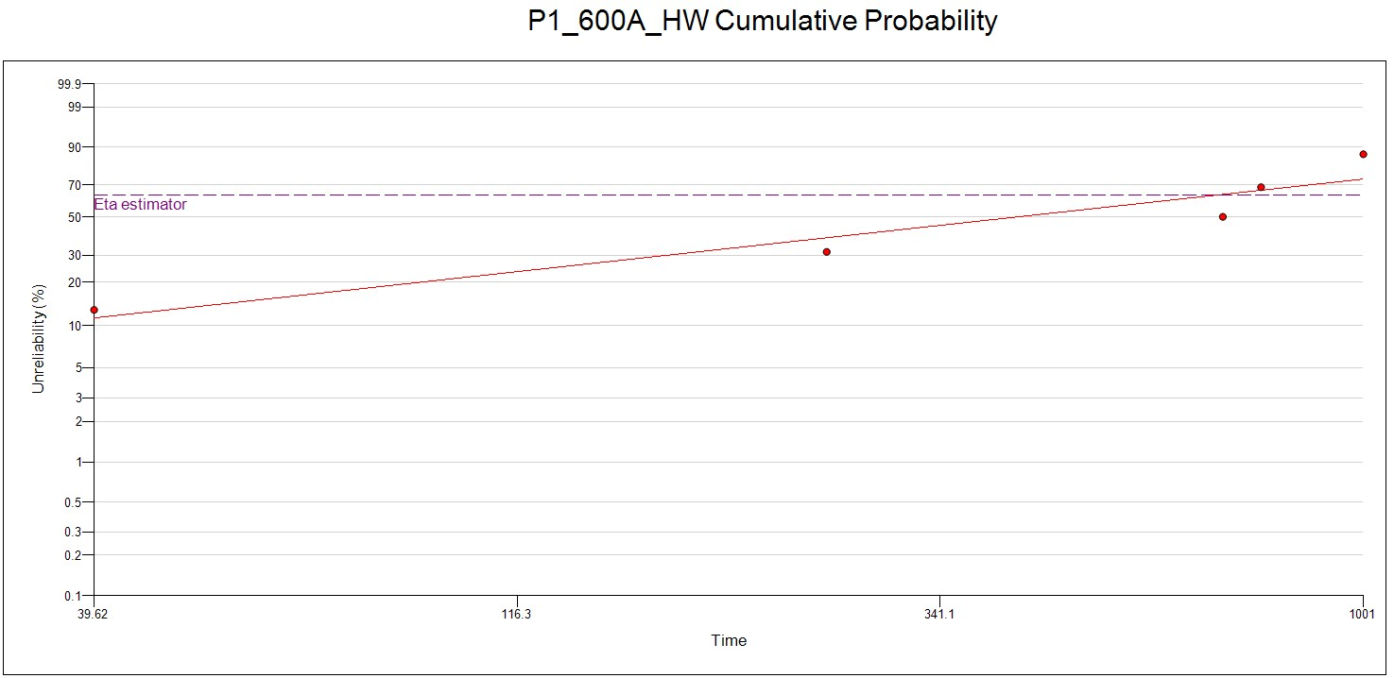
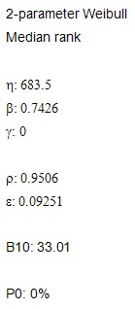
Failure studies - Weibull
Time period: 01.05.2012 – 25.06.2012
Data sources: AFT + COMS

Slide 13
Failure studies
Questions:
What data to use? (minors, shadows, access, child, ...)
How to process the data? (Methods)
How to structure?
Future tasks:
Intensity and beam parameters studies
Calculating Availability budgets (In cooperation with University of Stuttgart)

Slide 14
Thank you for your attention

Slide 15
Failure studies - Circuits
Cicuit family | #
MAIN DIPOLE | 8
MAIN QUADRUPOLE | 16
IT | 8
IPQ | 78
IPD | 16
600 A EE | 202
600 A no EE | 72
600 A no EE crowbar | 136
80-120 A | 284
60 A | 752
WARM | 35
EXPERIMENTS | 12
1612 in total

Slide 16
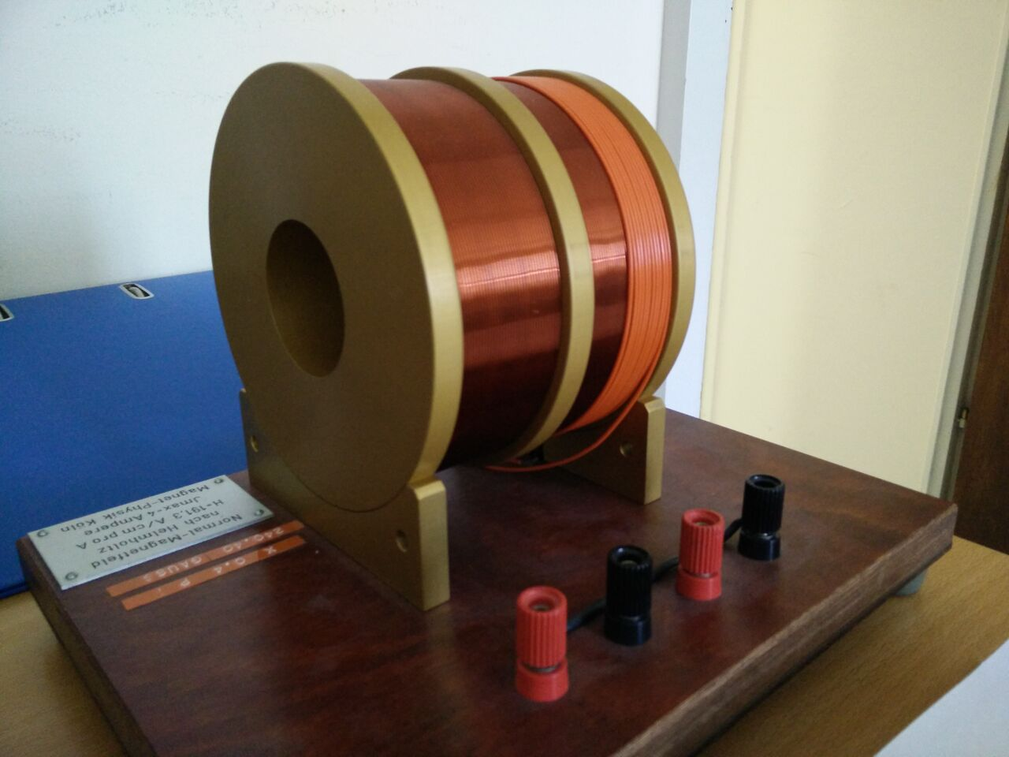
Basic Layout
Motivation:
Measuring of the transversal magnetic field
Magnetic needle with attached mirror
Laser for measuring offset
Control circuit for balancing the offset with secendary magnetic field

Slide 17
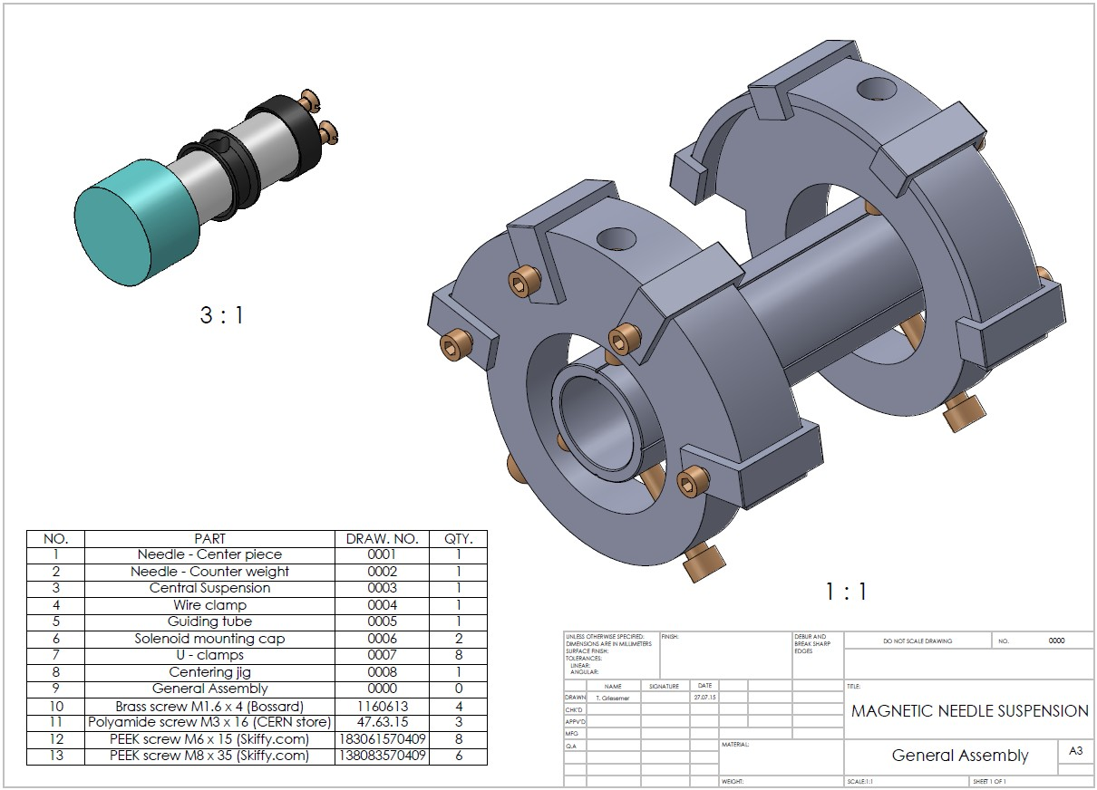
Modeling

Slide 18
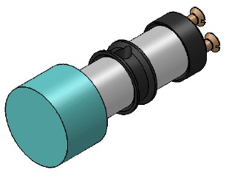
Modeling
Components magnetic needle:
  Mirror
  Magnets
  Iron parts
  Nylon string
  Brass screws
Important properties:
  Centre of mass
  Moment of inertia
  Maximum angle
Modeling
Designed parts are in production and screws are ordered ✔
Upcoming:
  Assembling the components (glue)
  Balancing needle with screws
  Testing the setup

