Slide 1
Object-Oriented Programming Workshop
Michał Maciejewski, Bernhard Auchmann, Lorenzo Bortot,
Mateusz Koza, Kamil Król, Jean-Christophe Garnier
TE-MPE-PE/MS
13.08.2015

Slide 2
Workshop Agenda
Speaker(s) | Topic | Duration
Michał Maciejewski | Summary of actions taken after 1st workshop | 0h10
Michał Maciejewski | Object Oriented Programming in MATLAB | 1h15+ 0h10 coffee break
Lorenzo Bortot | Code refactoring of QPS Neural Network tool: from scripted to OO code | 0h45

Slide 3




Software Development Workshop summary
Goal: To learn core software development skills/processes
Date: 09/07/2015, 9h30-12h30
Attendees: 12 people
Speakers: Raphaela Heil, Mateusz Koza, Kamil Król
Minutes: https://wikis.cern.ch/display/MPESC/2015-07-09+Minutes+from+workshop +about+clean+code+development

Slide 4

Lessons learnt…ailures made
…failures made
+
Raised awerness on good SW style
Coding Conventions for our section
Software projects summarised
Neural Network tool refactoring
Development of PM JAVA⬄ MATLAB tool
OOP Workshop
-
Repository not set up
Code Review tool not set up
Heuristics for GUI undefined
Coding convention
Software projects

Slide 5
Object-Oriented Programming Workshop
Introduction in MATLAB
Michał Maciejewski, Bernhard Auchmann, Lorenzo Bortot,
Mateusz Koza, Kamil Król, Jean-Christophe Garnier
TE-MPE-PE/MS
13.08.2015

Slide 6
OOP – simple facts
We use it unconsciously in other tools (e.x. COMSOL, DSL)
We have some code written this way (TESS, ANUBIS)
After the workshop we may appreciate its clarity and apply to solve certain problems


?
import com.comsol.model.*
import com.comsol.model.util.*
model = ModelUtil.create('Model');
model.modelPath('G:\Projects\lhccm\QuSi_ANSYS\Adaptive Mesh Refinement\Test');
model.modelNode.create('comp1');
model.geom.create('geom1', 1);
model.mesh.create('mesh1', 'geom1'); *Courtesy Deepak Paudel

Slide 7
Content
Scalability
Encapsulation
Operators Overload
Reusability
Interface
Private Access
Architecture
Properties
Maintainibility
Operability
Mindset
Objects
Classes
Abstract Class
Testability
Methods
Single Responsibility
Inheritance
Extendibility
UML Diagrams
Superclass
Fields
Constructor
Reusability
Hierarachy
Modularity

Slide 8
Content
OOP
Scalability
Encapsulation
Operators Overload
Reusability
Interface
Private Access
Architecture
Properties
Maintainibility
Operability
Mindset
Objects
Classes
Abstract Class
Testability
Methods
Single Responsibility
Inheritance
Extendibility
UML Diagrams
Superclass
Fields
Constructor
Reusability
Hierarachy
Modularity

Slide 9
Steve Jobs on OOP
You can build software literally five to 10 times faster, and that software is much more reliable, much easier to maintain and much more powerful.
-Steve Jobs
Read more: http://www.rollingstone.com/culture/news/steve-jobs-in-1994-the-rolling-stone-interview-20110117#ixzz3ia7pp8L1

Slide 10
Scripted vs OO code
Acquire
Analyse
Present

Slide 11
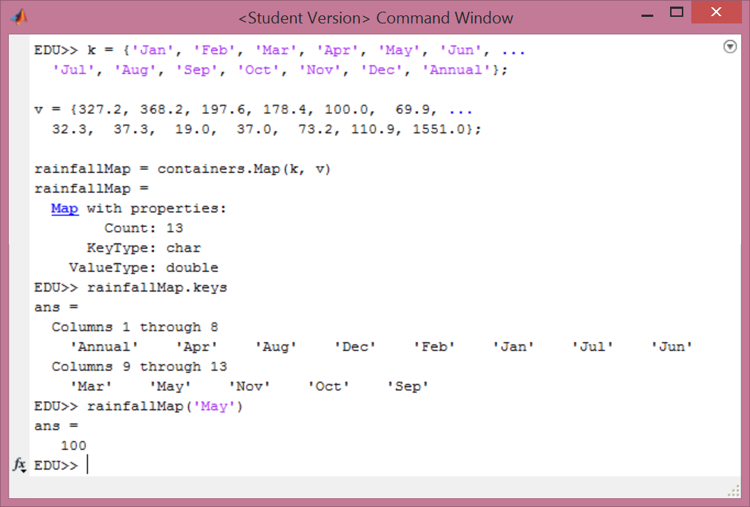
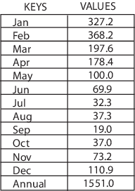
Map – built-in MATLAB class
Map of rainfall per month
http://www.mathworks.com/help/matlab/matlab_prog/creating-a-map-object.html

Slide 12
MException – built-in MATLAB class
http://www.mathworks.com/help/matlab/matlab_prog/throw-an-exception.html

Slide 13
Case study – plane figures drawer
Description: A simple GUI
to draw three geometric figures:
a circle, square and rectangle with selected color (r,g,b,k,m,c).

Slide 14
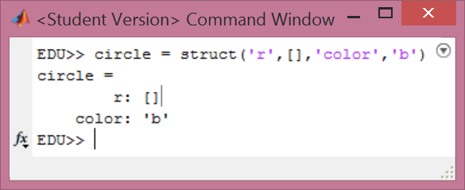
We all know structures, do we? ☺
circle = struct('r',[],'color',‚b');
function [area] = calculateArea(circle)
area = pi * circle.r ^ 2;
end
function plot(circle)
ang=0:0.01:2*pi; x=0; y=0;
xp = circle.r*cos(ang);
yp = circle.r*sin(ang);
plot(x+xp,y+yp, circle.color);
end
disp(circle)
area = calculateArea(circle);
plot(circle)
What if one has changed variable name from r to radius?

Slide 15
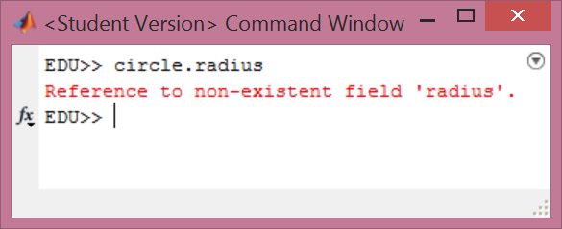
Class = structure + methods
circle = struct('radius',[],'color','red');
function [area] = calculateArea(circle)
area = pi * circle.radius ^ 2;
end
function plotFigure(circle)
ang = 0:0.01:2*pi; x = 0; y = 0;
xp = circle.radius*cos(ang);
yp = circle.radius*sin(ang);
plot(x+xp,y+yp, circle.color);
end
disp(circle)
area = calculateArea(circle);
plot(circle)
What if one has changed variable name from r to radius?
- One has to update two files (functions) accordingly.

Slide 16

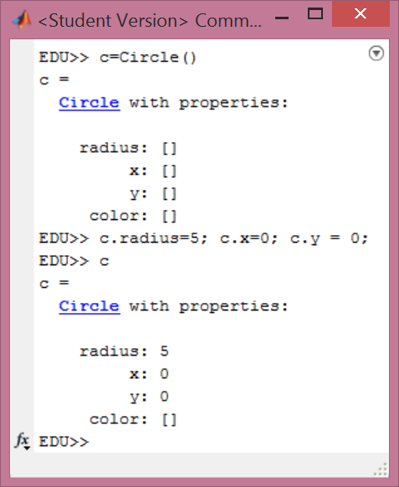
Circle: sample class
classdef Circle < handle
%Circle Class representing circle
% contains radius, x, y and color
properties
radius
x
y
color
end
methods
end
end
Not so different from good, old structure, huh?
Notes:
File -> New Class

Slide 17
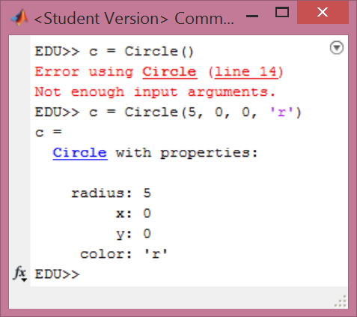
Class Constructor
classdef Circle < handle
%Circle Class representing circle
% contains radius, x, y, and color
properties
radius
x
y
color
end
methods
function obj = Circle(radius, x, y, color)
obj.radius = radius;
obj.x = x;
obj.y = y;
obj.color = color;
end
end
end

Slide 18
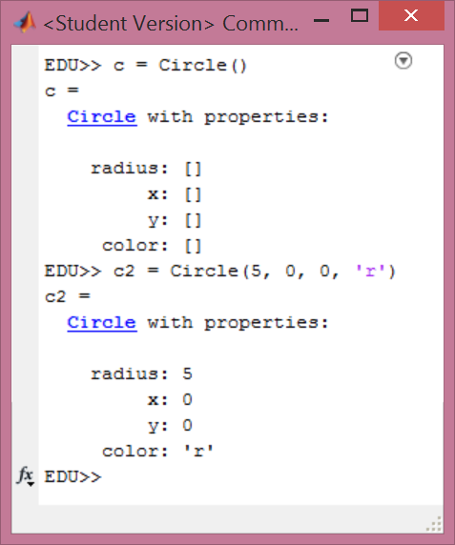
Class Default Constructor
classdef Circle
%Circle Class representing circle
% contains radius, x, y, and color
properties…
methods
function obj = Circle(radius, color)
if nargin > 0
obj.radius = radius;
obj.x = x;
obj.y = y;
obj.color = color;
else
% Default constructor
end
end
end
end

Slide 19
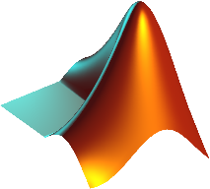
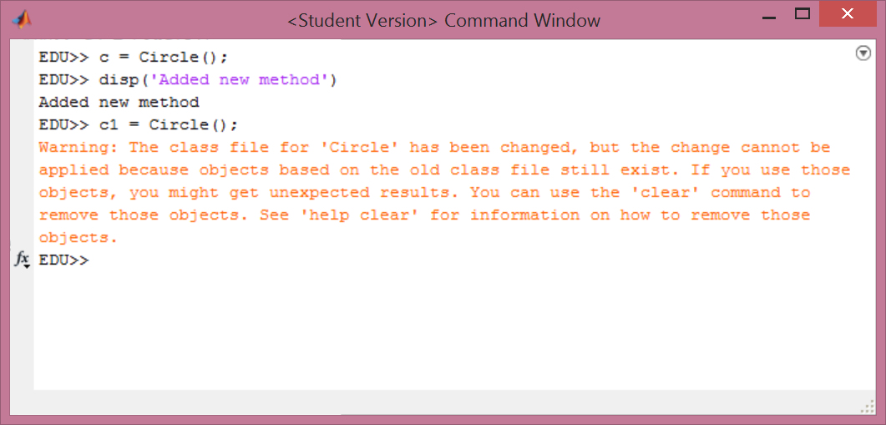
Rookie mistake

Slide 20
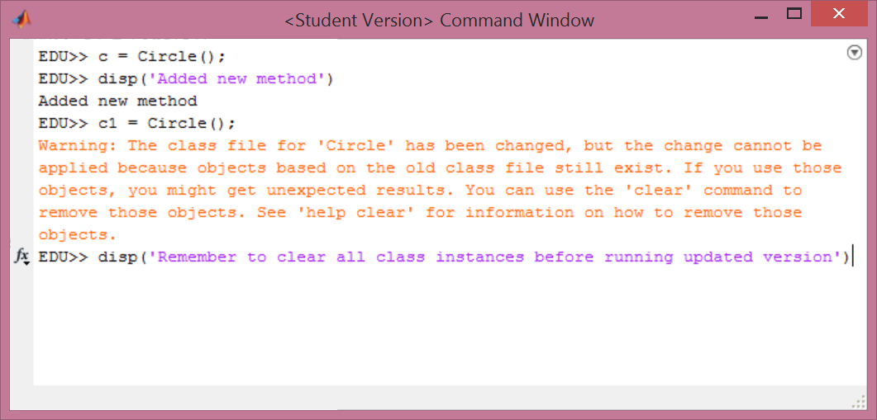
Rookie mistake

Slide 21
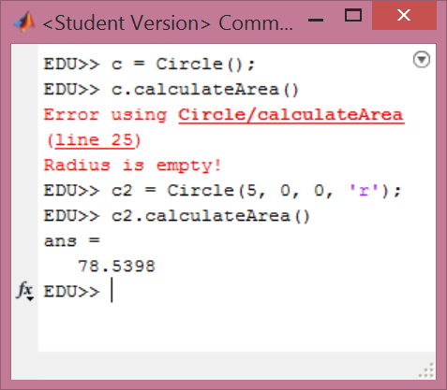
Class Methods – calculateArea()
classdef Circle < handle
%Circle Class representing circle
% contains radius, x, y, and color
properties…
methods
function obj = Circle(radius, x, y color)…
%-----------------------------------
function [area] = calculateArea(obj)
if isempty(obj.radius)
error('Radius is empty!');
else
area = pi*obj.radius^2;
end
end
end
end

Slide 22
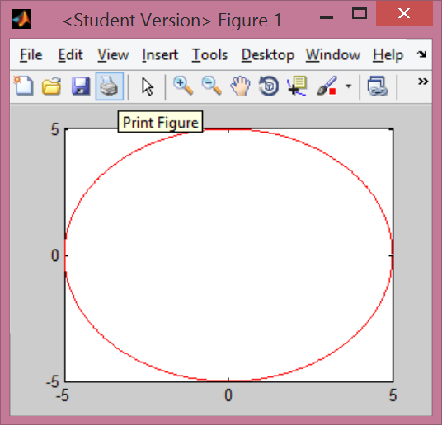
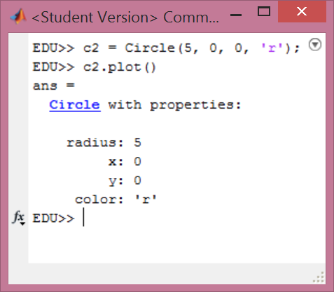
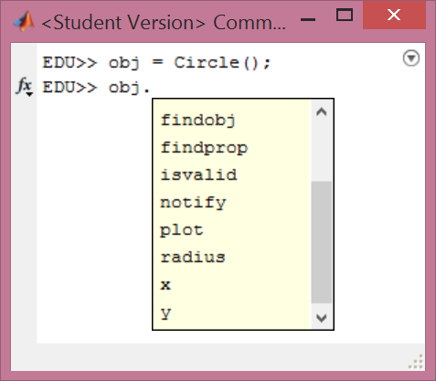
Class Methods – help from default constructor
Define obj as Class instance using default constructor
classdef Circle < handle
properties…
methods
function obj = Circle(radius, x, y, color)…
%-----------------------------------
function [area] = calculateArea(obj)…
%-----------------------------------
function obj = plot(obj)
ang = 0:0.01:2*pi;
xp = obj.radius*cos(ang);
yp = obj.radius*sin(ang);
plot(x+xp,obj.y+yp, obj.color);
end
end
end

Slide 23
Few more words on methods
First argument is always obj (instance of a class)
We can check internally parameters for type
ischar(), isnumeric(), iscell(), isa()
obj = method(obj, x, y)
[] = method(obj, x, y)
one can overload existing MATLAB methods like disp, plot, etc (only possible with classes).

Slide 24
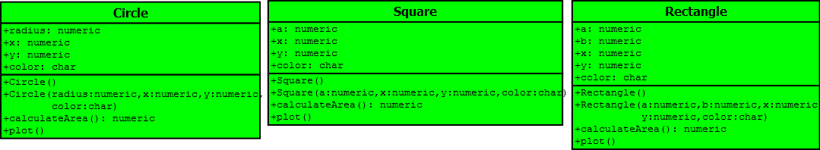

Class UML diagram - notation
properties:
+ public
- private
Class name (bold)
methods:
+ public
- private
Created with Dia: https://twiki.cern.ch/twiki/bin/view/TEMPEPE/UsefulSoftware
Notes:
Files in directory: 1. No hierarchy

Slide 25
Superclass GeometricFigure
classdef GeometricFigure < handle
%GeometricFigure
properties
x
y
color
end
methods
function obj = GeometricFigure(x, y, color)
if nargin > 0
obj.x = x;
obj.y = y;
obj.color = color;
else
% Default Constructor
end
end
end
end
Extracts common properties and methods for a set of objects

Slide 26
Circle Class Inherits from GeometricFigure
classdef Circle < GeometricFigure
%Circle Class representing circle
% contains radius, x, y and color
properties
radius
end
methods
function obj = Circle(radius, x, y, color)
obj = obj@GeometricFigure(x, y, color);
if nargin > 0
obj.radius = radius;
else
% Default constructor
end
end
function [area] = calculateArea(obj)…
function obj = plot(obj)…
end
end

Slide 27
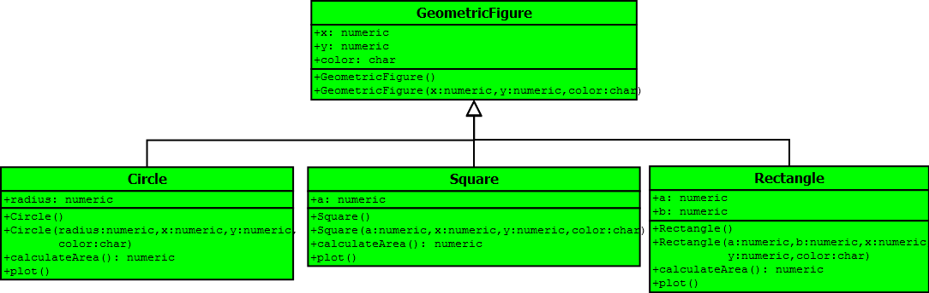
Class UML diagram
Inheritance
Created with Dia: https://twiki.cern.ch/twiki/bin/view/TEMPEPE/UsefulSoftware
Notes:
Files in directory: 2. Super Class

Slide 28
GeometricFigureAbstract - Abstract Class
classdef GeometricFigureAbstract < handle
%GeometricFigure
properties…
methods
function obj = GeometricFigureAbstract(x, y, color)...
end
methods (Abstract)
area = calculateArea(obj)
end
end
Abstract Method
No implementation! Every class that inheritates this
Abstract Class has to implement it on its own.
Very useful to simplify code extension – if we want to add triangle we have already a recipe what Triangle lass should do to keep our code in operation.

Slide 29
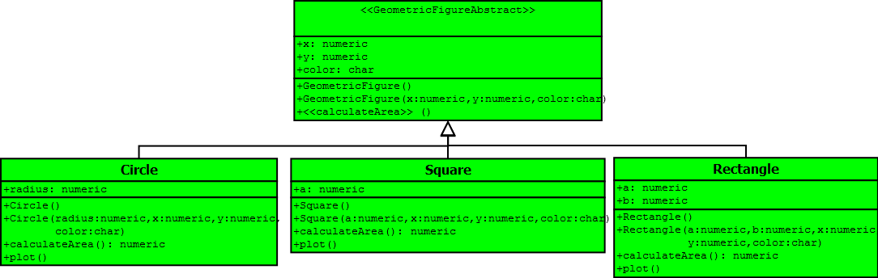
Class UML diagram - abstract class 1/2
Abstract class
Abstract method
Each Figure class should also know how to calculate its perimeter, right?
Notes:
Files in directory: 3. Abstract Class

Slide 30
GeometricFigure Abstract Class
classdef GeometricFigureAbstract < handle
%GeometricFigure
properties…
methods
function obj = GeometricFigureAbstract(x, y, color)…
end
methods (Abstract)
area = calculateArea(obj)
perimeter = calculatePerimeter(obj)
end
end

Slide 31
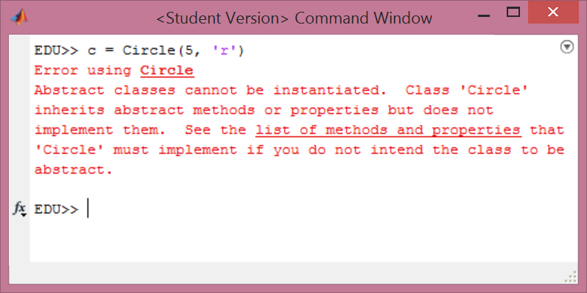
Wait, it’s not implemented in Circle, Square, Rectangle classes!

Slide 32
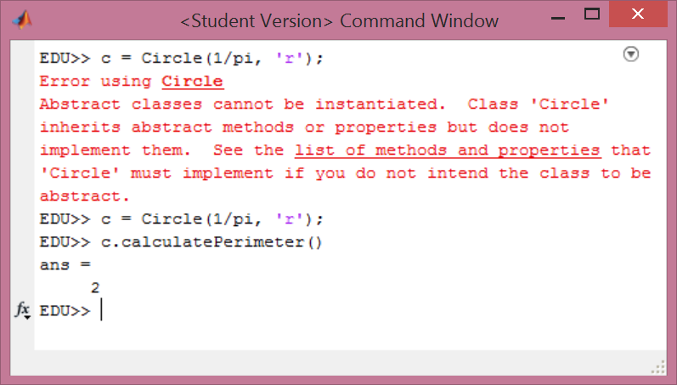
So let’s implement it

Slide 33
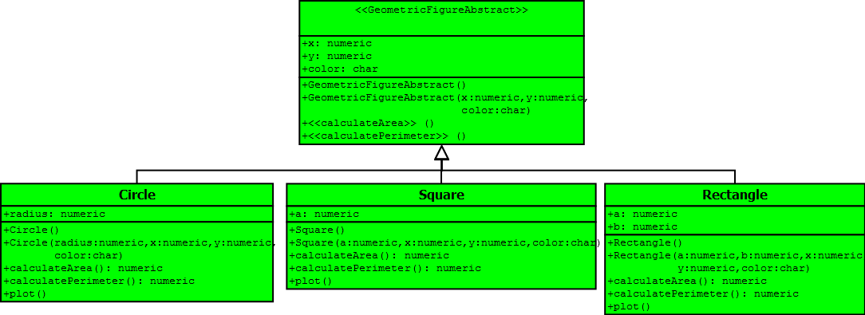
Class UML diagram – abstract class 2/2
In general plot() method is not an inherent feature of a figure
Notes:
Files in directory: 3. Abstract Class

Slide 34

DrawFigure interface
classdef DrawFigure < handle
methods(Abstract)
plot(obj)
end
end
classdef Square < GeometricFigureAbstract & DrawFigure
%Square Class representing circle
% contains side length and color
properties…
methods…
end
source: evolllution.com
Notes:
It is not a Geometric Figure thing to plot. This is something extra that we might, might not include. For our application we need plot.

Slide 35
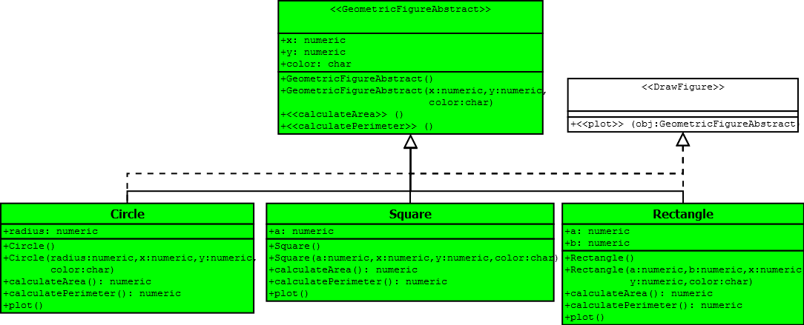
Class UML diagram - interface
Realisation
Notes:
Files in: 4. Interface

Slide 36
Collection of objects
Vector (1D) of objects
Array (2D) of objects
Cell of objects
Map of objects
Notes:
Files in: 5. Collection of objects

Slide 37
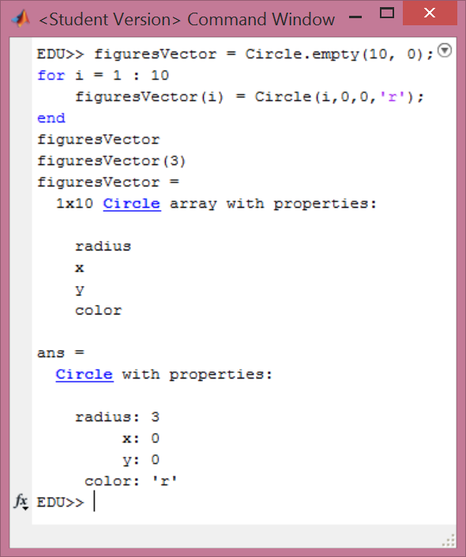
Collection of objects – vector of objects
figuresVector = Circle.empty(10, 0);
for i = 1 : 10
figuresVector(i) = Circle(i,0,0,'r');
end
figuresVector
figuresVector(3)
Notes:
Files in: 5. Collection of objects

Slide 38
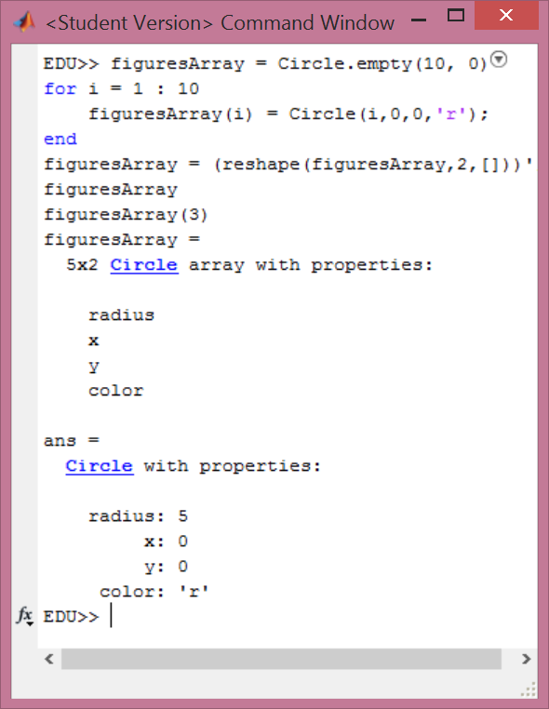
Collection of objects – array of objects
figuresArray = Circle.empty(10, 0);
for i = 1 : 10
figuresArray(i) = Circle(i,0,0,'r');
end
figuresArray = (reshape(figuresArray,2,[]))';
figuresArray
figuresArray(3)
Notes:
Files in: 5. Collection of objects

Slide 39
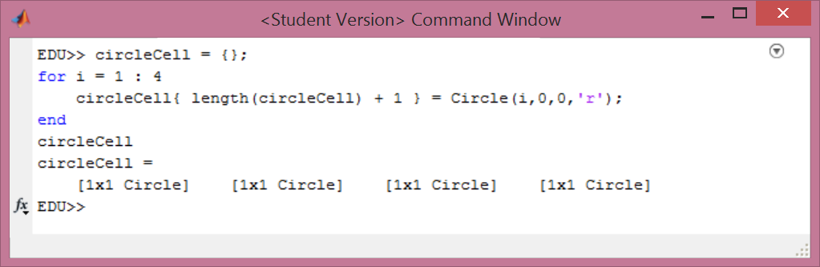
Collection of objects – cell of objects
circleCell = {};
for i = 1 : 4
circleCell{ length(circleCell) + 1 } = Circle(i,0,0,'r');
end
circleCell
Notes:
Files in: 5. Collection of objects

Slide 40
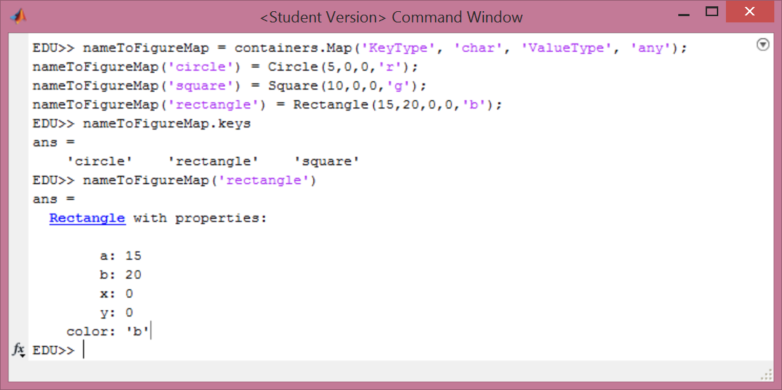
Collection of objects – map of objects
Notes:
Files in: 5. Collection of objects

Slide 41
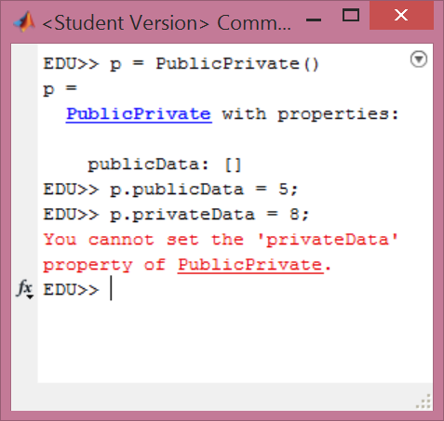
Access to fields: public or private
classdef PublicPrivate < handle
properties
publicData
end
properties (Access = private)
privateData
end
methods
end
end
Without additional definition properties and methods are public.
Notes:
Files in: 6. Public vs Private

Slide 42
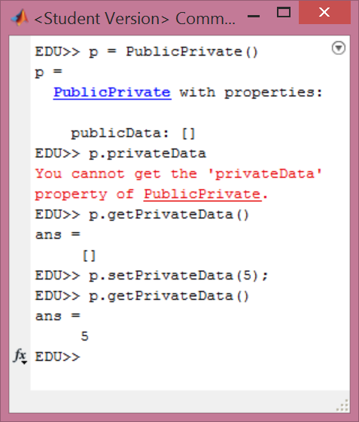
Setter & Getter methods
classdef PublicPrivate < handle
properties
publicData
end
properties (Access = private)
privateData
end
methods
function obj = setPrivateData(obj, value)
obj.privateData = value;
end
function value = getPrivateData(obj)
value = obj.privateData;
end
end
end
Notes:
Files in: 6. Public vs Private

Slide 43
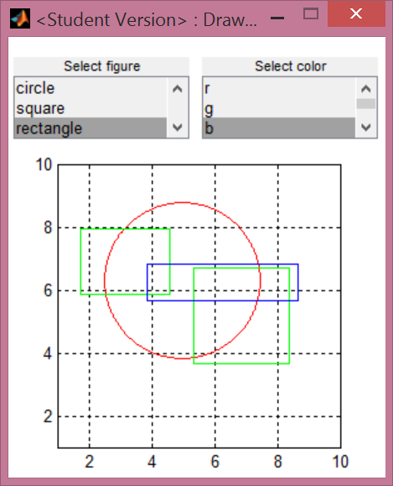
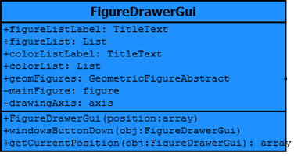
DrawerGui Class
It’s not a good idea to give figure handle a public access!
Notes:
Files in: 7. DrawerFigureGui

Slide 44
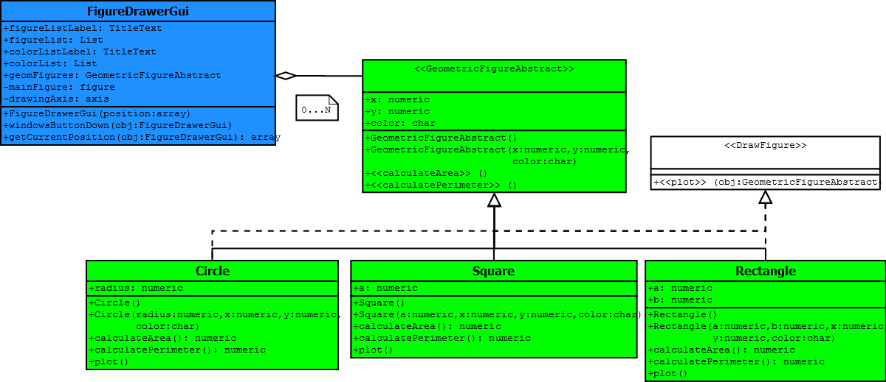
Wrapping all up – DrawerGui Class
Notes:
Files in: 7. DrawerFigureGui

Slide 45
Find Maximum area
maxArea = -Inf;
indexMaxArea = -1;
for i = 1 : length(drawer.geomFigures)
% If i-th cell entry is an instance of GeometricFigureAbstract
% code can calculate area no matter what object it is:
% Circle, Square, Rectangle.
if isa(drawer.geomFigures{i}, 'GeometricFigureAbstract')
area = drawer.geomFigures{i}.calculateArea();
if area > maxArea;
maxArea = area;
indexMaxArea = i;
end
end
end
disp(['Largest area has ' num2str(indexMaxArea) ' element.'])
drawer.geomFigures{indexMaxArea}
Notes:
vector of objects – check for superclass

Slide 46
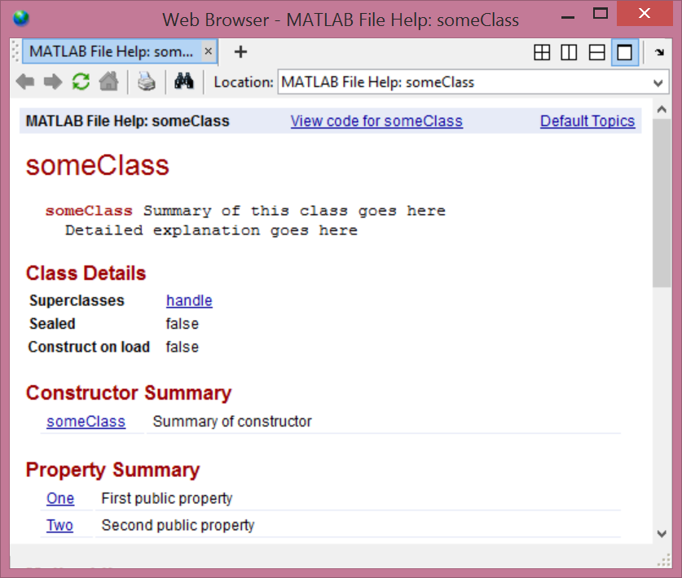
Documenting a class
classdef someClass < handle
% someClass Summary of this class goes here
% Detailed explanation goes here
properties
One % First public property
Two % Second public property
end
properties (Access=private)
Three % Do not show this property
end
methods
function obj = someClass
% Summary of constructor
end
function myMethod(obj)
% Summary of myMethod
disp(obj)
end
end
methods (Static)
function myStaticMethod
% Summary of myStaticMethod
end
end
end
doc someClass
Notes:
Files in: 8. Documenting a class

Slide 47
Case Study: TESS
Michał Maciejewski
Emmanuele Ravaioli
Notes:
Files in: 9. Object Oriented Modelling - snippets

Slide 48

Object-Oriented Modelling
Bottom-up modeling software development
Top-down physical system analysis
Notes:
Files in: 9. Object Oriented Modelling - snippets

Slide 49
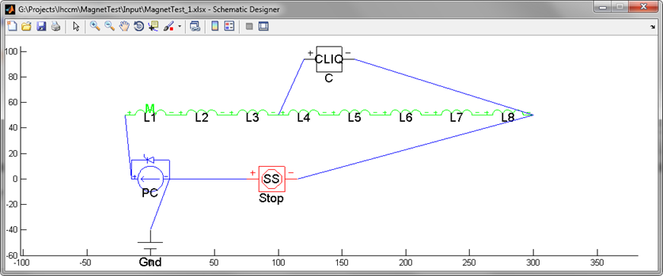
CLIQ protected S.C. magnet
Notes:
Files in: 9. Object Oriented Modelling - snippets

Slide 50
CLIQ protected S.C. magnet - schematic
Name | Magnet | Protection | Other | Position From | Direction
PC |  |  | PC_I | none | N
Stop |  |  | StopSimulation | PC | E
Gnd |  |  | Ground | PC | S
M | SCMagnetNb3Sn |  |  | PC | N
C |  | CLIQ |  | M | N
From Component | From Port | To Component | To Port
Stop | pos | PC | neg
PC | pos | M | pos
M | neg | Stop | neg
PC | neg | Gnd | gnd
C | pos | M | QR4_1/pos
C | neg | M | neg
Notes:
Files in: 9. Object Oriented Modelling - snippets

Slide 51
Model Creation Procedure
Read Model structure & parameters
Initialise components
Calculate component’s position
Place components on schematic
Connect components
Set component’s parameters
Notes:
Files in: 9. Object Oriented Modelling - snippets

Slide 52
1. Read Model structure & parameters
function [] = readConfiguration( obj )
obj.configuration = obj.excel.raw{ obj.CONFIGURATIONSHEET };
end
%------------------------------------------------------------------
function [] = readConnections( obj )
obj.connections = obj.excel.text{ obj.CONNECTIONSHEET };
end
%------------------------------------------------------------------
function mapParam = readMagnetParameters( obj, startSheet )
…
end
%------------------------------------------------------------------
function mapParam = readOtherParameters( obj )
…
end
Notes:
Files in: 9. Object Oriented Modelling - snippets

Slide 53
2. Initialise components – Factory Design Pattern
function obj = initialiseObjects( obj )
  for i = 1 : length( obj.configuration )
  prefix = obj.configuration{i}.name;
  switch obj.configuration{i}.libComponent
  case 'SCMagnetNb3Sn';
  mapTemp = containers.Map( prefix, SCMagnetNb3Sn(obj.sys, prefix, obj.md.get(prefix)));
  case 'CLIQ';
  mapTemp = containers.Map( prefix, CLIQ( obj.sys, prefix, obj.md.get(prefix), fullLoad) );
  case 'PC_I';
  mapTemp = containers.Map( prefix,PC_I(obj.sys, prefix, obj.md.get(prefix)));
  case 'StopSimulation';
  mapTemp = containers.Map( prefix, StopSimulation(obj.sys, prefix, obj.md.get(prefix)));
  case 'Ground';
  mapTemp = containers.Map( prefix, Ground(obj.sys, prefix, obj.md.get(prefix)));
  otherwise
  error(['This library component ' obj.configuration{i}.libComponent ' is not supported'])
  end
  obj.blocksMap = [obj.blocksMap; mapTemp];
  end
  obj.solver = Solver(obj.sys, obj.md.solver);
end
Notes:
Files in: 9. Object Oriented Modelling - snippets

Slide 54
3. Calculate component’s position
function obj = calculatePosition( obj )
% For the first component it is predefined
x = 200;
y = 200;
setPosition( obj.blocksMap(obj.configuration{1}.name), [x y] );
% For the other is is always relative
for i = 2 : length( obj.configuration )
ulv = obj.blocksMap(obj.configuration{i}.positionFrom).getUpperLeftVertex();
lrv = obj.blocksMap(obj.configuration{i}.positionFrom).getLowerRightVertex();
[x, y] = calculatePositionFromCardinalDirections(ulv, lrv);
setPosition(obj.blocksMap(obj.configuration{i}.name), [ ceil(x) ceil(y)]);
end
end
Notes:
Files in: 9. Object Oriented Modelling - snippets

Slide 55
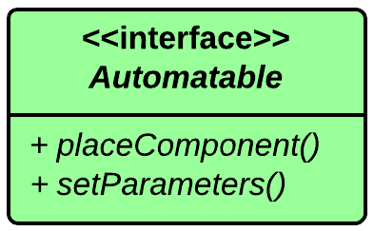
4. Place components on schematic
function obj = placeBlocks( obj )
for k = obj.blocksMap.keys
placeBlocks( obj.blocksMap( char(k) ) );
end
end
Notes:
Files in: 9. Object Oriented Modelling - snippets

Slide 56
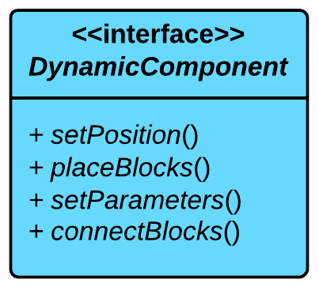
5. Connect components
function obj = connectBlocks( obj )
obj.connections = obj.cellText2connect( obj.md.connections );
for i = 1 : length( obj.connections )
fromBlock = obj.connections{i}.fromBlock;
fromPort = obj.connections{i}.fromPort;
toBlock = obj.connections{i}.toBlock;
toPort = obj.connections{i}.toPort;
add_line(obj.sys,...
obj.blocksMap( fromBlock ).getPortHandle( fromPort ),...
obj.blocksMap( toBlock ).getPortHandle( toPort ),...
'autorouting', 'on');
end
end
Notes:
Files in: 9. Object Oriented Modelling - snippets

Slide 57
6. Set component’s parameters
function obj = setParameters( obj )
for k = obj.blocksMap.keys
setParameters( obj.blocksMap( char(k) ) );
end
% Set simulation solver parameter
obj.solver.setParameters();
end
Notes:
Files in: 9. Object Oriented Modelling - snippets

Slide 58
*Operator overload
function r = eq(obj1, obj2) % m1 == m2
if isa(obj1, 'Model') && isa(obj2, 'Model')
r = true;
if length( obj1.configuration ) == length( obj2.configuration )
for i = 1 : length( obj1.configuration )
isSameLibrary = strcmp( obj1.configuration{i}.libComponent, …
obj2.configuration{i}.libComponent);
isSameName = strcmp( obj1.configuration{i}.name, obj2.configuration{i}.name);
if ~isSameLibrary || ~isSameName
r = false;
break
end
end
else
r = false;
end
end
Notes:
Files in: 9. Object Oriented Modelling - snippets

Slide 59



TESS Framework Architecture
GUI
Control Simulation Module
Parametric Sweep Module
Report Generation Module
Main application (server)
Simulink (Solver, Library, Model)

Slide 60
Case Study: ANUBIS
Lorenzo Bortot
Notes:
Files in: Lorenzo

Slide 61
Library of classes
GUI
Figure
Table
Button
TextField
Label
…
Utilities
Text
XML
CSV
Excel

Slide 62
Useful resources
https://www.mathworks.com/help/pdf_doc/matlab/matlab_oop.pdf
B. Meyer: Object-Oriented Programming
M. Maciejewski: Automated Object-Oriented Simulation Framework for Superconducting Magnets Modelling at CERN (available at our website)

Slide 63
Summary
OOP applies to certain class of problems
Class is a structure + methods
Problem can have hierarchical representation employing inheritance
Use superclass to extract common properties/methods for a group of objects
Abstract class provides common properties and set of methods
Interface is a contract to implement certain methods
Try yourself and ask colleagues for support!

Slide 64
What do you think
?

