Slide 2
EuroCirCol-FCC Workshop Summary (Paris, November 19-20)
B. Auchmann, 3.12.2015

Slide 3
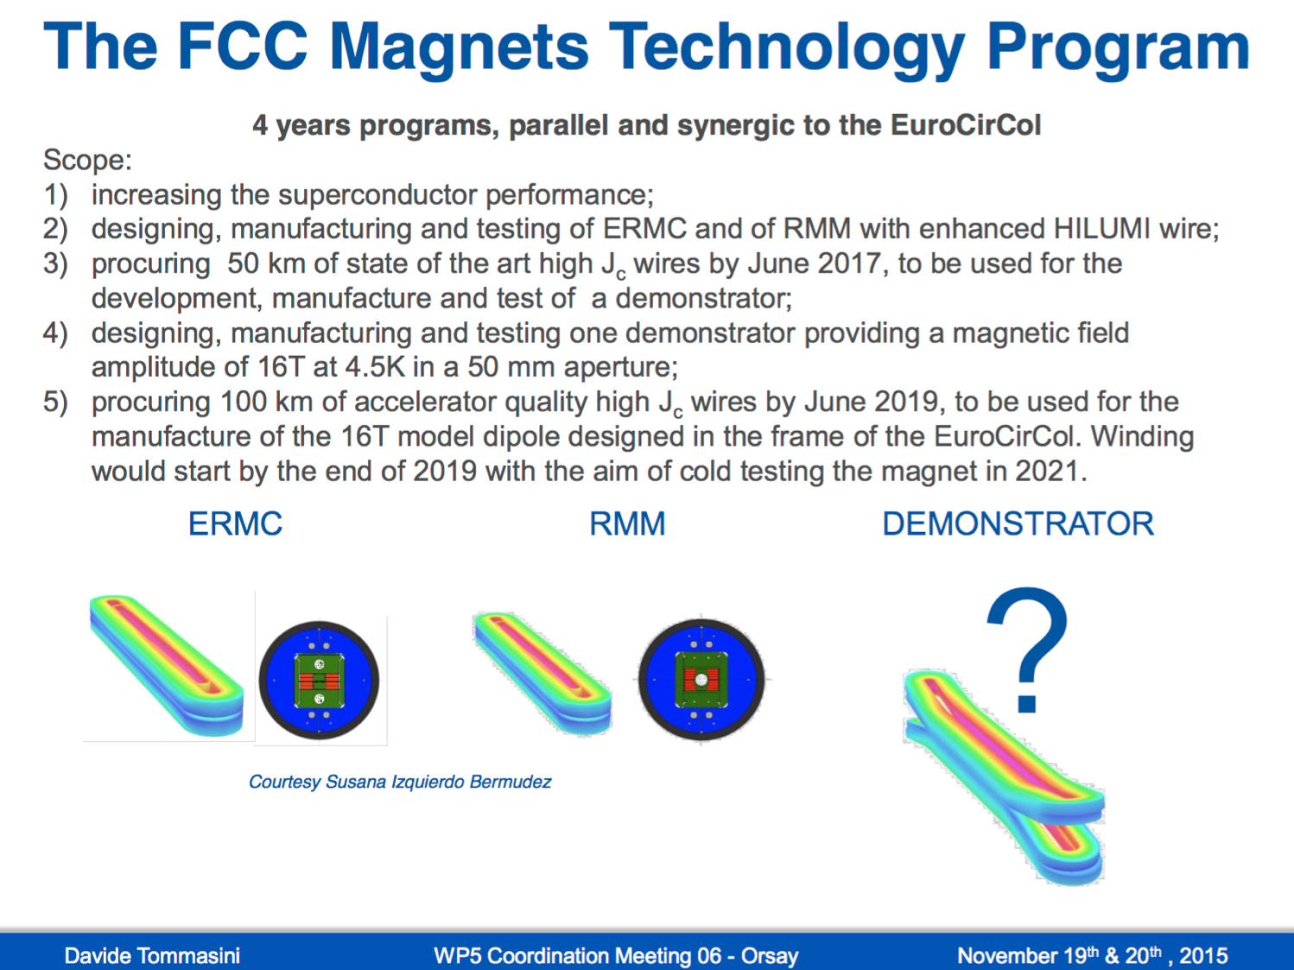
CERN FCC Magnet Technology Program

Slide 4
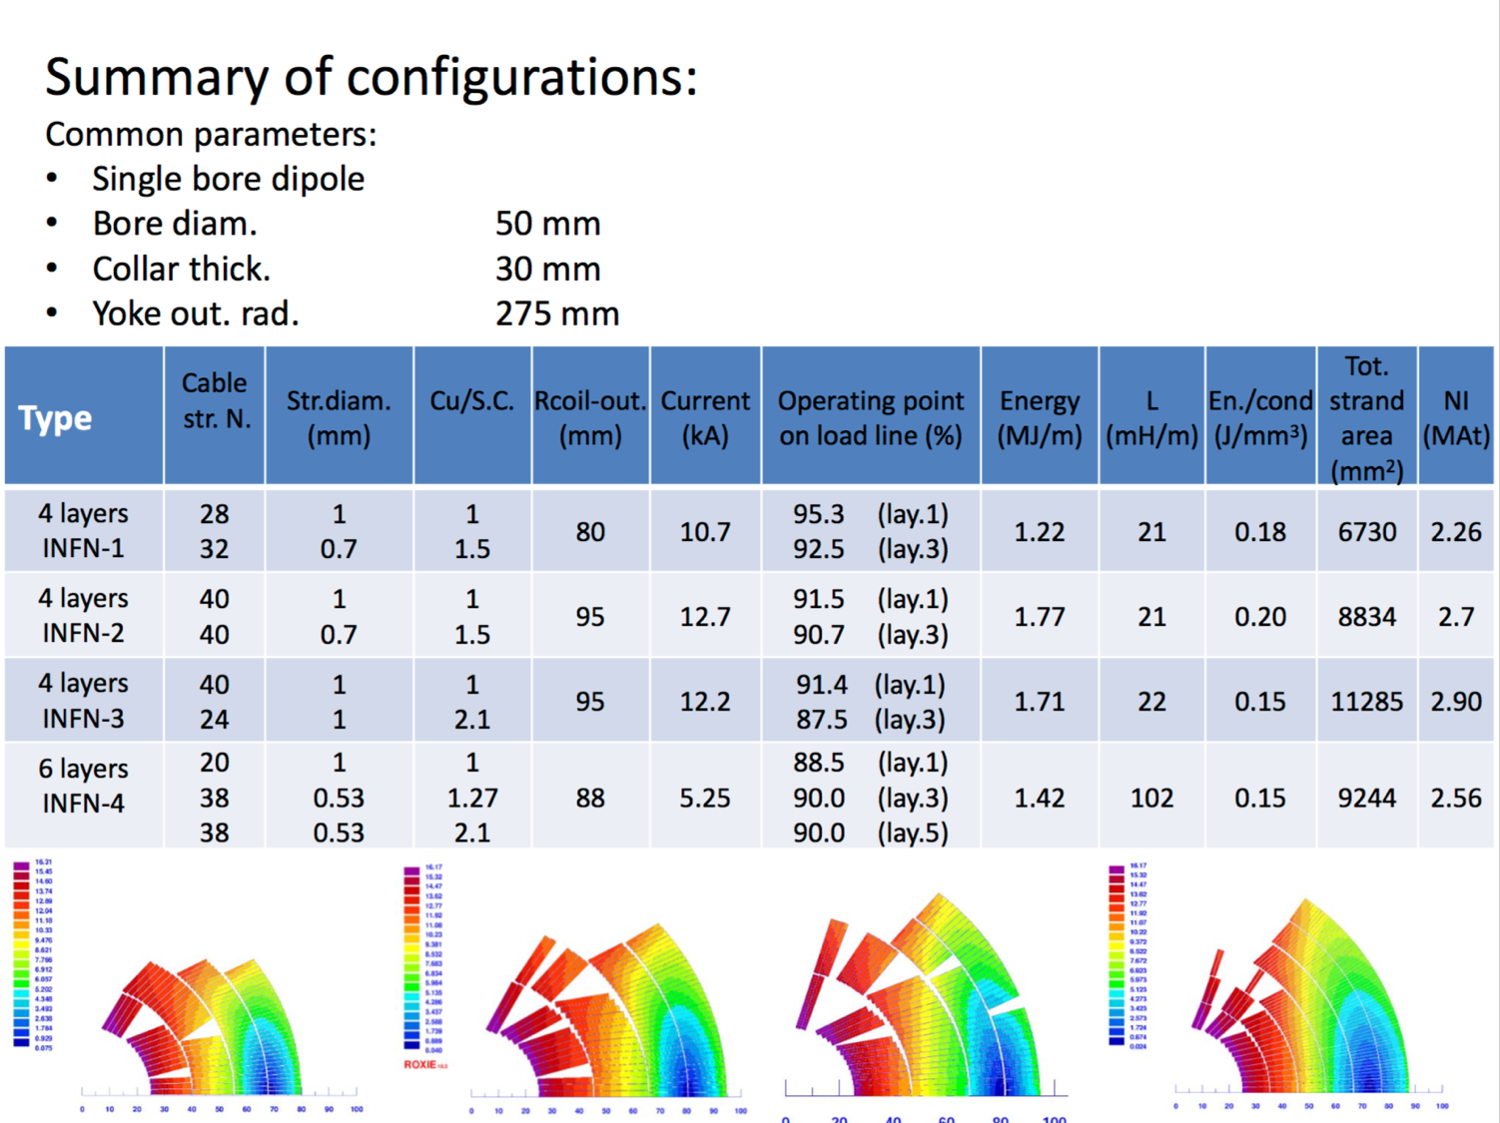
Cos-Theta Design Options

Slide 5
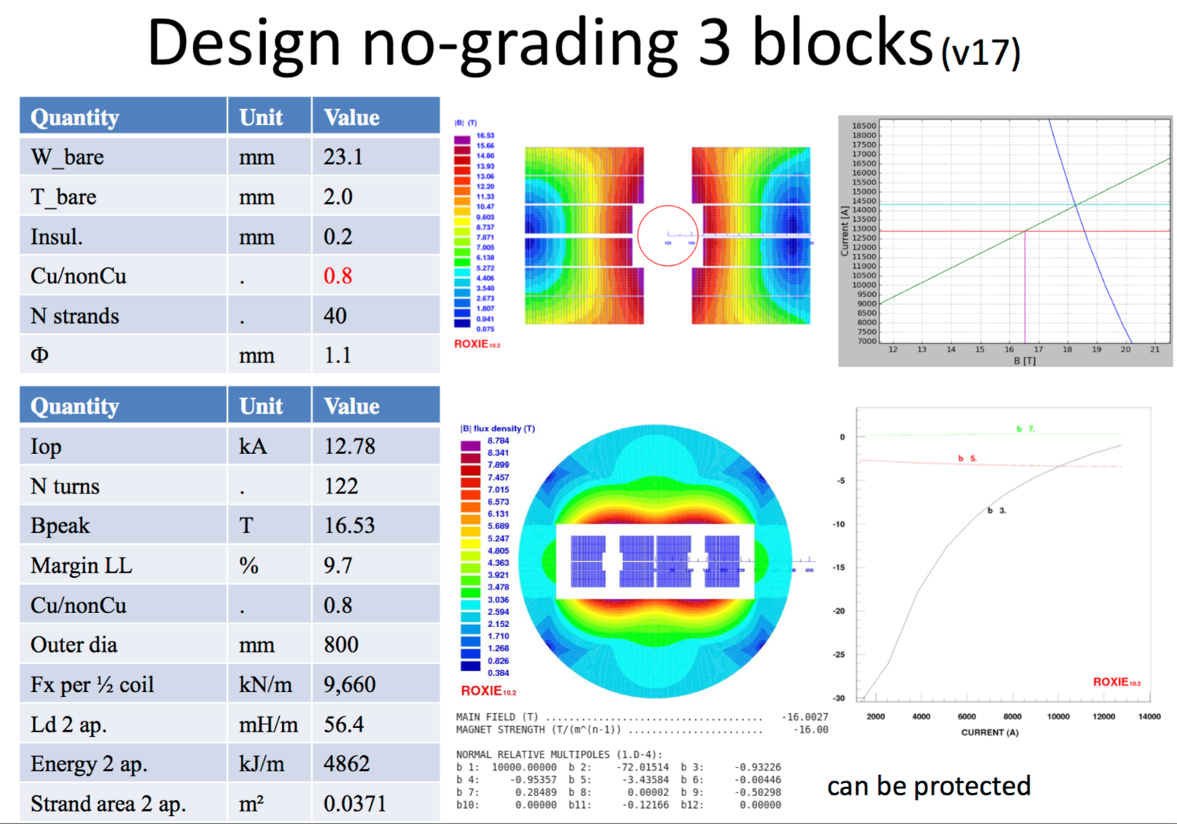
Block-Coil Design No Grading

Slide 6
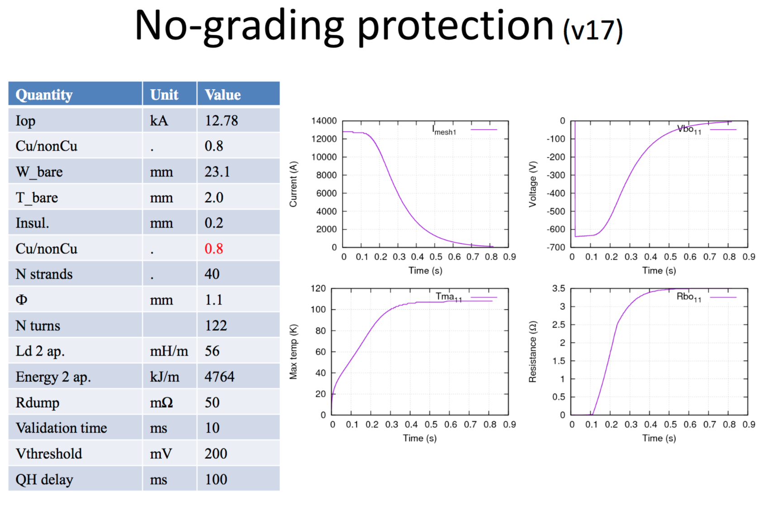
Protection Trivial
Indicates inefficient use of conductor!

Slide 7
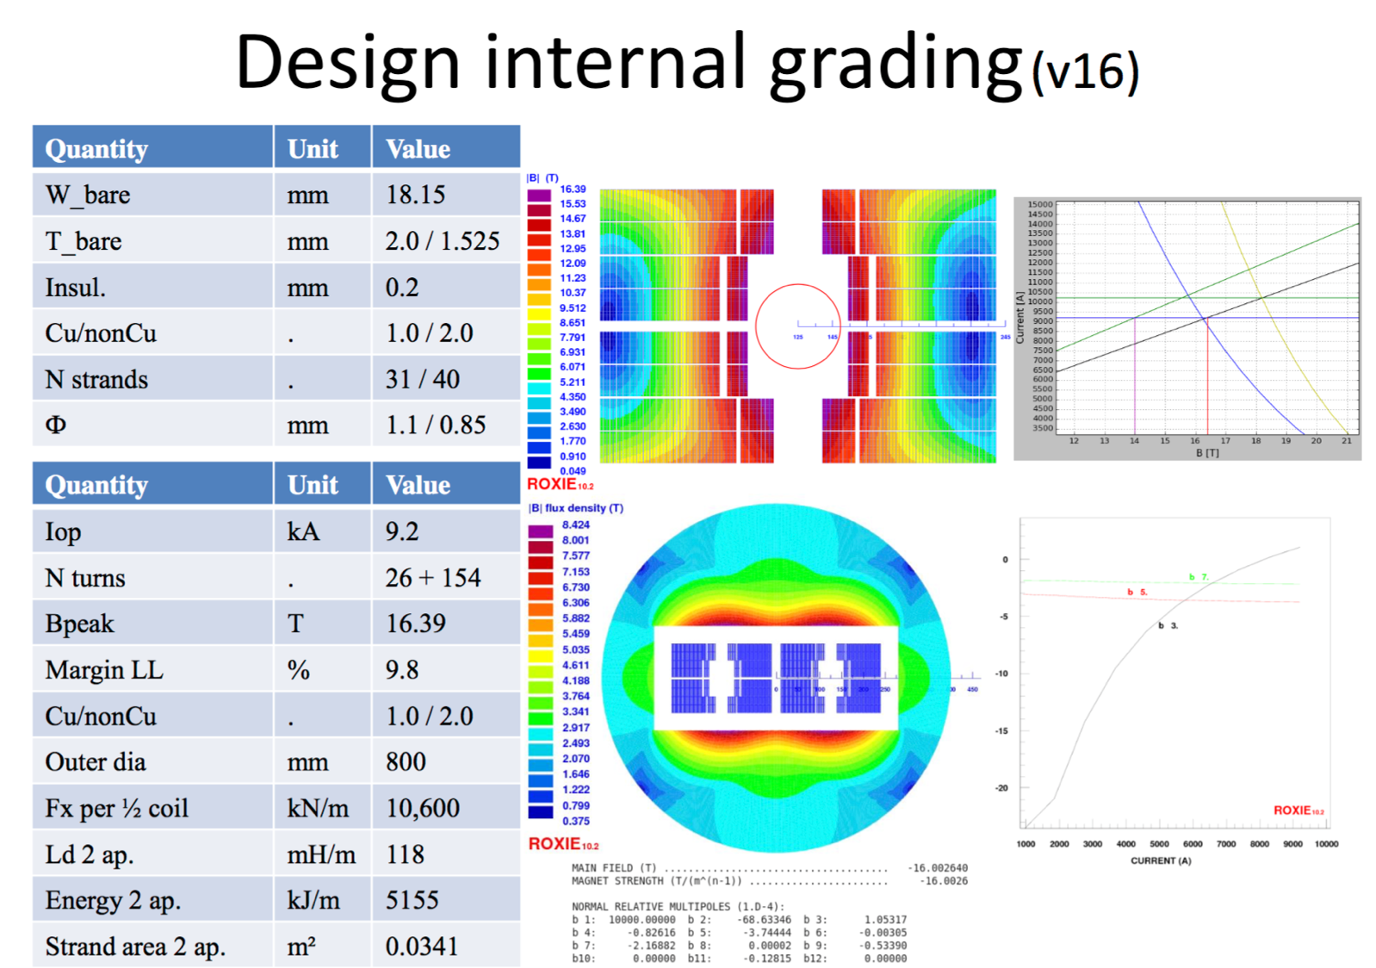
Block-Coil Design with Grading

Slide 8
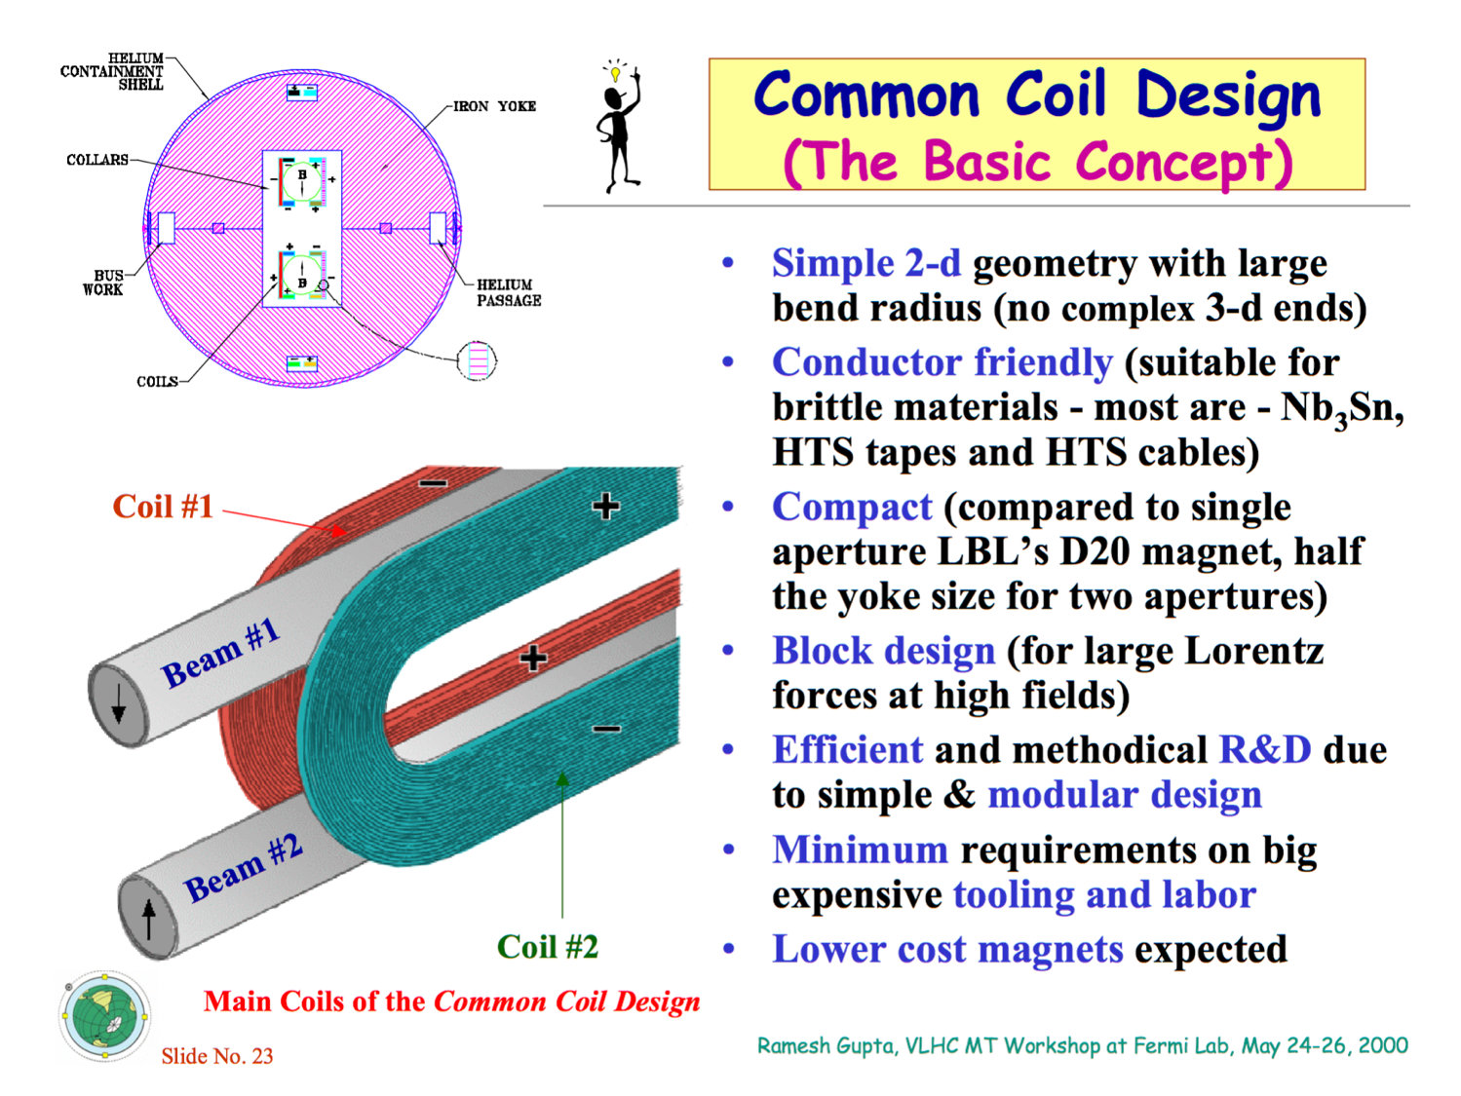
Common-Coil Intro

Slide 9
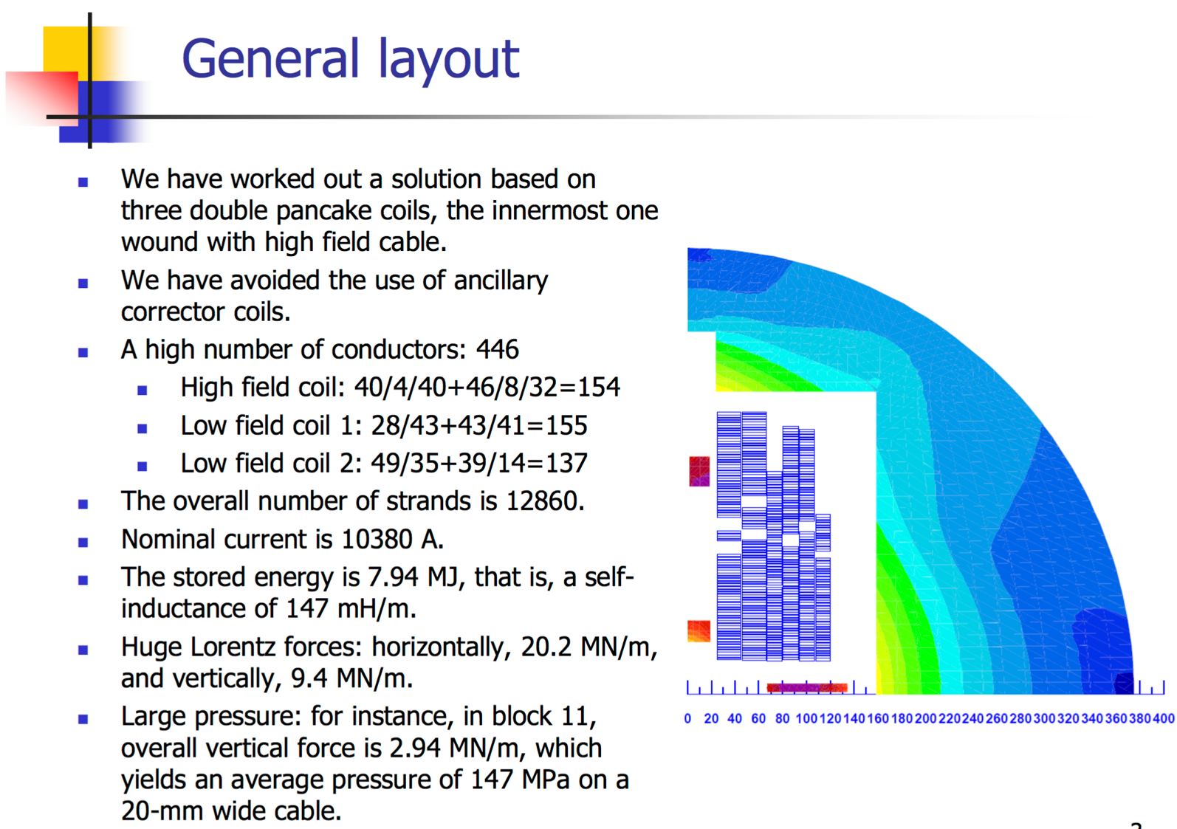
Common-Coil Design

Slide 10
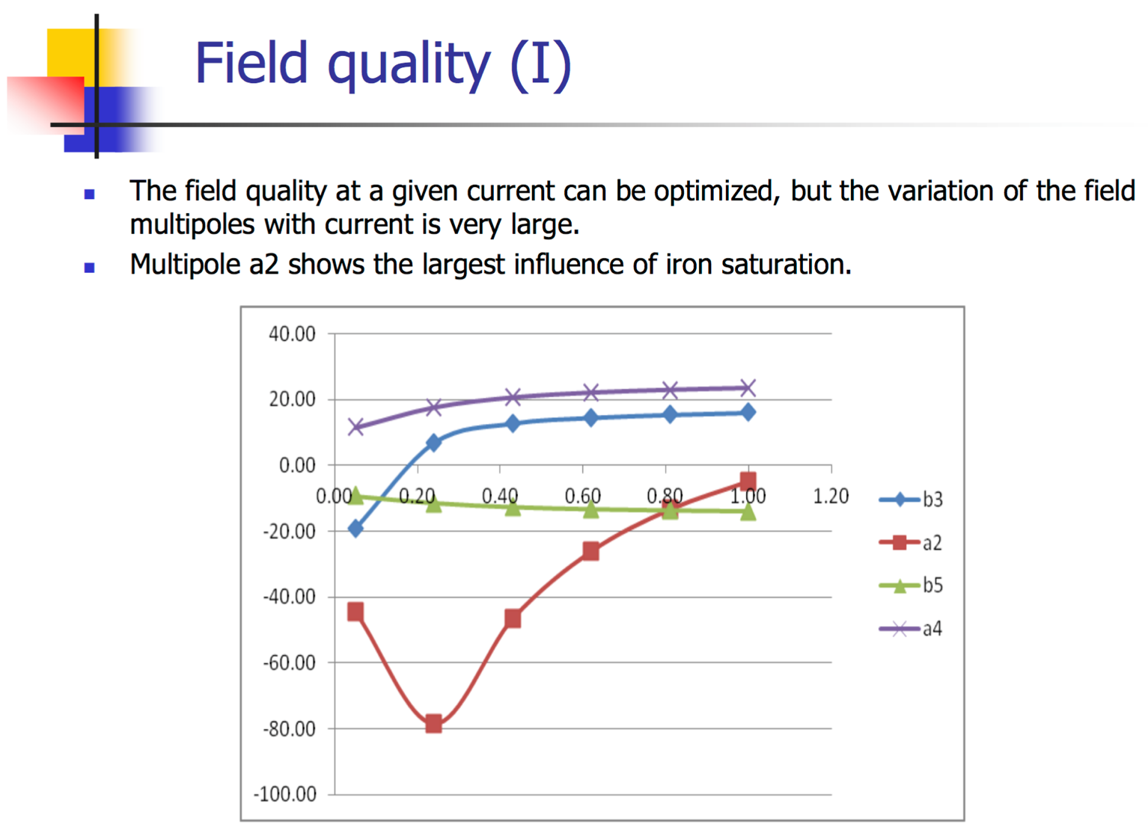
Field Quality Problem
Limitation of “only flat racetracks” may be too strong!

Slide 11
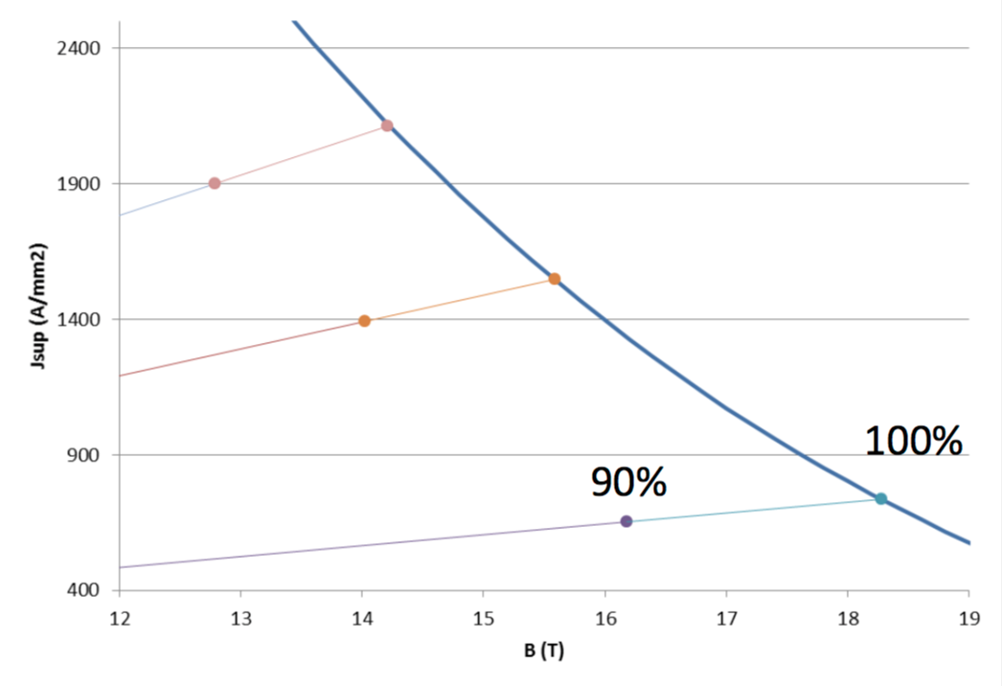
Protection HF vs. LF Turns
High-field turns automatically operate at lower current density.
Cu/Sc ratio bounded from below at 0.6-0.8.
Protection of HF-turns not critical.
LF turns operate more closely to HF-turns in HL-LHC Nb3Sn magnets!

Slide 12
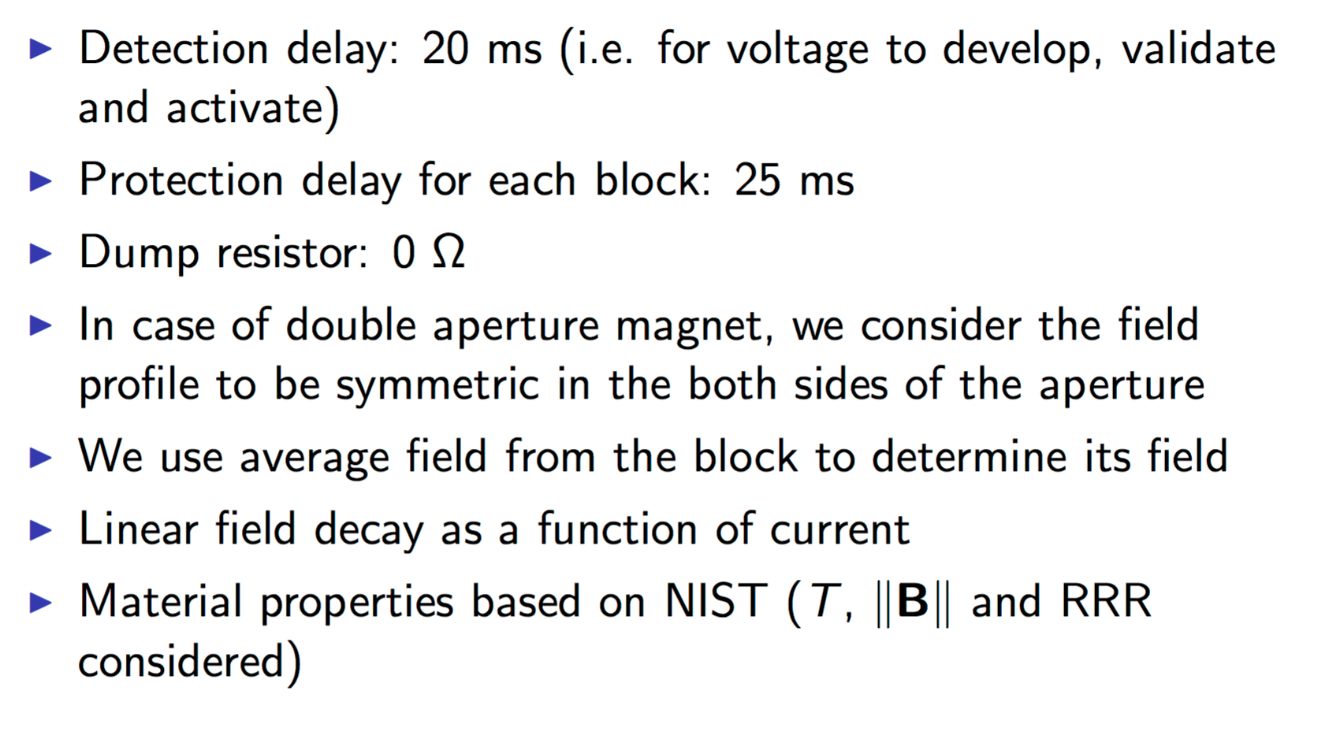
Methodology
Methodology ok for first comparison of designs. Needs improvements later.

Slide 13
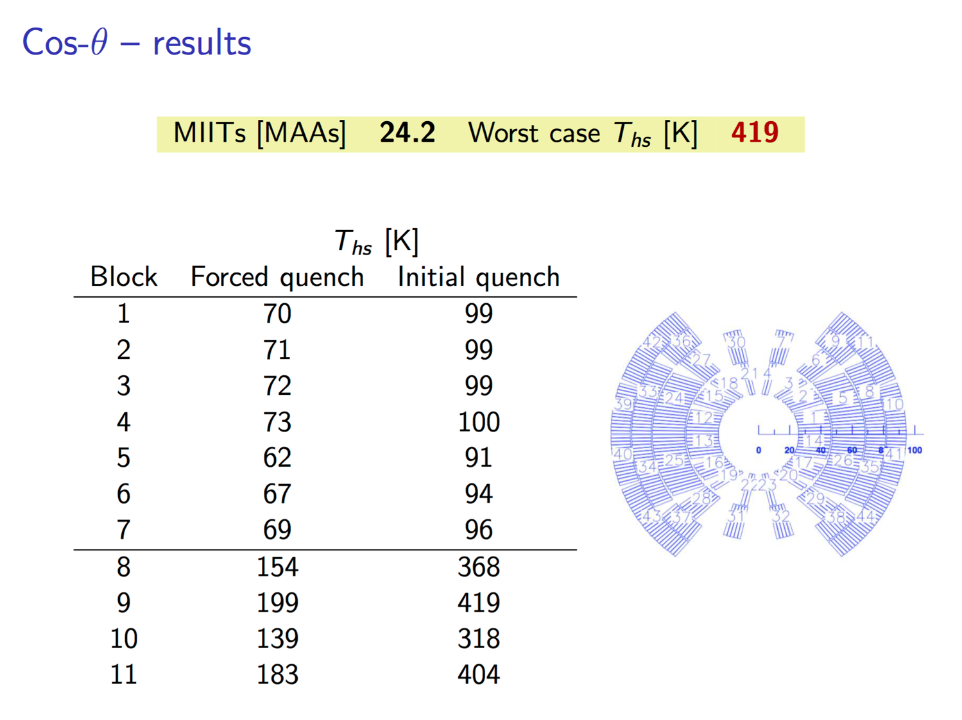
Protection Cos-Theta

Slide 14
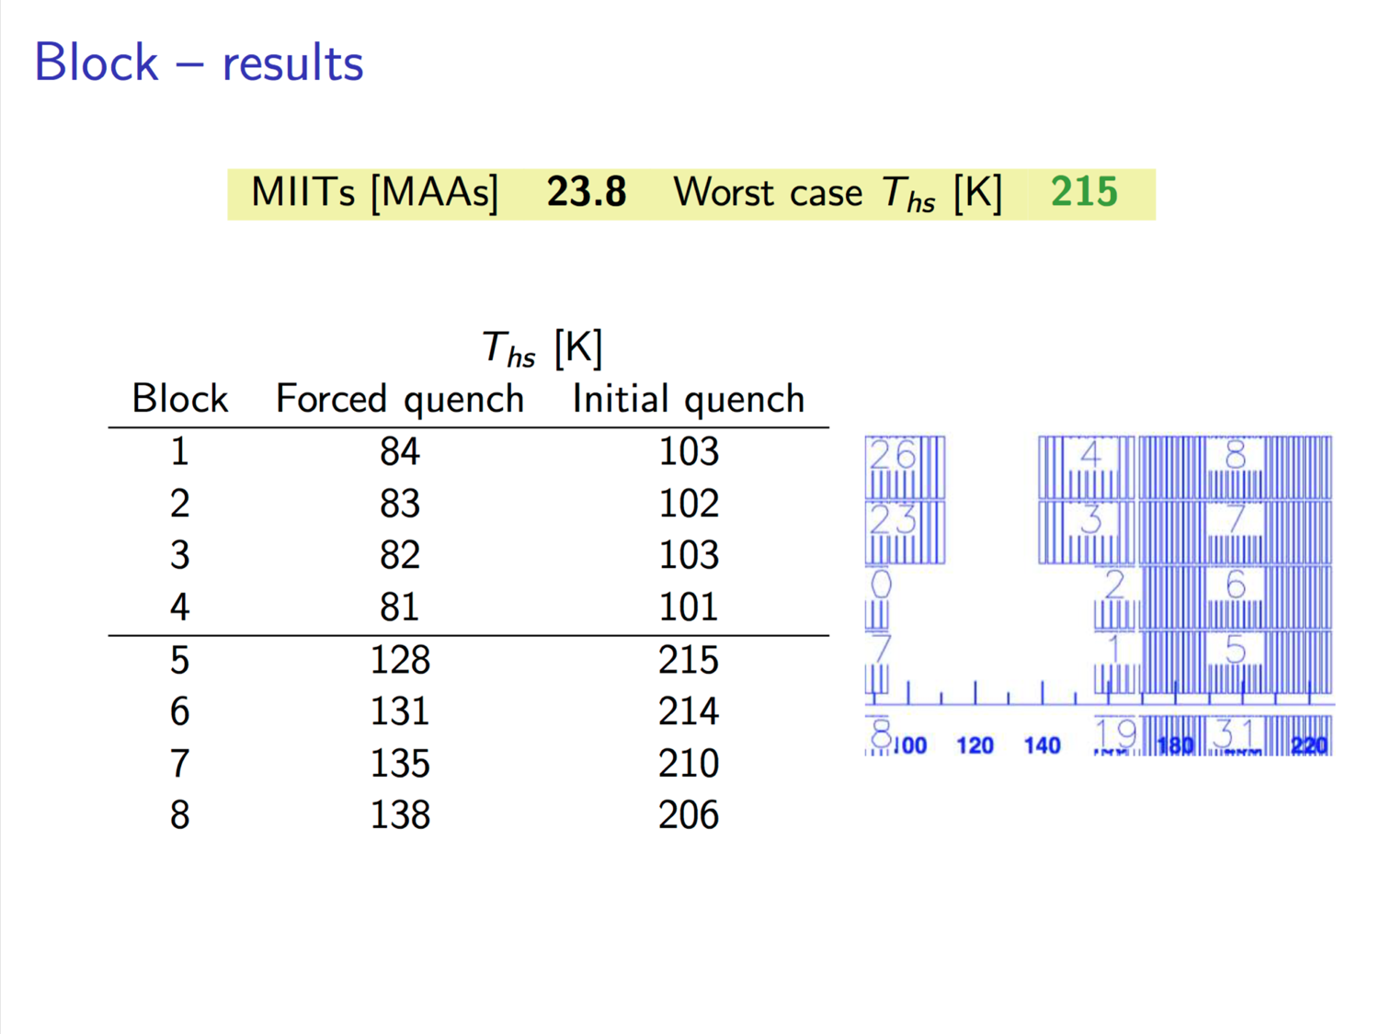
Protection Block Design
Inefficient designs are easy to protect.

Slide 15
Conclusion
Promising Cos-Theta designs might prove very difficult to protect.
Block-designs need more iterations to make them similarly efficient as Cos-theta.
Common-coil is not yet an option.
LF turns will be harder to protect than HF turns.

