Slide 1
LHC Failure studies
-
Focus on documentation
Thanks to Zinour and Andrea for the contribution

Slide 2
Content
1. LHC Failure statistics
2. Work process
3. Piquet data
  4. Analysis and results
  5. Efficient documentation
  6. Conclusion and outlook
  (7. Computer-aided design project)

Slide 3
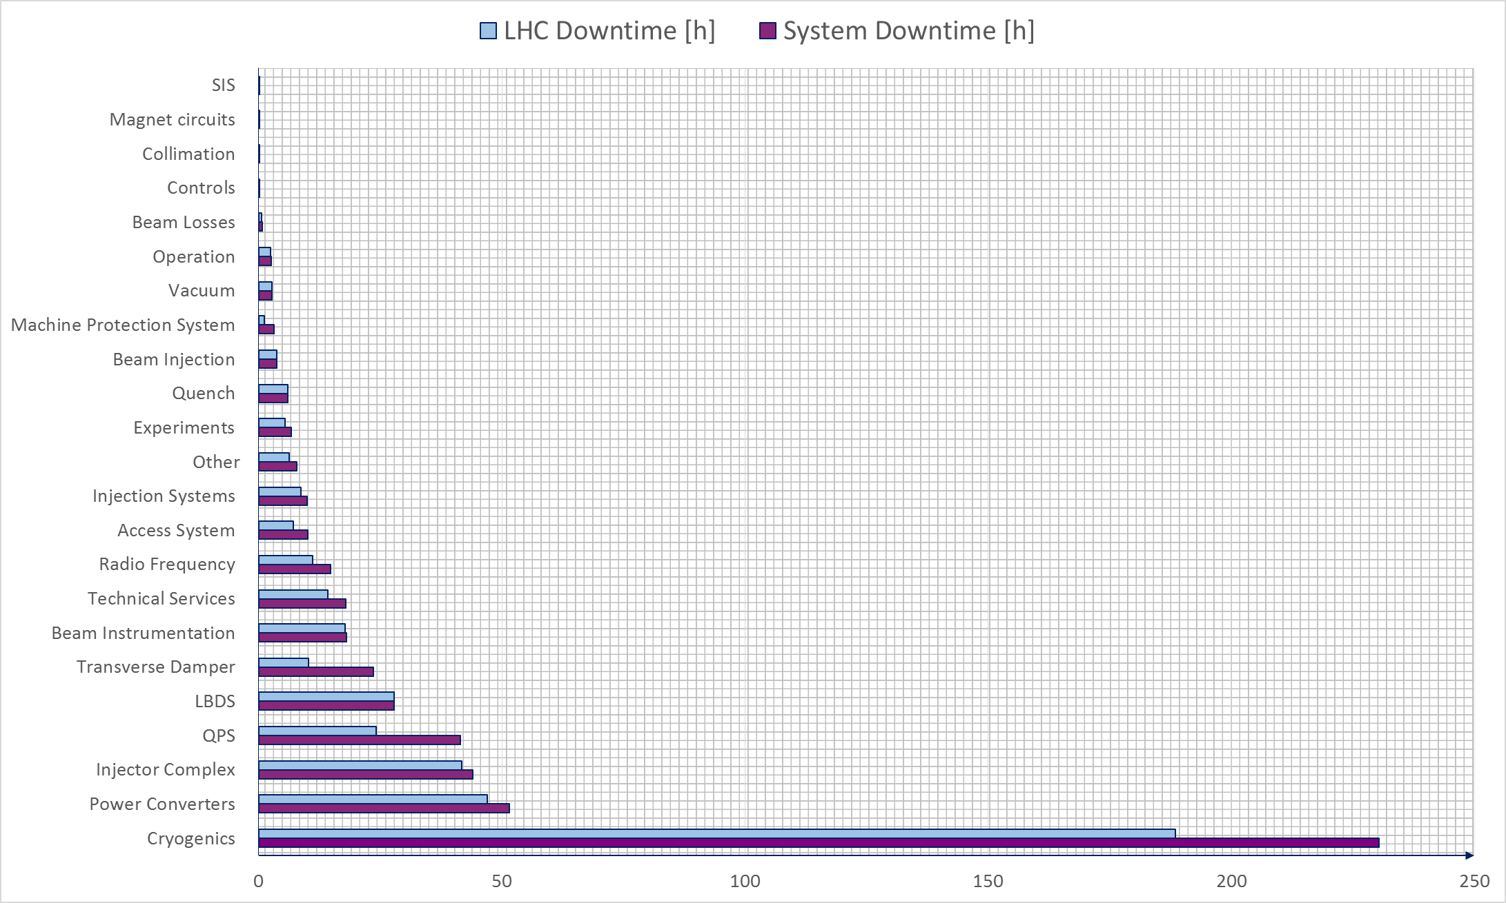
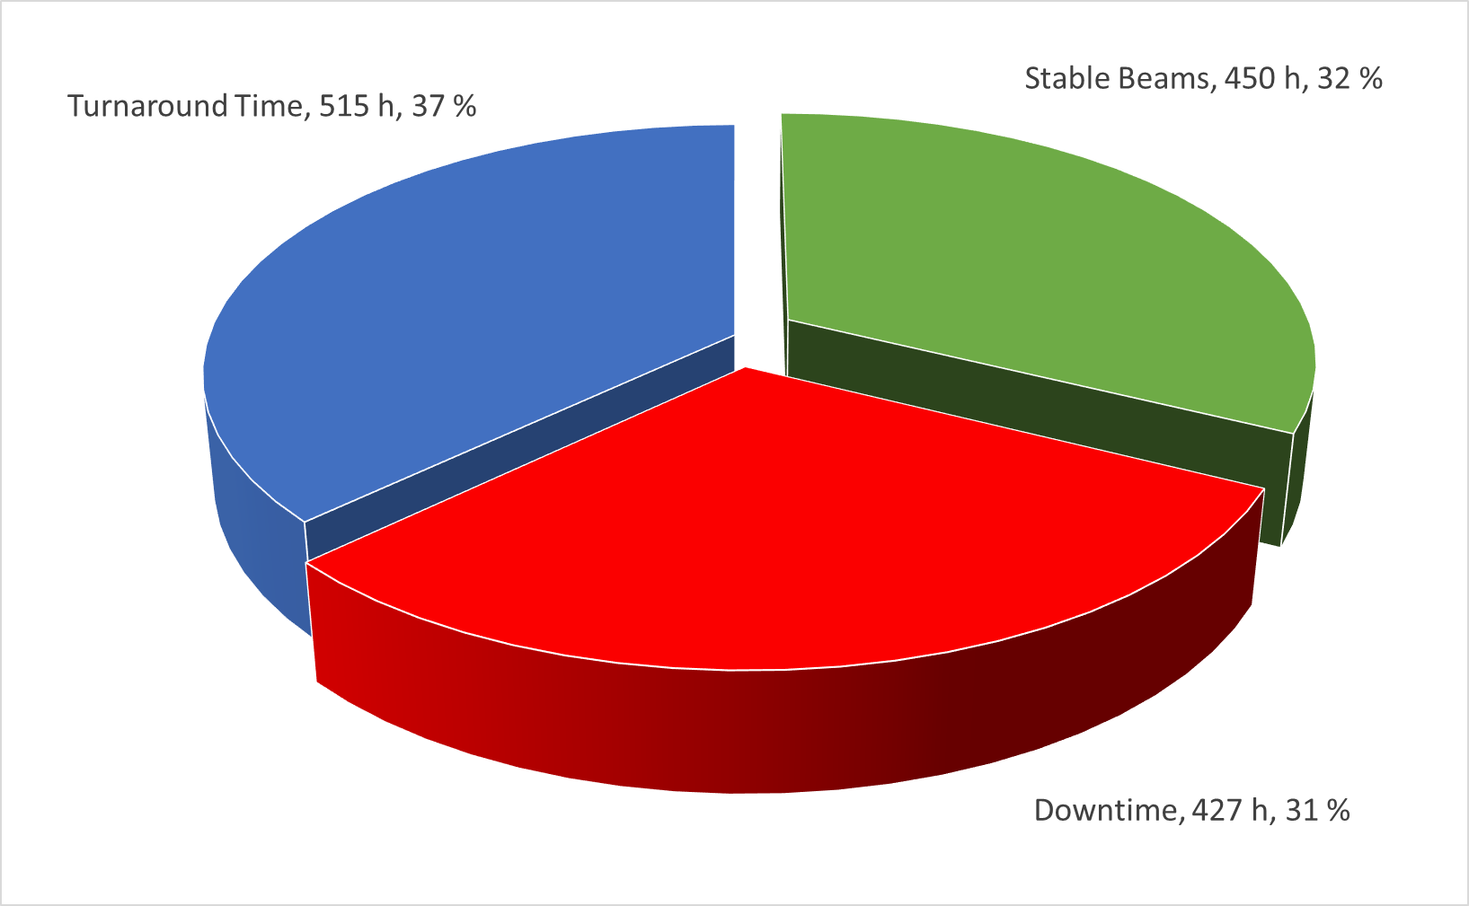
LHC failure statistics - 2015
25 ns run
Cryo: ~ 51 h quench recovery
(“child fault”)

Slide 4
Work process
Comparing logbook, AFT, COMS, Piquet data
Logbook and AFT do not provide much details
COMS more detailed but time assignment imperfect and includes minor concerns (Distributions)
Piquet data turns out to be most reliable data
Upgrading and correcting piquet data in collaboration with Zinour (lots of work)
New statistics of the faults
Proposal for AFT extension (implementing data)

Slide 5
Piquet data
Data concerns QPS and circuit failures
Piquet is the main responsible person for the maintenance work of the LHC
Each time there is a failure that requires maintenance work of the piquet, an entry in the piquet data is made
Piquet data is more detailed than other failure data (AFT, logbook, ...)
Data is not always provided with all required details

Slide 6
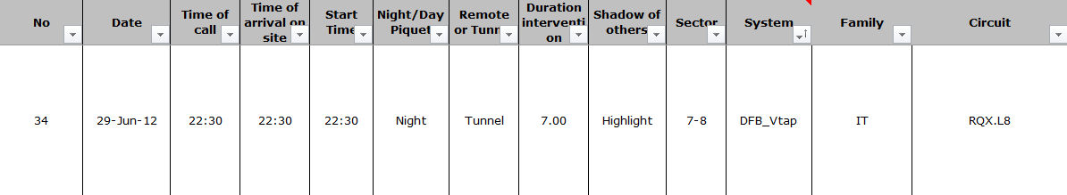
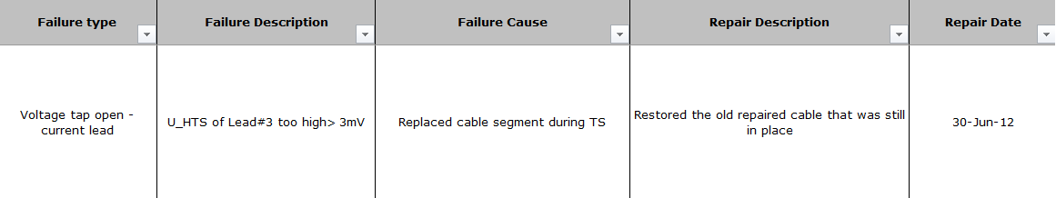
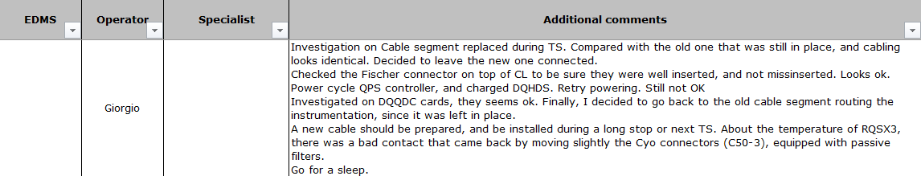
Piquet data - example
Example (2012):

Slide 7
Analysis and results
2012
failures sorted by
circuits

Slide 8
Analysis and results
2012 failures sorted by failure types

Slide 9
Efficient failure documentation
Important Information:
Failure type
Failure description
Failure cause
System/s
Start time
End time
Location
Remote or tunnel (access)
Highlight or shadow
Faults blocking current fault
Faults blocked by current fault
Preventing injection
Precycle needed
Radioprotection needed
Parent faults
Child faults
Operational mode
Beam intensity
Energy level
Repair description
Repair time
Severity
Recurring or first time
Reviewed by AWG – Availability Work Group (proof of correctness)
... ???

Slide 10
Availability budgets
Concept by PhD student of Stuttgart (M. Bartholdt, to be published)
Combination of availability and costs
Methods applied in industry to accelerator domain
Example: Machine Protection System
Goal: Find the best spots to invest

Slide 11
Conclusion and outlook
Main failure contributors are displayed in the analysis of the piquet data
Sufficient failure documentation is the first step of efficient failure studies
2015 data upgrading (ongoing work)
Power converter data studies (upcoming)
Availability budgets calculations (upcoming)

Slide 12
Thank you for
your attention

Slide 13
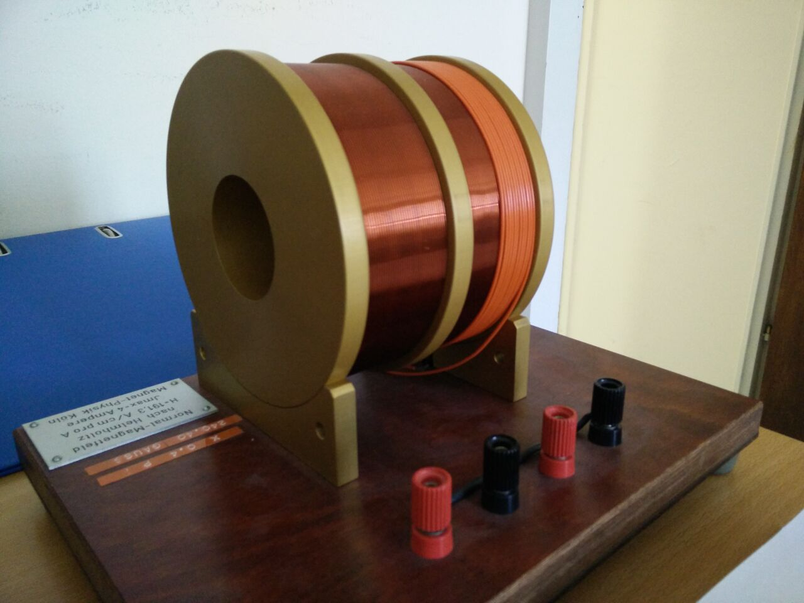
Computer-aided design project
Motivation:
Measuring of the transversal magnetic field of a solenoid magnet
Magnetic needle with attached mirror
Laser for measuring offset
Control circuit for balancing the offset with secendary magnetic field

Slide 14
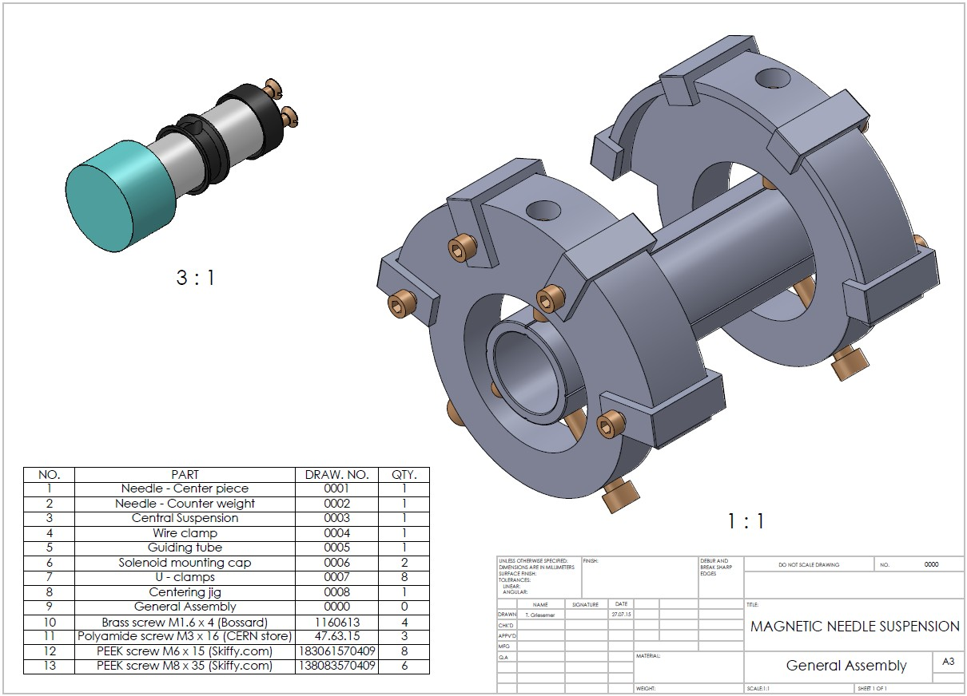
Modeling

Slide 15
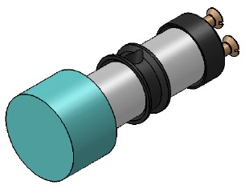
Modeling
Components magnetic needle:
  Mirror
  Magnets
  Iron parts
  Nylon string
  Brass screws
Important properties:
  Centre of mass
  Moment of inertia
  Maximum angle
Modeling
Parts designed, produced, assembled and tested.
Fully functional ✔

Slide 16
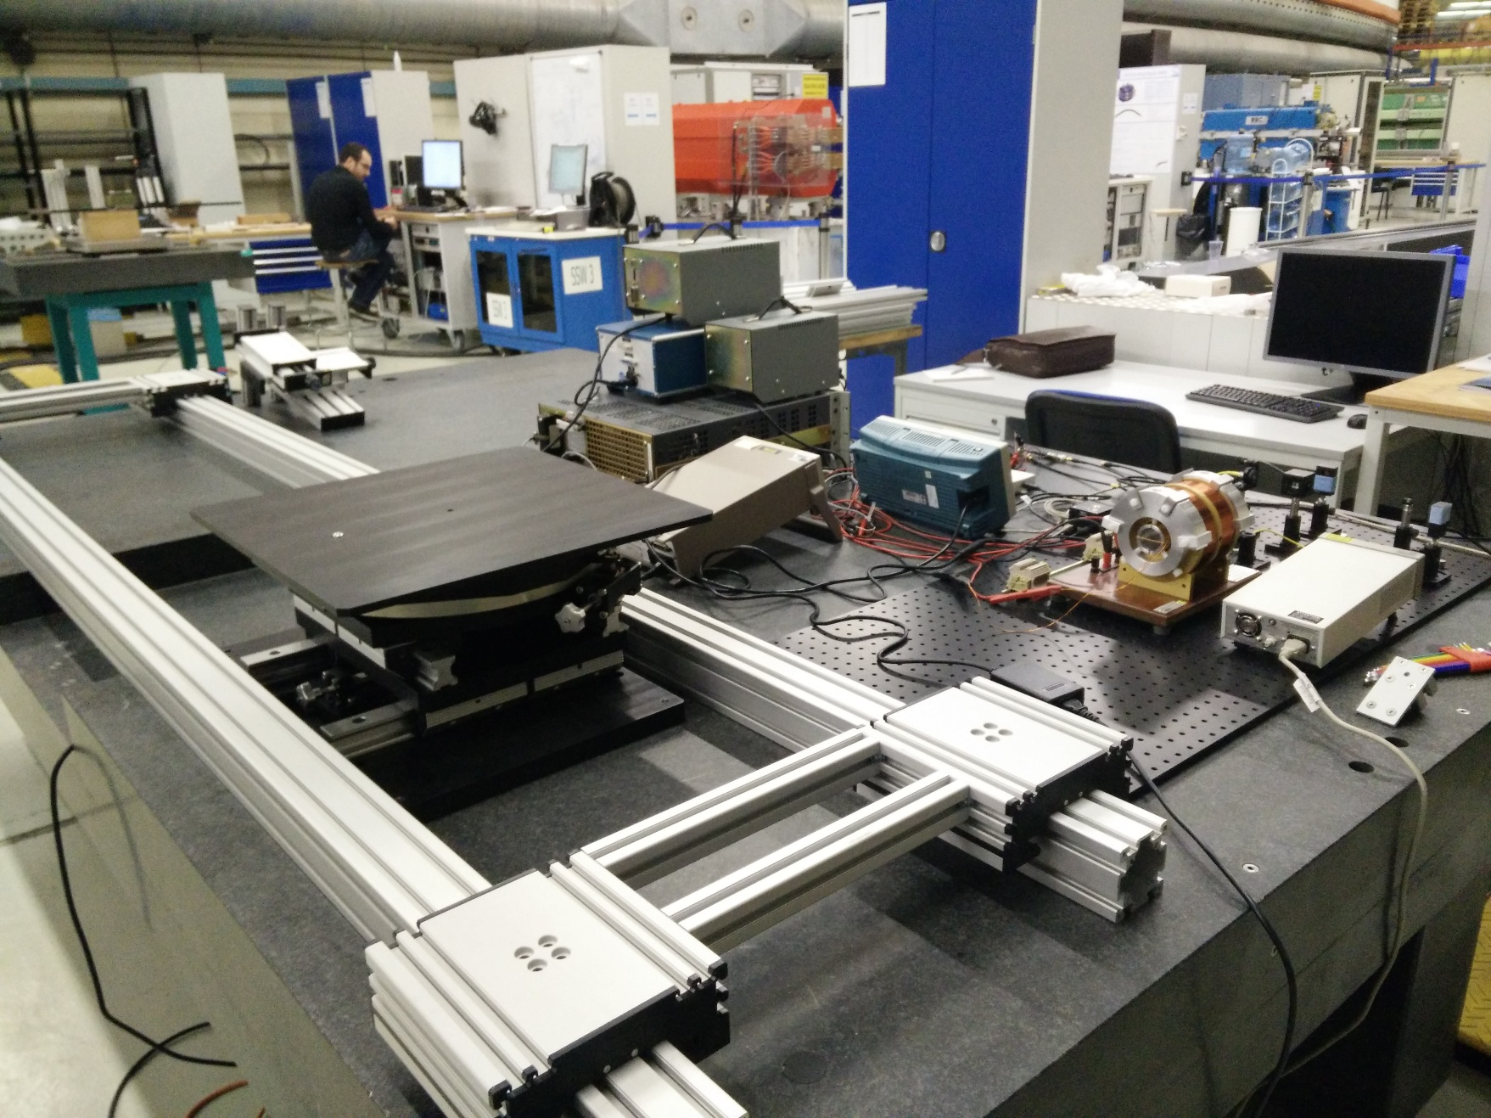
Setup in the lab

