Slide 2
Kickoff Collaboration Meeting CERN-LNL-STFC:
SRF cavity technology for the FCC

Slide 3
Scope of the meeting

Slide 4
Scope of the meeting
Review the capabilities of the Laboratories within the needs of this Collaboration
Define a consistent set of milestones and deliverables within and a credible and agreed planning
Discuss the monitoring process
AOB

Slide 5
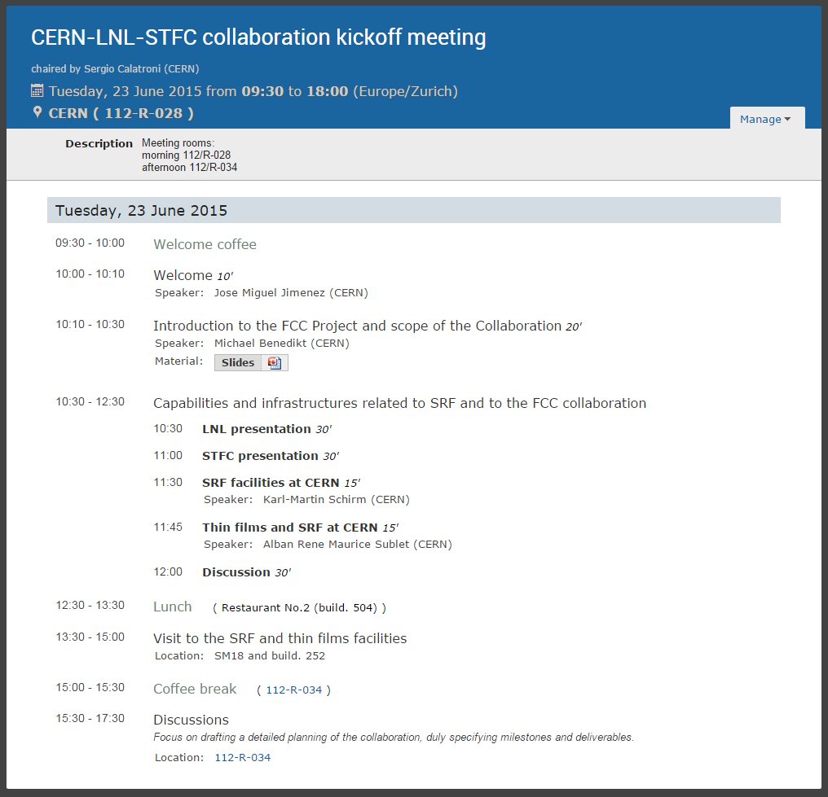
Agenda
https://indico.cern.ch/event/403142/
Tickets provided for visitors
Travel by car

Slide 8
Scope of work: CERN

Slide 9
Scope of work: LNL

Slide 10
Scope of work: STFC

Slide 11
Draft planning

Slide 12
Milestones & Deliverables

Slide 13
Monitoring process
Contractual committee:
  Michael Benedikt – CERN
  Enzo Palmieri – INFN-LNL
  Peter McIntosh – ASTeC
Review at least once a year (in person)
AOB
Define technical linkperson for each Lab.
Regular / on demand Internet meetings.

