Slide 1


Study Overview & Status
Michael Benedikt
CERN
23 June, 2015

Slide 2
Motivation for global FCC study:
European Strategy for Particle Physics 2013:
  “…to propose an ambitious post-LHC accelerator project….., CERN should undertake design studies for accelerator projects in a global context,…with emphasis on proton-proton and electron-positron high-energy frontier machines..…”
US P5 recommendation 2014:
  ”….A very high-energy proton-proton collider is the most powerful tool for direct discovery of new particles and interactions under any scenario of physics results that can be acquired in the P5 time window….”
Conceptual Design Report by end of 2018 in time for next European Strategy Update
Goal:

Slide 3
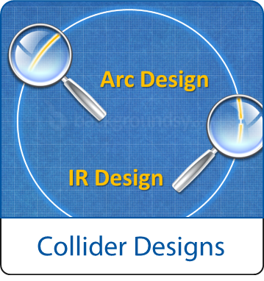
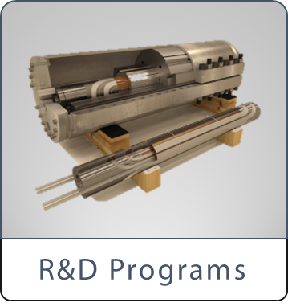
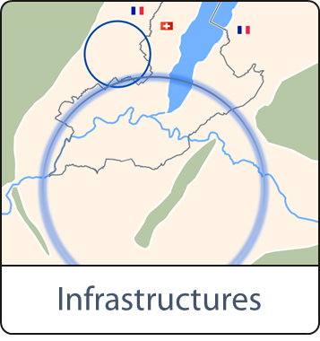
Scope: Accelerator & Infrastructure
FCC-hh: 100 TeV pp collider as long-term goal
→ defines infrastructure needs
FCC-ee: e⁺e⁻ collider, potential intermediate step
FCC-he: integration aspects of pe collisions
Push key technologies
in dedicated R&D programmes e.g.
16 Tesla magnets for 100 TeV pp in 100 km
SRF technologies and RF power sources
Tunnel infrastructure in Geneva area, linked to CERN accelerator complex
Site-specific, requested by European strategy

Slide 4

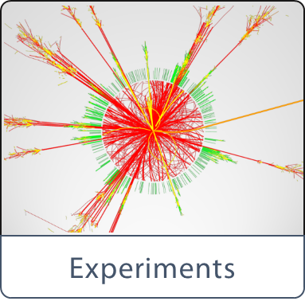
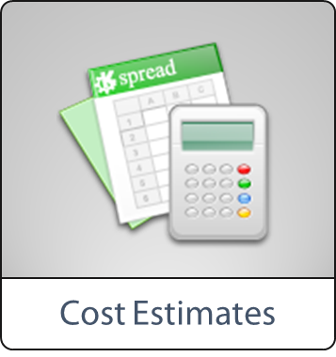
Scope: Physics & Experiments
Elaborate and document
- Physics opportunities
- Discovery potentials
Experiment concepts for hh, ee and he
Machine Detector Interface studies
Concepts for worldwide data services
Overall cost model
Cost scenarios for collider options
Including infrastructure and injectors
Implementation and governance models

Slide 5
CERN Circular Colliders + FCC
1980
1985
1990
1995
2000
2005
2010
2015
2020
2025
2030
2035
20 years
Constr.
Physics
LEP
Design
Proto
Construction
Physics
LHC
Design
Construction
Physics
HL-LHC
Future Collider
Design
Proto
Construction
Physics

Slide 6
Key Parameters FCC-hh
Parameter | FCC-hh | LHC
Energy [TeV] | 100 c.m. | 14 c.m.
Dipole field [T] | 16 | 8.33
# IP | 2 main, +2 | 4
Luminosity/IP_{main} [cm⁻²s⁻¹] | 5 - 25 x 10³⁴ | 1 x 10³⁴
Stored energy/beam [GJ] | 8.4 | 0.39
Synchrotron rad. [W/m/aperture] | 28.4 | 0.17
Bunch spacing [ns] | 25 (5) | 25

Slide 7
FCC-hh Luminosity Goals
Two parameter sets for two operation phases:
  phase 1 (baseline): 5 x 10³⁴ cm⁻²s⁻¹ (peak),
  250 fb⁻¹/year (averaged)
  phase 2 (ultimate): ~2.5 x 10³⁵ cm⁻²s⁻¹ (peak),
  1000 fb⁻¹/year (averaged)
  ➔ total luminosity a few 10’s of ab⁻¹
  over ~25 years of operation
OK for physics

Slide 8
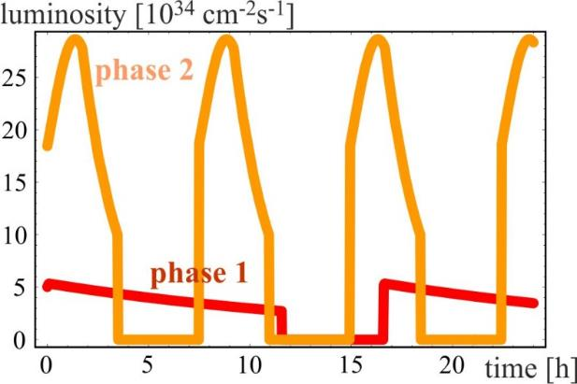
FCC-hh luminosity evolution 24 h
radiation damping: τ~1 h
  for both phases:
  beam current 0.5 A unchanged!
  total synchrotron radiation power ~5 MW.
phase 1: β*=1.1 m, ΔQ_{tot}=0.01, t_{ta}=5 h
phase 2: β*=0.3 m, ΔQ_{tot}=0.03, t_{ta}=4 h

Slide 9
Key Parameters FCC-ee
Parameter | FCC-ee |  |  | LEP2
Energy/beam [GeV] | 45 | 120 | 175 | 105
Bunches/beam | 13000- 60000 | 500- 1400 | 51- 98 | 4
Beam current [mA] | 1450 | 30 | 6.6 | 3
Luminosity/IP x 10³⁴ cm⁻²s⁻¹ | 21 - 280 | 5 - 11 | 1.5 - 2.6 | 0.0012
Energy loss/turn [GeV] | 0.03 | 1.67 | 7.55 | 3.34
Synchrotron Power [MW] | 100 |  |  | 22
RF Voltage [GV] | 0.2-2.5 | 3.6-5.5 | 11 | 3.5
Dependency: crab-waist vs. baseline optics and 2 vs. 4 IPs

Slide 10
FCC-ee: Luminosity vs. Energy
Crab waist 4 IP
Crab waist 2 IP
Baseline 4 IP
Baseline 2 IP
H?
with mono-chromatization

Slide 11
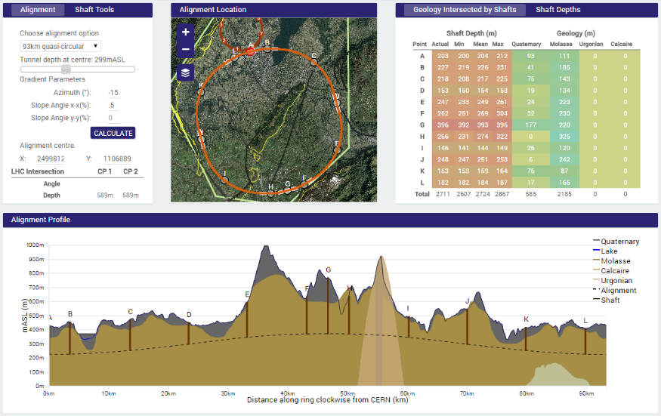
Geology Studies – Example 93 km
90 – 100 km fits geological situation well,
better than a smaller ring size
LHC suitable as potential injector

Slide 12
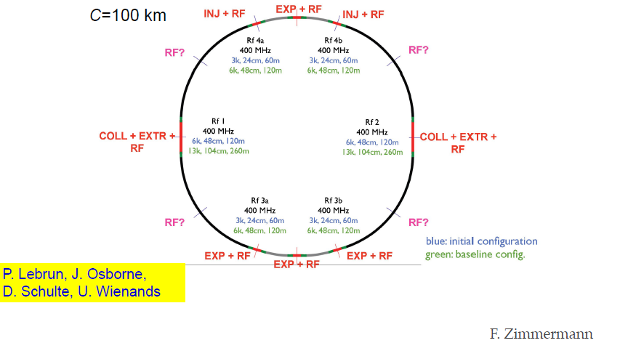
FCC-ee preliminary layout

Slide 13
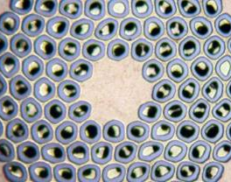
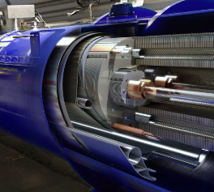
Key Technology R&D - HFM
Nb₃Sn
16 T
Conductor R&D
Magnet Design
Increase critical current density
Obtain high quantities at
required quality
Material Processing
Reduce cost
Develop 16T short models
Field quality and aperture
Optimum coil geometry
Manufacturing aspects
Cost optimisation
First demonstrator in 2016?

Slide 14
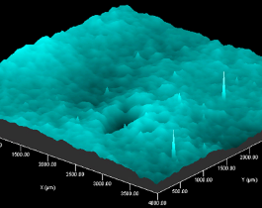
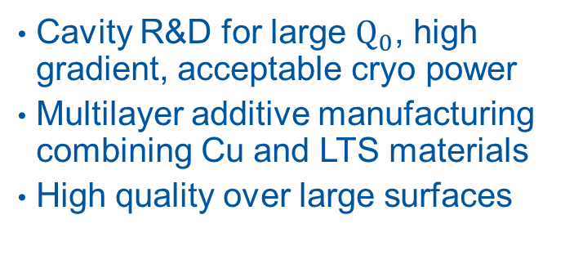
Key Technology R&D - RF
Beyond
Nb
Efficiency
Superconducting RF
Power Conversion
Cavity R&D for large $Q_{0}$, high gradient, acceptable cryo power
Multilayer additive manufacturing combining Cu and LTS materials
High quality over large surfaces
Push Klystrons far beyond 70% efficiency
Increase power range of
solid-state amplifiers
High reliability for high multiplicity

Slide 15


FCC Study timeline
2014 |  |  |  | 2015 |  |  |  | 2016 |  |  |  | 2017 |  |  |  | 2018
Q1 | Q2 | Q3 | Q4 | Q1 | Q2 | Q3 | Q4 | Q1 | Q2 | Q3 | Q4 | Q1 | Q2 | Q3 | Q4 | Q1 | Q2 | Q3 | Q4
Study plan, scope definition
Explore options
“weak interaction”
conceptual study of baseline “strong interact.”
FCC Week 2015:
work towards baseline
FCC Week 17 & Review
Cost model, LHC results
→ study re-scoping?
FCC Week 2016
Progress review
Elaboration,
consolidation
FCC Week 2018
→ contents of CDR
Report
CDR ready

Slide 16
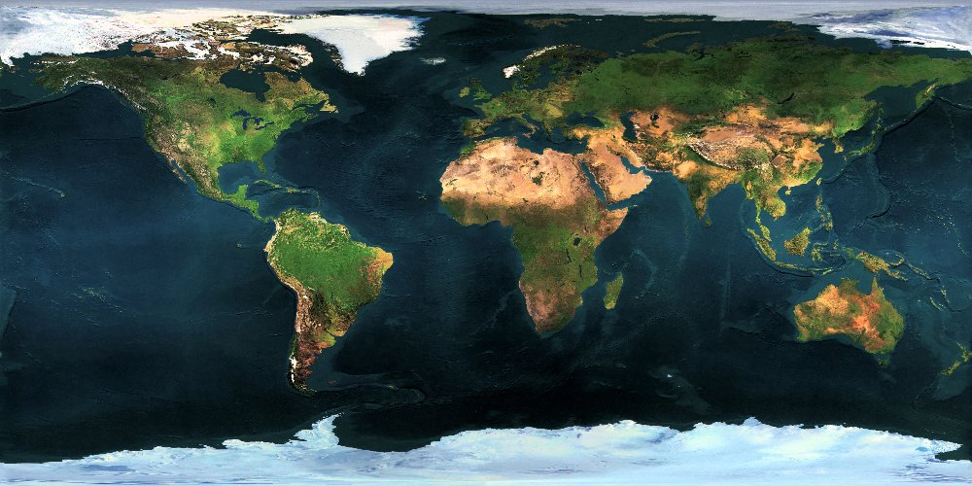




















FCC Collaboration Status
51 institutes
19 countries
EC participation

Slide 17


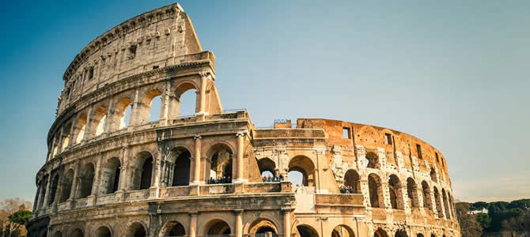
FCC Week 2016
Rome, 11 – 15 April 2016

