Slide 1
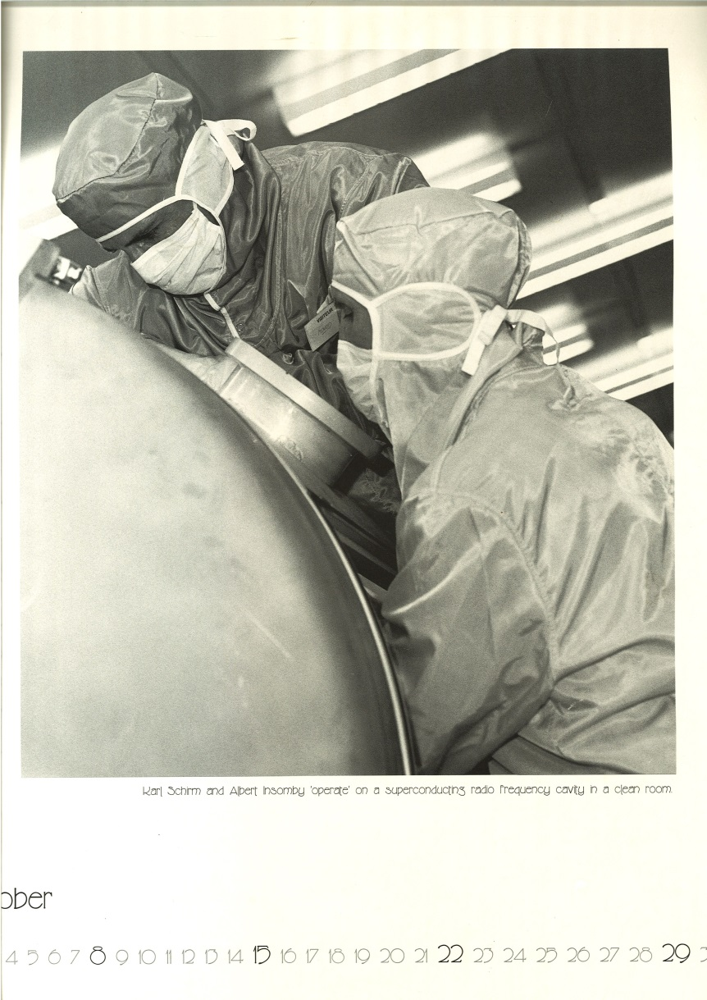
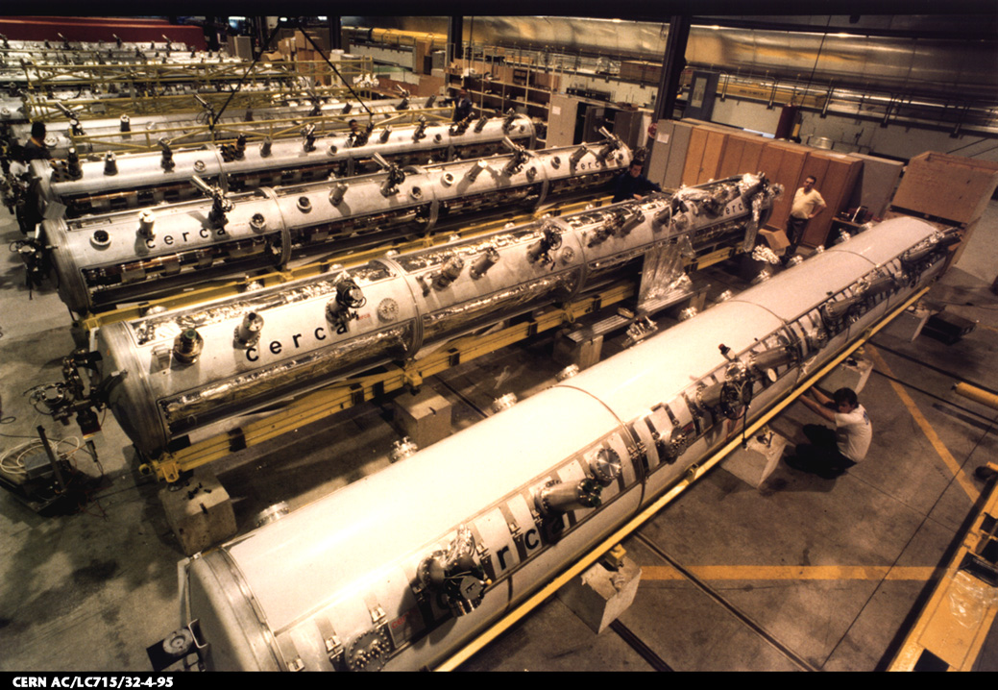
SRF Activities at CERN – Overview
SM18 in the 1990’s

Slide 2
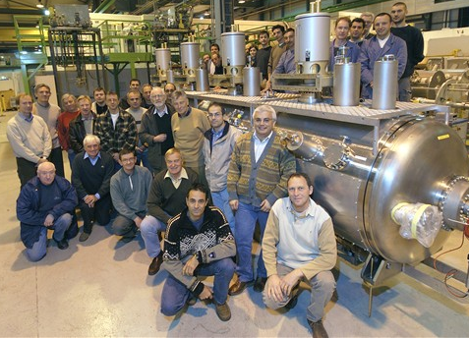
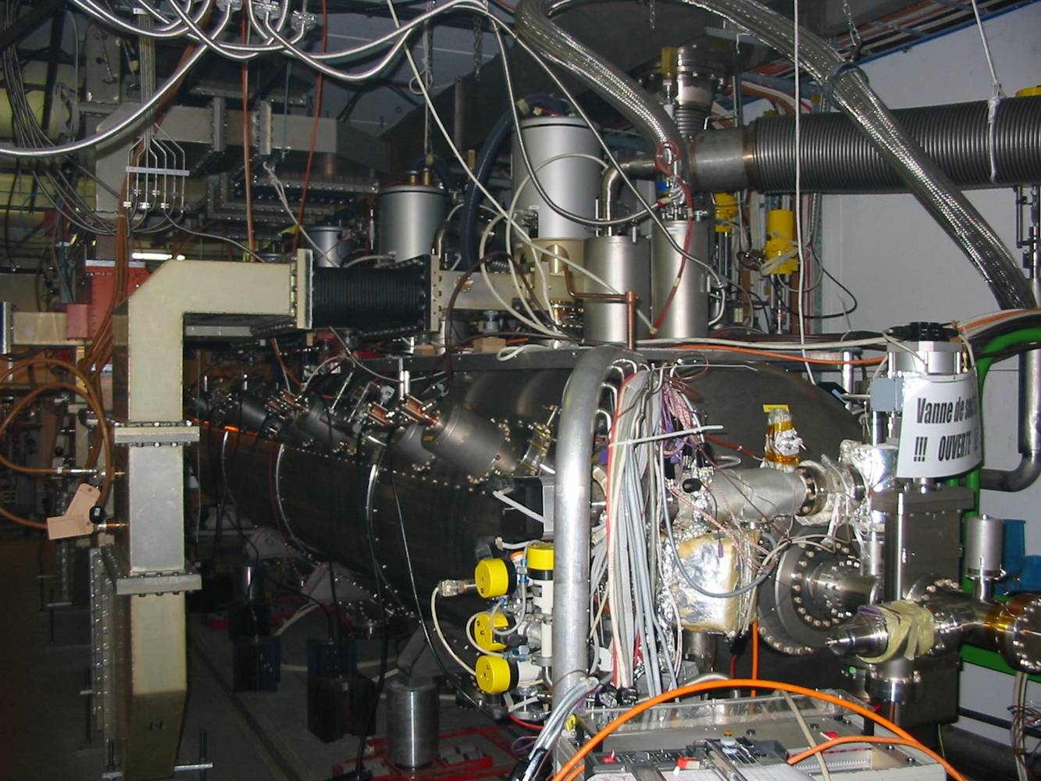
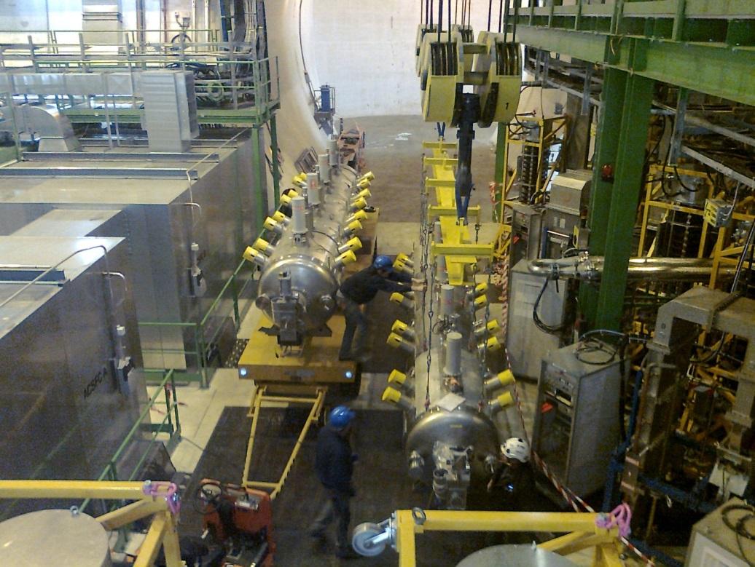
The LHC SRF
First module swap last year
Spare module needs refurbishing
Spare cavity programme underway

Slide 3
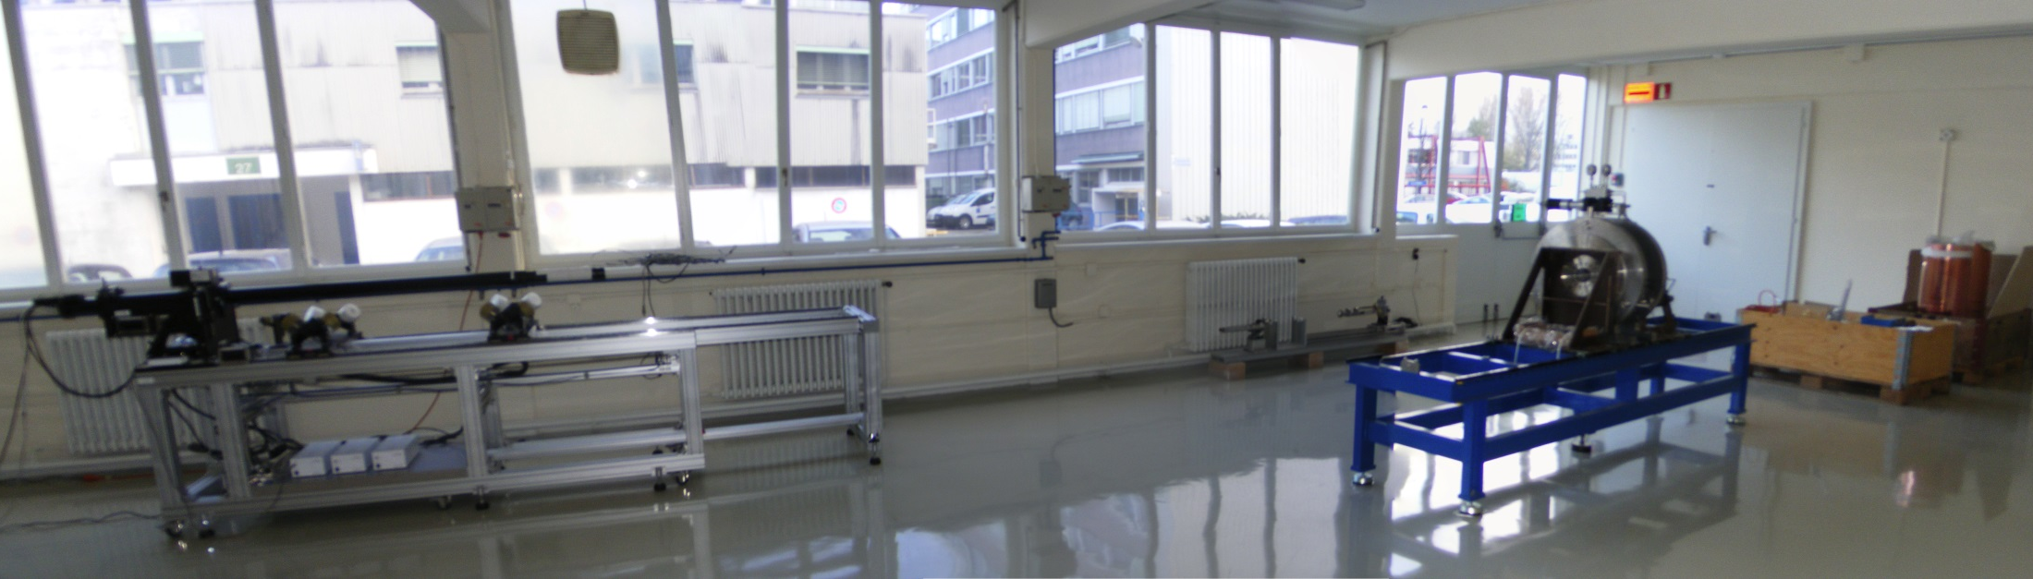
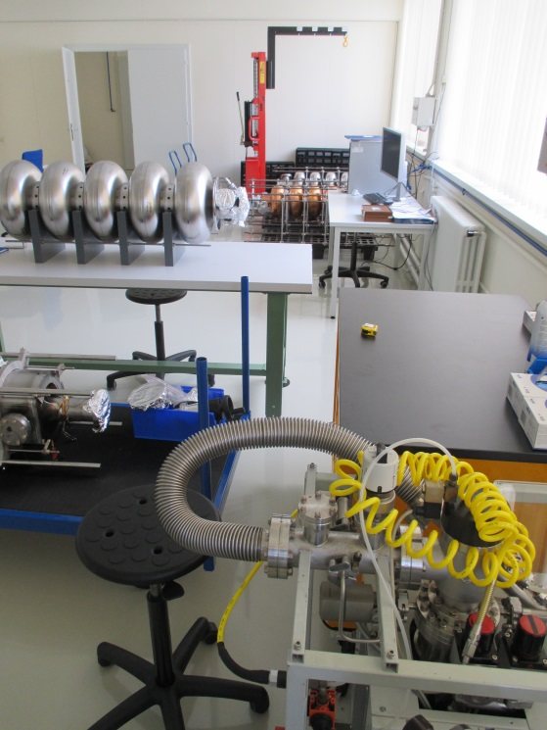
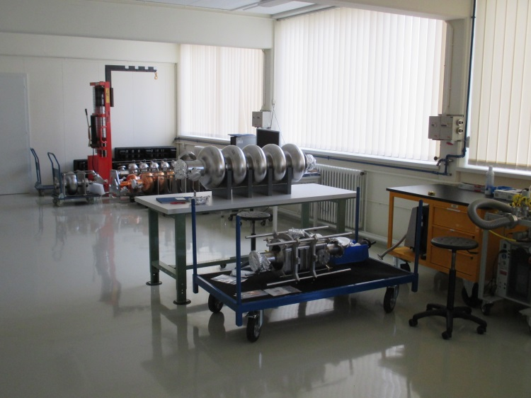
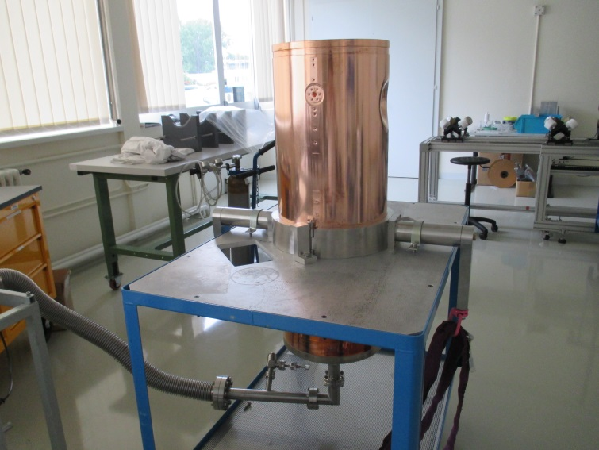
Bldg. 252: Cavity Production and Reception Area

Slide 4
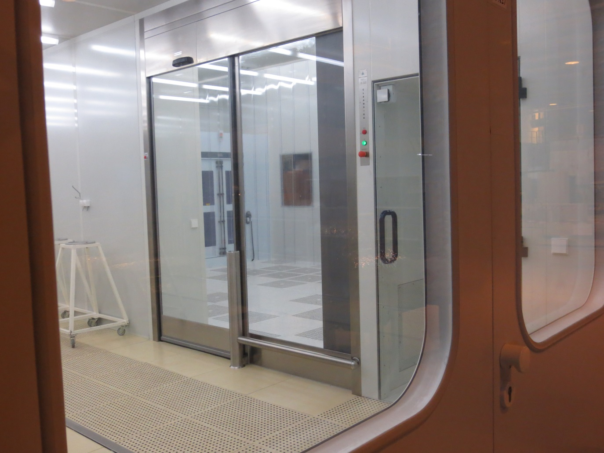
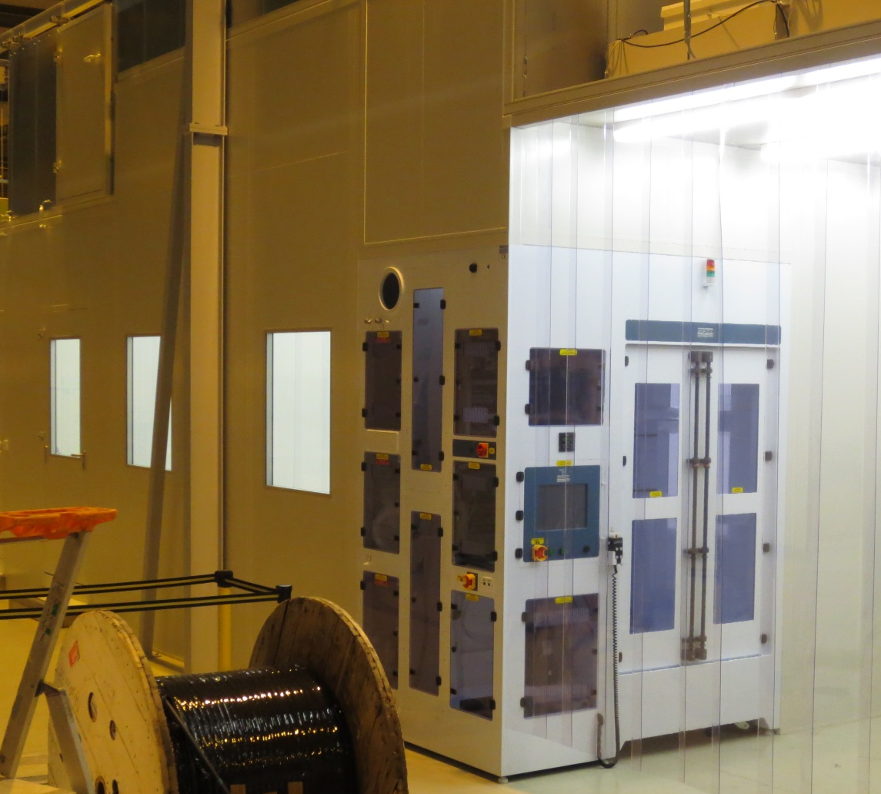
Clean Room Upgrade and Extension

Slide 5
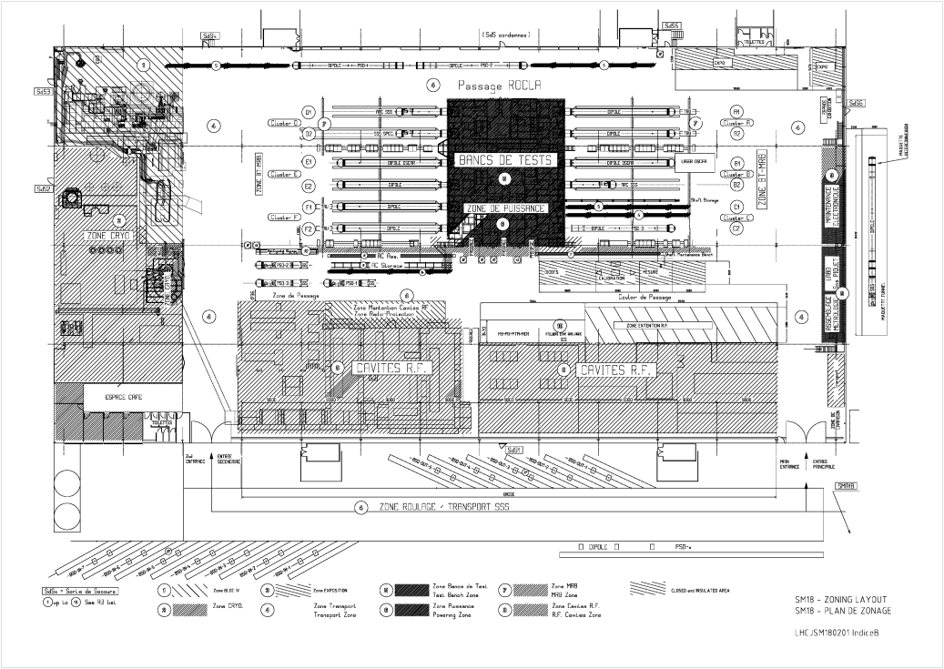
The SM18 Share of Activities

Slide 6
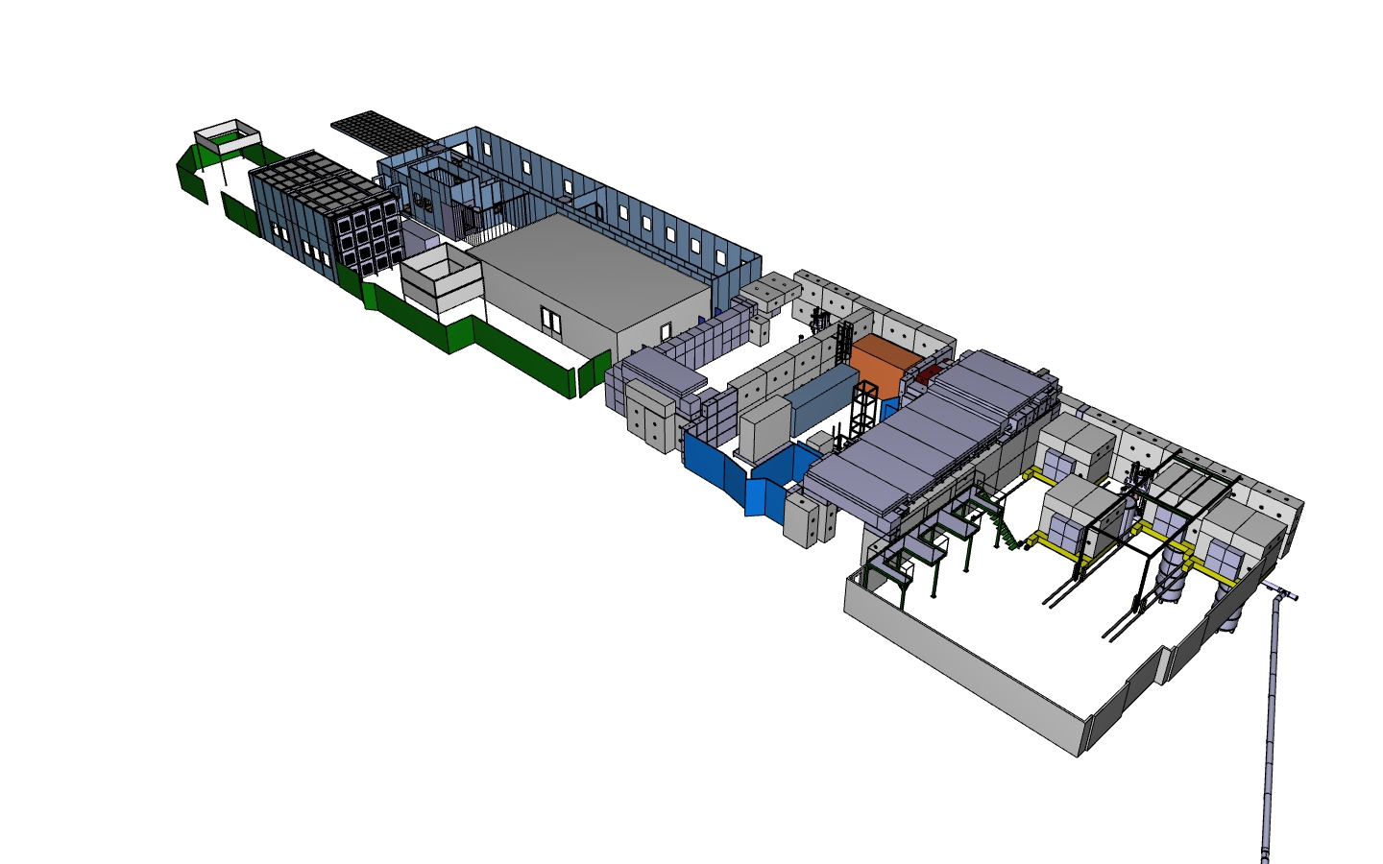
SM18 SRF New Infrastructure

Slide 7
The SRF SM18 Cryogenics Ugrade
M7
V3
V4
SM18 RF Area

Slide 8
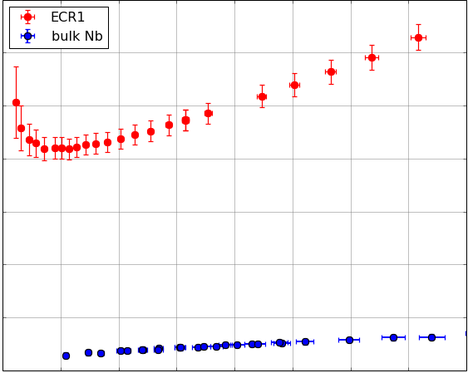
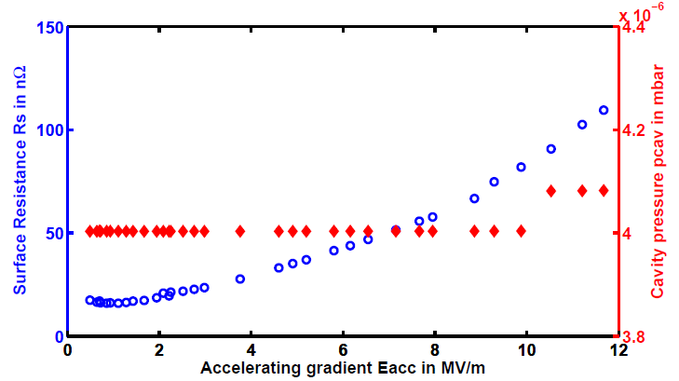
SRF Research in the Cryolab
1.3 GHz HIPIMS Cavities
Sample Testing with the
Quadrupole Resonator
High precision tests of HIPIMS cavities
Understanding, controlling and minimizing field dependent losses of Nb/Cu cavities
Effects studied:
  Low temperature baking
  Thermal cycling
  Thermal boundary resistance
140
Surface Resistance [nΩ]
20
0
40
RF Magnetic Field [mT]
Measurement of the cavity’s
inner surface temperature
RRR does not seem to be the cause of the Q-Slope of Nb Films.
Simultaneous measurement of R_{S} and pressure of helium gas introduced in the cavity as a function of E_{acc} show that global warming is not the cause for the field dependent surface resistance of Nb/Cu cavities
Cooling Rate [mK/s]
Thermal cycling has a strong impact on the R_{S.}

Slide 9
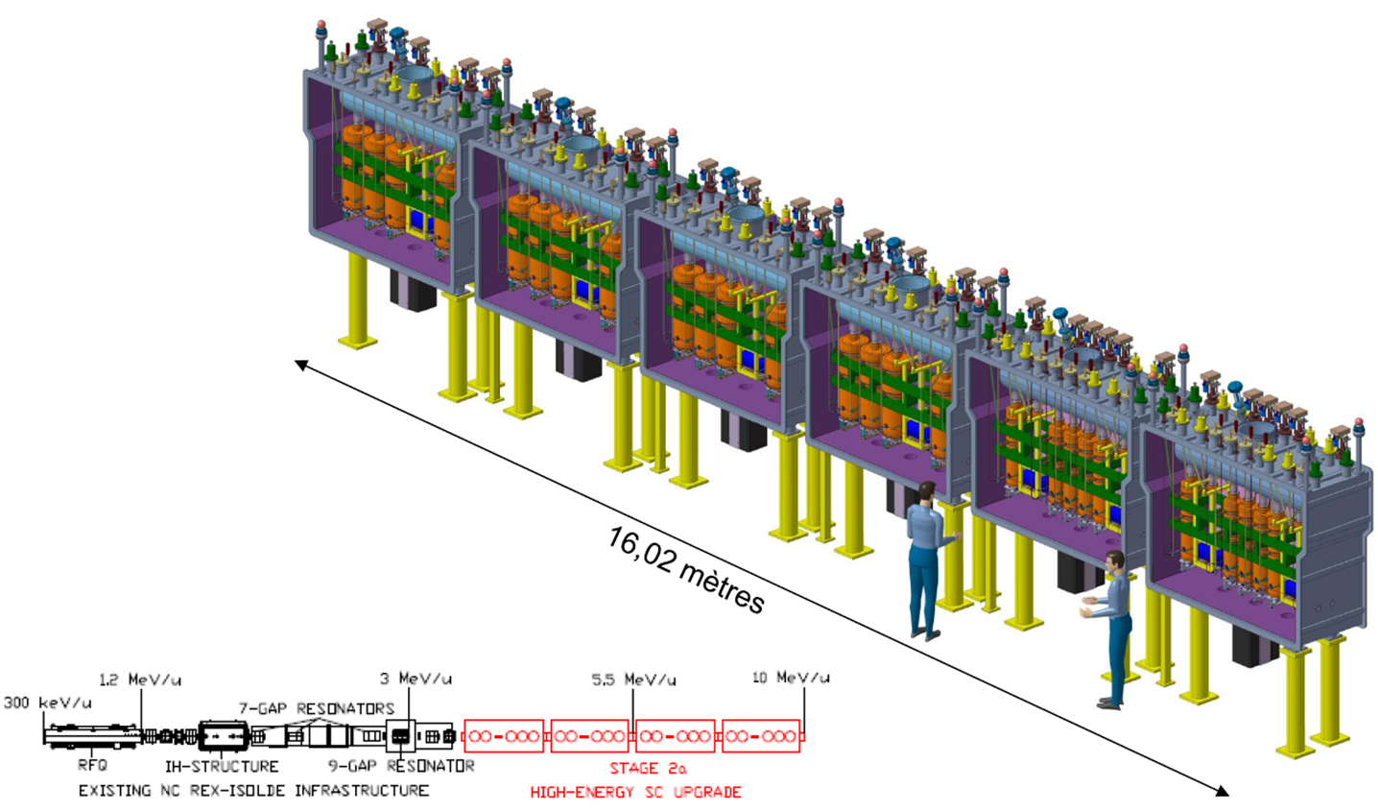
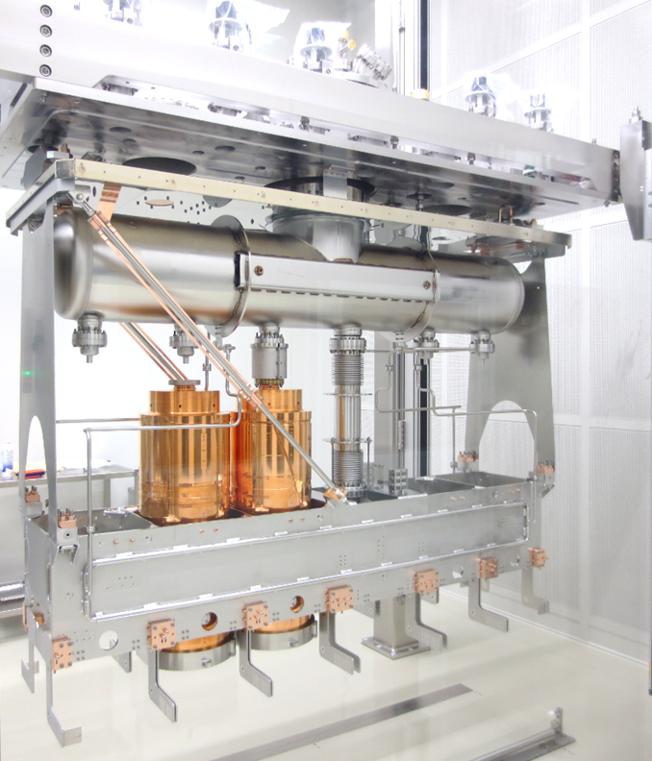
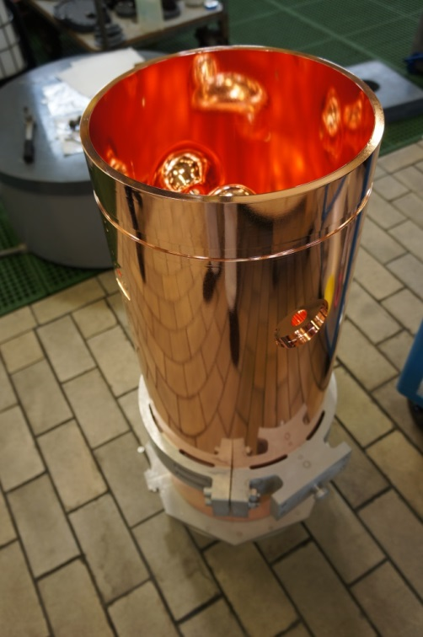
The HIE-ISOLDE Project

Slide 10
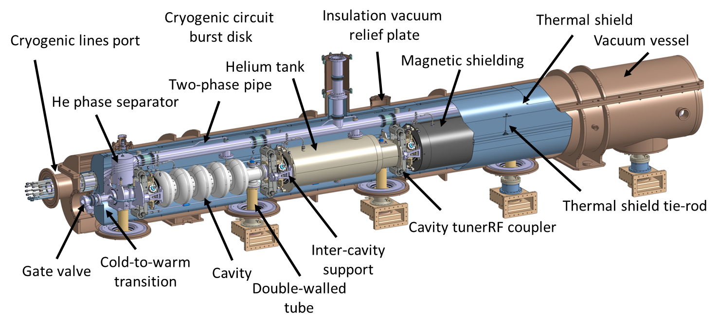
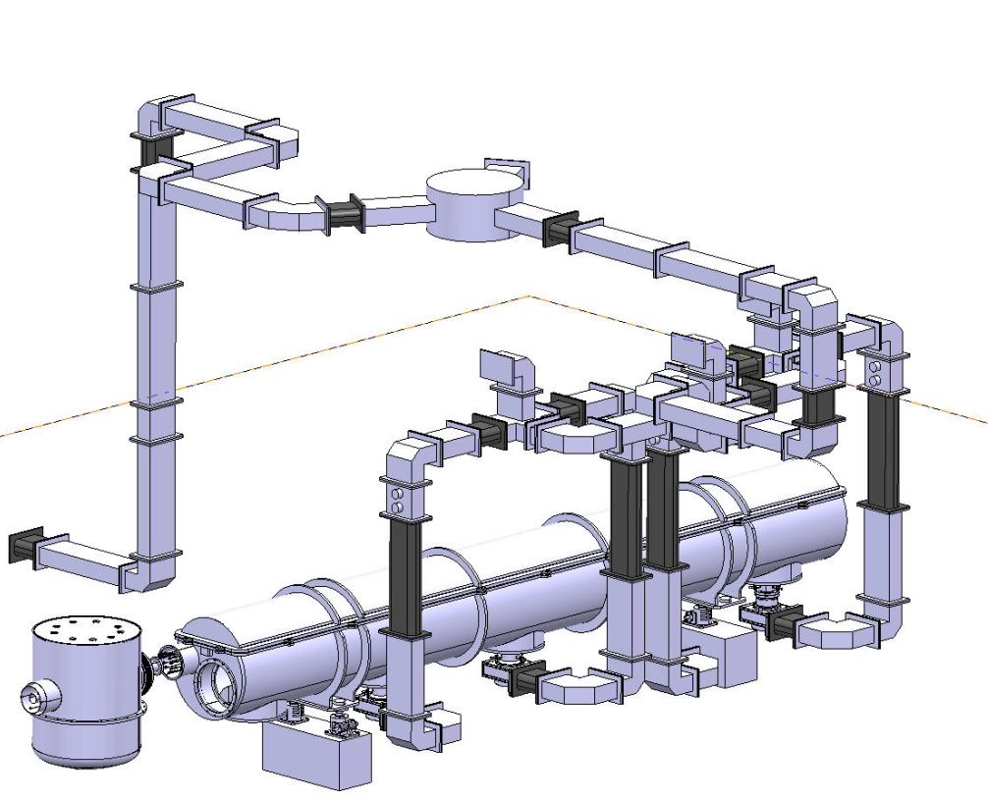
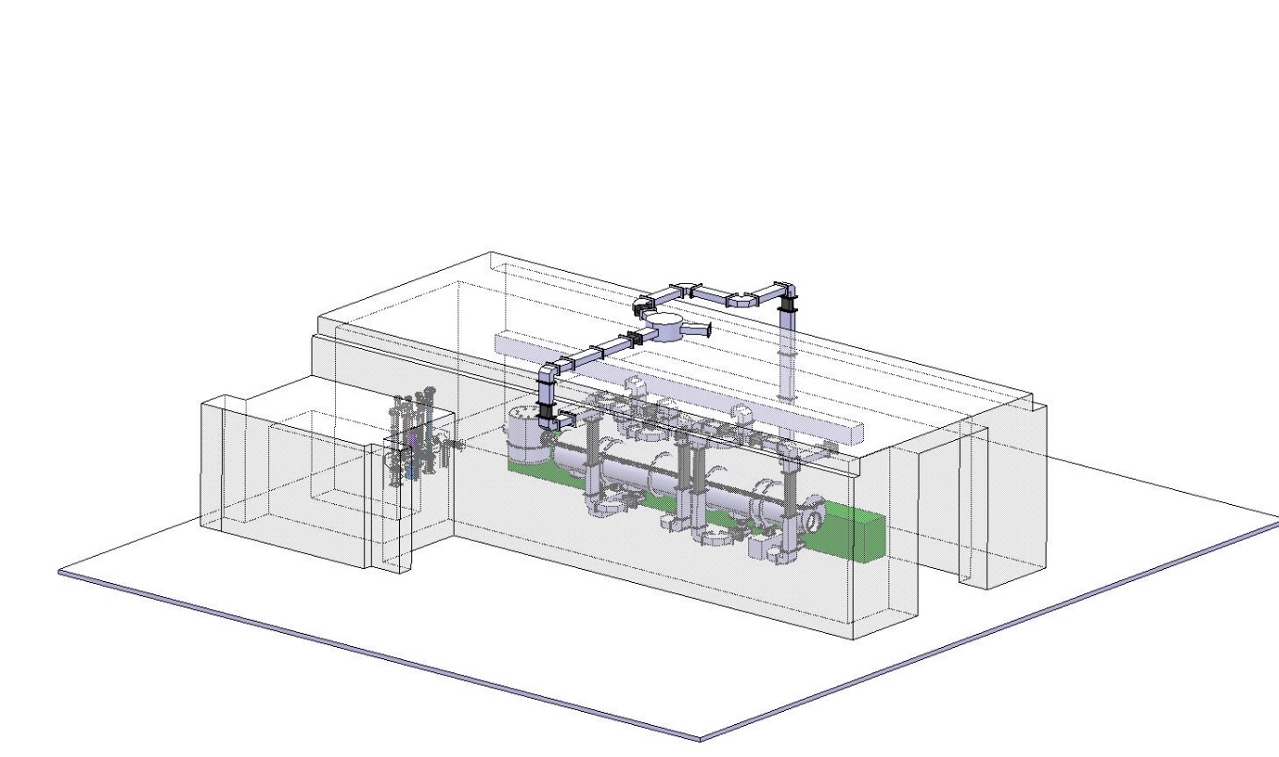
SPL 704 MHz half-module

Slide 11
High Gradient Programme: The SPL cavity testing

Slide 12
HL-LHC: SRF Crab cavities

Slide 13
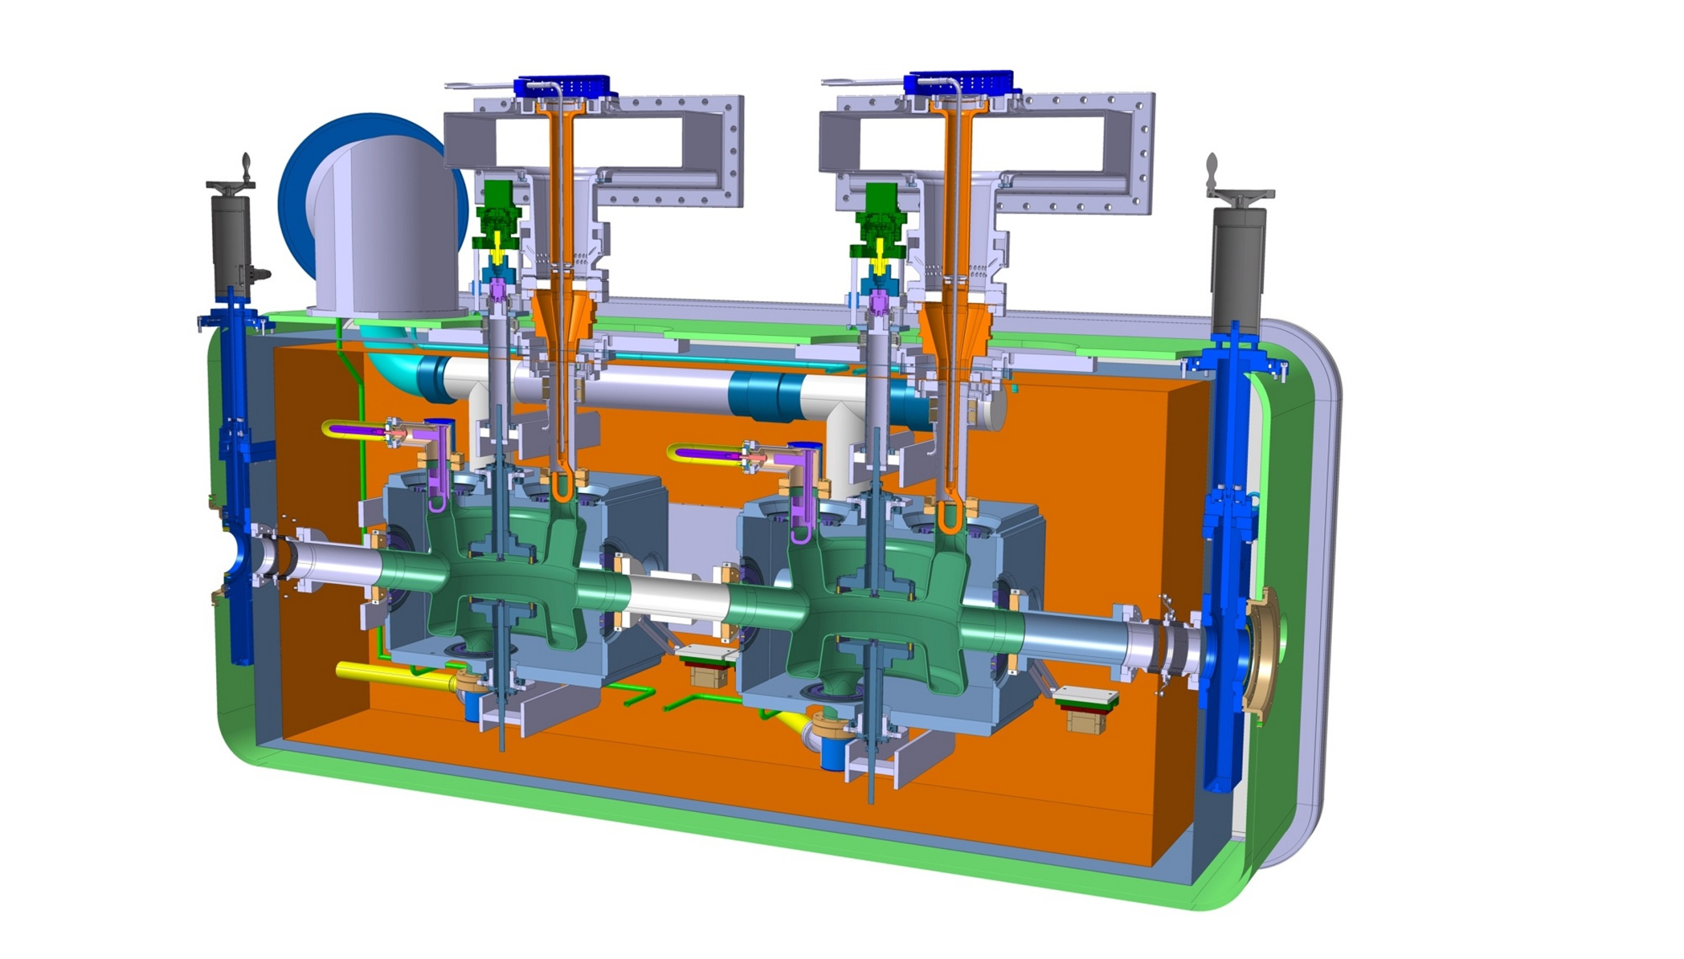
Cryomodule
Cryomodule with DQW cavities
Fundamental Power Coupler
Tuning system
Helium vessel
High Order Modes Suppressor
Thermal shielding
Cavity
Alignment monitoring system
Warm magnetic shielding
Vacuum vessel

Slide 14
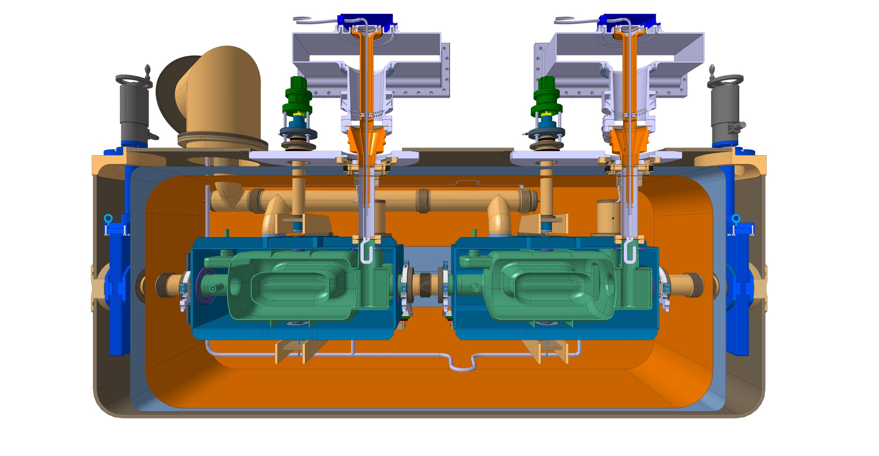
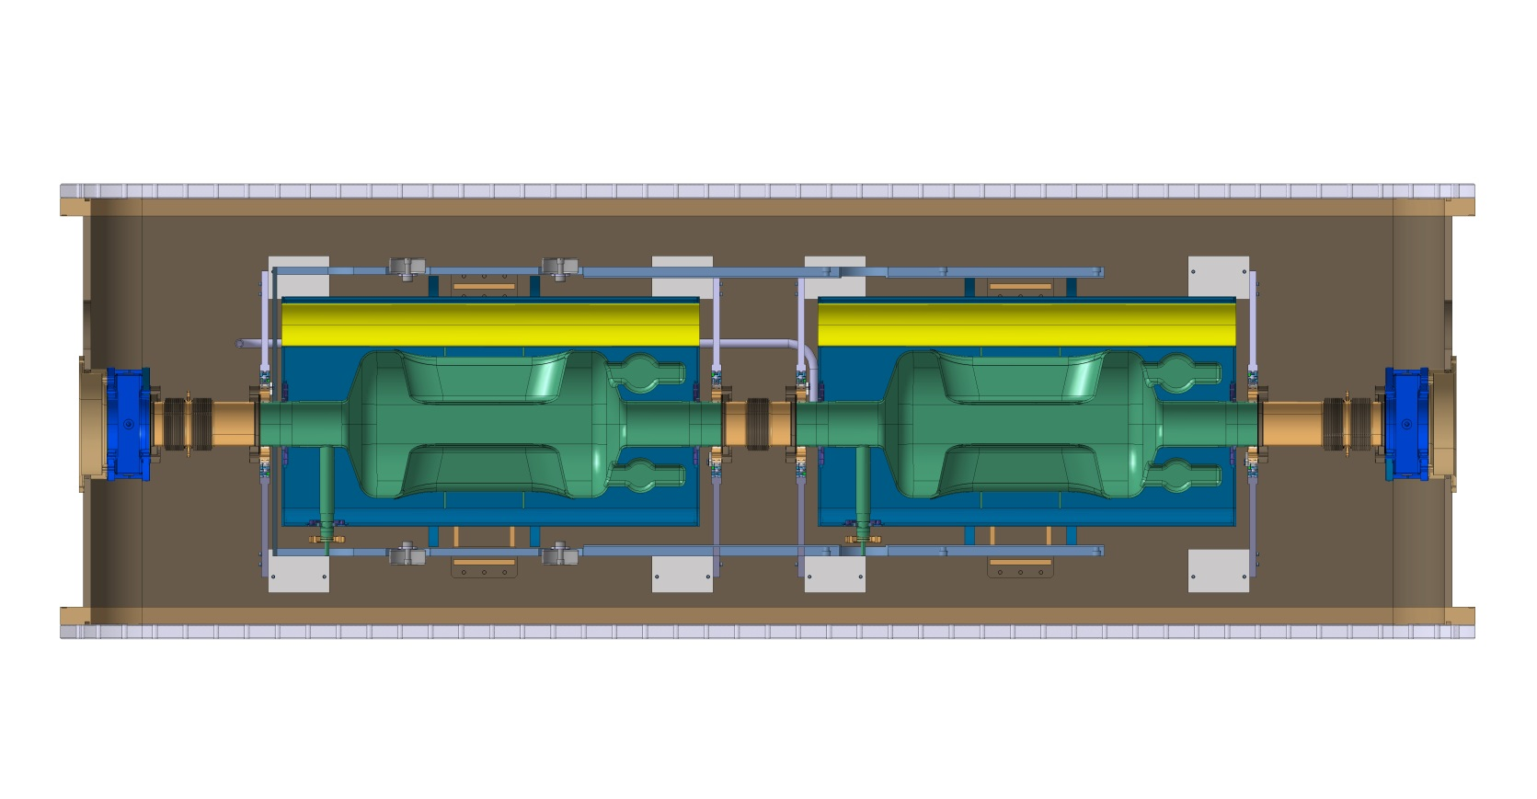
Cryomodule
Cryomodule with RFD cavities

Slide 15
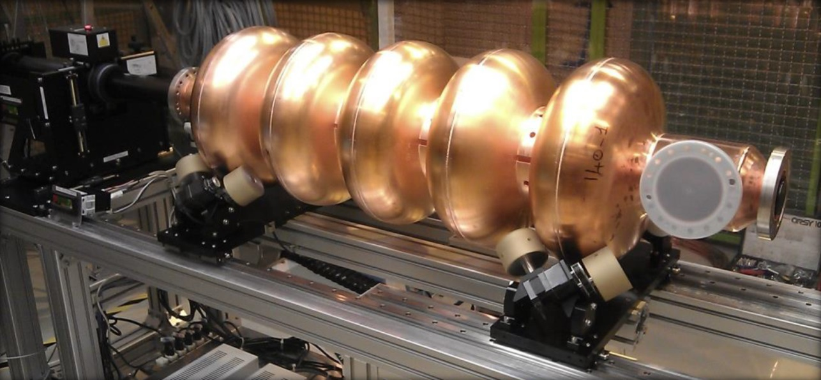
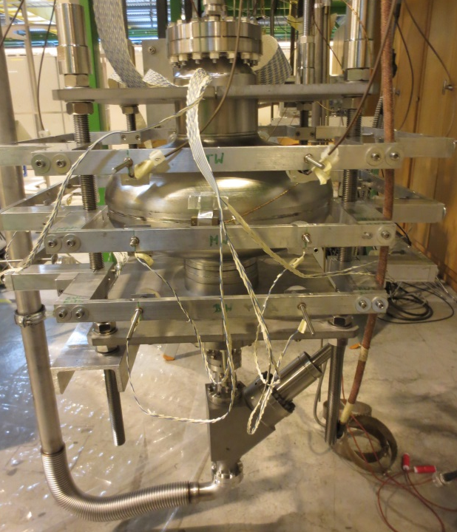
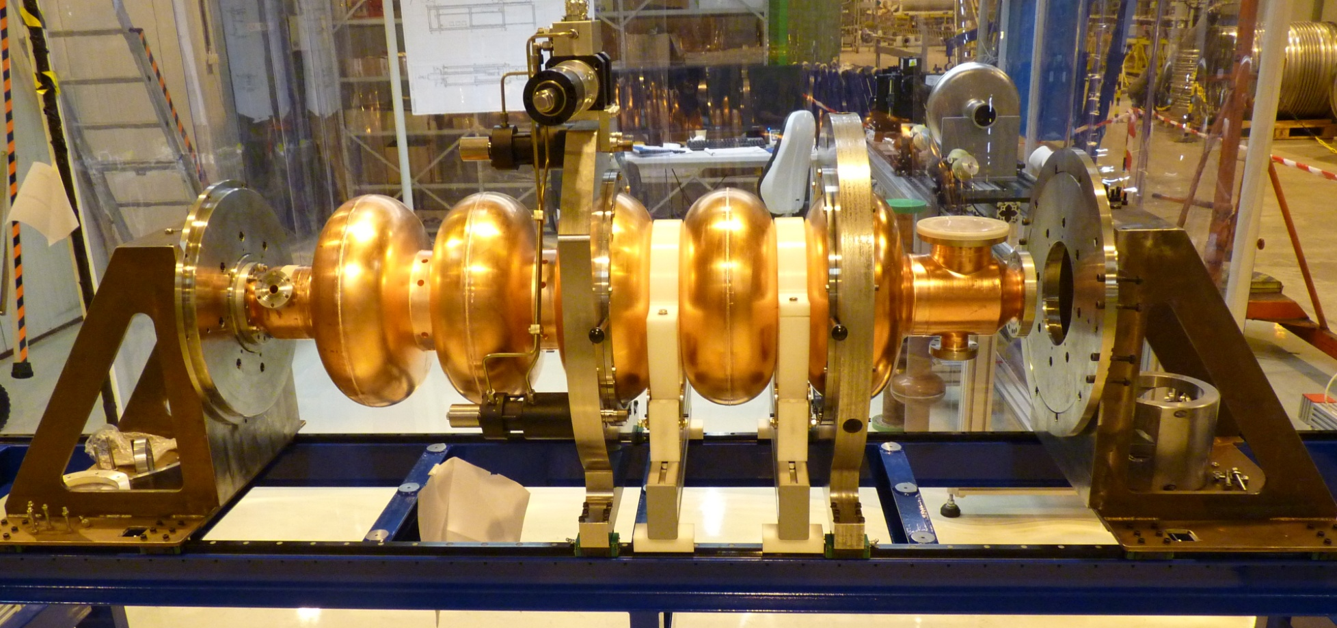
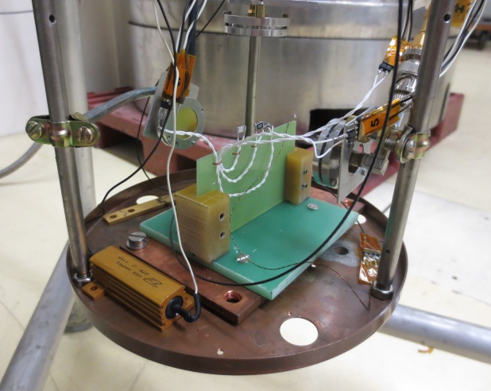
Ancillaries and Diagnostics

Slide 16
  Horizontal bunker M7
New long term decision
As M9 will be used for :
  LHC cryomodule
  HIE-ISOLDE cryomodule
  And later FCC 400 MHz project
M7 will be used for :
  SPL half cryomodule
  CRAB cryomodules
  And later new LHC 800 MHz project
  -------> Need to redesign a multipurpose cryo box !!

Slide 17
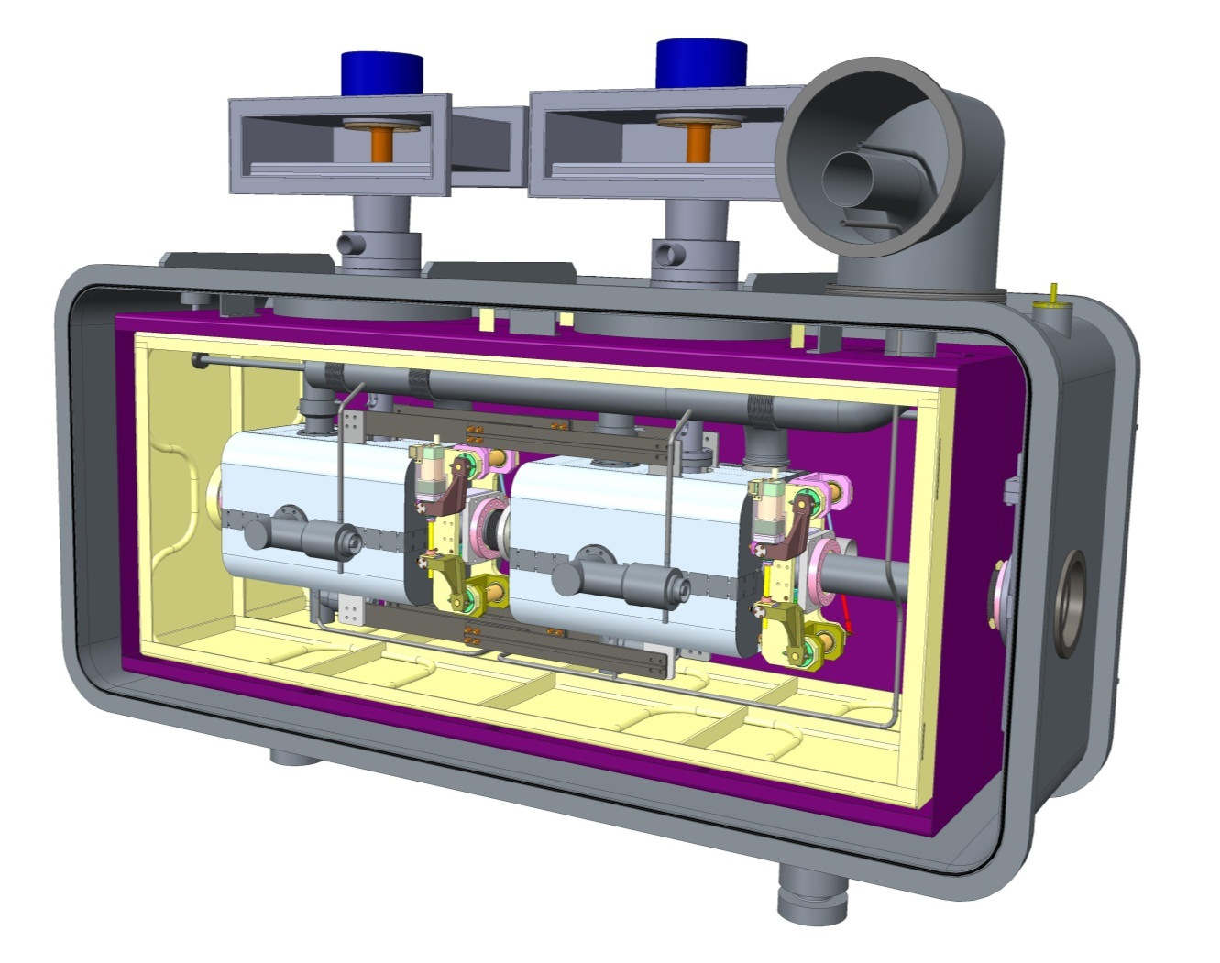
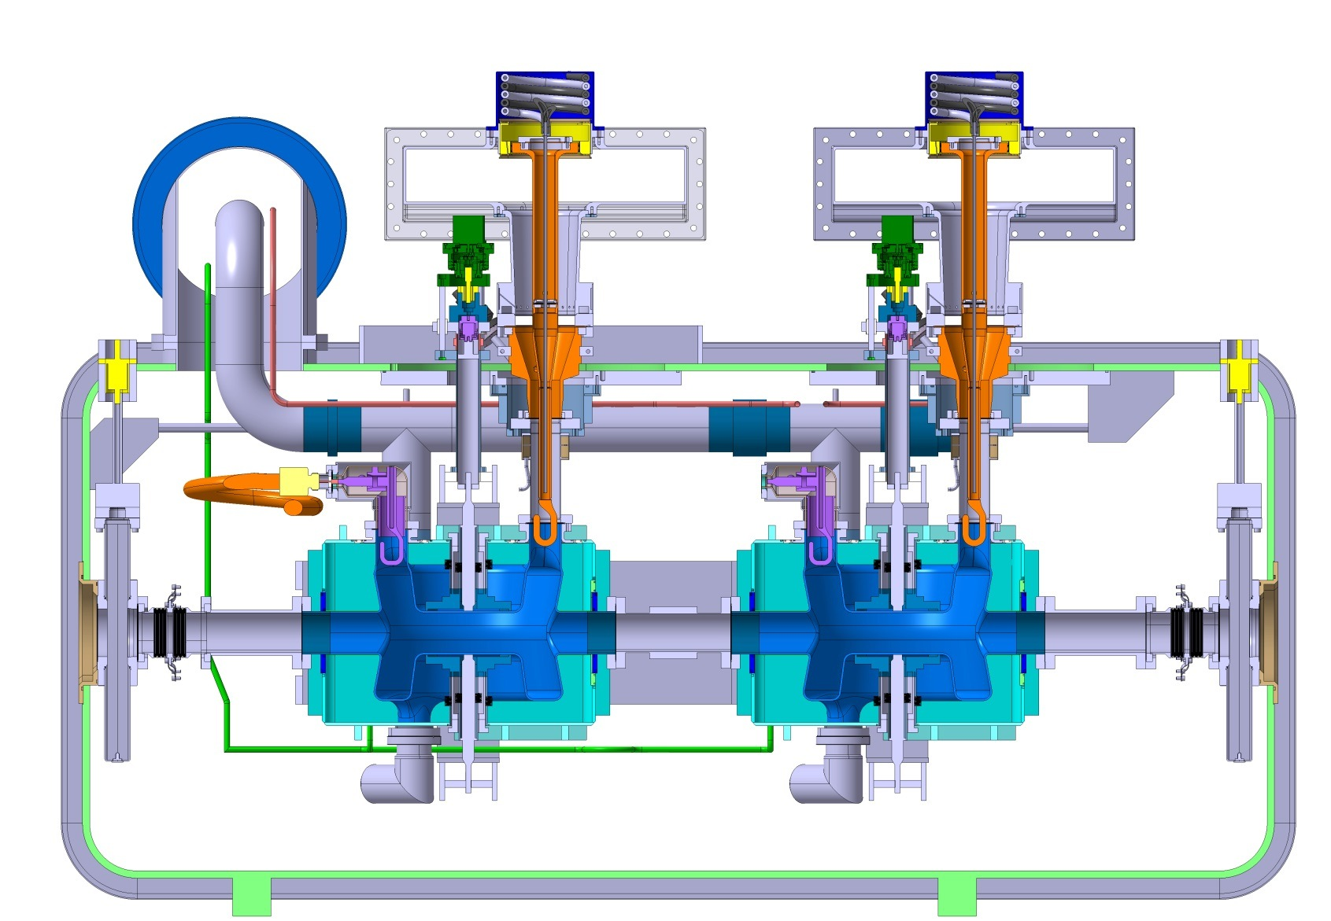
Summary: Cold Testing
Programme | Frequency (MHz) | Cavities | Units | Modules
LHC | 400 | 2 + 8 | 2 + 4 | 1 + 1
HIE-ISOLDE | 101 | 25 | 0 | 4
CRAB | 400 | ? | ? | 16 + 2 + 2
SPL | 704 | 5 + ? | 4 | 1
FCC | 800 (400) | ? | ? | ?

Slide 18
Conclusion
CERN SRF infrastructure and personnel today not sufficient for the medium term plan.
Material Budget available for partly compensation of needs.
Student and fellow requests underway for ramp-up of activities. Exchange with collaborations encouraged.
Some projects rely on In-Kind contributions from collaborations – follow-up essential.

