Slide 2
SRF thin films @ CERN
TE/VSC/SCC
Alban Sublet
23.06.2015 - CERN-LNL-STFC collaboration kickoff meeting

Slide 3
Technical challenges
→ “Thin films & new ideas for SRF” workshop LNL’14
Miguel:
  2018 end of run 2, start of LS2
  → run 2 physics results will define what’s needed for the future
  Cavities: bulk Nb not in-line with optimization, cost, raw material availability, need alternative for large scale projects (FCC)
    THIN FILM technology must be mature for 2018
    2.5 years to get to this level: get closer to bulk Nb RF-properties (Q0 + high accelerating gradients)
Erk:
  FCC: “The design study shall be organised on a world-wide international collaboration basis under the auspices of the European Committee for Future Accelerators (ECFA) and shall be available in time for the next update of the European Strategy for Particle Physics, foreseen by 2018.”
    → Must start studying now to be ready for 2035/2040

Slide 4
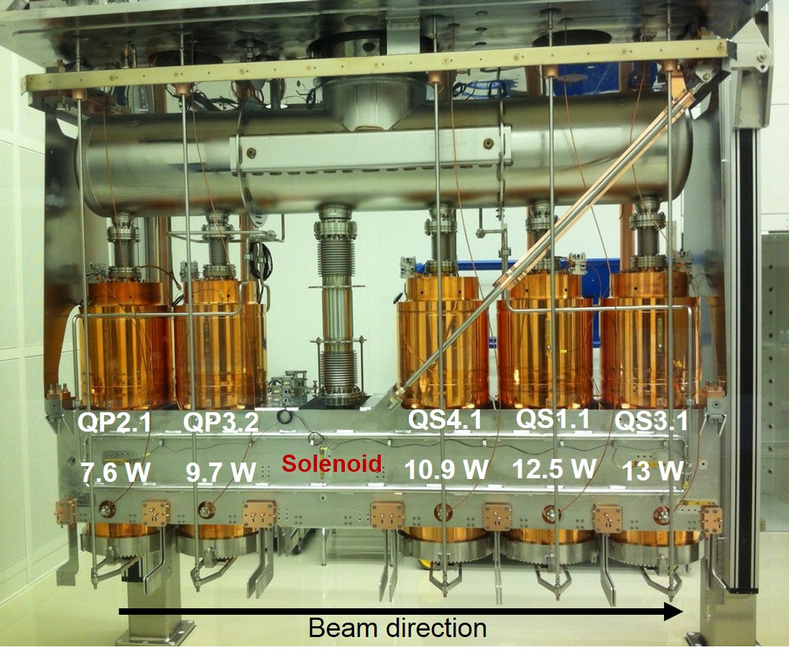
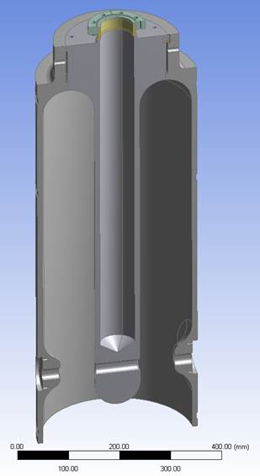
SRF thin films production activities I/II
HIE-ISOLDE QWR 100 MHz
  1 test cavity with sample holder + QPR sample
  20 “high-β” cavities (phase 1 + 2) → on going
  12 “low-β” cavities (phase 3) → to be approved
First cryomodule under commissioning
Coating of cavities for second cryomodule on the way
R&D continuing

Slide 5
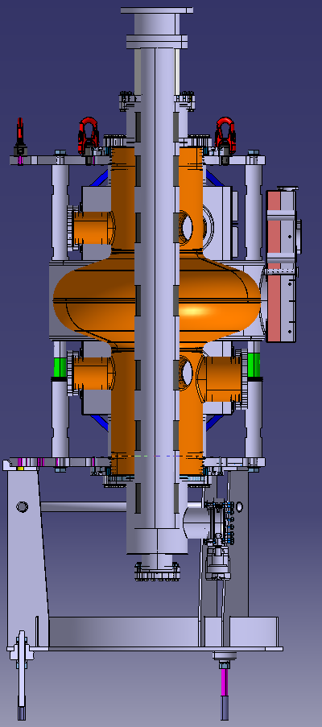
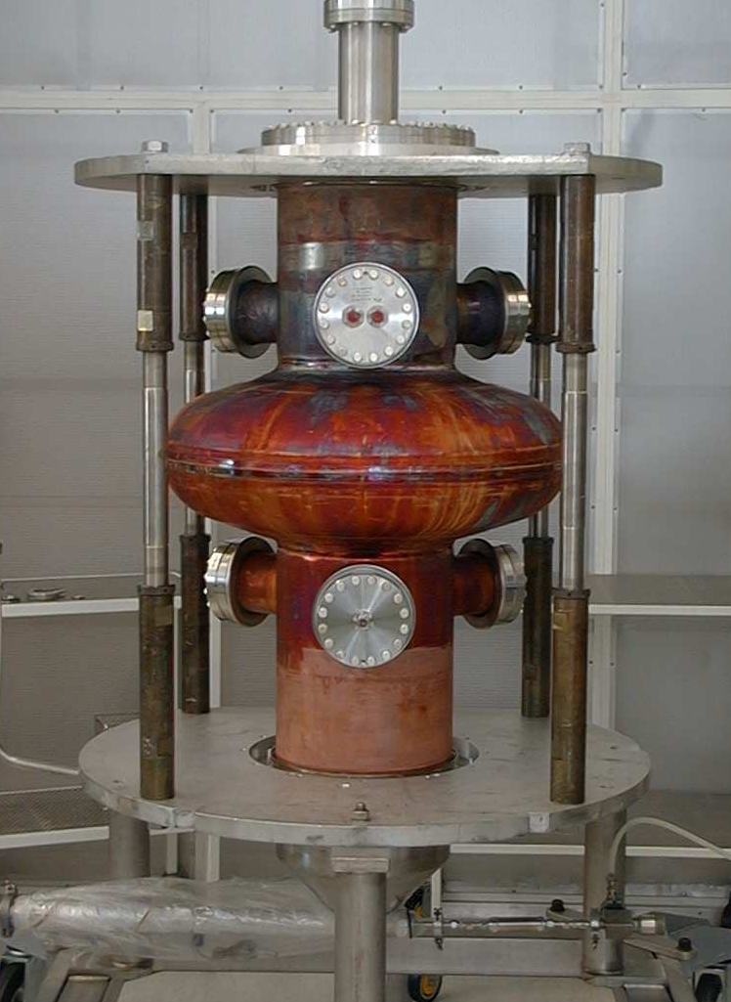
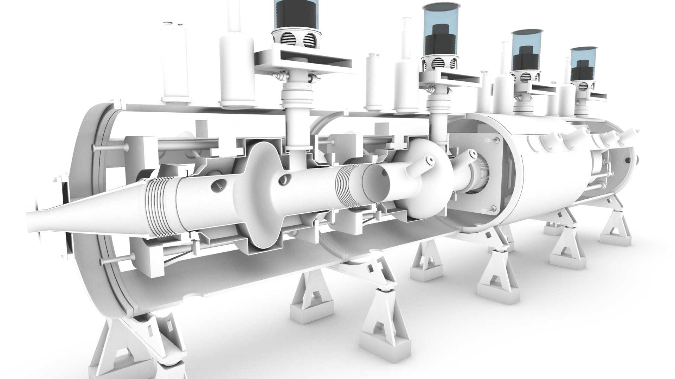
SRF thin films production activities II/II
LHC single cell 400 MHz spare cavities
  Test tube to asses coating setup
  2 prototypes → fabrication on going
  1 full cryomodule + spares

Slide 6
SRF thin films R&D: drivers I/II
HIE-ISOLDE high/low-β (100 MHz)
HL-LHC Crab Nb/Cu (400 MHz)
LHC upgrade/ERL/FCC (800 MHz)
FCC (400/800 MHz)

Slide 7
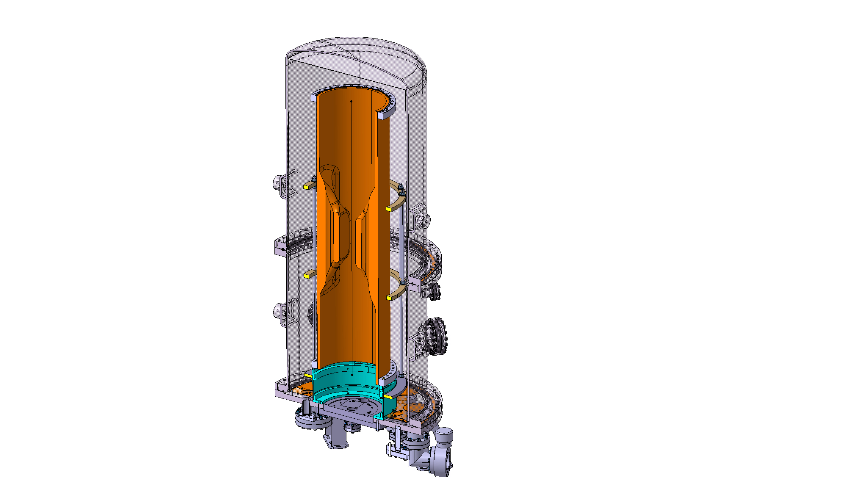
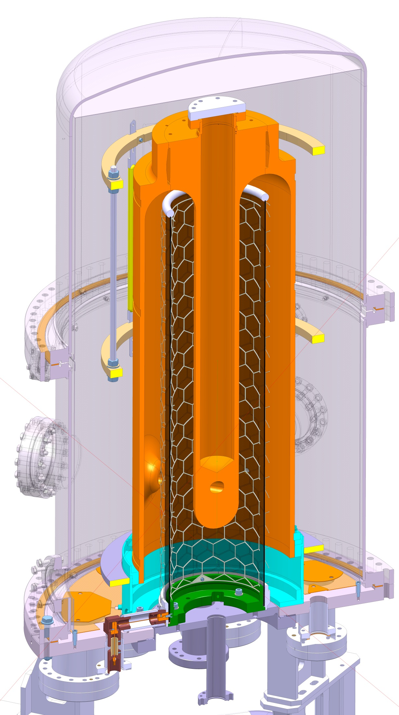
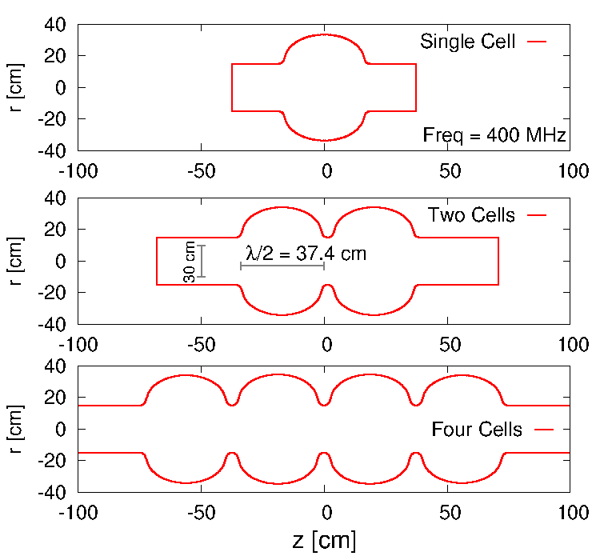
SRF thin films R&D: drivers II/II
0.9 m
1.2 m
R. Calaga
QWR (HIE-ISOLDE)
WOW Crab Nb/Cu (HL-LHC)
elliptical x-cell(s) (FCC)

Slide 8
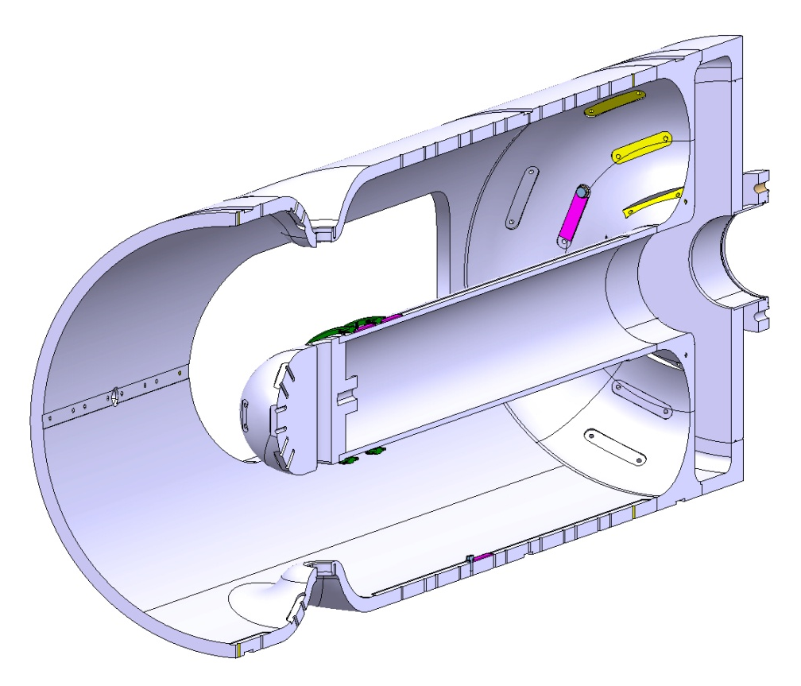
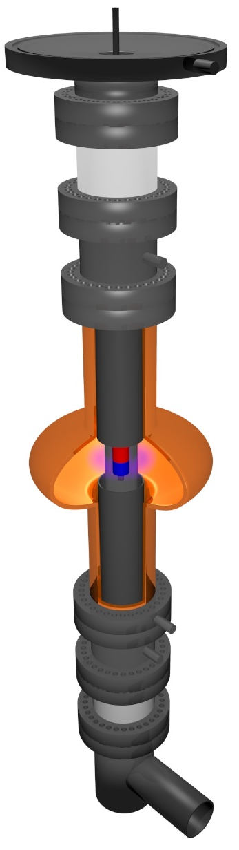
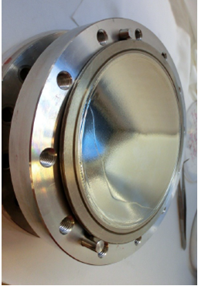
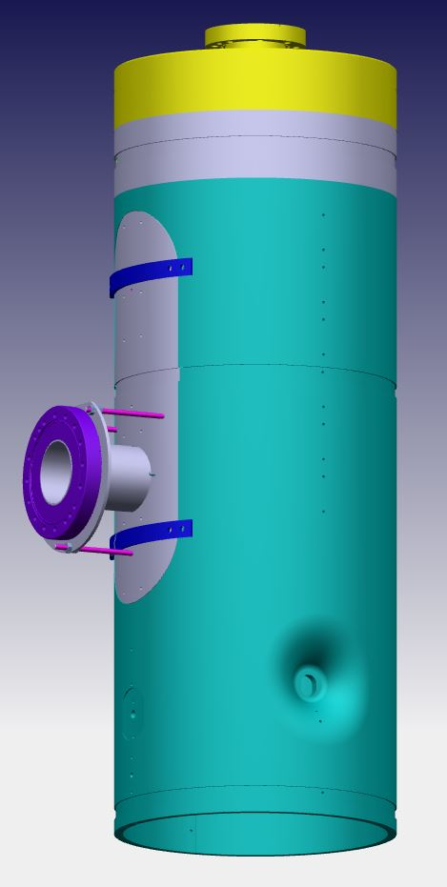
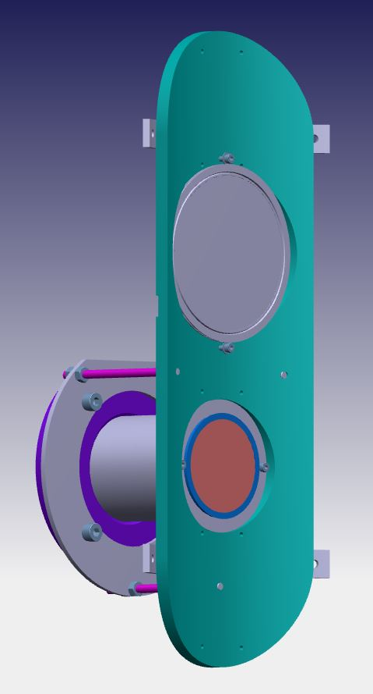
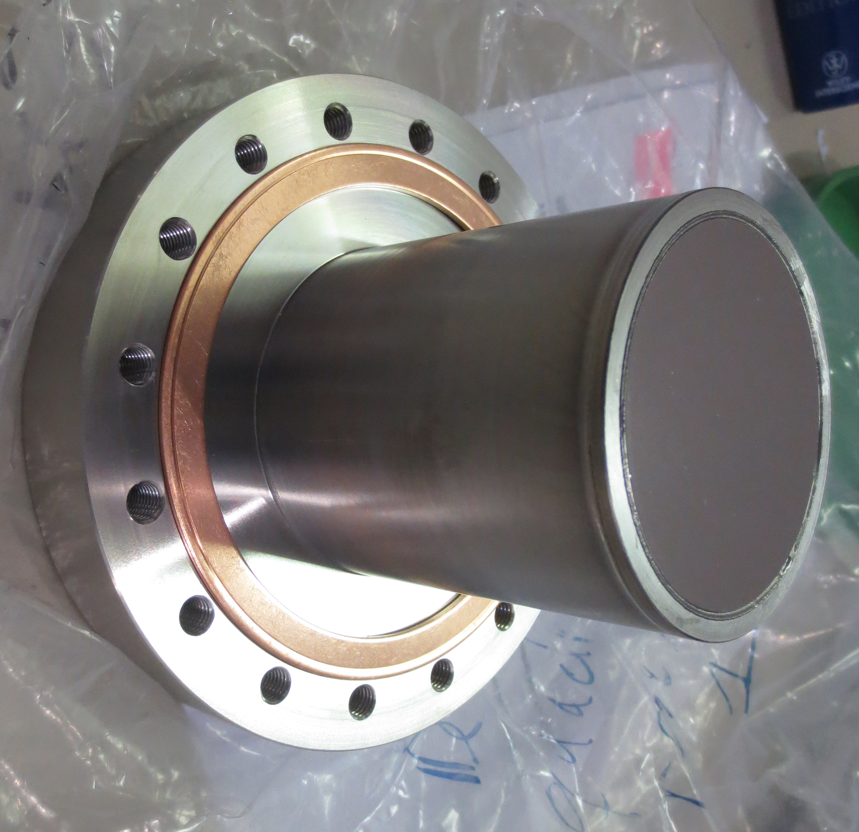
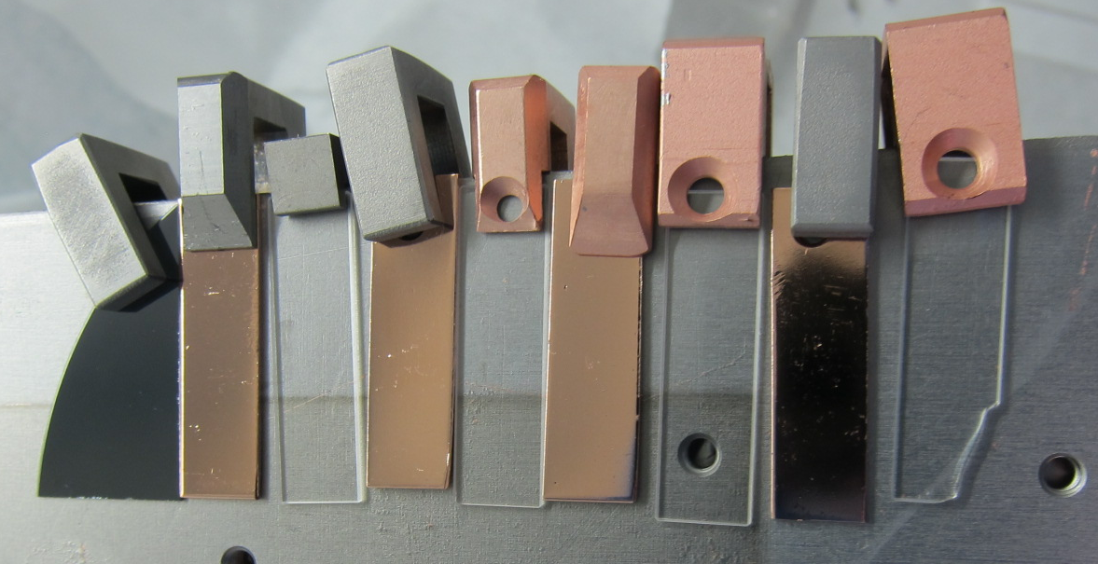
SRF thin films R&D: test substrates
126 mm
Upper anode bias connection
Orsay Cu-disk
Upper anode
400 mm
75 mm
Lower anode
Lower anode bias connection
QPR-sample
30 mm
Q4 sample cavity (HIE-ISOLDE)
elliptical 1.3 GHz
Si-wafer/quartz/Cu coupons

Slide 9
SRF thin films R&D: functionality characterization
Basic studies:
RRR on quartz sample → CERN
Point Contact Tunneling (PCT) → ANL
Muon Spin rotation (μ-SR) → PSI/TRIUMF
Third harmonic magnetometer → Saclay
RF characterization:
TE011 test cavity for Cu-disk → Orsay
RF Quadrupole Resonator test → CERN
RF test on 1.3 GHz cavity (cryolab) → CERN
RF test on cavities (SM18) → CERN

Slide 10
SRF thin films R&D: topics
Coating technics
SC Material
Material/thin film analysis
Plasma diagnostics and plasma simulation

Slide 11
SRF thin films R&D: coating technics
DC bias diode sputtering, production level
DC magnetron Sputtering, production level
HiPIMS (+bias), development level
Cathode design/shape
Biasing, grid design
Heat treatment
substrate temperature
Nitrogen treatments

Slide 12
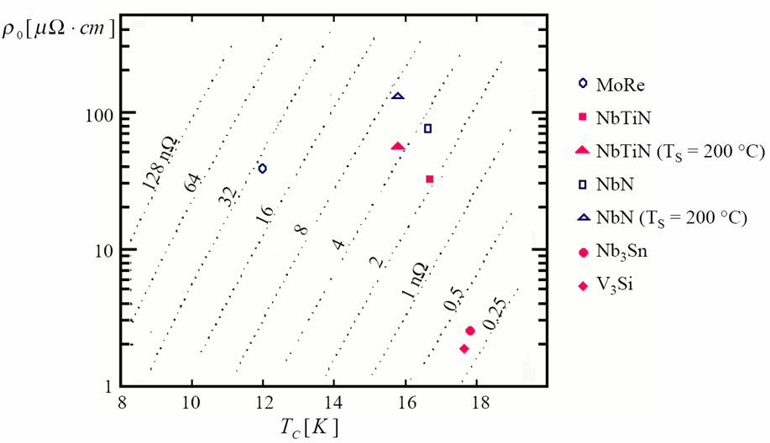
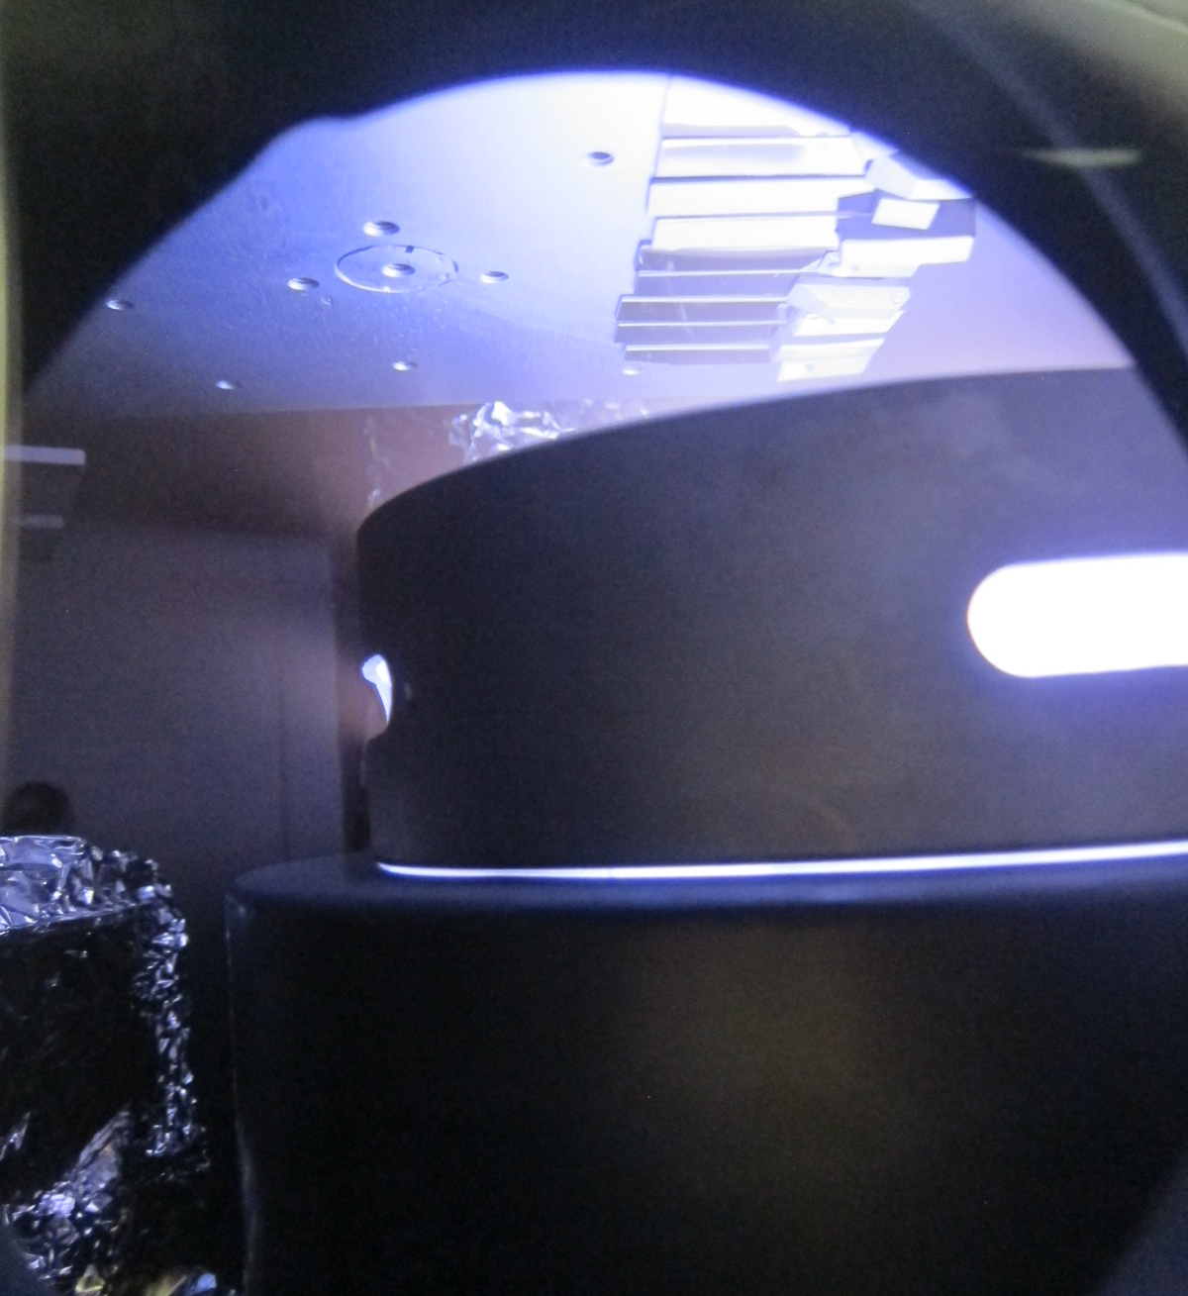
SRF thin films R&D: SC material
Niobium
A15 compounds: Nb3Sn (and V3Si)
BCS surface resistance at 4.2 K
and 500 MHz for films ( Nb ~ 45 nΩ)
Planar magnetron Nb3Sn target sputtering

Slide 13
SRF thin films R&D: material/thin film analysis
XRF, XPS, XRD (CERN), SIMS, …
SEM/EDS – FIB/SEM, STEM/TEM (CERN/EPFL)
HIE-ISOLDE
Q4 sample from middle antenna
Nb/Cu, 14 runs coating
Courtesy B. Bartova and EPFL-CIME

Slide 14
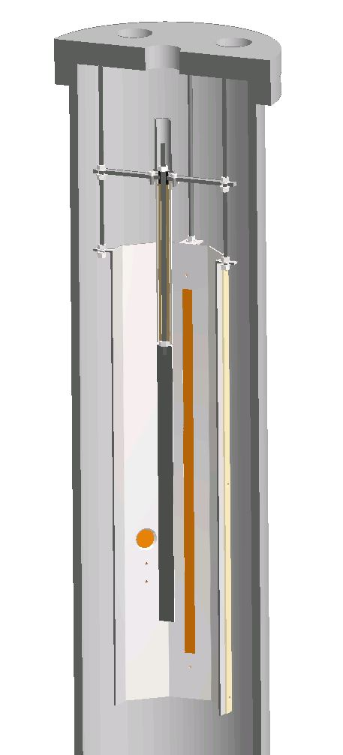
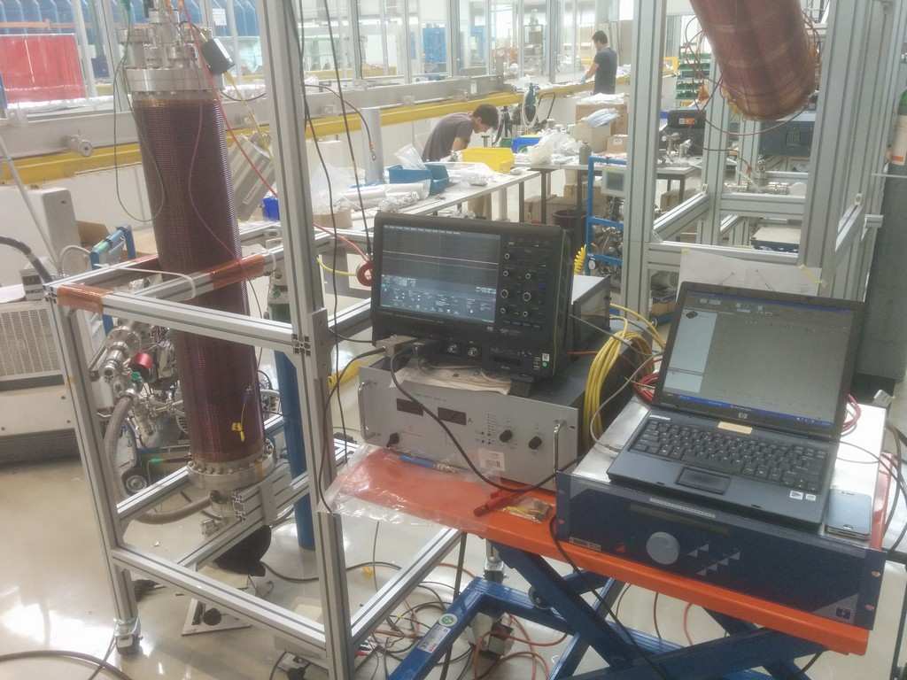
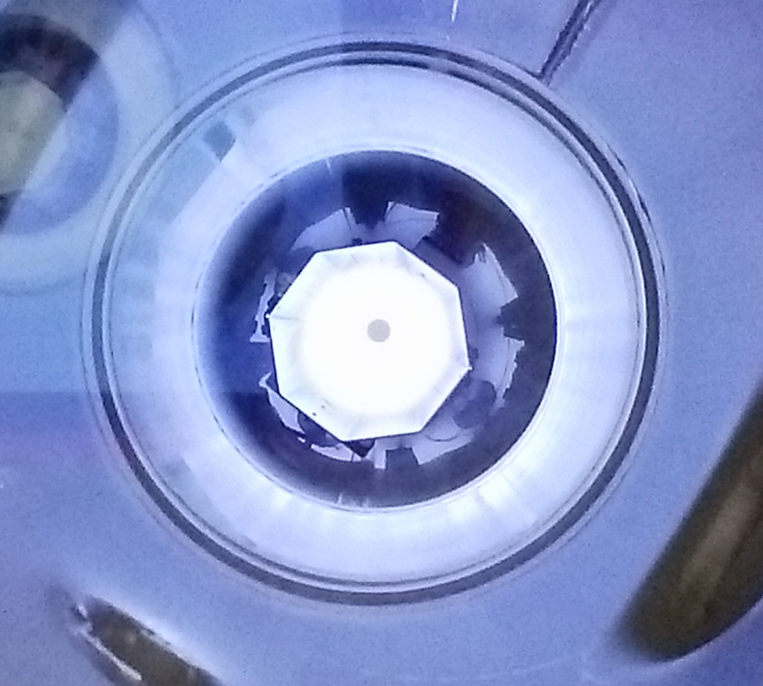
SRF thin films R&D topics: plasma diagnostics
UHV vacuum chamber
Plasma test bench
anode tube (+bias)
Nb cathode
DC bias diode
DCMS
(HIPIMS)
diagnostic port:
RFA, Qz-balance
  current/voltage probes
  Retarding Field Analyzer (RFA)
  Quartz balance
  OES
  Langmuir probe
Cu strip for thickness profile
400 mm height
Bottom view of plasma

Slide 15
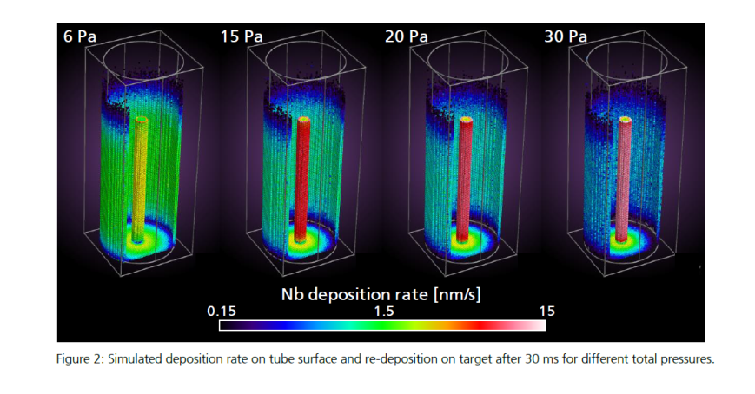
SRF thin films R&D: plasma simulation
DSMC/PIC-MC code
P = 0.32 mbar (diode discharge)
Constant wall temperature
Initial charged particles density = 10¹³ m⁻³
Power = 10 W
Maximum voltage = 1000 V
benchmarking with plasma test bench

Slide 16
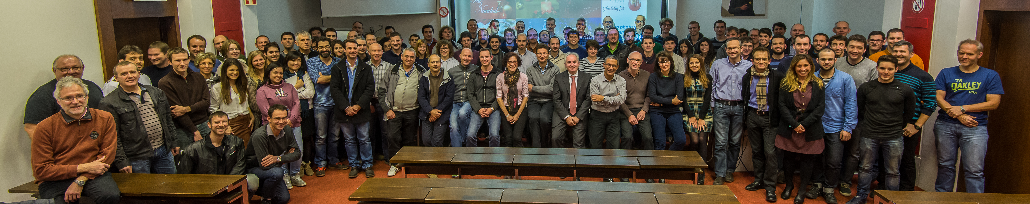
Thank you for your attention
TE-VSC group

Slide 18
SRF thin films R&D topics
Focus on:
Coating technics
  DC-bias diode
  DCMS + bias
  HiPIMS + bias
  New energetic deposition source?
SC Material → Nb, Nb3Sn, V3Si
Material analysis (ex-situ)
  SEM, FIB/SEM, XRD, XPS, etc.
Plasma diagnostics (in-situ)
  current/voltage probes
  Retarding Field Analyzer (RFA)
  Quartz balance
  OES
  Langmuir probe
Plasma simulation → Fraunhofer IST DSMC/PIC-MC simulation SW

Slide 19
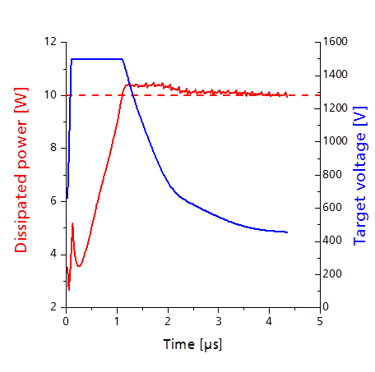
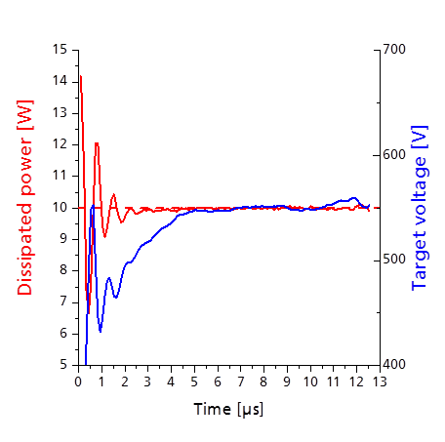
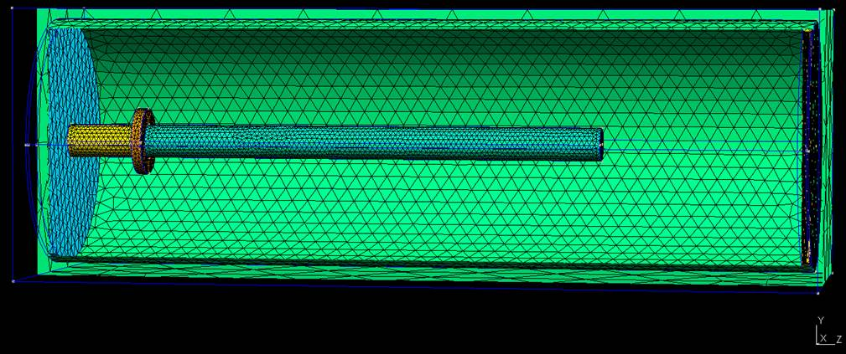
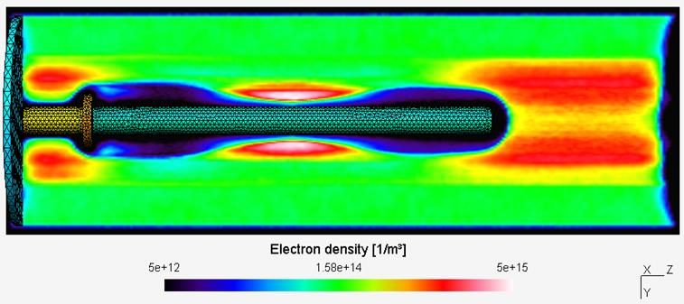
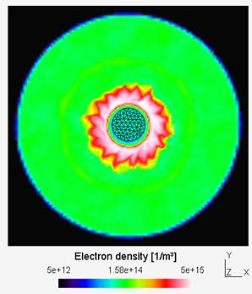
SRF thin films R&D topics
Plasma simulation: DSMC/PIC-MC code

