Slide 1
Distributed Computing in Norway –
Software and middleware
Jon Kerr Nilsen, Oslo, NO, 2 Oct 2015
RECFA open session

Slide 2
Norwegian Grid Team
Farid Ould-Saada, UiO/phys.dept. – NorduGrid coord, ATLAS ICB, Nordic LCG
David Cameron, UiO/phys.dept. - ATLAS DC lead, aCT, ATLAS@HOME, ARC developer
Vincent Garonne, UiO/phys.dept. – DDM, Rucio developer and coordinator (ATLAS-funded)
Cedric Serfon, UiO/phys.dept. – DDM, Rucio developer (Atlas-funded)
Silje Raddum, UiO/phys.dept. - PhD student, ARC developer
Dmytro Karpenko, UiO/NeIC – Nordic T1 operator, ARC debugger
Jon Kerr Nilsen, UiO/NeIC - aCT, ARC release manager, ARC developer
Håvard Helstrup, HiB – Research, Nordic LCG
Boris Wagner, UiB – Nordic T1 operations, research
Saerda Halifu, UiB – Nordic T1 operations
et al.

Slide 3
The Full Chain
ATLAS Nordic T1 operations
ALICE Nordic T1 operations
Advanced Resource Connector (ARC) Distributed Computing middleware
Rucio – Distributed Data Management
ARC Control Tower (aCT) – connecting ATLAS with ARC
ATLAS software

Slide 4
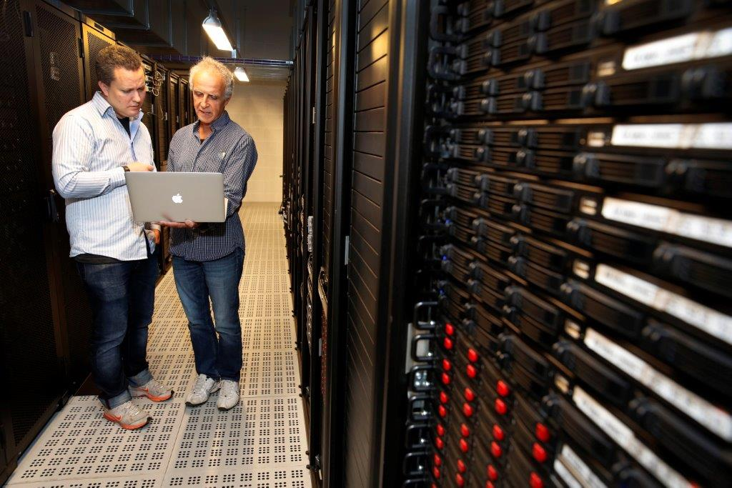
Computing infrastructure
Two sites
  ALICE: fimm.bccs.uib.no in Bergen
  ATLAS: grid.uio.no in Oslo
Nordic T1 pledges
  9% of total ALICE resources, 6% of total ATLAS resources
  Of which Norway should contribute ~50% for ALICE, ~25% for ATLAS

Slide 5
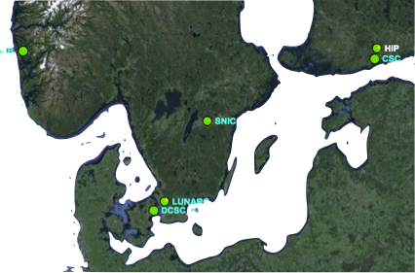
Norwegian ALICE Tier-1
The ALICE Tier-1 is part of the IT department of the University of Bergen (UiB).
Resources provided:
CPU: 704 cores
Disk: 1 PB
Tape: 200 TB
The storage resources are provided
via Nordic T1 with the dCache middleware.
Grid jobs come directly from CERN through the ALICE Grid middleware (ALiEn)
ALICE View of NDGF
UiB

Slide 6
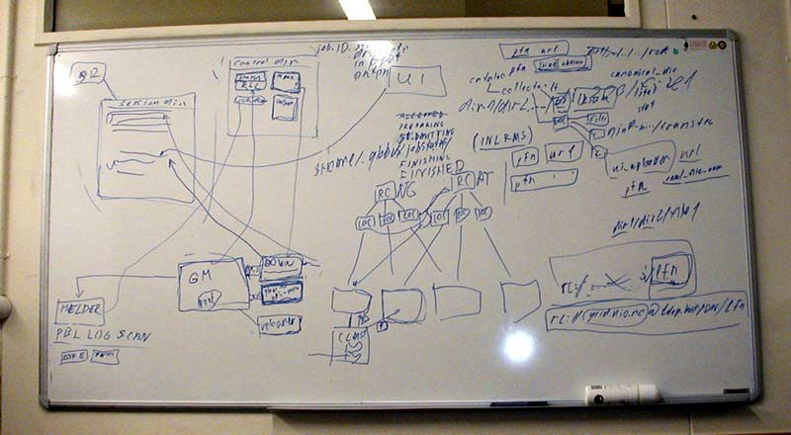
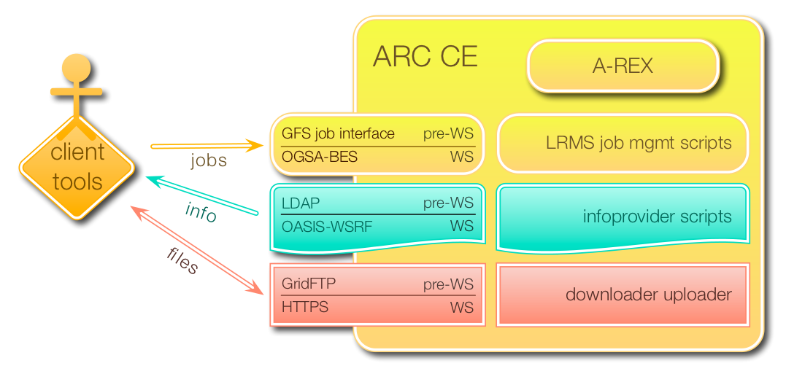

ARC Achievements and Highlights
2001- 2002
  “Transverse momentum distribution” of pre-LHC data simulated on HPC resources …
2012 - 2013
  Higgs discovery, Nobel prize
2015 - …
  13 TeV collisions, Dark Matter?

Slide 7
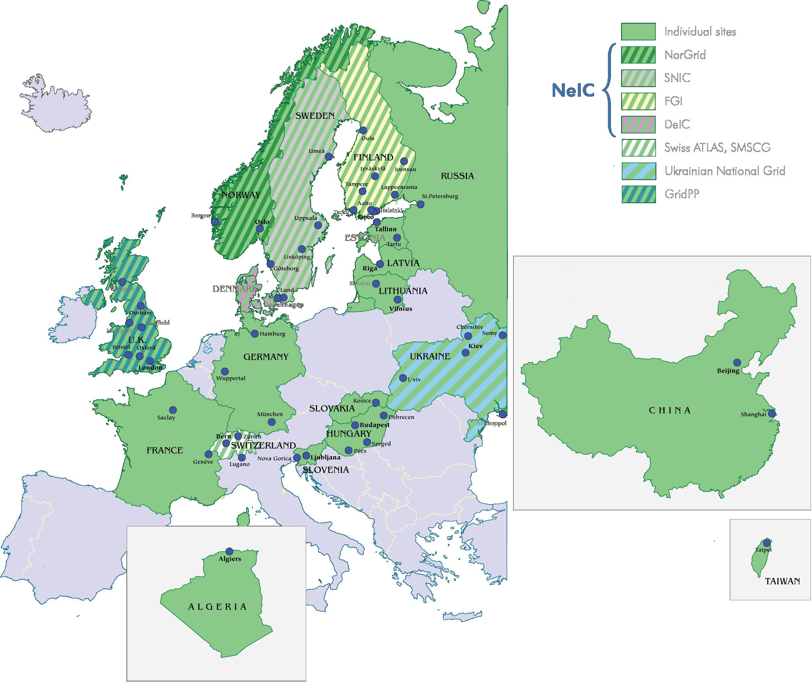
ARC Deployment Map
ARC spreads …

Slide 8
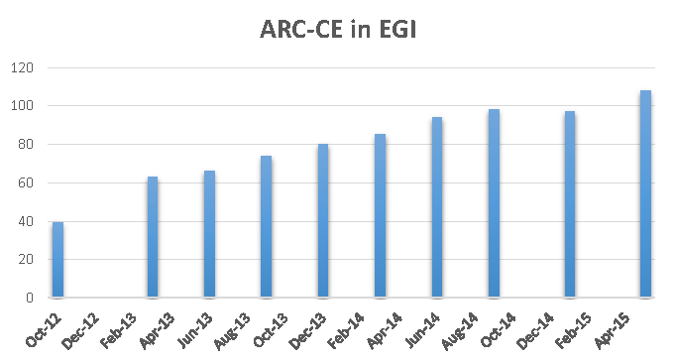
ARC CE in EGI
Some trend …
  # ARC CE services in EGI database – GOCDB
ARC CE at CERN
  2 ARC-CEs and HTCondor attached to it
  Production jobs expected soon
  2 ARC CEs for BOINC

Slide 9
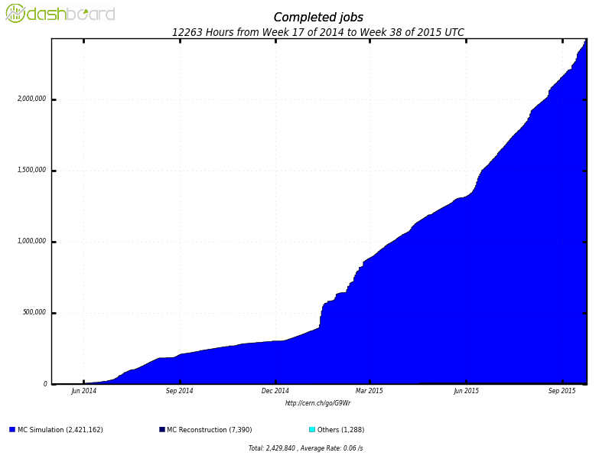
ARC and Volunteer resources
ATLAS@home
ARC and ARC Control Tower (aCT) as gateway between ATLAS job management system and BOINC – software used to distribute jobs to volunteers
Equivalent to a large Tier-2 centre
2.5M completed jobs so far

Slide 10
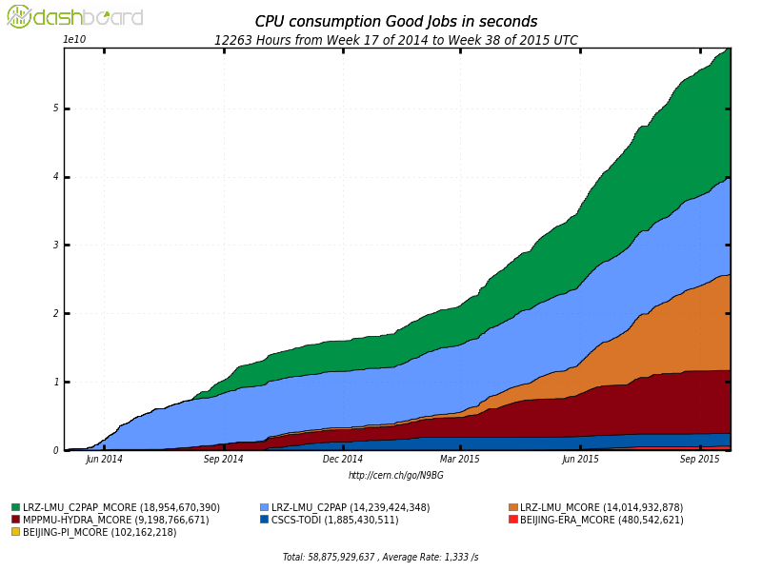
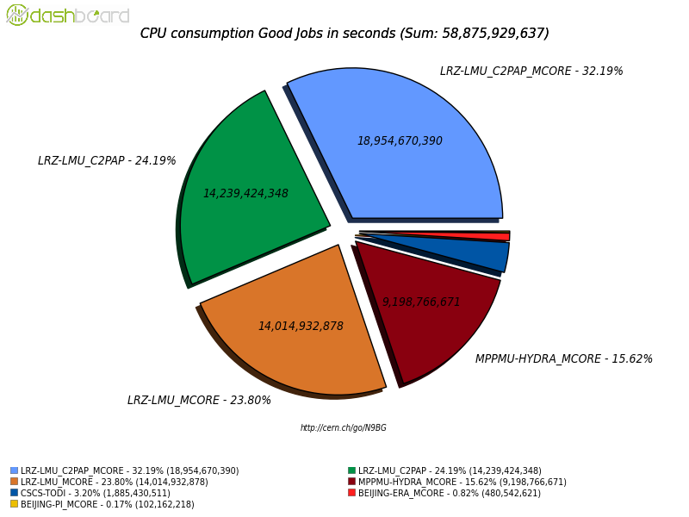
ARC back to HPCs
LRZ-LMU-C2PAP MC, DE
MPPMU-HYDRA MC, DE
LRZ-LMU-C2PAP, DE
LRZ-LMU MC, DE
CSCS-TODI, CH
BEIJING-PI, Shanghai China
BEIJING-ERA, Chinese HPC “grid”

Slide 11
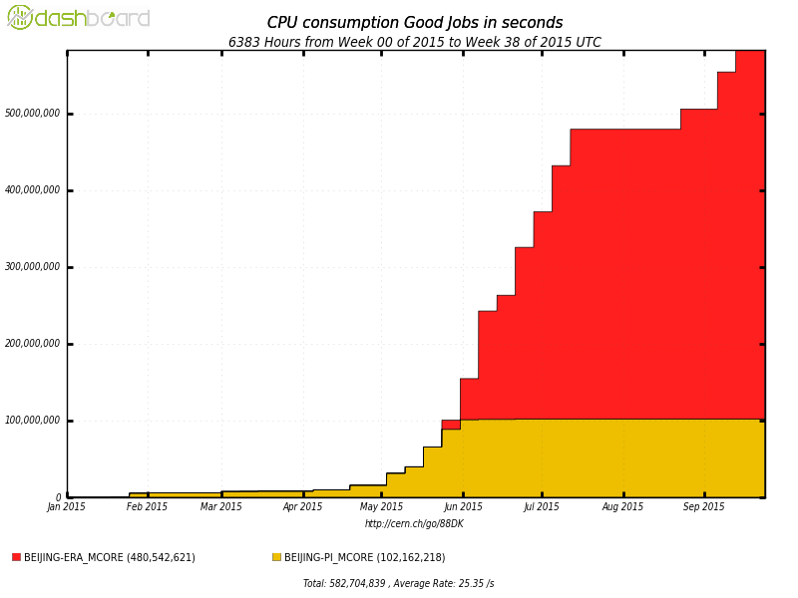
ATLAS+ARC in China
Remote ARC CE
New Python backend
David Cameron, Andrej Filipcic, Jon Kerr Nilsen, Silje Raddum (as ATLAS qual. task), Caoron Quiang, Xiao Haili
“the interface between Arc-CE and
the Chinese HPC grid won one of
The 4 HPC awards from the Chinese
Academy of Science (CAS)”
Two systems:
Pi – CE in Beijing, jobs through ssh to Shanghai
ERA – CE in Beijing connects to Chinese HPC Grid

Slide 12
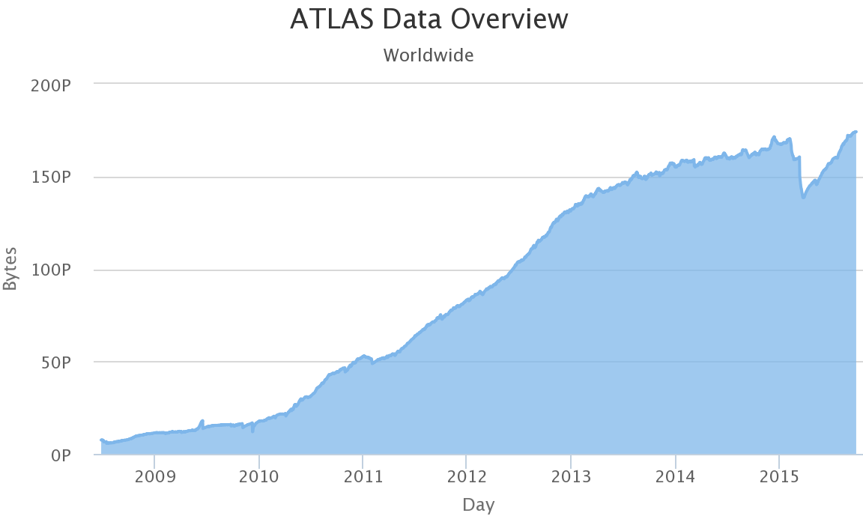
The ATLAS Distributed Data Management
The Distributed Data Management project manages ATLAS data on the grid
The Rucio Software project
  new major version to ensure
    system scalability
    reduce operational overhead
    support new ATLAS use cases for LHC
Rucio has demonstrated very large scale data management
  130 Storage sites
  2000 users
  170 PB, 700 M files
  25 M files transfered/day
Rucio is an open-source project
24 contributors/authors from 8 institutes
People involved: V.Garonne (Project lead, Core developer), C.Serfon (DDM operations lead, Core developer), D.Cameron (ATLAS Distributed Computing operations lead)
02.10.15
Distributed Computing in Norway

Slide 13
Publications
J. Phys.: Conf. Ser., 2015 ☺
  Dynamic Resource Allocation with the arcControlTower, A. Filipčič et al.;
  ARC Control Tower, A Flexible Generic Distributed Job Management Framework, J. K. Nilsen et al.
  The ATLAS ARC backend to HPC, S. Haug et al., ATL-SOFT-PROC-2015-039
  ATLAS computing on CSCS HPC, M. Hostettler et al., ATL-SOFT-PROC-2015-010
  Bringing ATLAS production to HPC resources - A use case with the Hydra supercomputer of the Max Planck Society, J. Kennedy et al., ATL-SOFT-PROC-2015-055
  ATLAS@Home: Harnessing Volunteer Computing for HEP, D. Cameron et al., ATL-SOFT-PROC-2015-012
  2 more not submitted …
  We need more … Still referring to old ARC publications
Publications in refereed journals ☹
  Task force necessary – work starting

Slide 14
Achievements
NorduGrid and ARC still – Year 14
ARC CE recommended European CE at least for ATLAS
ARC CE deployment at CERN on-going
Continuous steady increase of ARC CE usage in WLCG bringing new countries to the ARC community
ARC successfully integrated with volunteer computing (via Boinc) AND HPCs
The ARC Control Tower has been used efficiently and reliably to manage WLCG production over ARC resources
The aCT is being investigated/used by non-HEP communities
  (Galaxy and other open possibilities)
In 2015 delivered a major release, the NorduGrid ARC 15.03 release
  Major release represents outcome of an important consolidation, cleanup process.
HPC award from the Chinese Academy of Science for interfacing ARC and ERA
We have plans and dreams and/but need funding!

Slide 15
The need for New Projects
Maintenance & support
  ARC for eInfrastructures
  NeIC supervision
Long-term R&D project
  EXERCISE
  Opening HPCs to data intensive science at exascale
  Submitted to H2020 call for Future and Emerging Technology
    failed for lack of IMPACT!
Shorter-term R&D project
  ARChestrate
  Sensitive & Intensive data
  Beyond HEP
  Submitted to Research Council Norway
HEP
  Synergy with research, especially ATLAS
  Big customers, requiring extra resources and efforts
  HEP is main source of sustainability fuel
ARC4eInfrastructure
  NorduGrid’s maintenance of the Advanced Resource Connector (ARC) software over a period of three (3) years.
  2015-2017
  Overall goal
    Provide sustainable support for the ARC technology platform that enables NeIC infrastructure and thus provides a gateway to international e-infrastructures

Slide 16
ARChestrate – Research Council Norway
ARChestrate – Advanced Resource Connector for Secure Data-Services everywhere
  University of Oslo, NorduGrid and USIT
  Integrate portals for science and data analysis into the distributed computing environment to be orchestrated by aCT.
  Resulting framework capable of intelligent adaptive data-aware job brokering that will maximise job efficiency, optimise data I/O and have inherent resiliency.

Slide 17
ARChestrate – Advanced Resource Connector for Secure Data-Services Everywhere
IMPACT of ARChestrate
Access to and efficient utilisation of diverse, complementary, heterogeneous resources, ranging from powerful supercomputers to personal computers, whether dedicated, shared or voluntary
Satisfy computational needs of diverse user communities through a shared Grid of heterogeneous resources

Slide 18
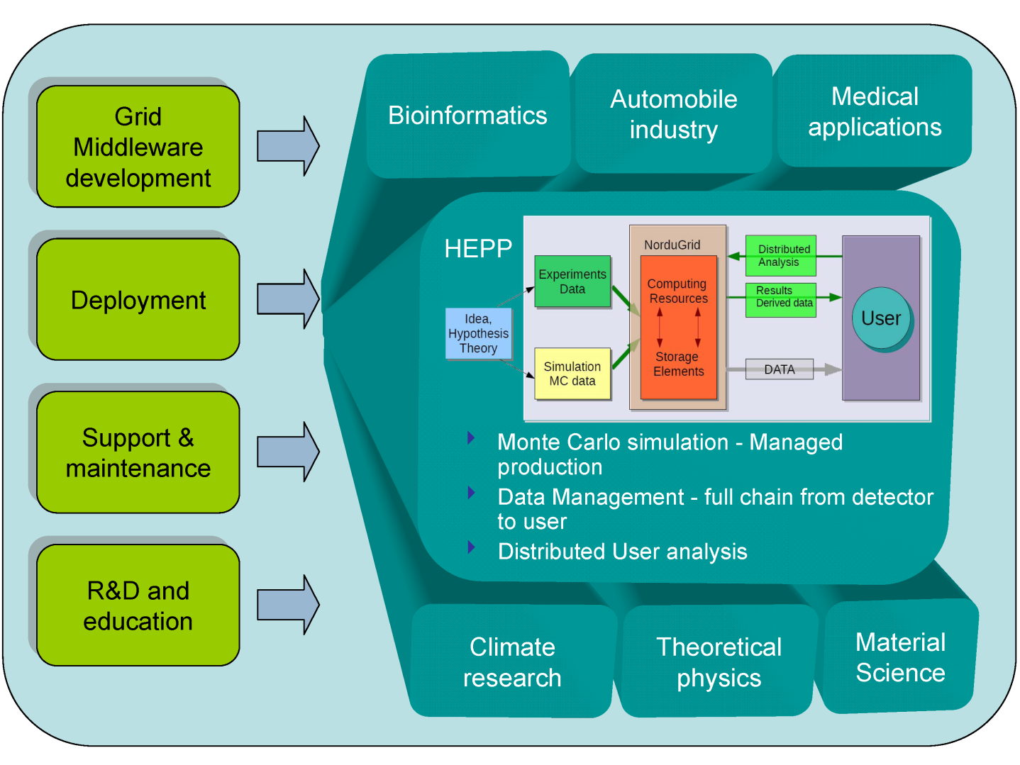
Is a complete, simple, efficient “Distributed” Computing environment for research on HPCs ++ possible?

Slide 19
Conclusion
Grid activities in Norway centered in Oslo and ATLAS
  Heavily involved in the full ATLAS computing chain
  Focus on ARC as the Grid middleware
ARC usage is growing
  ARC is the preferred choice for new CEs in ATLAS
Basic funding just enough to maintain ARC – project funding needed to push development further
  Will try Exercise again
  ARChestrate application pending
  ARC4eInfrastructures kick-off in October
We are connecting data intensive science to advanced resources
  HTC, HPC and more

Slide 20
Thank you!

Slide 21
Backup slides

Slide 22

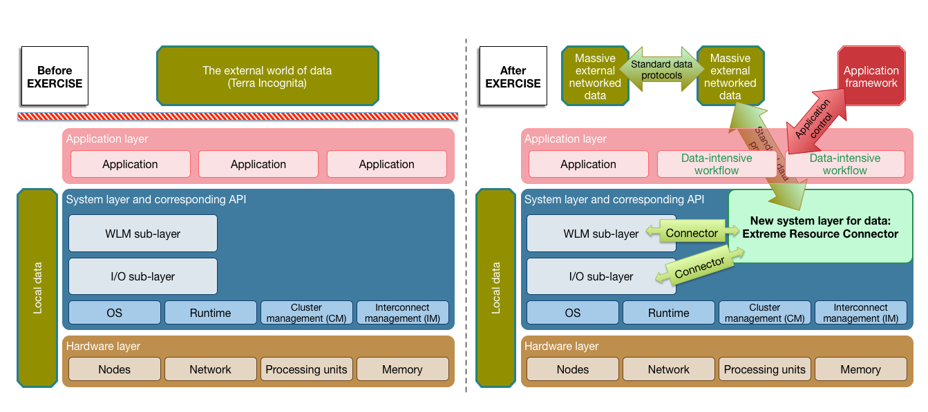
NorduGrid, HPC centres and experts, Researchers in data intensive science, technology providers …
Extreme Resource Connector for Data Intensive Science at Exascale
From “in-house” HPC computing to external data-intensive EXERCISEs

Slide 23
EXERCISE Objectives
Design and develop a new layer in the HPC system software stack for efficient automated processing of extreme scientific data on future Exascale HPCs – Extreme Resource Connector (ERC) will open up HPC centres for massive networked data processing.
Provide extensions to the foundational software layer of the HPC systems to address the Exascale I/O needs of data-intensive scientific workflows.
Demonstrate scalability of our novel approach to Exascale requirements through deployment and evaluation of the new system software developed by the project on some existing Top-500 HPC systems, future vendor prototypes, and by simulation.
Provide recommendations for future HPC systems design and usage, addressing data-intensive processing use cases.
Exploit system software developed project through the HPC centres beyond the immediate project participants and disseminate results to relevant standards bodies, HPC service providers, vendors, technology providers and researchers.

