Slide 1
CERN Industry Contracts, Technology Transfer and Recruitment
2nd October 2015
Ole Petter Nordahl
Norwegian Industry Liaison Officer and Technology Transfer Officer
ole.petter.nordahl@cern.ch

Slide 2
Norwegian industrial contracts
Norway has not enough contracts at CERN when taking into account our membership contribution.
Main reasons
  Few specialist companies with accelerator and detector technologies
    Most Norwegian suppliers to CERN are general production companies in the areas of mechanical work and electronics
  High industrial activity through the financial crises driven by oil industry
    Filled order books
    Less interest in other industries than oil
  High cost country
    High prices

Slide 3
Norwegian industrial contracts
However things are changing…
  Mid 2014 the activity in the oil industry started slowing down.
    Industry became more interested in new markets
  Oil price crash in end of 2014
    Drop in the value of the Norwegian Kroner
    NOK 18% down compared to EURO
    NOK 32% down compared to Swiss Franc
    Full stop in the oil industry
  Greatly improved the competitiveness of Norwegian industry

Slide 4
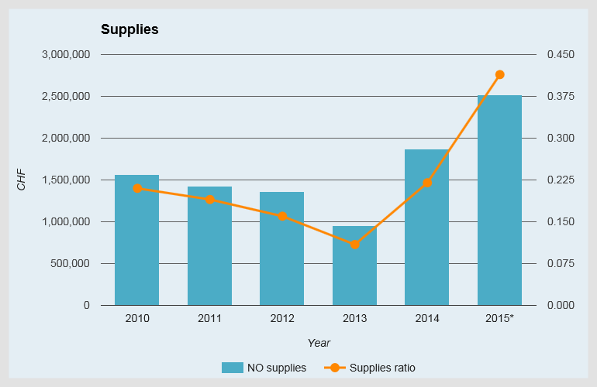
Norweigan Industrial Returns (2010 to 2015 YTD)
* Provisional figures for the year to October 2015

Slide 5
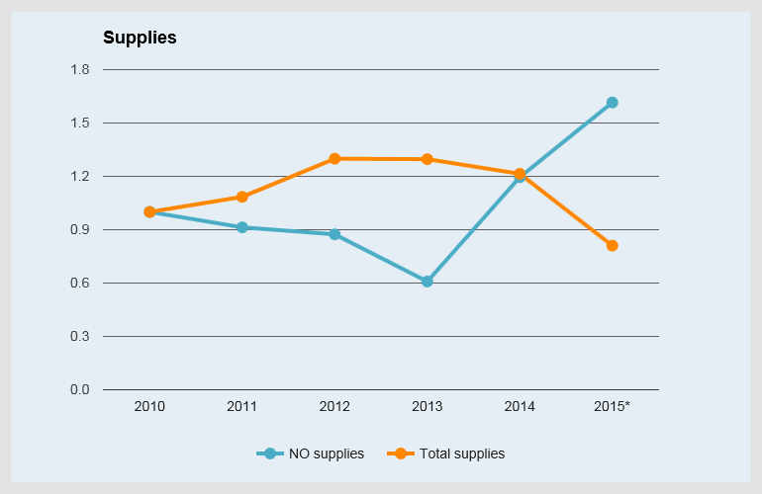
CERN Expenditure Trends (2010 to 2015 YTD)
* Provisional figures for the year to October 2015

Slide 6
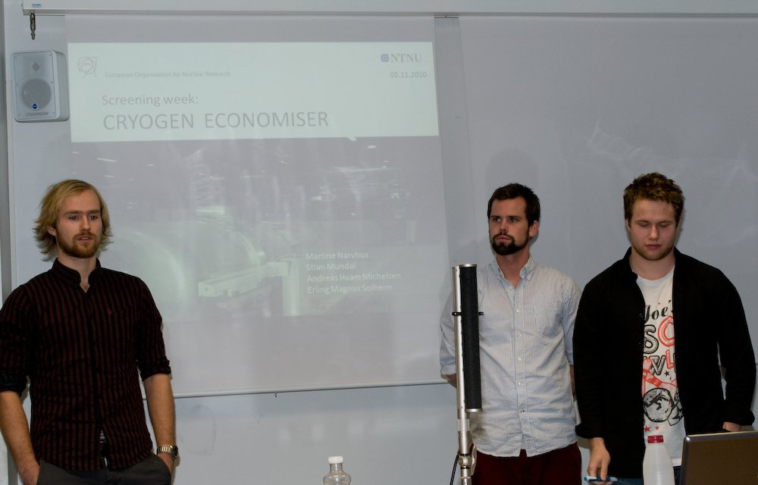
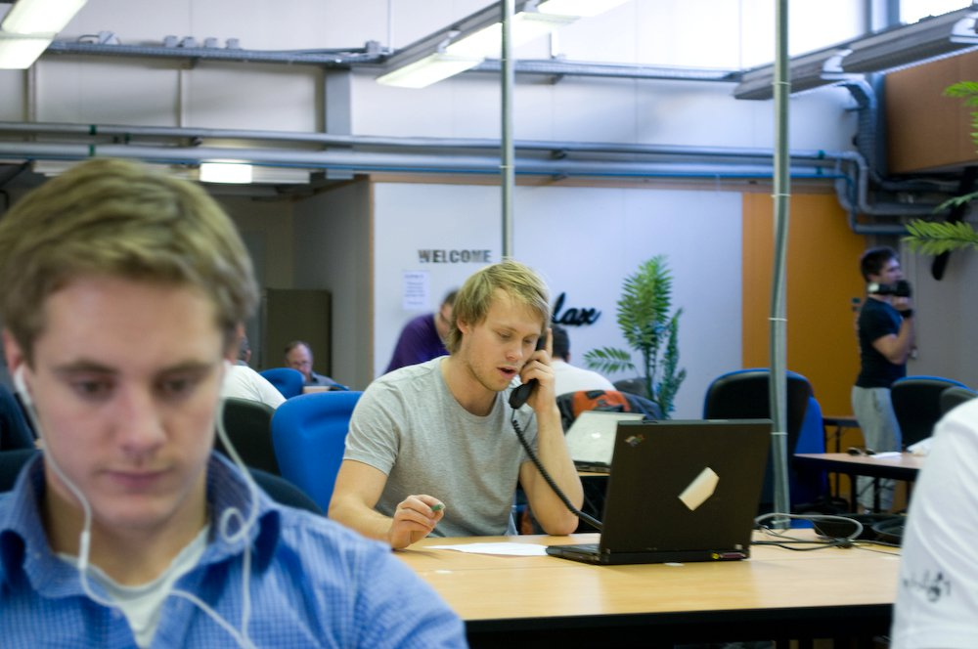
Technology Transfer: Screening Week
7 sessions until now in total
28 technologies screened
174 students visited and worked with the KT Group
Providing a large exposure of CERN Technologies to Norwegian Industry
2 Spin-off companies have been established based on the screening week
Discussions on potential new start-ups from this year’s edition are in progress
Notes:
By exposure, mean that the students contact mostly Norwegian industry and therefore expose them to CERN technology on a yearly basis.
As an example there where two meetings after the screening week last year between the students and Norwegian companies regarding ROOT.
In addition especially for the Open Source softwares, the students act to some extent as ambassadors for the software in contact with potential users. However, not anything tangible have gotten out of this.

Slide 7
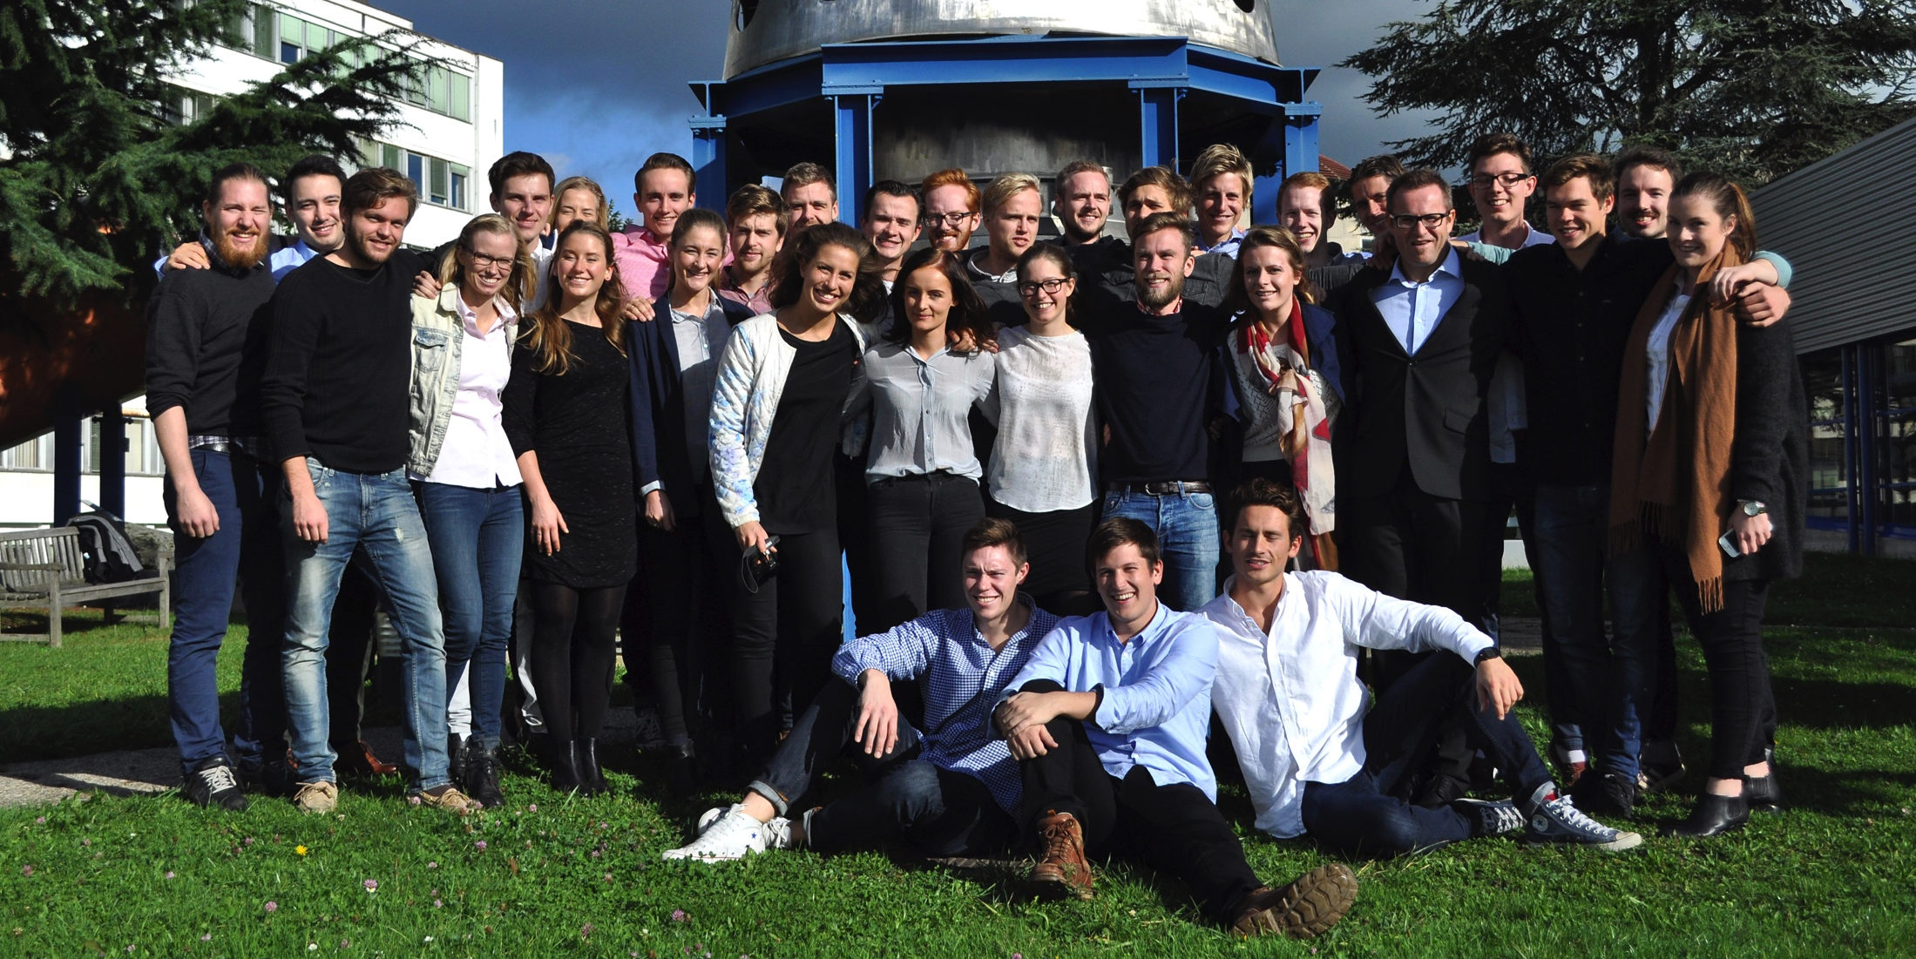
CERN-NTNU Screening Week
Notes:
The CERN-NTNU Screening week is a one week programme, where students from the Norwegian University of Science and Technology comes to CERN to evaluate the commercial potential of selected CERN technologies.
Around 30 students screen 3-5 technologies during the week.

Slide 8

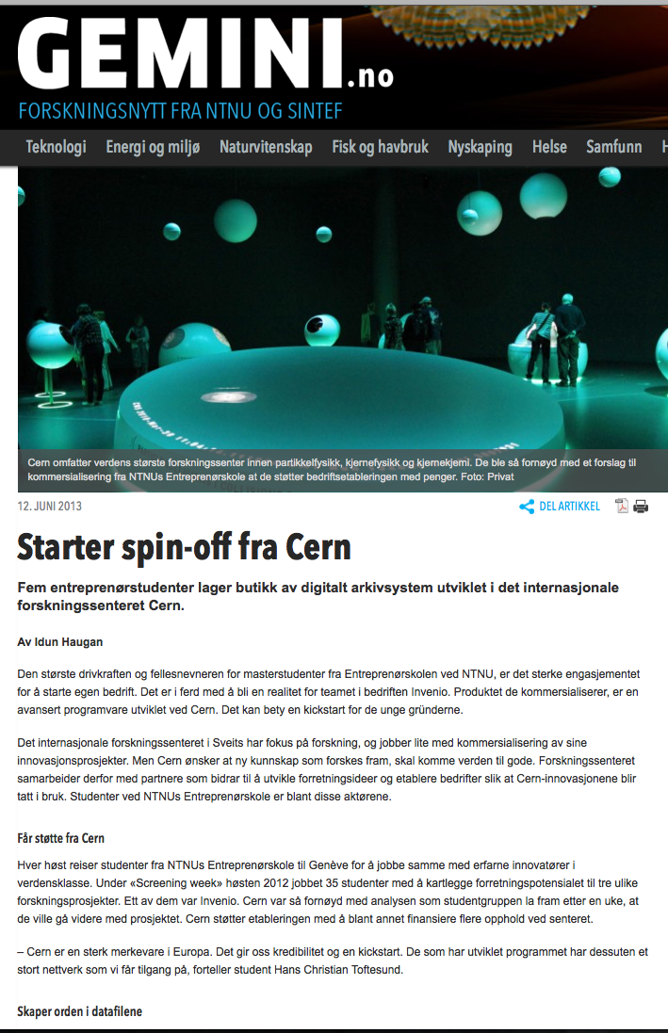
TIND Technologies
From the Screening Week 2012
INVENIO is a digital library or repository system, released open source
TIND Technologies are selling service, support and customization for the software
They have received extensive support from both the KT group and from the CERN library
Received a 1.5 MNOK grant from the NTNU Discovery Fund for developing the company
More info: www.tind.io

Slide 9
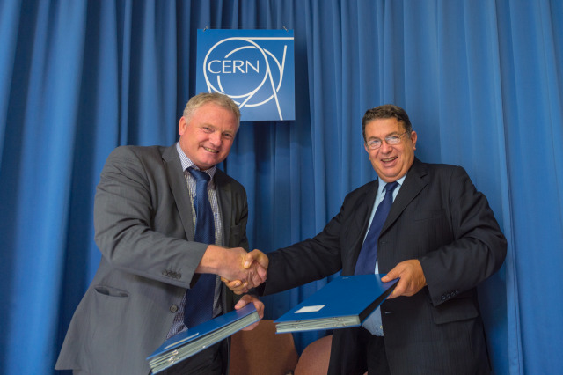
NTNU BIC of CERN Technologies
A scheme to support small businesses and entrepreneurs in taking innovative technologies related to high energy physics from technical concept to market reality
Launched 13.11.14
The scheme includes:
Accompanied technical visits to CERN
Access to expertise at CERN & NTNU
Business support provided by NTNU and CERN.
Funding – Discovery Fund and more
Use of CERN IP at favourable conditions.
Notes:
The CERN-STFC Business incubation center at the Sci-Tec Daresbury campus was officially launched the 23rd of April 2012.
The business incubator is intended to assist small businesses and entrepreneurs in taking innovative technologies related to high energy physics from concept to market.
Technologies that are related to high energy physics span from; particle accelerators, detectors, vacuum technology, cryogenics, magnets, superconductors, materials science and high performance computing among other.
To be able to assist the entrepreneurs, the scheme offers several components;
Technical visits to CERN and the possibility to access experts at both CERN and STFC to get help in the further development of the technology.
A grant of 40 thousand pounds provided by STFC, to help them get started. This money can be considered as a pre-seed fund to help the companies for a short while until they are able to get additional investments.
Access to the CERN IP portfolio at very favorable conditions

Slide 10
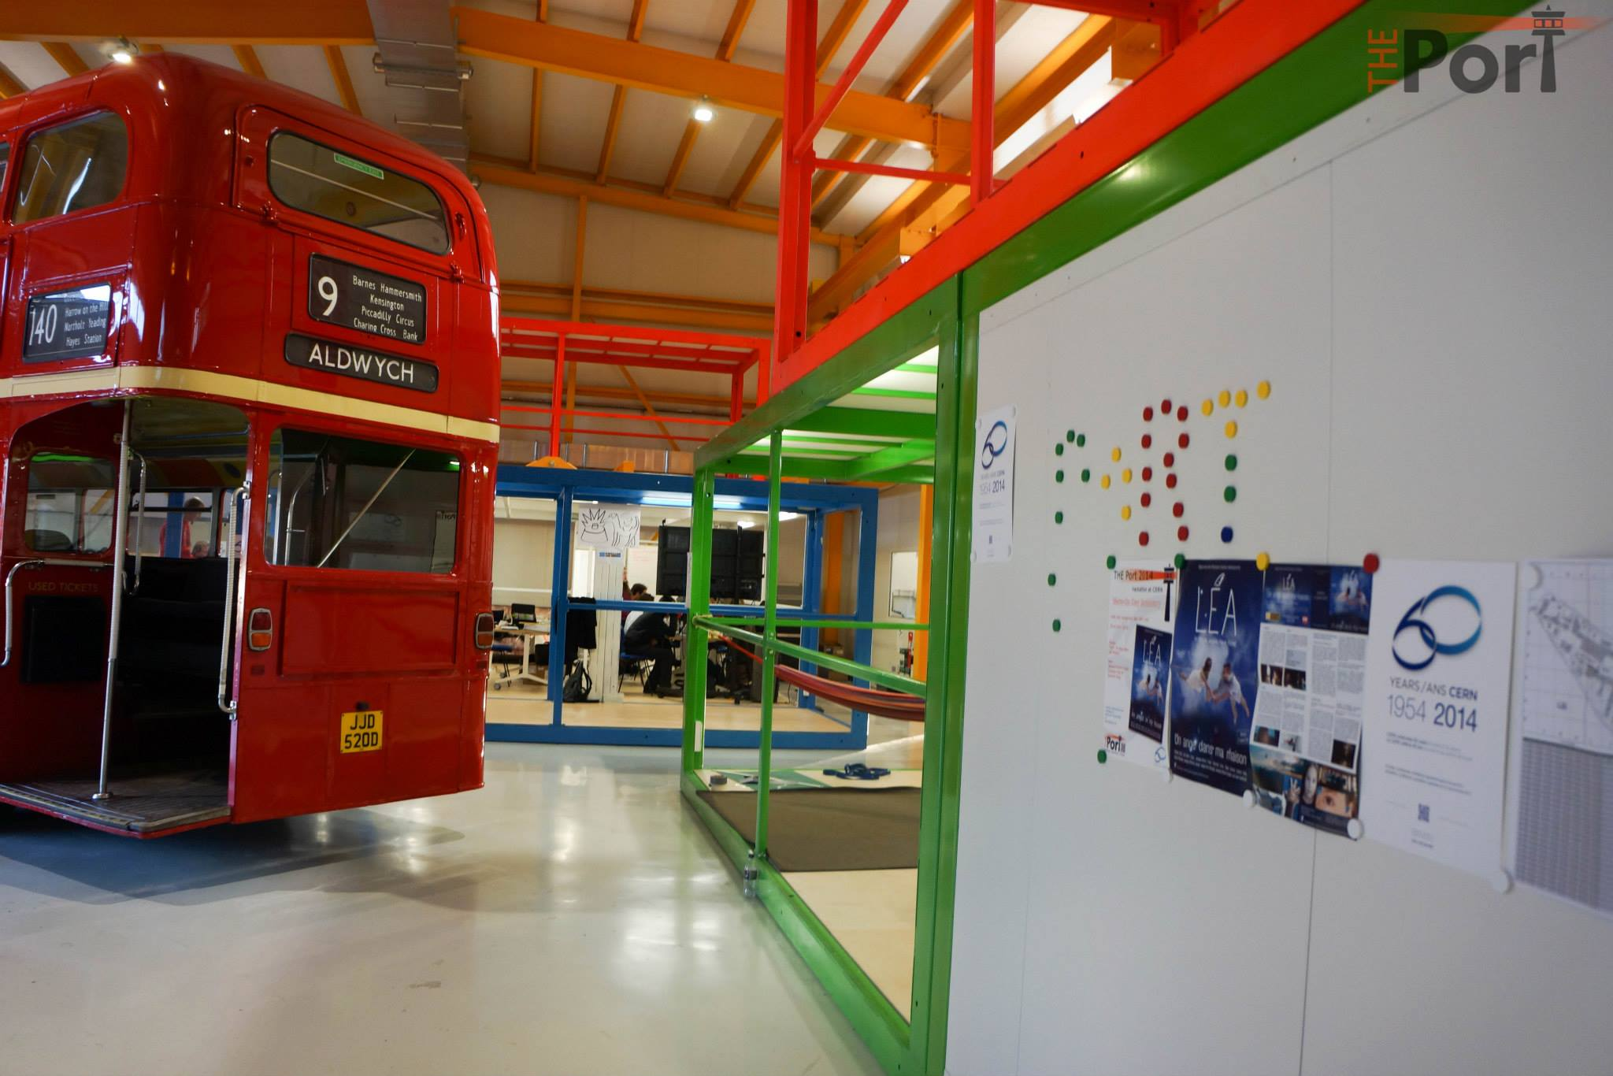
IdeaSquare
“IdeaSquare is a pilot project that brings together physicists, engineers, industrial partners, early-stage researchers and cross-disciplinary teams of students to work together on detector upgrade R&D technologies. The purpose is to co-develop new technologies for research purposes, and at the same time, create a fruitful environment for socially and globally relevant new product ideas and innovation.”
Students from NTNU Product Design and NTNU Engineering Design participate to the program

Slide 11
Norwegians at CERN: 2014 Numbers
Currently
12 Staff positions *~.5%

Slide 12
Personnel situation

Slide 13
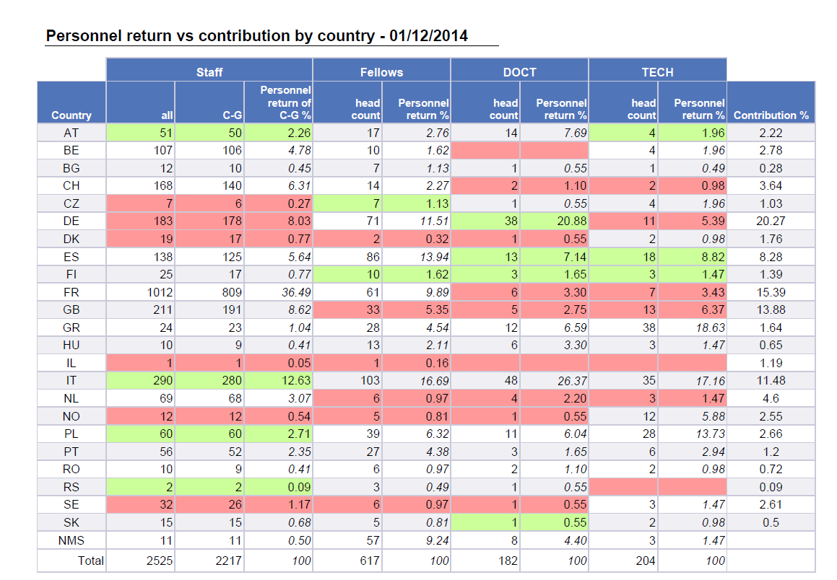
Internal Monitoring

Slide 14
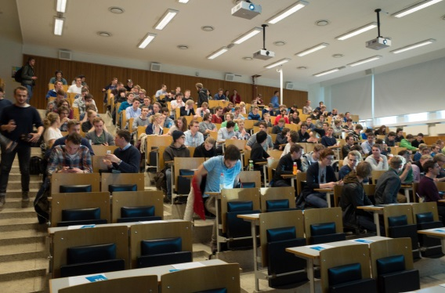
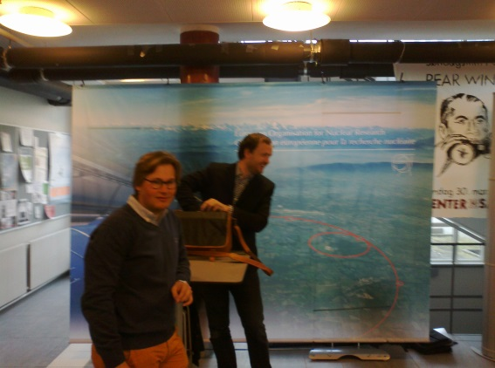
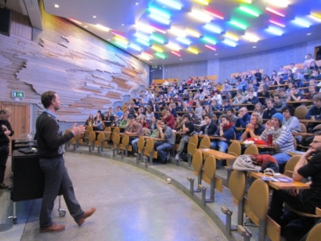
Recruitment activities
NTNU and Sør-Trøndelag University College (HiST)
  Nils Høimyr (IT), Vetle Nilsen (FP), Jens Vigen (GS)
  + Ole Petter Nordahl
  Joint event with ESS
  200 students in auditorium
  Visits to University of Stavanger, Trondheim Technical College and
  Stavanger Offshore Technical College (SOTS)
Targeted Sourcing
  LinkedIn
  Facebook
  Norwegian community
  Tekna student groups
  TTE
  FINN.NO – job-board contract & jobsafari

Slide 15
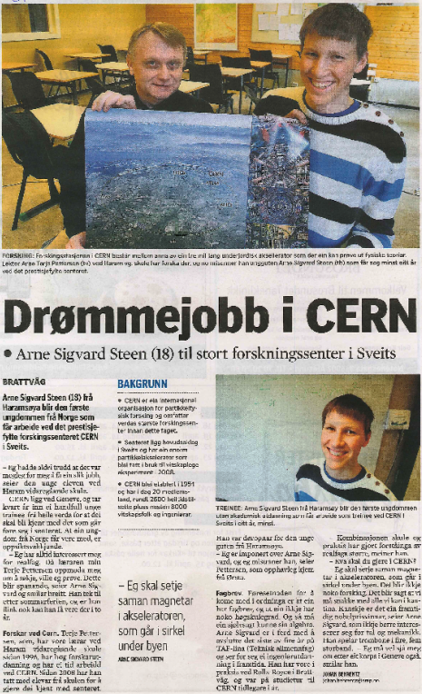
New Avenues of Success
(1) Technology Department - Cryogenic Operators
2 successful candidates through finn.no
  Thomas Melchior YTTERDAL
  Margrethe MALMEDAL
  Both experienced process operators from oil/gas
(2)TTE (Technician Training Experience)
2 successful candidates after diploma
  Arne Sigvard STEEN
  Kristian ANDERSEN

Slide 16
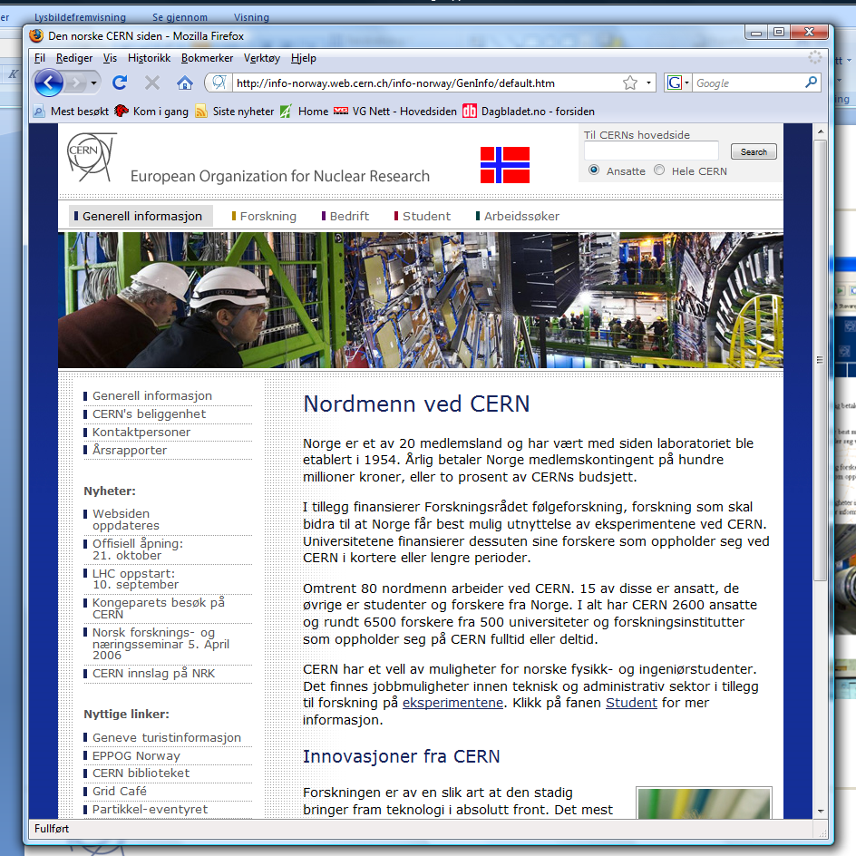
Norwegian CERN website
cern.ch/norway
Information for:
  Research community
  Students
  Companies
  Job applicants
  General news

