Slide 1


Development Status of the Beam Separation Dipole D1
T. Nakamoto
KEK
CERN-KEK Committee
31 July 2015, CERN

Slide 2
Participants & Supports
KEK
T. Nakamoto, M. Sugano, S. Enomoto, H. Kawamata,
N. Higashi, N. Okada, R. Okada, T. Ogitsu, K. Sasaki, N. Kimura.
CERN
E. Todesco, A. Musso

Slide 3
Collaboration, Agreement

Slide 4
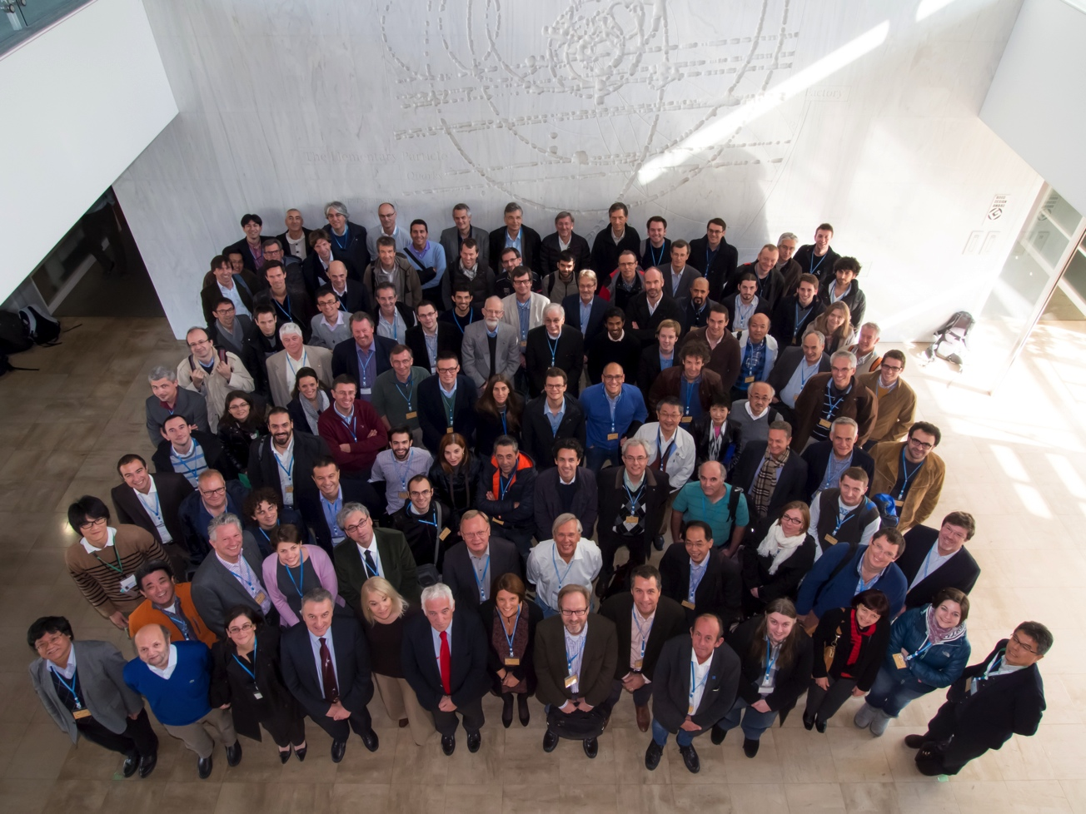

HiLumi LHC Meeting at KEK
4th Joint HiLumi LHC-LARP Annual Meeting. Nov. 17 – 21, 2014 at KEK, Tsukuba, Japan.
More than 110 experts joined the meeting.
  https://indico.cern.ch/event/326148/

Slide 5
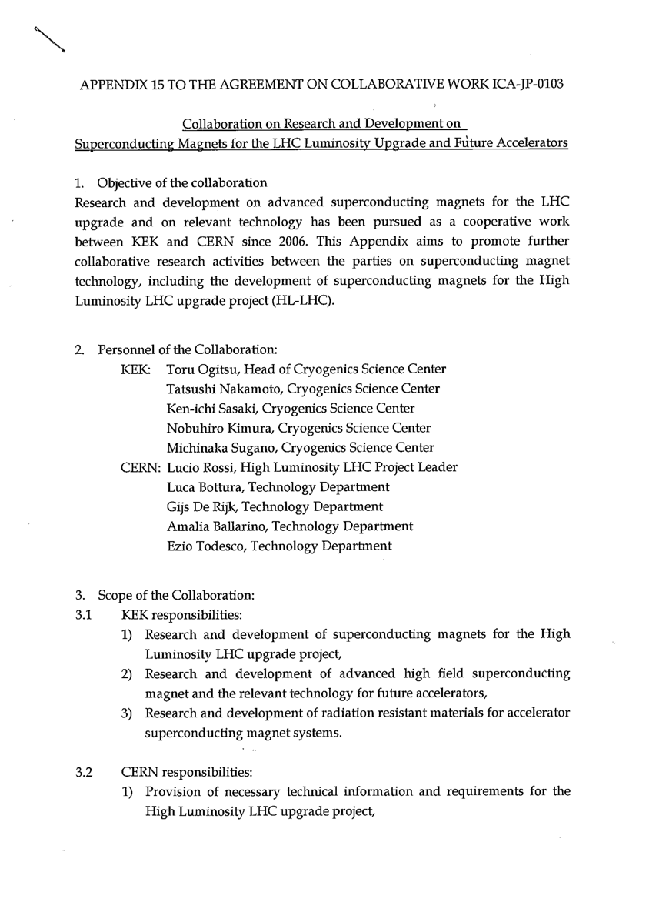
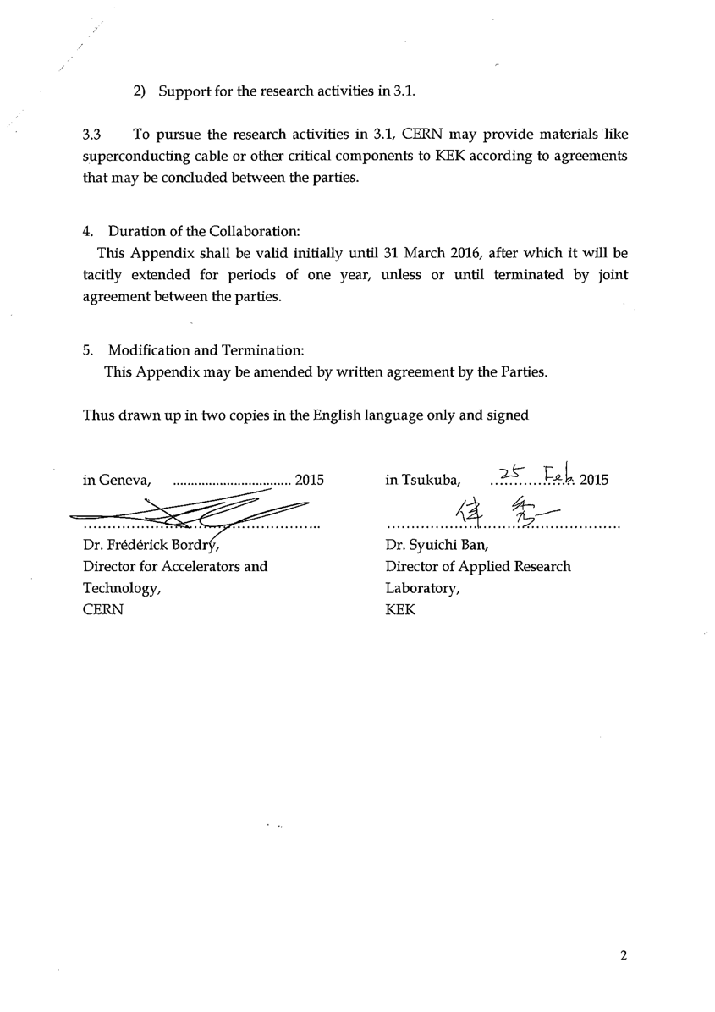
New Agreement under MoU
“Collaboration on R&D on SC magnets for the HL-LHC and future accelerators”
Effect: March 2015 ~

Slide 6
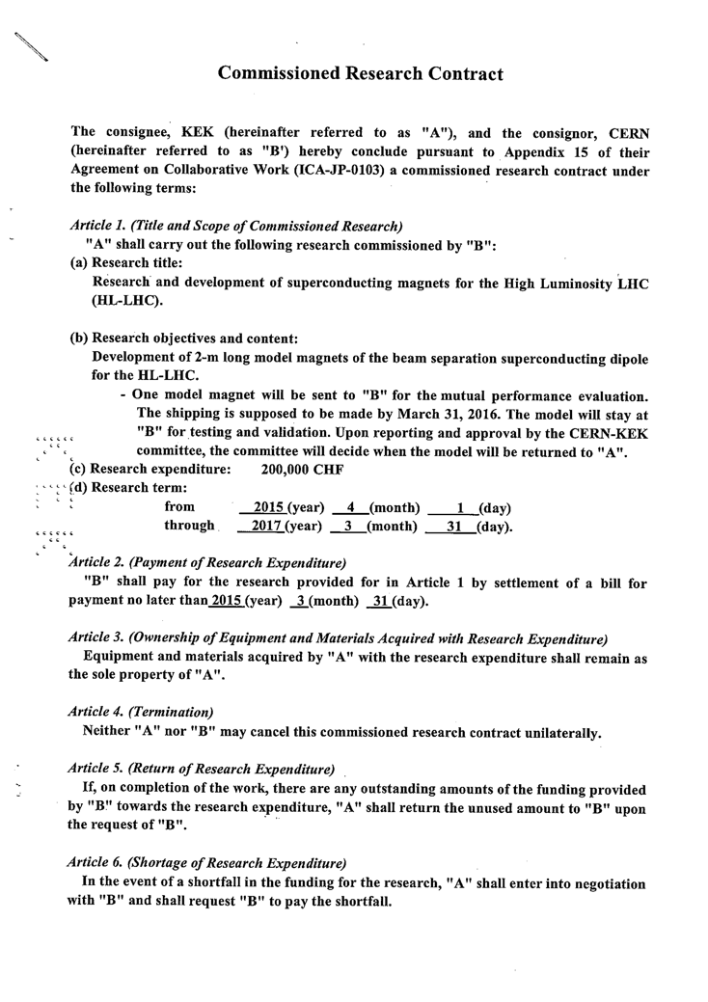
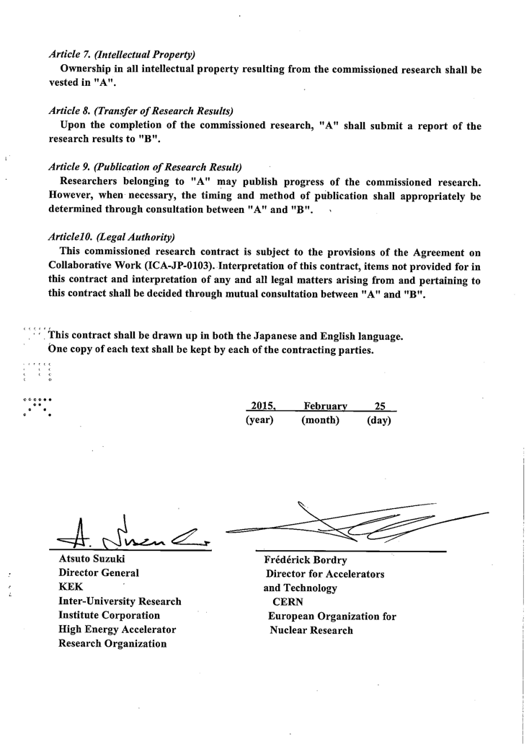
Support from CERN
A new Commissioned Research Contract to support development of model magnet at KEK.
  200 kCHF, April 1, 2015 to March 31, 2017.
One 2m long model magnet will be sent to CERN (March 2016).
  For mutual performance evaluation at KEK and at CERN.
  For development of HTS insert coil at CERN.

Slide 7
A Long-term Invited Fellow from CERN
Andrea MUSSO (TE-MSC-CMI) visited KEK from Dec. 2014 to May 2015 and participated to the 2m long model magnet development for the HL-LHC.
  Thanks to KEK for this invitation program.
  Thanks to CERN for the additional financial support for his visit.
He now becomes a link person at CERN to bridge KEK and CERN’s experts for development of the beam separation dipole magnets and cryostats.
  follow-up of the development and the construction at KEK
    Planning to re-visit KEK during development of the 2m model magnet in 2015.
  technical coordination for the practical and technical issues with the CERN’ experts: cold mass specification, safety issues, cryostats, cryogenics, alignment…

Slide 8
Activity within EC-FP7 “HiLumiLHC”
WP3 IR Magnets
Close communications and discussions with the colleagues from CERN, INFN, CIEMAT, CEA-Saclay and US-LARP on magnets as well as correctors, radiation, cryogenics, integration, etc.
Year 2011 to 2015
  Deliverable Report is being prepared.
draft

Slide 9
2m Model Magnet Development for the HL-LHC

Slide 10
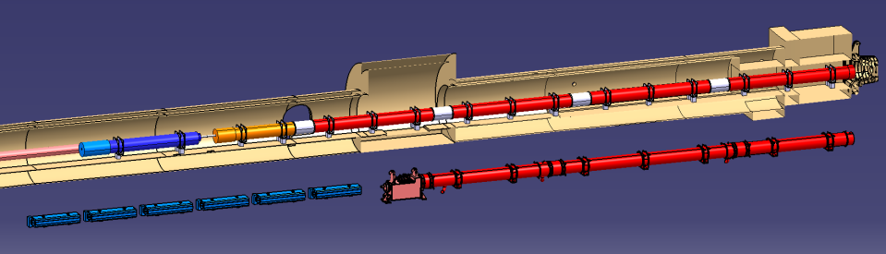





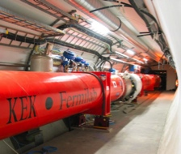

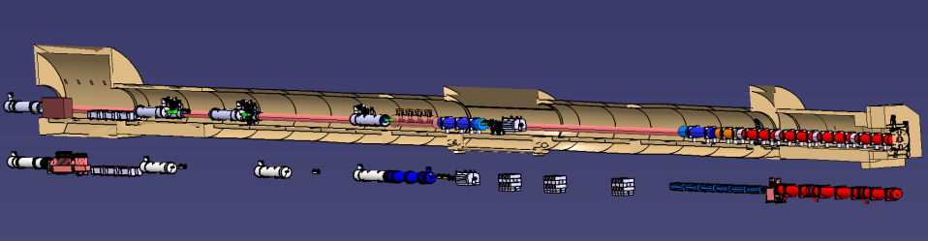

Layout of IR Magnets
Courtesy of P. Fessia
IT Quads.& D1
HL-LHC
IT Quads. w/ Nb₃Sn
Q1
Corrector
Package
Q2b
Q2a
Q3
SC D1
Nominal LHC
NC D1
Long Straight Section
HL-LHC
Crab Cavity
Q4
D2
Nominal LHC
Aperture increase in IT Quads:70mm→150mm Large bore also for the new D1
Replacement of current NC D1 by SC D1: Shortening magnet length by 15m
Making room for new crab cavities

Slide 11
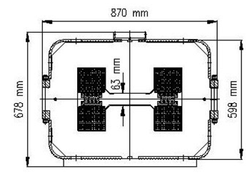
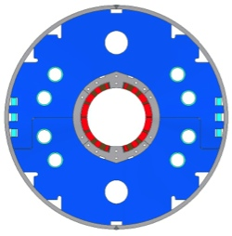
NC vs SC
 | Beam separation dipole, D1
 | LHC | HL-LHC
Aperture | 52mm gap | 150mm
Nominal Field (Peak Field) | 1.4 T | 5.6 T (6.5 T)
Magnetic Length | 3.4 m x 6 ~21m | 6.27 m
Stored Energy | 0.014 MJ/m | 0.34 MJ/m
MBXF

Slide 12

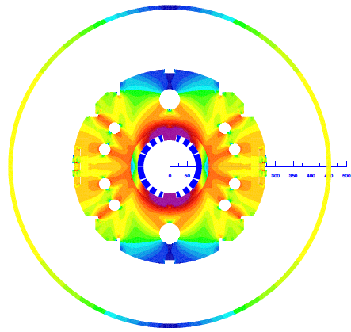
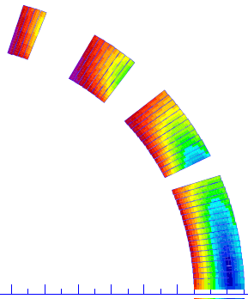
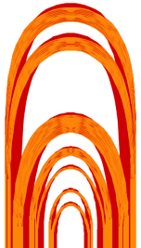
Latest Design Parameters of MBXF for D1
Coil ID: 150 mm
Integrated field:35 T m (26 Tm at present LHC)
  5.59 T at 12 kA. L_{coil}=6.6 m
T_{op}: 1.9 K by HeII cooling
Op. point (2D coil): 75 %
Coil layout: 1 layer of 15.1 mm cable
  Better cooling. Saving space for iron yoke.
Conductor: Nb-Ti LHC MB outer cable
Structure: Collared yoke structure by keying
Field quality: < 10⁻⁴ at R_{ref} = 50 mm
Cold mass OD: 550 +10 x 2 = 570 mm
Cryostat OD: 914 mm, same as MB cryostat (*TBD)
Radiation, energy deposition:
135 W in total, 2 mW/cm³ at local peak, Radiation dose >25 MGy
4
8
13
44 turns
19
12

Slide 13
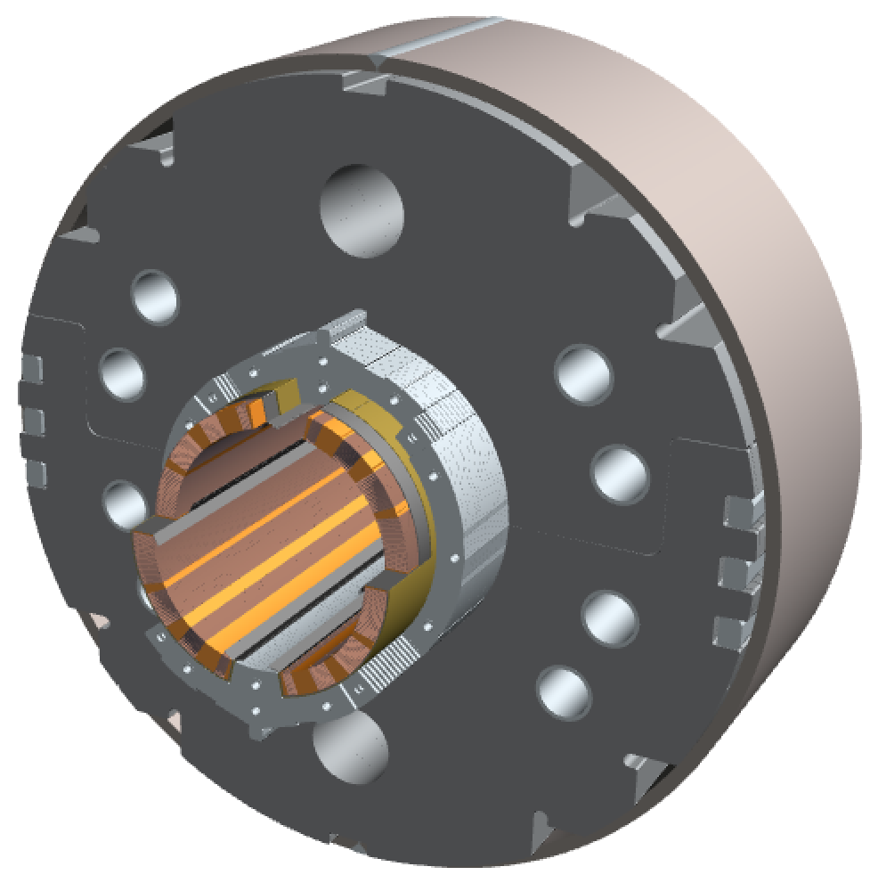
2m-long Model Magnet - Overview
Single-layer coil, 4-split spacer collars, collared yoke by keying
Notches and φ 34 mm holes for iron saturation effects
φ60 mm HX hole
HeII cooling channel
Shell: SUS304L
4 split stainless steel spacer collars: NSSC130S
Brass shoes
QPH+Insulations
Collaring keys
NbTi SC cable (LHC MB outer) + Apical insulation
Horizontal split iron yoke:
low-carbon steel (EFE by JFE steel)
Radiation resistant GFRP (S2 glass + BT resin) wedges

Slide 14
Goal
One 2m long model magnet will be built and tested at KEK.
The second model development is also planned.
Design parameters | Production | 2-m model
Field integral | 35 T•m | 9.3 T•m
Magnetic length | 6.27 m | 1.66 m
Coil mechanical length | 6.57 m | 2.00 m
Magnet mechanical length | 6.72 m | 2.15 m
Cold mass weight | 12 tons | 3.8 tons
Cable unit length per coil | 570 m | 180 m

Slide 15
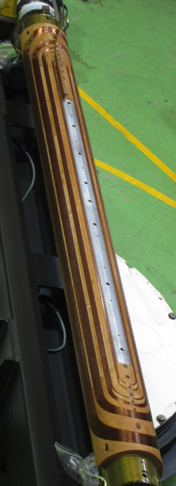
Test Coil Fabrication – Sep. 2014 –
Demonstration of coil fabrication with a first 2m (test) coil.

Slide 16

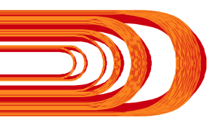
Modification of Coil End Design
Coil-end found in practice
winding
(2-m test coil)
Old version (Ver 2)
Modified design
(Ver3)
1A
1B
2
3A
4A
3B
4B
Subdivision
Points in modification of coil-end designs
Elongation of end part
To make the cable stand more uprightly
Subdivision of the outer most block
To make it easier to predict the angle of the last turn
Adjustment of distance between the blocks “1B” and “2”
To minimize integral multipole
This modified coil end will be adopted for the 1st 2-m model

Slide 17
Magnetic Design – 2D –
ROXIE 2D model
Main field (T) | 5.573
b₃ (unit) | -0.059
b₅ (unit) | -0.097
b₇ (unit) | -0.111
b₉ (unit) | 0.284
b₁₁ (unit) | 0.360
b₁₃ (unit) | -0.663
b₁₅ (unit) | -1.115
b₁₇ (unit) | -0.788
b₁₉ (unit) | 0.399
Peak field (T) | 6.440
Load line ratio (%) | 75.4
R_{ref}=50 mm

Slide 18
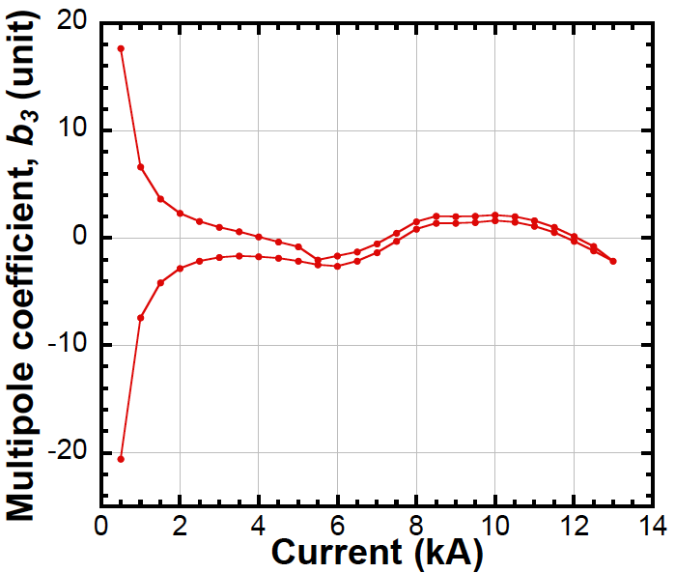
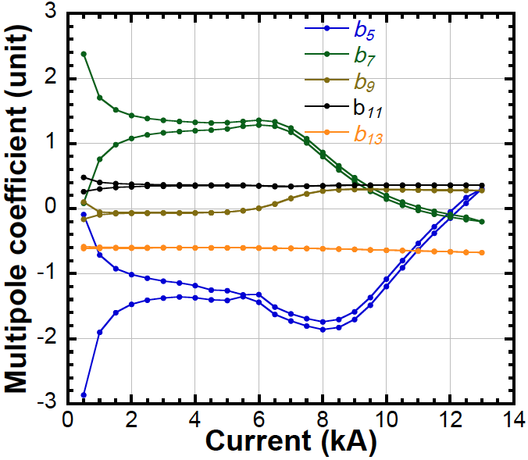
Magnetic Design – 2D –
Variation of multipole coefficients
b₃
b₅ ~ b₁₃
Nominal
current
Nominal current
b₃

Slide 19
Magnetic Design – 3D –
ROXIE 3D model

Slide 20
Magnetic Design – 3D –
Thanks to elongation of coil end and subdivision, the coil peak field can be reduced.
Load-line ratio in straight section: 75.4%
Load-line ratio in coil end: 76.6% (78% in the previous design)

Slide 21
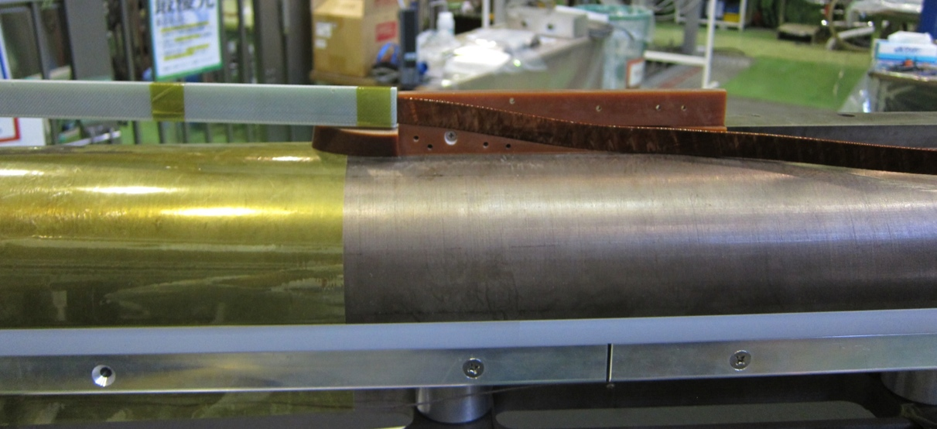
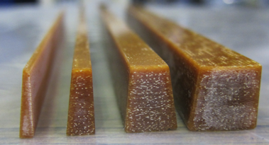
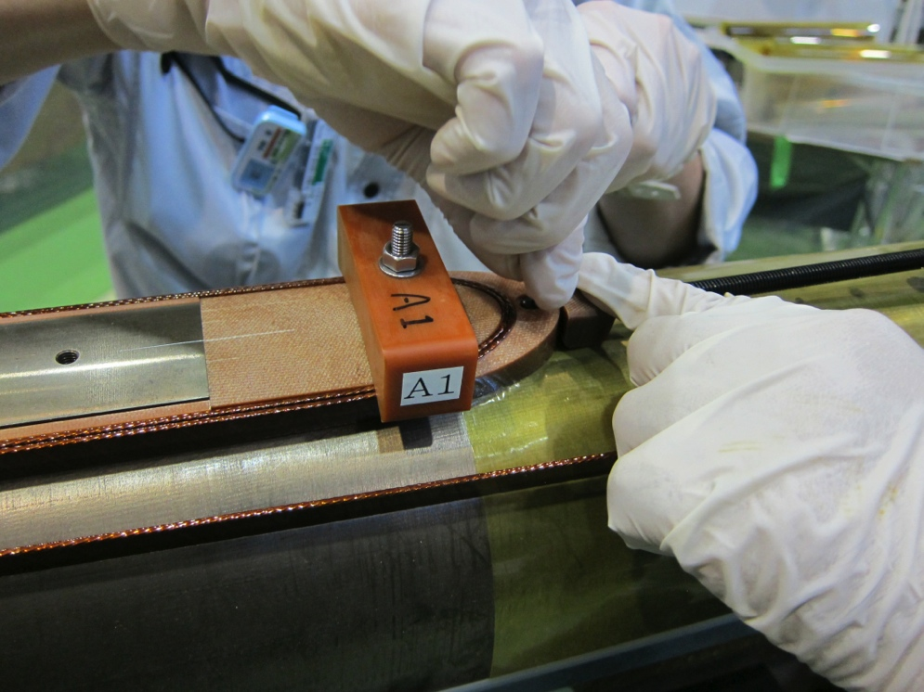
Coil Winding of the 1st Model Magnet
Started in July 2015.
Pole shim and wedges
End spacers

Slide 22
200 mm Long Mechanical Short Model
To prove the mechanical design and magnet assembly procedure prior to the model magnet fabrication.
  Cutout of the test coil with ground insulations.
  Collars and yokes were made by laser cutting and fine-blanking processes.
First trial was unfortunately unsuccessful.
  Modification of alignment features in collars and yokes.
Second trial was successful.
Modified alignment features

Slide 23
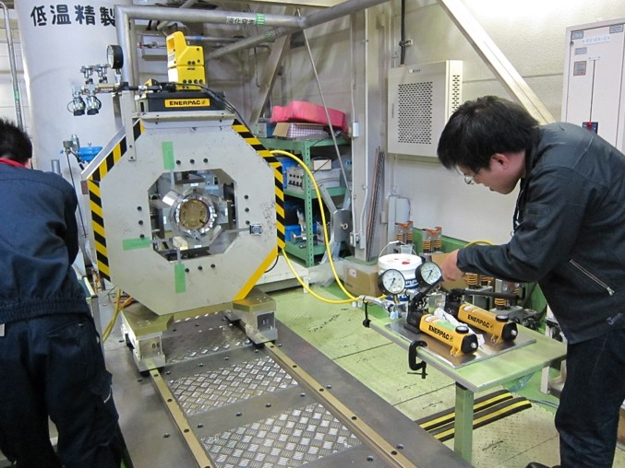
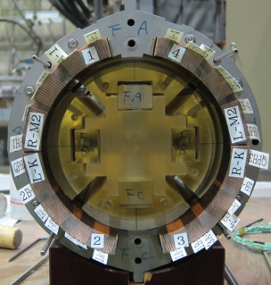
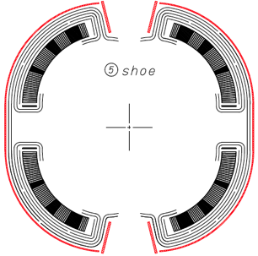
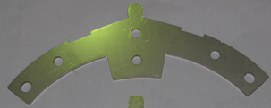

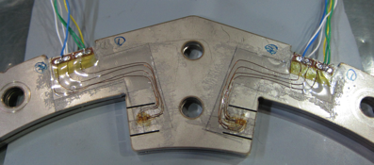
200 mm Long Mechanical Short Model
Coil: Cut-out from the 2m test coil
QPH dummy: Polyimide sheet (t0.25 mm)
Insulation: 4 layers of polyimide sheets
(t0.125 mm each)
Brass shoe: t0.5 mm
Brass pole shim: t1 mm
Collar: newly designed, made by laser cutting
for quick prototyping
Strain gauge to monitor pole stress
Collaring mandrel: Made by a 3D printer for test
Pole shim
Gap between
insulations
QPH dummy
Brass shoe
4 layers of insulations
23

Slide 24
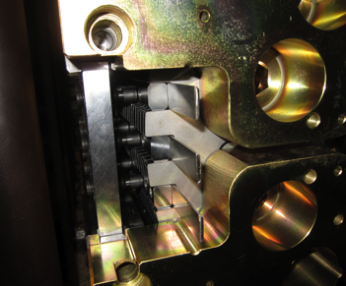
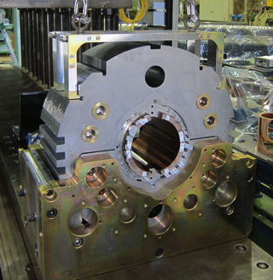
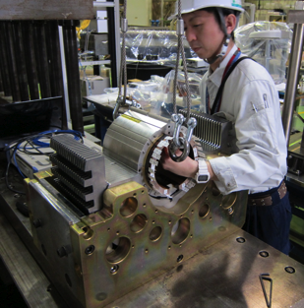
200 mm Long Mechanical Short Model
Key insertion
Hydraulic pressure=27 MPa
Yoking was completed
Collared coil could be easily disassembled
from yoke by crane

Slide 25
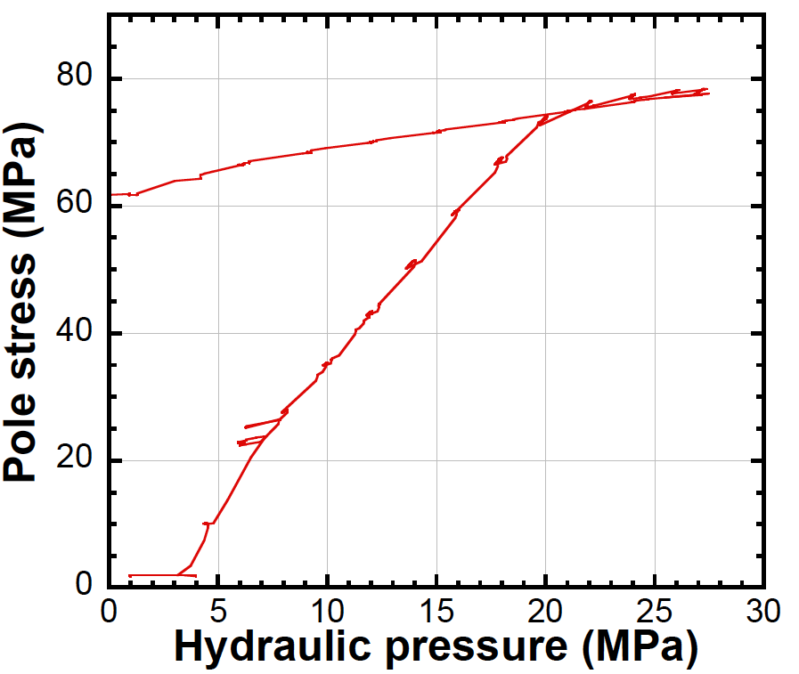
200 mm Long Mechanical Short Model
unloading
Key insertion
(Maximum stress)
Upper/lower
yokes touch
Remaining
pole stress
Loading
Pole stress
Expected value
80 MPa
Measured
61 MPa
Lower pole stress would be caused by inaccurate size of parts made by laser-cutting.
→ Third trial is underway by using more accurate parts made by fine-blanking.

Slide 26
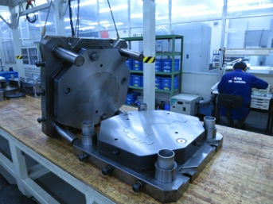
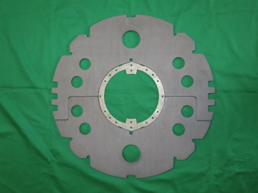
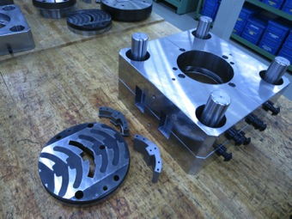
Procurement: Collar, Yoke
Fine-blanking dies for collars and yokes with a “original design” were completed.
  However, as reported, the fine-blanking dies need to be modified for the new cross section: vertical rectangular notches, horizontal extended tapers.
  Refurbishment will be until the end of July. Yokes and collars for the 1st model magnet will be fine-blanked in August.
  Additional work making holes are needed for the yokes. Scheduling is underway.
Iron yokes and SS collars made by FB (before modification).

Slide 27
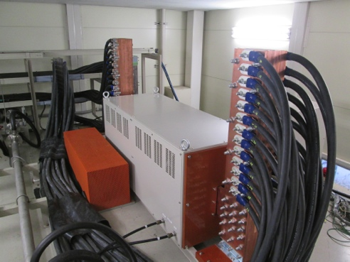
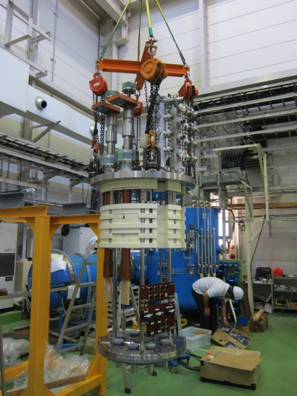
Preparation for Cold Tests
Procurement
  New header w/ larger warm bore
  New 15 kA CLs, 15kA-DCCT (calibrated by CERN), dump resistor (75 mΩ).
  New DAQ systems
Modified 9m-deep vertical cryostat with new header must be inspected in accordance with High Pressure Gas Safety Act in Japan.
  But, the procedure was stopped for 3 months because KHK (The High Pressure Gas Safety Institute of Japan) additionally asked to confirm the pre-approval by the local government (Ibaraki Prefecture).
  The procedure resumed recently and the Completion Inspection for the vertical cryostat is scheduled in the middle of September.
  And then, the wiring and instrumentation will be followed.
Commissioning at 1.9K, 15kA without magnet previously planned in June was cancelled.
  Due to delayed schedule, a lack of budget.
First cold test of the 1st model will be possible in Nov. 2015 at earliest.
  We confirmed the operators will be available even in January to March 2016 and this period will be another timeslot.

Slide 28
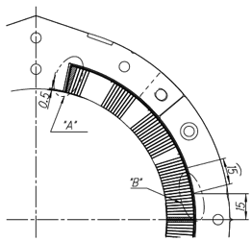
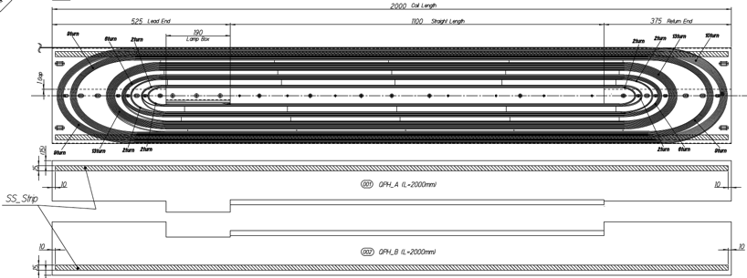
Quench Protection Scheme
Baseline of quench protection scheme for D1 was changed in the last WP3 meeting: D1 will be protected by QPH w/o E.E.
QPH provided by CERN will be used for 1st 2 m model magnet
(Thanks to Juan Carlos Perez )
  SUS strip (w15 mm, t25 mm, l1980 mm) → 2.7 mW at cold
  SUS part covers 9 cables in the first coil block
  Thickness of QPH from CERN will be 100 mm and 150 mm
  thick polyimide sheet will be added for thickness compensation by ARISAWA
2 sets of power supply for QPH will be provided by CERN. (by August?)
Quench simulation with ROXIE (Thanks to Susana Izquierdo Bermudez)
SUS strip

Slide 29
Schedule of the 1st model of MBXF
*Work related to the 1st model fabrication
July 2015 Coil winding, curing, size measurement, instrumentation (~October)
A 200 mm mechanical short model with parts made by fine-blanking
Aug. 2015 Fabrication of SS collars and iron yokes
Nov. 2015 Collaring and Yoking
Dec. 2015 Shell, splice work
>> Completion of the 1st model
Jan. 2016 Cold test of the 1st model: 1st cycle
Feb. 2016 Start of fabrication of the 2nd model (if no design change…)
March 2016 Cold test of the 1st model: 2nd cycle
May 2016 Shipping the 1st model to CERN. (plan)

Slide 30
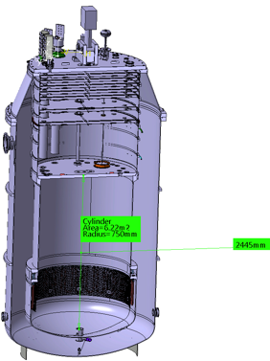
1st model for HTS coil development at CERN
Video meeting on May 12, 2015.
Information exchange on interface, specification
  weight, length, cross section.
  SC leads, nominal current
  support structure
  stray field: check cryostat and environment.
3D model will be sent to CERN soon.

Slide 31
Accounting Report

Slide 32
Accounting for D1 model R&D
 | Item | Sub-item | 2013 | 2014 | 2015
 |  |  |  |  | as of today | prediction
Income | CERN-KEK account | Carry-over | - | 11.83 | 21.45 | 21.45
 |  | Money transfer | 29.57 | 46.16 | 0.00 | 0.00
 | Commissioned Research (CERN) | HL-LHC | - | - | 24.51 | 24.51
 | KEK (ATLAS-J) |  | 82.60 | 58.46 | 40.00 | 40.00
 | External fund | Kakenhi | 13.70 | 7.22 | 16.86 | 16.86
 | Total |  | 125.86 | 123.66 | 102.82 | 102.82
Expenditure | D1 model magnet | Engineering (CAD support) | 6.07 | 6.86 | 2.34 | 7.01
 |  | Tooling | 18.17 | 16.09 | 3.27 | 7.00
 |  | Parts | 19.72 | 31.35 | 25.58 | 35.00
 |  | R&D | 3.05 | 5.73 | 3.73 | 5.00
 | Test stand |  | 51.71 | 28.53 | 1.64 | 11.82
 | Technical support |  | 5.26 | 9.56 | 4.36 | 10.00
 | Travel & others |  | 3.24 | 3.15 | 0.11 | 1.00
 | R&D for HFM |  | 6.80 | 0.94 | 0.02 | 1.00
 | Carry over |  | 11.83 | 21.45 | 25.00 | 25.00
 | Total |  | 125.86 | 123.66 | - | 102.82
Unit: MJYen (~10kCHF)
* Assuming 100 JYen=1 CHF

Slide 33
Summary
KEK has been engaged in the FP7 HiLumi-LHC design study. R&D of the beam separation dipole magnet, MBXF for D1, including the 2-m model is underway with supports of CERN.
The design change of the coil end was made after the test coil development in Sep 2014.
200mm mechanical short model successfully demonstrated the mechanical design and assembly procedure including tooling.
Fabrication of the 1st 2m model magnet started with the coil winding in July 2015. The magnet will be completed within 2015 followed by the cold testing at the vertical cryostat in early 2016.
  The 1st model will be sent to CERN spring 2016.
The 2nd 2m model magnet is also planned to be fabricated after evaluating the performance of the 1st model.

