Slide 1
CERN – KEK LC activities
Overview:
  Xband testing at KEK (see also talk of Seiya Yamaguchi earlier)
  Formal papers: Addendum to CERN-KEK agreement and research contracts (yearly)
CERN involvement in ILC preparation (see talk of Akira Yamamoto)
ATF – this talk
Formal papers: In CERN-agreement and in 2014 a research contract to support operation, also world-wide collaboration with CERN as participant
Detector and Physics – this talk
Formal papers: Addendum to CERN agreement
E-JADE: Horizon 2020 project 2015-18 (much wider than LCs) – one slide
Related: CERN – KEK offices: Addendum to CERN-KEK agreement (see talk of Katsuo Tokushuku later) – also scope beyond LCs

Slide 2
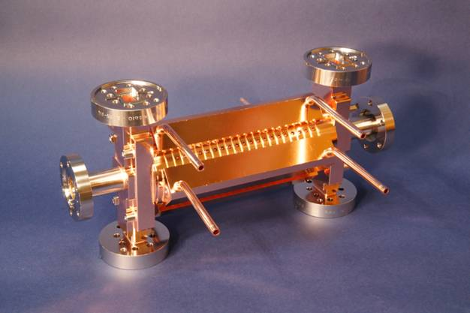
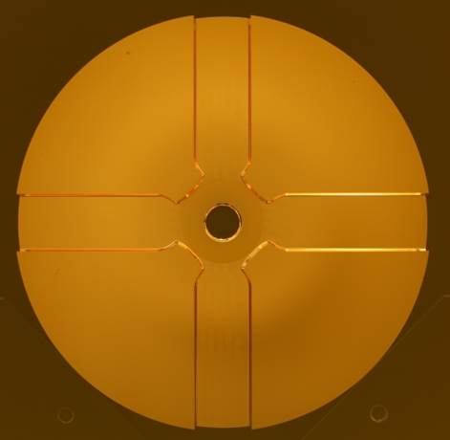
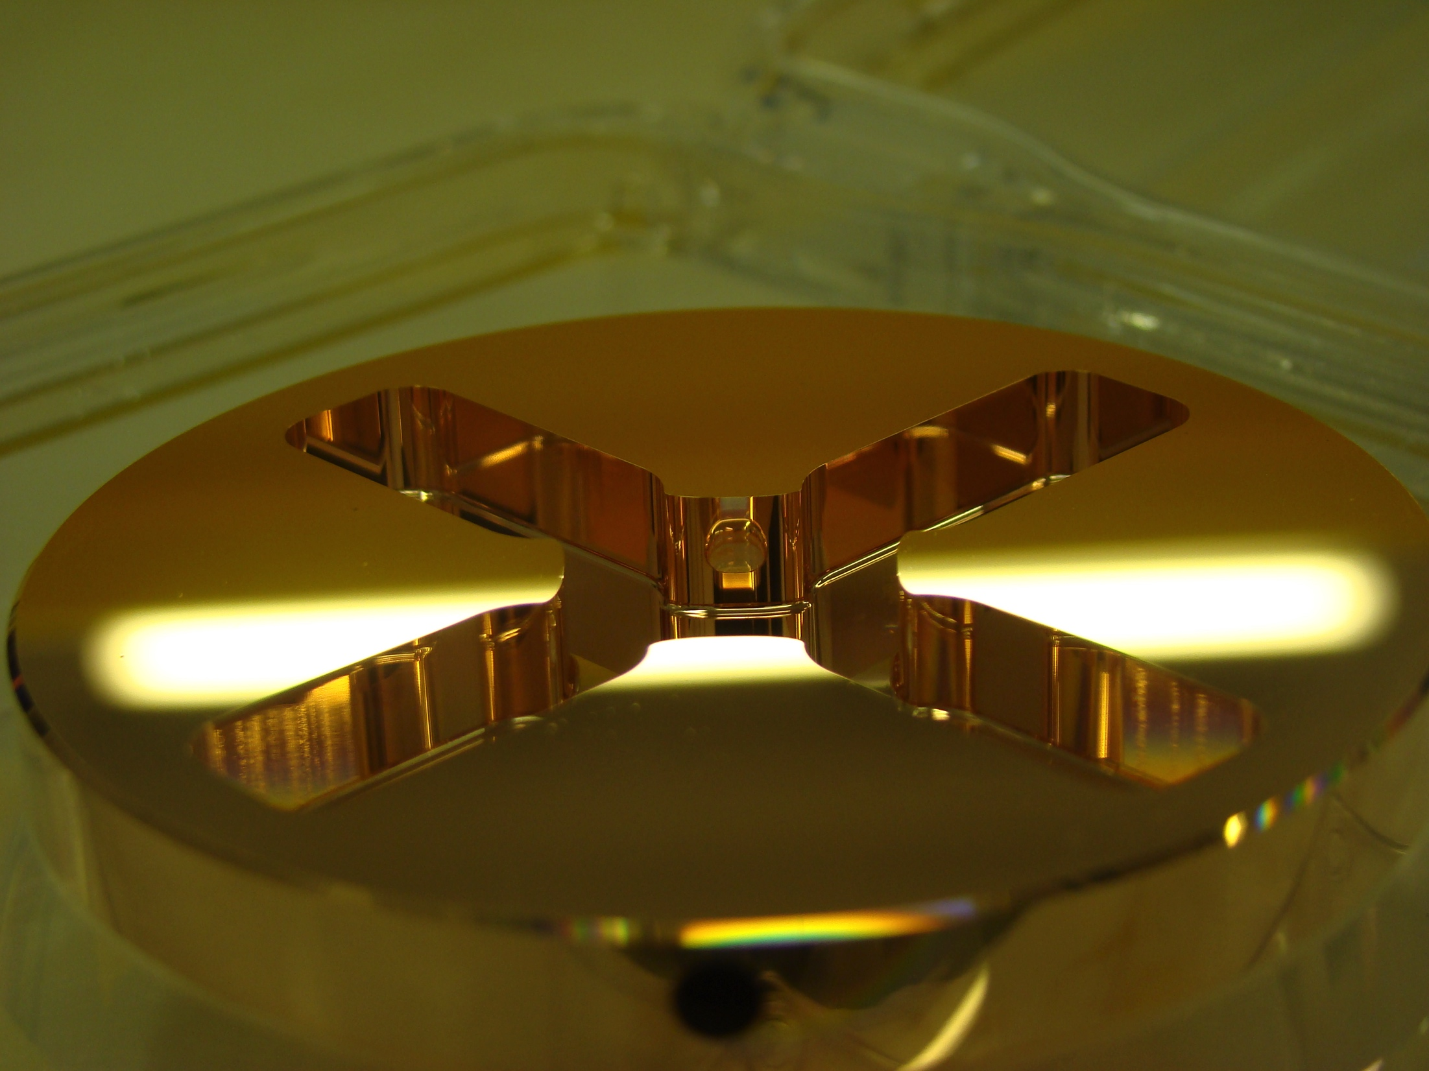

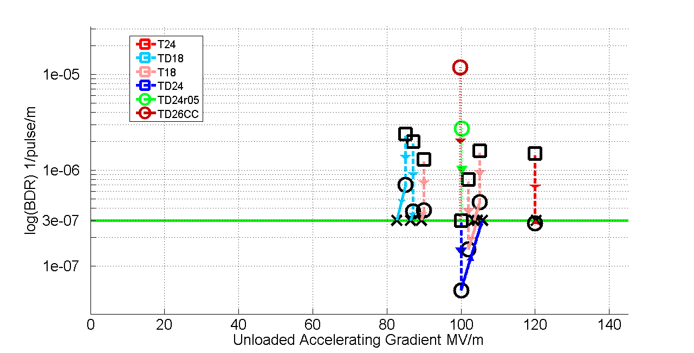
X-band structures and testing
X-band Technologies:
High gradient structures and high efficiency RF (structure prod. in green)
X-band High power Testing Facilities (x3 increase) (in red)
Use of X-band technologies for FELs
VDL
CERN
PSI
CIEMAT
SLAC
◉
KEK
◉
◉
◉
◉
Tsinghua
SINAP
◉
◉
◉
◉
◉
◉
Structure manufacturing and testing at KEK crucial, now also for structures produced at Tsinghua and SINAP
8

Slide 3
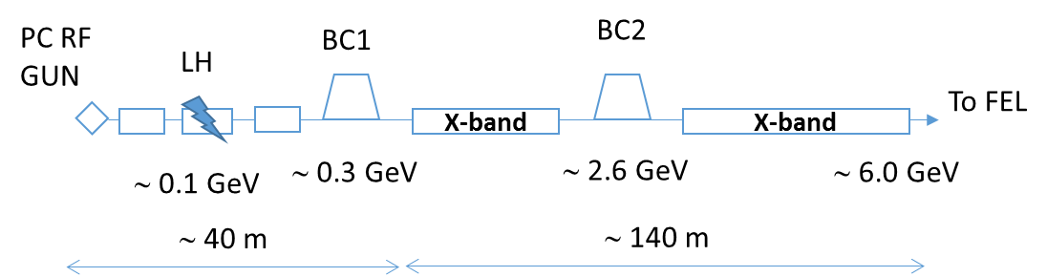
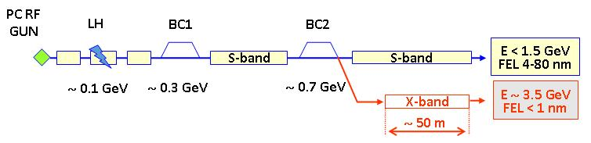
Xband facilities - FELs
X-band technology appears interesting for compact, relatively low cost FELs – new or extensions
  Logical step after S-band and C-band
  Example similar to SwissFEL: E=6 GeV, Ne=0.25 nC, σ_{z}=8μm
Use of X-band in other projects will support industrialisation
  They will be klystron-based, additional synergy with klystron-based first energy stage
Started to collaborate on use of X-band in FELs
  Australian Light Source, Turkish Accelerator Centre, Elettra, SINAP, Cockcroft Institute, TU Athens, U. Oslo, Uppsala University, CERN
Share common work between partners
  Cost model and optimisation
  Beam dynamics, e.g. beam-based alignment
  Accelerator systems, e.g. alignment, instrumentation…
Define common standard solutions
  Common RF component design, -> industry standard
  High repetition rate klystrons (400Hz system at CERN from Toshiba)
Great potential for collaboration

Slide 5
ATF2: Stabilisation Experiment
The CLIC coll. is very interested in a longer term programme at ATF2 and ideas exist for:
FFS performance, including building 2 octupoles for ATF2 (to study FFS tuning with octupoles)
Stability, feedbacks, instrumentation
General support for ATF2 operation
Support UK and Spanish LC activities (contracts with 7 universities with 50/50 sharing) that are have a significant ATF component

Slide 6
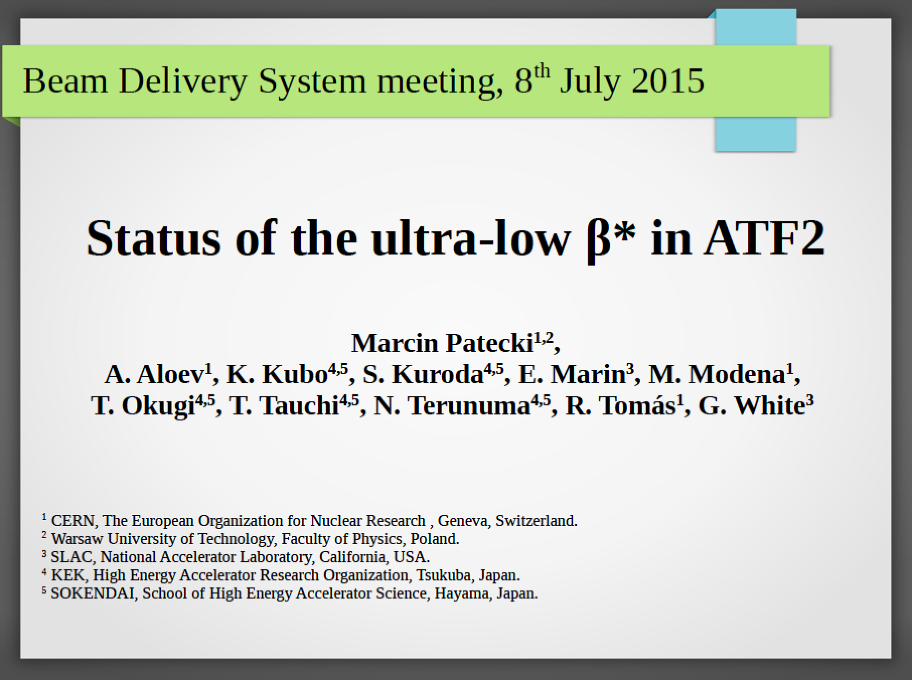
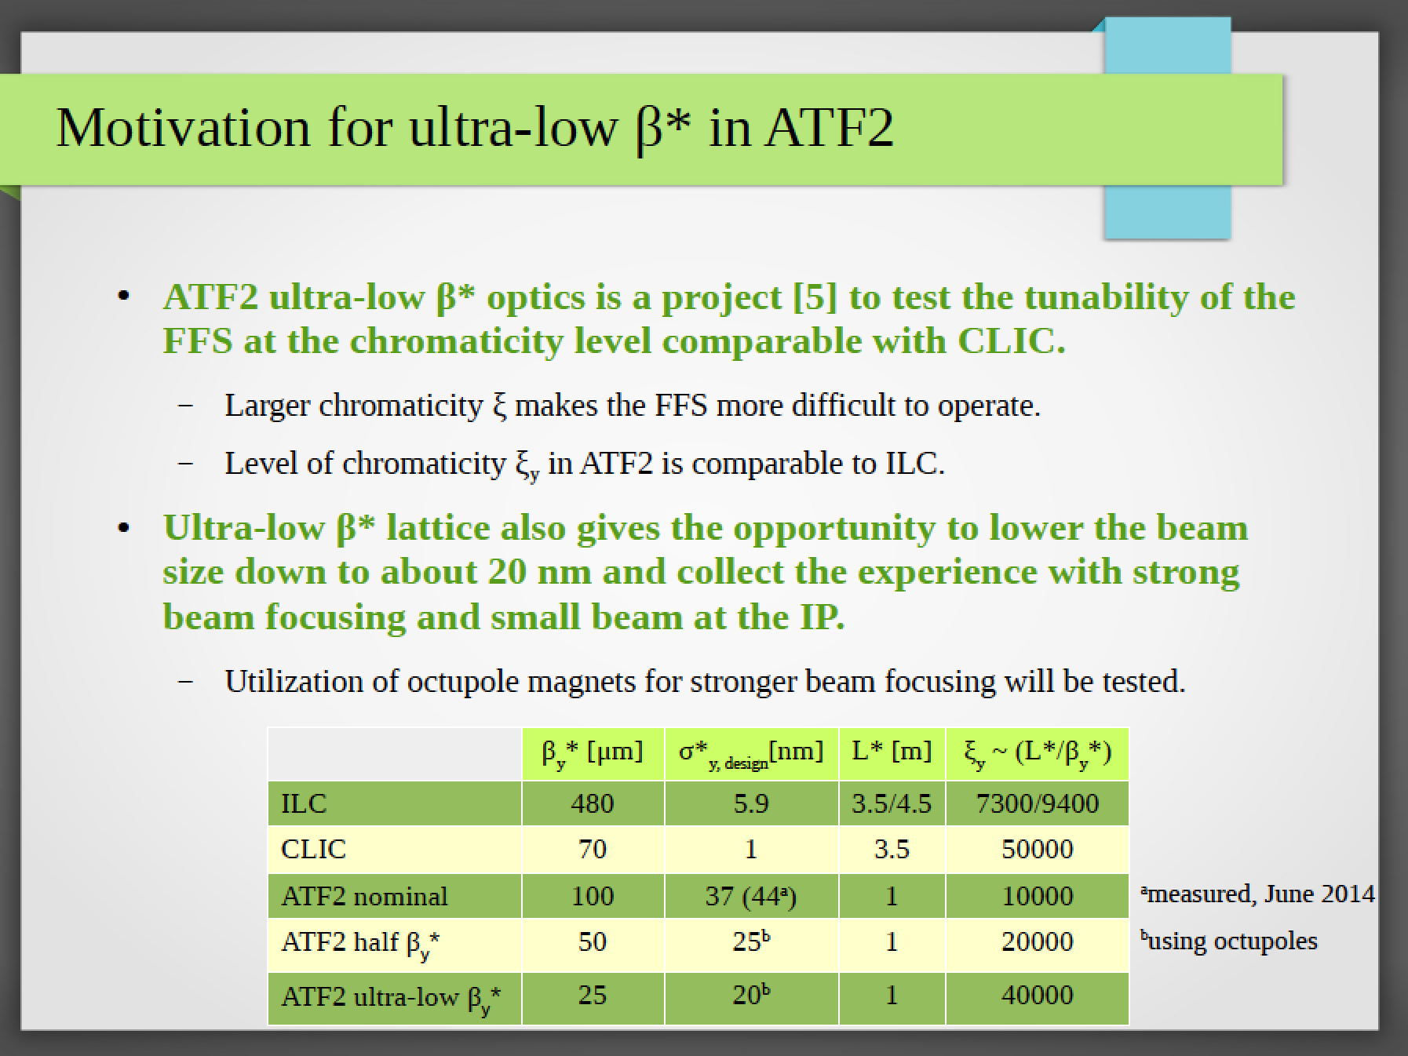
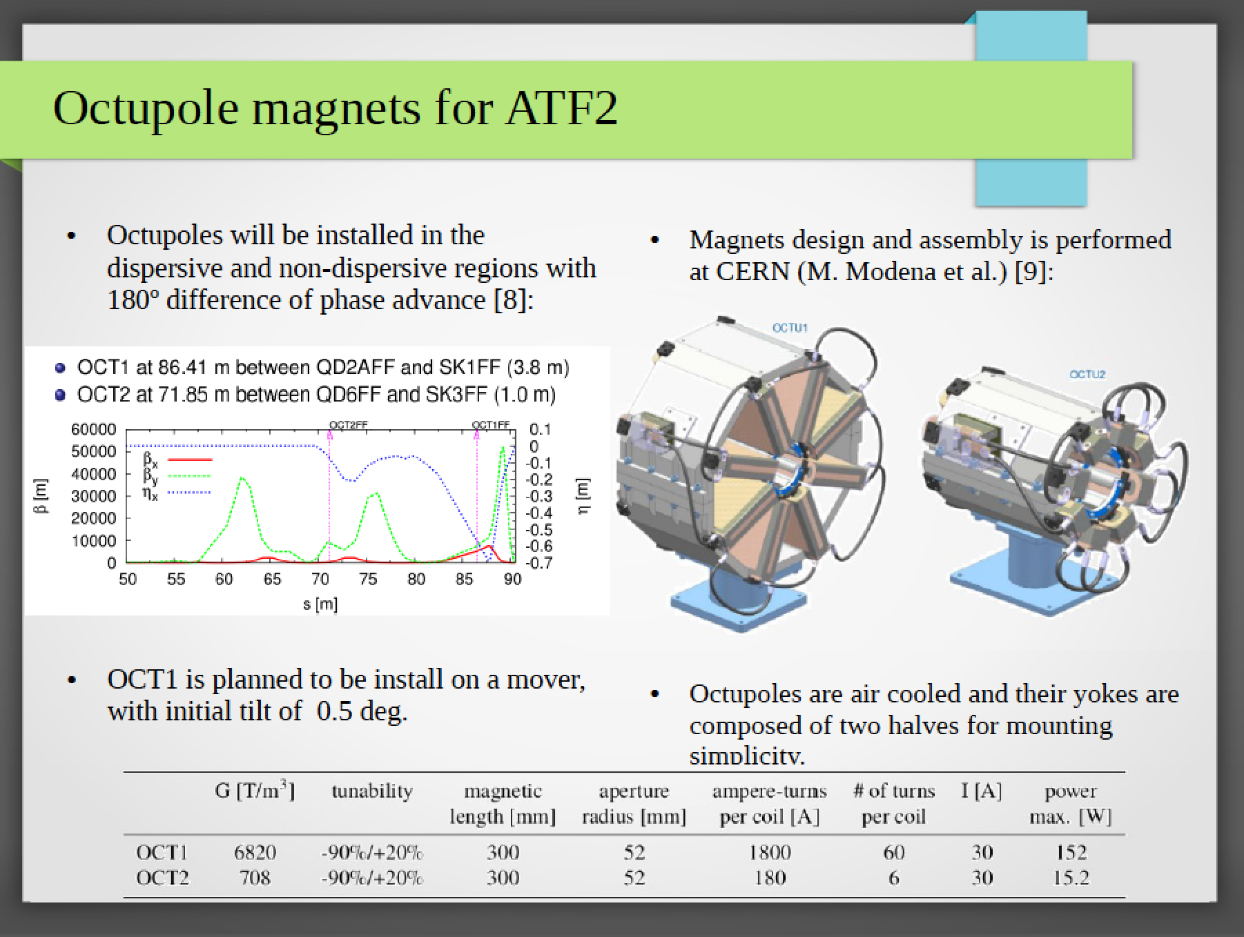

Slide 7
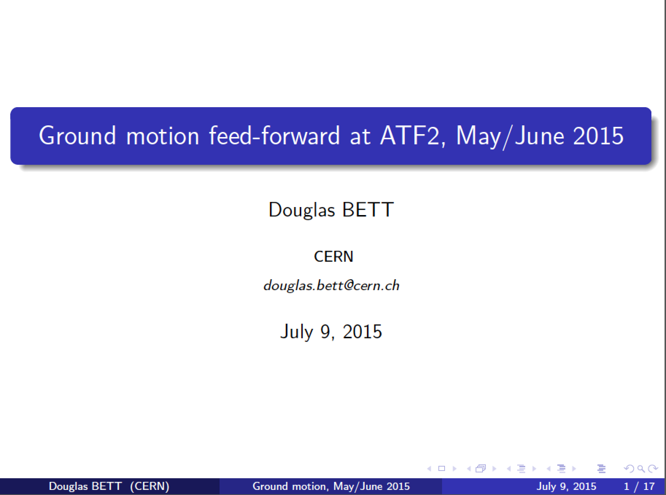
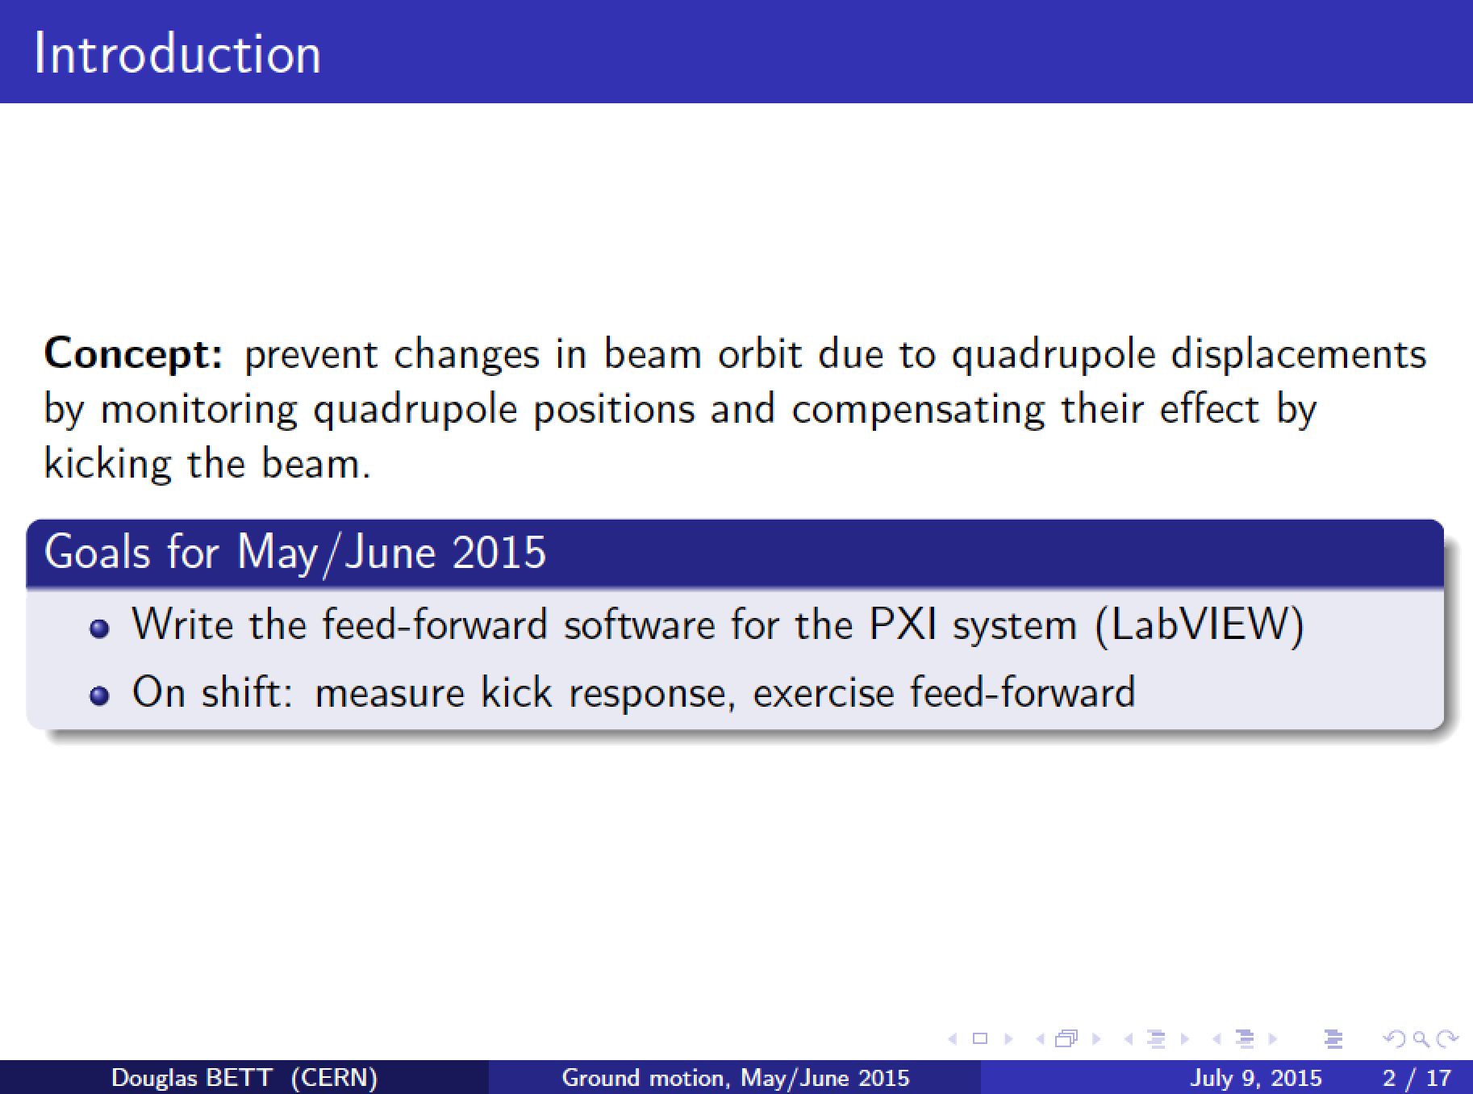

Slide 8
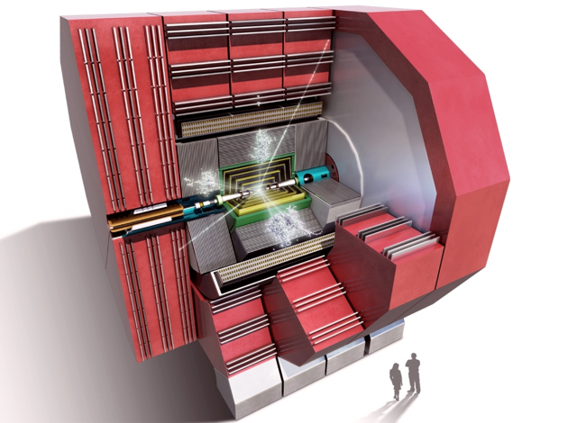
CLICdp
and overlapping activities with ILC detectors
ILC/CLIC synergies in many areas
CLIC CDR detector concepts are based on ILC concepts, adapted for CLIC
Common software tools
  Major upgrade of tools ongoing through a common ILC/CLIC effort
Overlapping physics case below 1 TeV
  Sharing methods; making cross-checks
Large overlap in detector technologies
  Strong synergies within CALICE and FCAL
  Synergies in engineering and magnet design
Ongoing detector optimisation for ILC and CLIC
  Overlapping activities; opportunities for cross-checks
CLIC detector and physics study
http://clicdp.web.cern.ch/
currently 26 institutes
Overall a long-term work-floor-type cooperation
a few examples in the next slides

Slide 9
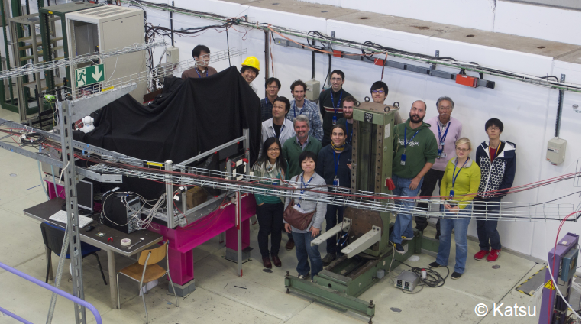
ECAL + HCAL Optimisation / R&D
Optimisation of calorimeter systems for PFA: Understanding the parameters driving performance
  Concrete example: Impact of cell size on jet energy resolution
Development of technology for highly granular calorimeters – main detector systems and forward instrumentation
Radiation hard sensors for the forward region: GaAs, Diamond,…
Test beams of technological prototypes of highly granular calorimeters

Slide 10
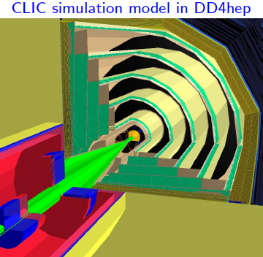
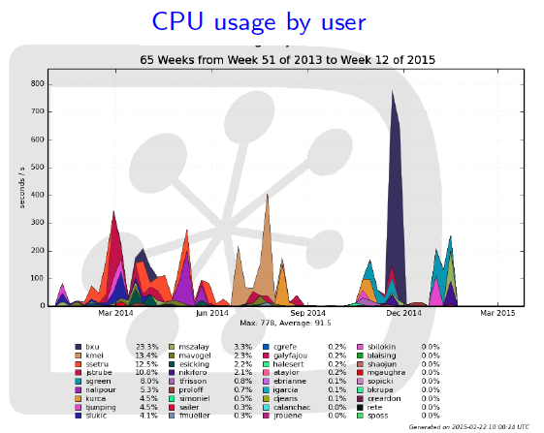
Linear Collider software suite
Work ongoing on major improvements to simulation and reconstruction software
New geometry description (DD4hep)
  For simulation, reconstruction, event display, alignment….
  Generic, for ILC and CLIC, and also for other projects (FCC)
  DD4hep interfaces (e.g. to simulation/reconstruction) also under development
New/optimised track reconstruction
Common ILCDIRAC grid production tool

Slide 11
E-JADE
Europe-Japan Accelerator Development Exchange Programme
Programme 2015-2018:
Three main technical WPs (1-3 above)
Supports extended stays of European Researchers in Japan
Started January 1st
Can also support CERN office at KEK (WP 4)

Slide 12
CERN-KEK LCs
Solid activity in all areas, interesting results expected in all area during 2015-16 ….

