Slide 1
Status of CERN-KEK office
Steinar Stapnes and Katsuo Tokushuku

Slide 2
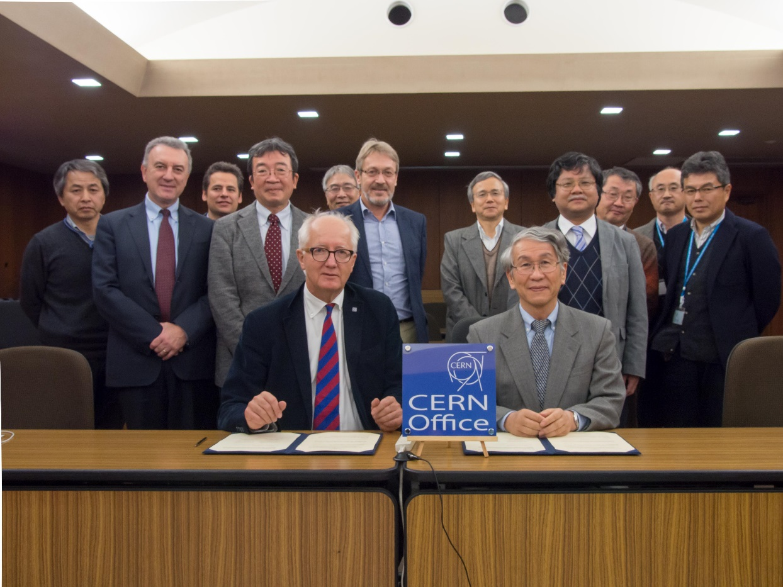
Signing Ceremony in the previous CERN-KEK meeting (25/Nov/2014)
KEK News release:
https://www.kek.jp/en/NewsRoom/Release/20141125114000/
CERN Courier:
http://cerncourier.com/cws/article/cern/59942

Slide 3
Organisation:
Under the CERN-KEK committee
Supervisors:
  Steinar Stapnes and Katsuo Tokushuku
Overall Coordination:
  CERN: F. Bordry, R. Voss and S. Stapnes
  KEK: Y.Okada, K.Oide, A. Yamamoto
  (K. Oide -> S. Yamaguchi from April/2015)

Slide 4
Status:
Office Rooms are identified:
  CERN office at KEK: (temporary) Building 3-404
      Shared by Toshiko-Yuasa-LB (French-Japan collaboration)
  KEK office at CERN: Building 30-6-021
      M. Watanabe (Administrative trainee) stay half time.
The document to transfer money to each side is being prepared. (Hope to start transaction in a month)

