Slide 1
Funding for upgrade,
Training programs,
CERN-Japan Fellow,
CERN summer student
Katsuo Tokushuku (KEK)
30-07-2015
CERN-KEK Committee

Slide 2
Steps toward requesting new resource
(reminder)
November 2013:
  International review on the Japanese contribution on LHC and ATLAS.
    Chair: Eckhard Elsen (DESY)
    Members including, Fabiola, Jordan Nash (CMS), Andreas Schopper (LHCb), Jonathan Dorfan (OIST), Lucio Rossi…..
Year 2013: Proposal submission to the update of ‘Master Plan of big science project’ called by the Science Council of Japan.
  ~100 proposals in total are accepted from various area of science.
  27 projects were chosen as ‘the high priority’ projects in March 2014
  Unfortunately, HL-LHC was not chosen among the 27.
    (High priority projects in HEP/NP are, Hyper-Kamiokande and J-PARC extension. ILC is handled separately.)
  It is very difficult to push HL-LHC under the condition that the Japanese HEP first priority is on the ILC.
  Outcome: It is not so easy to request HL-LHC budget in the straight way before the next update of the Master plan.
  But, the importance of the LHC upgrade is known to the KEK-DG and (a part) of the MEXT section. => Prepare and update the budget plan to be ready for any chance.

Slide 3
Preparation on funding for LHC Upgrade: recent update
The situation is unchanged. We cannot submit the funding requests of LHC/ATLAS upgrade for the next FY (FY2016)
The straight solution is to wait for the next update of the master plan.
-> Call for re-vision: Dead line ; March 2016:
The New list is likely to be created by March 2017.
  => We are always keep the budget profile updated, preparing for the sudden resource release such as the stimulus plan etc.

Slide 4
Budget proposal (un-submitted)
(July 2015 version: tuned with the new LHC schedule)
1 Oku-yen = 10⁸ yen ~ 1MCHF
(if 1CHF=100yen : =129 yen today)
JPFY (Oku-yen) | 2016 | 2017 | 2018 | 2019 | 2020 | 2021 | 2022 | 2023 | 2024 | 2025 | Total
LHC/PSB in-kind | 0.68 | 1.05 | 4.42 | 11.9 | 8.99 | 4.40 | 2.00 | 1.22 | 0.28 | 0 | 34.9
LHC (industrial contribution) | 1.33 | 2.00 | 3.33 | 4.67 | 4.67 | 3.33 | 3.67 | 2.00 | 0 | 0 | 25.0
ATLAS | 0.71 | 1.44 | 4.79 | 8.55 | 8.00 | 6.79 | 6.83 | 5.97 | 3.16 | 1.28 | 47.5
Total | 2.72 | 4.49 | 12.54 | 25.10 | 21.66 | 14.52 | 12.50 | 9.19 | 3.44 | 1.28 | 107.4
The critical itmes in 2016-2017:
RF amplifiers for PS-Booster and R&D for the D1 magnet

Slide 5
Training Programmes of KEK ATLAS institute staff at CERN
Administrative Staff
Oct. 2000 - Oct. 2001 M. Gomita ATLAS (P. Schmid)
Oct. 2001 - Oct. 2003 H. Koda ATLAS (M. Nordberg)
Oct. 2003 - Dec. 2004 A. Yamaguchi ATLAS (M. Nordberg)
Apr. 2005 - Mar. 2007 S. Iwami ATLAS (M. Nordberg)
Apr. 2007 - Mar. 2009 Y. Kawanishi ATLAS (M. Nordberg)
Apr. 2009 – Mar. 2011 H. Fukuda ATLAS (M. Nordberg)
Apr. 2011 – Mar. 2013 H. Ishikawa ATLAS (M. Nordberg)
Apr. 2013 －Mar. 2015 K.Yoshida ATLAS (F. Dittus)
Apr. 2015 – Mar. 2017 Ms. Miyako Watanabe ATLAS (F. Dittus)
This program is supported by the interests of Japanese Fund-in-Trust for LHC.
Safe until 2018 but we need a new fund for the stable continuation -> CERN-KEK office!

Slide 6
Training Programmes of KEK ATLAS institute staff at CERN
(2) Academic Staff
Oct. 2002 - Jun. 2003 T. Kosuge Interlock system
Aug. 2003 - Aug. 2004 H. Nakamura Radiation instrumentation
Apr. 2004 - Mar. 2005 Y. Yasu DAQ system for ATLAS
Aug. 2005 - Jul. 2006 M. Taira Chemical environmental impact
Oct. 2006 - Sep. 2007 A. Ueda High power pulse magnet for LHC
Oct. 2007 – Sep. 2008 H. Nakajima Works at AB/RF division
Oct. 2008 – Sep. 2009 H. Katagiri Works at AB/RF division
Oct. 2011－Sep. 2012 Y. Ikemoto Works on Electronic designs.
2014- March 2015: Wataru Takase Works on (cloud) computing
2014- June: 2015: Masato Kawamura Works on Accelerator-RF
( A call for 2015 was closed in November. : No candidate
A call for 2016 will be soon announced)
These programs is supported by the interests of Japanese Fund-in-Trust for LHC. Safe until 2018 but we need a new fund for the stable continuation
-> CERN-KEK office!

Slide 7
CERN-Japan fellows
Ex-fellows
Apr. 2006 - Mar. 2009 T. Kono ATLAS Trigger (N. Ellis)
(Now at Ochanomizu women Univ)
Sep. 2006 - Aug. 2009 M. Kataoka ATLAS Eγ (D. Froidevaux) (Now at Texas/Arlington)
Oct. 2006 - Jul. 2009 M. Aiba LHC injector upgrade (R. Garoby) (Now at PSI)
Dec. 2007- Nov. 2010 H. Yokoya Theory (J. Ellis) (Now at Taipei TNU)
Oct. 2008 - Sep. 2011 T. Sumida ATLAS, Tile CAL / Jet (T. Carli) (Now at Kyoto Univ)
Jun.2009 - May 2012 S. Shimizu ATLAS, Tile CAL / Jet (T. Carli) (Now at Kobe Univ)
Apr.2011 – Mar 2014 Y. Nakahama ATLAS, Trigger (B. Petersen)
(Now JSPS fellow CERN/KEK)
Apr.2011 - Mar 2014 M. Kaneda ATLAS Trigger (T. Wengler)
(Now Tokyo Institute of Technology: Double Chooz)
Current fellows
May.2013 – Apr 2016 Hideyuki Oide ATLAS IBL (H. Pernegger)
May.2013 - Apr 2016 Yuta Takahashi CMS HCAL (E. Perez)
May.2014- Apr 2017 Akira Miyazaki Isolde (Accelerator) (Maria Jose Garcia Borge)
Only one more fellow! :
8 applicants in Nov 2014, Interview 5 in Feb: No good candidates
-> We will make the (last) call again in Nov 2015.
N.B. Term of CERN-Japan fellow is 3 years by default.
No extension is possible.

Slide 8
Financial status and Future Plan
F. Dittus‘s summary
Code |  | July2015 Balance
T290310 | Was Fellow | 0
T290320 | Magnet | 0.52
T290330 | Training+Fellow | 1,113,900.61
Fellow 9000CHF/month
Training 5000CHF/month
On Dec 2019： - 24k CHF deficit
i.e. We need new source from Sept. 2019

Slide 9
CERN summer school
Supported by KEK
CERN total (Year 2015): 140 NMS students selected among 1251 applicants
136 MS students selected among 988 applicants

Slide 10
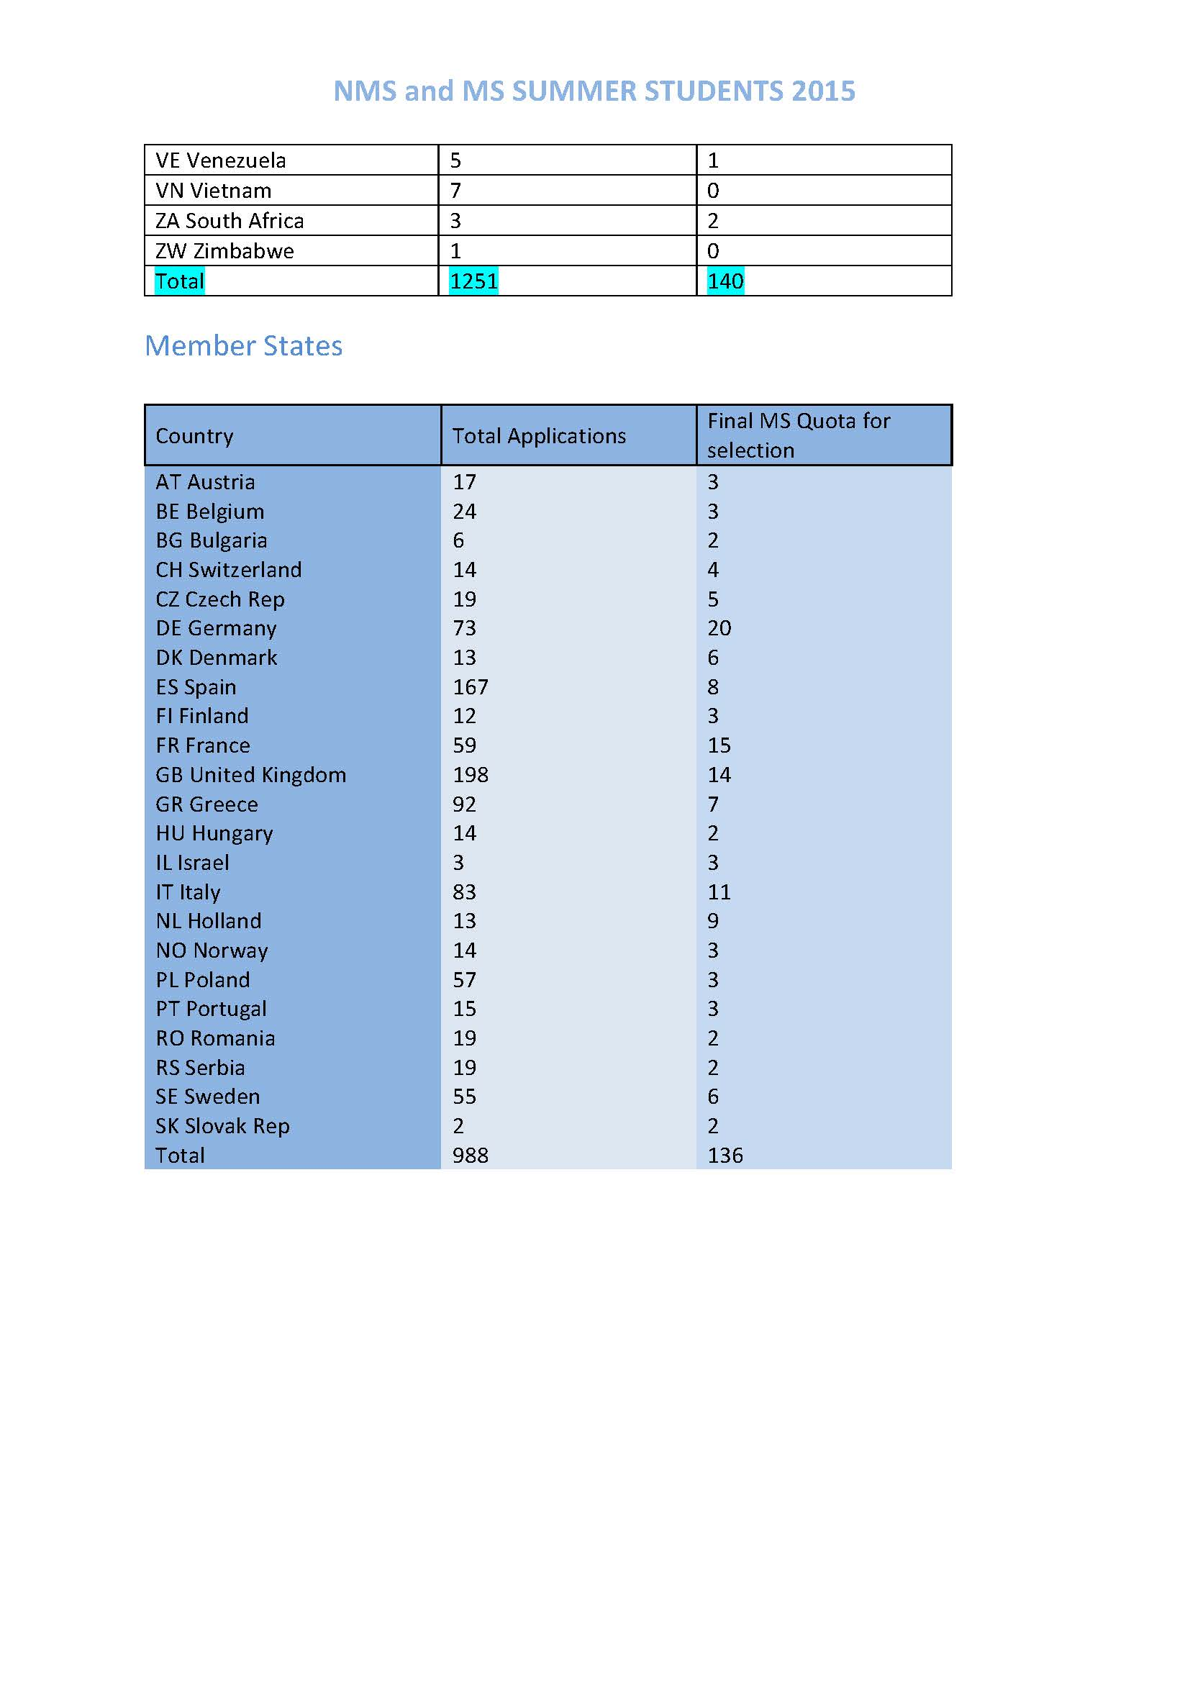

Slide 11
Two issues:
Rating of Summer students candidates
  Japanese summer students are pre-selected in Japan after interviewing all applicants. (5 among 18 for Year 2015)
  MS students can apply freely, but selected by CERN supervisors up to their quota.
  There is a ‘rate’ for MS students to show the good candidates (“*” is set by the pre-selectors). -> Supervisors selects good students by searching for the “*” mark -> None of Japanese students are caught from the search!

Slide 12
Two issues:
Support for Academic/Administrative person
  Per Diem is calculated by yen and converted to CHF. -> Rapid decrease after “Strong CHF”.
  2007: 4885 CHF/month
  2009: 5914 CHF/month
  2013: 5782 CHF/month
  2014: 4272 CHF/month
  2015: 3682 CHF/month:
  (Shall we re-think about the scheme, including the improvement for the current visitor?)

