Slide 1
Accelerator R&D status in cooperation with CERN and KEK
BSM, BHM (T. Mitsuhashi)
2. Crab Cavity (Y. Morita)
3. X-band Acc. Structure (T. Higo)
10th Meeting of the CERN-KEK Committee
30th July, 2015, at CERN
Seiya Yamaguchi, KEK

Slide 2
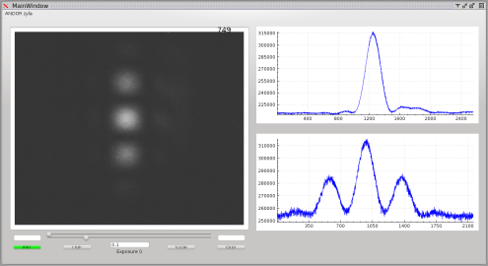
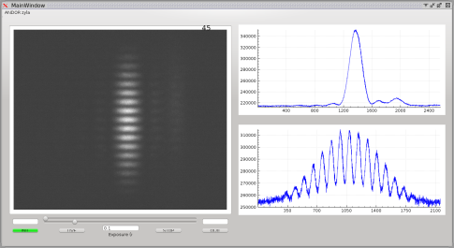
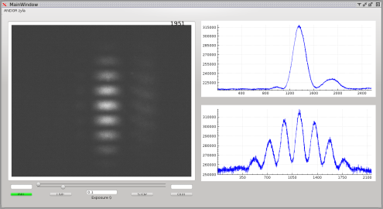
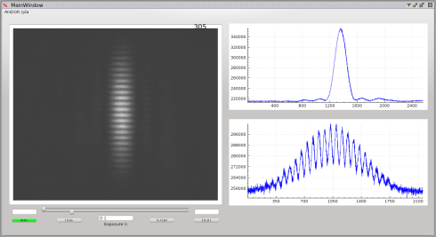
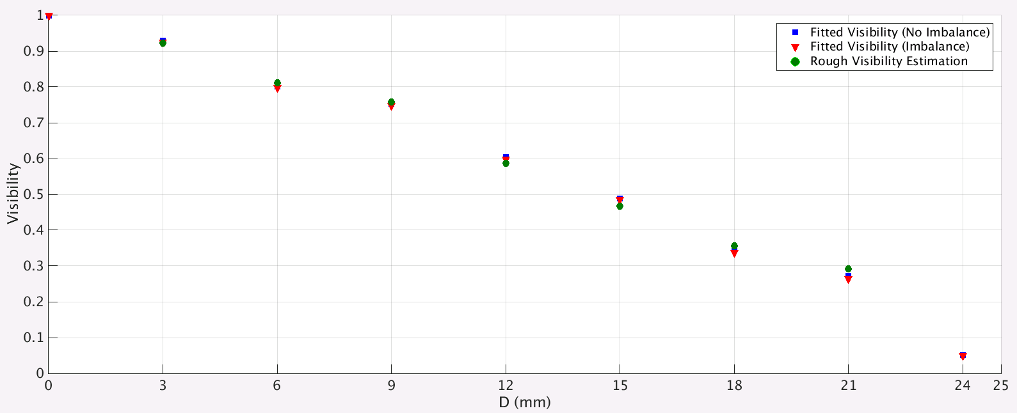
BSM by SR interferometry
LHC beam size measurement at 6.5TeV
World first interferogram from proton beam!
d=3mm
d=9mm
d=6mm
d=18mm
Vertical beam size via Fourier transform 230μm
Spatial coherence as a function of double slit separation

Slide 3
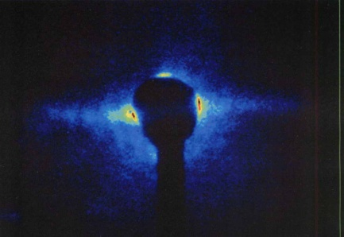
Coronagraph for beam halo measurement
Opaque disk for eclipse
Relay lens
Source
Field lens
Lyot stop
Objective lens
Setup of the coronagraph at B1
Objective lens
Obstacle blocking the
Beam core
Square slits
defining the aperture
Field lens
Relay lens
Magnifier
lens
Lyot stop

Slide 4
Schedule hereafter
Interferometer
remaining issues;
Install automatic double slit.
Calibration with Hartmann mask.
Test for horizontal beam size measurement.
Coronagraph
Construct the first coronagraph (10⁴ contrast) until end of October.
Optical testing in November.
Install to B1 in December.
Budget in JFY2015: 0.30MJPY for lenses

Slide 5
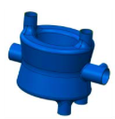
CERN-KEK collaboration on the crab cavity development
Valid initially until 31 March 2017
Objectives:
Based on research and development on crab cavities for the LHC luminosity upgrade progressed, as a cooperative work between KEK and CERN, this agreement, Appendix 16, aims to develop state of the art surface treatment techniques for high field superconducting crab cavities that deflect beam bunches in order to realize the crab crossing for the LHC accelerator luminosity upgrade.
Crab Cavity
・ Type : DQW (400 MHz)
・ Used at ATLAS and CMS
KEK responsibilities for:
Development of a vertical electro-polishing (VEP) system,
Application of VEP to crab cavities,
Fundamental studies on vertical electro-polishing conditions,
CERN responsibilities for:
Necessary technical information and requirements for LHC crab cavities,
Support for the research activities in 3.1, such as experimental evaluation for electro-polishing and cavity performances,

Slide 6
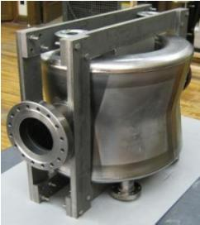
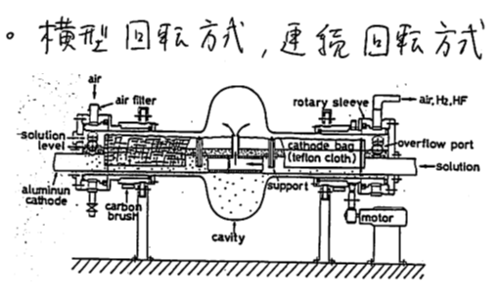
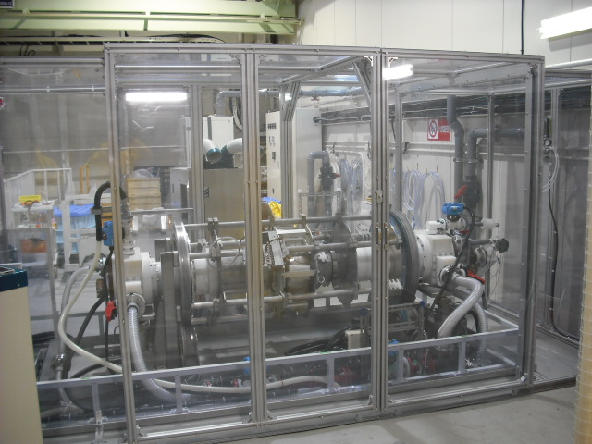
Crab cavities for HL-LHC
LHC Crab Cavity
Compact and complicated cavity structure to meet space requirements
High fields are required to sufficiently deflect beam bunches
  3.4 MV per cavity at 400 MHz with Q=10¹⁰,T=2K
  14 MV per interaction point using 4 crabs
  (KEKB crab: 1.4 MV at 509MHz with Q=10⁹,T=4.4K)
Surface treatment is one of important issues
  CP(Chemical polishing) has been used so far
EP (Electro-polishing)
Developed for TRISTAN SC cavities
Horizontally rotating technique
Smoother surface than CP
Standard treatment method for high field cavities
VEP (Vertical EP)
We proposed an R&D on application of EP to LHC crab cavities
Horizontally rotating EP system can not be used
Vertical positioning EP at our EP facility
BNL DQW cavity
Horizontally rotating EP system developed for TRISTN SC cavities
Our EP apparatus for 500 MHz cavity

Slide 7
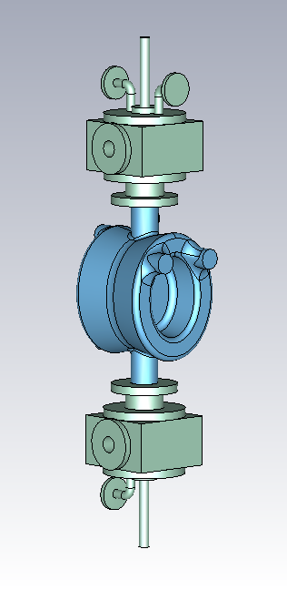
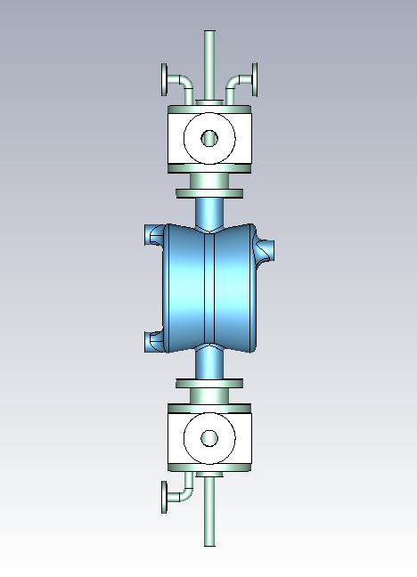
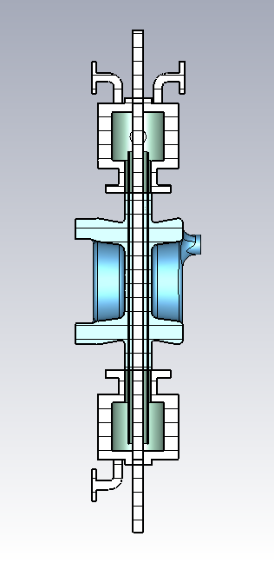
Vertical EP apparatus
N₂ inlet
N₂ outlet
Upper Teflon box
Electrolyte outlet
Al electrode
Teflon cathode bag
Electrolyte inlet
Lower Teflon box
Drain port

Slide 8
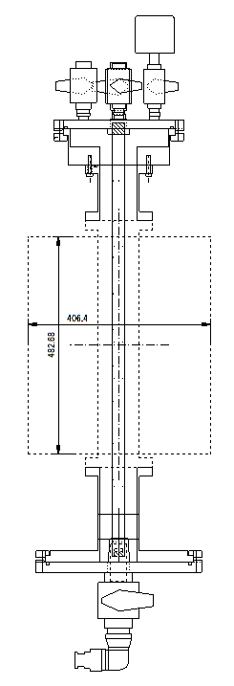
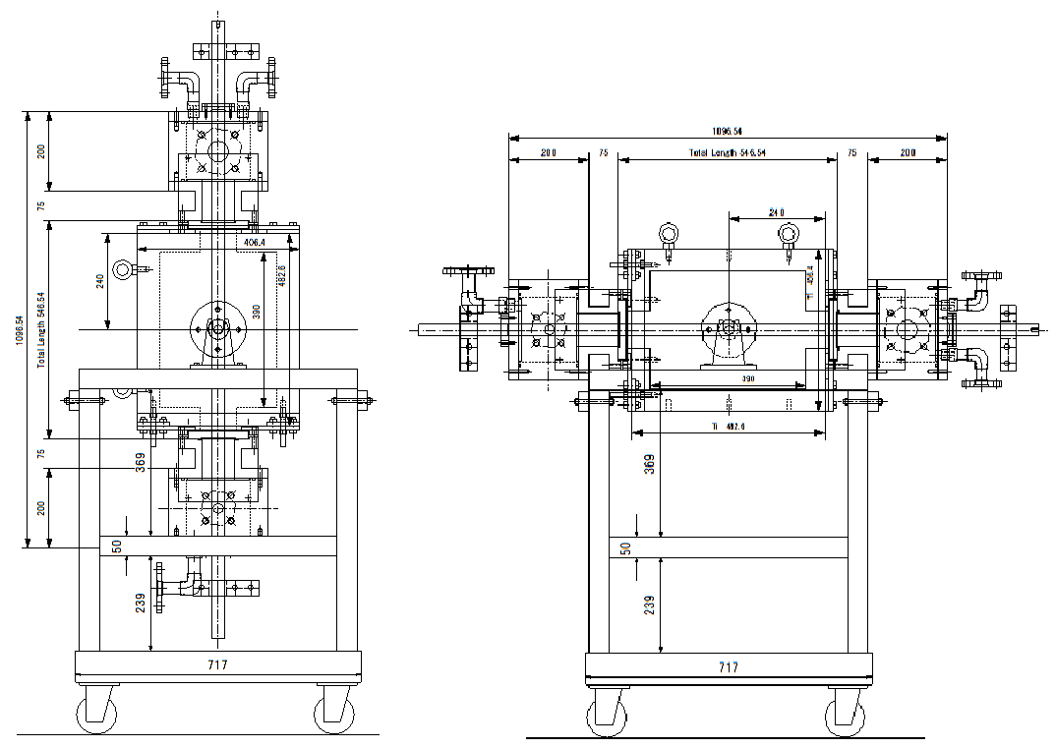
Timetable for Vertical EP at KEK
Item | July 2015 | Aug. | Sep. | Oct. | Nov. | Dec. | Jan. 2016
Electrode
Teflon box
Rotation jig
Ozone rinsing jig
Dummy cavity
Fitting check
Vertical EP
SRF operation for SuperKEKB
Fabrication
Fabrication
Fabrication
Fabrication
Fabrication
Coupler conditioning
at room temperature
Start up
for SuperKEKB

Slide 15
E³⁰・t_{p}⁵
BDR
=const.
E*
Normalized gradient is increasing smoothly with pulse number.
BDR is roughly decreasing linearly with pulse number.

Slide 20
end

