Slide 1


LHC Upgrade update
Lucio Rossi – CERN
HL-LHC project leader
talk to 9th CERN-KEK committee
21 November 2014 @ KEK

Slide 2
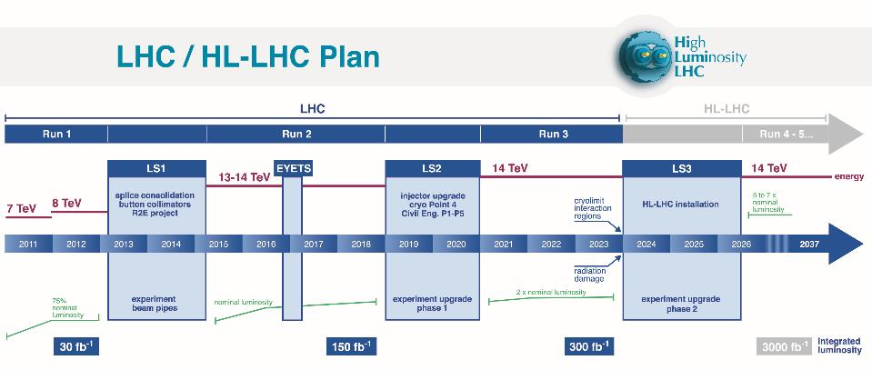
0.75 10³⁴ cm⁻²s⁻¹
50 ns bunch
high pile up ∼40
1.7 10³⁴ cm⁻²s⁻¹
25 ns bunch
pile up ∼45
1.7-2.2 10³⁴ cm⁻²s⁻¹
25 ns bunch
pile up ∼60
Lumi saturation &
Technical bottlenecks:
50 ⇒ 25 ns

Slide 3

HL-LHC Baseline Parameters
WP2 charge – PLC webpage
Parameter | Nominal LHC​ (design report) | HL-LHC 25ns (standard)​ | HL-LHC 25 ns (BCMS) | HL-LHC 50ns
Beam energy in collision [TeV] | 7 | 7 | 7 | 7
N_{b} | 1.15E+11 | ​2.2E+11 | 2.2E11 | ​3.5E+11
n_{b} | ​2808 | ​2748¹ | 2604 | ​1404
Number of collisions at IP1 and IP5 | 2808 | 2736 | 2592 | 1404
N_{tot} | 3.2E+14 | 6.0E+14 | 5.7E+14 | 4.9E+14
beam current [A] | ​0.58 | 1.09 | 1.03 | 0.89
x-ing angle [μrad]​ | 285 | 590 | 590 | 590
beam separation [σ] | 9.4 | 12.5 | 12.5 | 11.4
β* [m] | 0.55 | ​0.15 | 0.15 | ​0.15
ε_{n} [μm]​ | 3.75 | ​2.50 | 2.50 | 3
ε_{L} [eVs]​ | 2.50 | ​2.50 | 2.50 | ​2.50
r.m.s. bunch length [m] | ​7.55E-02 | ​7.55E-02 | ​7.55E-02 | ​7.55E-02
Piwinski angle | ​0.65 | 3.14 | 3.14 | 2.87
Geometric loss factor R0 without crab-cavity | ​0.836 | 0.305 | 0.305 | 0.331
Geometric loss factor R1 with crab-cavity | (0.981) | 0.829 | 0.829 | 0.838
beam-beam / IP without Crab Cavity | 3.1E-03 | ​3.3E-03 | ​3.3E-03 | 4.7E-03
beam-beam / IP with Crab cavity | 3.8E-03 | 1.1E-02 | 1.1E-02 | 1.4E-02
Peak Luminosity without crab-cavity [cm⁻² s⁻¹] | 1.00E+34 | 7.18E+34 | 6.80E+34 | 8.44E+34
Virtual Luminosity with crab-cavity: Lpeak*R1/R0 [cm⁻² s⁻¹] | (1.18E+34) | 19.54E+34 | 18.52E+34 | 21.38E+34
Events / crossing without levelling w/o crab-cavity | ​27 | 198 | 198 | 454
Levelled Luminosity [cm⁻² s⁻¹] | - | ​5.00E+34 | 5.00E34 | 2.50E+34
Events / crossing (with levelling and crab-cavities for HL-LHC) | 27 | 138 | 146 | 135
Peak line density of pile up event [evt/mm] (max over stable beam) | 0.21 | 1.25 | 1.31 | 1.20
Levelling time [h] (assuming no emittance growth) | - | 8.3 | 7.6 | 18.0
LIU required
Collision values
Impedance, efficiency etc.
New IT Quads & ATS
This makes 250 fb⁻¹/y a solid goal
Crab Cavity required
Levelling required
Efficiency requires long fill times (ca. 10h)!

Slide 4
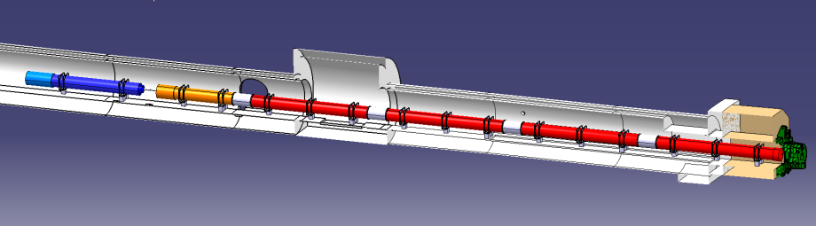





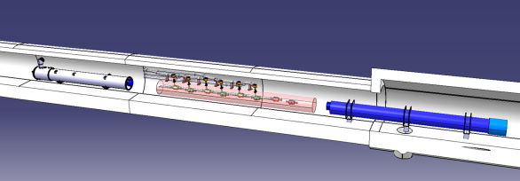


In-kind contribution and Collaboration for HW design and prototypes
ATLAS
CMS
Q1-Q3 : R&D, Design, Prototypes and in-kind USA
D1 : R&D, Design, Prototypes and in-kind JP
MCBX : Design and Prototype ES
HO Correctors: Design and Prototypes IT
Q4 : Design and Prototype FR
CC : R&D, Design and in-kind USA
CC : R&D and Design UK

Slide 5
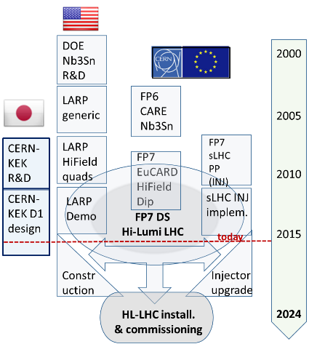
Collaborations
In addition to the FP7-HiLumi LHC (CERN contracts):
CEA (FR) for Q4 Design & proto (also completion Fresca2 technological demo)
INFN-Milano (IT): HO Corrector magnets Design and Prototypes
INFN-Genova (IT): D2 Design
CIEMAT (ES): IT Orbit corrector magnet (nested) desing and prototype
UniMan, UniLiv, UniLanc, STFC, SOTON … (UK) for collimators, CC, SC links
UniGE (CH), Uni. Bratislava (SK), Twente Univ. (NL) for Nb3Sn
KEK for D1 support and CC polishing
Greece and Sweden under discussion

Slide 6
Status of approval and Budget
March 2011: first budget evaluation of ∼830 MCHF
May 2013 Brussel : approval by Council as EU
June 2013: first construction money for HL-LHC in the CERN MTP
In 2014 HiLumi LHC established as 1st US priority by P5, process under way
June 2014: approval of MTP 2014-2018 with HL-LHC as main CERN project for the next decade. Provsion ofr CtC (till 2025 for 740 MCHF)
MTP 2016-2020 : discussion in June – for vote inSeptember 2015
    For approval) the Budget HiLumi until 2020: ∼400 MCHF
    It informs about the total CtC until 2026: ∼950 MCHF (material)

Slide 9
Charge to the Review Committee
Is the estimated budget of the project adequate (within reasons)?
Are there any options to reduce the budget and does the review team see opportunities for savings? What is the possible scope contingency?
What are the areas of high risk for scope, schedule or cost overrun?
Is the schedule well developed, credible and synchronized between the ongoing activities (as well as the LHC experiments)?
Are the foreseen resources correctly evaluated?
Will the expertise (management and technical) be available when needed?

Slide 10
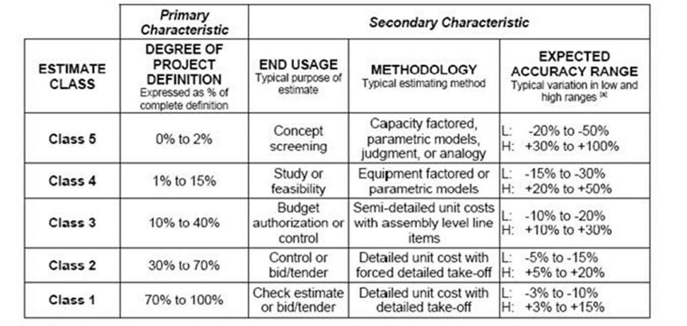
Table Uncertainty Class/ Risk Analysis

Slide 11
Overview of the Uncertainties
Syb-system | Design Readiness | Cost Risk | Schedule Risk
LIU
Linac 4 | final | Low | Low
PSB | detailed | Low | High
PS | detailed | Low | Low
SPS | detailed | Low | Med
Ions | adv conc | Med | Med
HL – LHC*
Magnets for IRs | detailed | High | High
Civil Engineering | conc | High | High
Cryogenics | detailed | Med | Low
Syb-system | Design Readiness | Cost Risk | Schedule Risk
Crab Cavities | preliminary | Med | Med
11 Tesla dipoles | preliminary | High | High
Cold powering | detailed | Med | Low
Collimation | preliminary | Med | Low
Ʃ = > 75% of HL LHC cost
Vacuum | preliminary | Low | Med
Warm powering | detailed | Med | High
MPS | preliminary | Med | Low
Beam Diagnostics | adv conc | High | Med
*WP are in the order of total cost
Description of design readiness by major subsystem. [Conceptual <10%,
Advanced Conceptual 10-30%, Preliminary 30-60%, Detailed 60-90%, Final >90%]
Notes:
Project Management & Technical Coordination
Accelerator Physics and Performance
Magnets for IRs (Inter.Regions and Match. Sections)
Crab Cavities (CC)
Collimation project
A)Cold Powering B)warm powering
Machine Protection & Magnet QPS
Collider-Experiment Interface
CryogenicsBeam
Energy Deposition & Absorber
11-T Dipole Two-in-One for DS
Vacuum
Beam Diagnostics
Kickers and Beam Transfer Lines
Integration and (de-)installation
Hardware commissioning
Infrastructure, Logistic and Civil Engineering

Slide 12

Executive summary
The review committee is very impressed with the enormous amount of work that was presented.
A very competent, engaged and effective management team is in place to manage both projects.
The Project Management tools used at CERN are state of the art, well utilized and well understood by the management team.
The presented project organizational structures are suitable to execute the projects. They matrix in-house as well as external resources very effectively into the organizations and they report directly to the Director of Accelerator and Technology.
The QA and QC programs are well established, flexible and effective. They allow to manage foreign contributions, In-Kind participation and international collaborations effectively.
The risk management program is somewhat new and should be fully integrated
The LIU and the HL-LHC project are well advanced in planning and execution for the stage they are in.
HL-LHC has received a clean bill of health
Rolf Heuer
Congratulations !

Slide 13
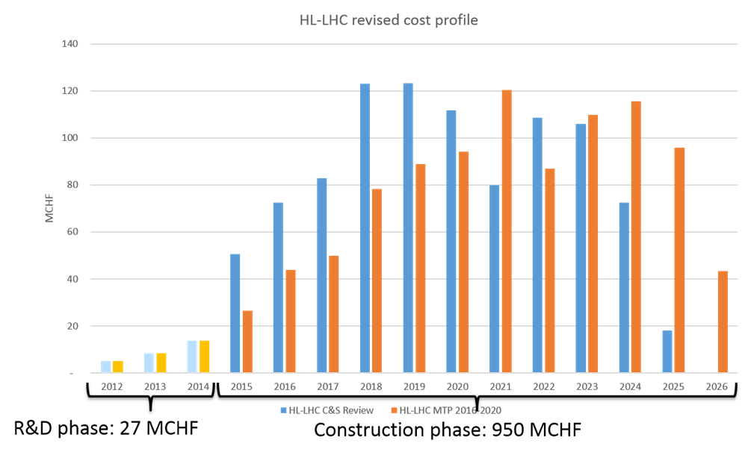
Budget Profile endorsed by C&SR (blue) and the one in CERN budget (orange)

Slide 14
HiLumi Book : a collection of papers in scientific style
20 papers, 300 pages
Coming out now

Slide 15
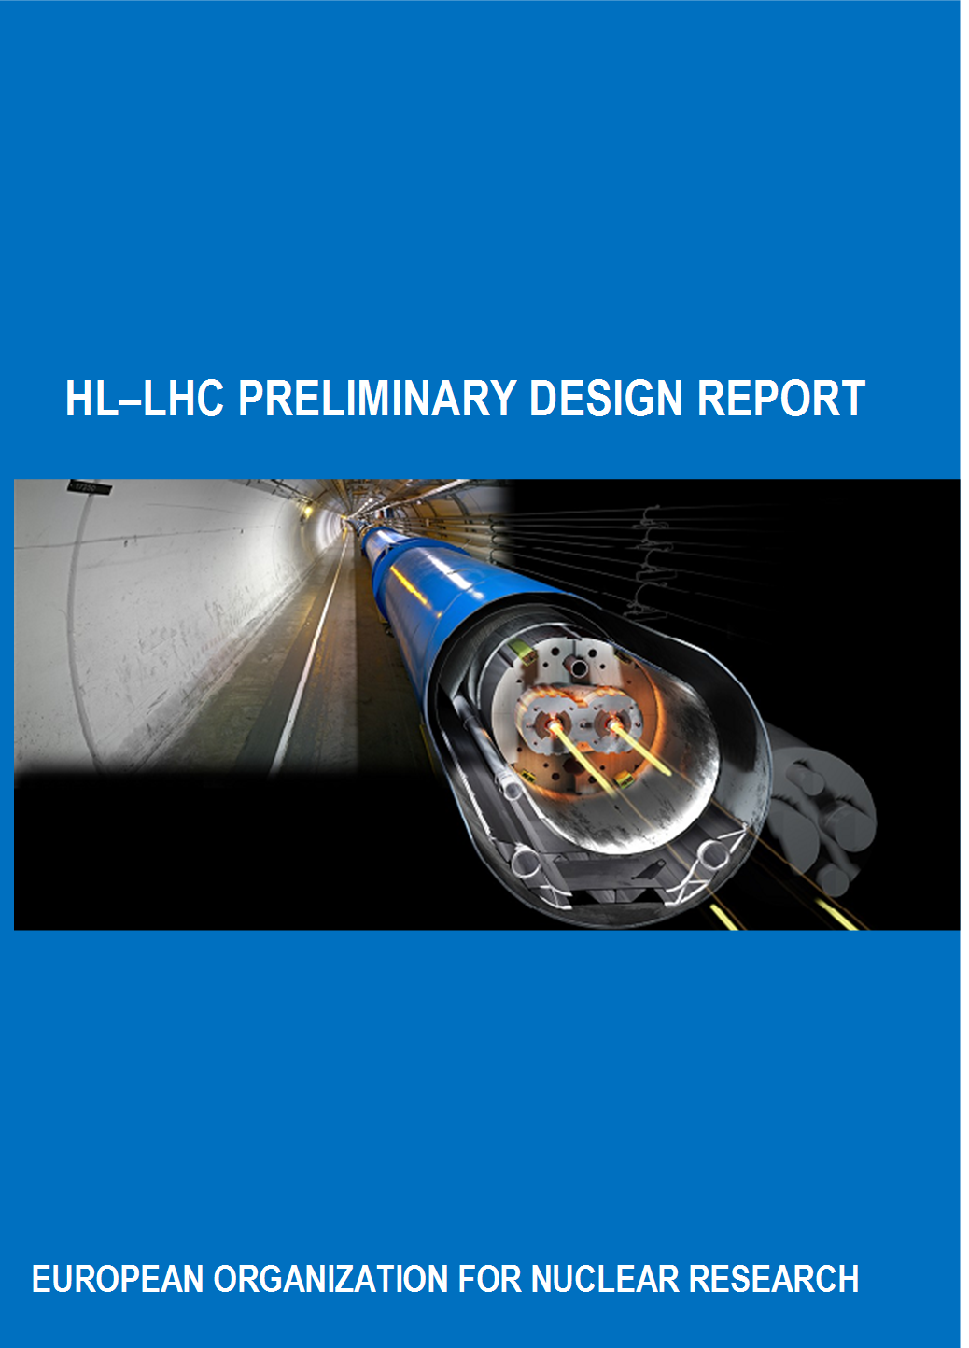
Preliminary
Design Report
PDR
CERN ATS report

Slide 16
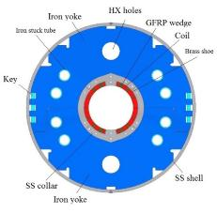
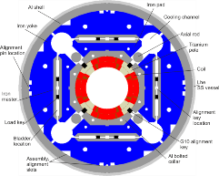
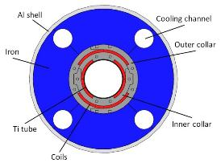
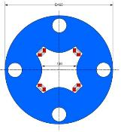
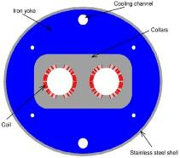
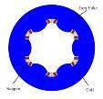
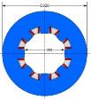
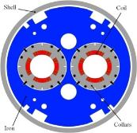
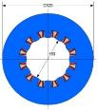
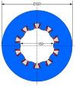
The magent zoo in the IR
Ezio Todesco
Triplet QXF (LARP and CERN)
Orbit corrector (CIEMAT)
Separation dipole D1 (KEK)
Skew corrector (INFN)
Corrector sextupole (INFN)
Corrector octupole (INFN)
Recombination dipole D2
(INFN design)
Q4 (CEA)
Cross-sections in scale
Corrector dodecapole (INFN)
Corrector decapole (INFN)

Slide 17
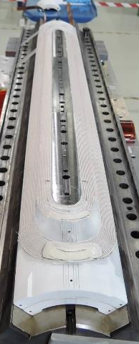
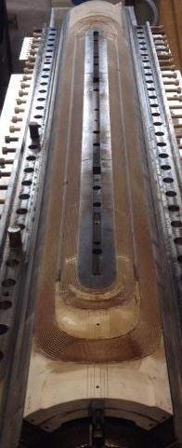
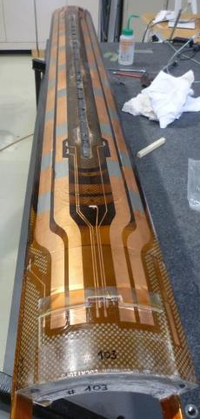
First real (short) Nb3Sn coils for HiLumi inner triplet quadrupoles
After winding/curing
After reaction
After impregnation

Slide 18
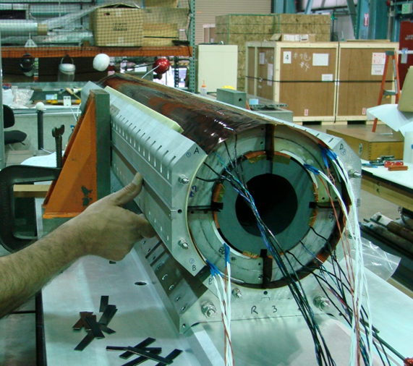
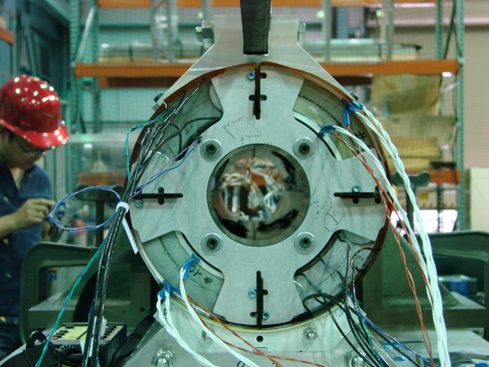
First real MQXFS coil assembly

Slide 19
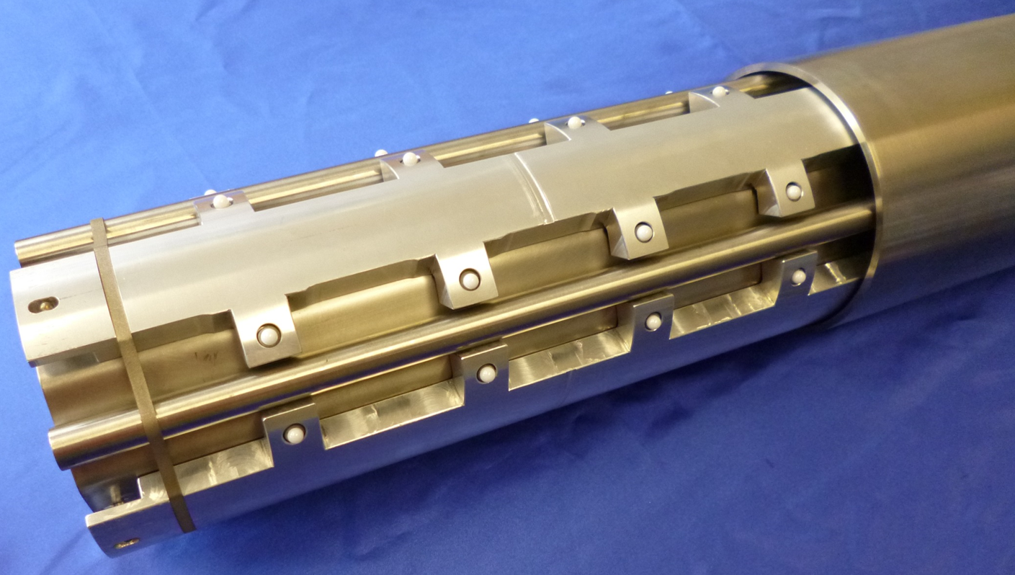
Beam pipe and Beam screen model with heavy W-shielding

Slide 20
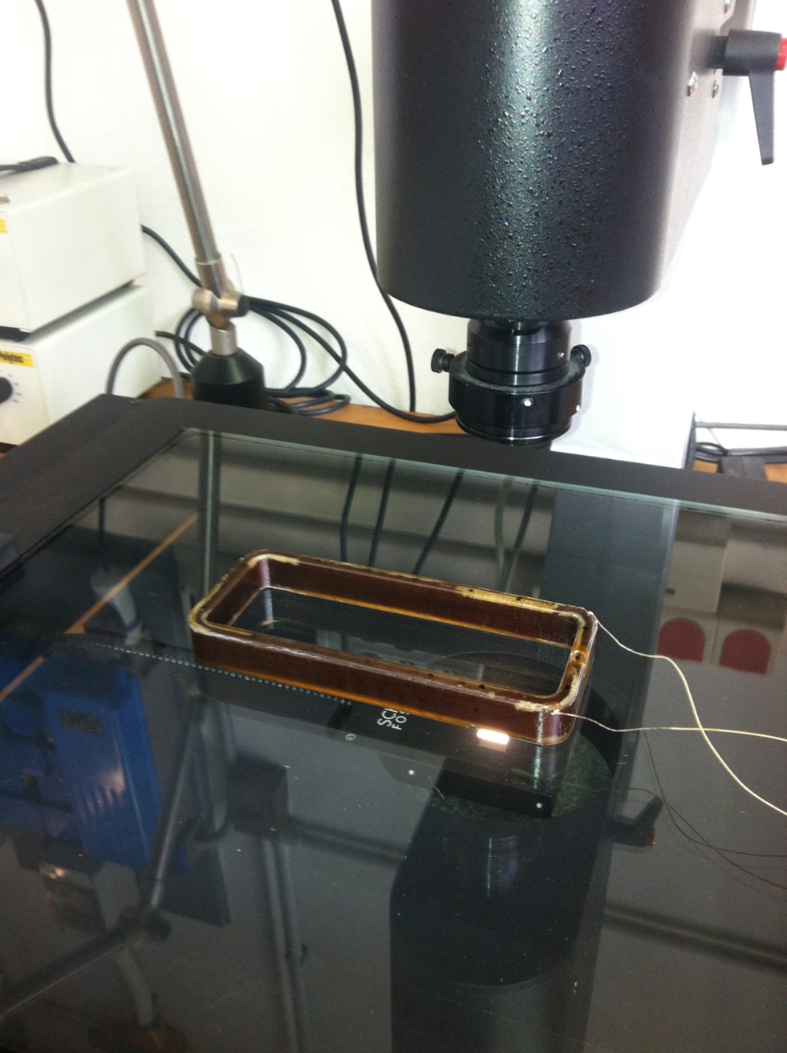
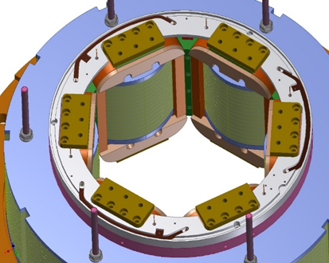
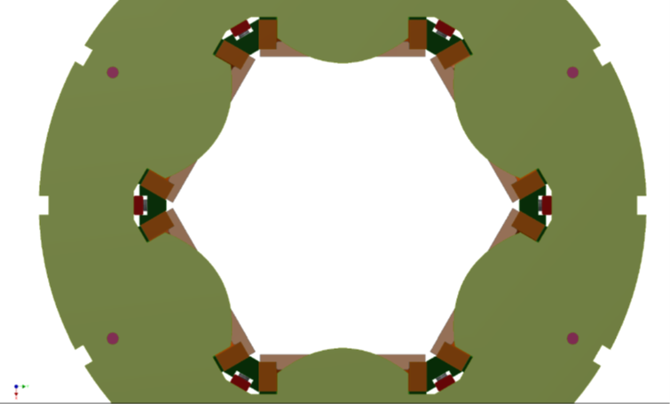
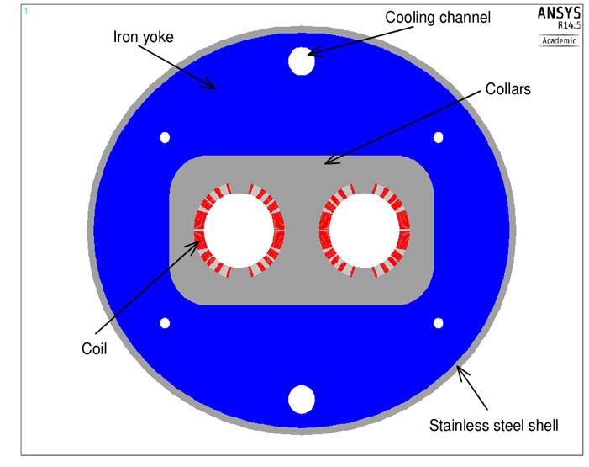
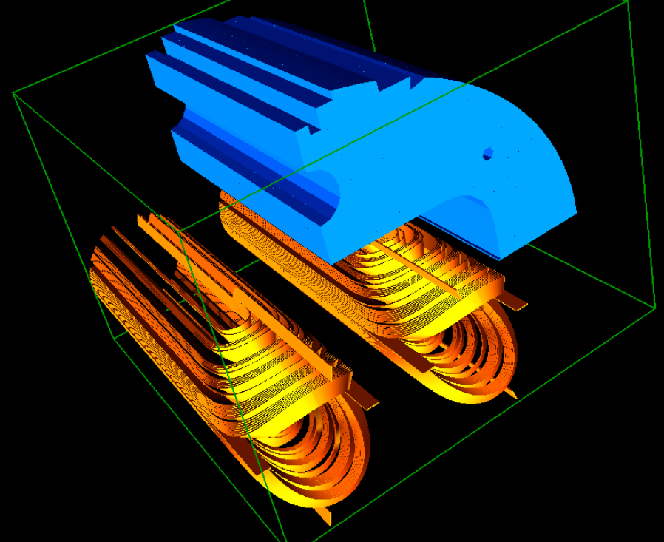
INFN collaboration
Superferric Sextupole corrector: first coil tested successfully
D1 dipole design

Slide 21
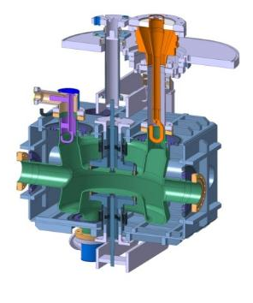
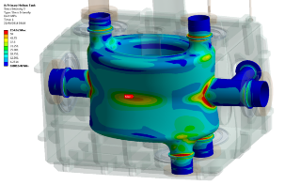
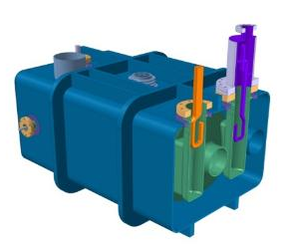
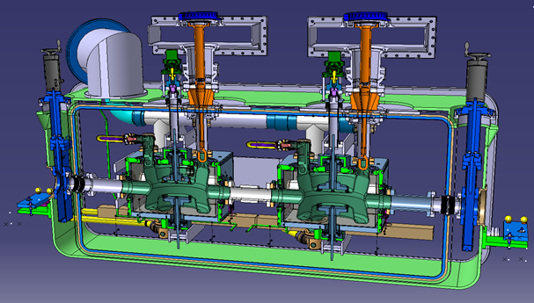
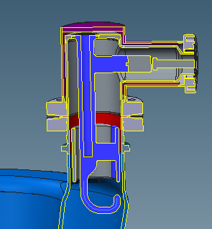
WP 4 : Progress on cavity nad cryomodule
R. Calaga

Slide 22


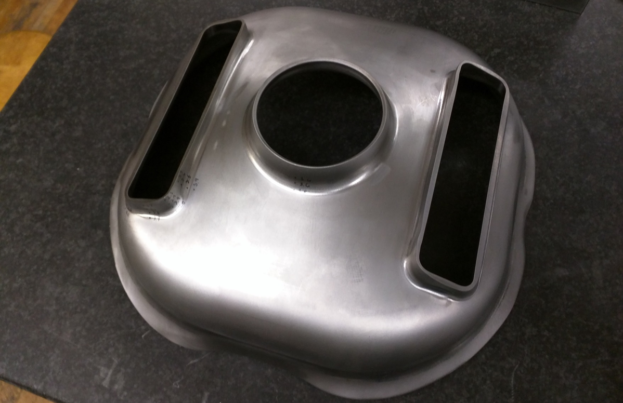
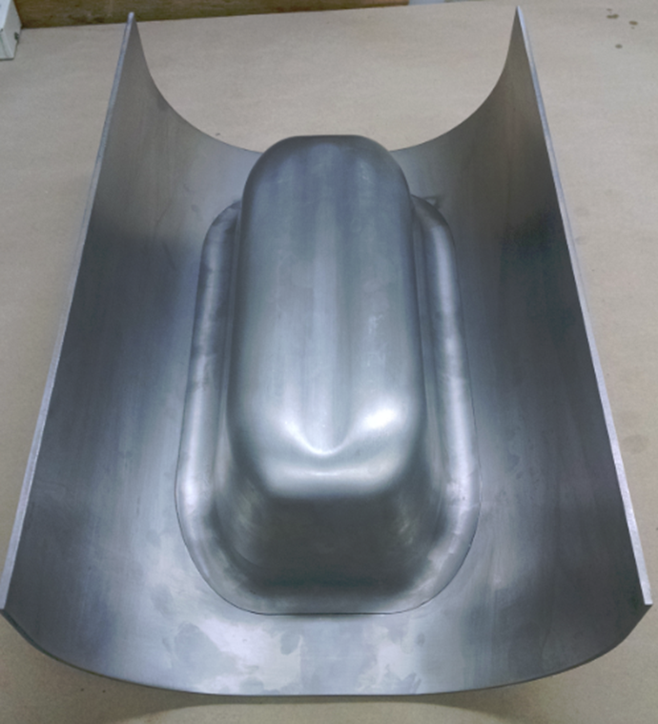
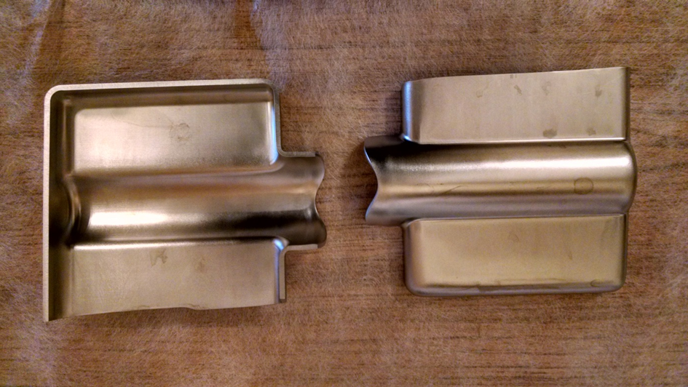
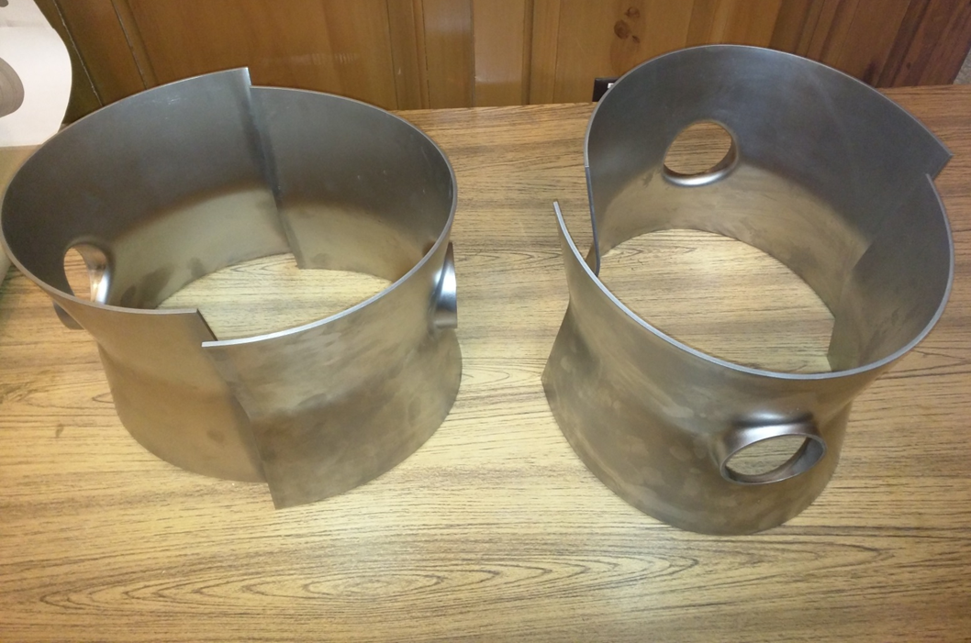
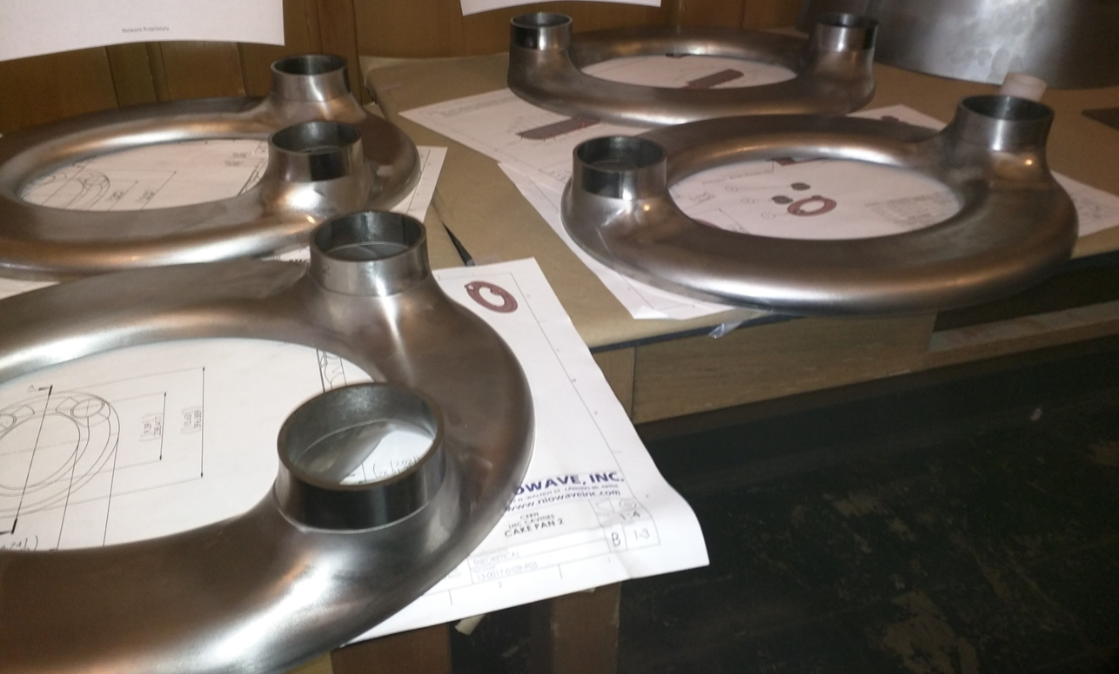
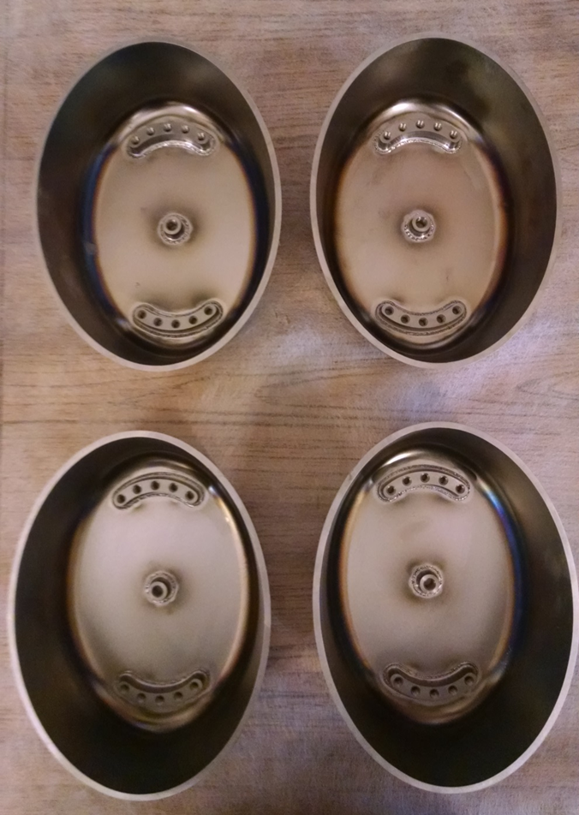
CC: Cutting metal!
RF Dipole
Double Quarter Wave

Slide 23
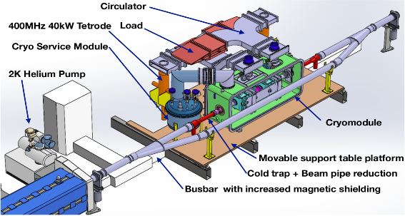
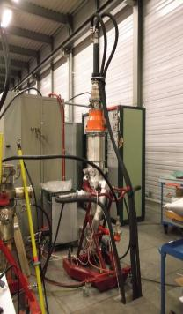
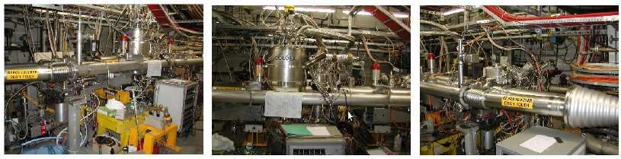
CC SPS tests
New place in BA6

Slide 24
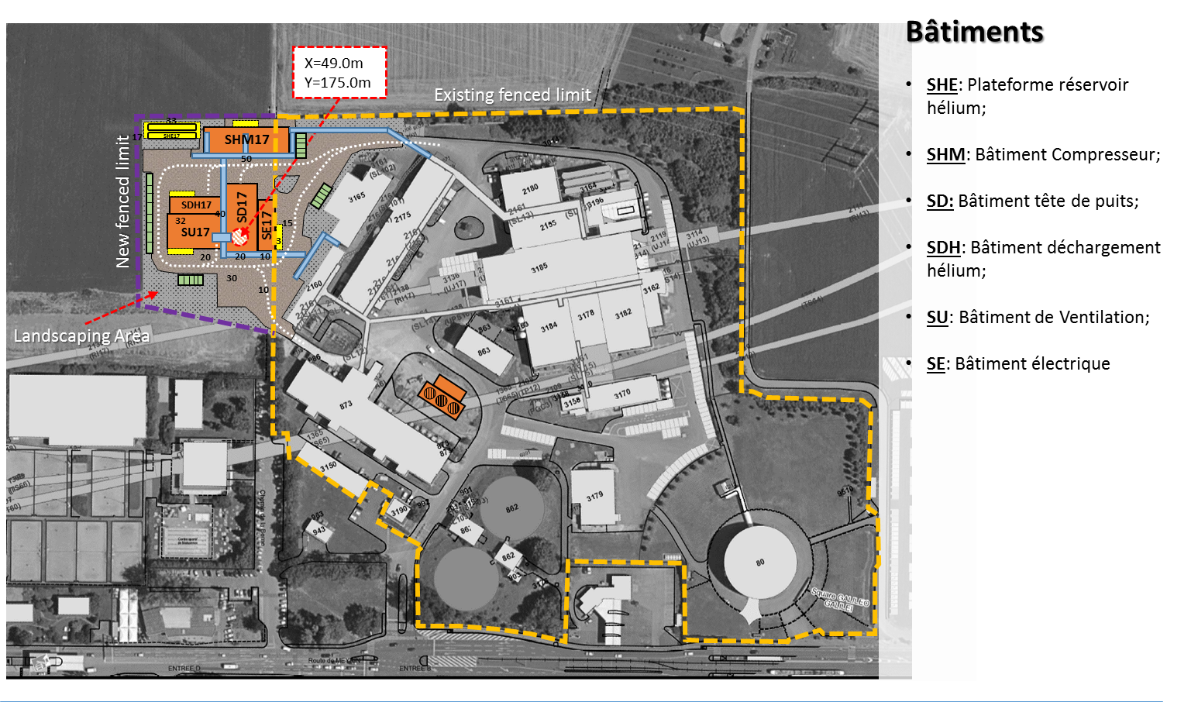
Diascussion started with local authority for Civil Engineer

Slide 25
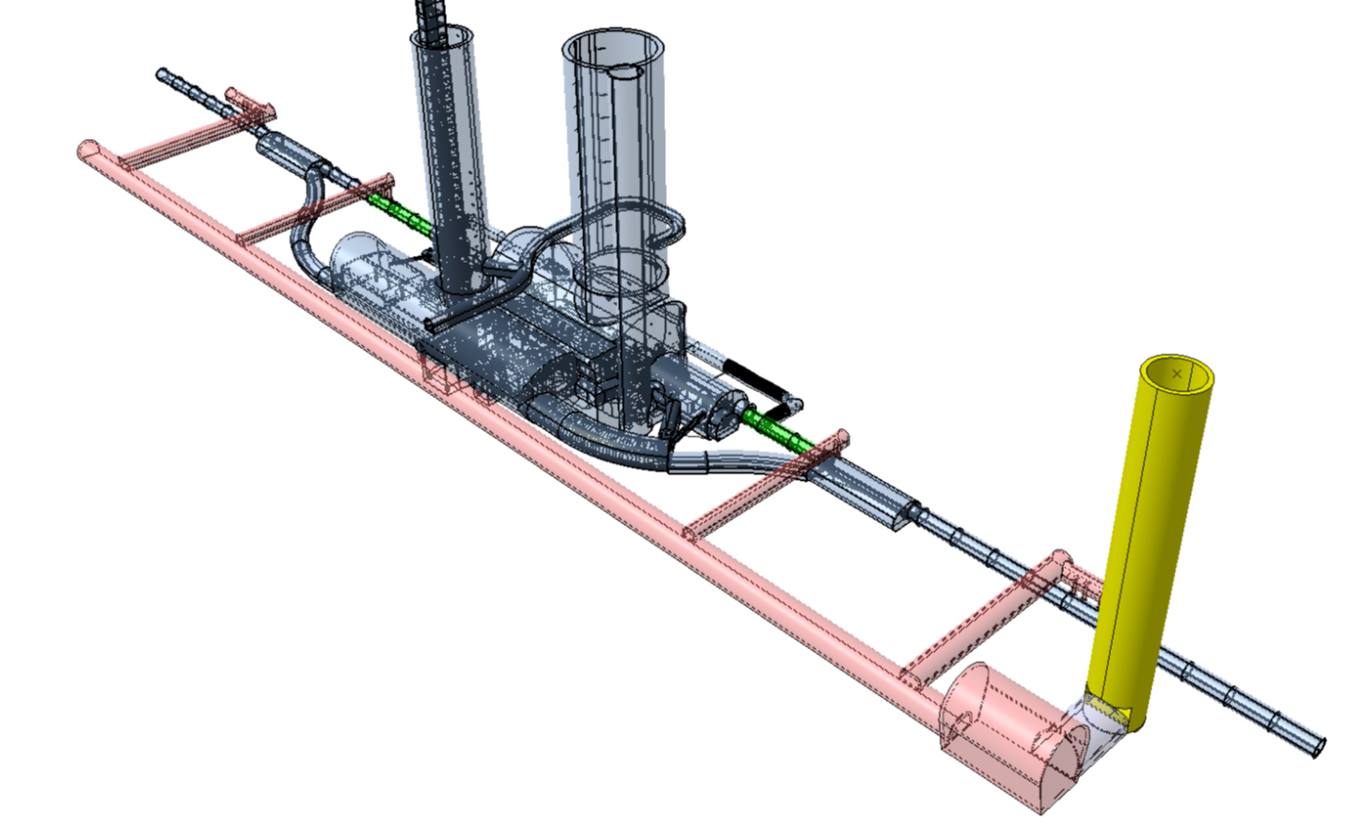
New Gallery and new Tunnel (300 m) along the IP1 and IP5

Slide 26
