Slide 1

Collective Flow in Large and Small Systems at the LHC
Huichao Song
宋慧超
Peking University
SQM 2016
Berkeley, CA, June27-July 2, 2016
In collaboration with Hao-Jie Xu, Xiangrong Zhu, You Zhou … …
June. 30, 2016

Slide 2
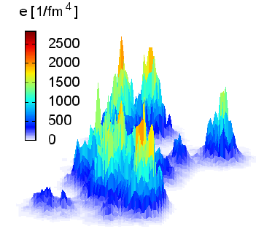
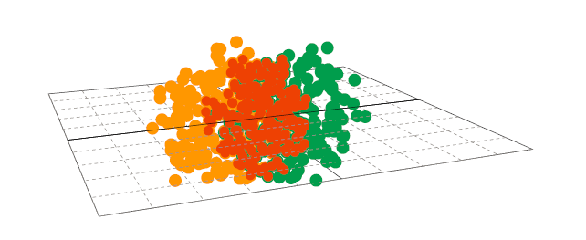
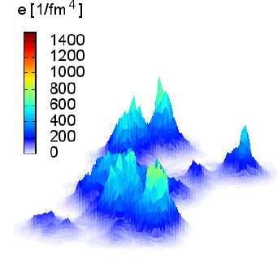
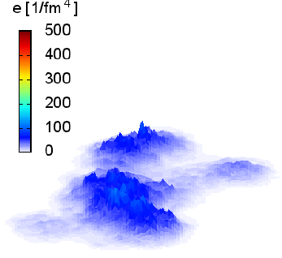
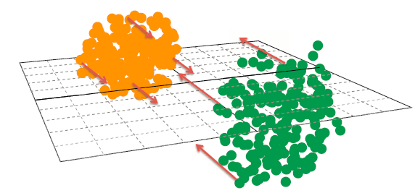
Collective Flow

Slide 3
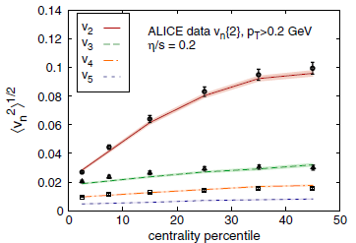
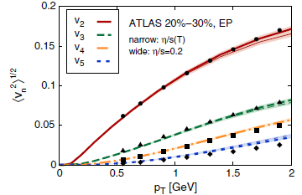
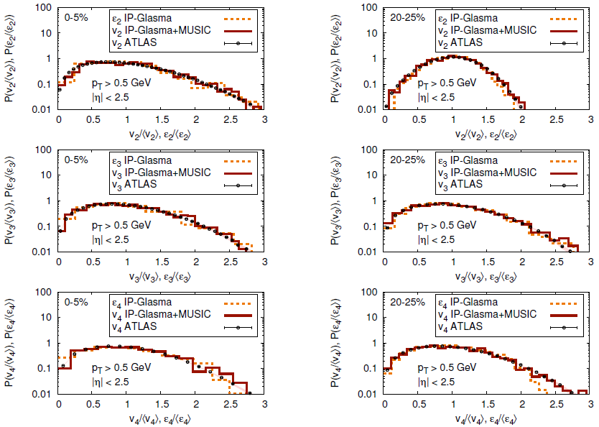
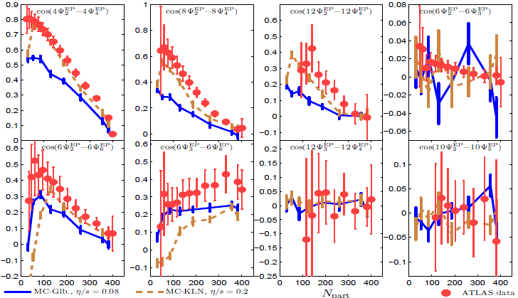
C. Gale, PRL2013
Qiu & Heinz, PLB 2012
TODAY’S TOPIC: Collective Flow in Large and Small Systems
-2.76 A TeV Pb+Pb collisions
-Higher-Order Flow Harmonics of Identified Hadrons (Xu, Li, Song PRC2016)
-Correlations of Flow Harmonics (Zhu, Xu, Zhou, Song, in preparation)
-Collective flow in 7 & 13 TeV p+p collisions (Zhu, Xu, Deng, Zhou, Song, in preparation)

Slide 4
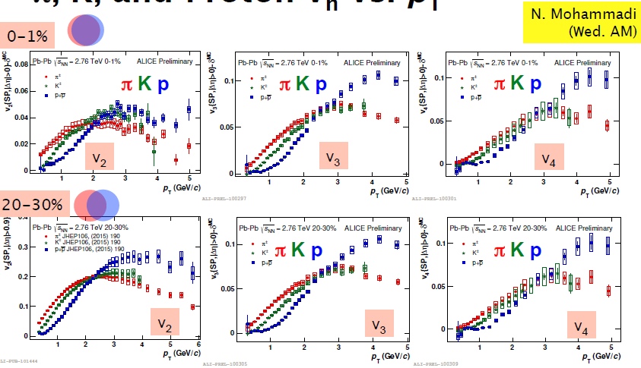
Higher-Order Flow Harmonics of Identified Hadrons
in 2.76 A TeV Pb+Pb collisions
ALICE: 1606.06507

Slide 5
iEBE-VISHNU
Hadron
Gas
QGP
Initial conditions viscous hydro hadron cascade
Initial conditions
- MC-Glauber or MC-KLN ( … Song et al PRL 2011, PRC 2011 … …)
-fluctuations of nucleon positions
- AMPT initial conditions (Xu, Li & Song PRC2016 )
-fluctuations of partons in momentum & position space
Notes:
Introduction
5

Slide 6
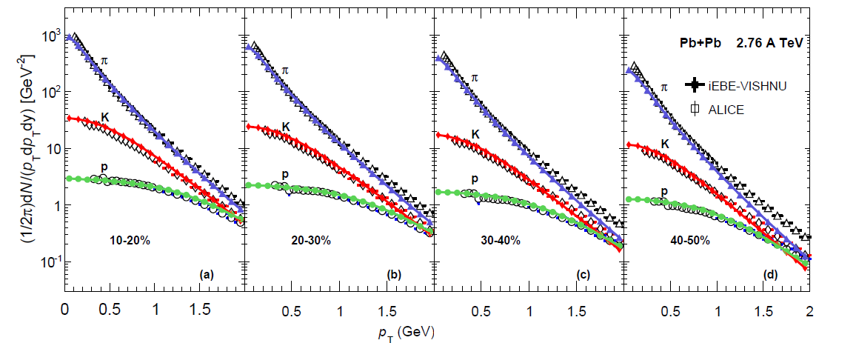
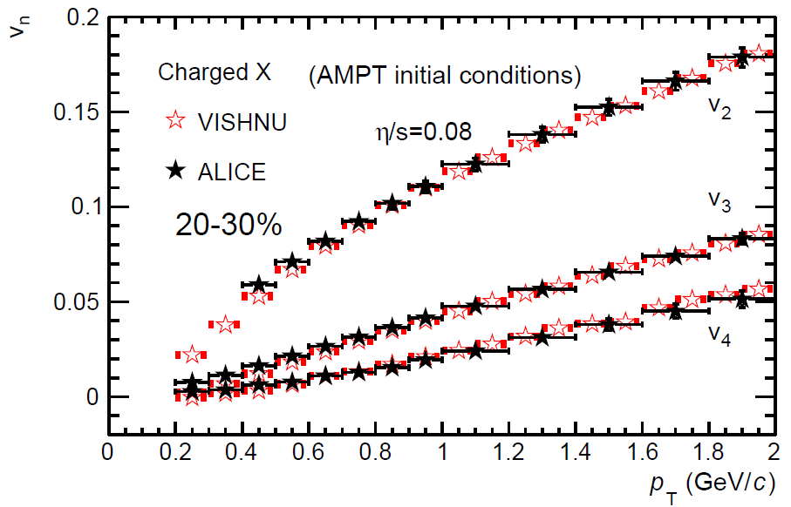
PT spectra & Vn
Xu, Li, Song PRC 2016
iEBE-VISHNU
(AMPT initial conditions)
- Free parameters: ( τ0, S0 , η/s , σ)
- Fine tune free parameters to nicely fit
the pT spectra (PID) and Vn of all
charged hadrons

Slide 7
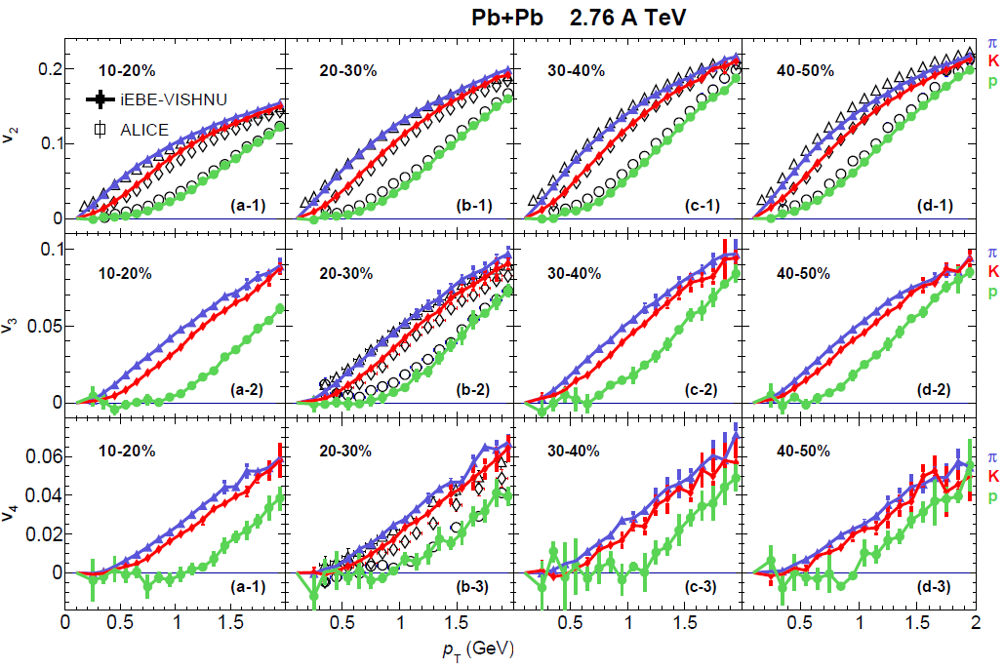
V2, V3, V4 of identified hadrons
Xu, Li, Song PRC 2016
-V3 & V4 shows similar mass orderings as V2 for various centrality

Slide 8
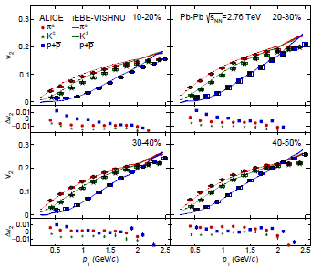
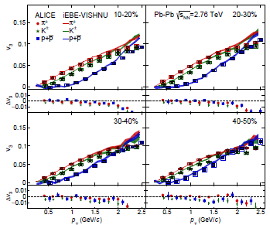
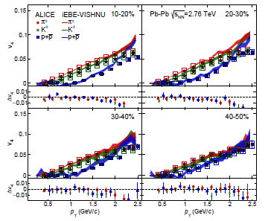
-iEBE-VISHNU (AMPT initial conditions) nicely describe the ALICE Vn of pions,kaons and protons at various centralities
ALICE: 1606.06507
iEBE- VISHNU: Xu, Li, Song PRC 2016

Slide 9
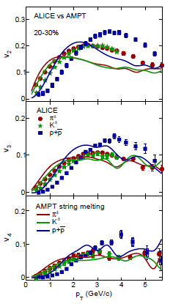
-iEBE-VISHNU (AMPT initial conditions) nicely describe the ALICE Vn of pions,kaons and protons at various centralities
-AMPT can only capture the Vn mass-ordering, but not quantitatively describe the data
ALICE: 1606.06507
iEBE- VISHNU: Xu, Li, Song PRC 2016

Slide 10
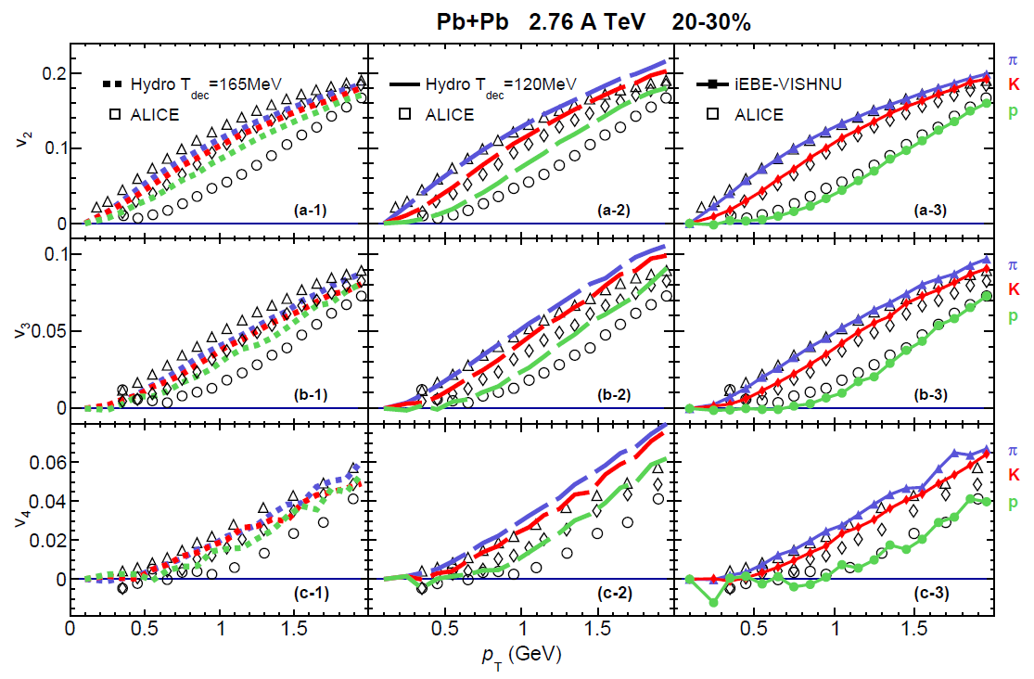
Mass splitting of Vn
Xu, Li, Song PRC 2016
-Hadronic interactions rebalance the generations of radial and anisotropic flow, leading to a nice description of vn of identified hadrons

Slide 11
Correlations of Flow Harmonics
in 2.76 A TeV Pb+Pb collisions
Zhu, Xu, Zhou, Song, in preparation

Slide 12
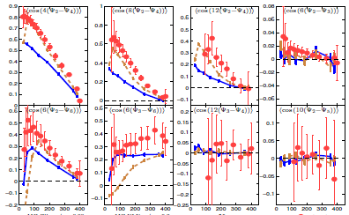
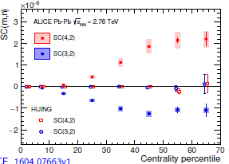
Correlations of Event Plane Angles
Qiu & Heinz, PLB 2012, ATLAS, PRC 2014
Correlations of Flow Harmonics
ALICE, 1604.07663
-V2 and V4 are correlated
-V3 and V4 are anti-correlated
-SC(m,n) from HIJING are compatible to zero

Slide 13
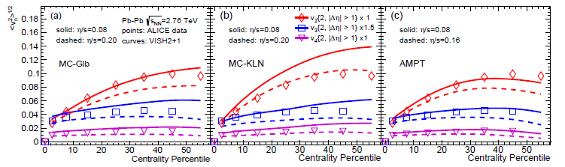
EBE-VISH2+1
QGP
Hadron
Gas
Initial conditions viscous hydro
Initial conditions
- MC-Glauber or MC-KLN (… … Song et al PRL 2011, PRC 2011 … …)
-fluctuations of nucleon positions
- AMPT initial conditions (Xu, Li & Song PRC2016 )
-fluctuations of partons in momentum & position space

Slide 14
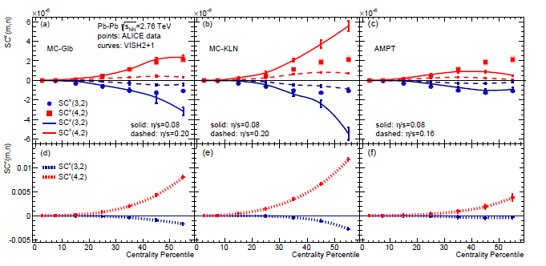
SC^{v}(3,2) & SC^{v}(4,2)
Zhu, Xu, Zhou, Song, in preparation
-SC^{v}(3,2) and SC^{v}(4,2) are sensitive to both initial conditions and η/s
-hydrodynamic simulations correctly capture the sign of SC^{v}(3,2) and SC^{v} (4,2)
-V2 and V4 are correlated, V2 and V3 are anti-correlated
-SC^{v}(3,2) and SC^{v}(4,2) follow the sign of SC^{ε}(3,2) and SC^{ε}(4,2)

Slide 15
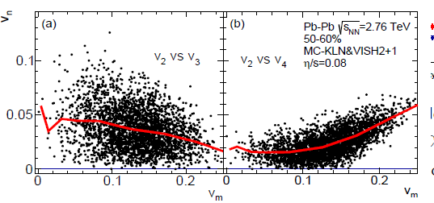
SC^{v}(3,2) & SC^{v}(4,2)
Zhu, Xu, Zhou, Song, in preparation
-SC^{v}(3,2) and SC^{v}(4,2) are sensitive to both initial conditions and η/s
-hydrodynamic simulations correctly capture the sign of SC^{v}(3,2) and SC^{v} (4,2)
-V2 and V4 are correlated, V2 and V3 are anti-correlated
-SC^{v}(3,2) and SC^{v}(4,2) follow the sign of SC^{ε}(3,2) and SC^{ε}(4,2)

Slide 16
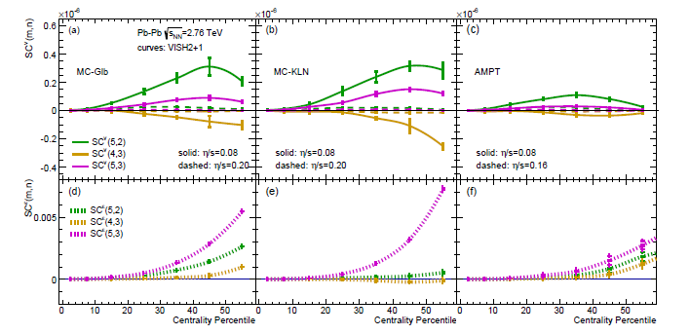
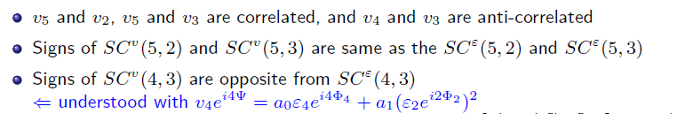
SC^{v}(5,2), SC^{v}(4,3) & SC^{v}(5,3)
Zhu, Xu, Zhou, Song, in preparation
-V2 and V5 ; V3 and V5 are correlated, V3 and V4 are anti-correlated
-SC^{v}(5,2) and SC^{v} (5,3) respectively follow the sign of SC^{ε}(5,2) and SC^{ε}(5,3)
-SC^{v} (4,3) & SC^{ε}(4,3) show opposite signs

Slide 17


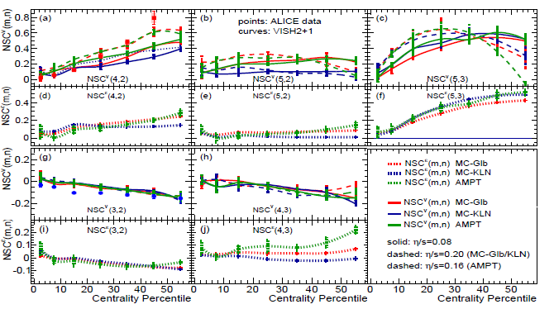
Normalized Symmetric Cumulants NSC^{v}(m,n)
Zhu, Xu, Zhou, Song, in preparation
-NSC^{v} (3,2): insensitive to η/s and initial conditions, roughly fit the ALICE data
-NSC^{v} (4,2), NSC^{v} (5,2) & NSC^{v} (5,3): sensitive to η/s and initial conditions

Slide 18


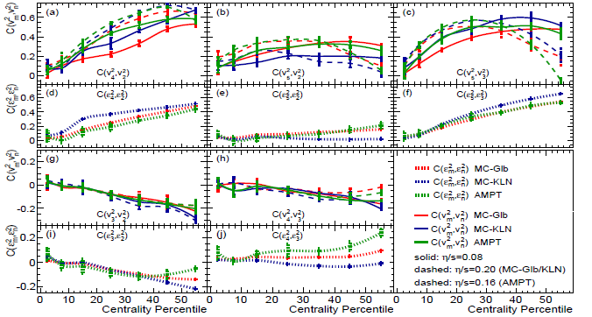
Pearson correlation coefficients
Zhu, Xu, Zhou, Song, in preparation
-None of the Vn and Vm pairs are linearly correlated or linearly anti-correlated

Slide 19
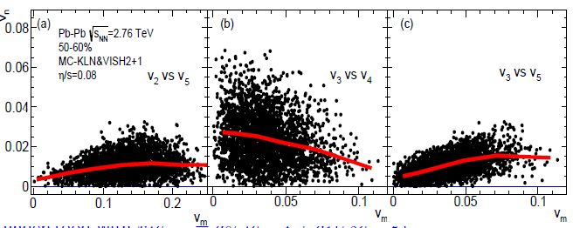
Pearson correlation coefficients
Zhu, Xu, Zhou, Song, in preparation
-None of the Vn and Vm pairs are linearly correlated or linearly anti-correlated

Slide 20
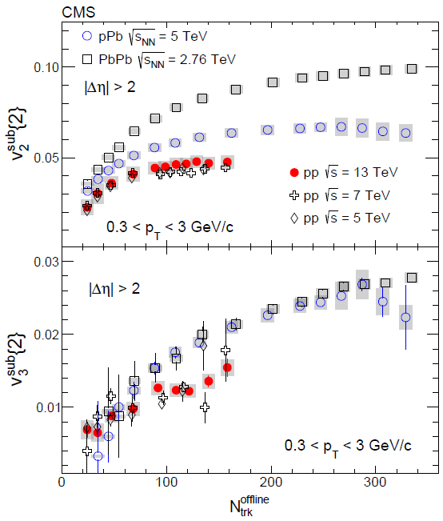
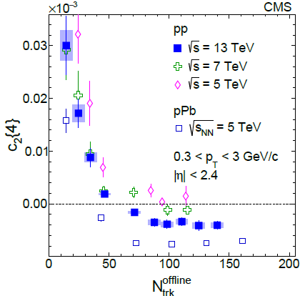
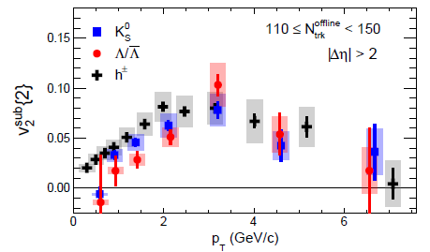
Collective flow in smaller systems
-p+p collisions at 7 & 13 TeV
CMS 1606.06198

Slide 21
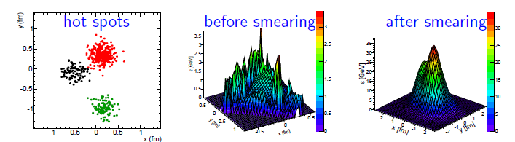
iEBE-VISHNU
Hadron
Gas
QGP
Initial conditions viscous hydro hadron cascade
Initial conditions
- HIJING initial conditions (depose energy by strings)
Notes:
Introduction
21

Slide 22
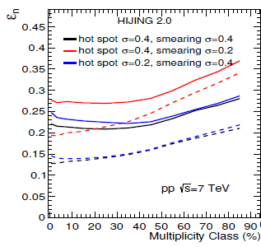
iEBE-VISHNU
Hadron
Gas
QGP
Initial conditions viscous hydro hadron cascade
Initial conditions
- HIJING initial conditions (depose energy by strings)
Notes:
Introduction
22

Slide 23
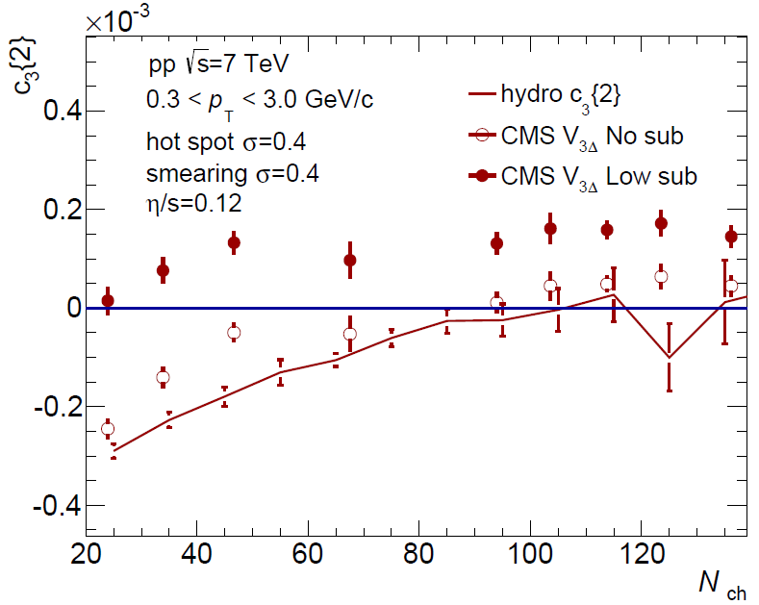
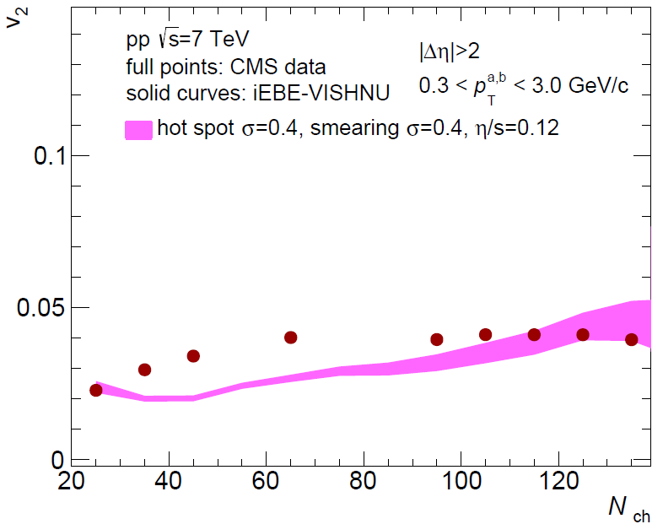
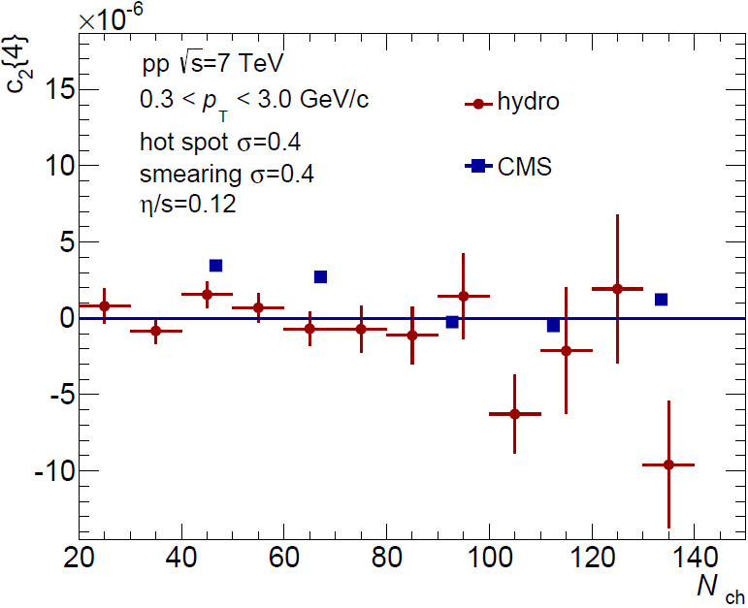
Collective flow in p+p -- Hydro Simulations
iEBE-VISHNU
(HIJING (hot spots))
-Multiplicity dependent V2
-development of triangular flow at
high multiplicity events
-The trend of changing sign of C2{4} (high statistical run is still needed )

Slide 24
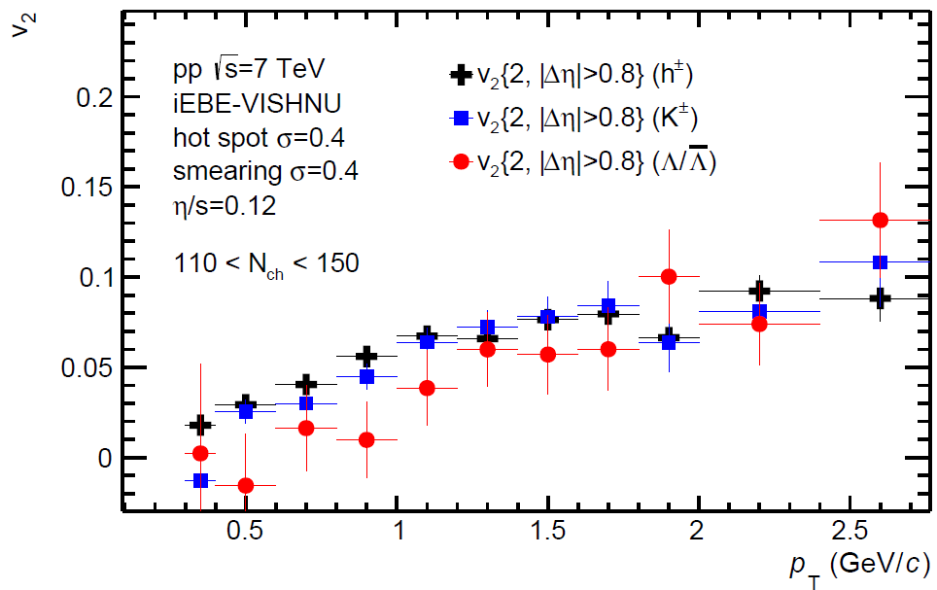
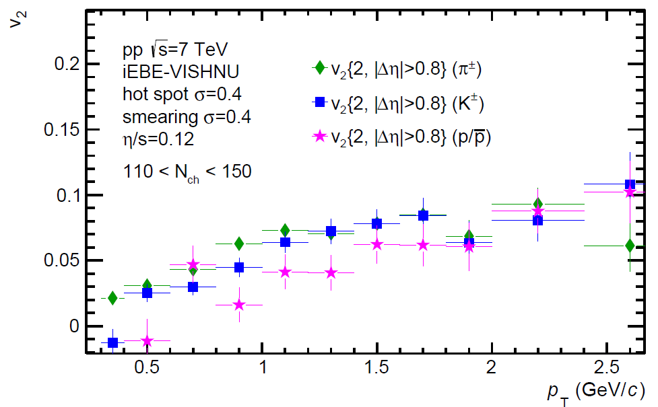
Collective flow in p+p -- Hydro Simulations
iEBE-VISHNU
(HIJING (hot spots))
-Similar mass-ordering of h K and Λ as observed in exp.
-also shows mass-ordering of
π K p.

Slide 25
Summary
Higher-Order Flow Harmonics of Identified Hadrons in 2.76 A TeV Pb+Pb collisions
-iEBE-VISHNU nicely describe the Vn data from ALICE
-Hadronic interactions rebalance the generations of radial and anisotropic flow, leading to a nice description of vn of identified hadrons
Correlations of flow harmonics in 2.76 A TeV Pb+Pb collisions
-iEBE-VISH2+1 qualitatively describe SC(3,2), SC(4,2); V2 and V4 are correlated, V2 and V3 are anti-correlated ;
-Predictions of SC(5,2), SC(5,3) and SC(4,3) shows V2 and V5, V3 and V5 are correlated, V3 and V4 are anti-correlated ;
-Normalized symmetric cumulants NSC(3,2) are insensitive to both initial conditions and η/s
Collective flow in p+p collisions
-hydrodynamics can naturally describes v2 v3, C2{4} and the v2 mass-ordering
in the high multiplicity events

Slide 26
Thank You

Slide 27
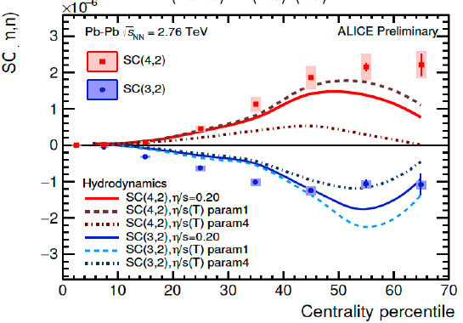
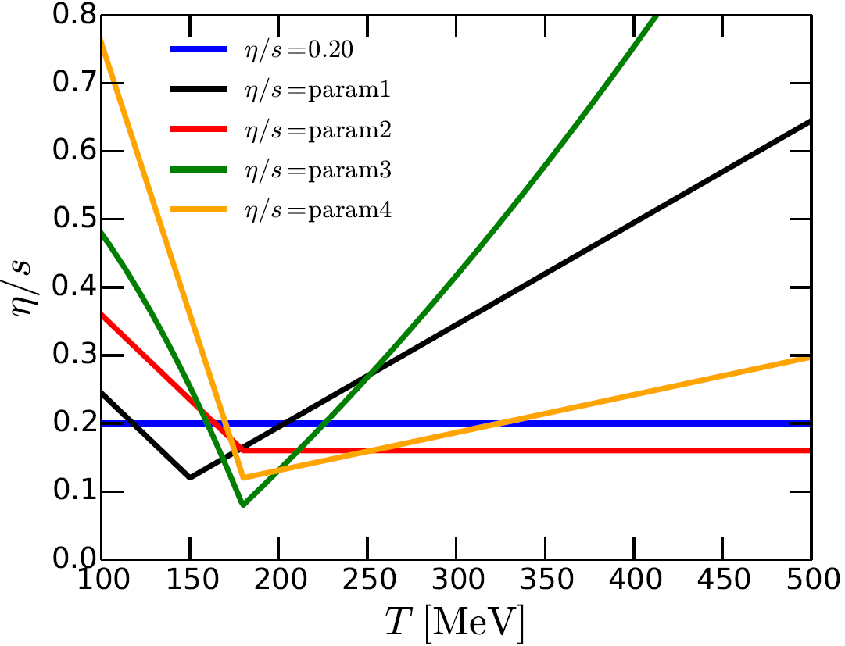
SC^{v}(3,2) & SC^{v}(4,2) –hydrodynamic simulations with η/s(T)
Niemi et al, arXiv:1505.02677
-hydrodynamic simulations with η/s(T) correctly capture the sign of SC(3,2) and SC(4,2), but can not quantitatively describe the data

Slide 28
Fluctuations and Correlations
in smaller systems
-p+Pb collisions at 5 TeV
Where dose the correlations (collective flow) in 5.02 TeV p-Pb collisions come from?
-Initial State?
-QGP ?
UrQMD Baseline Calculations
Zhou, Zhu, Li, Song, PRC 2015
Assumption: p-Pb collisions only produce hadronic systems without reach the thresh hold of the QGP formation

Slide 29
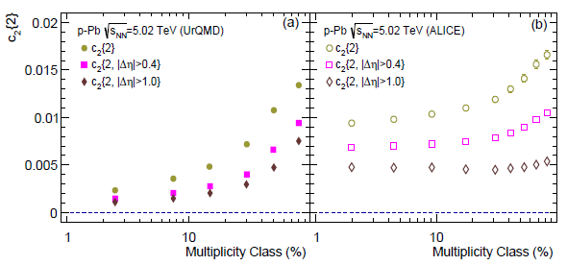
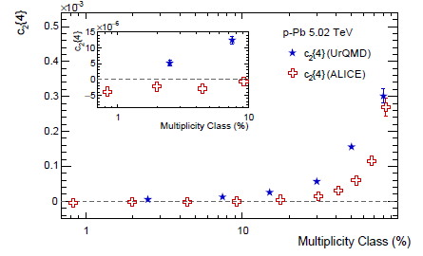
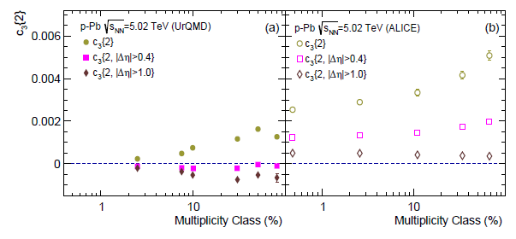
Zhou, Zhu, Li, Song, PRC2015
-The UrQMD systems are largely influenced by non-flow effects
-To reproduce the flow data, effects from initial state and/or QGP are needed

Slide 30
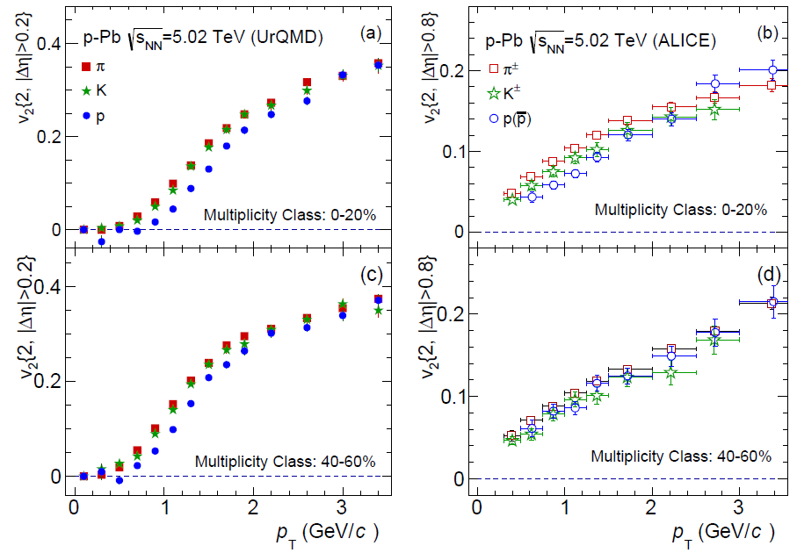
V2 mass ordering in p+Pb collisions at 5.02 TeV
V2 mass ordering is produced by UrQMD, similar to the ALICE data

Slide 31
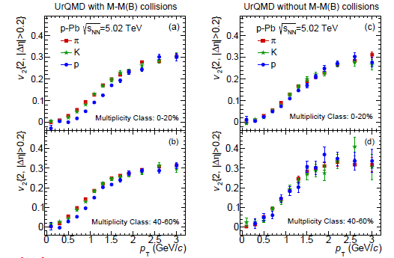
Hadronic interactions & v2 mass ordering
Zhou, Zhu, Li, Song, arXiv: 1503.06986
-Hadronic interaction can generate a mass ordering for 2- particle correlations
-Additive quark model: different M-M M-B cross-sections

