Slide 1
Phenomenological Implications of the p_{T} spectra of φ and Ω produced at LHC and RHIC
Rudolph C. Hwa
University of Oregon
Strangeness in Quark Matter 2016, Berkeley, CA June 30, 2016

Slide 2
Outline Nature of this talk
Mostly data
Search for simplicity and regularity
Not much theory
Implications
more far-reaching than φ and Ω themselves
Work done in collaboration with
Lilin Zhu (Sichuan University)

Slide 3
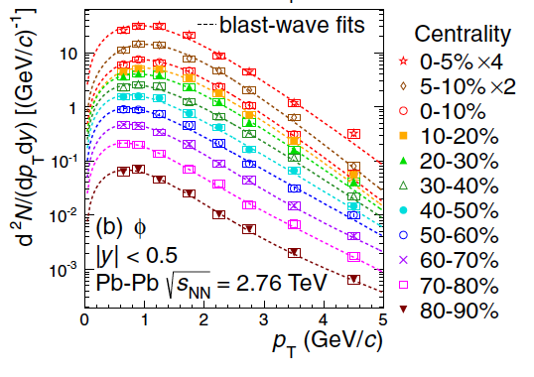


φ production at LHC --- ALICE Phys. Rev. C 91, 024609 (2015)
,

Slide 4
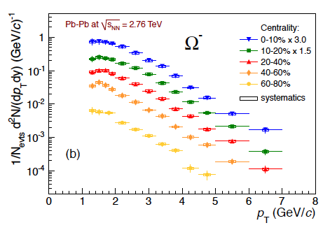
Ω production at LHC
ALICE PLB 728, 216 (2014)

Slide 5
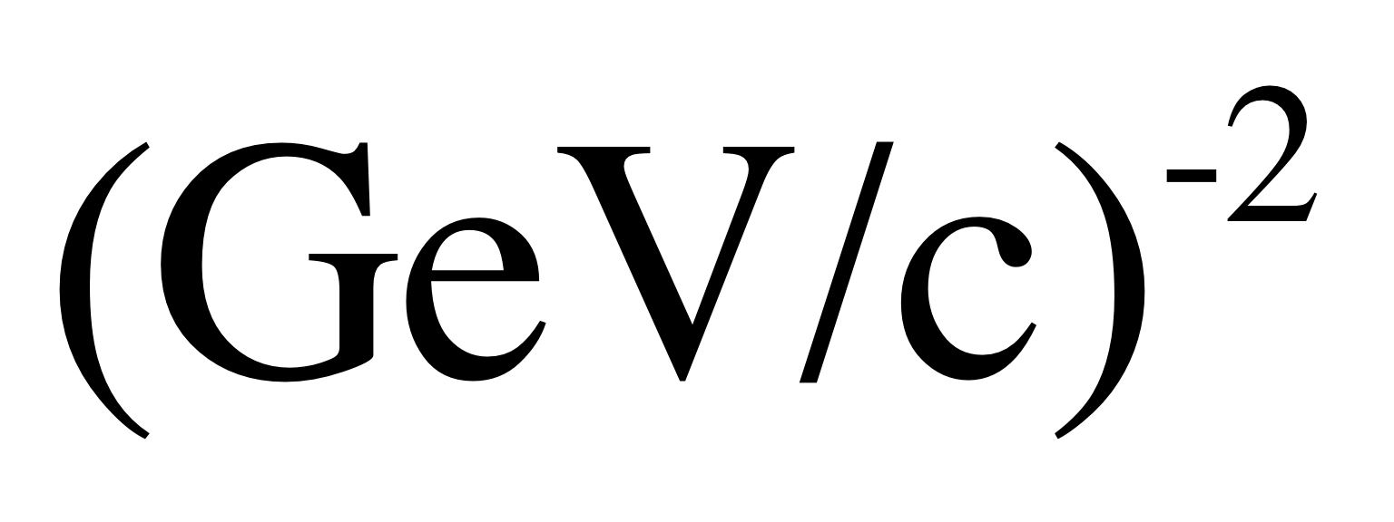
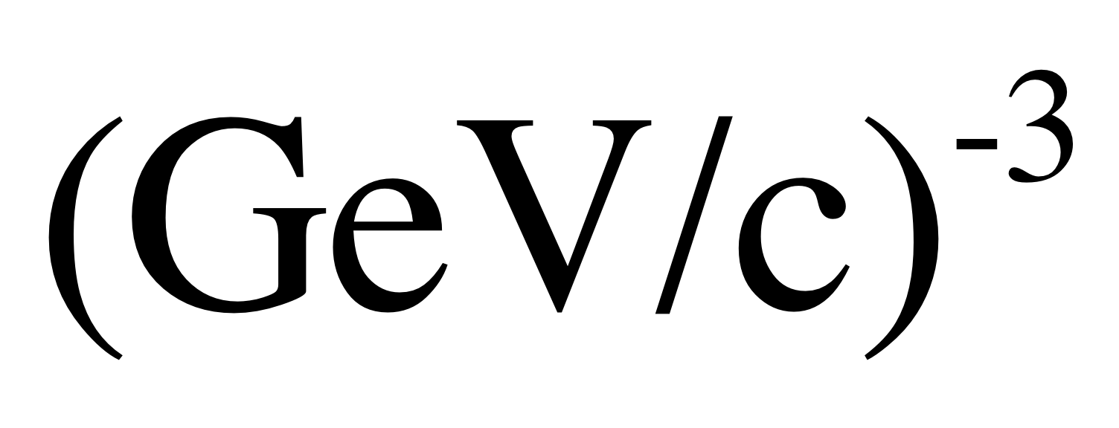
A different presentation of data
Mesons
usual presentation of data
modified presentation of data
different dimensions
Baryons

Slide 6
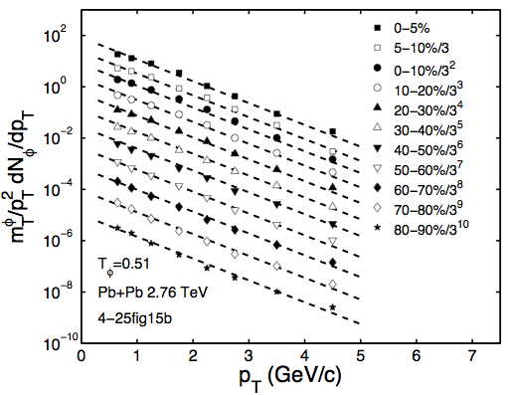
One parameter: Inverse slope T_{φ} for all centralities

Slide 7
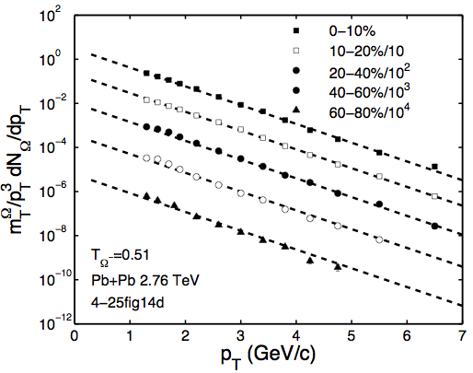

Slide 8
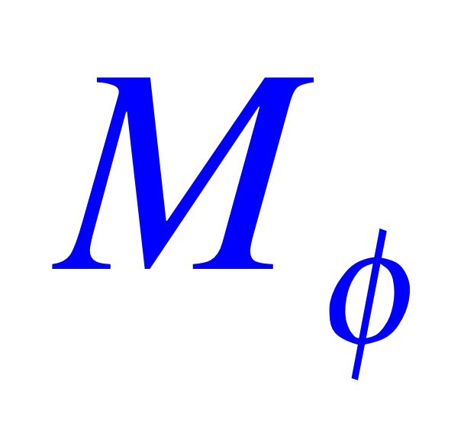
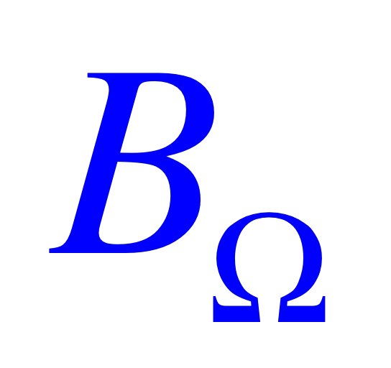
No theory
T_{φ} = T_{Ω} same inverse slope for and
of different dimensions
Exponential in p_{T} thermal
, out to p_{T}=6 GeV/c!
p_{T} and N_{part} dependencies are factorizable
Centrality dependence
a_{φ}=0.9 , a_{Ω}=1.35

Slide 9
That is for LHC energy at 2.76 TeV, but true also for nearly all lower energies.
At RHIC 200 GeV
φ
Ω
and at 130 GeV

Slide 10
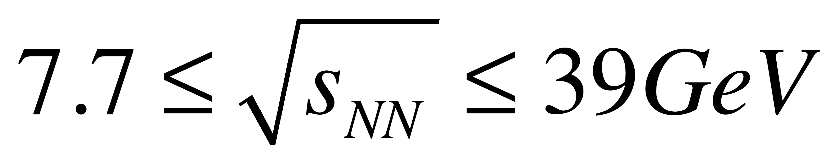
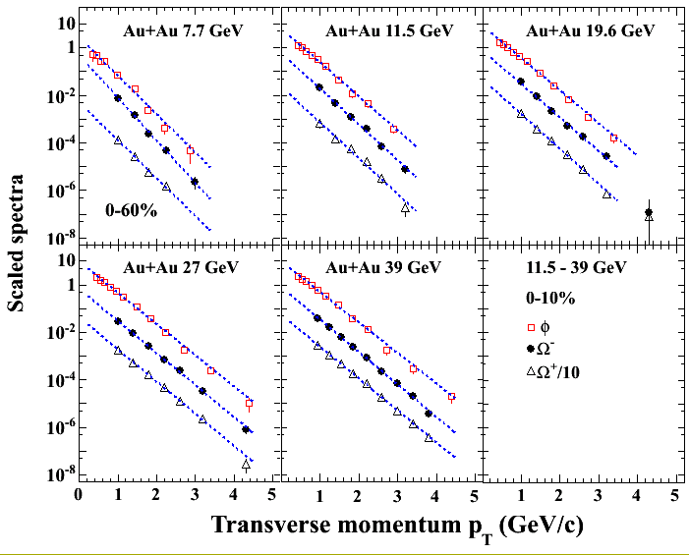
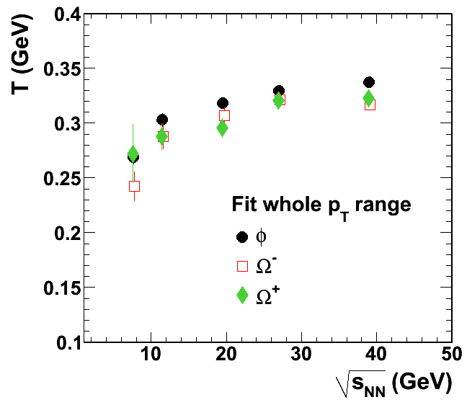
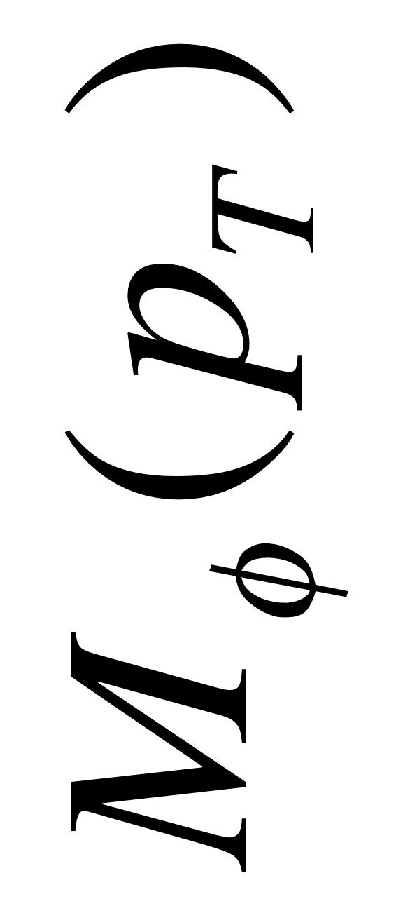
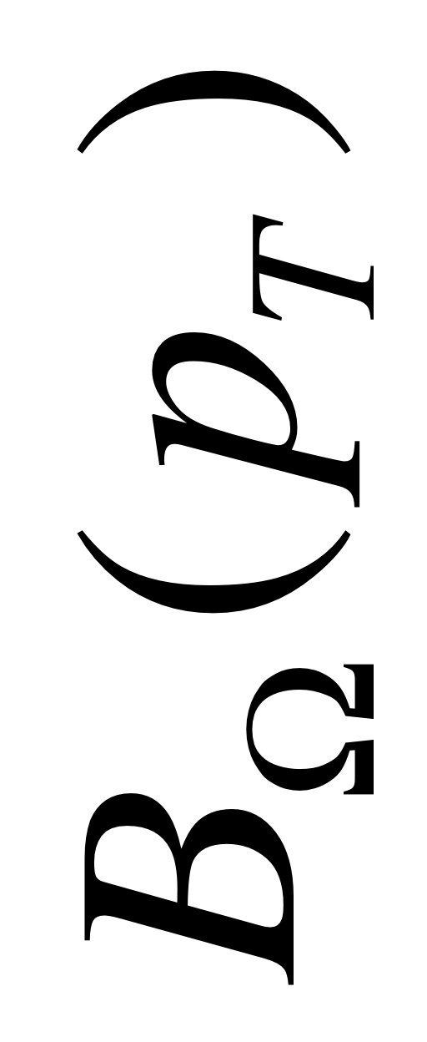
STAR BES
PRC 93, 021903 R (2016)
STAR preliminary
Courtesy of Xiaoping Zhang (STAR)

Slide 11
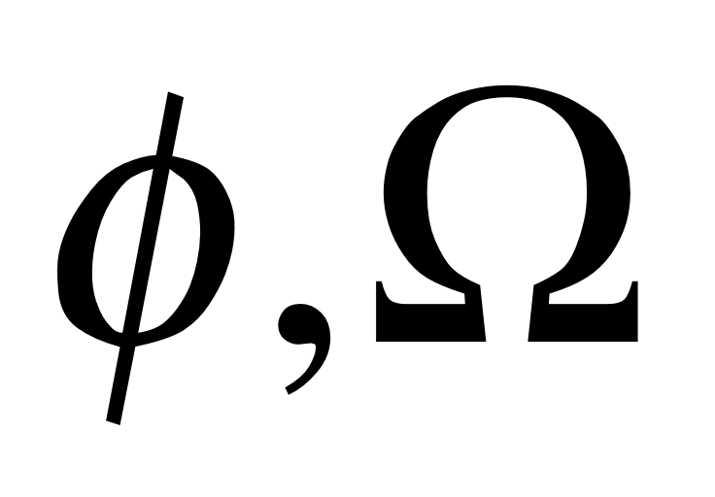
2.76
200
130
Prediction without theory
At √s=5.02 TeV, T_{φΩ}=0.54 GeV for 0<p_{T}<7 GeV/c, N_{part}>100

Slide 12
The simple description works very well for φ and Ω because s quarks are suppressed in jet fragmentation.
There are few s quarks in parton showers.
TT + TS + SS TTT + TTS + TSS + SSS
The situation is different for light quarks.
u, d quarks dominate parton showers
hard partons generate soft pions
semihard partons (minijets) give rise to soft partons in medium
resonance decays
+ …

Slide 13
ALICE 2.76 TeV
p
π
p

Slide 14
The origin of and
can be found in the Recombination Model.
It can be shown that T_{φ}=T_{Ω}.
(2 slides at the end)
Continue with phenomenological observations.

Slide 15


ALICE
PRC 93, 034913 (2016) PLB 728, 216 (2014)
STAR PRC 88, 024906 (2013) PRL 98, 062301 (2007)
Not much change at low p_{T}.
Not what hydro can explain.
No mention of flow .
No need for radial velocity, T_{kin}, blast wave, etc.
We are concerned about the physics that make sense for p_{T} up to 7 GeV/c.
Compare the data of to p.
ΔT=T_{Ω}-T_{p}=65 MeV (Au-Au 200 GeV)
=100 MeV (Pb-Pb 2.76 TeV)
Ridge

Slide 16


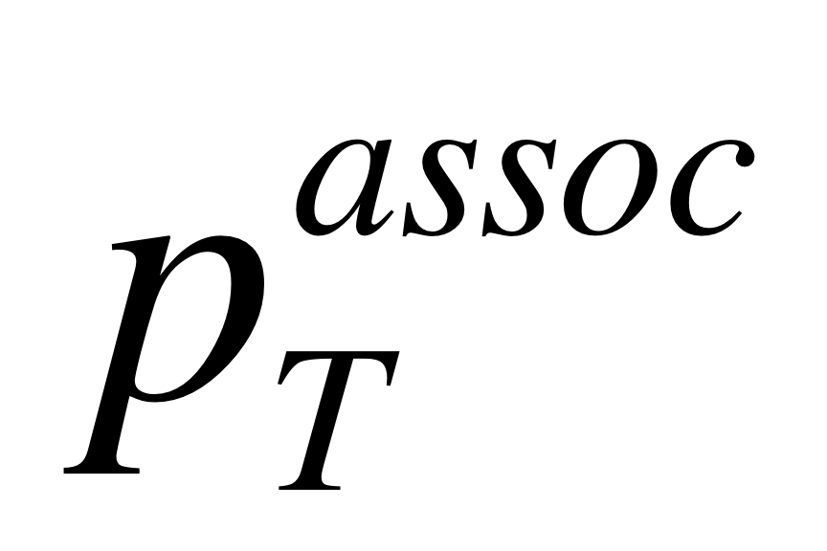
Recall the original discovery of Ridge by STAR --- J. Putschke at QM06
STAR PRC 80, 064912 (2009)
Identified, un-triggered
So far no LHC data on dependence of Ridge.

Slide 17
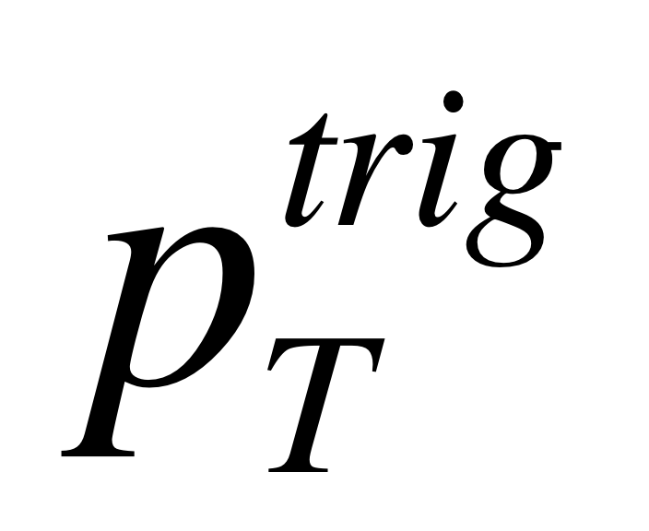
on dependence
CMS JHEP07(2011)076
Ridge is suppressed at high trigger p_{T}.

Slide 18
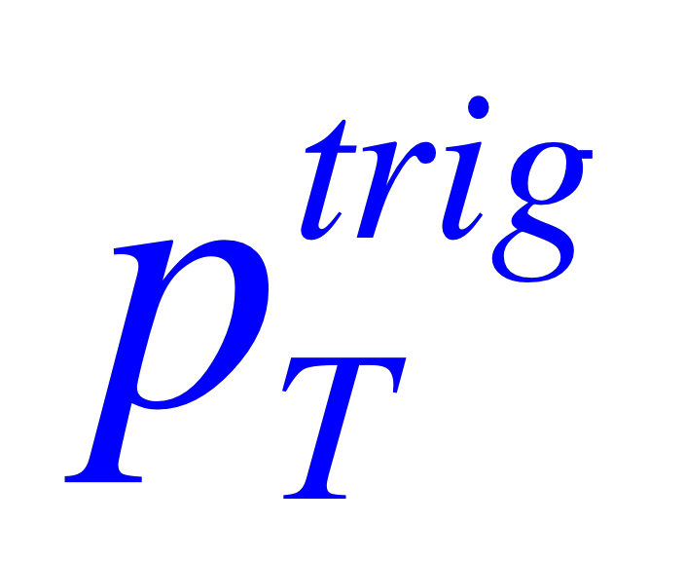



Transverse plane
hard parton from interior
0-5% c
low trigger
hard parton from near the surface
high trigger
Energy loss enhances thermal partons
Ridge comes from the enhanced thermal partons
Thus ridge yield is suppressed at high
and are in the Ridge with higher T
Jets and Ridges are in all events, whether triggered or not.

Slide 19
For every hard parton that emerges, there may be a partner that traverses the whole medium without emerging.
The energy-losing processes take time, since partons can take 10 fm/c to traverse …
There can be many semihard partons, copiously produced at LHC, that can alter the thermal description throughout the evolution.
Hard and soft processes are intricately mixed.

Slide 20
Ridge-tsunami analogy

Slide 21
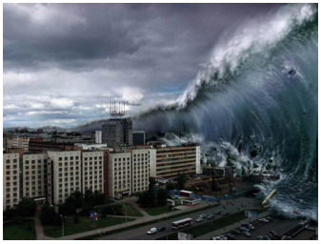

Slide 22
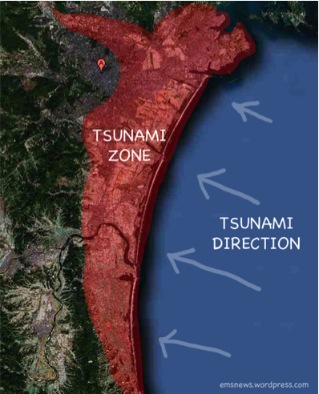
A & B are not longitudinally correlated, but are “vertically” correlated, when a tsunami strikes.
z
A
A
x
hard scattering
B
B
medium
Ridge is analogous to tsunami.
Rising tide raises all boats

Slide 23
SUMMARY
Mainly empirical observations
Not much theory
and are special, since they receive no contribution from jet fragmentation
No need for flow, radial velocity, or blast wave
Usual hydrodynamics cannot generate thermal s quark distribution out to 4 GeV/c
It is suggested that φ and Ω are to be found in the Ridge.
We need more experimental and theoretical verification of that idea.

Slide 24
Derivation of and
in the Recombination Model.

Slide 25
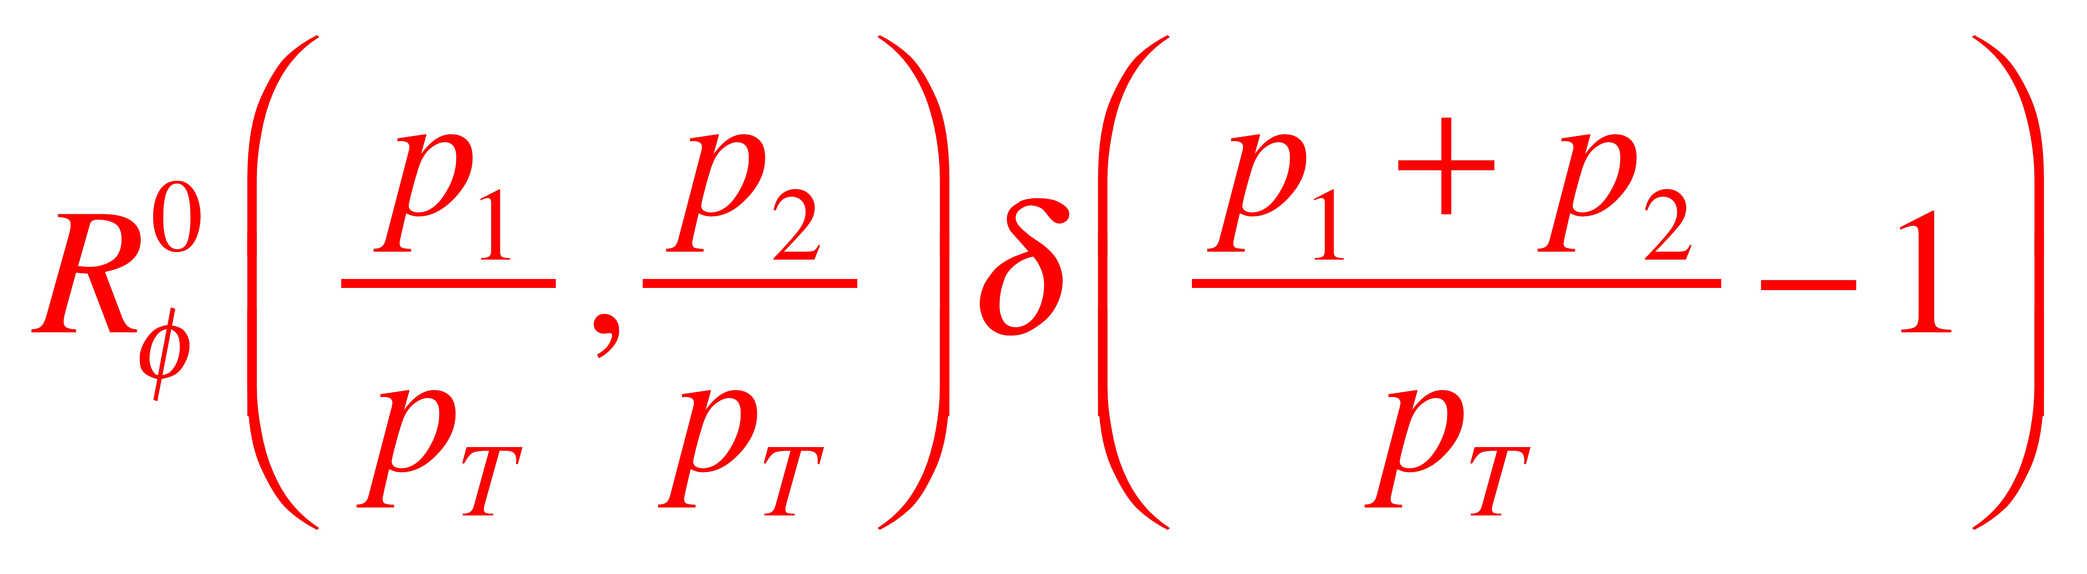
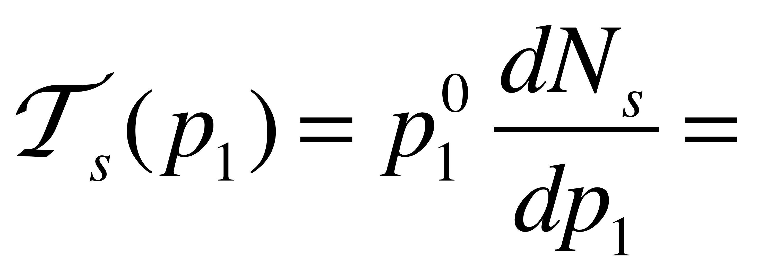
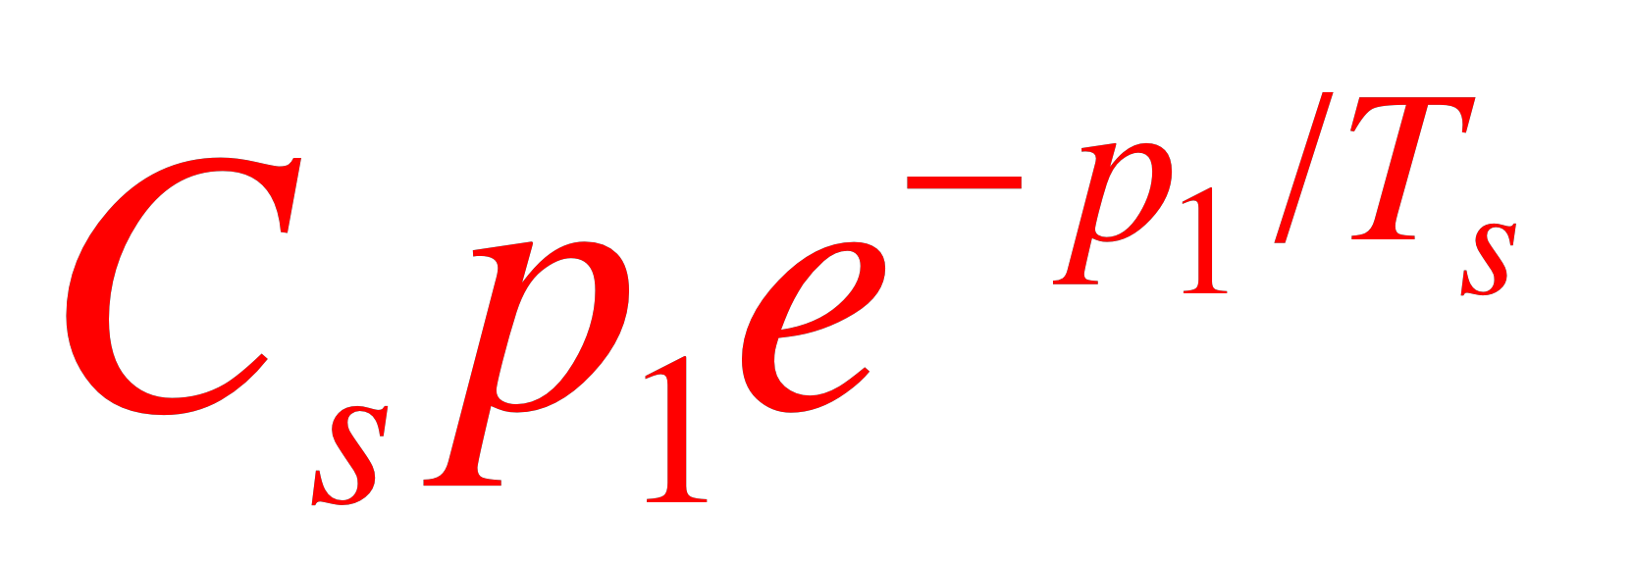
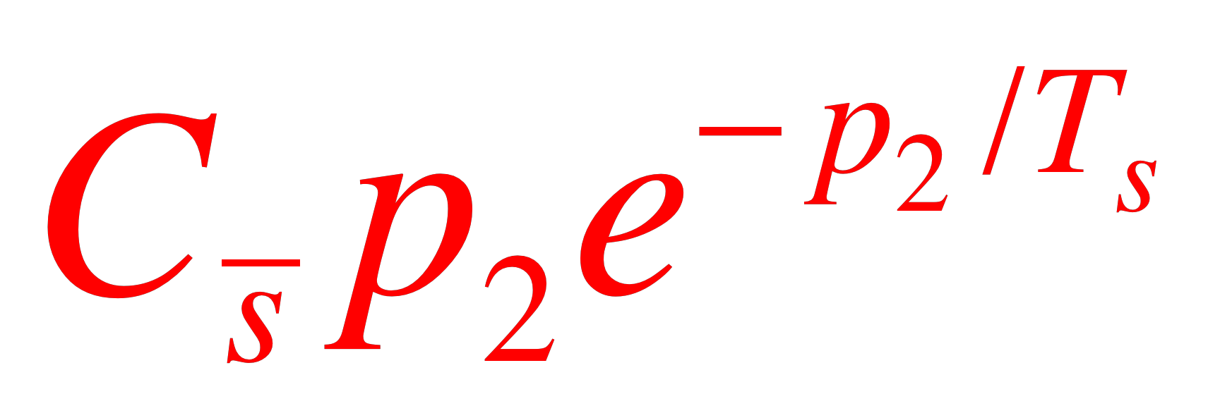
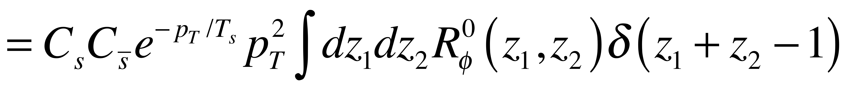
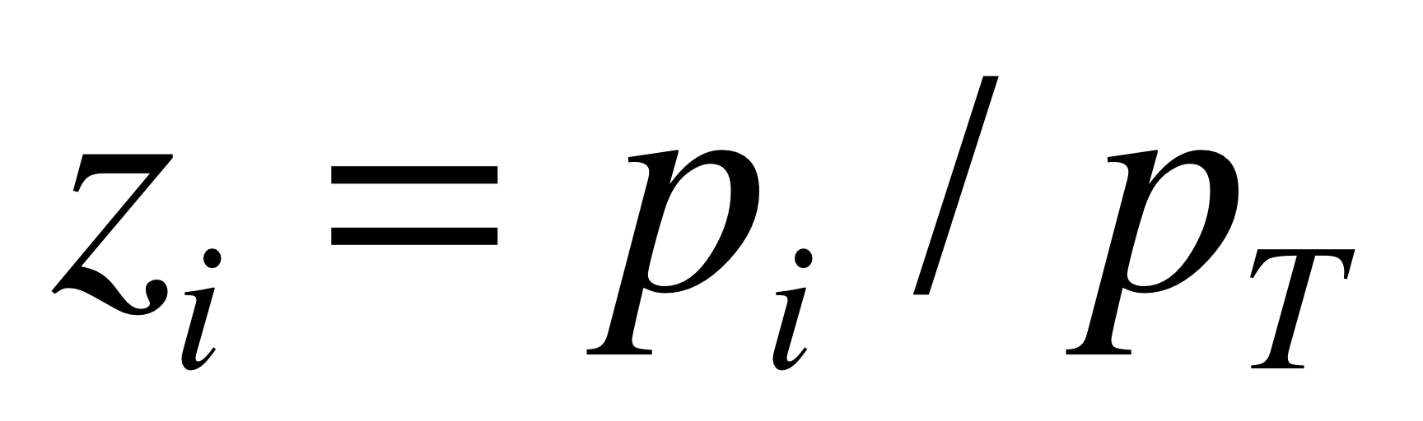
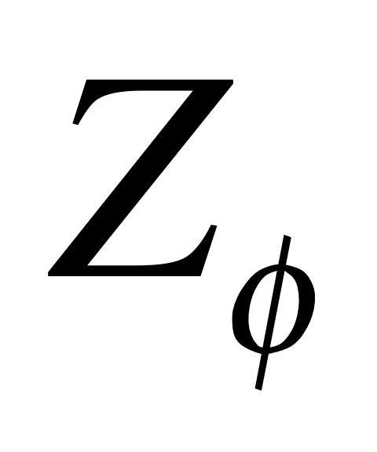
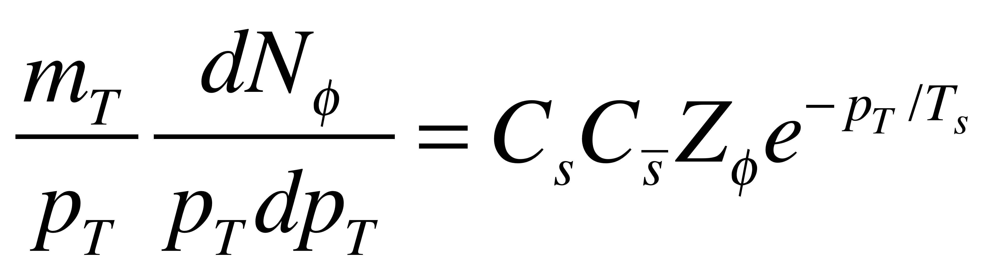
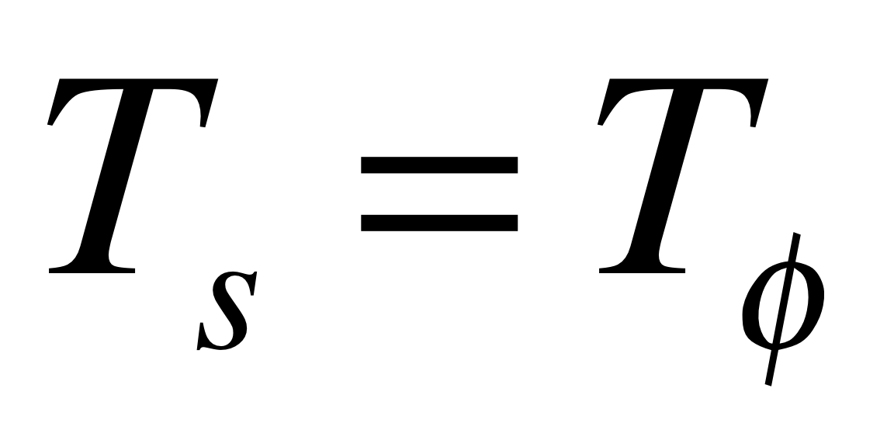
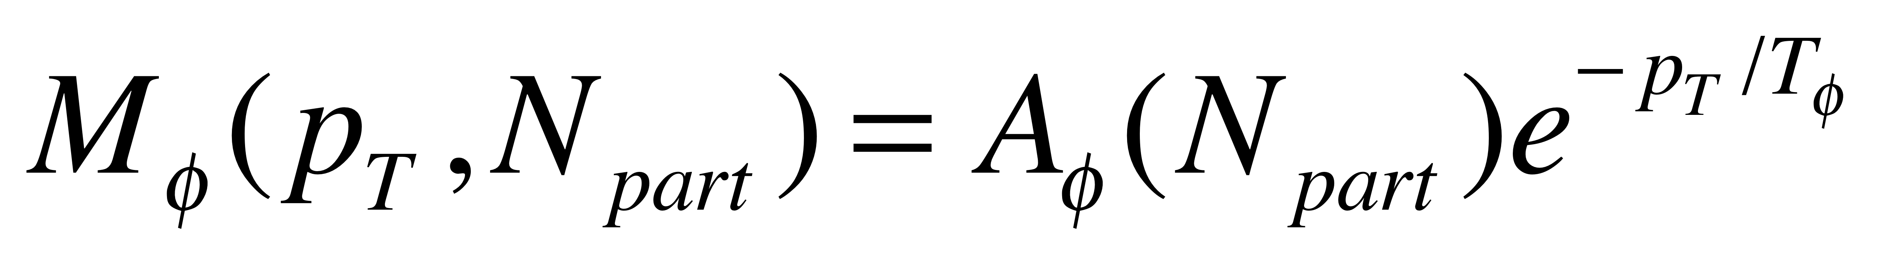
In the Recombination Model
Invariant distribution at hadronization at y≈0

Slide 26
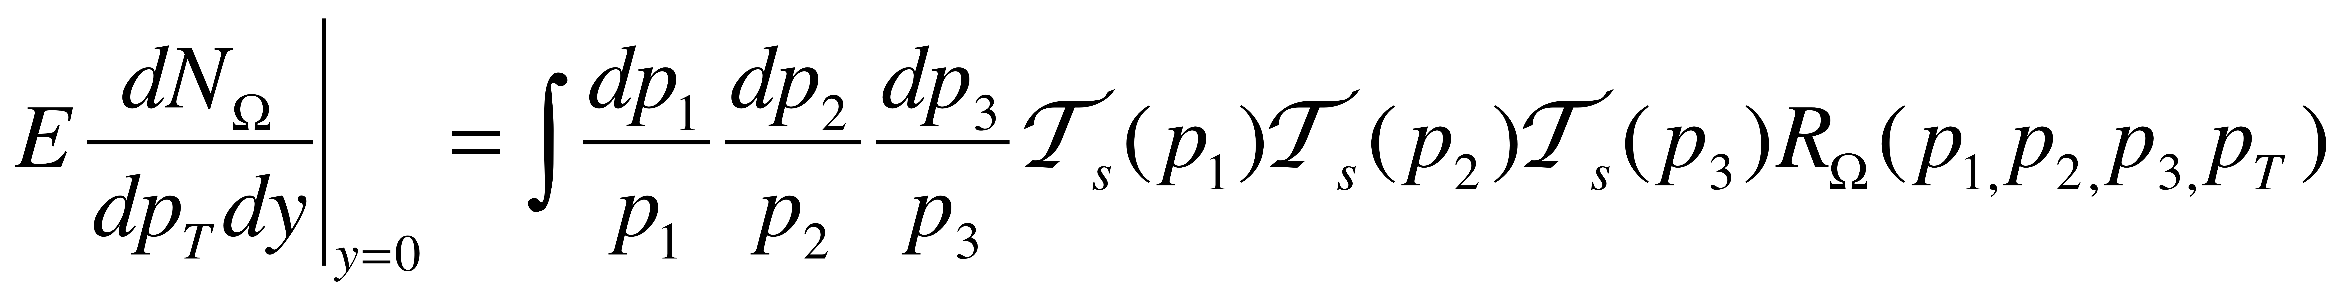
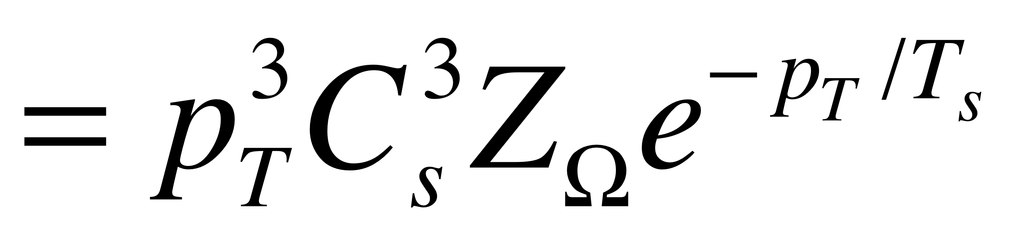
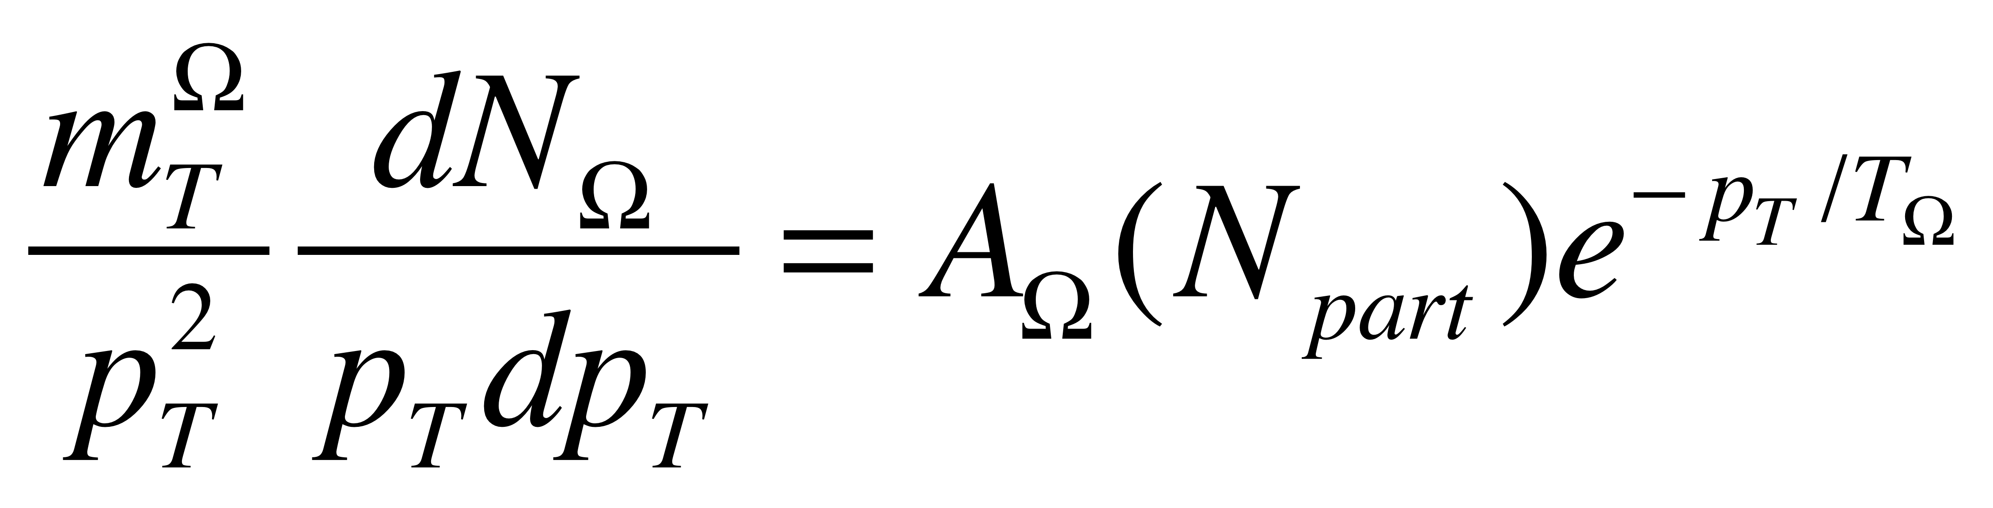
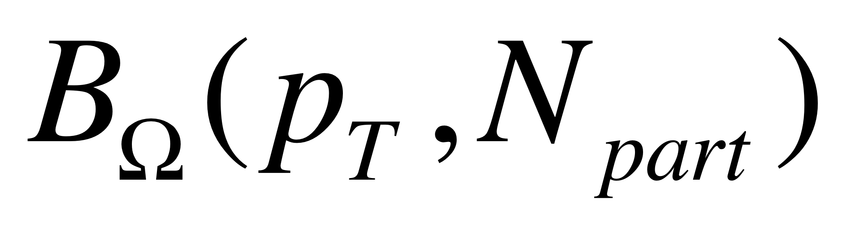
Similarly, Baryons
exponential in p_{T}
3:2
Expected in Recombination model
Empirical
3:2

Slide 27

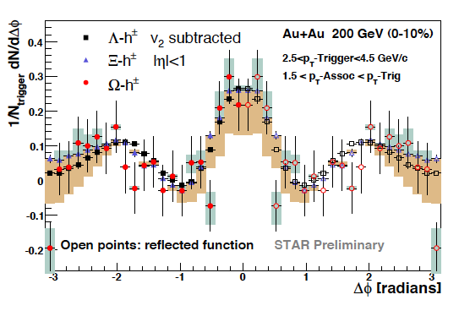
spectra are exponential out to p_{T}=6.5 GeV/c
If it is thermal, randomness would imply that particles are uncorrelated.
But STAR has found hadrons correlated to triggers.
That can be explained by being in the Ridge: all particles in the Ridge are correlated to the trigger and to each other.
(0705.3371)

