Slide 1



Medium Modification of Open Heavy Flavor Production in Heavy-Ion Collisions
Shanshan Cao
Lawrence Berkeley National Laboratory

Slide 2
Outline
Overview of heavy quark transport models
Phenomenological results – comparison to experimental data and possible improvements
Simultaneous description of heavy and light flavor hadrons
Precise extraction of QGP properties with Bayesian analysis
Summary

Slide 3
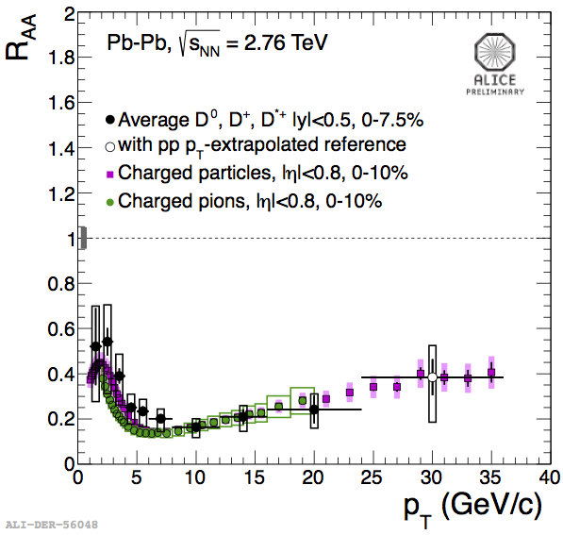
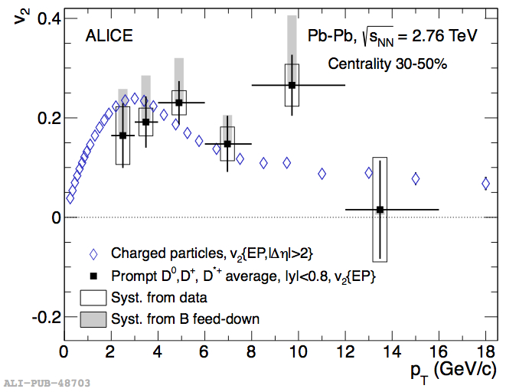
Why to Study Heavy Quarks?
Heavy → produced at early stage: probe the full QGP history
Large suppression and flow that are comparable to light hadrons!
“Heavy vs. light flavor puzzle”: is ΔE_{g}> ΔE_{q}> ΔE_{c}> ΔE_{b} still right?
“R_{AA} vs. v₂ puzzle”: can we describe R_{AA} and v₂ simultaneously?
Challenge: fully understand heavy flavor dynamics within the same framework of light partons

Slide 4

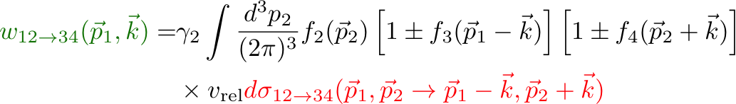
Heavy Quark Transport in QGP
Boltzmann equation for parton “1” distribution:
The collision term:
transition rate from p₁ to p₁-k
Elastic Scattering (2->2 process)
microscopic cross section of 12->34

Slide 5
Heavy Quark Transport in QGP
Assume small momentum change of heavy quark:
Fokker-Planck equation:
Langevin equation – stochastic (multiple scattering limit) realization of Fokker-Planck equation:
random force
Simplifications are only valid for collisional energy loss of HQ.

Slide 6

Implementation of Collisional Energy Loss
Boltzmann Transport
Calculate C[f_{Q}] with LO diagrams for heavy quark scatterings with light quarks and gluons
Dominant contribution from the t-channel
Regulate IR singularity by m_{D}:
[ P. B. Gossiaux and J. Aichelin Phys. Rev. C78 (2008) 014904 ]
[ J. Uphoff, O. Fochler, Z. Xu, C. Greiner, Phys. Rev. C84 (2011) 024908 ]
[ SC, T. Luo, G.-Y. Qin, X.-N. Wang, arXiv: 1605.06447 ]

Slide 7
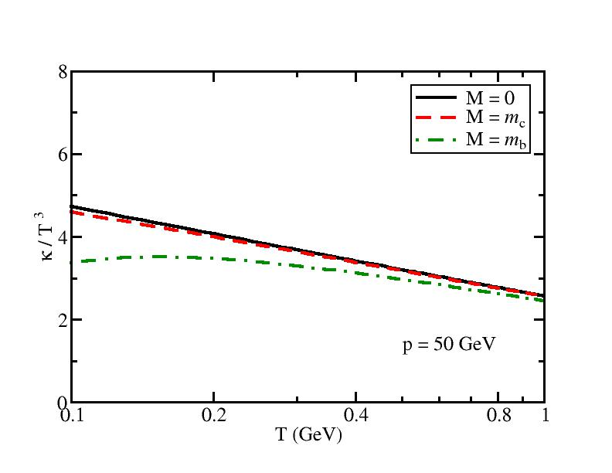
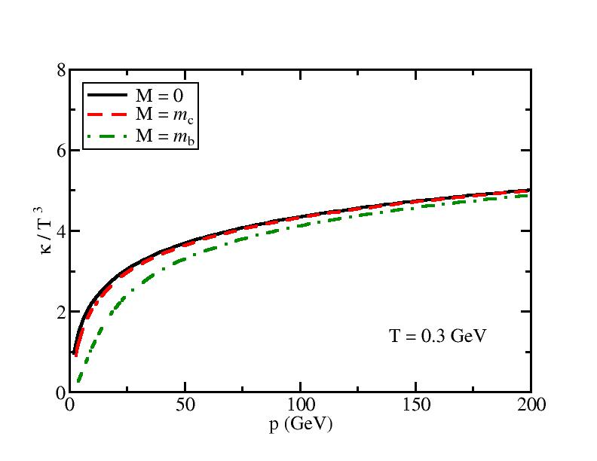
Implementation of Collisional Energy Loss
Langevin equation
Interactions are encoded in transport coefficients
pQCD calculation
drag
p-space diffusion
spatial diffusion
quark transport

Slide 8
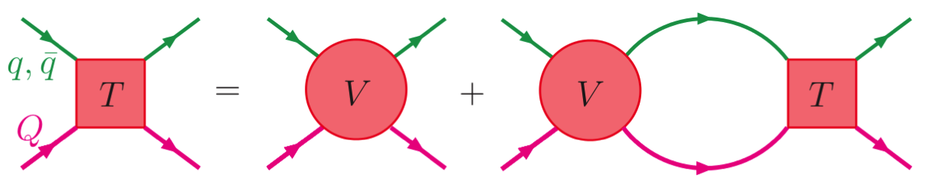
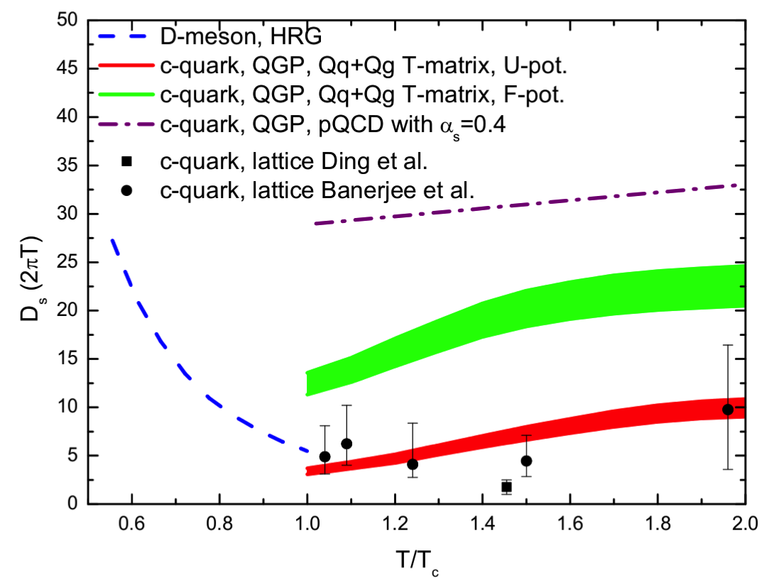


Implementation of Collisional Energy Loss
Non-perturbative resonance scattering
[ Hees et al., PRC 73, 034913, PRL 100, 192301 ]
[ He et al., PRC 86, 014903 ]
Assume two body (qQ) interaction with U or F
Solve T-matrix and extract transport coefficient
Enhanced energy loss than in pQCD due to resonant heavy meson and di-quark states
❖ Shuai Liu’s talk (Tuesday 15:00)
Lattice QCD calculation
No reliable input for transport models due to the large error bars; no p dependence.
Parton-Hadron String Dynamics (PHSD)
Incorporate dynamical quasi-particles due to the finite width of the spectral functions
❖ Elena Bratkovskaya’s talk (Tuesday 16:20)
[ Plot provided by M. Nahrgang ]

Slide 9

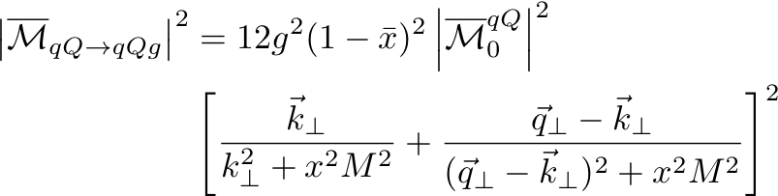


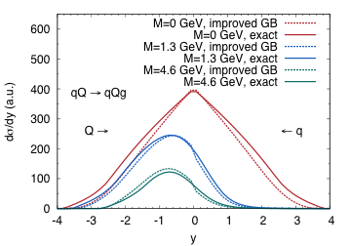




Implementation of Radiative Energy Loss
Boltzmann Transport
[ Gossiaux et al., JPG 37, 094019 ]
[ Fochler et al., PRD 88, 014018 ]
Calculate C[f_{Q}] with LO diagrams for qQ->qQg and gQ->gQg
Gunion-Bertsch Approximation derived at high energy limit
[Kunszt et al., PRD21, (1980) ]
Implementation of the LMP effect
Require
X = 0: no LPM effect
X = 1: only completely independent scatterings
0 < X < 1: allow some interference effect
[ Uphoff et al., JPG 42 (2015)]

Slide 10




Implementation of Radiative Energy Loss
Alternative approach: calculating inelastic scattering probability based on the average number of medium-induced gluon
Improved Langevin Framework (Duke): SC, Qin, Bass, PRC 92 (2015) 024907
LBT Model (LBL-CCNU): SC, Luo, Qin, Wang, arXiv: 1605.06447
Average gluon number in Δt:
Spectrum of medium-induced gluon (higher-twist formalism):
[ Guo and Wang (2000), Majumder (2012); Zhang, Wang and Wang (2004) ]
Number n of radiated gluons during Δt – Poisson distribution:
Probability of inelastic scattering during Δt:

Slide 11
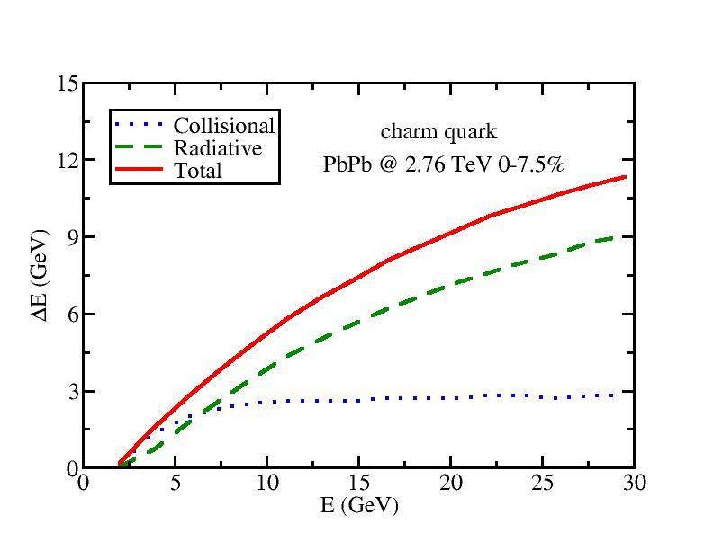
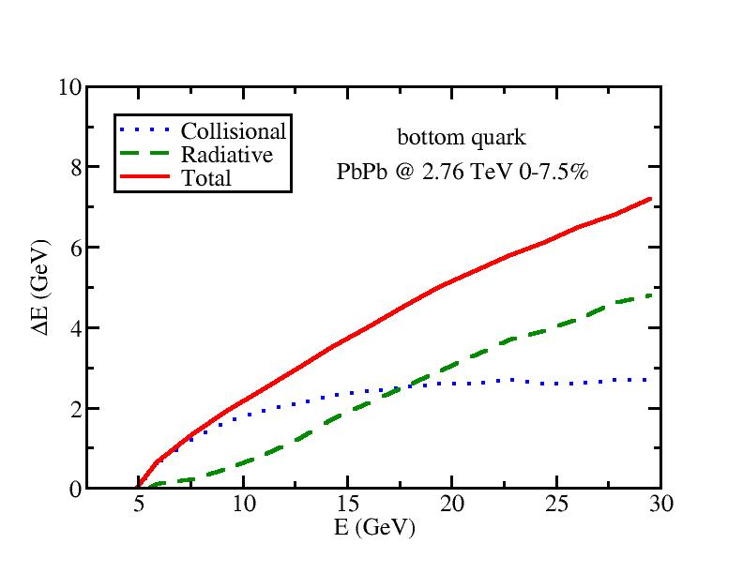
Collisional vs. Radiative Energy Loss
[ SC, Qin and Bass, PRC 92 (2015) 024907]
Collisional energy loss dominates low energy region, while radiative dominates high energy region.
Crossing point: 7 GeV for c and 18 GeV for b quark.
Collisional energy loss alone may work well to describe previous RHIC data but is insufficient for LHC.

Slide 12
Hadronization
HQ: Fragmentation + Recombination
Most high momentum heavy quarks fragment into heavy mesons: Petersen fragmentation function, Pythia simulation, etc.
Most low momentum heavy quarks hadronize to heavy mesons via heavy-light quark coalescence mechanism: instantaneous coalescence model, resonance recombination model, etc.

Slide 13
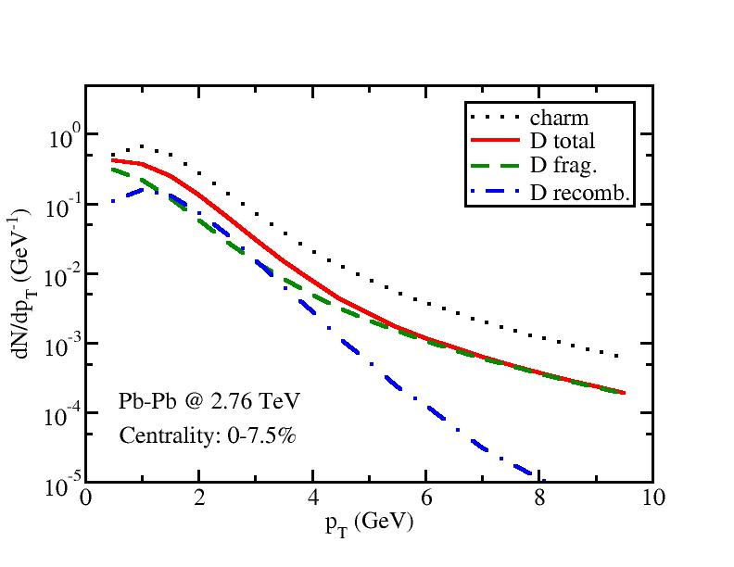
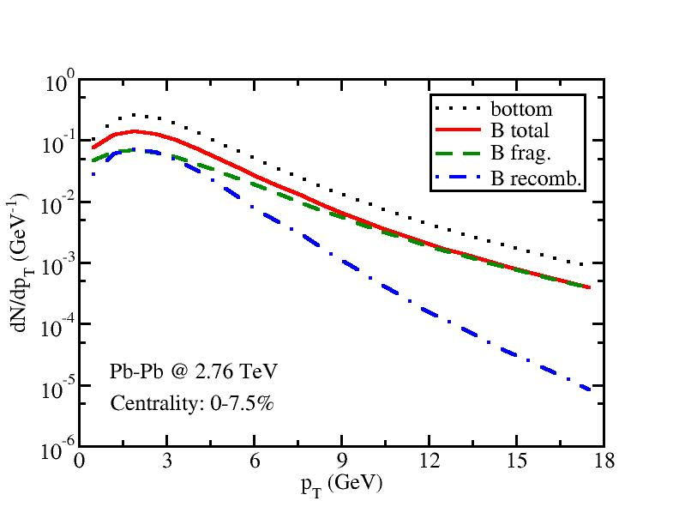
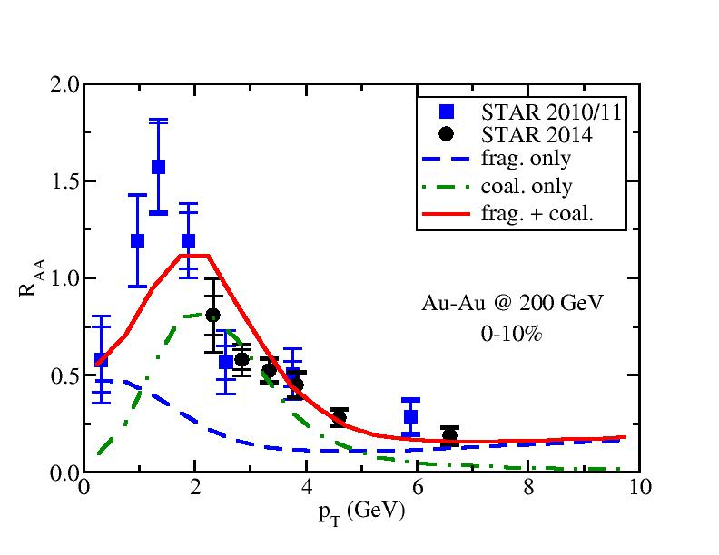
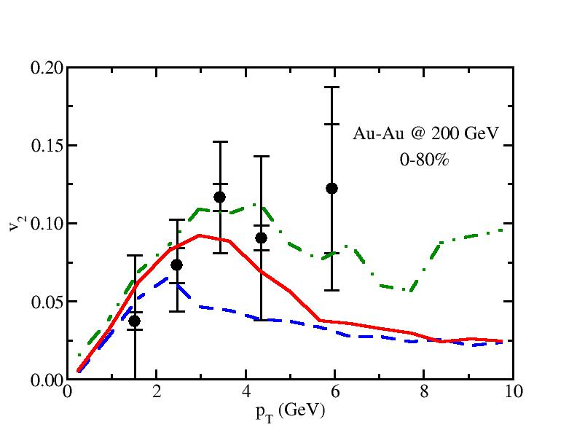
Fragmentation vs. Coalescence
Heavy Meson Spectra
[ SC, Qin and Bass, PRC 92 (2015) 024907]
Heavy Meson R_{AA} and v₂ at RHIC
[ SC, Luo, Qin and Wang, arXiv: 1605.06447 ]
At medium p_{T}, coalescence enhances heavy meson production, increases its R_{AA} (the bump structure) and v₂.

Slide 14
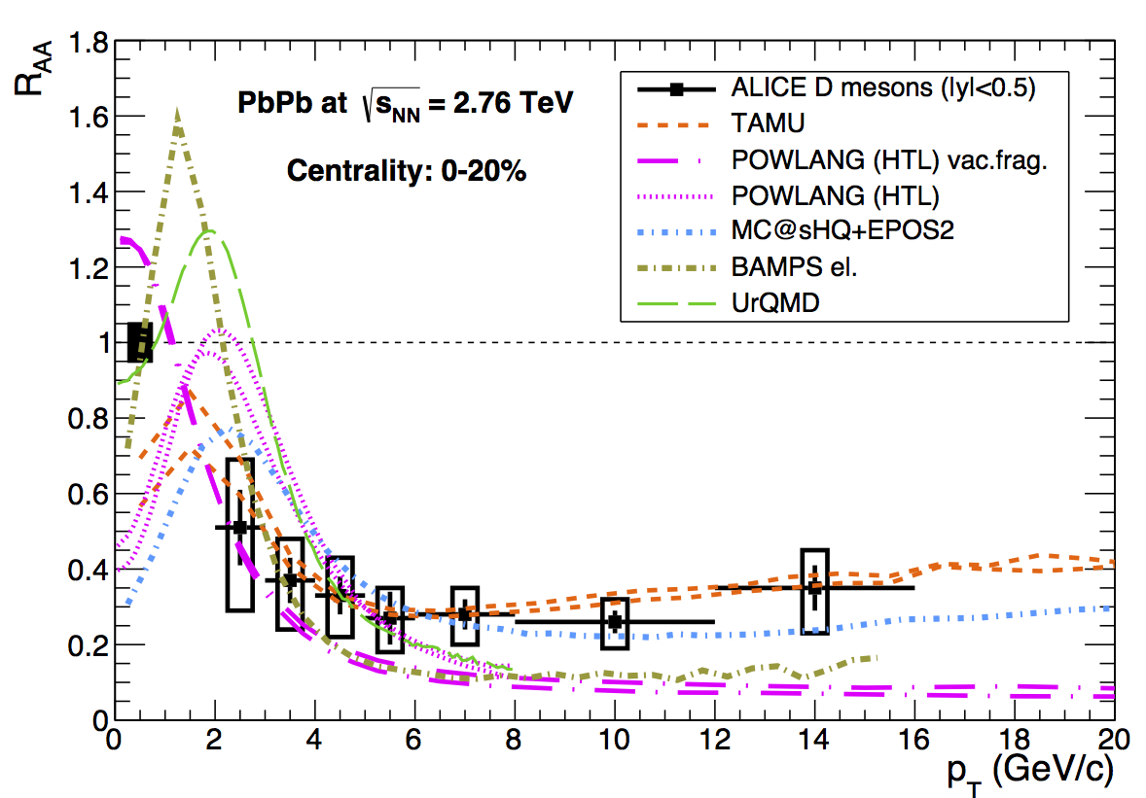
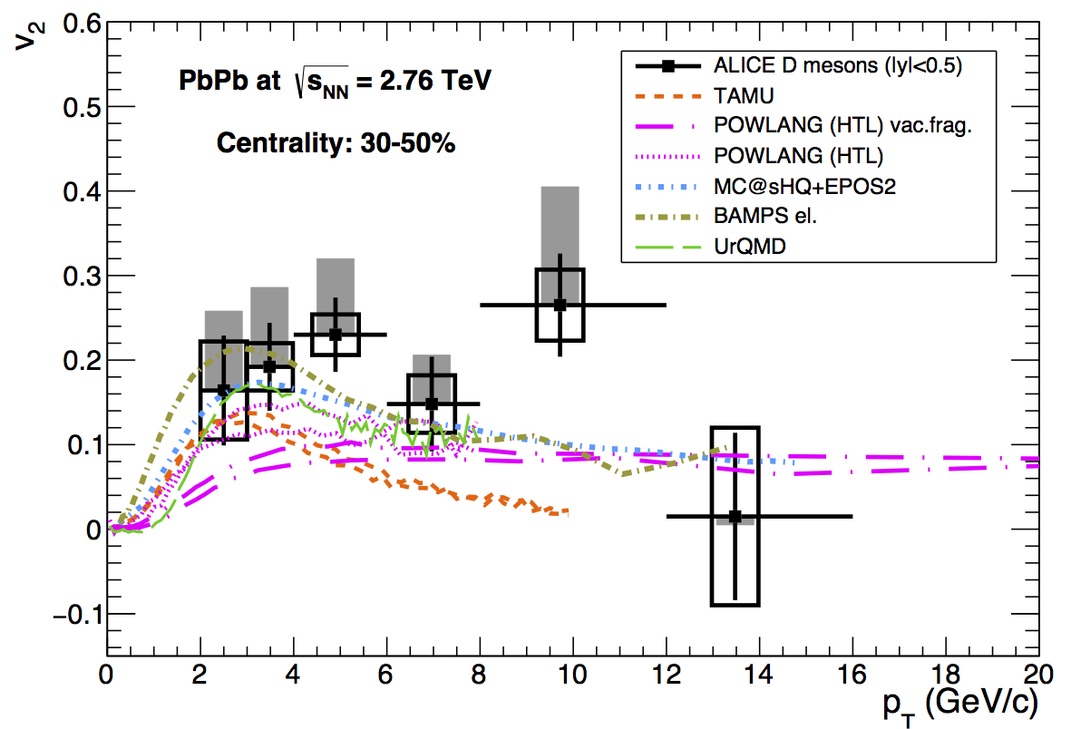
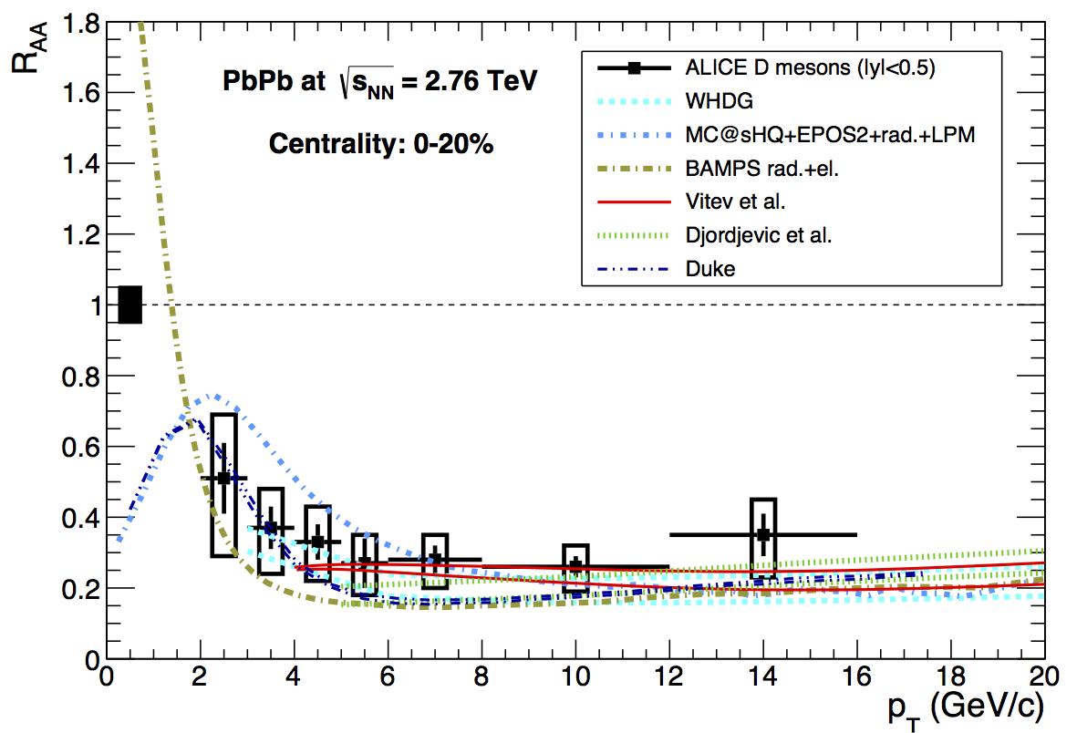
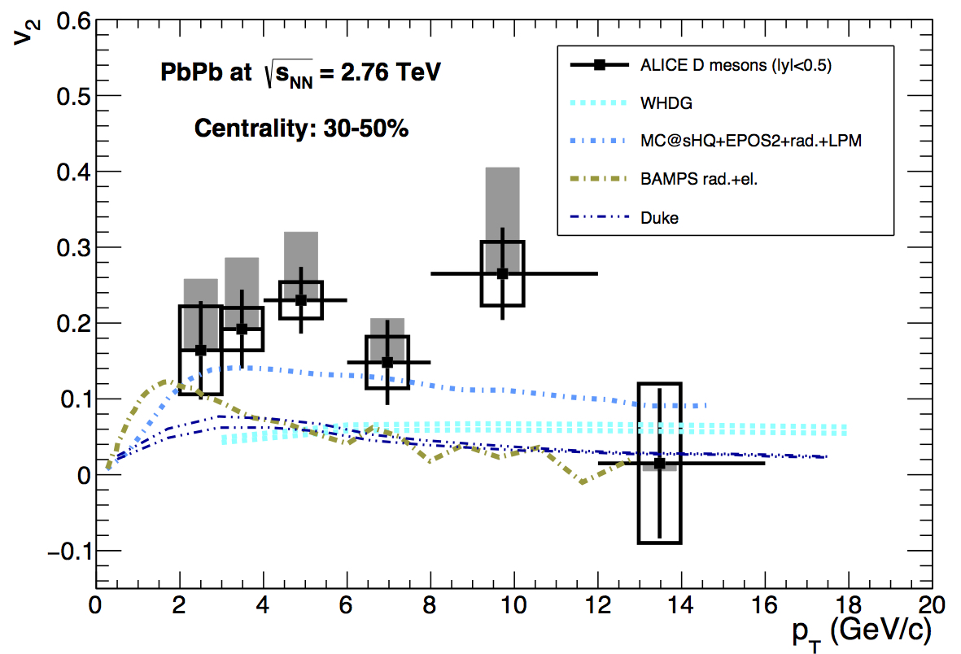
R_{AA} vs. v₂
[Andronic et al., Eur.Phys.J. C76 (2016) 107]
col. only
col. + rad.
Reasonable descriptions of D meson observables with proper tunings of transport coefficients, but still a challenge for an exact simultaneous description of R_{AA} and v₂ .

Slide 15
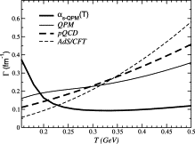
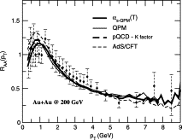
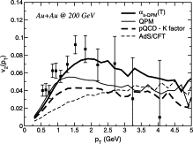
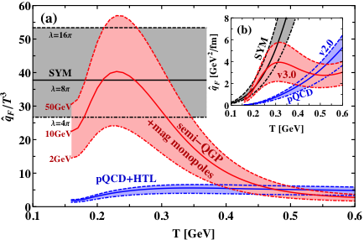
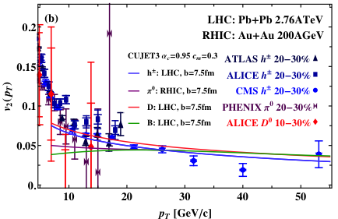
A Possible Solution to the v₂ Puzzle
Different temperature dependence of the interaction strength may lead to different v₂ while R_{AA} is kept the same.
[ S. Das et al., Phys. Lett. B747 (2015) 260-264 ]
[ J. Xu et al. arXiv: 1411.3673 ]
Semi-quark-gluon monopole plasma model increases around T_{c} and enhances hard probes’ v₂.
❖ Santosh Kumar Das’s talk (Tuesday 16:20)
❖ Caio Alves Garcia Pradotalk (Thursday 09:20)

Slide 16
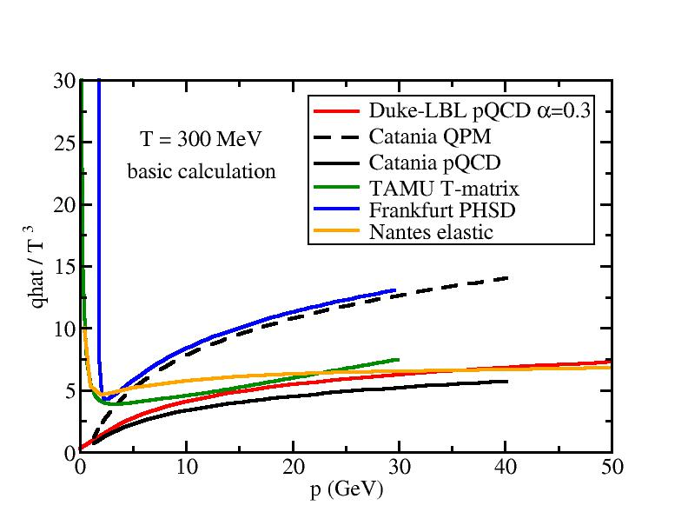
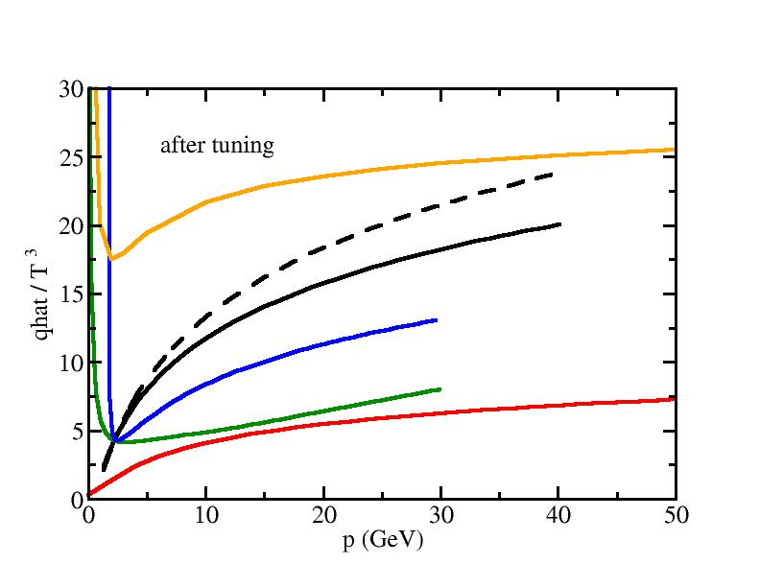
Systematic Comparison of Transport Coefficient
Without any tuning, transport coefficient from different groups within HQWG are consistent with each other -> common baseline
After tuning to describe experimental data, different models require very different inputs of transport coefficient
HQWG targets at systematically exploring the origin of these differences (heavy quark dynamics, hydro background, hadronization mechanism, etc.) and the their phenomenological consequences

Slide 17
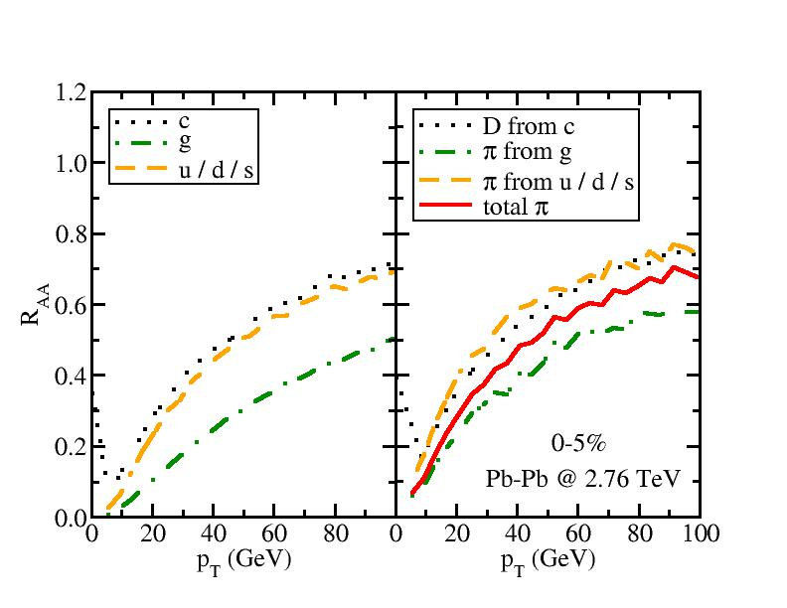
Heavy vs. Light Hadron Suppression
Calculation from LBT model:
SC, Luo, Qin and Wang,
arXiv: 1605.06447
u/d/s are more suppressed than c quark at low p_{T} but they have very similar R_{AA} at high p_{T}, g is significantly more suppressed
Due to different fragmentation function (harder for c than for u/d/s), π from light quark is slightly less suppressed than D
R_{AA} of mixed π is sensitive to fragmentation function of light quark vs. gluon [Chen et. al., J. Phys. 37 (2010) 015004]

Slide 18
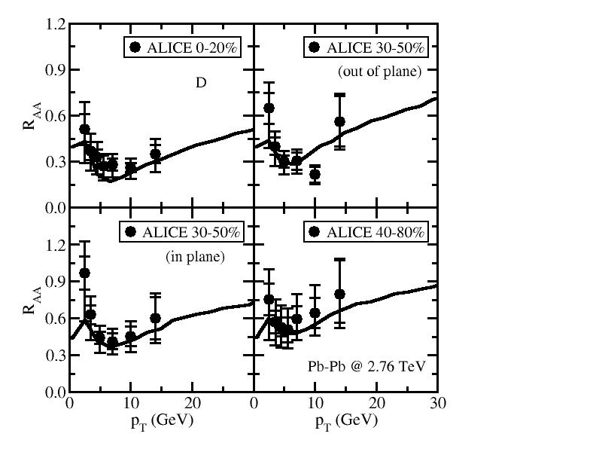
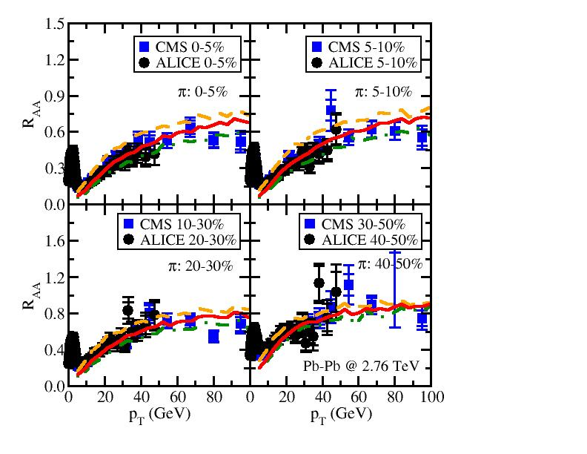
Simultaneous Description of D and π R_{AA} in 2.76 TeV Pb-Pb Collisions

Slide 19
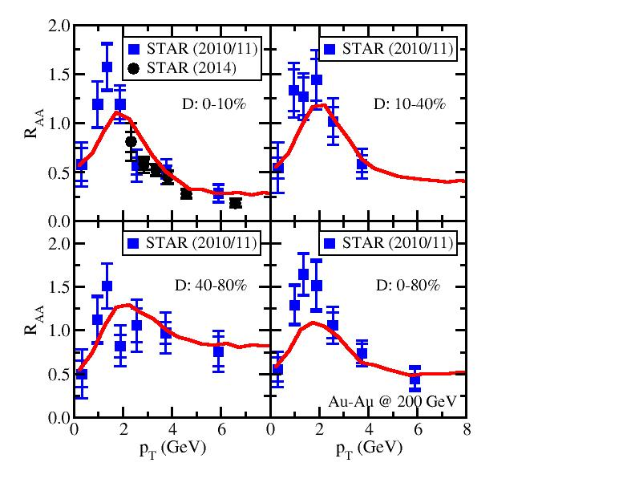
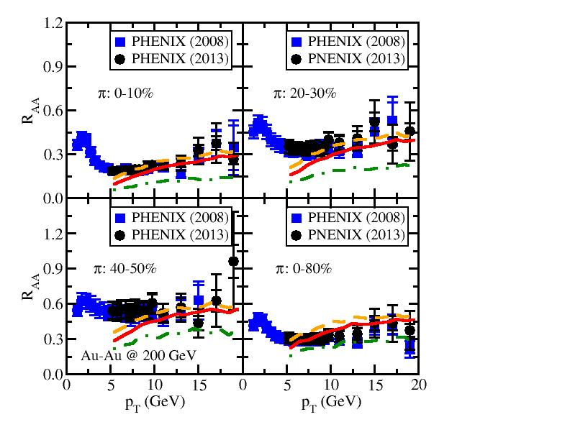
Simultaneous Description of D and π R_{AA} in 200 GeV Au-Au Collisions

Slide 20
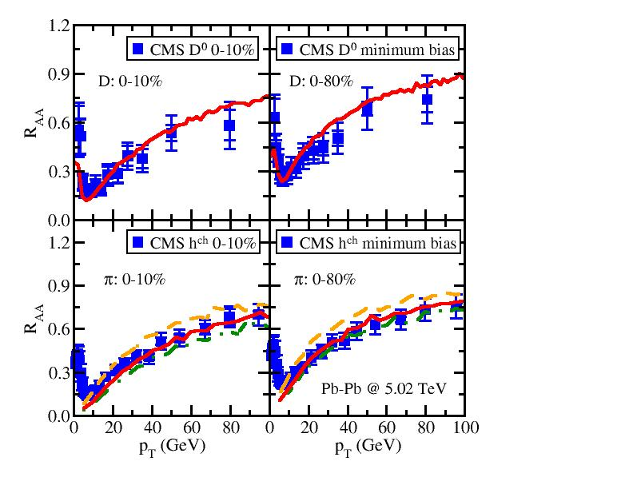
Simultaneous Description of D and π R_{AA} in 5.02 TeV Pb-Pb Collisions
With a delicate treatment of heavy and light parton in-medium evolution and their hadronization process, one naturally obtains similar R_{AA} of heavy and light flavor hadrons and provides simultaneous descriptions of experimental data.
❖ Guang-You Qin’s talk (Tuesday 14:20)

Slide 21
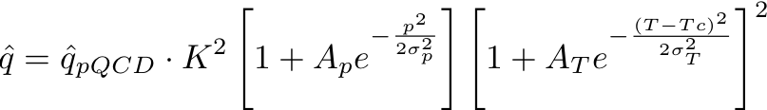
Bayesian Analysis
( Precise Extraction of QGP Properties )
Assume intuitive parametrizations of transport coefficients:
Build state-of-art model:
Initial (trento) + hydro (VISHnew) + HQ transport (Duke Langevin)
Compare to data and extract best set of parameters
5 dimensional Parameter space: [K, A_{p}, σ_{p}, A_{T}, σ_{T}]
Gaussian Emulator and Bayesian Analysis:
Train Gaussian emulator with smartly chosen points (Latin Hypercube) in the parameter space (10*dimension points are sufficient)
Use the emulator to sweep over the parameter space, compare with data, and compute the posterior probability of each set of parameters based on the Bayes’ Theorem

Slide 22
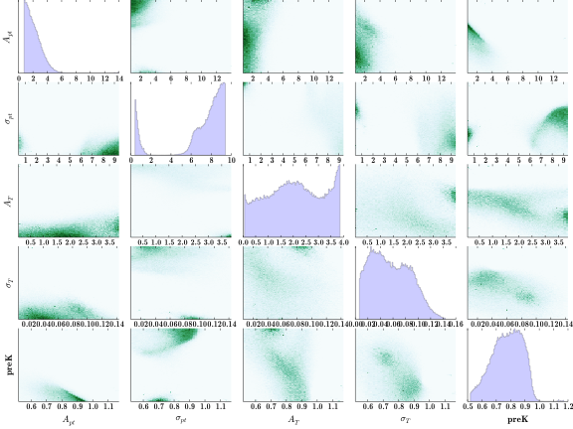
Bayesian Analysis – Results
Probability distribution of the parameter space after comparing with the STAR 2014 data (HFT)
[ From Yingru Xu, Duke University ]

Slide 23
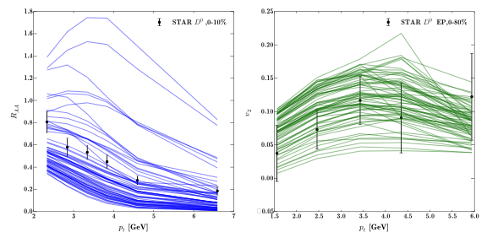
Bayesian Analysis – Results
Calculation prior to Bayesian analysis (no knowledge of parameter space )

Slide 24
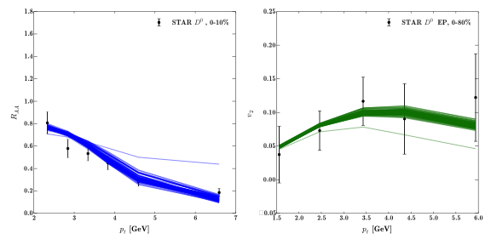
Bayesian Analysis – Results
Calculation prior to Bayesian analysis (no knowledge of parameter space )
Calculation with posterior probability distribution given by Bayesian analysis

Slide 25

Bayesian Analysis – Results
Calculation prior to Bayesian analysis (no knowledge of parameter space )
Calculation with posterior probability distribution given by Bayesian analysis
Best fit to data with together with a 60% C.L. band
Better constraint is expected on the heavy quark transport coefficient when we incorporate more experimental data into our analysis.
❖ Jussi Auvinen’s talk (Tuesday 15:00)

Slide 26
Other Topics on Heavy Quark Theory
Heavy flavor production from soft collinear effective theory  Felix Ringer’s talk (Tuesday 16:40)
D-meson observables in p-Pb collisions  Vitalii Ozvenchuk’s talk (Tuesday 17:20)
Angular correlations between heavy and light mesons  Martin Rohrmoser’s talk (Thursday 10:00)
Effect of strong magnetic field on heavy quark diffusion  Ho-Ung Yee’s talk (Thursday 10:20)

Slide 27
Summary
Summarized different transport models and their implementations to heavy quark energy loss in QGP – collisional vs. radiative energy loss
Compared numerical results to experimental data and provided a simultaneous description of heavy and light hadron suppression – “heavy vs. light puzzle” solved
Discussed a possible solution to the “R_{AA} vs. v₂ puzzle” – temperature dependence of interaction strength
Presented a statistic tool – Gaussian emulator + Bayesian analysis – for precise extraction of QGP properties

Slide 28
Thank you!

Slide 29
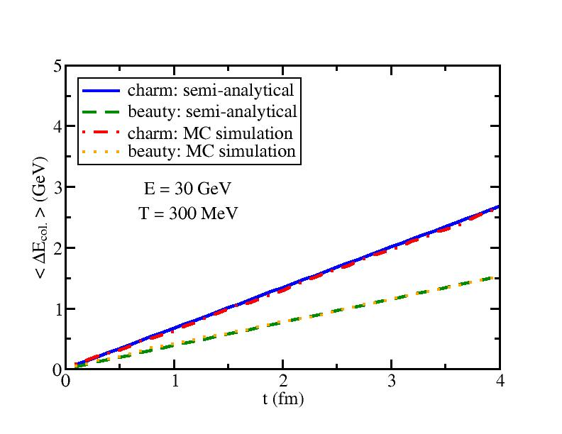
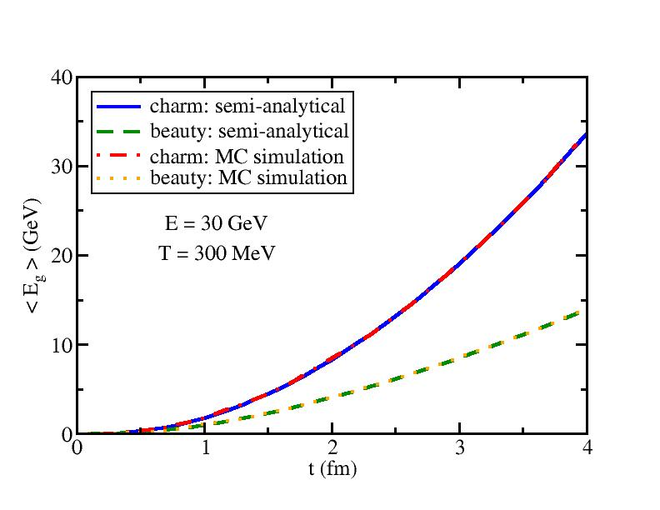
Collisional vs. Radiative Energy Loss
[ SC, Luo, Qin and Wang, arXiv:1605.06447 ]
Elastic scattering leads to linear increase of energy loss w.r.t. time; medium-induced gluon radiation leads to quadratic increase.
Collisional and radiative energy loss are comparable at early time, but radiative energy loss dominates when t is large.

Slide 30
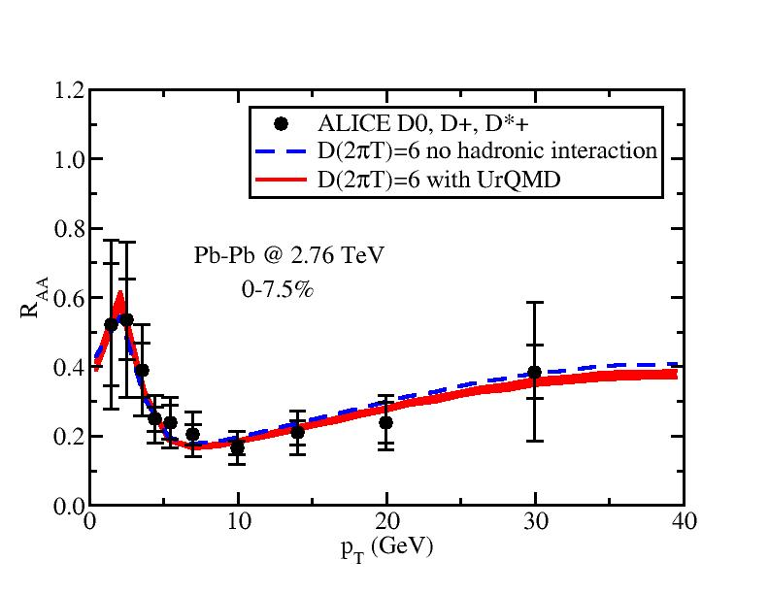
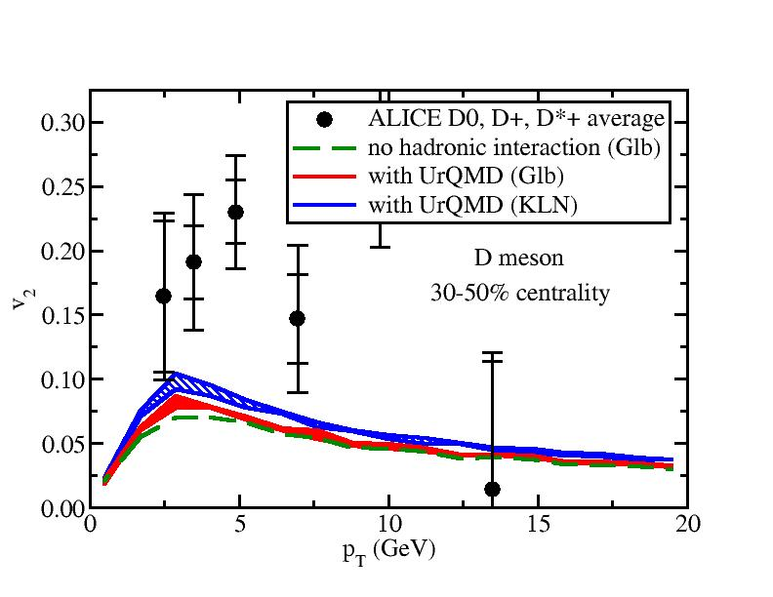
Hadronic Interactions
Boltzmann Transport
[ SC et al, PRC 92, 024907; Song et al, PRC 92, 014910 ]
Soft hadrons from QGP
σ
Boltzmann model
e.g. UrQMD
Heavy hadrons from heavy quarks
Langevin Transport
[ He et al, PLB 735, 445 ]
Diffusion constant of D mesons in a hadron gas
Additional scatterings of heavy mesons inside the hadrons gas further suppress their R_{AA} at high p_{T} and enhance their v₂.

Slide 31
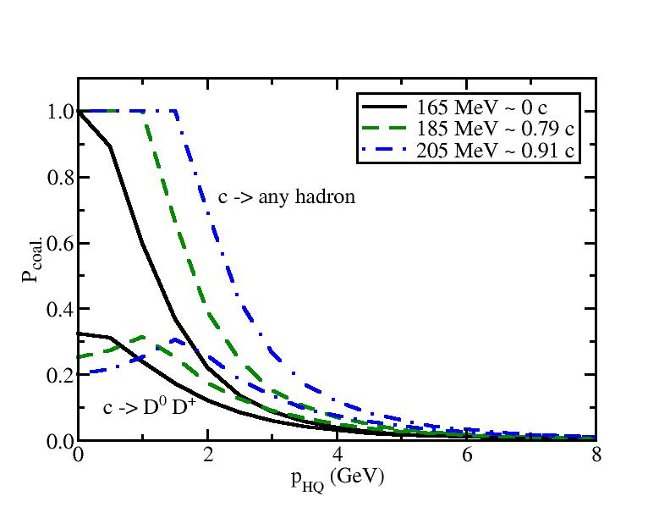
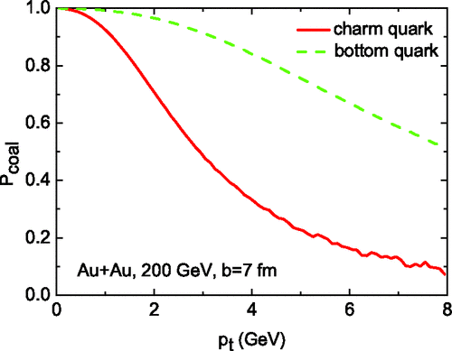
Coalescence Models
Instantaneous Coalescence
[ SC et al., PRC 92, 024907]
[ Gossiaux et al., PRC 78, 014904 ]
[ Song et al., PRC 92, 014910 ]
Distribution of partons
Wigner function, overlap between wavefunctions of partons and the final hadron, probability to combine
( D Λ Σ Ξ Ω )
Three regions: coal. to heavy meson, coal. through other channels, fragmentation
Resonance Recombination
[ He et al., PRC 86, 014903 ]
Time window during which resonance states exist
h formation rate
Qq resonance cross section (T-matrix)

Slide 32
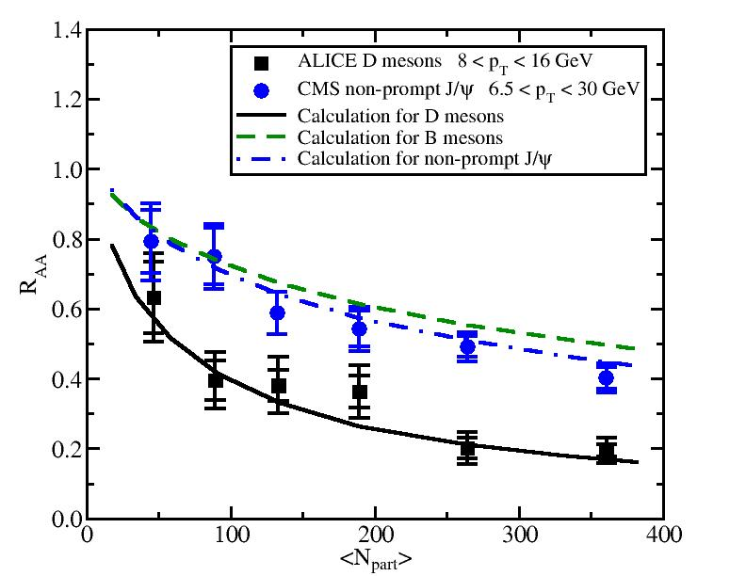
R_{AA} of D, B mesons and non-prompt J/ψ
Good description of N_{part} dependence of the D meson R_{AA}
With the same transport coefficient for c and b quarks, reasonable description of the non-prompt J/ψ R_{AA}
Mass hierarchy of heavy quark energy loss: ΔE_{c}> ΔE_{b}

Slide 33
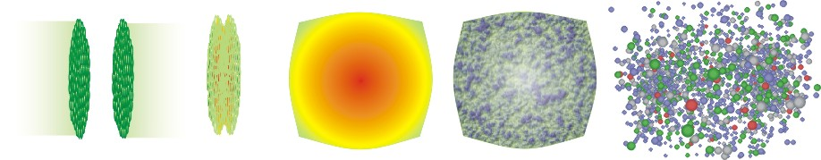
Interim Summary of HF Dynamics
( arXiv: 1505:01413 )
hadronic phase
and freeze-out
QGP and
hydrodynamic expansion
initial state
pre-equilibrium
hadronization
Bulk Matter: Glb/KLN initial (2+1)-d viscous Cooper-Frye
condition hydro (OSU) (OSU iSS)
UrQMD
Heavy Flavor: Glauber for x Improved Hybrid model
LOpQCD+CTEQ Langevin of frag.+coal.
+EPS09 for p col.+rad.

Slide 34
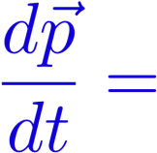



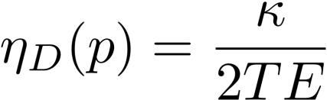
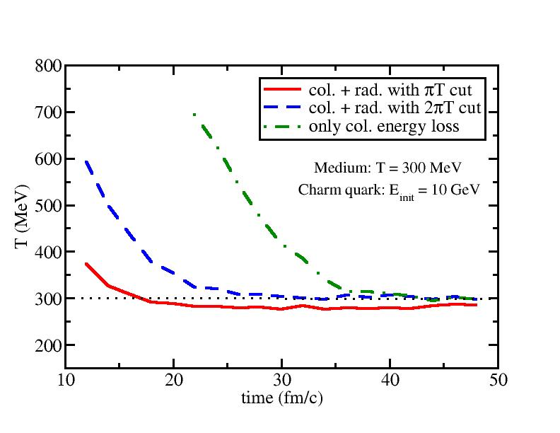
Check of Detail Balance
Modified Langevin Equation:
Gluon radiation only, may break the detail balance
Cut off gluon radiation at low energies where collisional energy loss dominates and detail balance is preserved.
Large enough cut reproduces charm quark thermalization behavior.
More rigorous solution: include gluon absorption term into the higher-twist formalism directly and recalculate term.

Slide 35
Heavy Quark Transport in QGP
Assume small momentum change of heavy quark:
Fokker-Planck equation:
Langevin equation – stochastic (multiple scattering limit) realization of Fokker-Planck equation:
random force
Note: Simplifications are only valid for collisional energy loss.

