Slide 1
Observation of global hyperon polarization in non-central heavy ion collisions
Mike Lisa, Ohio State University
for the STAR Collaboration

Slide 2
Outline
Motivation
  angular momentum and plasma substructure
  CME / CVE – the need for quantitative “non-chiral” input
  global hyperon polarization as a unique probe
First observation of global hyperon polarization
  Analysis details: acceptance, resolution correction
  √s_{NN}-dependence and splitting for Lambdas and AntiLambdas
    & comparison with prev. result
  Feed-down correction
Model-dependent estimate of B-field and plasma vorticity
Summary & Outlook

Slide 3
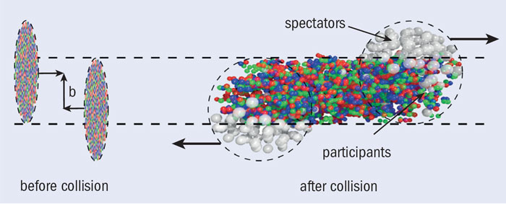
Non-central collisions - J ~ 10⁴ ħ
Is angular momentum distributed thermally?
Does it generate a “spinning QGP?”
  consequences?
How does that affect fluid/transport?
How would it manifest itself in data?
Relevance to novel phenomena?

Slide 4
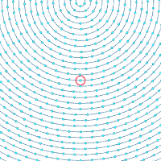
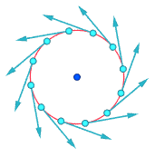
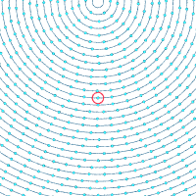
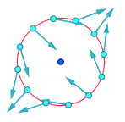
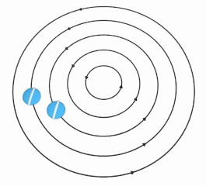
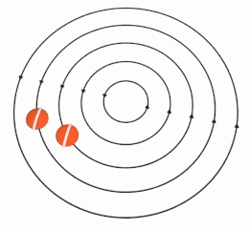


Rotational & Irrotational Vortices
Rigid-body-like vortex
Irrotational vortex – e.g. tub drain
This one is like the moon,
always facing the same
side toward Earth
Notice the rotation, or lack thereof, in the fluid elements

Slide 5
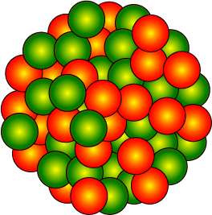
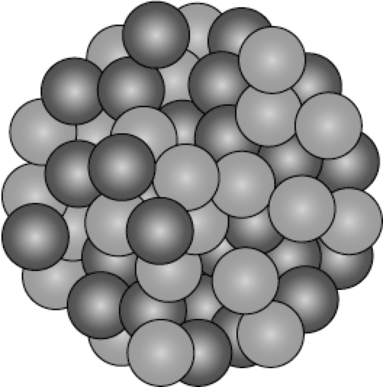
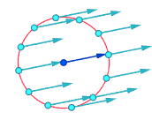
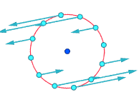
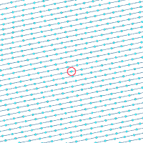

Localized vortex generation via baryon stopping
Viscosity dissipates vorticity to fluid at larger scale
Vorticity – fundamental sub-femtoscopic structure
of the “perfect fluid” and its generation

Slide 6
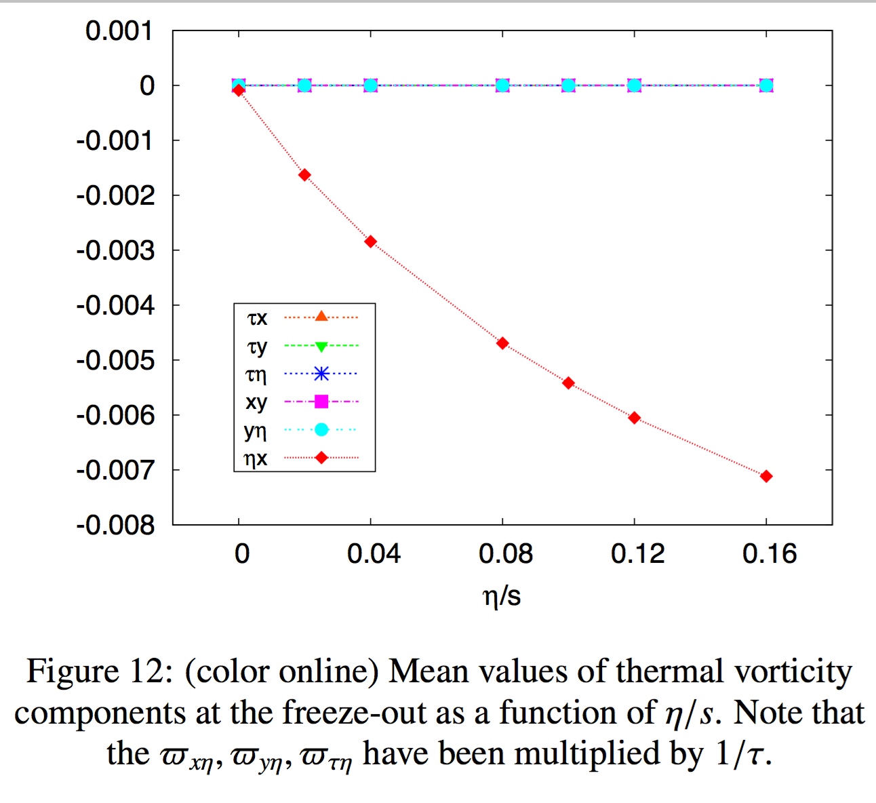
Becattini arxiv:1501.04468
Viscous hydro.
Au+Au @ 200 GeV
Localized vortex generation via baryon stopping
Viscosity dissipates vorticity to fluid at larger scale
Vorticity – fundamental sub-femtoscopic structure
of the “perfect fluid” and its generation

Slide 7

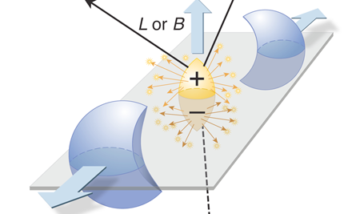
Contributors to Global Polarization
Vortical or QCD spin-orbit:
  fluid cell emits polarized particles
  Becattini, Csernai, Torrieri, Gyulassy, Gao, Liang, Wang, Sorin...

Slide 8
Contributors to Global Polarization
Vortical or QCD spin-orbit:
  fluid cell emits polarized particles
  Becattini, Csernai, Torrieri, Gyulassy, Gao, Liang, Wang, Sorin...
Magnetic coupling
  particles polarized according to magnetic moment

Slide 9
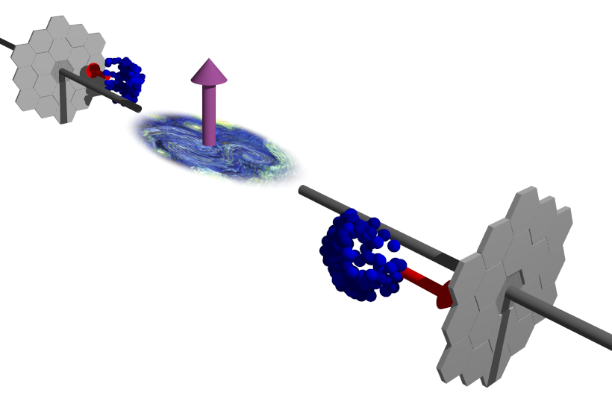
Input needed to extract physics from CME/CVE
Kharzeev & Son PRL106 062301 (2011)
See talks by Liwen Wen & others
Tuesday afternoon
CME and CVE hold promise to access fundamental features of QCD
Novel phenomena are among RHIC’s most exciting and visible new results
To put these discoveries on firmer footing, we need calibrated estimates of B-field and vorticity
Hyperon polarization: non-“chiral”, independent and likely unique measure

Slide 10
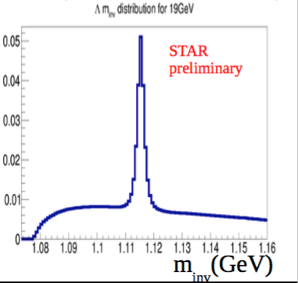
Lambdas are “self-analyzing”
reveal polarization by preferentially emitting daughter proton in spin direction
E. Cummins, Weak Interactions (McGraw-Hill, 1973)

Slide 11
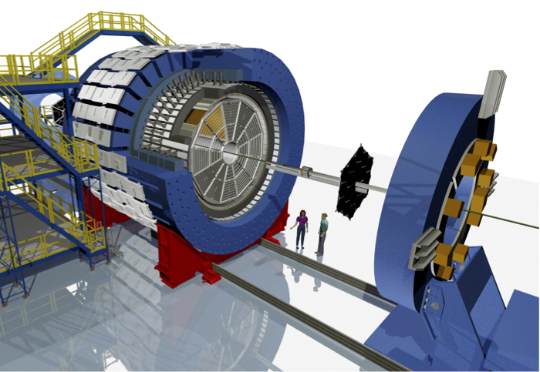
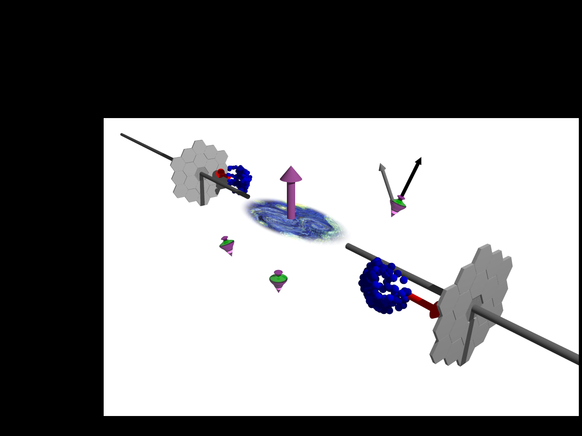
STAR BES energies 7.7, 11.5 14.5, 19.6, 27, 39 GeV Au+Au collisions
Also compare to previously published 62.4, 200 GeV analysis, using ZDC for Reaction Plane

Slide 12
[1] STAR, PRC76 024915 (2007)

Slide 13
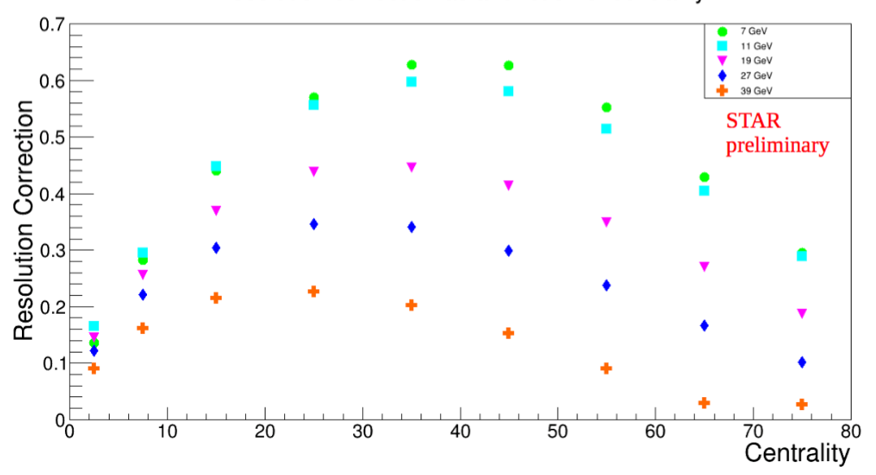
Event plane resolution
Event-plane resolution
best for mid-central collisions
significantly worse at higher energy
errorbars

Slide 14
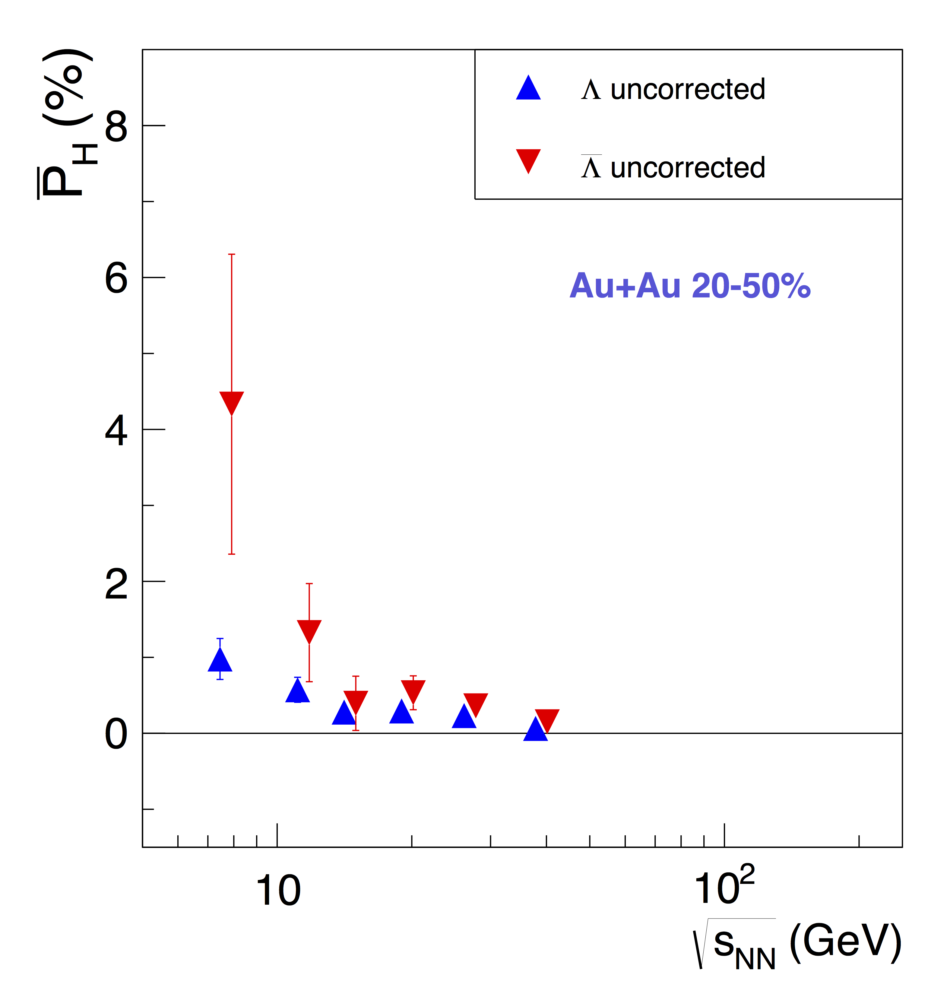
Preliminary results – uncorrected for RP resolution
First clear positive signal of global polarization in heavy ion collisions!
systematic errors vanishingly small beneath statistical errors
Both Lambdas and AntiLambdas show positive polarization
vorticity, spin-orbit mechanism dominant
Splitting?
suggests additional magnetic effect
Signal falls with energy – physics or simply loss of resolution?
STAR Preliminary
√s_{NN} (GeV) | 7.7 | 11.5 | 14.5 | 19.6 | 27 | 39
Λ | 3.6σ | 3.5σ | 2.4σ | 3.1σ | 3.5σ | 1.1σ
anti-Λ | 2.2σ | 2.1σ | 1.1σ | 2.4σ | 2.9σ | 1.6σ
Marginal significance for one energy.
Ensemble & trend adds confidence.

Slide 15
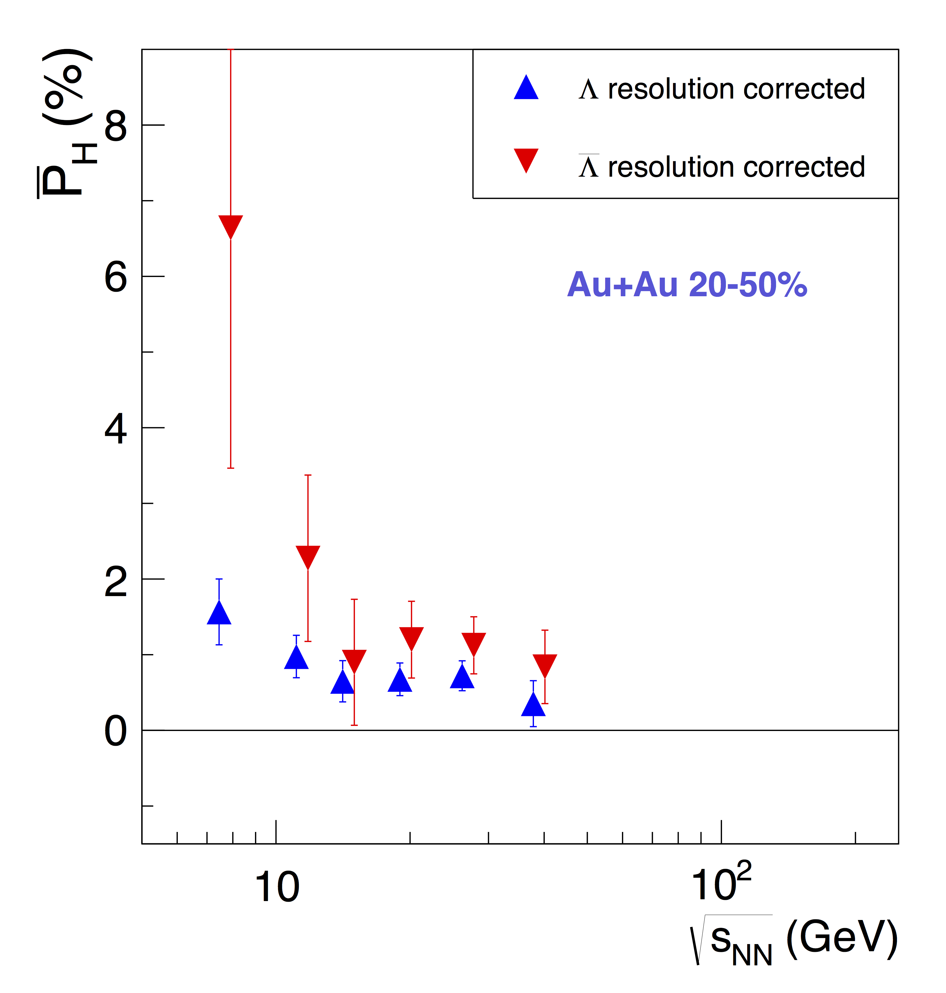
Preliminary results – corrected for RP resolution
First clear positive signal of global polarization in heavy ion collisions!
systematic errors vanishingly small beneath statistical errors
Both Lambdas and AntiLambdas show positive polarization
vorticity, spin-orbit mechanism dominant
Splitting?
suggests additional magnetic effect
Signal falls with energy – physics or simply loss of resolution?
STAR Preliminary
√s_{NN} (GeV) | 7.7 | 11.5 | 14.5 | 19.6 | 27 | 39
Λ | 3.6σ | 3.5σ | 2.4σ | 3.1σ | 3.5σ | 1.1σ
anti-Λ | 2.2σ | 2.1σ | 1.1σ | 2.4σ | 2.9σ | 1.6σ
Marginal significance for one energy.
Ensemble & trend adds confidence.

Slide 16
Preliminary results – corrected for RP resolution
First clear positive signal of global polarization in heavy ion collisions!
systematic errors vanishingly small beneath statistical errors
Both Lambdas and AntiLambdas show positive polarization
vorticity, spin-orbit mechanism dominant
Splitting?
suggests additional magnetic effect
Signal falls with energy – physics or simply loss of resolution?
STAR Preliminary
√s_{NN} (GeV) | 7.7 | 11.5 | 14.5 | 19.6 | 27 | 39
Λ | 3.6σ | 3.5σ | 2.4σ | 3.1σ | 3.5σ | 1.1σ
anti-Λ | 2.2σ | 2.1σ | 1.1σ | 2.4σ | 2.9σ | 1.6σ
 | BES average
Λ | 6.8σ
anti-Λ | 3.7σ

Slide 17
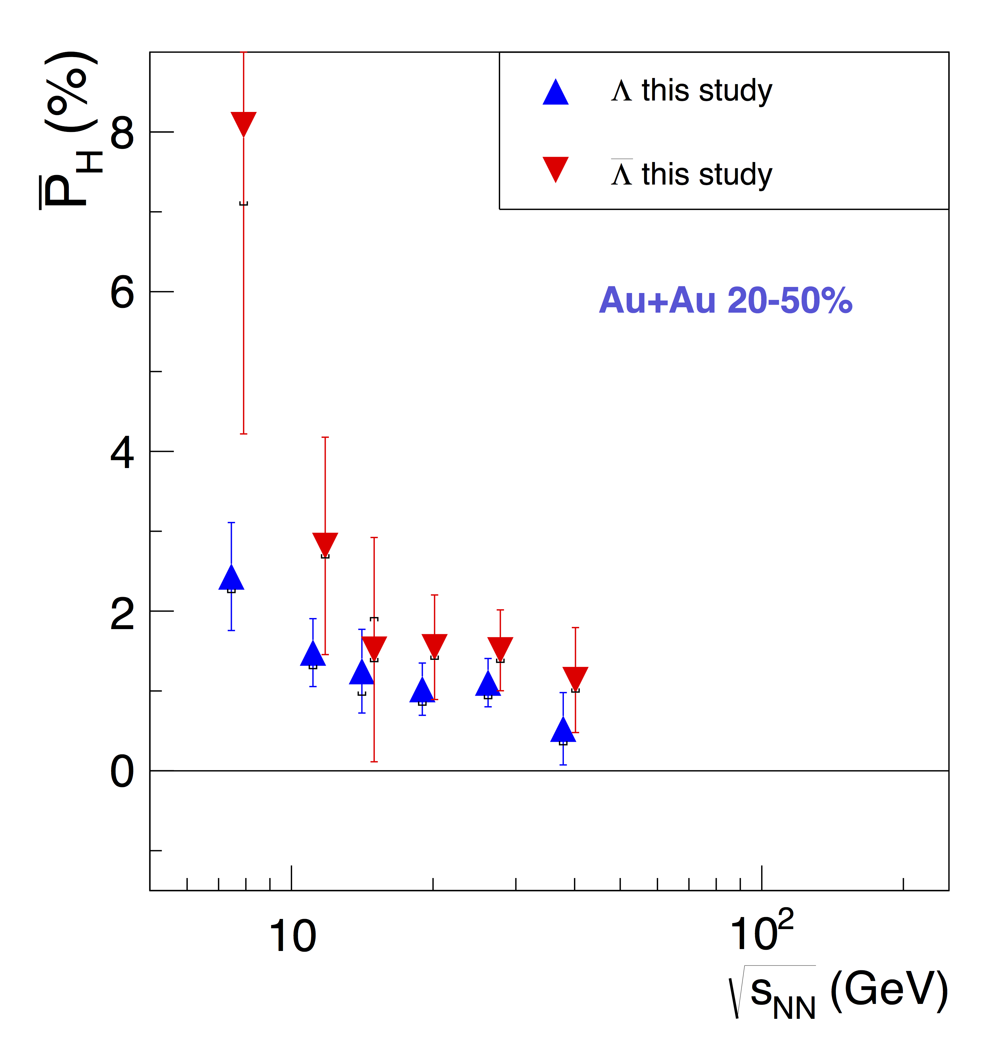
Preliminary results – corrected for RP + combinatorics
First clear positive signal of global polarization in heavy ion collisions!
systematic errors vanishingly small beneath statistical errors
Both Lambdas and AntiLambdas show positive polarization
vorticity, spin-orbit mechanism dominant
Splitting?
suggests additional magnetic effect
Signal falls with energy – physics or simply loss of resolution?
Small systematic error from combinatoric background subtraction
STAR Preliminary

Slide 18
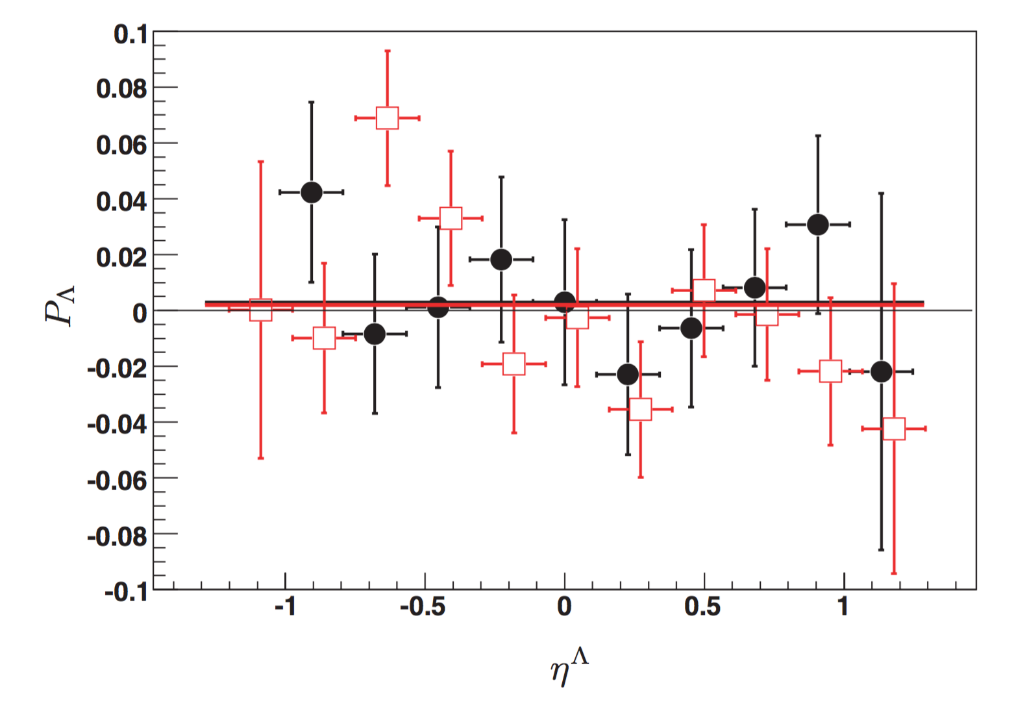
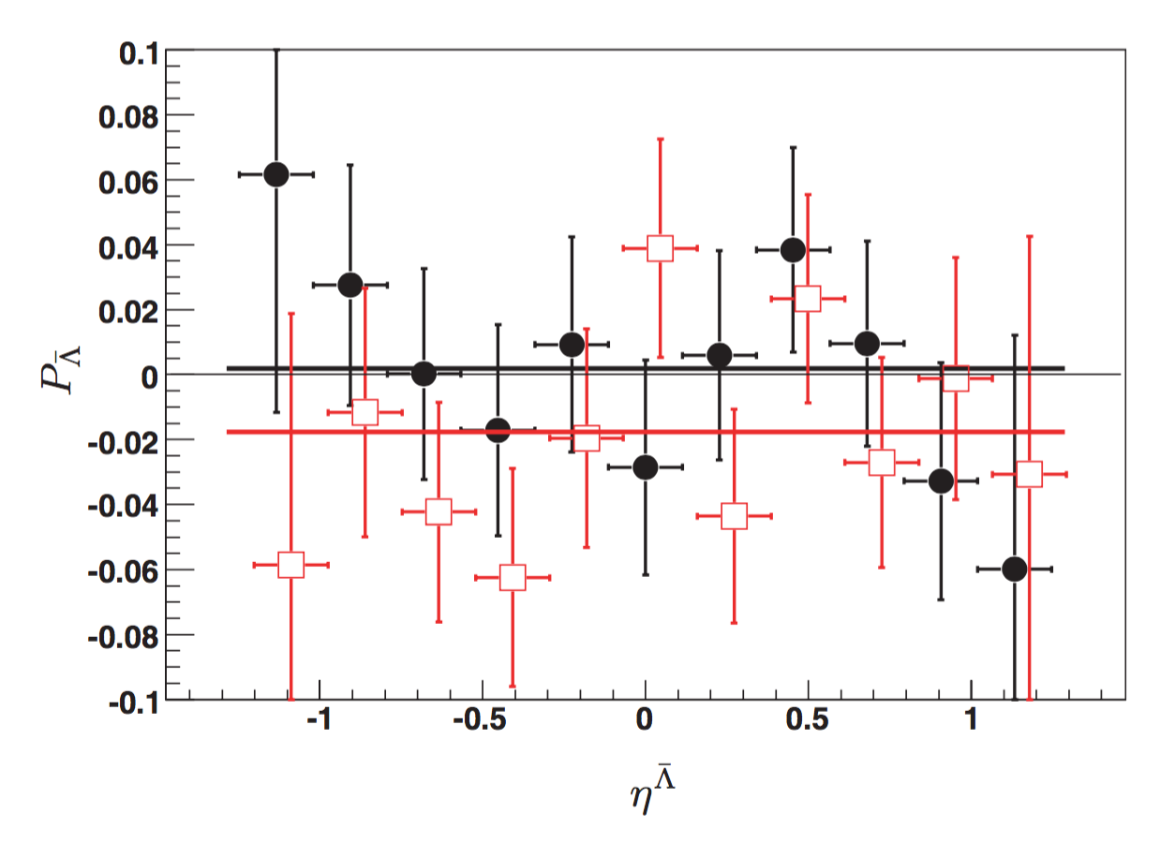
Previous STAR result
Phys RevC 76, 024915 (2007)
concluded null signal (2% limit)
oops
200 GeV (20-70% σ_{TOT})
62.4 GeV (0-80% σ_{TOT})

Slide 19
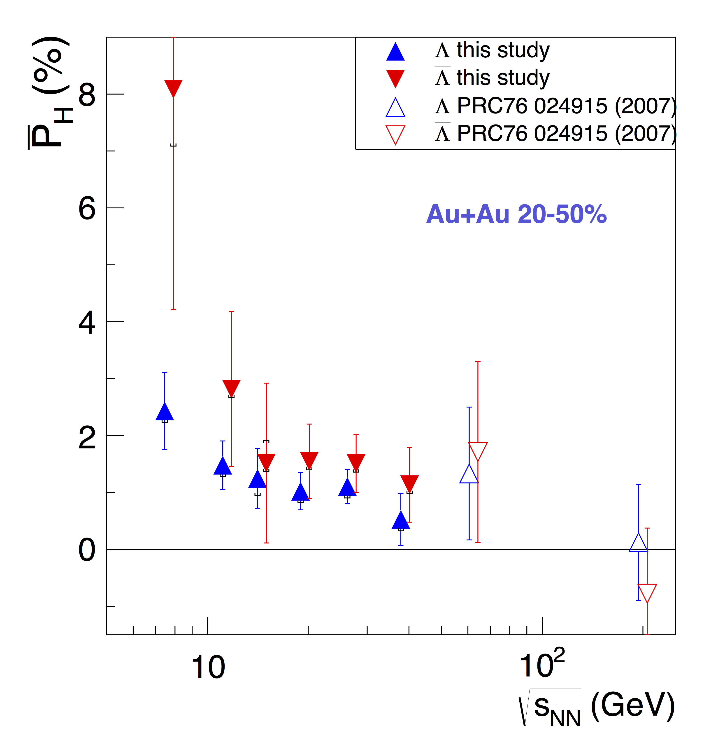
Complete energy range
STAR Preliminary
Large uncertainties, but previous results follow trend established at BES

Slide 20
Extracting Vortical and Magnetic Contributions
The data reveals a dominant common component and suggests a small splitting
Magneto-hydrodynamics interpretation
  vortical component is the average
  magnetic component is the difference
    coupling to μ_{B} may produce similar effect [Becattini, Wang, Sorin...]
STAR Preliminary

Slide 21
Extracting Vortical and Magnetic Contributions
The data reveals a dominant common component and suggests a small splitting
Magneto-hydrodynamics interpretation
  vortical component is the average
  magnetic component is the difference
    coupling to μ_{B} may produce similar effect [Becattini, Wang, Sorin...]
However, must account for ~50-60% feed-down contributions
  ~75%, including resonances (not done here)
STAR Preliminary
... which, themselves, will likely be polarized...

Slide 22
Accounting for (polarized) feed-down
Assume other hadrons, X, are polarized by the same vortical and magnetic mechanisms as the Lambdas

Slide 23
Accounting for (polarized) feed-down
Assume other hadrons, X, are polarized by the same vortical and magnetic mechanisms as the Lambdas
Relationship to Lambdas:
  Common vortical polarization:

Slide 24
Accounting for (polarized) feed-down
Assume other hadrons, X, are polarized by the same vortical and magnetic mechanisms as the Lambdas
Relationship to Lambdas:
  Common vortical polarization:
  Magnetic coupling proportional to dipole moment:

Slide 25
Accounting for (polarized) feed-down
Assume other hadrons, X, are polarized by the same vortical and magnetic mechanisms as the Lambdas
Relationship to Lambdas:
  Common vortical polarization:
  Magnetic coupling proportional to dipole moment:
Polarization transfer:

Slide 26
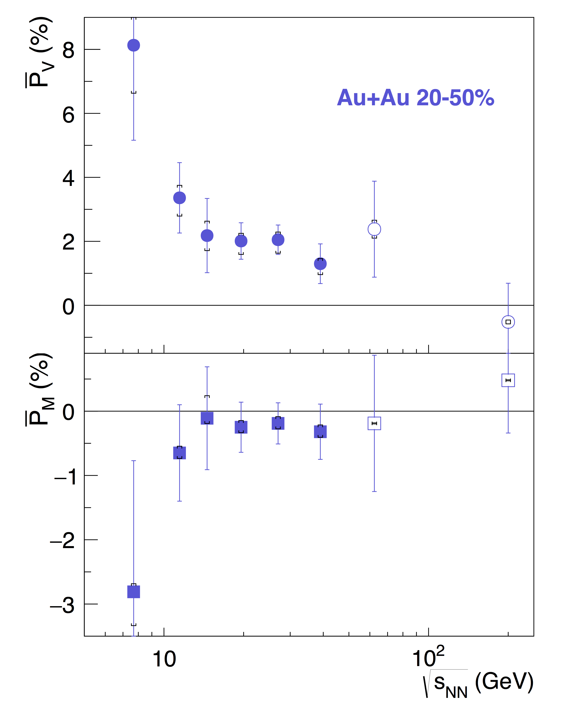
Calculated polarization of primary Λ
Model-dep.
Corrected for polarized feeddown
  model-dependent
8% polarization!!
Significant (2-5 sigma level) vortical polarization, falling with energy
Magnetic polarization consistent w/ 0 at all energies, but “wants” to be < 0
  (P_{M}<0 expected)
Statistical errors dominate
  systematic uncertainties from UrQMD versus THERMUS feeddown estimates
STAR Preliminary
systematic uncertainties from model variation in feeddown
√s_{NN} | 7.7 | 11.5 | 14.5 | 19.6 | 27 | 39 | 62.4
P_{V} | 2.7σ | 3.0σ | 1.9σ | 3.5σ | 4.5σ | 2.1σ | 1.6σ
BES ave
5.4σ

Slide 27
Extracting vorticity and B-field from data
Model-dep.
Nonrelativistic equilibrium limit:
STAR Preliminary
systematic uncertainties from model variation in feeddown

Slide 28
Extracting vorticity and B-field from data
Model-dep.
Nonrelativistic equilibrium limit:
Thermal vorticity:
STAR Preliminary
systematic uncertainties from model variation in feeddown
* Using T=200 MeV

Slide 29
Extracting vorticity and B-field from data
Model-dep.
Nonrelativistic equilibrium limit:
Thermal vorticity:
Magnetic field
  very close to a first measurement
STAR Preliminary
B (m_{π}²)
systematic uncertainties from model variation in feeddown
* Using T=200 MeV

Slide 30
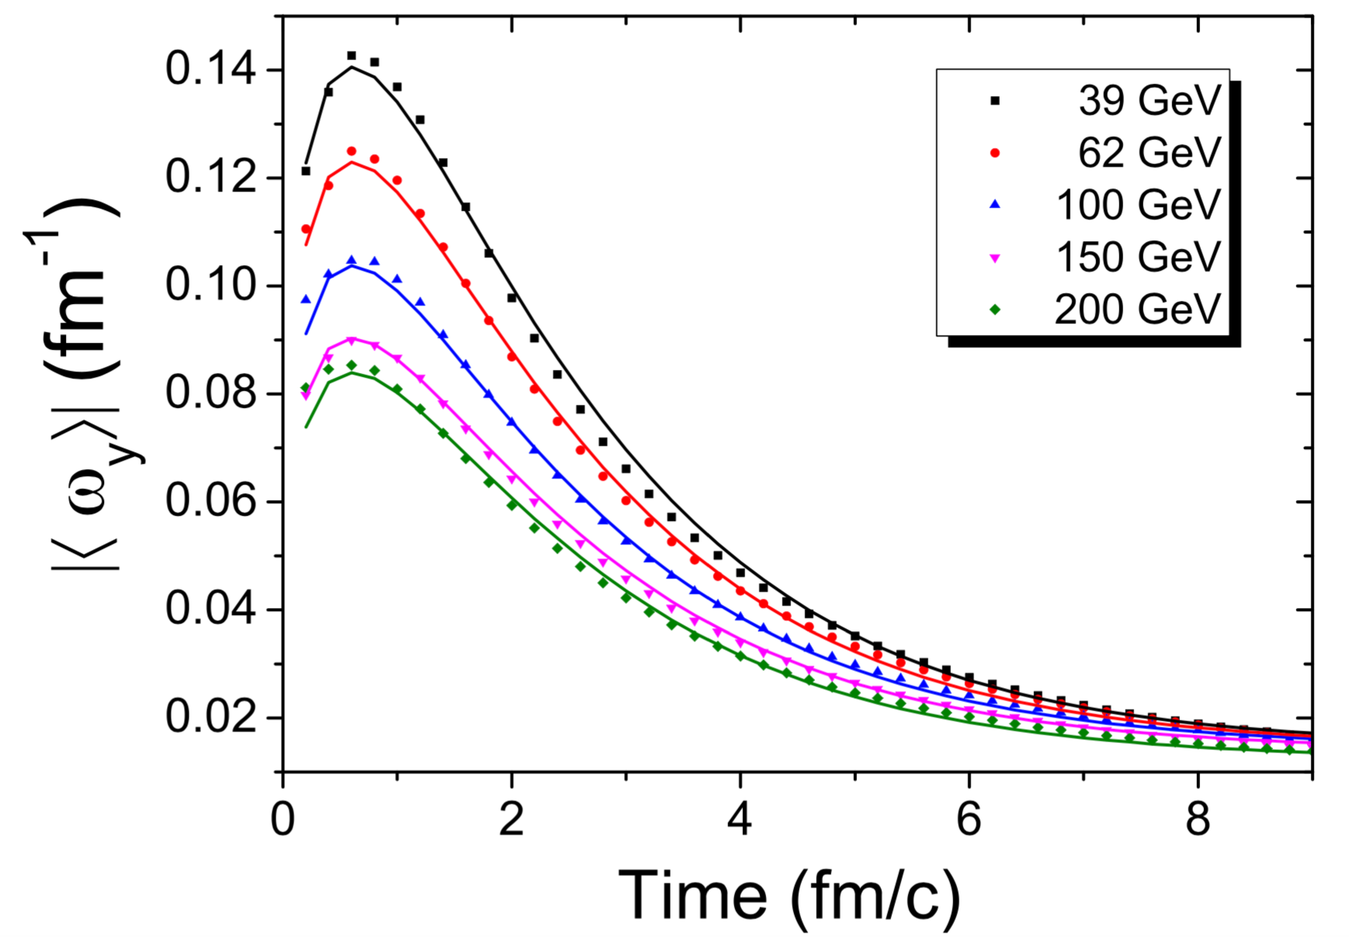
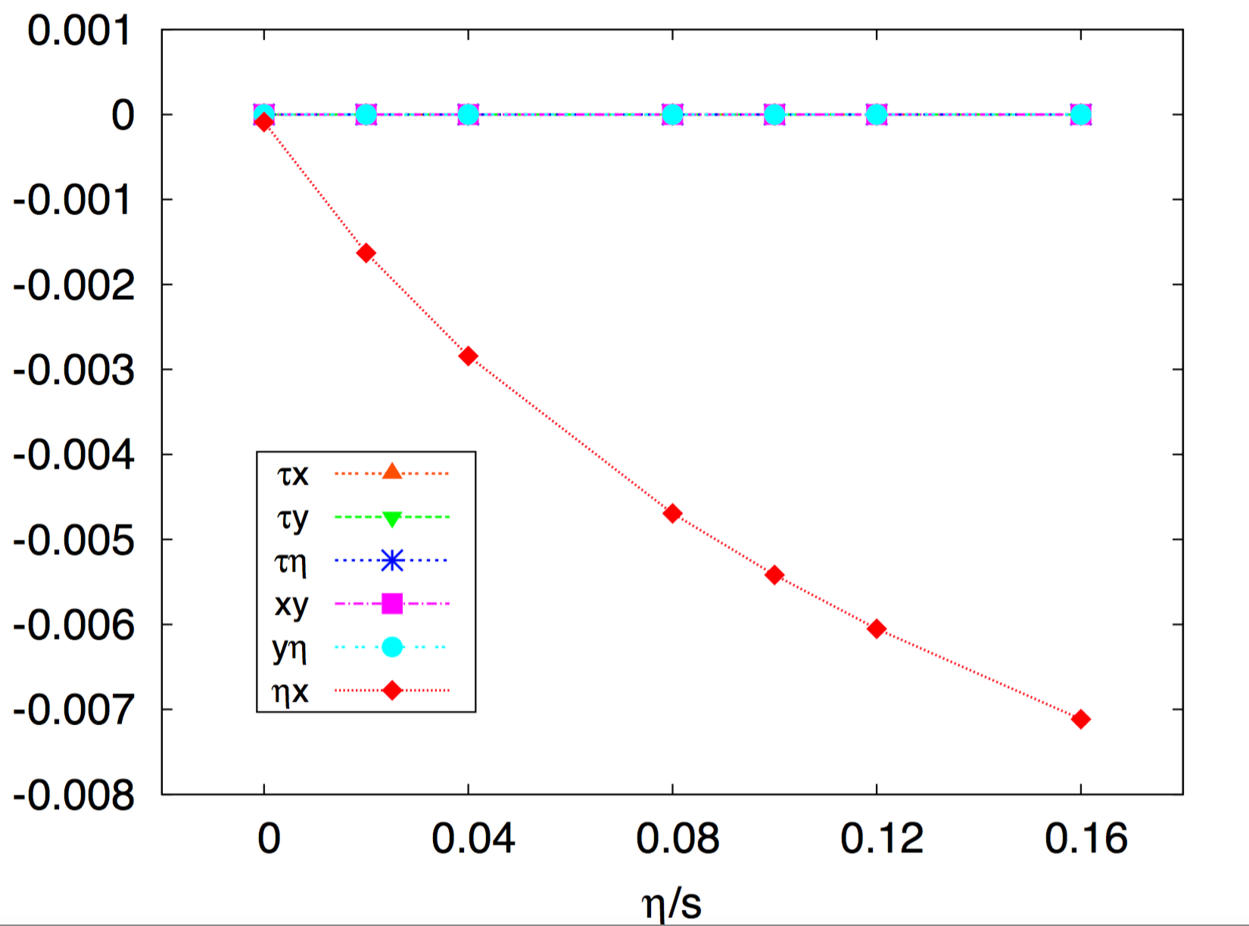
Vorticity ~ theory expectation
Model-dep.
STAR Preliminary
Thermal vorticity:
* Using T=200 MeV
200 GeV Au+Au
Becattini et al, EPJ C75 406 (2015)
Jiang et al,1602.06580

Slide 31
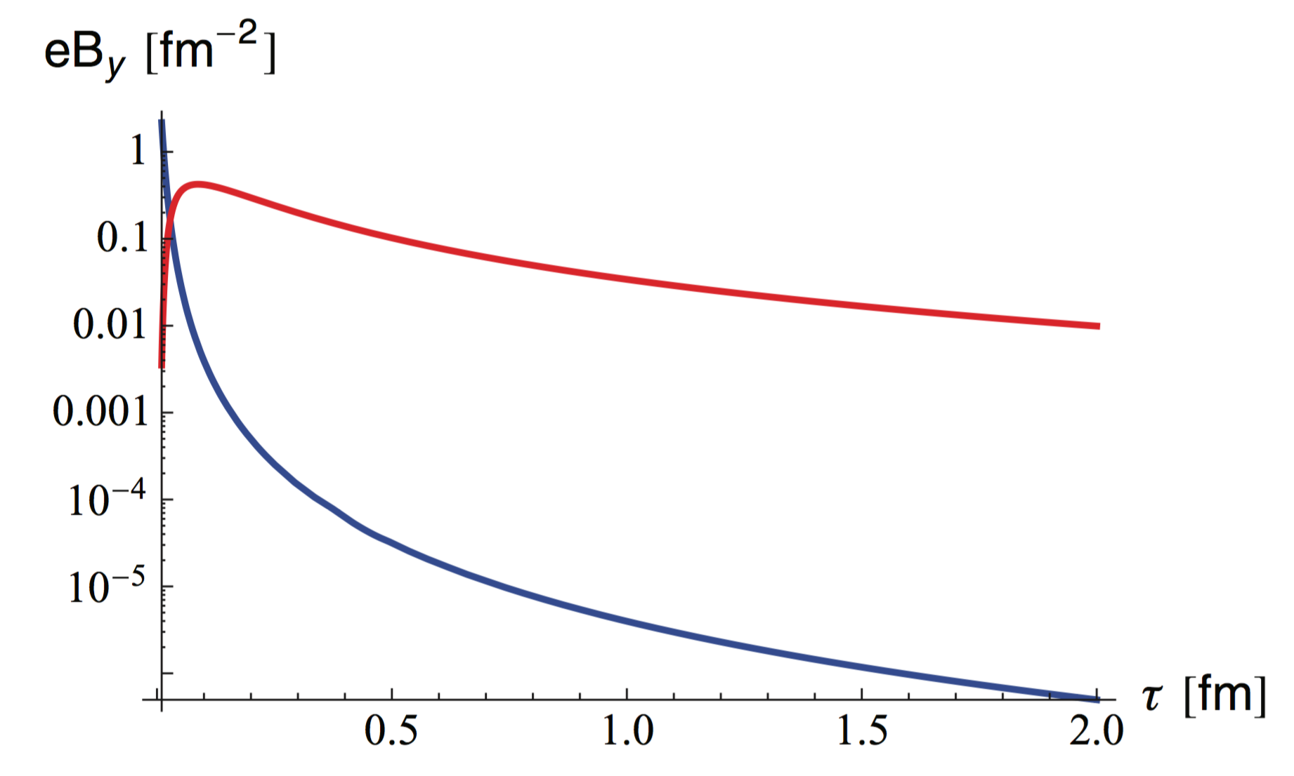
B-field ~ theory expectation
Model-dep.
Magnetic field
P_{M} suggests B-field ~ “right” magnitude
A definitive statement requires more
statistics/better EP determination
B (m_{π}²)
STAR Preliminary
Gursoy, Kharzeev & Rajagopal
PRC89 054905 (2014)
m_{π}²
effect of QGP electrical conductivity

Slide 32
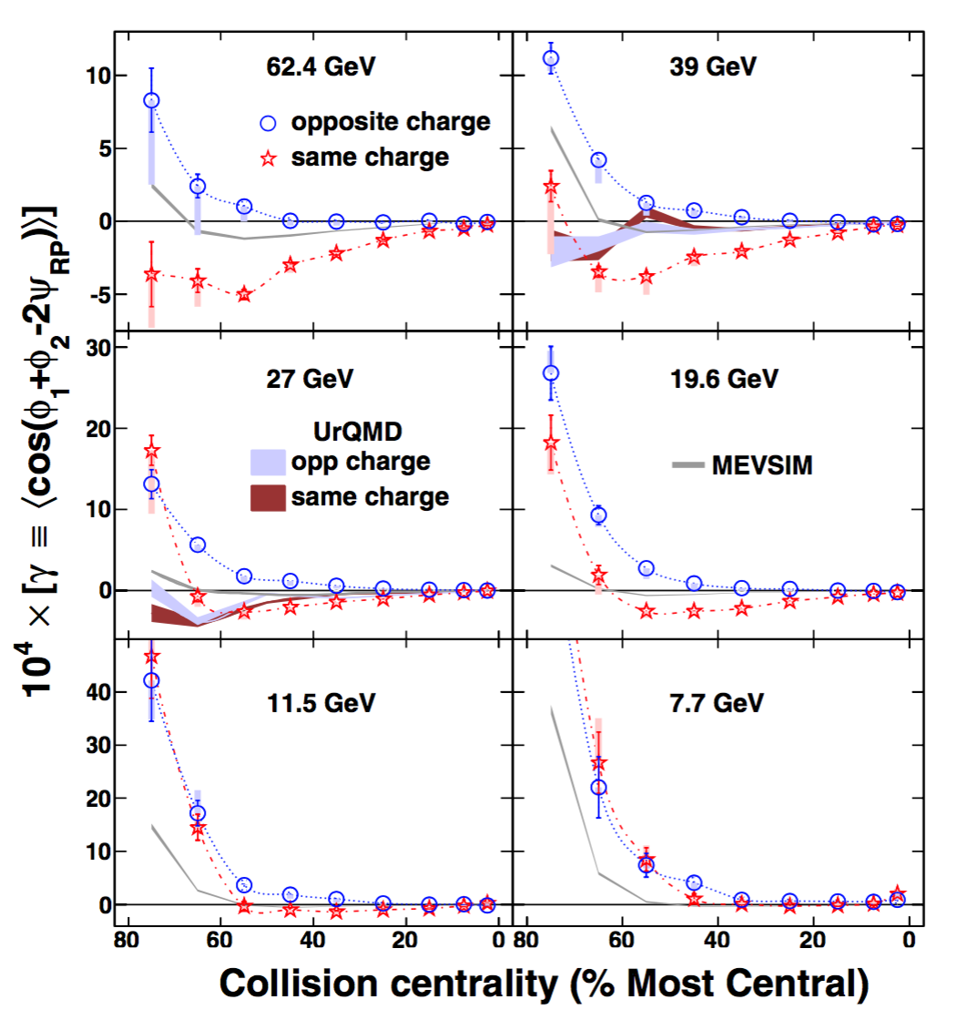
Crucial to discovery
STAR, PRL 113 (2014) 052302
Magnetic field
P_{M} suggests B-field ~ “right” magnitude
A definitive statement requires more
statistics/better EP determination
A definitive statement is crucial, to
put CME discovery on solid ground
Want field for √s_{NN} >~ 20 GeV
With EPD upgrade and 3-week run at 27 GeV, could get ~5σ measurement in 2018

Slide 33
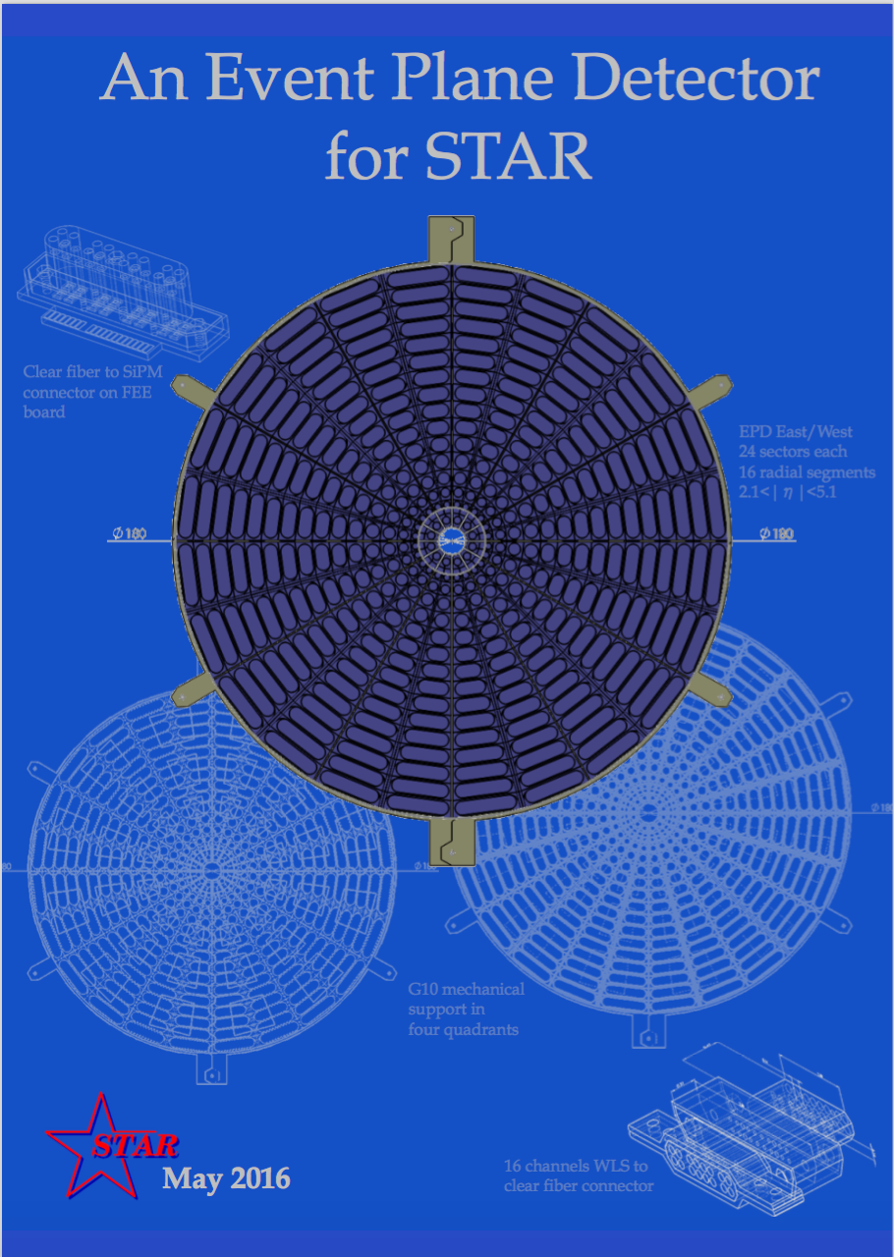
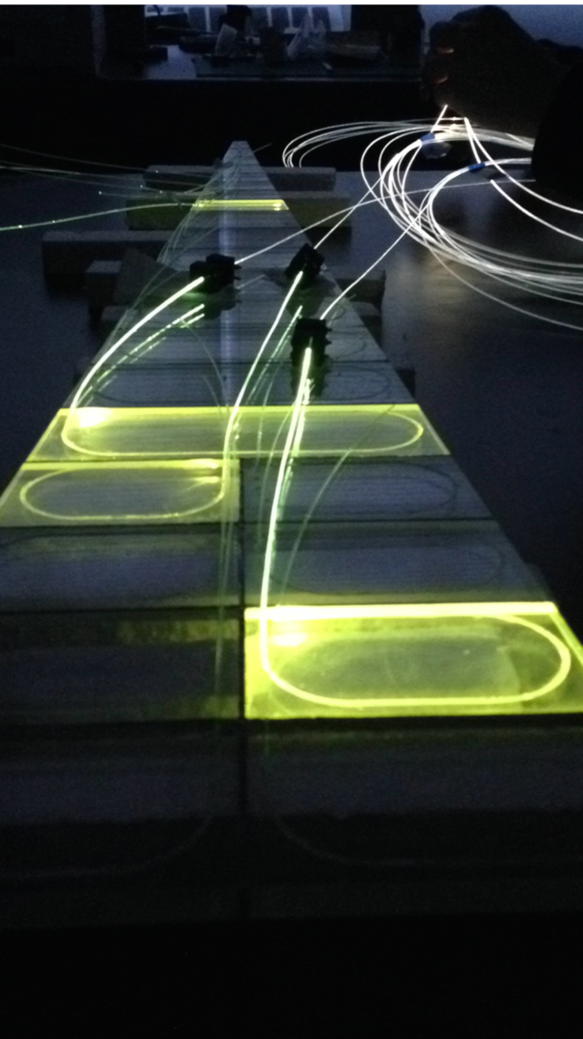
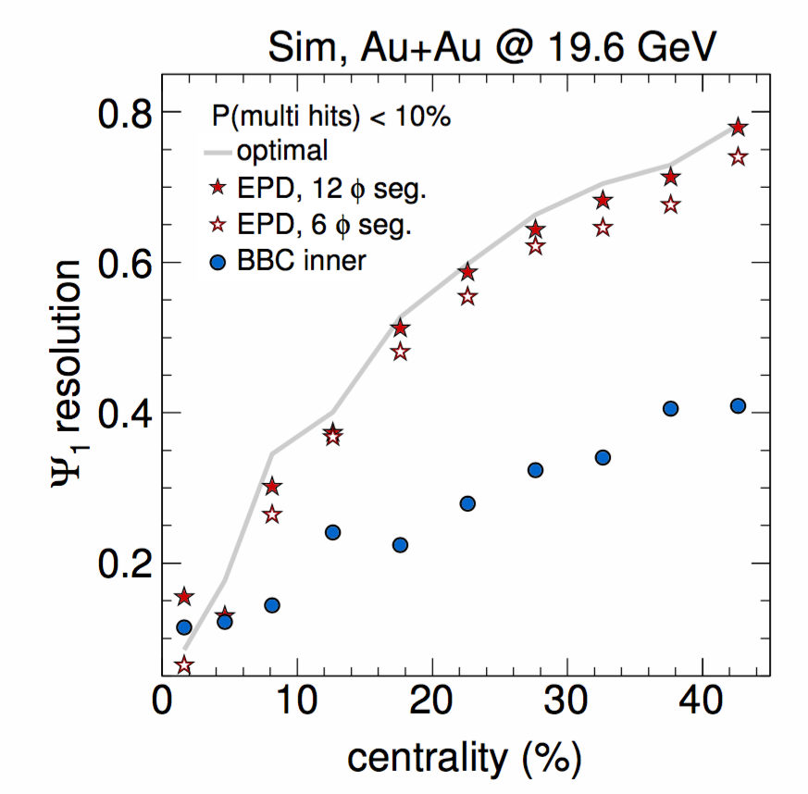
A crucial upgrade to STAR
Improved EP resolution and statistics
→ p_{T}, centrality dependence of P_{V}
→ ~4-5σ measurement of B-field
See talks by Jinlong Zhang (Thursday)
& Alex Schmah (Friday)

Slide 34
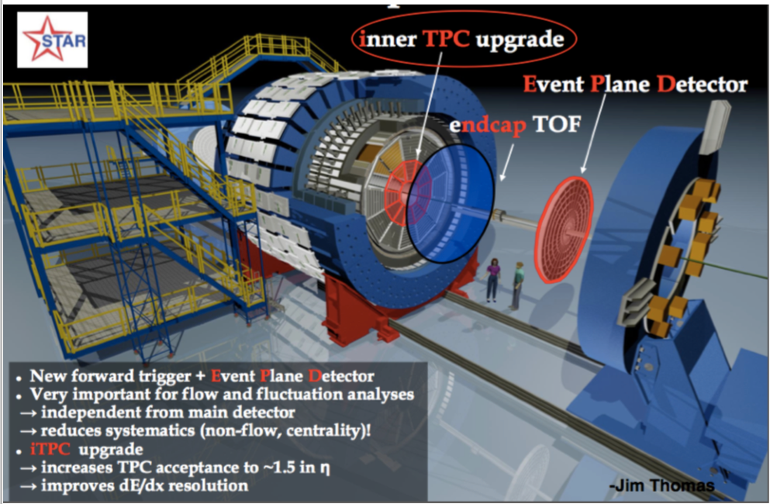
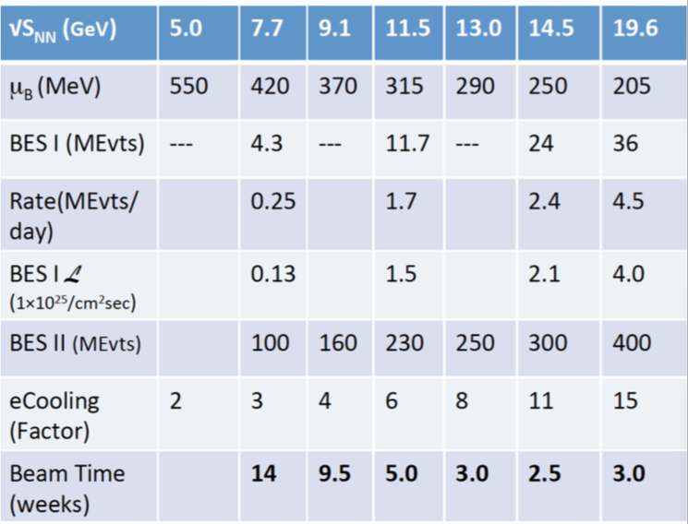
Next steps – experimental: BES II
See talks by Jinlong Zhang (Thursday)
& Alex Schmah (Friday)
BES-II ~ 2019-2020
Dedicated high-statistics running
Collider (e-cooling) & detector upgrades
Finer-grained measurements
Better control on initial conditions (RP)
Forward tracking/PID
fixed-target mode – full coverage of FAIR energies
Detector upgrades

Slide 35
Summary I – extreme conditions
non-central heavy ion collisions may create QGP with vorticity
  generated by early shear viscosity, persists through low viscosity
  fundamental feature of any fluid, unmeasured and nonconvergent theory for QGP
    an incomplete characterization of QGP
    relevance for other hydro-based conclusions?
Huge and rapidly-changing B-field in non-central collisions
  not directly measured
  theoretical predictions vary by orders of magnitude
  sensitive to electrical conductivity, early dynamics
Both of these extreme conditions must be established & understood, to put discovery of chiral effects on firm ground

Slide 36
Summary - II
Global hyperon polarization: unique probe of vorticity & B-field
  non-exotic or chiral
  quantitative input to calibrate chiral phenomena
STAR has made the first observation of global Λ polarization
  statistics- & resolution-limited: 1-5 sigma effect for any given √s_{NN}
    ~5-6 sigma effect on average
Interpretation in magnetic-vortical model:
  clear vortical component of right sign, magnitude for √s_{NN}< 30 GeV
  magnetic component of right sign, magnitude hinted at, but consistent with zero at each √s_{NN}
BES-II: Statistics & upgrades will allow characterization & model discrimination
  but B-field for √s_{NN}>~ 20 GeV required to calibrate/establish CME

Slide 37
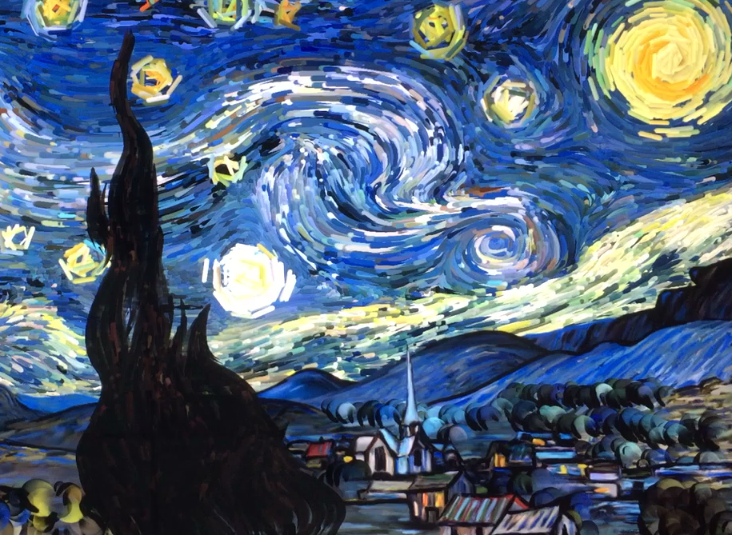
Thanks for your attention

Slide 38
END

Slide 39
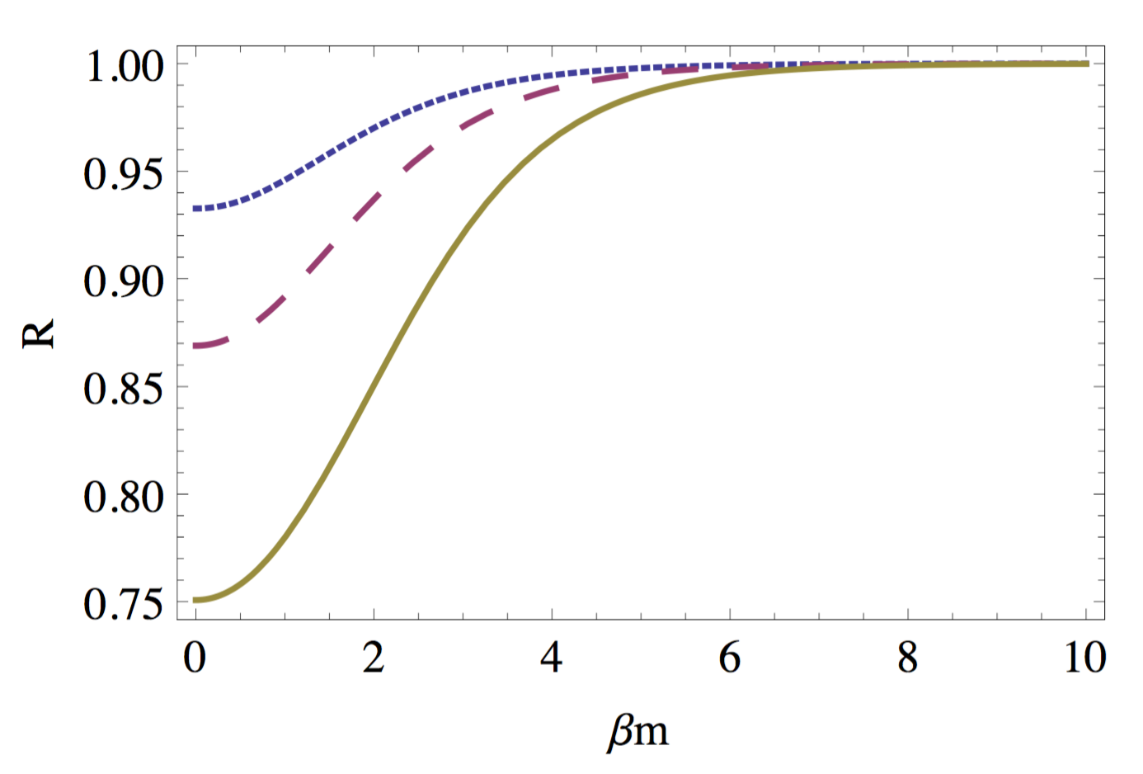
Splitting effect of finite μ_{B}
Fang et al, arxiv:1604.0403

Slide 40
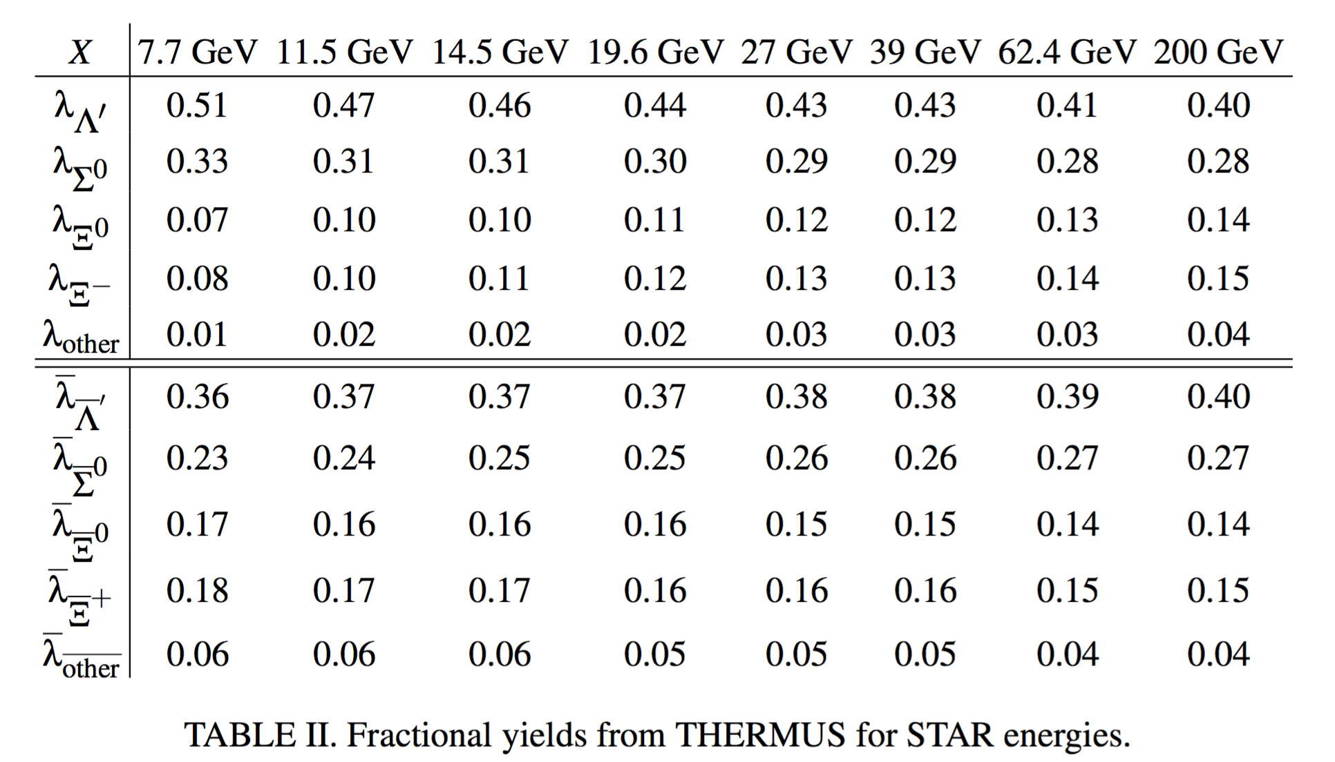
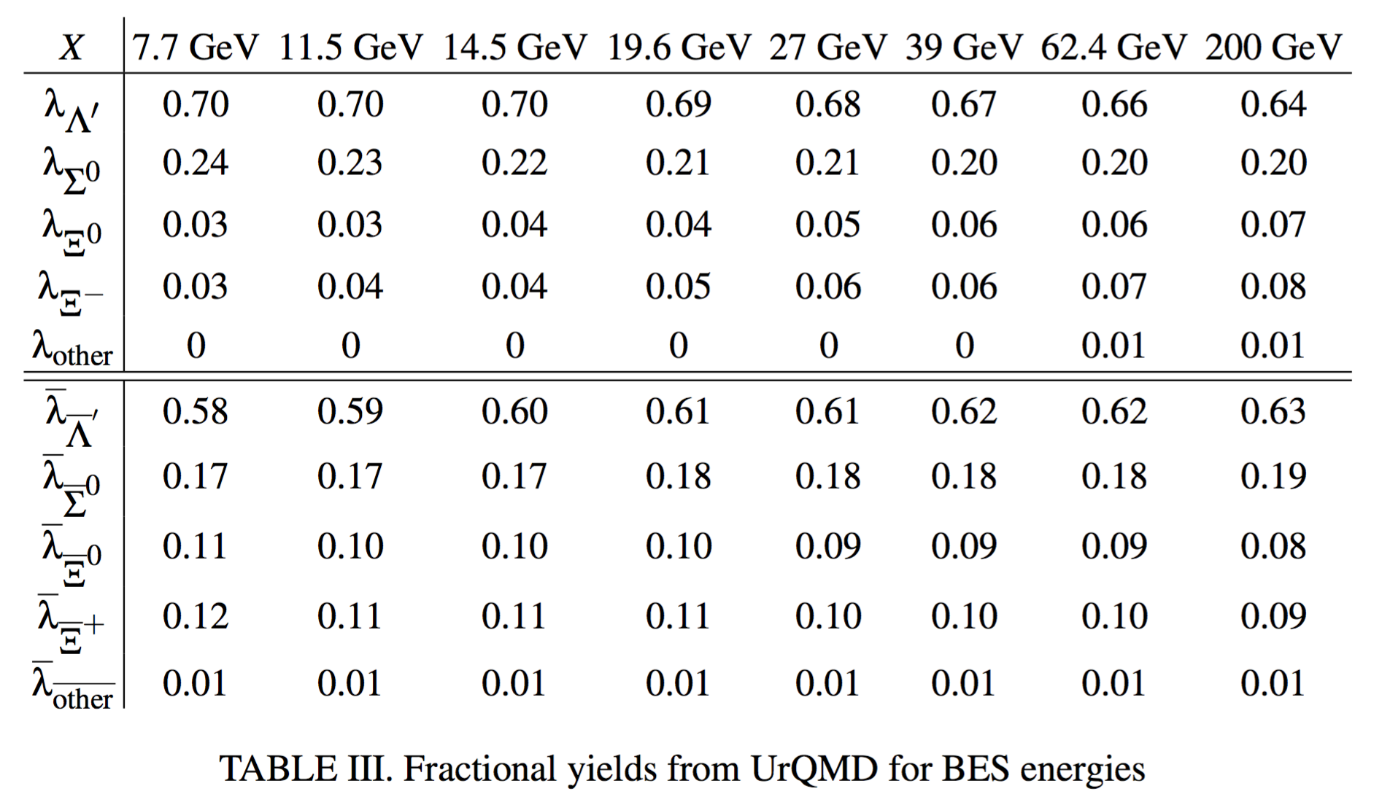
Accounting for (polarized) feed-down
Midrapidity contributions, including STAR efficiency & cuts
Feed-down contribution depends on energy, model

Slide 41
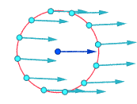
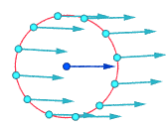
Vorticity examples
Rigid-body-like vortex
Parallel flow
with shear
Irrotational vortex
Figures by Jorge Stolfi
posted on Wikipedia
Flow field:
Absolute velocities
around highlighted point
Relative velocities
around highlighted point
(i.e. in fluid rest frame)
Vorticity:

Slide 42
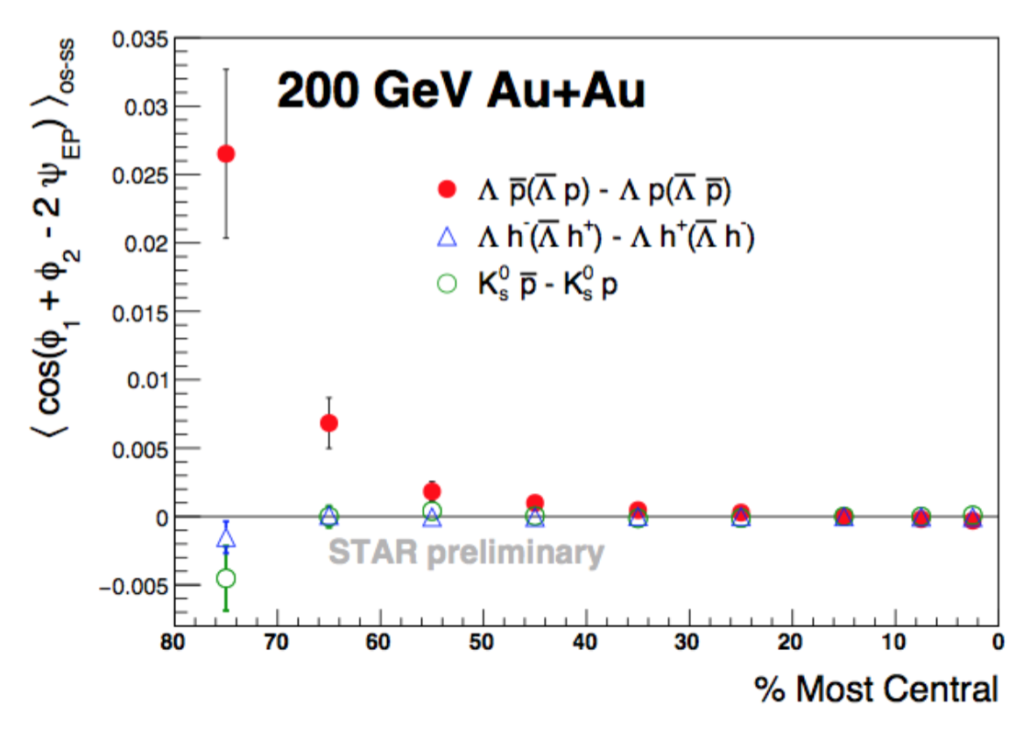
Unique, quantitative measure
STAR Preliminary
Thermal vorticity:
* Using T=200 MeV
For illustrative purposes only
√s (GeV) | μ_{B} (MeV) | ω (fm⁻¹) | μ_{B}ω (MeV/fm)
7.7 | 420 | 0.16 | 68
11.5 | 314 | 0.07 | 21
14.5 | 260 | 0.05 | 11
19.6 | 205 | 0.04 | 8
27 | 155 | 0.04 | 6
39 | 115 | 0.03 | 3
62.4 | 70 | 0.04 | 3
200 | 20 | ~0 | 0
Liwen Wen

Slide 43
Connection to experiment
Fluid vorticity may generate global polarization (alignment of spin with collision system angular momentum) of emitted particles
  Betz, Gyulassy, Torrieri PRC76 044901 (2007)
  Becattini et al., PRC88 034905 (2013)
  Becattini et al., JPhys 509 012055-5 (2014) (SQM2013)
  Csernai et al., JPhys 012054-5 (2014) (SQM2013)
  Grossi JPhys 527 012015-5 (2014) (XIV Conf. Th. Physics)
  Becattini et al. arxiv:1501.04468
Collective vorticity in microscopic transport (AMPT)
  Jiang, Lin, and Liao, arxiv:1602.06580
Similar conclusions based on QCD quark spin-orbit coupling
  Voloshin arxiv:nucl-th/0410089
  Liang and Wang, PRL94 102301 (2005) [errat-ibid 96 (2006) 039901
  Liang and Wang PLB629 (2005) 20 (2005)
  Gao et al, PRC77 044902 (2008)
  Gao et al, PRL 109 232301 (2012)
Notes:
8 minutes by end

Slide 44
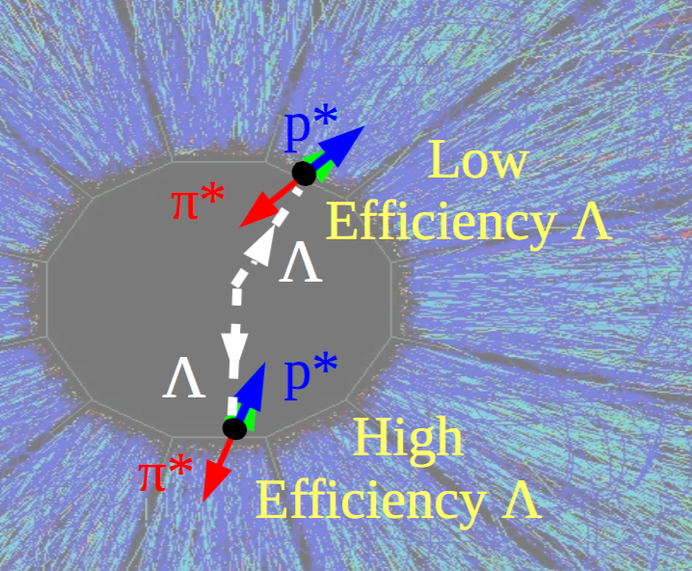
Topologically-dependent efficiency
Spin-orientation-dependent efficiency (!)
In Lambda frame, proton & pion have equal-magnitude momentum, but not in STAR frame
pion emitted backward in Lambda c.m., → tight curl, large DCA (distance to collision vertex)
→ much-reduced efficiency
→ higher efficiency to find negative-helicity Lambdas

Slide 45
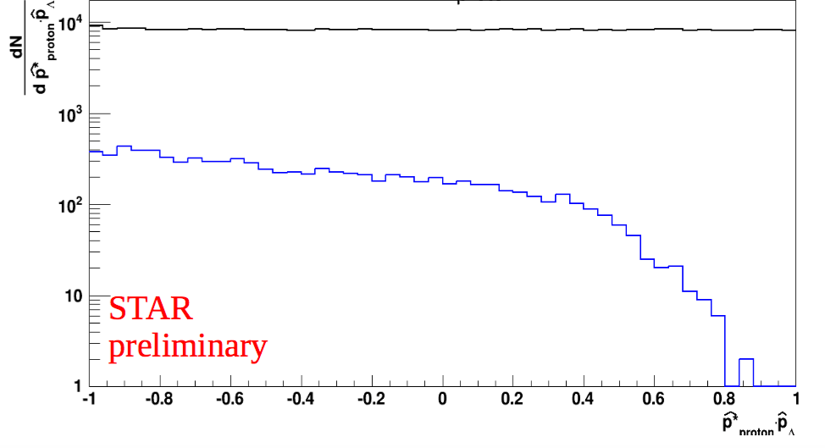

Topologically-dependent efficiency
Spin-orientation-dependent efficiency (!)
Same effect seen in embedding/GEANT simulations
p_{T}-dependent
not correlated with RP
explicitly cancels when summing regions separated by 180 degrees
HIJING events through simulated STAR detector & tracking
input
output

Slide 46
Contributors to Global Polarization
Known effect in p+p collisions [e.g. Bunce et al, PRL 36 1113 (1976)]
Lambda polarization at forward rapidity relative to production plane
p
p
Vortical or QCD spin-orbit:
  Feed-down dampens the signal
Magnetic coupling:
  Feed-down affects signal very little
Polarization w/ production plane:
  No integrated effect at midrapidity for Lambda
  no effect at all for AntiLambdas

